Slide 1
C5.2 Population Health Management Gareth Thomas
Digital Innovation Director Health Innovation Manchester and NHS Greater Manchester
Consultant in Intensive Care Medicine
Northern Care Alliance NHS FT

Slide 2
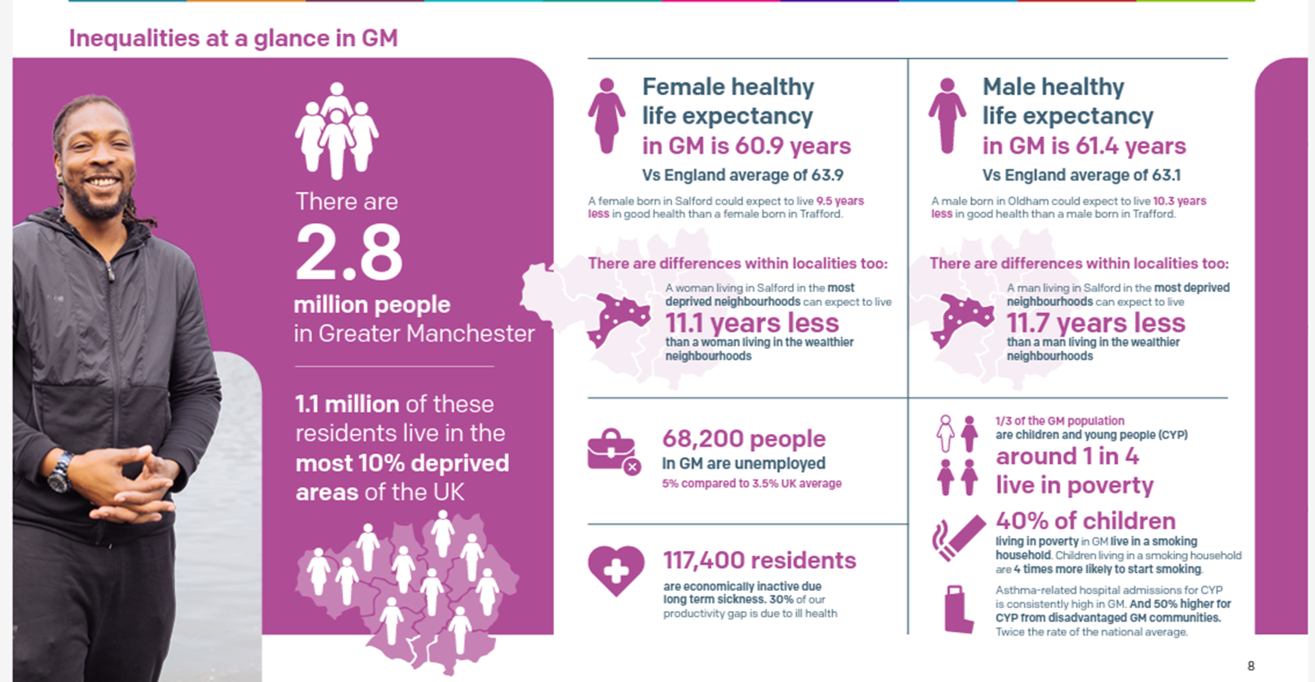
The Health of our Population

Slide 3
Meeting our ambitions
1
2
3
4
5
We deliver joined-up, coordinated and safe care to citizens.
We enable staff and services to work efficiently and productively.
We empower citizens to manage their health and care needs.
We understand population health needs and act upon insights.
We accelerate research and innovation into practice, as a globally leading centre.
We will achieve our 5 ambitions through 3 areas of focus:
INNOVATE
Deliver new technologies and approaches that improve quality of care for everyone
INTEGRATE
Connect patients, carers, healthcare professionals and services
DIGITISE
Get the basics right, making sure all our services are up to date and work efficiently
Notes:
REPLACE AND LIFT FROM STRATEGY

Slide 4
Meeting our ambitions
1
2
3
4
5
We deliver joined-up, coordinated and safe care to citizens.
We enable staff and services to work efficiently and productively.
We empower citizens to manage their health and care needs.
We understand population health needs and act upon insights.
We accelerate research and innovation into practice, as a globally leading centre.
We will achieve our 5 ambitions through 3 areas of focus:
INNOVATE
Deliver new technologies and approaches that improve quality of care for everyone
INTEGRATE
Connect patients, carers, healthcare professionals and services
DIGITISE
Get the basics right, making sure all our services are up to date and work efficiently
Notes:
REPLACE AND LIFT FROM STRATEGY

Slide 5
Source data
GM (only) ICS digital & data assets
Interface
Users
Purposes for access
GMCR
Clinical & non-clinical staff
Direct care
informing clinical decision making
care planning
data quality and audit
Patient held record (local solution to be integrated to NHS App)
viewing and contributing to own record
The GM Care Record
Public
NHS Primary Care, Secondary Care and MH Providers
GP data
GM ADSP
Direct care
identifying high risk patients and address inequalities
Planning
population health - identifying high risk cohorts and addressing inequalities
understanding patient journeys and clinical pathways to inform commissioning
Health and care organisations
The GM Analytics and Data Science Platform
GM Health & Care Intelligence Hub
Remit of GM Data Access Committee
National datasets
GM SDE
Social Care data
Health and care or other public sector organisations
Research and development
AI/Algorithm Development
Clinical Trial Activity
Real World Studies
Translational Research
Epidemiological Studies
Health Systems Research
Data linkage via person pseudonym unique ID
Hospital & Community (incl MH) data
De-identified
A lens defined and agreed within the application, onto deidentified data within the SDE (with virtual walls around it)
The GM Secure Data Environment
Universities
NWAS
VCSE organisations
Industry partners

Slide 6
Strategic Financial Framework - Key Messages
First time that we have drawn on the actual care record of every resident in GM to project the nature of future demand based on current trends. This is a unique asset for GM based on the Advanced Data Science Platform (ADSP)
The framework shows that the proportion of the population in ‘good health’ is set to decline by 10% in the next five years under a ‘do nothing’ scenario – this leads to an additional £1.9bn of acute activity beyond our expected allocation
It highlights which groups of the population are likely to experience the worst deterioration in health. It sets out the population health interventions that will make the most significant impact in improving the health of these groups.
We need to address both the immediate financial challenge in the system and the drivers of future demand signalled in the population health analysis to secure a sustainable health and care system in GM

Slide 7
The Strategic Financial Framework is developed via a four-stage approach
Understand baseline and “do nothing” forecast
Consider opportunities to improve health, performance and finance
Phasing and Investment
Reflect in financial framework
Population
Understand place
Segment population by age, condition and deprivation
Level of consumption of healthcare
Allocation growth
Spend on providers
Reducing the growth in prevalence and progression of ill-health
Optimising models of care to optimize total spend (across all settings) for each segment
Improving care for the most disadvantaged communities
Identification of interventions and ROI
Non-recurrent investment to ramp up/double run services
Investment in data and digital capabilities
Calculate the total allocation change including ICS and NHSE in the do nothing baseline
Optimise spend while improving population health and shift pattern of spend
Provider
Understand provider
Understand current activity and expenditure
Apply growth assumptions
Understand the underlying recurrent financial position of each trusts
Improve model of care to increase quality and flow (theatres, OP, discharge)
Pure unit labour productivity (skill mix, rota, bank/agency)
Procurement (drugs, medical consumables, nonclinical)
Estates (facilities, capital, etc)
Back office (IT, admin)
Non-recurrent costs to support transformation
Any restructuring of costs to address a deficit
Investment in data and digital capabilities
Forecast current underlying position for each provider
Understand the productivity gains that are required to address the underlying position

Slide 8
The population segmentation enables division of the population by age band, place, and condition, showing 28% of the GM population experiences some aspect of poor health
Cost per person
% of GM population
% of GM spend
Total population health baseline in 2022/23 for Greater Manchester
Age
1
2
3
4
5
6
7
8
Good health
2.1m (72%)
£1.4b (22%)
Single LTCs
352.8k (12%)
£690m(11%)
Multiple LTCs
217.3k (7%)
£1.0b (16%)
Mental Illness
165.1k (6%)
£1.0b (16%)
Homelessness
& substance misuse
11.0k (0.4%)
£234m (4%)
Cancer
46.5k (2%)
£444m (7%)
Frailty
52.4k (2%)
£1.2b (19%)
Palliative care
1.5k (0.1%)
£116m (1%)
0-17
Pop: 520k
Total Cost: £560m
Size: 442k
Size: 20k
Size: 7.89k
Size: 46.4k
Size: 306
Size: 164
Size: 3.0k
Size: 15
£559
£2k
£4.3k
£4.5k
£21.0k
£29.9k
£6.6k
£49.1k
14.7%
4.0%
0.7%
0.6%
0.3%
0.5%
1.5%
3.4%
0.0%
0.1%
0.0%
0.1%
0.1%
0.3%
0.0%
0.0%
18-64
Pop: 2m
Total Cost: £3.1b
Size: 1.55m
Size: 222k
Size: 92.1k
Size: 95.7k
Size: 8.95k
Size: 18.1k
Size: 14.3k
Size: 471
£618
£1.7k
£4.1k
£6.7k
£20.7k
£9.5k
£19.9k
£84.4k
51.6%
15.5%
7.4%
6.1%
3.1%
6.1%
3.2%
10.4%
0.3%
3.0%
0.6%
2.8%
0.5%
4.6%
0.0%
0.6%
65+
Pop: 482k
Total Cost: £2.6b
Size: 165k
Size: 111k
Size: 117k
Size: 22.9k
Size: 1.7k
Size: 28.2k
Size: 35.1k
Size: 1k
£1.2k
£2.5k
£5.3k
£8.2k
£24.8k
£9.5k
£25.3k
£74.6k
5.5%
3.2%
3.7%
4.5%
3.9%
10.2%
0.8%
3.1%
0.1%
0.7%
0.9%
4.3%
1.2%
14.4%
0.0%
1.2%
Source: ADSP (Please note, segmentation approach currently excludes primary care data)

Slide 9
From 2022/23 – 2027/28, the health of the Greater Manchester population is deteriorating, with 10% fewer people in ‘Good Health’ Segments
Population count
% of GM population
% of GM spend
Total population health baseline in 2027/28 for Greater Manchester
Age
1
2
3
4
5
6
7
8
Good health
1.9m (62%)
£1.3b (16%)
Single LTCs
225k (7%)
£428m (5%)
Multiple LTCs
439k (14%)
£2.0b (24%)
Mental Illness
319k (10%)
£2.0b (24%)
Homelessness
& substance misuse
18k (0.6%)
£376m (4%)
Cancer
69k (2%)
£658m (8%)
Frailty
58k (2%)
£1.5b (18%)
Palliative care
1.4k (<0.1%)
£107m (1%)
0-17
Pop: 515k
Total Cost: £701m
Spend: £221m
Spend: £44m
Spend: £69m
Spend: £340m
Spend: £8.5m
Spend: £5.5m
Spend: £12m
Spend: £444k
396k
22k
16k
76k
408
184
4k
9
12.9%
2.6%
0.7%
0.5%
0.5%
0.8%
2.5%
4.0%
0.0%
0.1%
0.0%
0.1%
0.1%
0.1%
0.0%
0.0%
18-64
Pop: 2m
Total Cost: £4.3b
Spend: £948m
Spend: £253m
Spend: £852m
Spend: £1.32b
Spend: £303m
Spend: £266m
Spend: £271m
Spend: £46m
1.4m
150k
210k
198k
15k
28k
19k
551
45.9%
11.1%
4.9%
3.0%
6.9%
10.0%
6.5%
15.5%
0.5%
3.6%
0.9%
3.1%
0.6%
3.2%
0.0%
0.5%
65+
Pop: 522k
Total Cost: £3.5b
Spend: £163m
Spend: £131m
Spend: £1.13b
Spend: £365m
Spend: £64m
Spend: £386m
Spend: £1.23b
Spend: £60m
133k
53k
212k
45k
2.6k
41k
35k
803
4.3%
1.9%
1.7%
1.5%
6.9%
13.4%
1.5%
4.3%
0.1%
0.8%
1.3%
4.5%
1.1%
14.4%
0.0%
0.7%
Source: ADSP (Please note, segmentation approach currently excludes primary care data)

Slide 10
Quantified opportunities map to primary, secondary, and Social Determinant focussed interventions
For the purposes of initial investment quantification – opportunities one has been aligned with primary intervention, opportunity two with secondary interventions, and opportunity three with Social Determinants of Health interventions
Opportunity 1: Reducing the growth in prevalence and progression of ill health
Opportunities to reduce prevalence and progression of ill health relative to baseline trend based on targeted prevention and early detection activities
Primary Prevention intervention across five key areas:
Smoking
Obesity
Diet
Exercise
Alcohol Dependency
Opportunity 2: Optimising models of care
Opportunities to change models of care to deliver more consistent proactive care to support effective population health management
Secondary intervention, targeting 5 specific patient cohorts:
Cardiovascular Disease
Diabetes
Respiratory Conditions
Frailty
Serious Mental Illness
Opportunity 3: Improving care for the most disadvantaged communities
Opportunities to improve health and address and reduce disparities in care for people in deprived socioeconomic groups
Interventions targeting 4 social determinants of health areas:
Housing
Food Insecurity
Transport
Substance Misuse

Slide 11
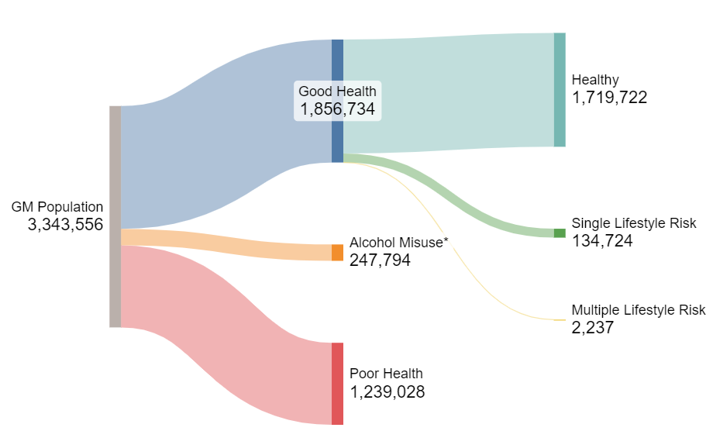
A more nuanced and holistic view of health…
Initial work using just secondary care data suggested 28% of population experienced some form of poor health.
Further analysis suggests this may be nearer 49%
* Alcohol category includes people in treatment and those reporting very heavy use

Slide 12
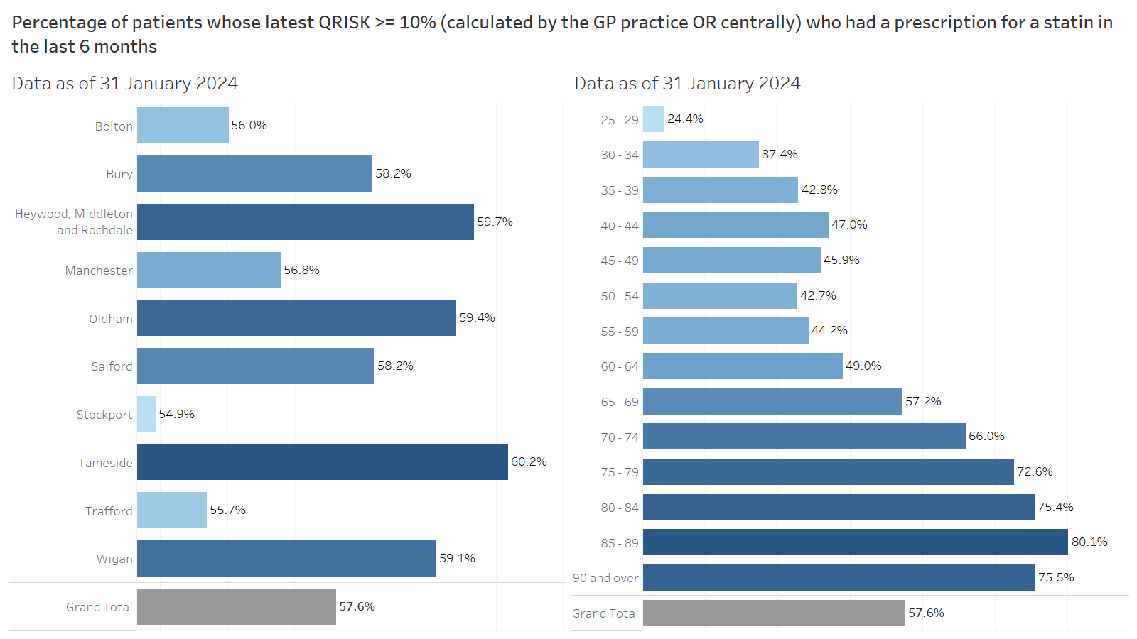

Slide 13
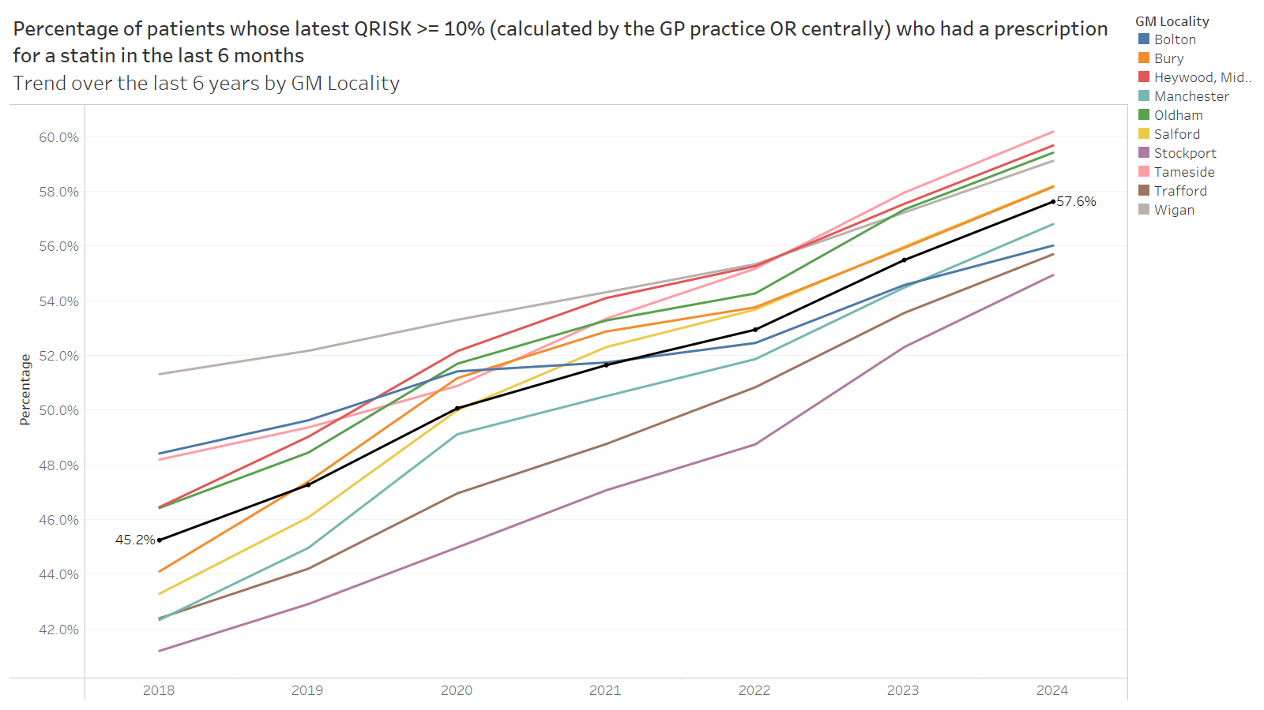

Slide 14
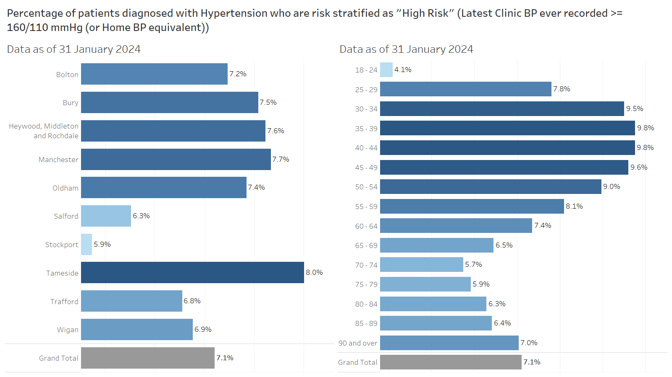

Slide 15
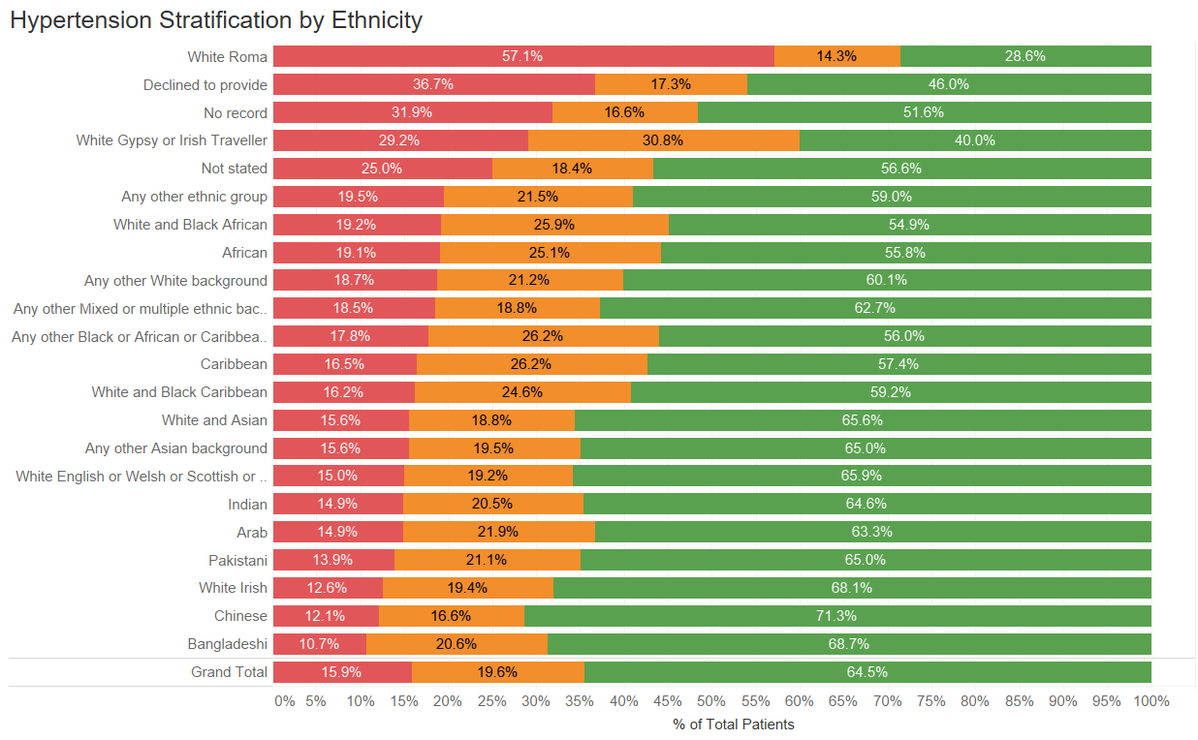
Identifying inequalities in provision of cardiovascular care: Hypertension
Notes:
Patient level GP data to develop dashboards and products
Update in near real time with the ability to understand population health and reduce health inequalities
Identifiable data will allow us to highlight patients that require direct care interventions

Slide 16
Identifying inequalities in provision of cardiovascular care risk status
The CVNeed score can be visualised geographically to understand unmet CV need across Greater Manchester.
It demonstrates the distribution of the CVNeed score based up on an individual's postcode highlighting unmet clinical need on a community level .
Compliance against best practice drug pathways is applied within the dashboard, to demonstrate opportunities to reduce unmet need and provision further interventions e.g. hypertension management
Attribution to Dr Aseem Mishra and Matthew Conroy
Notes:
COMMERCIAL PARTNERSHIPS – HIA.
SUMMARY SLIDE HIA.

Slide 17
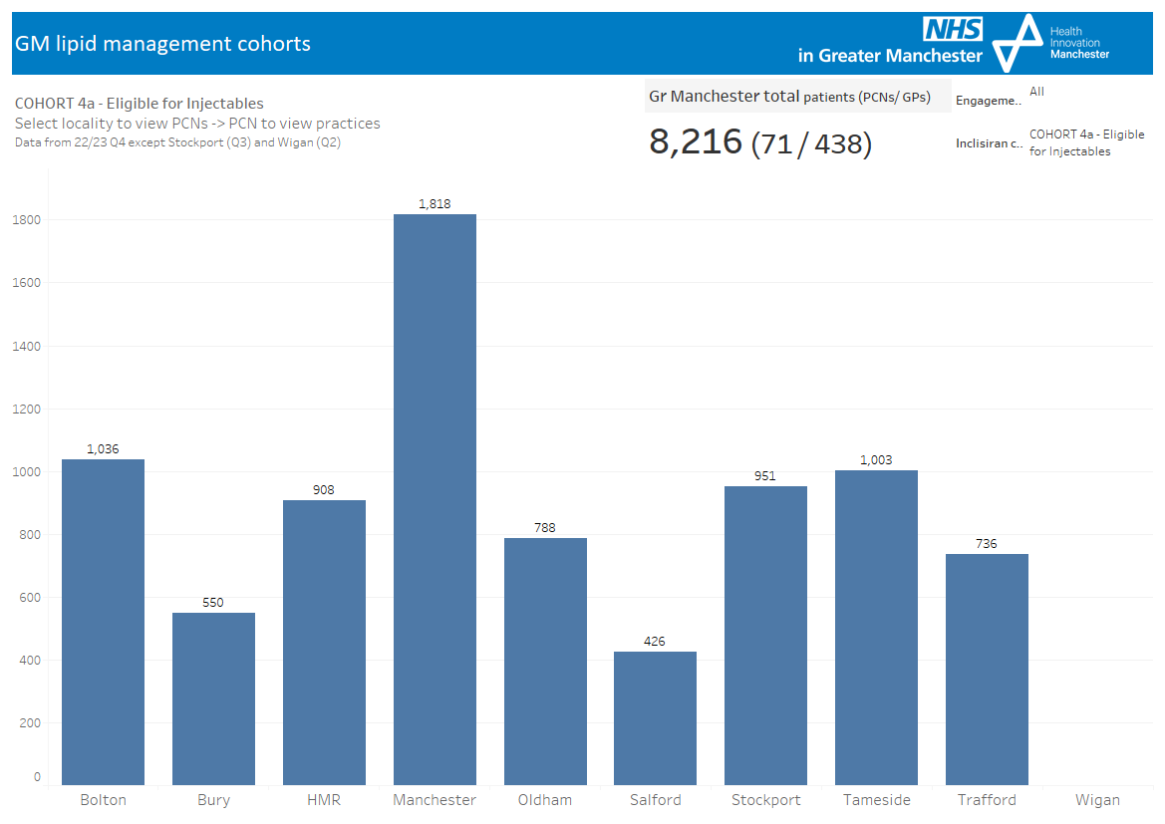
Targeting lipid lowering therapy in areas of deprivation

Slide 18
Targeting lipid lowering therapy in areas of deprivation: inclisiran
First population approach for delivery of a medication in primary care & in a collaborative working agreement with pharma.
9,500 patients are eligible for receiving injectables in GM
Delivery of 4280 doses will save 89 lives
£1.39m in healthcare utilization events avoided
Prevent 301 non-fatal major CVD events
Reduction in UEC admissions

Slide 19
Essential Enabler of Population Health Approach: Award winning Information Governance
IG Innovator of the Year
Health Innovation Manchester, University of Manchester & NHS Greater Manchester
Information Sharing Champion of the Year
Anton King, Health Innovation Manchester
National Strategic Information Governance Network awards, March 2024

Slide 20
Thank you
Gareth Thomas Digital Innovation Director
Health Innovation Manchester & NHS Greater Manchester
gareth.thomas@healthinnovationmanchester.com

