Slide 1
C5.1 Population Health driven, digitally enabled system Transformation Sharon Boundy Director of Transformation and Digital Frimley ICS

Slide 2
Whole System Change
Unscheduled
Scheduled
PROACTIVE
keep
well
Reduce avoidable attn and admission
Early intervention
Improving care for our patients
Reaching those we’ve never reached before
Benefits of cost avoidance

Slide 3
What is Connected Care?

Slide 4
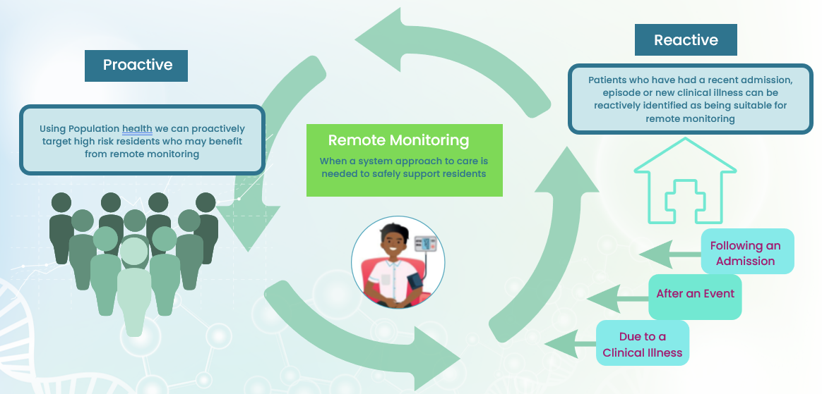
System Approach
Remote Monitoring supports our highest risk residents -
Proactively by identifying them using Population Health
Under the care of specialist teams, like Heart Failure or Diabetes
As part of a care pathway, such as a Virtual Ward or Early Discharge Support
At the point of contact, when the patient is deemed high risk and would benefit
High Risk
High Risk Acute
Standard package of care for Remote Monitoring
Increase frequency to support acute care e.g. Virtual Ward
High Risk +
Or, living in a Care Home
Notes:
Creating capacity and re-focusing on scheduled, care rather than unscheduled care
Using population health data to drive a proactive approach, identifying patients at higher risk of acute illness and hospital admission. Not only waiting for patients to be admitted to enrol them into remote monitoring

Slide 6
Remote Monitoring: Current Status
Proactive Frailty
Care Homes
Long Term Conditions
Programme is clinically-led & driven. Through clinical population health leads, clinical leaders are building clinical networks, driving innovation & transformation.
Patients can be enrolled into multiple interventions & escalate and de-escalate across pathways. Thresholds can be set at patient level to support personalised care.
Alerts managed through remote monitoring services & when indicated, escalated to primary care or urgent care services.
Use John Hopkins Patient Need Groups (PNG) to segment our population into cohorts.
Each care home receives clinical monitoring hubs which are a certified medical device.
Extend digital capability and delivery approach to support diabetes and heart failure patients.
61 practices live with 7,000 patients actively monitored.
Started in Nov ‘22 & rapid progression to support winter pressures.
First area in the country to deploy PNG best practices.
Selected ~60k high risk patients steered by the ICS Medical Director, supported by the ICS clinical reference group.
34 care homes live with 950 patients actively monitored.
Started the programme to spot early deterioration.
A clinical monitoring hub device is setup on each floor of the care home & digitises Sp02, respiration rate, blood pressure, pulse & body temperature.
Baselines captured monthly with daily monitoring for a potentially deteriorating patient.
700 diabetic patients & 120 heart failure patients being actively monitored.
Pilots for disengaged diabetes patients in areas of deprivation and newly diagnosed patients.
Remote monitoring heart failure patients who are already on BHFT and FHFT caseloads.
Alerts managed by Heart Failure teams.
Notes:
Focus on monitoring proactive frailty patients

Slide 7
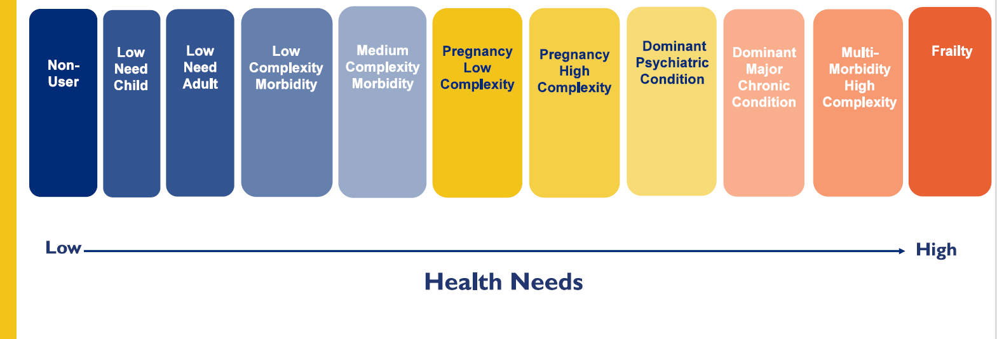
Patient Needs Groups Segmentation Frimley population overview
1
2
3
4
5
6*
7
8
9*
10
11
1.9%
16.7%
33.6%
18.5%
9.3%
1.1%
0.2%
2.5%
6.8%
2.0%
0.4%
80.0%
3.8%
9.3%
Green / Low need
Amber / Moderate need
Red / High need
70.7%
19.9%
2.5%
Notes:
Using ACG PNG groups 10 and 11 to identify cohort for intervention 2.5% of total ICS population.
Cohort clinically validated by GPs working in system
First approach 50% enrolled, trial on second approach showing further 17% opting to enrol

Slide 8
Remote Monitoring
Clinical Model
Clincal Differentiators
UCR /
Virtual
Wards
Two Digital Health Teams are clinically led with an approximate breakdown of 1 nurse supporting 2500 patients, 1 care navigator for 909 patients and 1 care coordinator for 909 patients.
Sign-posting
Acute Virtual Ward / UCR
Virtual Ward
Digital Health Team
Primary
Care
Community / Speciailst Teams
Remote Monitoring
Primary Care
Remote Self Monitor
Resident / Carer
Local
Intervention linked to
PCNs
Commnuity
The Digital Health Team continue to support the resident and the escalation point may change as the resident’s needs change
Self Care
A single digital system allows residents to escalate up and down levels of care within the system
Residents remain safe across transfer of care points as they are supported by the digital health care team using a single digital solution
Frequency of remote monitoring may increase as the resident becomes more acutely unwell
Once residents are self-actualised and well, they can move to
remote monitoring without clinical intervention or self care
Notes:
Single system intervention across all ICS partners and services.
The same digital health team act on alerts.
What changes – patient can be escalated or de-escalated seamlessly to a different clinical protocols allowing escalation or de-escalation of frequency of monitoring.
For example, frail patient in primary care on ‘keeping well’ protocol with weekly monitoring/data and virtual ward with monitoring prompts 3 times a day.
Policies written and developed by clinical groups

Slide 9
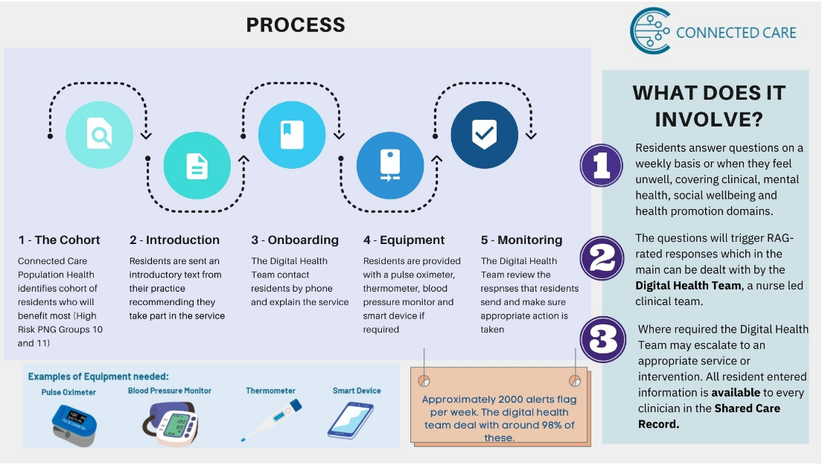
Notes:
How does it work for patients.

Slide 10
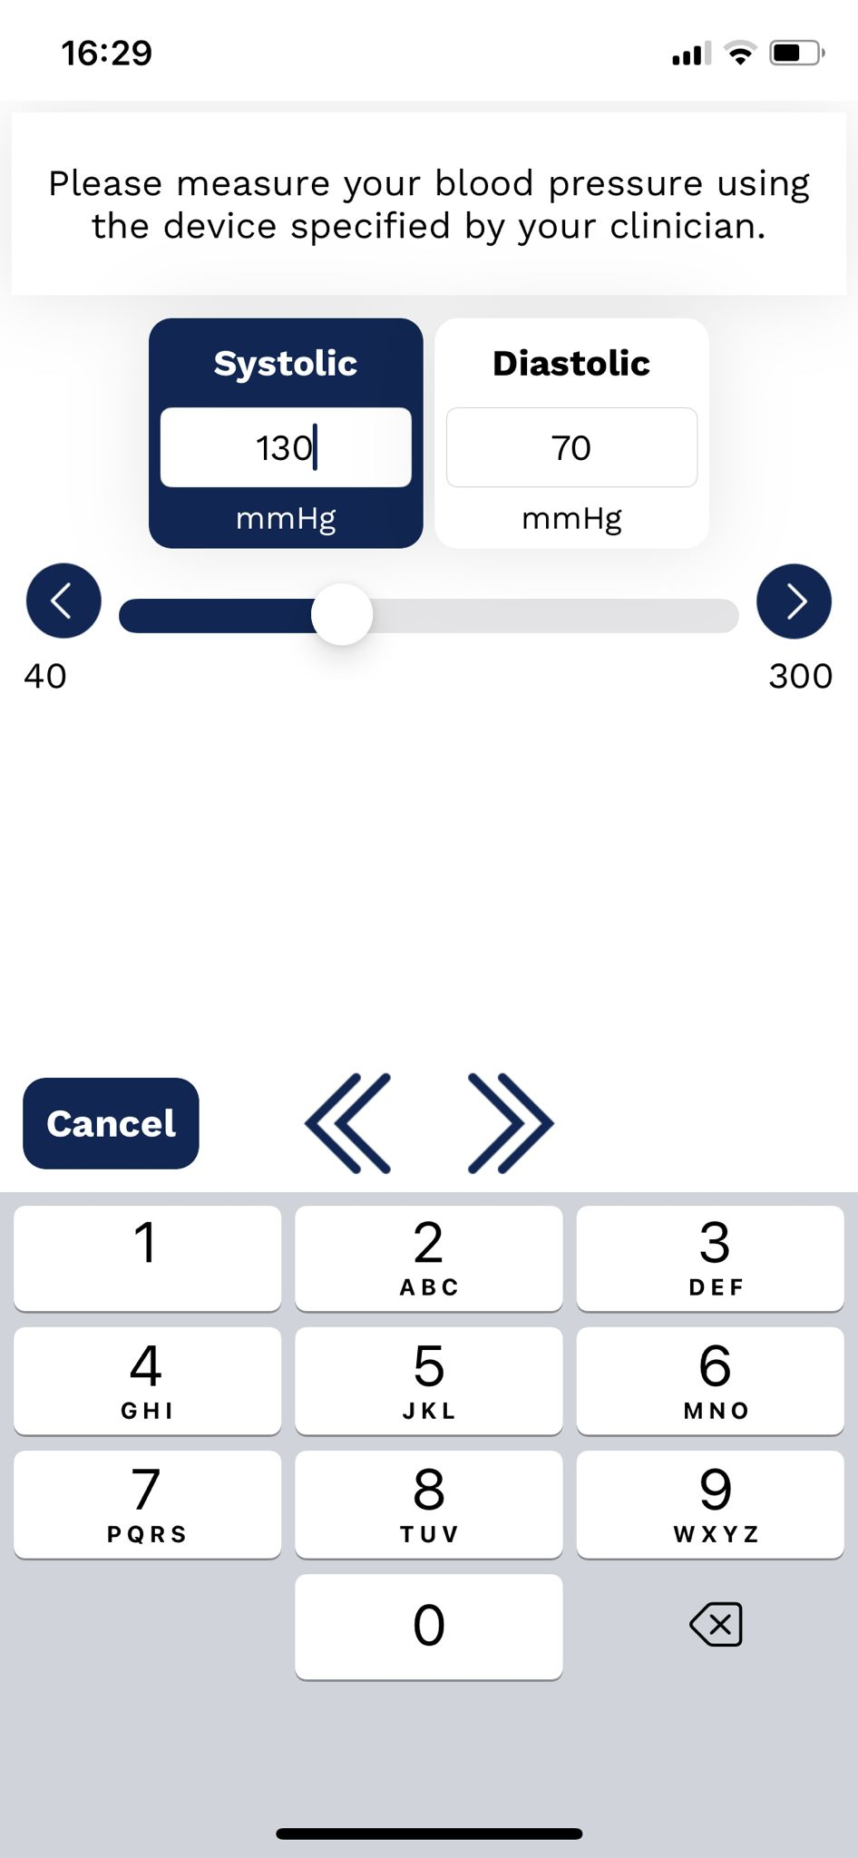
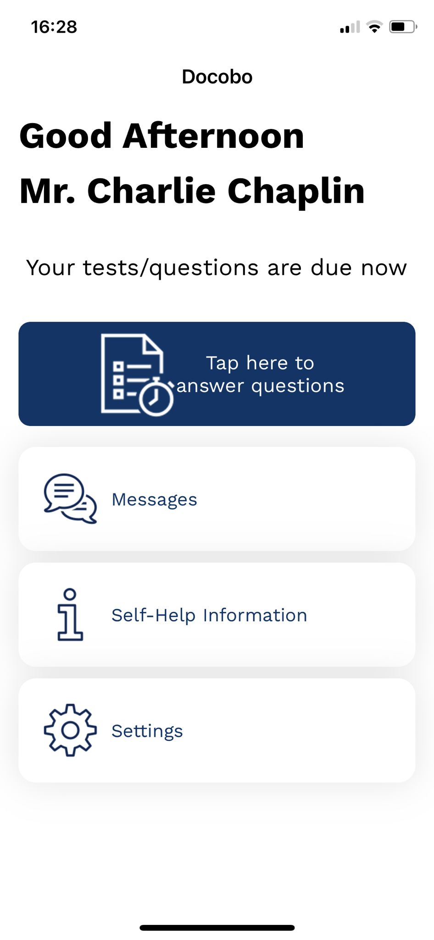
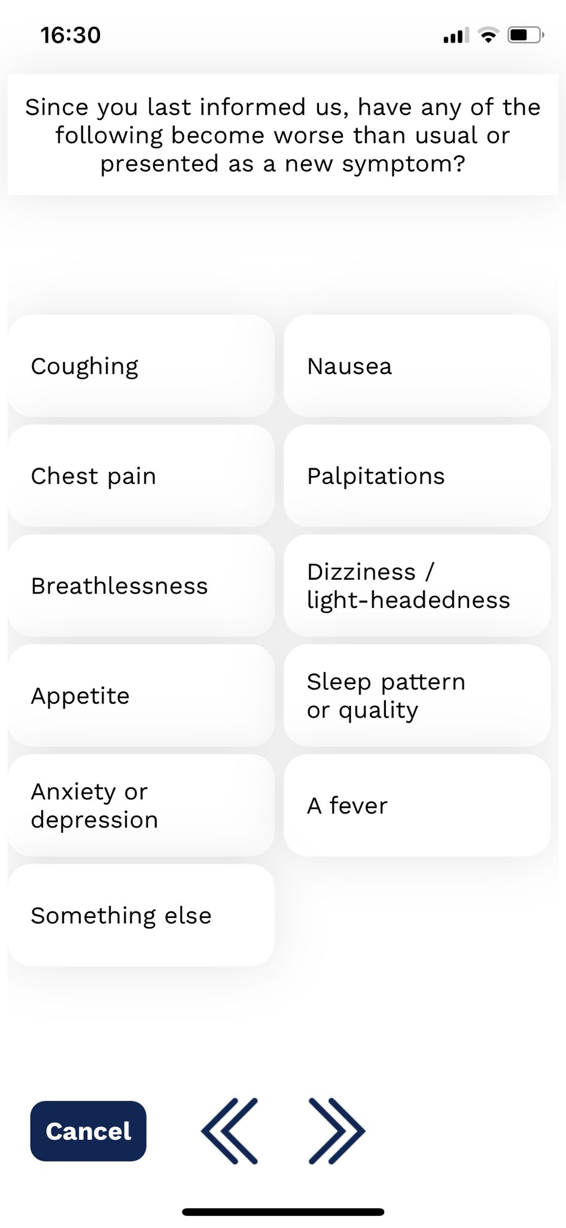
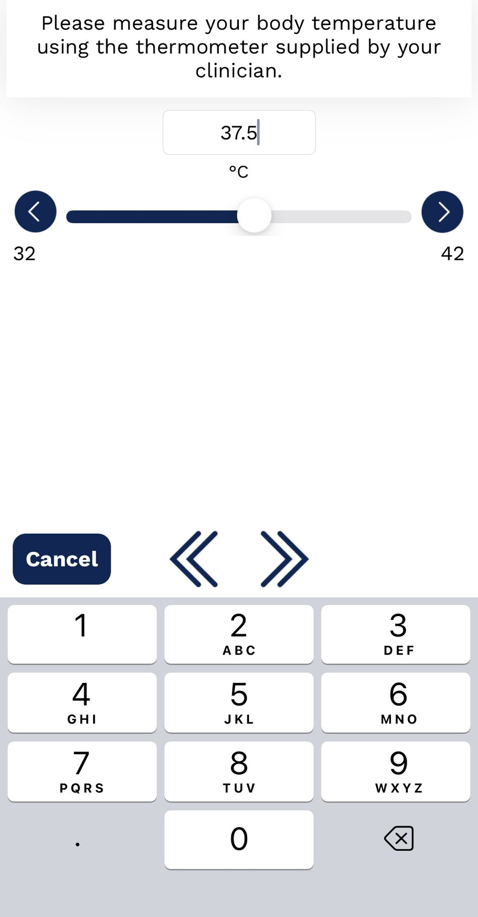
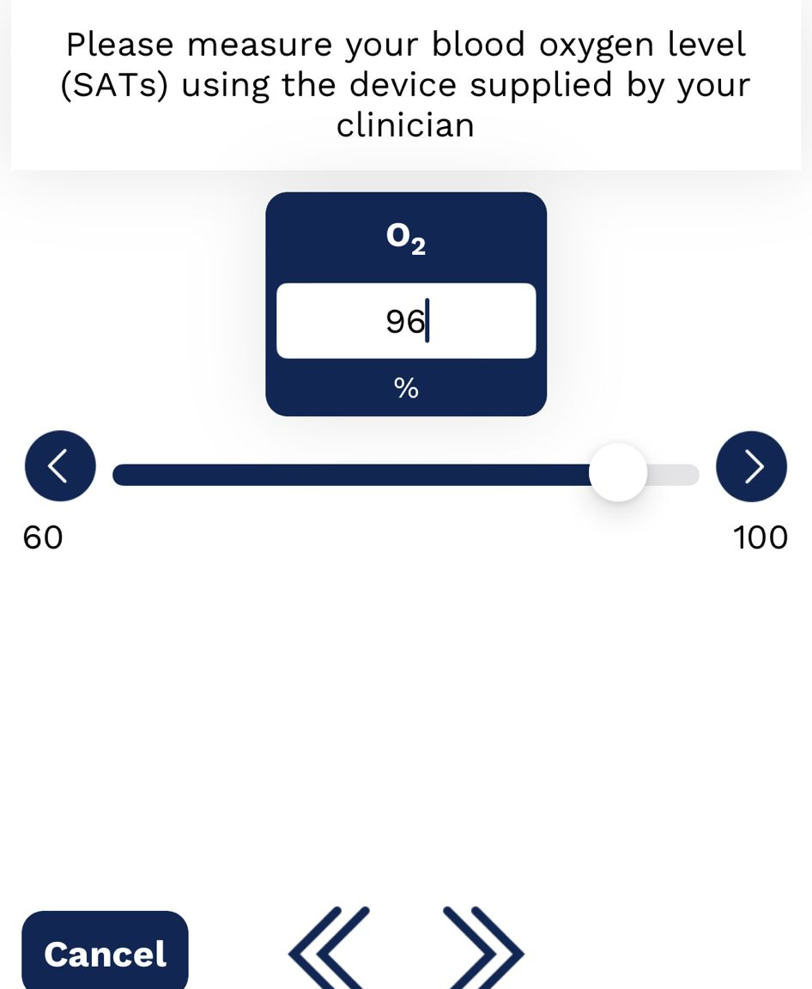
Remote Monitoring
Resident Interface
Notes:
Docobo patient interface

Slide 11
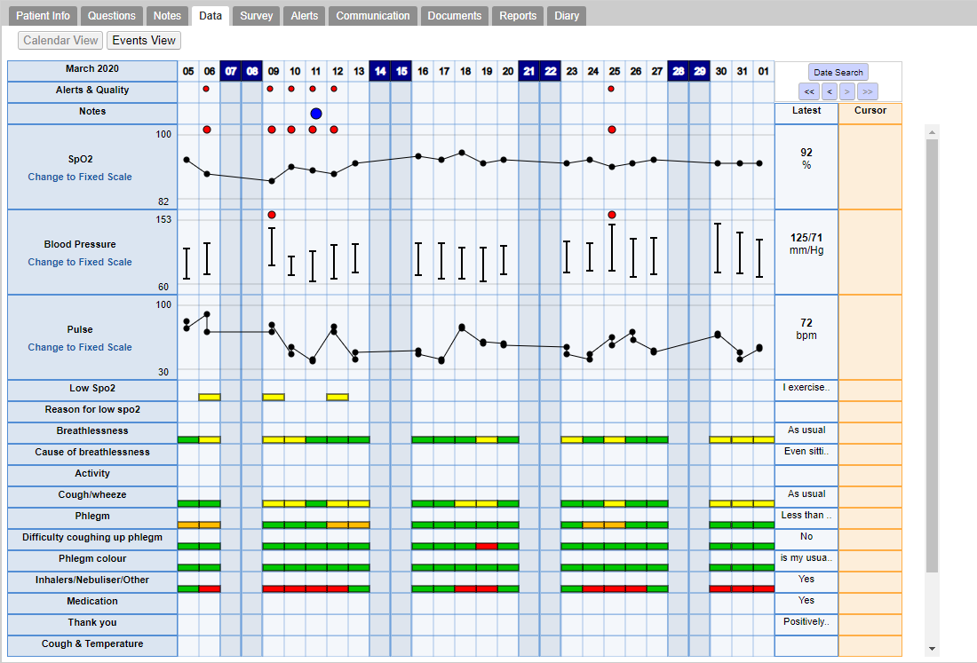
Clinician View
Double clicking on a date column will highlight it and present a detailed summary of information input on that date.
Red and amber markers indicates when alerts have been triggered and a threshold breached.
Notes:
Data feeds back into the shared care record. In any situation, healthcare professional can access patient’s remote monitoring data and baseline – e.g. primary care, A&E, Ambulance service, 111

Slide 12
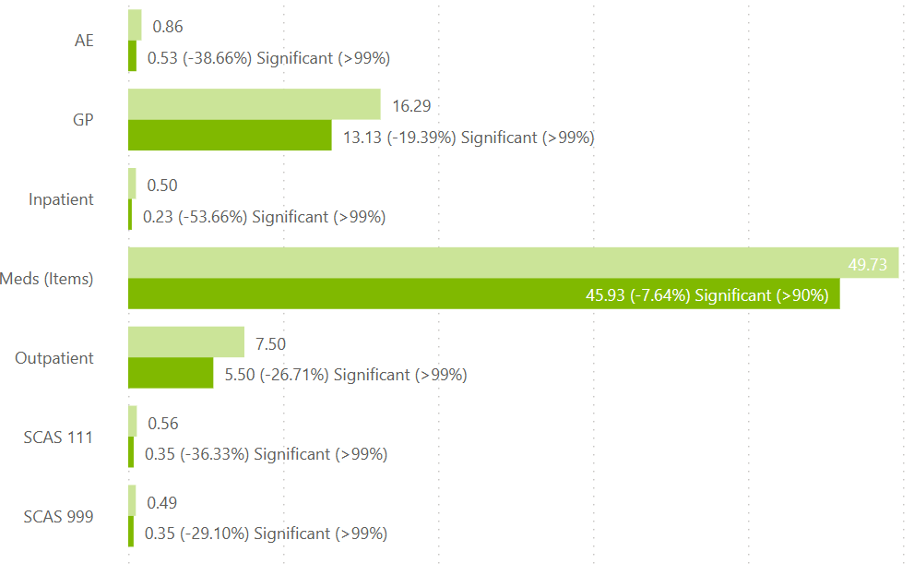
Service outcomes – RM High Risk (3,673 patients)
Tables format
Tables format
Tables format
Key insights
Light green bar represents how we think our intervention group would have acted had we done nothing, per person per year following intervention
(based on comparator group)
We observed the following service outcomes in our (3,673 unique) enrolled patients compared to our case-matched comparator group (n = 14,607):
Reduced A&E attendance by 38.6%
Reduced Admissions by 53.7%
Reduced Outpatient appointments by 26.7%
Reduced GP contacts by 19.4%
Reduced volume of prescriptions issued by 7.6%
Inpatient stays have fallen by 0.27 per person per year, applying this to the total eligible population would give us a reduction of 5,087 admissions per year
We plot the change in activity before and after intervention, this is compared to their expected activity if they exhibited the same trend as the comparator group.
Saving per year | A&E | GP | IP
Estd saving on currently enrolled | 1,212 | 11,607 | 992
Estd saving on remaining eligible | 5,005 | 47,931 | 4,095
Total estd saving | 6,218 | 59,538 | 5,087
Currently deceased patients excluded
Notes:
Data also flows into population health analytics platform at granular level.
Allows us to enable rapid evaluation as the project is rolled out.
Essential to help us go further, faster, providing oversight of outcomes that are too good for GP practices to ignore
Now getting scale to evidence impact on ICS – 7,000 patients in 15 months

Slide 13
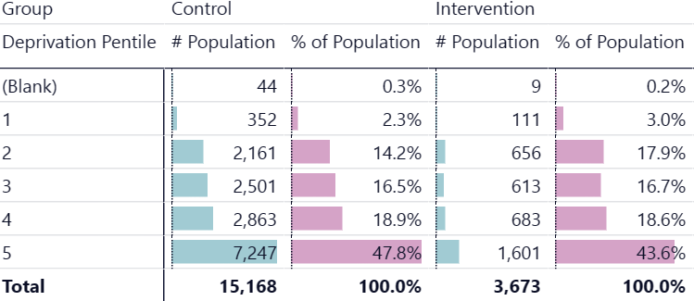
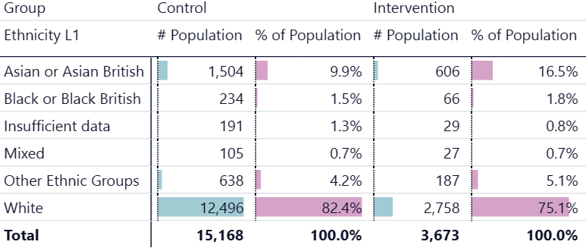
Remote Monitoring – High Risk summary
Tables format
Tables format
Tables format
Definitions
Intervention group | Patients enrolled onto Frimley Remote Monitoring – High Risk Care Package between 1st December 2022 and 30th September 2023 | 3,673 unique patients
Remaining eligible cohort | Patients aged 30+, with higher needs (as defined by John Hopkin’s Patient Need Groups), who currently meet enrolment criteria and are registered in a Frimley practice | 15,168 unique patients
Deprivation distribution
Ethnicity distribution
Shape of plum bars indicates accessibility of service, comparing intervention group against remaining eligible cohort
Currently deceased patients excluded
Notes:
As well as evaluating initial clinical impact, data flowing into pop health platform enables us to monitor equity of access – the project is currently over-representing lower deprivation deciles and Asian communities. With plum bars on the right of each table indicating accessibility of service, compared to intervention group against remaining eligible cohort.

Slide 14
The approach
Population health analytics identified that sleep issues contribute to poorer outcomes for patients and increasing activity in primary and secondary care.
Big Health offer Sleepio, an automated digital CBT programme for insomnia consisting of 6 sessions and guides accessed via web and app. We are looking to purchase population-wide access to Sleepio for residents of Frimley ICS (uncapped licenses in exchange for joint evaluation and delivery) initially for one year.
Aim to get Sleepio to the right people using population health data. Mechanisms to tell people about Sleepio:
Encourage
Text message from GP
(+ potentially GP website)
Inform
ICS web page
Why & how to access Sleepio
Sign up to Sleepio
Sleepio web page
Sleepio Privacy Policy
Access Sleepio programme
Link to Sleepio sign up page
Signpost to other services that might be relevant - talking therapies
Link to ICS web page
Identify
Case finding analytics
Cohorts for messaging and evaluation
Describe process
Patient lists provided via email - per cohort per practice:
Txt file
NHS no. only
GP Practice loads list into EMIS
EMIS puts list into AccuRX
Add a rule in AccuRX to automatically code list into EMIS when message sent.
Add link to this info from GP web page and Sleepio sign up page in case residents come via these routes
Content to be provided which can be added to GP websites, linking through to ICS web page.

Slide 15
Cohorts
Using population health analytics case finding, patient lists will be provided to practices. Three separate cohorts have been identified to allow for different messaging and approaches to raise awareness, engage and encourage signups:
Cohort 1 - Those most likely to benefit because they have gone to their GP with conditions that would benefit from digital CBT support to sleep.
Residents with active problems including the one or more of the following codes:
- Insomnia - Dyssomnia - Stress - Anxiety - Depression - Menopause - Perimenopause - Patients who have had 3 or less issues of Z-drugs (hypnotics - Zopiclone, Zolpidem, Zimovane) in the last 6 months
- Exclude patients in cohort 2 (below)
˃ AccuRX SMS text message signposting patients to Frimley ICS web page including information about Sleepio (automatic code for evaluation).
Cohort 2 - Those who are on medications to help them sleep, could benefit from Sleepio digital CBT but need to be approached as part of a discussion with their care team.
Residents with one or more of the following:
- Repeat prescription of a Z-drug (hypnotics - Zolpidem, Zopiclone Zimovane) issued 4 or more times in the last 6 months
- 4 or more issues of Z-drugs in the last 6 months
These residents in Cohort 2 will be offered more support to help reduce their usage e.g. as part of their structured medication review, a letter including information about Sleepio could be attached to the SMS text inviting patients to review their medication.
Cohort 3 - Many don’t come forward with issues but could still benefit, this group is therefore aimed at whole population minus cohorts 1 & 2 for whom more targeted messaging is appropriate.
All residents not in cohort 1 or 2. AccuRX text signposting to Frimley ICS web page including Sleepio.

Slide 16
ICS Web page (currently unpublished – screenshot for reference)

Slide 17
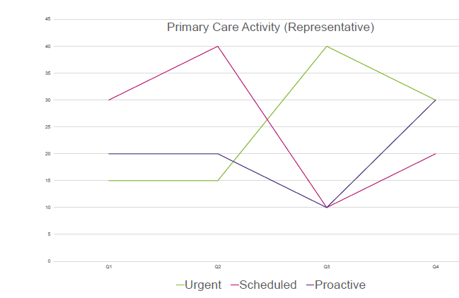
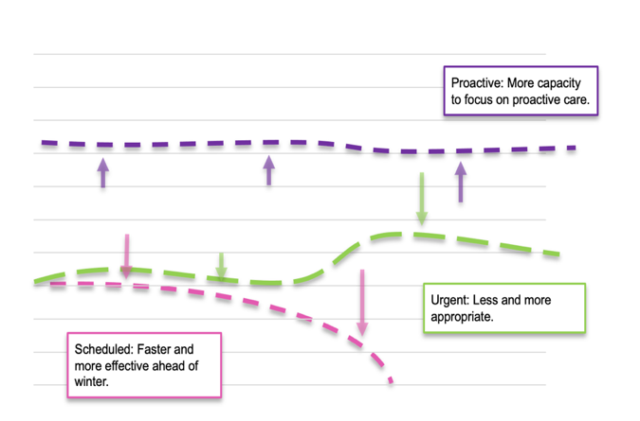
Optimising Primary Care access and outcomes
Scheduled: More efficiently
What we do
What it is and current challenges
Vision
How we can work differently to achieve this
Unscheduled
(Urgent & Routine)
Unplanned activity; usually patient initiated. May also be clinically initiated such as for test results .Known unknowns in terms of when, what and who.
Unscheduled to scheduled
Use patient segmentation and acuity of presenting complaint to embed more efficient triage/care navigation that supports directing appropriate demand elsewhere, using wider skill mix and making every contact count.
Scheduled care
Practice initiated, known workload across the year. Ensures all patients with long term conditions are checked annually and builds relationship with patient.
Creating capacity for change
Use at scale, automatable solutions to efficiently manage patients where checks can be done entirely remotely. Focus F2F capacity on patients that do need to be seen in person.
Proactive care
Little capacity in the practice to focus on this in a strategic way. Missed opportunity to reduce unscheduled care pressures.
Reactive to proactive
Use case-finding to continuously identify patients with opportunities to improve care, identify new diagnoses and get those lists to an appropriate workforce as well as opt into wider system interventions that support access.

Slide 18
Segmentation Example Applications
CONNECTED CARE
Unscheduled Care
Scheduled Care
Proactive Care
Living and Staying Well
Every Contact Counts
Every Contact Counts
Support in Triage (Primary and Secondary Care)
Opportunistic condition management / baseline measurements.
Low need patients referred to CPCS.
Use case finding to optimise patients on different pathways. E.g. Acute waiting list, pre-natal.
Post-admission home visit.
Structured Medication Reviews (PCN pharmacist).
Social Prescribing.
Demand and Capacity Management
Right care – right channel. E.g. Green patients using Online appointments.
Waiting Well
Complex patients longer appointments to manage their complex history
QOF Prioritisation
Patient feels supported and understands their health conditions better.
More faith in the system
Better outcomes & quality of life
Less inappropriate ED attendances
Less demand for same day Access
Triage and on-day demand: Embedding knowledge of the patient’s boarder needs into triage and care navigation models as a soft signal alongside why they are presenting…
…allows triage teams / FOH staff to separate need from want and ensure patients get signposted and/or booked into appointments that make best use of the wider workforce and other resources.
QOF prioritisation: Prioritising QOF by PNG (need) allows for more complex patients to be seen earlier in the year, when resources are more flexible and to optimise them before winter .
This is linked to that fact that 60% of the bed base is attributed to PMG 10,9,5 and 4 , PNG 11 is being remote monitored (in Frimley).
Notes:
Priya

Slide 19
Segmentation Primary Care Framework
Creating a ‘clinical currency’ – a signal/marker that everyone in your practice can understand…
RAG | LOW |  |  |  | MODERATE |  |  |  |  | HIGH
PNG | 1 Non-User | 2 Low Need Child | 3 Low Need Adult | 4 Multi-Morbidity, Low Complexity | 5 Multi-Morbidity, Medium Complexity | 6 Pregnancy, Low Complexity | 7 Pregnancy, High Complexity | 8 Dominant Psychiatric/Behavioral Condition | 9 Dominant Major Chronic Condition | 10 Multi-Morbidity, High Complexity | 11 Frailty
Unscheduled
(Urgent & Routine)
Scheduled
Proactive
Notes:
Priya

Slide 20
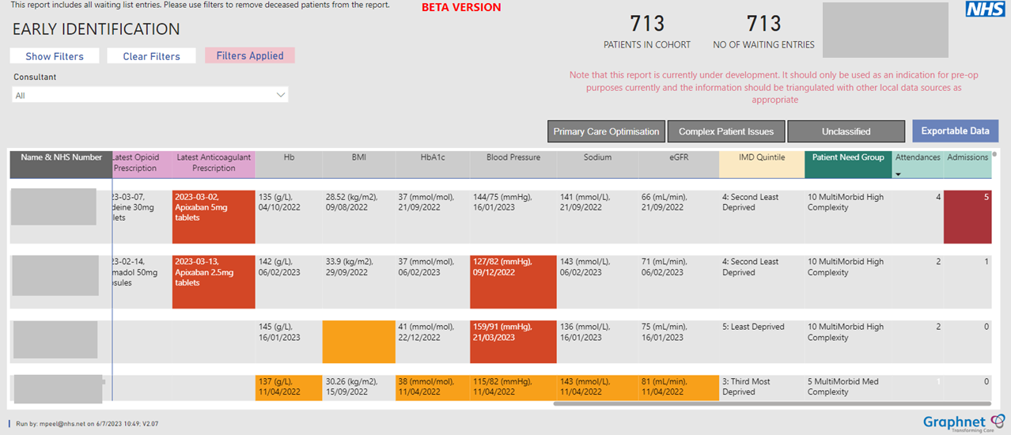
Same patient cohort with details to support conditions that may need optimising

Slide 21
Thank you
Sharon Boundy
Director of Transformation and Digital
Frimley ICS and Connected Care
sharon.boundy@nhs.net

