Slide 1
C4.3 Long Term Public Patient Engagement Lee Rickles Yorkshire & Humber Care Record Director

Slide 2
Why engage!

Slide 3
Public Concerns around data sharing
Security Risks
Lack of Control
Privacy Violations
Erosion of Trust
High Stakes if misused
Opacity in Use
Transparency
Strong Security Measures
Public Control
Open Dialogue
Notes:
The NHS faces public concerns around data sharing, despite its potential benefits. Here's a breakdown of the key points:
Concerns:
Security Risks: Data breaches and hacking incidents can expose sensitive medical information. The public worries that the NHS might not have robust enough safeguards.
Lack of Control: Some people feel they lack control over who accesses their data and how it's used. Concerns arise about data being used for commercial purposes or unintended consequences.
Privacy Violations: Sharing data with private companies or research institutions raises privacy concerns. People might be uncomfortable with their health information being used in ways they don't anticipate.
Erosion of Trust: Past data breaches or unclear communication about data use can erode public trust in the NHS's ability to handle information responsibly.
Reasons for Concern:
High Stakes: Health information is highly personal and can have significant consequences if misused.
Opacity in Use: The public might not fully understand how their data is being used or with whom it's being shared.
Past Experiences: Previous data scandals or high-profile cases can make people wary of further data sharing initiatives.
What the NHS can do:
Transparency: Clearly communicate how data is collected, stored, used, and protected.
Strong Security Measures: Invest in robust cybersecurity infrastructure and protocols to minimize data breaches.
Public Control: Provide clear opt-in/opt-out options for data sharing and empower patients to manage their data preferences.
Open Dialogue: Engage with the public, address concerns openly, and explain the potential benefits of data sharing for improving healthcare.
Current Initiatives:
Public Engagement Events: The NHS is planning large-scale consultations to gather public views on data usage and empower public participation in shaping policy.
National Data Guardian: This independent role oversees data protection within the NHS and ensures responsible data use.

Slide 4
Patient Public Journey
2018 Exploring people's beliefs in how health and care records could and should be used
2020 Joined Up Yorkshire and Humber Report - PHM explanations
2021 Explaining data flow: Joined Up Yorkshire and Humber Report
2023 Talking to patients and public about their data
We keep an open dialogue and publish as open-source information

Slide 5
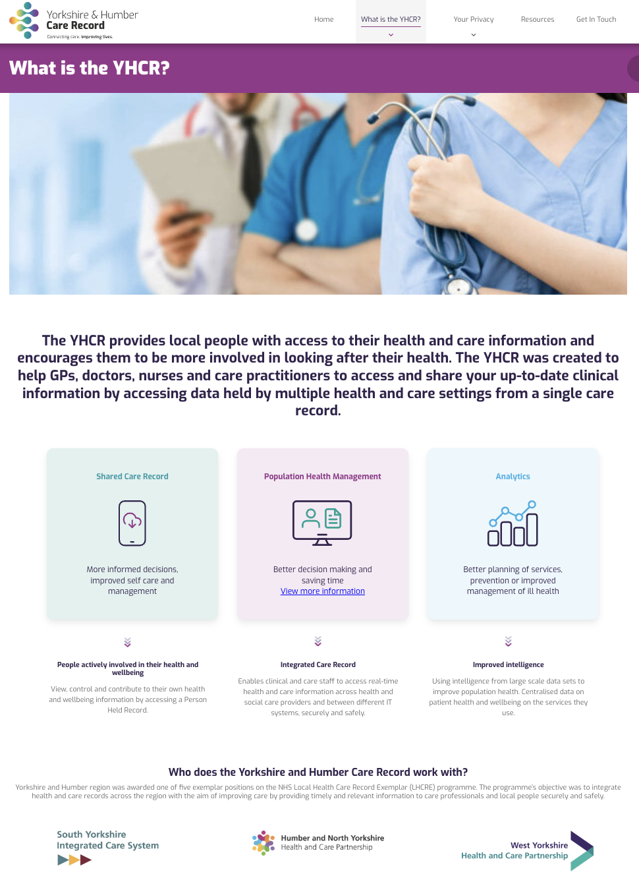
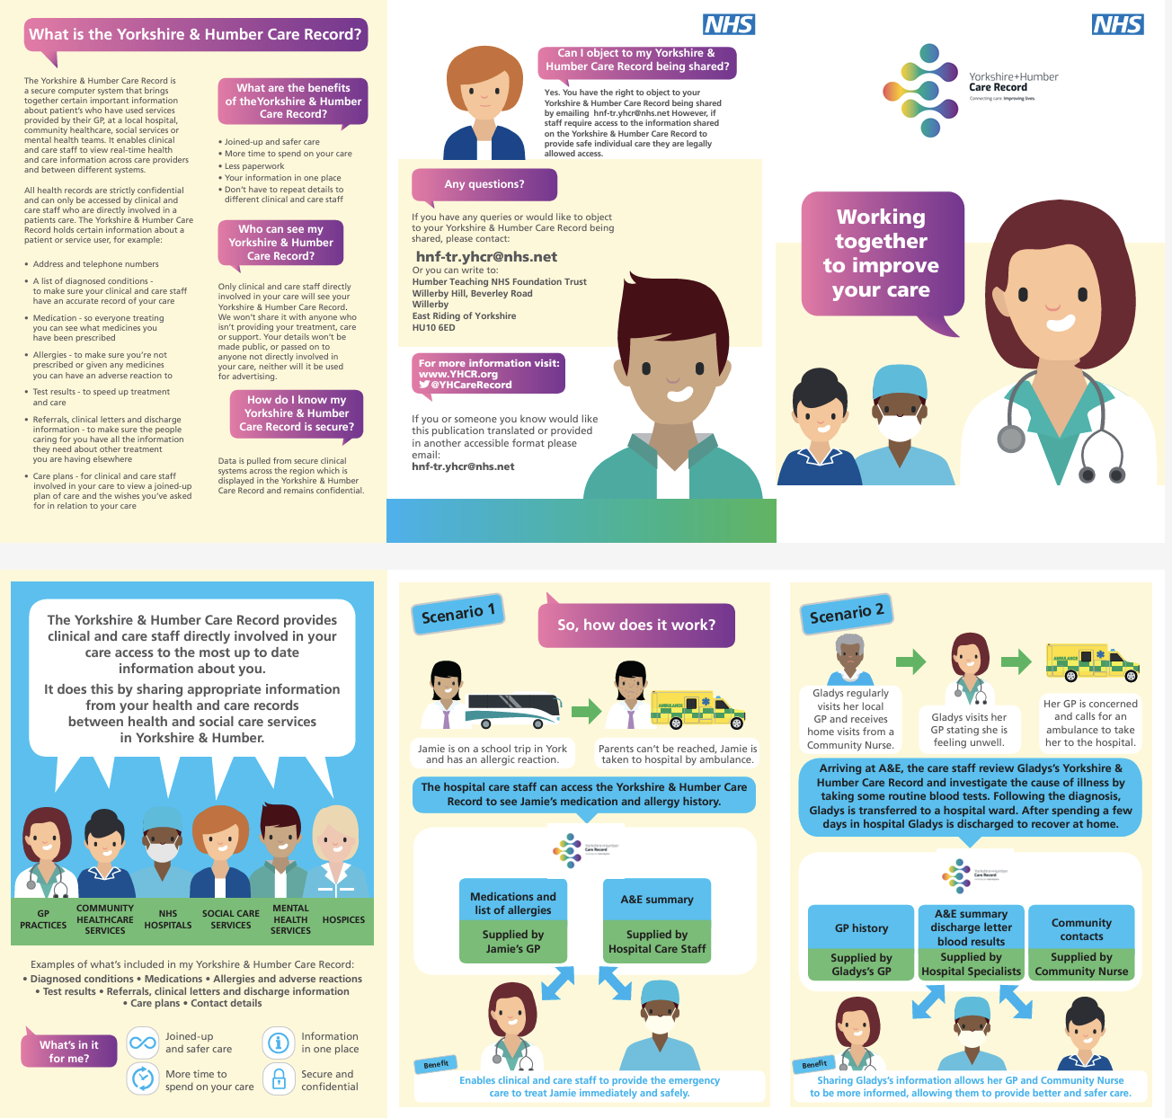
Resources shared with partners
Notes:
https://www.youtube.com/watch?v=5gD2ahiyUMg

Slide 6
Thank you

