Slide 1
C4.1-2 Public engagement in data sharing
Joanna Stapley - DHSC
Helen Dobson - Citizens Online
Victoria Betton - SmartCo
Notes:
TIMINGS - 30 mins - Joanna (5 mins) Helen (5 mins) Victoria (10 mins) Joanna (5 mins) + 20 mins groupwork + 10 mins shareback

Slide 2
Today we will be covering:
Public Engagement plans - DHSC/NHSE
Digital & data literacy - Citizens Online
Involving the public in conversations about data - SmartCo
Group exercise - A3 planning

Slide 3
Why is engaging the public so important?
Effective and meaningful public engagement helps us to build public confidence in how we use their health and care data
Public engagement helps us to develop effective policy that resonates with the population of England
It enables us to speak to seldom heard groups and ensure that policy development and programme delivery are inclusive
It builds provenance for the work that we do for the future
Notes:
Going over why it’s important and introducing agenda for session

Slide 4
Engaging the public on health and care data
Joanna Stapley DHSC

Slide 5
Data Saves Lives
Data saves lives: reshaping health and social care with data was published in June 2022​
The strategy sets out ambitious plans to harness the potential of data in health and care, while maintaining the highest standards of privacy and ethics​
The strategy has over 100 commitments focused on how we will deliver against our headline goals, including improving trust in the health and care system’s use of data
Our vision: the public have confidence in how their data will be handled, and are happy for their data to be used to improve the care that they and others receive​
As someone using health and adult social care services, I and those who support me will have:​
Confidence that my data is being handled in a way that is safe and secure​
A good understanding of how my data is being used, both for my individual care, and for improving population health, planning, innovation and research​
Greater access to my own health and care data, and the power to choose how it is used
Notes:
Speak to DSL and why engaging the public is so important

Slide 6
Large-Scale Public Engagement
What are we working towards?​
Around £2 million of funding was allocated to deliver on public engagement commitments until March 2025.​
The majority of this funding will be spent on large-scale public engagement focussed on the development of products committed to in the data strategy and utilise in-progress, high profile data policies and programmes as use cases​
This work does not preclude local activity or programme-specific engagement and the team are ensuring coordination with all other activity.​
DHSC and NHSE have procured an external supplier (Thinks Insight and Strategy) with the skills, experience and expertise to deliver a comprehensive programme of engagement. ​
​
Where are we now?​
We have signed the contract with the successful supplier and are kicking off the programme of work.​
We are going through planning and design until April, with engagement commencing in May 2024 and concluding by March 2025
Notes:
Speak to DSL and why engaging the public is so important

Slide 7
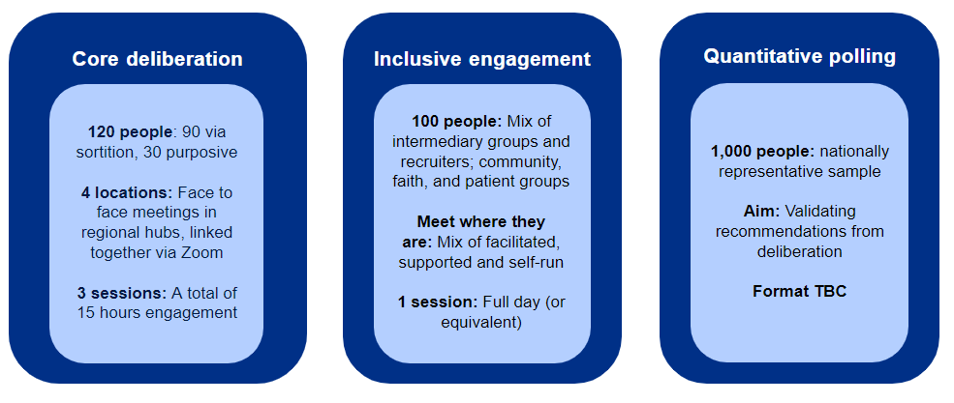
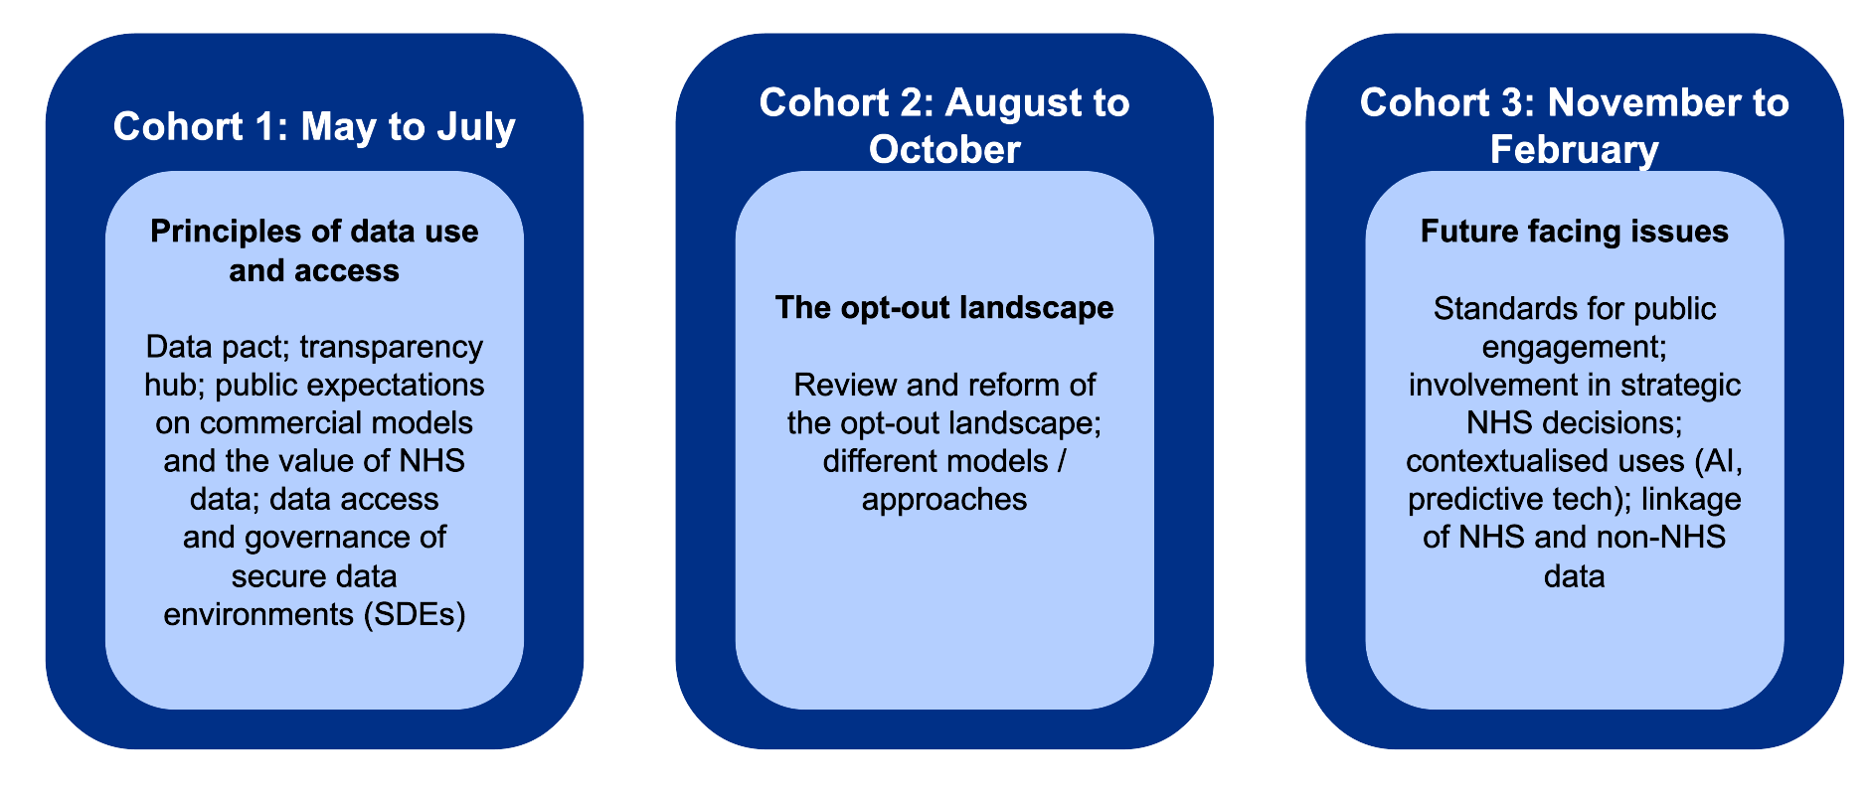
Methodology
Meaningful Engagement
This approach builds public trust and confidence by generating opportunities for the public to meaningfully and visibly influence policy and services.​
It is designed to mitigate exclusion inherent to some deliberative approaches. ​
This combines three tiers of engagement, repeated three times across 2024/25.
Notes:
Speak to DSL and why engaging the public is so important

Slide 8
Digital & data literacy
Helen Dobson, Citizens Online

Slide 11
Involving the public in conversations about data
Victoria Betton, SmartCo

Slide 12
Developing resources to explain how patient health and care data is used for population health management
hnf-tr.yhcr@nhs.net
Yorkshire & Humber Care Record Unit 1, Calder Close Calder Park Wakefield WF4 3BA
Delivered by SmartCo Victoria Betton Jennifer Are Helen Fisher

Slide 13
The brief
To develop further practical resources for the Yorkshire & Humber Care Record team and its ICS partners. Enabling them to better engage and consistently inform staff and the public, about how their data is used.
The updated resource produced is specifically focused on feedback from people from ethnic minority backgrounds and with lived experience of mental health difficulties.

Slide 14
Our approach
Reviewed national and local evidence to better understand:
the different ethnic minority communities in Yorkshire and Humber and their geographical locations to inform where and how we deliver workshops
the prevalence of people with lived experience of mental health difficulties in Yorkshire and Humber and the types of difficulties they experience
how these groups have already been engaged around the use of their health data for population health management
best practice for engaging these specific groups and communities
Delivered four workshops through intermediaries across Yorkshire and Humber that have access to our target groups:
Bradford African community
Black Health Initiative
The Peel Project
The Adult Mental Health Co-Production Group at Humber Teaching NHS Foundation Trust
Workshops were designed to test the current resource and gather feedback to inform the updated version(s) of the resource(s)
Developed the resource
Used feedback and findings from the workshops to update the resource to incorporate new materials that meet the needs of a diverse group of people
Produced reports
Produced a full and summary report detailing our approach, key findings and recommendations for the Yorkshire and Humber Shared Care Record (YHCR)

Slide 15
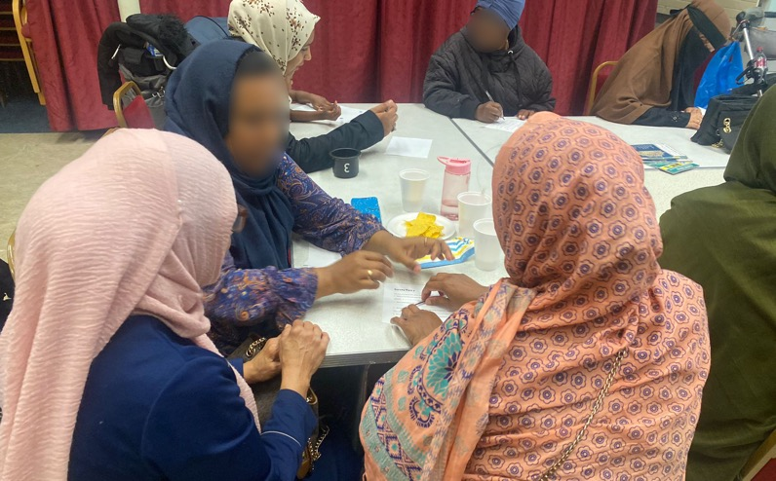
Engagement workshops
Following our review of local and national data, we conducted four engagement workshops in Bradford, Leeds, Hull and online with ethnic minority communities and people with lived experience of mental health difficulties.
Our aims were:
to better understand what participants knew and felt about population health management and their data being accessed for this purpose, before and after sharing the resource
to share the current resource to raise awareness about the YHCR and the benefits of data sharing and access for population health management
to gather feedback on how the resource could be improved and tailored to better engage these specific communities

Slide 16
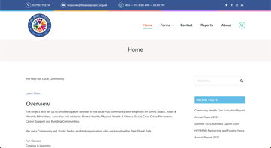
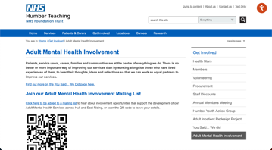
The intermediaries
Bradford African Community (Bradford): Predominantly current or previous refugees and asylum seekers from African countries.
https://bradfordafrican.co.uk
Black Health Initiative (BHI) (Leeds): Predominantly Black Caribbean/ Black British service users.
https://www.blackhealthinitiative.org
Peel Project (Hull): predominantly Asian communities
https://www.thepeelproject.org.uk
The Adult Mental Health Co-Production Group at Humber Teaching NHS Foundation Trust (remote): to engage people with lived experience of mental health difficulties.
https://www.humber.nhs.uk/Get%20Involved/adult-mental-health-involvement.htm
Overall, we engaged: 38 participants, diverse ethnicities, a wide range of age groups, though only 5% between 18-24, 86% female, 14% male, 16% had a disability

Slide 17
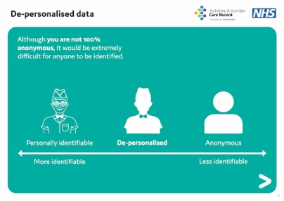
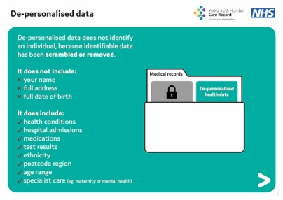
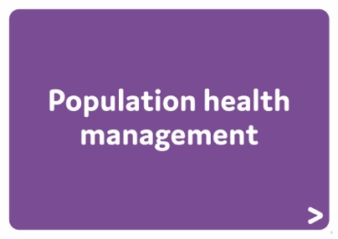
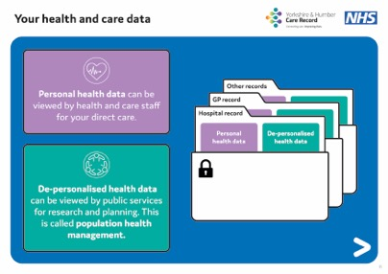
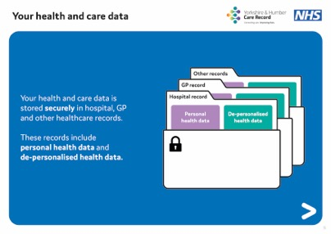
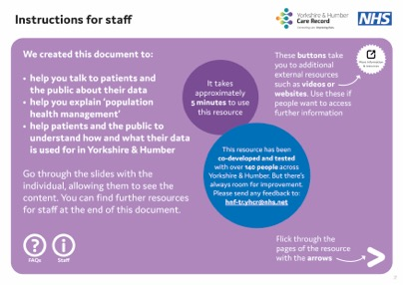
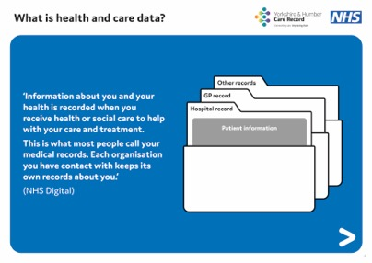
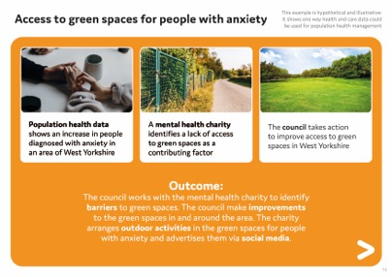
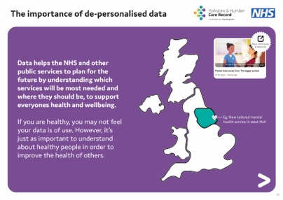
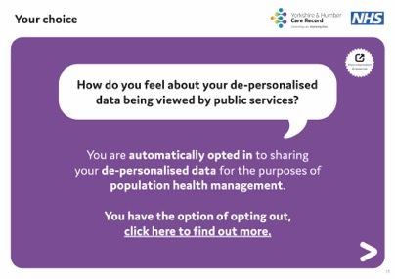
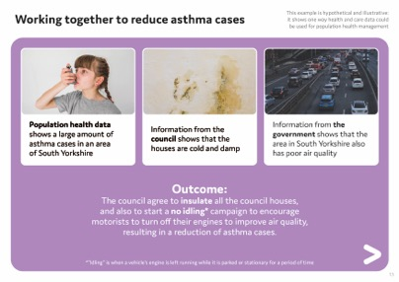
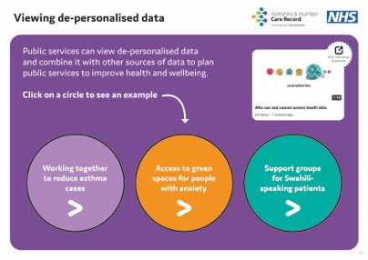
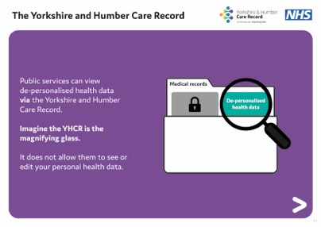
The resource went through multiple iterations before and after workshops with YHCR feeding into the development. We concluded with a 29-page interactive PDF of which you can see the main body here.
The main resource

Slide 22
Group activity:
A3 Planning

Slide 23
Group exercise: A3 planning
What is working well for you?
What can you apply to existing/new projects?
How will you know you’ve made a difference?

Slide 24
Thank you

