Slide 1
B5.2 Care Plans Discovery Findings NECS and NHS England Amy Soutter Rachel German Hannah Wall

Slide 2
Introduction
Wider care plans work (Connecting Care Records)
The Connecting Care Records team commissioned North of England Care System Support (NECS) to conduct a wider piece of discovery work to look at the current position of all care plans within England including patient and clinician user experience of care plans.
NHS App Discovery (Products and Platforms)
Assess viability of extending use of the NHS App to surface care plan information – as a 'front door' for the patient - and the different options for how this could be achieved.

Slide 3
Discovery Overview
Key Deliverables and Approach
Standards & Policy Background Desktop research to understand the policies and standards that apply to digital care plans
ICS Engagement Meet with ICSs to discover approach to digital care plans - current provision /access / provider
Clinical Engagement Mixed approach (desktop and engagement) to outline best approach to clinical engagement
Patient Views Mixed approach (desktop and engagement) to understand requirements for a digital care plan
Benefits Appraisal Outline the benefits of digital care plans to patients and NHS
Digital Solutions Research Meet with solution providers to understand their digital care plan offer
Objective
Determine whether it is appropriate to include care plans as a standard element of shared care records, and if so, how best this should be approached, highlighting the major considerations. To do this, understand the level of variation, what solutions are in place and the effectiveness of each solution.

Slide 4
ICS Engagement

Slide 5
ICS Engagement: Approach
All 42 ICSs were approached for a qualitative interview to understand:
The level of digital care planning maturity in the ICS
The success factors of implementing a digital care plan
The barriers to implementation
The clinical need and wants
Technical capability and interoperability of the implemented systems
Any patient feedback
Any benefits analysis
Some quantitative measures were included such as volumes of care plans created, volume of pathways and type of care plans available.
We met with 38 / 42 ICSs
We did not meet with Frimley ICS, however their care plan solution is included in our data due to information from the care plan supplier. We are not aware of the care plan provision for the remaining three ICSs.

Slide 6
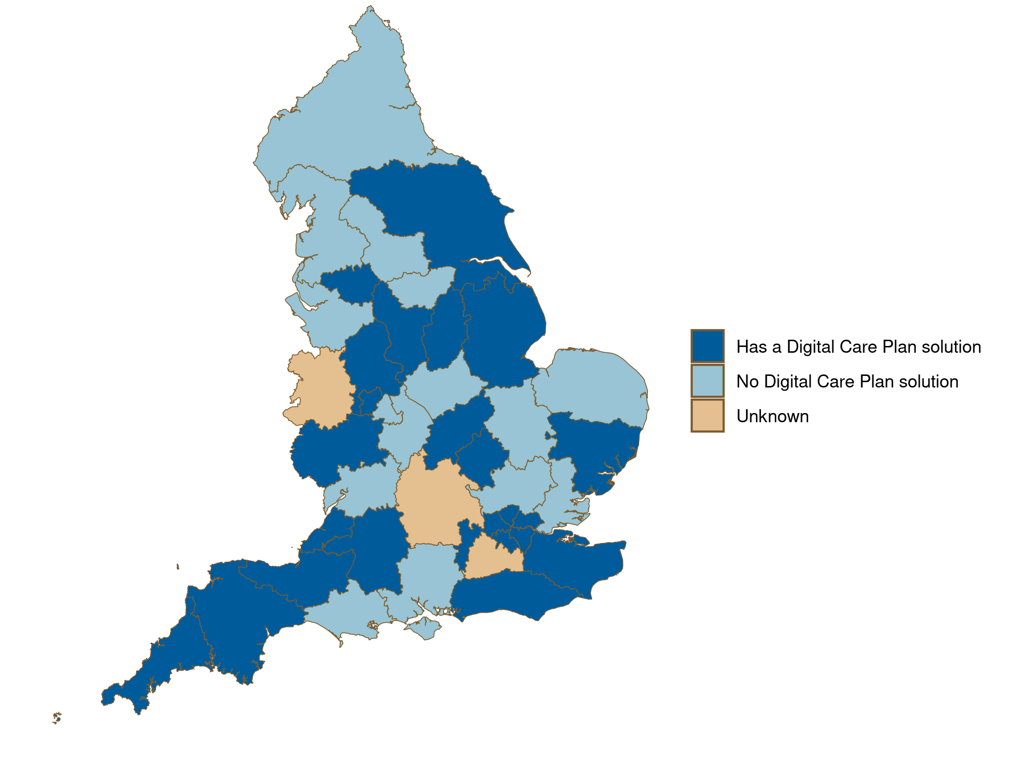
ICS Engagement: Digital Care Plan Solution
Digital Care Plan Solution Provision across ICSs
18 (46%) ICSs have a digital care plan solution in use across the system.
6 (15%) ICSs have a care plan solution, but it is not currently being used.
15 (39%) ICSs do not have a digital care plan solution

Slide 7
ICS Engagement: Active Care Plan Suppliers
There are several care plan suppliers
In London, 5 ICSs have collectively procured Better for their digital care planning

Slide 8
ICS Engagement: Care Plan Types
16 ICS have an active end of life care plan
Otherwise, there a wide range of conditions with a shared digital care plan.
There are more pathways planned, based on local clinical need

Slide 9
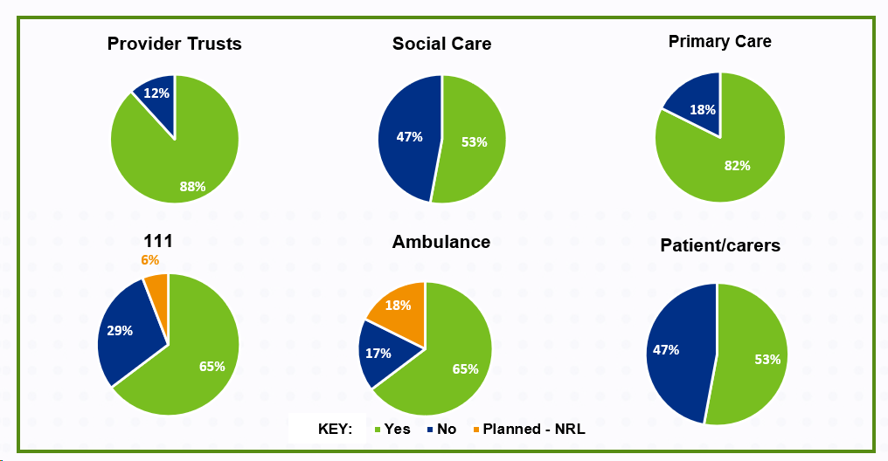
ICS Engagement: Care Plan Access
88% of ICSs are sharing digital care plans with their provider trusts – acute, mental health and community.
65% of ICSs are sharing digital care plans with ambulance trusts through in-context launch in the ambulance trust EPR.
18% of ICSs are planning to integrate with the NRLS to surface care plans to ambulance trusts.
53% of ICSs have the capability to surface care plans to patients, but the provision is very limited.

Slide 10
ICS Engagement: Care Plans within ShCR
There is a mixed approach between digital care plan provision being embedded within ShCR solutions and independent solutions.
ShCR Supplier | Care plan within ShCR | Separate care plan solution | No care plan solution
Black Pear | 1 | 0 | 0
Cerner HIE | 0 | 7 | 2
Graphnet | 6 | 2 | 0
Intersystems | 1 | 1 | 3
Interweave | 0 | 1 | 3
Orion | 3 | 1 | 5
Plexus | 0 | 1 | 0
Tiani | 0 | 0 | 1
Various* | 0 | 0 | 1
*various one ICS has multiple shared record providers

Slide 11
ICS Engagement: Digital Care Plan Maturity
Less Mature More Mature
Maturity criteria
1
2
3
4
5
No digital care plan solution and no plans for a digital care plan solution
No digital care plan currently but plans to implement a solution
Sharing digital care plans from EPRs as pdfs (view only via ShCR) OR care plans active in discreet digital care plan solution but not shared across providers
Shared digital care plan solution for one condition, those that need to are able to view and edit care plans
Digital care plan solution for more than one condition; view/edit/create available /cross organisation users
% of ICSs

Slide 12
ICS Engagement: Digital Care Plan Enablers
Clinical Engagement
Clinical leads and clinical reference groups
The most successful ICSs had a clinical lead involved in the roll-out from the outset
IG Support
IG leads and IG support group
Standing up an IG group at the start of the care plan rollout ensured IG expertise was provided throughout
In-context launch
In context launch and single sign on make accessing the digital care plan easy for clinicians, increasing the likelihood of the care plan becoming part of routine workflow
Digital care plan launches from EPR system.
Support from ICB on necessity of sharing care plans crucial to successful implementation
A flag in an EPR that alerts a clinician to a care plan being available is a useful nudge to ensuring clinicians check the care plan solution
Clinical reference groups providing input and expertise led to an engagement clinical workforce and solution that clinicians were happy to use
Support from DPO and IG leads on the documentation required was a common success factor

Slide 13
ICS Engagement: Digital Care Plan Barriers
Standards
Lack of data / information standards
No data standards for many condition care plans means ICS are unclear what should be included in digital care plans
Funding
Difficulties with type of funding and timing of funding
Uncertainty over funding and access to wrong type of funding (capital) means ICSs are unable to plan new digital roll-outs
Resourcing
Information Governance
Digital teams that consist of 2-4 people unable to manage large-scale digital rollout across systems
Small digital teams unable to manage large-scale rollouts
Difficulty understanding IG and convincing all organisations to share data
Lack of standards may result in a variation in the care plans across England
Data standards required to collect population health data from digital care plans
Funding required to sustain new care plan solutions
Funding often given with a short notice period to spend; therefore, ICSs are unable to plan adequately
No funding for additional resources
Some uncertainty from ICBs that digital care plans should be shared across systems
Uncertainty about the IG that should be in place to share care plans that can be edited / modified by users
Some health providers unwilling to share data

Slide 14
Clinical Engagement

Slide 15
Clinical Engagement: Approaches
Key finding: a successful digital care plan implementation involves clinicians from day one.
Recommended Approach
Approach One: Digitally enabled implementation
Approach Two: Digitally led implementation
Clinical leads identified, informed and engaged throughout the design and roll-out of care plan.
Clinical groups identified and stood-up to feed into the care plan design and implementation
Clinical staff identified to facilitate roll-out and training of end-users
Clinical teams have a mechanism to feed back to digital teams regarding the solution
Digital team is open to feedback from clinical users
Digital team provides regular clinical feedback to care plan suppliers
Digital care plan content and format developed between digital team and digital care plan supplier
Roll-out plan consists mostly of communication - emailing clinical staff / running webinars on solution
Digital teams lead all training and communication on care plan solution

Slide 16
Clinical Engagement: Recommended Approach
Identify
Co-create
Develop
Test
Go-live
Feedback & Modify
Clinical engagement and collaborative design has been prominent in successful implementation of digital care planning solutions.
A recommended approach is demonstrated, which has been used by several ICSs.
You need to do more than clinical engagement, you need clinicians to co-produce and validate the solution, this is the way you build ownership and momentum within clinical teams
Evelyn White Programme Director, Kent Community Health NHS Foundation Trust

Slide 17
Patient Engagement

Slide 18
Patient Requirements: Literature Review
Search terms to understand clinical requirements for care plans: 'digital care plans', 'care planning' and 'advanced care plans’, 'digital tool rollouts’, 'digital implementation' and 'digital change'
Shared Decision Making
A commitment by both clinician and patient to shared decision making is essential for successful personalised care planning
Collaboratively set goals and self‐selected behavioural targets are as more motivational than clinician‐assigned goals
Personalised Care
Personalised care planning enables an increased awareness of local services, support with accessing practical and financial assistance and increased confidence and motivation to address specific issues in their lives
46 papers reviewed
Key themes
16 papers included
Self-Management
Identifying the most effective methods by which self-management programs can be delivered and scaled for use at the population level should be a priority
Tools that were designed to support self-management were successful in improving engagement with patients

Slide 19
Patient Requirements: Charity Engagement Findings
Joined up Care
Patients want joined up care – where all clinical teams involved in their care have access to their up-to-date care plan and record.
Joined up care prevents patients from repeating themselves and having to remember every aspect of their care plan.
Personalised Care Plan
Patients would like a care plan that is personalised to their individual needs and takes their circumstances into account.
View / Edit
Patients would like to view their care plan and have a simple, accessible way to do so.
The ability to edit will not be a requirement for all patients.
Mobile Application
Joined up care is seen as a huge factor in improving patient – clinician trust.
Patients would benefit from care plan standards that ensure a specified set of information is included, alongside their personal information and goals.
Proxy access to carers / parents can access and view a care plan is viewed as an essential requirement.
Many patients are already using mobile applications to manage their care
Patients often share data and insights from these applications with clinicians on scheduled visits
The NHS App is seen as a trusted health product and would provide a simple way for patients to access their care plan(s).

Slide 20
Digital Care Plan Benefits

Slide 21
Benefits Overview
Non-Cash Releasing
Public
Improved health outcomes
Improves patients' ability and access to tools to manage health conditions.
Provides HCPs with joined-up information so they can make the best decision about a patients care.
Reduced admissions
Visibility of patient wishes / treatment plan reduces admission to urgent care.
Time saving
Access to digital care plan reduces time spent searching for patient information / asking patient history / calling GPs.
Qualitative
Quality
Patient Experience
Clinical access to care plan will avoid patients having to provide their history / repeat conversations. Joined-up care provides patients with confidence that provider is aware of their condition, care, and goals
Preferred place of death
A shared view of a patients advanced care plan will increase the likelihood of the patient dying in their preferred place
Treatment Certainty
View of a shared care plan will give care providers an understanding of the treatment plan, patient wishes, medication and dosage.

Slide 22
Conclusion

Slide 23
Conclusion
There is a clear want and need from patients and clinicians for a joined up digital care planning solution. Some ICSs have mature systems and are measuring tangible benefits.
The current landscape is varied with 18 ICSs with an active digital care planning solution and 21 with no current solution.
Digital care planning is on every ICSs roadmap; however, ICSs lack clarity on requirements and an NHSE recommendation outlining expectations should be provided, enabling equity for patients.
NHSE should address the expectation that funding will be provided as part of a recommendation
There is currently no superior approach or supplier being used by the most mature systems
Sharing the information gathered in this discovery work with help the ICSs who are less mature with their digital care solution
ICSs would not welcome a one-size-fits all approach, however they would welcome a joined-up approach and a procurement framework to prevent duplication of effort
Clinically led implementation is the most pertinent success factor of mature ICSs, ensuring the system is embedded within the clinical workflow
Patients are already using apps to help them manage their health conditions and would welcome the introduction of their care plan on a digital platform

Slide 24
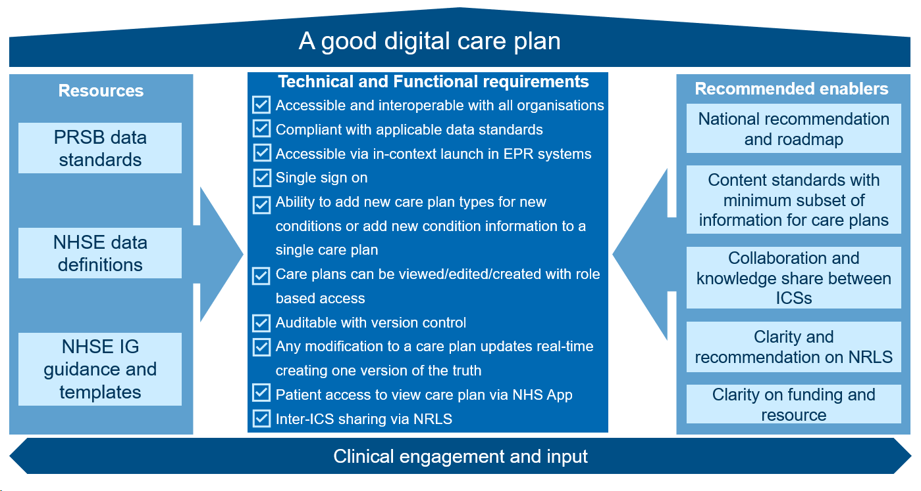
A good digital care plan

Slide 25
Next steps
A read-out of the ConCR Discovery Report will be made available post Summit which will include:
The standards and policy findings – separate document, with support form PRSB
Which care plans are digitised and what the standard for those should be, where these exist
A breakdown of supplier products and availability
Best practice example case studies on success factors and overcoming barriers
Benefits

Slide 26
Digital Care Plans - NHS App Discovery Steven Dodd Head of Digital Transformation - NHS England

Slide 27
The Discovery Hypotheses
H1
Digital care plans deliver value to patients.
There is an existing and viable PHR digital ecosystem that could be leveraged to accelerate patient access to care plans.
Design and architectural changes would be required to the NHS App.
H2
H3
Approach:
The discovery incorporated a mixed method approach across the user-centred design and market research to understand market maturity, technical considerations and engagement with the PRSB standard.

Slide 28
Approach
5 Sprints (10 weeks)
A combination of qualitative & quantitative analysis across UCD & Market Research
19 semi-structured interviews with patients, proxy users and clinicians to understand user needs and experience with using (digital) care plans
18 semi-structured interviews across England's healthcare ecosystem; Shared Care Records (ShCR), Acute EPRs; Primary / Community / Patient Engagement Portals (PEP)
1,395 survey responses across 2 surveys to better understand care plans usage & experience
Social Listening & Secondary Research
Notes:
Does not meet patients' expectations
‘Care Plan’ is NHS terminology with diversity across the NHS in how care plans are used, protocols, workflows and solutions resulting in differences in how the term is applied, understood, and interpreted. As a reflection, Care Plan is recognised but unclear to patients and was used by them to describe being able to view information about their condition, test results and upcoming appointments.
Visibility to all organisations involved in a patients care –
Patients expect their record to be visible to all organisations involved in their care; this is not generally being met other than those services integrated to the ShCR programmes
Resources required to support Clinical Transformation
The pilot in London to shared End of Life care plans demonstrated a significant period of clinical engagement was required to generate consistent documentation within the ShCR prior to exposing a patient specific view.
Lack of adoption and coverage
Although there are examples of good practice in the use of care plans, there are low levels of adoption and often limited to specific condition types. .
Complexity of patient entered data
Introducing the ability for patients to input information, contributing to their clinical record via the NHSAPP e.g. About Me information, would require transformation across front line services to allow this data to be consumed and acted upon in line with the expectation set by introducing the capability.

Slide 29
Mapping findings against hypotheses
Hypothesis 1
Before Graphnet, it was quite complicated... I feel like I would be lost without it.
Digital Care Plans deliver value to patients
It’s a good tool [Mindwave's Maia] and it makes conversations with the specialists much easier.
Patients consider ‘care plans’ more holistically as their health record
The Discovery has proven that digital interaction with their health record provides significant value
Patients want to view their health records in a single place, and they want to do so via the NHS App
37% of users engaged want to access their digital care plans only through the NHS App.
With the help of my digital care planning app, I was able to make positive changes to get healthier and better manage my conditions.
I find the app particularly useful during flare-ups as I can track the effectiveness of exercises that I'd been assigned.
Everything is linked up and in one place [such as health record, letters] which provides a positive experience.

Slide 30
Mapping findings against hypotheses
Hypothesis 2
Coverage of all user needs by segment
40-50%
User needs met by the market; with a resulting gap in 50-60% of user needs
An existing and viable PHR digital ecosystem could be leveraged to accelerate patient access to care plans
ShCR | 37%
EPR | 11%
PEP | 18%
3-5x
ShCR providers demonstrate 3-5 times the coverage of user needs.
ShCRs aggregate patient data from multiple sources across the broader healthcare ecosystem, offering the most holistic view of the patient's health record.
ShCR best aligns with the goals of the NHS Long-Term Plan, emphasizing personalized and joined-up care by facilitating data sharing and collaboration among healthcare providers.
Leveraging an existing and viable PHR digital ecosystem is more complex than previously envisioned
ShCR systems are best positioned to address the fundamental patients’ need of making health data visible through the NHS App ShCR suppliers also provide the largest geographical coverage (79%)
Coverage of priority 1 user needs by segment
ShCR | 53%
EPR | 11%
PEP | 20%

Slide 31
Mapping findings against hypotheses
Hypothesis 3
Design and architectural changes would be required to the NHS App
Patients want to be able to manage their health care digitally and expect all their health information to be available through a single source in the NHS App.
Design and architectural changes are required to surface patients’ health data in the NHS App.
Modular design does not meet patient needs for viewing health data
Digital services and health record data cannot be directly linked to patients
“I'm all for paperless.”
“I'm used to digital... I hate paper.”​​

Slide 32
Recommendation 1 –Standalone Digital Care Plans should not be integrated into NHS App
There are significant challenge exposing standalone Care Plans through the NHSApp
Does not meet patients' expectations
Limited visibility to all organizations/heath professionals involved in a patients care
Resources required to support Clinical Transformation
Lack of adoption and coverage
.
Notes:
Does not meet patients' expectations
‘Care Plan’ is NHS terminology with diversity across the NHS in how care plans are used, protocols, workflows and solutions resulting in differences in how the term is applied, understood, and interpreted. As a reflection, Care Plan is recognised but unclear to patients and was used by them to describe being able to view information about their condition, test results and upcoming appointments.
Visibility to all organisations involved in a patients care –
Patients expect their record to be visible to all organisations involved in their care; this is not generally being met other than those services integrated to the ShCR programmes
Resources required to support Clinical Transformation
The pilot in London to shared End of Life care plans demonstrated a significant period of clinical engagement was required to generate consistent documentation within the ShCR prior to exposing a patient specific view.
Lack of adoption and coverage
Although there are examples of good practice in the use of care plans, there are low levels of adoption and often limited to specific condition types. .
Complexity of patient entered data
Introducing the ability for patients to input information, contributing to their clinical record via the NHSAPP e.g. About Me information, would require transformation across front line services to allow this data to be consumed and acted upon in line with the expectation set by introducing the capability.

Slide 33
Recommendation 2 – Further integration of SHCRs into NHS App
Making a patient’s health record visible via the NHS App (including care plans where available)
This report recommends that a patient appropriate view, of their data held on a Shared Care Record, is exposed via the NHSApp.
Visibility to all organisations involved in a patients care - utilising Shared Care Record data will provide access to organisations involved in a patients care.
Leverages existing local delivery and governance structures
>50% ShCR offer currently offer Care Plans and feature in majority ShCR future roadmaps
Clinical Transformation – the need to transform clinical services should be reduced / removed other than the need for a clear communications and awareness campaign

Slide 34
Recommendation 3 – Phase two discovery
Engage local ShCR programmes and suppliers to validate data availability and clinical safety considerations for how data should be displayed and managed
Engage clinicians and NHS front line services to understand impact on clinical service model and create a benefit case
User testing to validate patient experience through prototyping to inform the benefit case
Test and validate the best technical design and interactions – understand volume impact on ShCR services and downstream suppliers
Create a service design compatible and complimentary with other areas of the NHS App - to prevent siloed information while ensuring a comprehensive and connected information architecture and user experience across the app

Slide 35
Thank you
Hannah Wall Steven Dodd Connecting Care Records Head of Digital Transformation
NHS England NHS England
Hannah.wall3@nhs.net steven.dodd@nhs.net
Rachel German Head of Region
NECS Consultancy
rachel.german1@nhs.net
Amy Soutter Senior Consultant
NECS Consultancy
amy.soutter@nhs.net

