Slide 1
B5.1 Universal Care Plan (UCP) Programme Tomas Ince, OneLondon

Slide 2
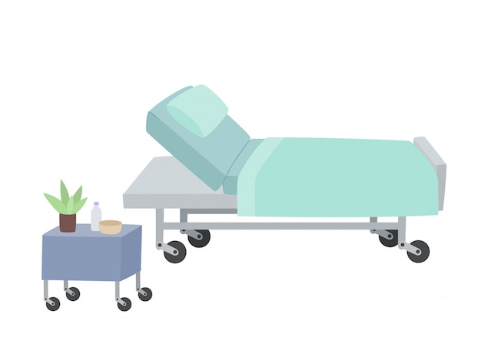
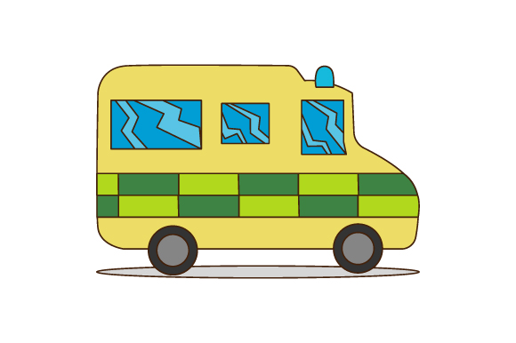
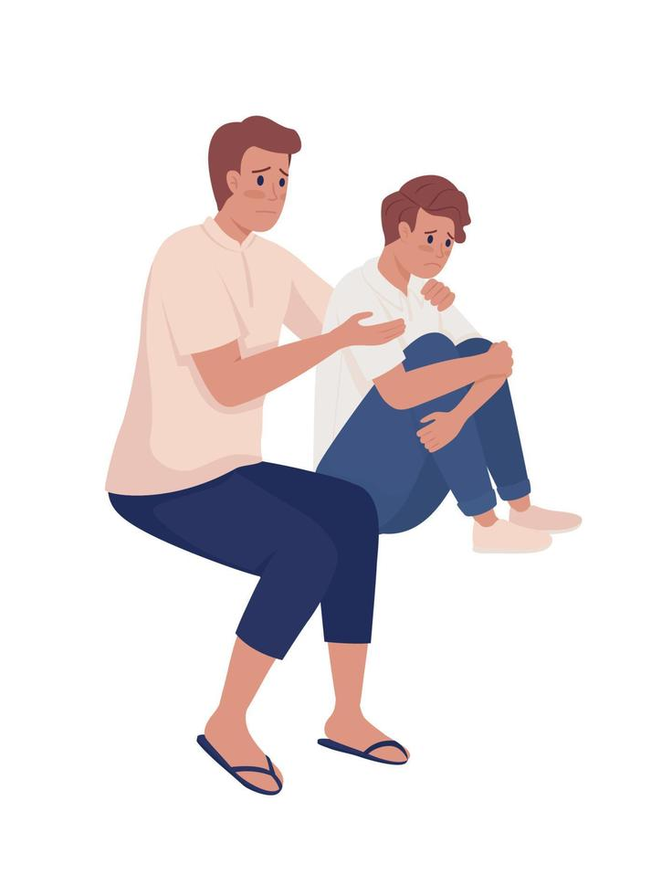
Notes:
Scenario 1
I’d like to you imagine you’re a paramedic. It’s 3am on a cold January night. Its raining. Not heavy rain, but uno that light drizzle that we all hate.
A 999 call comes through for a 77 year old lady in cardiac arrest. You are the closest ambulance. You know nothing further about the patient.
You get there and they aren’t in cardiac arrest, but she looks very unwell and in a hospital bed. She has an elderly husband in a hospital bed next to each other. The son reports that they’ve been sleeping next to each other for 50 years and they weren’t going to stop now they’re in hospital beds. There are multiple family members there in distress. No DNCPR and no UCP. It is very challenging to take a history from the family, so you search for letter to try and identify her PMH and current issues.
You are now multi tasking, gathering history from distressed family, sieving through multiple discharge letters, calling the OOO GP, at the same time assessing and caring for the patient & supporting their family. From letters on scene I ascertain Hx MS, delirium, recurrent UTI and chest infections, a recent discharge letter stated a referral to a dietitian for swallowing. The lady had deteriorated over the last 3/7becoming less responsive.
You're worried errors happen / stormy seas. Prepared the family that we believe their mum was now dying. Ask what mums wishes were. You encourage them to call other family members they felt should be here.
Was this the time to be asking these questions?
Had there been missed opportunities for these conversations to have occurred before today?
You are left coming away feeling that there was more you could have been done. Riding those waves with the family
Scenario 2
That very same wintery night you are called to attend an 80yr old lady who is reported to be having a seizure.
However this time, a flag is highlighted on your cleric ipad that this lady has a UCP. You’re not driving so you can read it before you get to the persons address. She has a history of dementia and is under palliative care. You could see the history and an updated treatment plan.
When you get there you were able to be guided by this information, there was no scrambling, calmer for the patients, the family and you. You were able to provide direct care and a better all round experience. You felt that you provided a professional service and you felt better about your job.
Don’t need to repeat their story. Makes the patient important, puts them at the centre of care
Feeling good – longevity of careers
These scenarios very much happened and are real. They come from Jodie Grace, a paramedic working in LAS today.
The UCP is a platform accessible to patients and all health and care professionals across. It provides a platform for care planning and patients wishes so people don’t need to repeat their story.

Slide 3
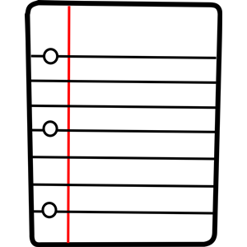
Learning Disabilities
Respiratory
Dementia
Frailty
Carer Contingency
Sickle Cell
Personalised Care
Notes:
There has been an Electronic Palliative Care Coordinating System in London for 10 years. This is where the UCP started, as an advanced care planning solution, ensuring patient's wishes and preferences for care are documented and shared with everyone who cares for them, whether that be urgent care, secondary care or community focused care, like GP’s, palliative care services and care homes. It's been going well, and we are approximately capturing 70% of the expected end of life population in London.
The UCP uses openEHR technology through our software provider Better, which enables us to reshape the form to meet our users needs. This would enable the UCP to benefit citizens across many use cases potentially. Im pleased to say our board agreed with this approach.
Following lots of engagement with pan london networks, 7 groups came forwards to come on the journey with us. But how to start shaping a care planning solution that meets all 7 use cases.
Do we develop a care planning solution that has a care plan for each condition, with the possibility of a shared summary screen highlighting the important elements of a person. OR do we think about developing a blended template that encompasses all those data fields, but use some clever age, business and conditional logic to ensure only the relevant data fields show for that citizen.
Our users choose a blended form approach. (no right or wrong approach)
One care plan for one person
Personalised
GP / clinicans across more than one use can don’t want to fill in multiple care plans
Minimise data duplication and discrepancy
Ease the burden of data modelling – mobility for one use case may need to be more detailed compared with another
Developing a blended care planning solution has been tough. An acknowledgement from stakeholders that their paper form will not automatically transfer to the platform.
Blah blah
Developed a prototype and specification – We are now in the build phase with a planned launch in the summer.

Slide 4
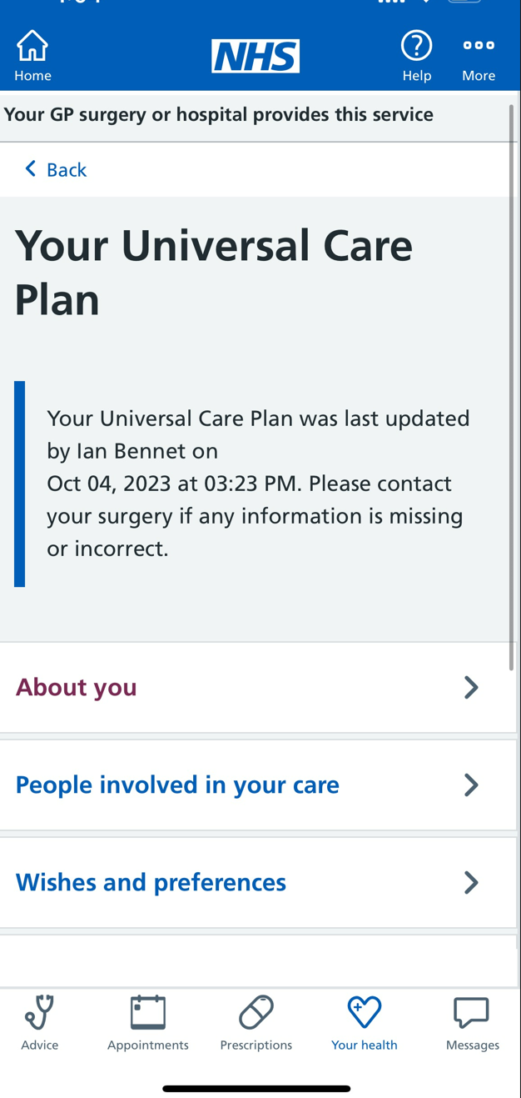
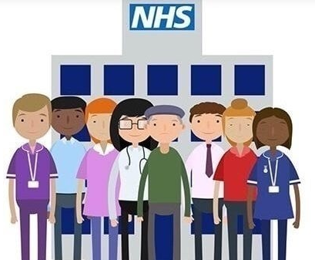
Notes:
It’s all well and good, clinicians having access to your wishes, preferences and what matters to you but what about the citizen. Don’t they own their care plan? They are the experts.
As a patient myself I want to be more involved and work in partnership with their health and social care providers so they can achieve the best possible outcomes for themselves. We think so.
Three quarters of adults in England are signed up to the NHS app. For us this seemed like the most logical place for the citizens of London to access their UCP.
Over the past year with have work with the regional NHS app team to integrate.
Since January we have been live in the NHS app, providing citizens with viewable access to their care plans. We have some controls on what information is viewable.
Since go live we are getting about 16000 jump offs a month, however not all of these people actually have a UCP.
What if patients were able to not only read their care plans, but also contribute to them via the NHS app. That would be truly collaboration.
We are now starting work with the regional team to deliver read/write access into the NHS app and hope to have a specification by the summer and a launch before the end of the year.

Slide 5
Access and Integrations
Web Portal
Notes:
The UCP uses OpenEHR technology utilising the Better platform. They have a stand here so go check them out.
The UCP platform has over 1400 integrations and if you are interested in this detail, I have added it to the appendix of this presentation. On the left hand side we have access points and some integrations and on the left hand side we have integrations only.
The London care record is our shared care record platform, which the UCP integrated with. The LCR is built on oracle cerna HEI which doesn’t support read / write access which is why they are separated.
3 integrations
General availability service – query whether there is a careplan to flag a UCP. Makes it easy to identify who does / doesn’t have a UCP
In context launch – separate, launch the UCP within your system
Bi-directional information exchange – reduce data entry - SNOMED terms
OneLondon – LYCRA born independently of Co-ordinate my care. Q for Phil/Joss
General availability service – query whether there is a careplan to flag a UCP. Makes it easy to identify who does / doesn’t have a UCP
In context launch – separate, launch the UCP within your system
Bi-directional information exchange – reduce data entry - SNOMED terms
SNOMED terms
The UCP has multiple access routes
-
Technical integrations

Slide 6
Universal Care Plan Programme The London Care Record – How do we integrate? Email: tomas.ince@swlondon.nhs.uk
Notes:
I’d like to show you how the UCP appeared in our shared care record.
How you see care planning in contrast to a shared care record.
Wanted care plan that was read / write (LCR built on oracle cerna HEI which doesn’t support read / write access)

Slide 7
Notes:
1 key feature is the BI dashboard.

Slide 8
Easily accessible & updatable technology (OpenEHR & Better)
If we make it easy to use, people will use it
If you think you’ve communicated enough…. you haven’t!
User led design is essential
Notes:
The UCP’s progress has not been linear, but even through there are hurdles we continue to move forwards.
- On reflection.

Slide 9
Thank you
Tomas Ince UCP Transformation Lead
South West London ICB (on behalf on all London ICB’s)
Tomas.ince@swlondon.nhs.uk
https://ucp.onelondon.online/
X: @LondonUCP

Slide 10
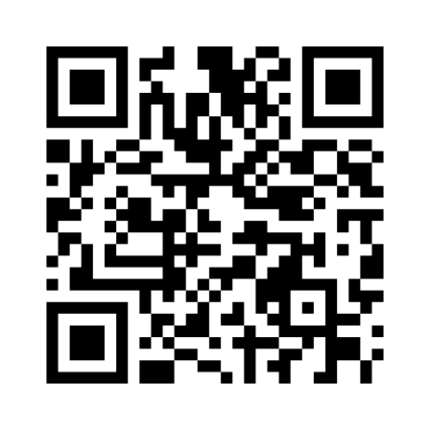

Slide 11
Appendix 1 – Integrations map

