Slide 1
The Challenges of Ownership Understanding the Benefits through change John Mitchell Associate Director of Digital Humber and North Yorkshire ICB

Slide 2
Humber and North Yorkshire

Slide 3
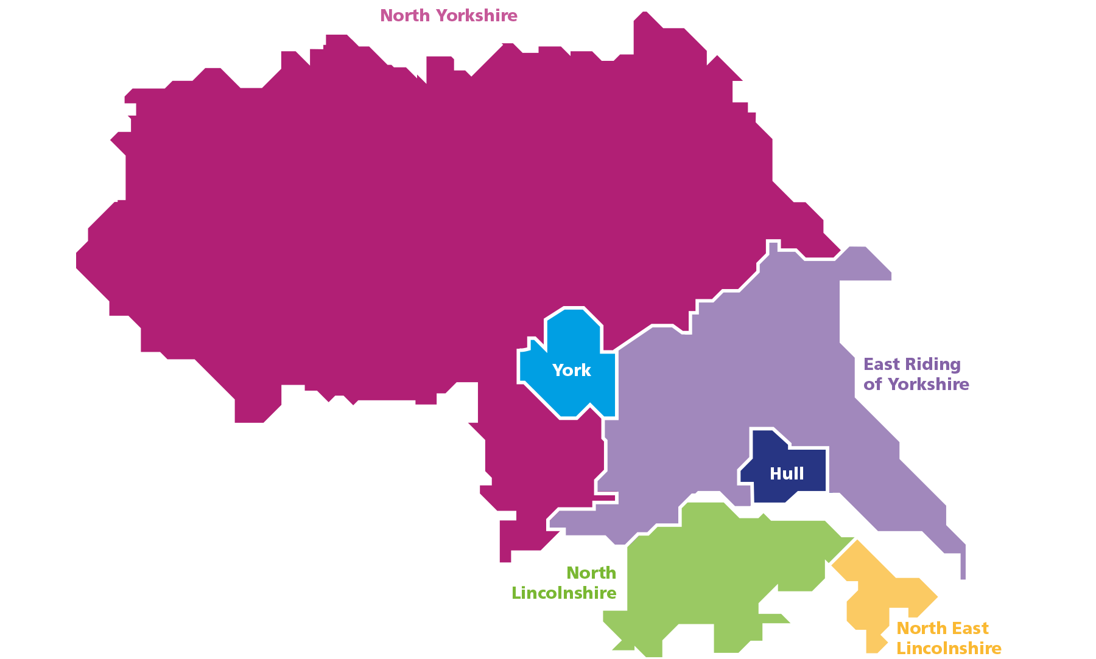
Humber and North Yorkshire
1.7 Million Population
6 Local Authorities
6 Places
4 CICs
7 Trusts
5 Collaboratives
2 Ambulance Trusts
Many Others

Slide 4
Is True Integration “a thing” and how does it function

Slide 5
3 Key Questions
?
In the Current Climate Can we succeed if we don’t act as an Integrated System?
?
Can we Truly Align Ambition across Partners?
?
Is It Possible to Jointly Own Solutions?

Slide 6
Can we Truly Align Ambition across Partners?

Slide 7
Our Aim
Narrowing the gap in healthy life expectancy by 2030
Increasing healthy life expectancy by five years by 2035
Our Outcomes
Start Well
Live Well
Age Well
Die Well
Our partnership ambitions
Enabling wellbeing, health and care equity
Transforming people’s health and care experiences and outcomes
Radically improving children’s wellbeing, health and care
Our person-centred and strengths-based approach means we:
Think Person
Think Family
Think Community
Our big 4 health outcome priorities
Reducing harm from cancer
Cutting cardiovascular disease
Living with frailty
Enabling mental health and resilience
Our drivers
LEADING FOR EXCELLENCE
1. delivery improvement
2. digital and data
3. an enhanced role for collaboratives
LEADING FOR PREVENTION
4. enabling population health
5. a new relationship with place
LEADING FOR SUSTAINABILITY
6. system workforce
7. sustainable estate / net zero
8. outcomes-led resourcing 5year pace of change plan
VOICE AT THE HEART 9. transformative public engagement;
10. a strong and impactful system voice (professional, political)
Let’s get better together

Slide 8
Investing in the drivers
LEADING FOR EXCELLENCE
1. delivery improvement
2. digital and data
3. an enhanced role for collaboratives
LEADING FOR PREVENTION
4. enabling population health
5. a new relationship with place
LEADING FOR SUSTAINABILITY
6. system workforce
7. sustainable estate
8. outcomes-led resourcing
VOICE AT THE HEART 9. transformative public engagement;
10. a strong and impactful system voice (professional, political)

Slide 9
Is It Possible to Jointly Own Solutions?

Slide 10
Further Questions to Ponder as a System:
Who Benefits?
Who Owns?
Who Pays?
So What?
How does a System Manage these
Questions as a system?
An Example Our Shared Care Record……

Slide 11
Humber and North Yorkshire
Humber and North Yorkshire
Yorkshire and Humber Care Record MVS 2.0 Programme
Shared Care Record Showcase
Consumer Projects successfully delivered since April 21
GP
Practices
Local Authorities
Acute
Trusts
157
5
4
26
Police
Custody
Suites
Organisations interacting with the YHCR
Safeguarding
Team
Private
Hospitals
Care
Home
Hospices
3
1
2
5
1
FHIR resources live across Provider organisations since April 21
Community
Health Care
Service
Mental
Health
Trusts
Ambulance
Services
30
1
2
2

Slide 12
Humber and North Yorkshire
Humber and North Yorkshire
Yorkshire and Humber Care Record MVS 2.0 Programme
Shared Care Record Showcase
Usage Stats
200-300
Patients benefitting from enhanced sharing across HNY
Month on month increase in Shared Care Record usage
New EPaCCs created each month
1.7m
103,595
GP Connect views per month via York & Scarborough Teaching Hospital, Harrogate District Foundation Trust, Northern Lincolnshire and Goole NHS Foundation Trust and Humber Teaching Hospital
5000
Health and Care IT systems interacting with the YHCR
User logins per month via the Interweave Portal
13
Patients dying in their preferred place of death increasing from
1/3 to over 1/2

Slide 13
Understand Benefits to Support the Discussion

Slide 14
Analysis Shows that Patients with EPaCCS More Likely to Die Out of Hospital
'Early data gathered in Northern Lincolnshire from closed EPaCCS records is encouraging as it shows that only 14% of this cohort of patients die in hospital compared to a national average of 42-45% and a previous northern Lincolnshire average of between 36-40%. It suggests that the whole process of advance care planning and subsequently recording a patients wished and preferences in a EPaCCS record in combination makes a significant difference to a patients end of life care journey and ultimately where they die.
We are aware that although take up and use of EPaCCS records is gradually increasing, closing down a patients EPaCCS record when a patient dies is very inconsistent. To give us greater confidence in the data and impact that this process is having we need all patients who have died with an EPaCCS record in place to have their records closed down so that we are capturing the outcomes for all of these patients.’
Dr Yousef Adcock, Consultant in Palliative Medicine at Northern Lincolnshire and Goole NHS FT

Slide 15
Benefit Personas with Projected Values: Validated by North Yorkshire Council, Hull City Council, & North Lincs Council
Adult Social Care (ASC.01): Time savings by removing need to phone GPs and Trusts for Client Information
BENEFIT IN BRIEF
BENEFIT METHODOLOGY
PROJECTED BENEFIT VALUE
Social Workers make an average of two telephone calls per day, to various health care settings, to obtain critical information about their clients.
For social workers, in ASC, access to the YHCR data via the Interweave Portal, removes the need to contact GP practices and NHS Trusts to find out important health information about the people in their care.
An average of 22.5 minutes is saved every time this information is required by removing the need to make phone calls and spend time waiting in call queues.
Data Points:
The average time spent on the phone each time information is required from a GP/Trust is 22.5 minutes
Two calls are made per day equals 45 minutes
Adult Social Care staff on Grade K average salary is £19.06 per hour (calculated from a mid-point in the pay scale)
An allowance has been made for Focus ASC to only apply 50% of the benefit to reflect existing SystmOne access
Assumptions:
The number of staff with access will start at 100 and increase every six months (capped at 1,000 users) this will apply for NYC
For the remaining five ASC the number of staff with access will start at 100 and increase every six months (capped at 200 users)
The percentage of staff who access the Interweave Portal twice daily will start at 10% and increase every six months by increments of 10% this will apply to all ASC
The combined projected annual benefits of all six ASC providers in HNY based on a phased roll-out and benefit start date: HCC, NYC, ERYC, NLC, CoYC and Focus Adult Social Care:
Year | Efficiency Savings | Time in days
FY23/24 | £685,920 | 4,800
FY24/25 | £1,714,800 | 12,000
FY25/26 | £3,018,048 | 21,120
FY26/27 | £4,595,664 | 32,160
FY27/28 | £6,447,648 | 45,120
Total over 5 years | £16,462,080 | 115,200
‘'I had a safeguarding case whereby the person was suspected of having an insulin overdose. We could see from the YHCR how often the nurses attended, and they had regular input, it also has the history of insulin abuse from the client in the past. Although a meeting had to be held and further conversations needed about this incident, access to the YHCR cut call times down as the information was readily available.’
Eleanor Namih - Team Manager – North Lincolnshire Council

Slide 16
Benefits Start to tell a Story Empowering Discussion and Decision making
Benefit | Potential 5-Year Efficiency Saving
Adult Social Care: Time savings by removing need to phone GPs and Trusts for Client Information | £16,462,080
Acute: Transfer Of Care (TOC) data supports a reduction in Emergency Department (ED) administration time | £488,370
Acute: Reduction in unnecessary admissions for palliative and end-of-life patients to acute trusts | £6,723,118
Ambulance: Transfer of Care data supports a reduction in ambulance crew time spent in the handover to the Emergency Department | £917,829
Ambulance: Reduction in the number of unnecessary conveyances to hospital | £1,362,205
Total | £25,953,602

Slide 17
A Reflection on Delivery Across the System
By the Outgoing Team

Slide 18
Our Programme Highlights
Debbie
Stuart
Sara
Eula
YSFT 1st EVER data provider live in the YHCR/Interweave (Nov 21)!
The sheer volume of capability delivered by the HNY Shared Record Team since Apr 21!
Responding positively to critical feedback from practices about data richness and developing what is now the Interweave minimum valuable dataset
Speaking to clinicians, it's clear to see the benefits of the YHCR. The significant time savings to clinicians undoubtedly improves the level of patient care. There is an appetite to provide data from most organisations and the collaborative approach and interaction between organisations has been good to witness.
The YHCR has had such a positive impact on the delivery of care being achieved.
Having real time clinical data available at a click of a button has enabled staff to make more informed decisions and reduced delays in having to wait for information to be returned. Staff have been able to re-invest the time saved to deliver more care.
Liaising with users of the YHCR and EPaCCS and listening to their comments and observations has been rewarding as we have made a difference to the lives of the citizens of HNY.
Proud to be part of the Team
Tara
Gayle
Catherine
Rachael
The impact of EPaCCS on patients and professionals and recognition of the Blueprint.
Getting end-of-life data into the YHCR for ambulance trusts.
Pioneering benefits approach.
HNY paving the way with first of types and the Five Point Plan.
Changing the conversation around IG.
Our Team!
First of type organisations to go live with YHCR – Care Homes, Private Hospitals, Hospices, Safeguarding Team, Police Custody
Value to organisations/teams & the patients/clients they serve, who have had no data sharing previously
NHSE change of stance on Care Home access for clinical staff
Getting context launch set-up in Badgernet, facilitating access to additional information for the Maternity teams.
Getting maternity data provision live be a big achievement as this will be the first time data has been shared this way, and will pave the way for getting the data from other Trusts
Creation of a streamlined process to support on-boarding of practices to obtain data that was 'new' to them.
Collaboration with partners to streamline and automate the process (contextual launch) for practices making on-boarding process simple and less time consuming!

Slide 19
Our key learnings
Our Key Learning
Debbie
Stuart
Sara
Eula
Having the right skills available to the delivery team in a timely way will keep progress moving.
Having clinical leadership always elevates your programme.
Having exec and organisation buy-in / support for the programme is essential.
Good communication is successes secret weapon!
Engagement with all appropriate teams from the outset is critical for the success of a provider project. Often, key workstreams are not involved in the initial discussions, which leads to delays to the delivery timelines. The ability to test connections to all environments at an early stage assists progress when developing resources.
Adopting a collaborative approach to find solutions to challenges faced is invaluable.
Reflecting on what we have learnt throughout the project, sharing best practice and celebrating team success and achievement has enabled opportunities for growth.
Clinical leadership collaboration and communication is key
Tara
Gayle
Catherine
Rachael
Baseline the current position and identify benefits early.
Identify quick win opportunities and share successes.
Keep the patient impact front and centre at all times.
Learn from and share with partners –don’t reinvent the wheel.
Things won’t always go to plan – we’ve learned and improved most when we take time to look at why.
Early and consistent engagement & comms with internal partners (Interweave, Synanetics, IG) is essential part of process
Organisation types must be approached differently –understanding of the burden of work (e.g. smaller organisations)
Clarity on expectations for all parties at the outset, so plans and timelines can be understood.
Be prepared to adapt to change.
Pilot practices played a huge part in setting the scene and allowed us to streamline the process further.
The provision of a dedicated delivery team that communicated regularly and provided the support wrap for not only each other but also the practices.

Slide 20
It’s a Journey
Systems Need to be Integrated
We all need to grow the systems together
Thank you

