Slide 1
B4.1 Evaluating the Benefits of the London Care Record – An Economic Analysis Jocelyn Palmer – OneLondon Programme Director Dr Ethna McFerran - Health Economist, Queen’s University Belfast

Slide 2
Introduction
Who we are
What is OneLondon?
Economic evaluation- why?
What we did
What we found out
Summary

Slide 3
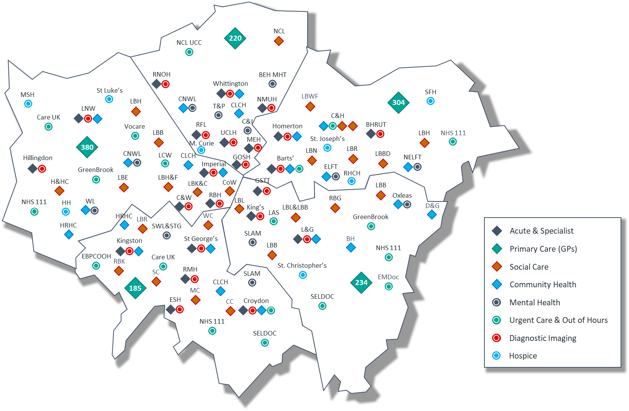
Introduction - OneLondon
Almost 10 million population
5 Integrated Care Systems
40+ NHS Trusts, 1,400 general practices, 33 local authorities
About 30% of Londoners receive care in an ICS that is not their ‘home ICS’
4 of 5 of London ICSs have at least one NHS Trust where under 50% of their patients are from that same ICS.

Slide 4
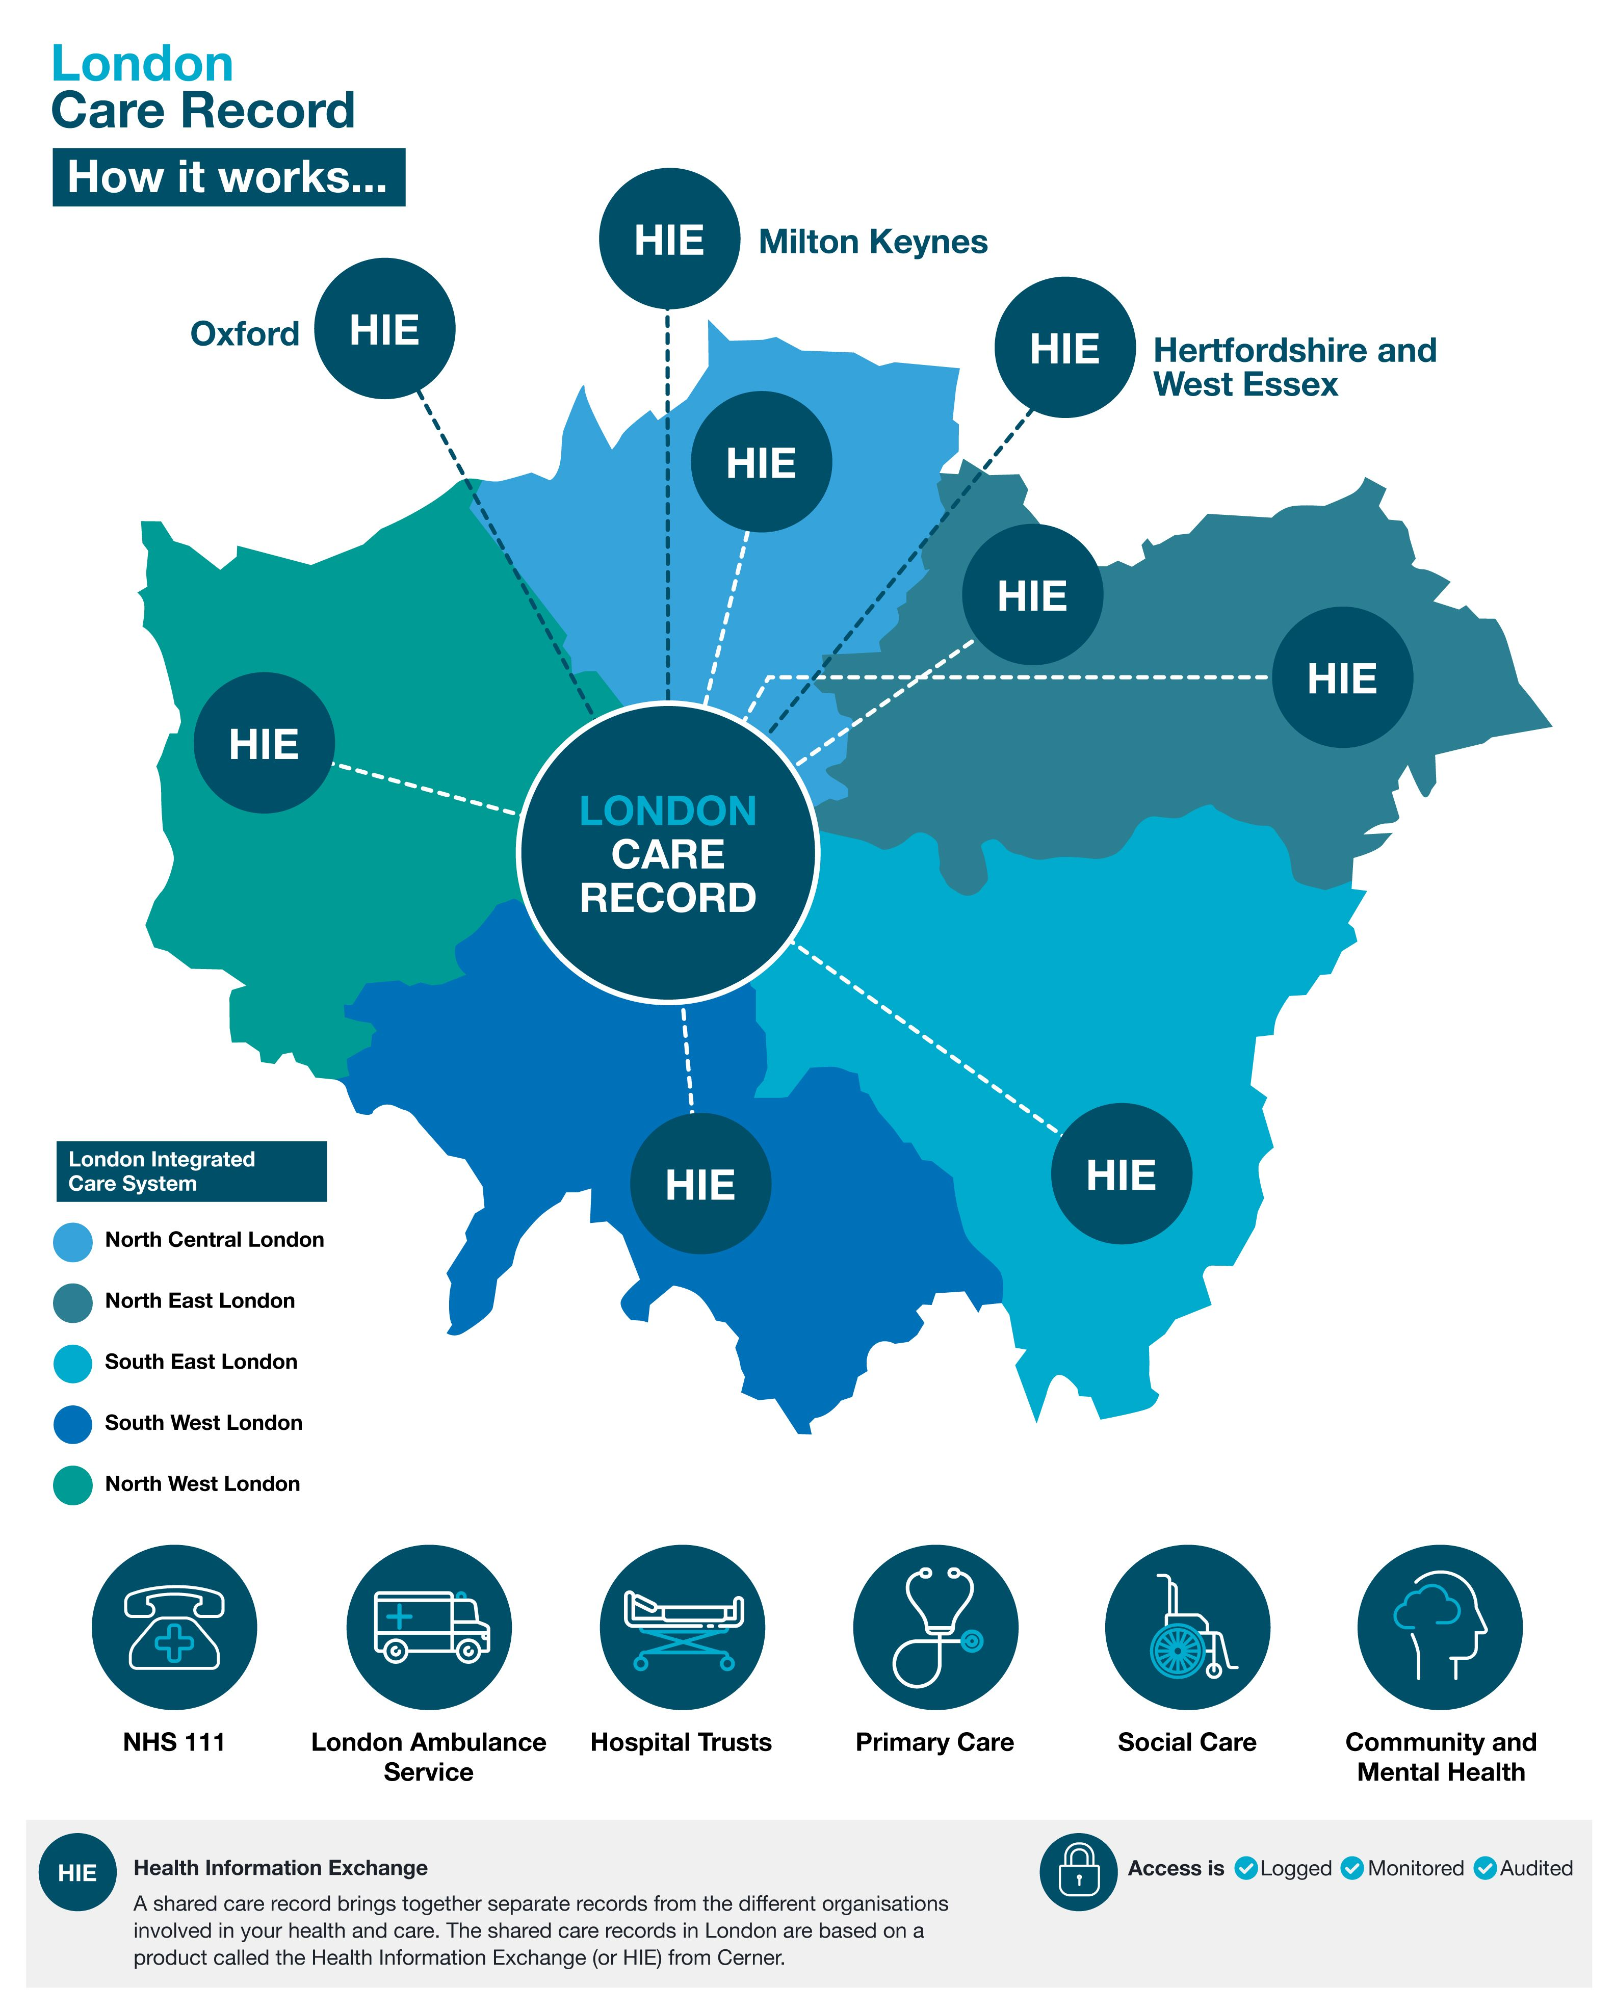
Introduction - The London Care Record
London Care Record is based on the Cerner HIE system
We have a ‘federated’ approach – each ICS has their own HIE (NEL have 2 HIEs)
The OneLondon ‘hub’ connects London up
The London Care Record was used over 17.7 million times by frontline health and care staff during 2023
Over 100,000 staff use the London Care Record each month
Viewed around 2 million times a month

Slide 5
Economic Evaluation – why?
The evaluation study is part of a wider benefits strategy for the OneLondon programme.
The economic evaluation is critical to understanding the value of the London Care Record – to support future funding, commissioning and evaluation of OneLondon (or similar digital investments of London-wide programmes).
OneLondon commissioned an independent academic evaluation to assess the economic value of the London Care Record (OneLondon).
The economic evaluation focused on key 'user-reported benefits' relating to time-saving, quality and safety outcomes.
The evaluation was led by Dr Ethna McFerran, Post-Doctoral Research Fellow in Health Economics, Queen’s University Belfast, supervised by Professor Mark Lawler, Professor of Digital Health.

Slide 6
Approach
The specific aims of the evaluation were:
To model London Care Record (OneLondon) utilisation metrics mapped to improved safety and care outcomes
To estimate the costs of changes to safety and time consequences of OneLondon users
To model the potential downstream consequences of OneLondon on morbidity
Timeline
The scope of the evaluation was discussed and agreed in March 2023.
The OneLondon programme team provided support and input on utilisation metrics and existing benefits work carried out since the programme began in 2020.
Work commenced in April 2023.
Ongoing analysis and findings were reviewed during (June & August) to help refine the report and approaches used.
Report published November 2023.

Slide 7
Evaluation – methods (1)
Model developed to determine cost savings attributable per system access encounter and quantify estimated time-saving costs
Utilisation metrics of OneLondon = NHS accesses 71.4% / GP Practice accesses 28.6%
Staffing assumptions apply NHS National Workforce Statistics and General Practice Workforce data (January 2022), with a preference for professionally qualified clinical staff groups in the base case.
Applied NHS staff pay estimates (January 2022), and GP Practice Contractor & Salaried GP data (2022).
Cost assumptions were derived by user group obtained from NHS Staff Pay Estimates Statistics, supplemented by literature.
On-costs: National Insurance, Pension Contributions and London Weighting were applied.
Time assumptions were informed by searches of published literature, comparing time savings relative to historical resource utilisation methods in care assessment, planning, and coordination.
Base case estimates assumed a minimum time saving of 0.5 minutes per system access, with the potential for up to 20 minutes of saved time in complex cases.
Three alternative scenarios were modelled to account for different levels of time saving, including potential net time loss due to training deficit or user errors.
Data from both January 2022 and January 2023 are analysed.

Slide 8
Evaluation – methods (2)
Secondary analyses examine quality and safety outcomes, including potential changes in mortality or morbidity associated with OneLondon programme.
Based on existing data on patient safety incident reports in the National Reporting and Learning System (NRLS) for England.
Relative risk for reported incidents in OneLondon sites versus non- OneLondon sites were compared.
Likely changes to doctor and nurse staffing levels were also estimated based on the time cost saving.
Analysis offers a broad perspective on safety and mortality outcomes through a comparison of incident rates between OneLondon and non- OneLondon sites.
Objective was to estimate relative risk reduction associated with OneLondon's impact on safety.

Slide 9
Results – cost savings
The OneLondon healthcare system recorded ~84k system access visits in January 2022.
Applying the minimum estimated time saving of 0.5 minutes per system access results in a cost-saving equivalent of £242,166 per month.
Different scenarios, including more complex time-saving, are modelled to show potential savings.
In January 2023, system access visits increased significantly to ~1.3 million per month, leading to higher cost savings.
Total potential cost savings from OneLondon access are estimated to be between £7.9 million and £44.4 million.

Slide 10
Results – cost savings
London Care Record Accesses | January 2022 | January 2023 | Cumulative Accesses Since March 2020 | Average £ saved /Access | Cumulative Total Hours Saved
Number | 839,996 | 1,297,786 | 27,559,911
Net Time Change (mins) | Average (£) saved
+ 0.5¹⁸ | 242,166 | 374,143 | 7,945,347 | 0.29 | 229,666
+ 1.4¹⁹ | 678,063 | 1,047,602 | 22,246,972 | 0.81 | 459,332
Mixed Scenario 1* | 1,356,127 | 2,095,203 | 44,493,944 | 1.61 | 1,286,129
Mixed Scenario 2** | 1,174,503 | 1,814,596 | 38,534,934 | 1.40 | 1,113,880
Mixed Scenario 3*** | 1,259,261 | 1,945,546 | 41,315,806 | 1.50 | 1,194,263
*Scenario 1 = 75% of system accesses save 1 min, 10% save 3 min and 5% each save 5,10,20 mins respectively (av =2.8mins). ** Scenario 2 = 75% of system accesses save 0.5 mins, 10% save 3 min and 5% each save 5,10,20 mins respectively (av = 2.4mins). ***Scenario 3 = 10% lose 1 min and 65% of system accesses save 1 min, 10% save 3 min and 5% each save 5,10,20 mins respectively (av = 2.6mins).

Slide 11
Sensitivity analysis – North West London
Reported London Care Record Accesses | January 2022 | January 2023 | Cumulative Accesses Since March 2020 | Average £ saved /Access | Cumulative Total Hours Saved
Number | 839,996 | 1,297,786 | 27,559,911
Net Time Change (mins) | Average (£) saved
+ 0.5¹⁸ | -16,557 | -25,581 | -543,242 | 0.27 | 229,666
+ 1.4¹⁹ | -46,361 | -71,627 | -1,521,078 | 0.75 | 459,332
Mixed Scenario 1* | -92,722 | -143,254 | -3,042,157 | 1.50 | 1,286,129
Mixed Scenario 2** | -80,304 | -124,068 | -2,634,725 | 1.30 | 1,113,880
Mixed Scenario 3*** | -86,099 | -133,022 | -2,824,860 | 1.40 | 1,194,263
*Scenario 1 = 75% of system accesses save 1 min, 10% save 3 min and 5% each save 5,10,20 mins respectively (av =2.8mins). ** Scenario 2 = 75% of system accesses save 0.5 mins, 10% save 3 min and 5% each save 5,10,20 mins respectively (av = 2.4mins). ***Scenario 3 = 10% lose 1 min and 65% of system accesses save 1 min, 10% save 3 min and 5% each save 5,10,20 mins respectively (av = 2.6mins).

Slide 12
Results - safety findings
A comparative analysis between OneLondon Sites and Other Sites is conducted on incident categories.
Findings show variations in incident reporting and relative risks, suggesting differences in safety outcomes.
Study highlights the potential for safety benefits and relative risk reduction associated with OneLondon.
The limitations and potential confounding factors in safety reporting are acknowledged.
Suggestions are made for future research to enhance the accuracy and validity of safety findings.

Slide 13
Results - safety findings
Estimated relative risk reduction associated with OneLondon's impact on incident reporting
Type of Incident Reported | Sample Size | Total No of incidents | Average No. incidents In Intervention Sites | Std Dev | Confidence Interval |  | Sample Size | Total No of incidents | Average No. incidents In Other Sites | Std Dev | Confidence Interval |  | Relative Risk
 | One London Sites |  |  |  |  |  | Other Sites
Organisational Totals | 36 | 31,357 | 871.03 | 414.20 | 290.34 ± 135.19 |  | 177 | 180,522 | 1019.90 | 493.79 | 340.52 ± 72.72 |  | 0.85
Death | 36 | 83 | 2.31 | 1.40 | 0.39 ± 0.58 |  | 177 | 470 | 2.66 | 1.67 | 0.44 ± 0.12 |  | 0.89
Severe | 36 | 71 | 1.97 | 1.12 | 0.33 ± 0.47 |  | 177 | 630 | 3.56 | 2.53 | 0.60 ± 0.18 |  | 0.55
Moderate | 36 | 1,146 | 31.82 | 20.74 | 5.30 ± 7.63 |  | 177 | 5,487 | 31.00 | 17.93 | 5.19 ± 3.14 |  | 1.02
Low | 36 | 6,725 | 186.79 | 92.46 | 31.13 ± 43.32 |  | 177 | 48,323 | 273.01 | 138.24 | 45.58 ± 27.04 |  | 0.68
No Harm | 36 | 23,332 | 648.12 | 317.27 | 108.02 ± 148.03 |  | 177 | 125,611 | 709.66 | 356.02 | 118.45 ± 66.77 |  | 0.91
Note: Using the NHS England - Number of patient safety incidents uploaded per month by provider in England Apr 2022 to Mar 2023, stratified those trusts participating in the OneLondon v’s those who were not. Data were totalled by type of incident and then relative risk values, standard deviation and confidence intervals calculated. Relative Risk was calculated to indicate the ratio of the average incidents reported in OneLondon sites compared to other sites for each type of incident. A value less than 1 indicates a lower risk in OneLondon sites, while a value greater than 1 indicates a higher risk in OneLondon sites.

Slide 14
Summary
Estimated monthly savings potentially up to ~£1.9m compared to base case
Since its Launch, OneLondon is estimated to have saved time equivalent to ~£44 million
FTE staff release may be up to approx. 840,920 minutes / 80.9 FTE staff
The average time-based saving per system access ranges from £0.29 - £1.61
Overall, the OneLondon initiative presents significant economic benefits by improving efficiency, reducing costs, and enhancing patient safety in the healthcare system.
The study highlights the need for more research on outcome metrics for safety and mortality.

Slide 15
Further information
Full report available at https://www.onelondon.online/
​
To stay updated:
Follow us on X @OneLondon4​
LinkedIn https://www.linkedin.com/company/onelondon/
Signup to our newsletter https://www.onelondon.online/newsletter​

Slide 16
Thank you
Jocelyn Palmer OneLondon Programme Director
jocelynpalmer@nhs.net
enquiries.onelondon@nhs.net
Dr Ethna McFerran
Health Economist
e.mcferran@qub.ac.uk

