Slide 1
A5 Changing Platforms: ShCR Platform Migration Andrew Haw, Nottingham and Nottinghamshire Úna Rice, Gloucestershire Paul Cook, Synanetics

Slide 2
Nottingham and Nottinghamshire

Slide 3
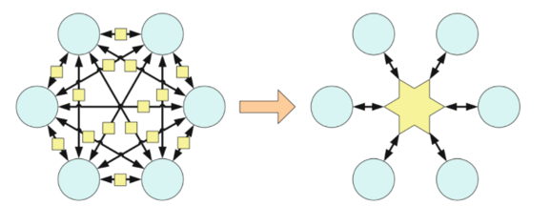
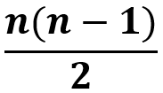
Integration Proliferation Dilemma – why we need an Ecosystem Platform
It can be very easy to connect two systems/teams with a simple interface that can be agreed by small group of practitioners and developed by technical specialists.
However, the problem with point-to-point solutions is that they snowball at an exponential rate. The diagram on the left highlights the difference between a point-to-point and Ecosystem Platform approach.
The formula above can be used to determine the possible number of integration for ‘n’ nodes. Hence for 100 nodes, there would be a requirement for 100*99/2 = 4,950 integrations.

Slide 4
Our ICS Digital Strategy 2000-2004 – part of
To deliver the right information, about the right patient, at the right time, for direct care anywhere; why we needed a 2nd generation Shared Care Record:
Change of tech & provider: Interweave based on Yorkshire and Humber Care Record:
Changes to data are visible in near real time – every 15 minutes
New data – community care, mental health, social care and our in house GP Repository of Clinical Care
From GPRCC : Care Plans, End of Life, Frailty, Mental Health Diagnoses & Major Diagnoses
New types of data – documents – End of Life preferences / ReSPECT form
New capabilities such as structured messaging and alerts
Launch from a patient record in Nervecentre / RiO / SystmOne / Mosaic / Liquid Logic so no login needed
Data is not stored so not duplicated
Aim to stop using the MIG in preference to use of GP Connect
No licenses
Driven and Owned by the NHS – we the customers are in control; pace of change faster
As 1st generation product is replaced, there will be much change for some
New benefits: examples include ability to send alerts in real time to avoid nugatory visits; fewer duplicated diagnostics, improved discharge to assess processes (bed days), better match to patients wishes e.g. About Me, End of Life preferences etc.

Slide 5
Why we needed an Ecosystem Platform (ESP)?
From experience of using the Graphnet Notts Health and Care Portal since 2016, and the previous needs, we also need:
To move towards structured, standards based data
To develop capabilities to do things once, e.g.. a structured referral message or structured transfer of care message, not a different solution for every point to point need, as we are forced to do now
An event driven architecture: i.e. users ‘subscribe’ to the ‘events’ that they need, using business rules such that organisations receive only those triggers & data items that they need for their services and staff, so there is no data overload and no unnecessary sharing of data; e.g.. when a patient is admitted to ED and has a domiciliary appointment the same day, an alert can go to the DN/CPN/social worker in real time, to prevent them making an unnecessary visit
To reduce duplication of data stored twice and the cost of future new integrations, as we create new structured data
One channel to the ESP to receive data from the (future) Internet of things platform, to access patient captured data
Greater flexibility and independence, e.g. so we can change the content and look of the data in the portal without suppliers permission or costs; but with the choice to go it alone in just our ICS or to do new developments together in consortia
To speed up development/change at a predictable cost: as providers change data increasingly from text to structured via EPR programmes, and create new data, we need to make these changes when we like, without suppliers cost or permission
To view knowledge / data shared in near real time, in multiple applications, such as gaps in care, overdue events, risk factors
To be to see data from outside Notts e.g.. South Yorkshire, Derbyshire, Leicestershire, i.e. to avoid re-storing data that exists elsewhere

Slide 6
Work you have to do – start 2-3 years before contract end date
Plan for sustainability before you start; e.g. all data providers’ integration staff need to understand FHIR to the point where they can convert other data types such as HL-7 into FHIR resource types – enduringly
When critical staff leave, have a contingency plan and a budget to buy in the resource
Line of business systems need to support a contextual link; without that a separate login will be required
Plan to step around other big changes carefully, e.g. a LIMS migration; a conversion from PAS to EPR in ED
Have a governance process to deal with new requirements while still under development – i.e. whether to deal with them once strategically or deliver them twice, with the legacy supplier too
Demonstrate what you plan early, e.g. a proof of concept
Use metrics from the current ScR to calibrate the forecast quantum of clinical change work required, as it will vary from provider to provider, as will the aspirations for deploying new capabilities
Split data providers and data consumers into phases so the new or smaller users go after the bigger users have proved it is safe to change
Separate data provision from data consumption – so you can consider 1 big bang (all data is ready to consume) that is separate from n little bangs (a single trust or council is ready to consume the new platform)
Have a pleasant team! No one can force anyone to do anything, so be empathetic to your data providers’ pressures and all their other work

Slide 7
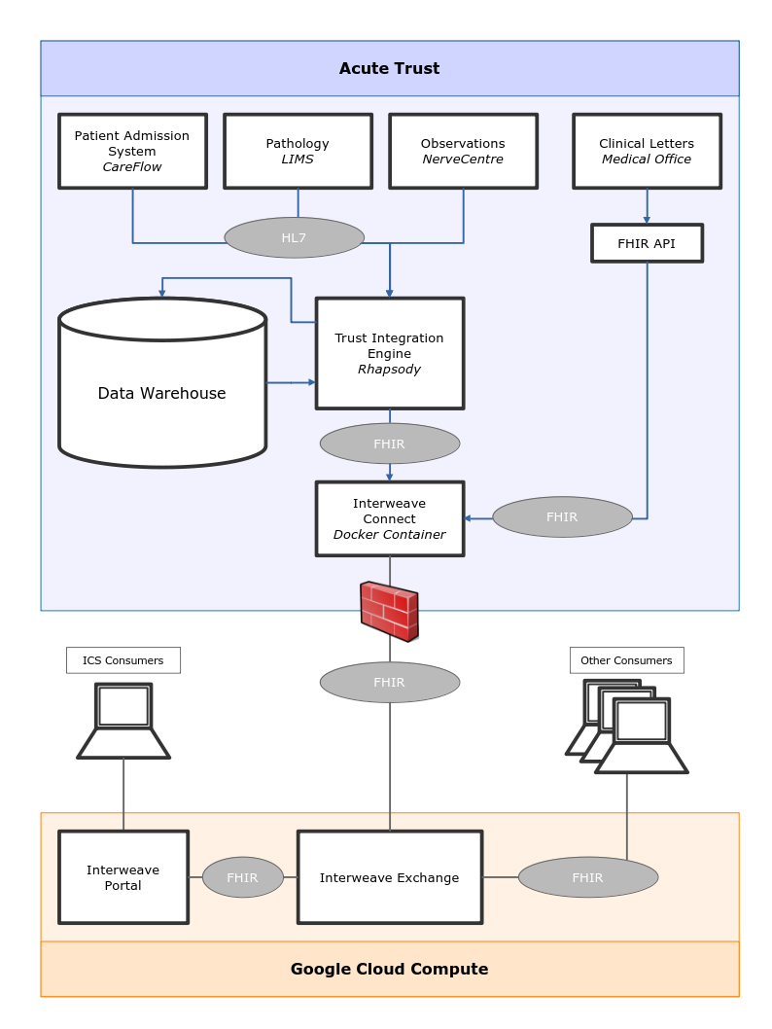
An Acute Trust in Nottingham
& Nottinghamshire
An example data flow architecture for one of our acutes is shown:
All data that is to be made visible in the Notts Care Record (NcR) must be placed in the Interweave Connect device
It is the choice of each data provider how to populate the Connect device; here the Trust already manipulates some of the data and commits it to their enterprise data warehouse. So it makes sense for them to make that available to the NcR
Not all flows are shown, just 4 are chosen to make the point ;3 of them are Commercial Off The Shelf packages and the last one Medical Office is a bespoke trust built application used to distribute documents electronically; examples missing from the diagram include Radiology reports and Ambulance Service Handover documents

Slide 8
Gloucestershire

Slide 9
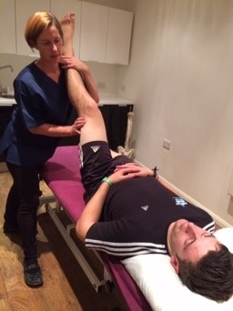
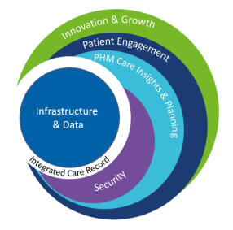
A bit about me
Frontline care as an Osteopath
Early career – teaching, banking and health insurance
First of type MIU/OOH model
111 and Document Sharing
Patient Access
Early Shared Care Record
Gloucestershire ICS
Notes:
Shared Care Record early days. In Glos from concept to delivery …heading for round 3

Slide 10
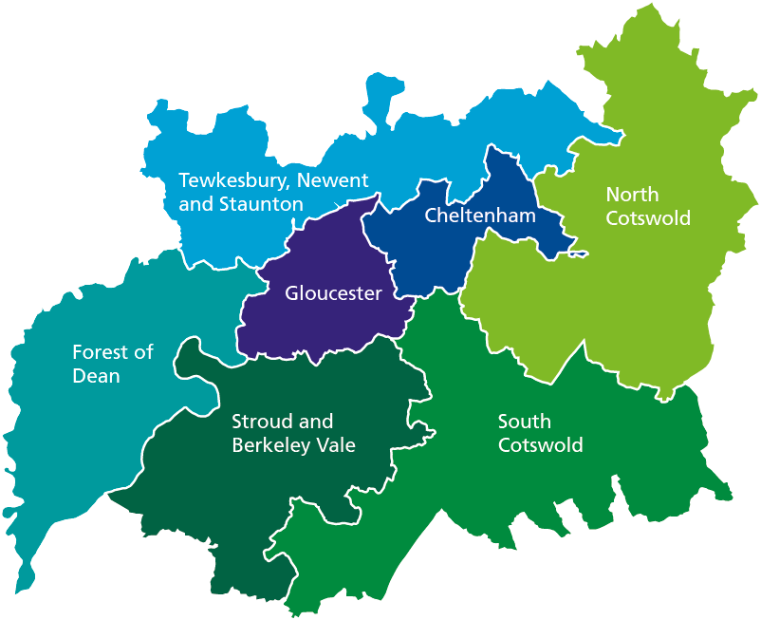
47,500
77,000
A bit about Gloucestershire…..
over 65 with LT condition
Projected rise by 2030
632,500
2015
674,500
2030
2,653km²
Area covered by the STP

Slide 11
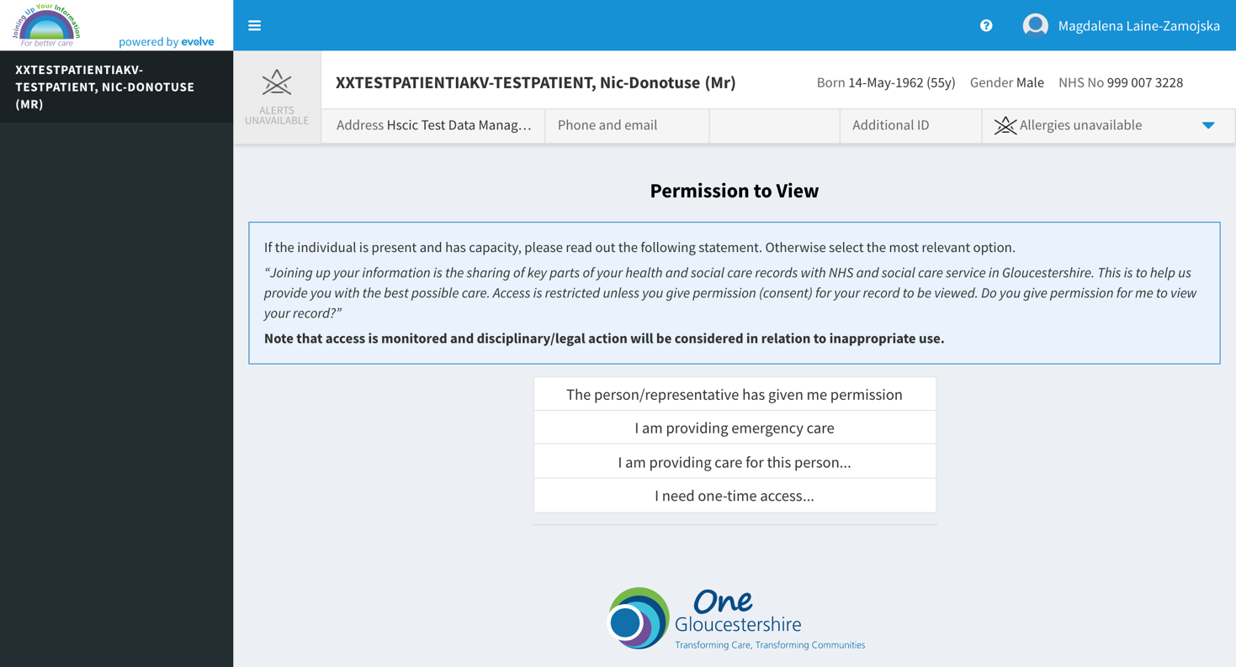
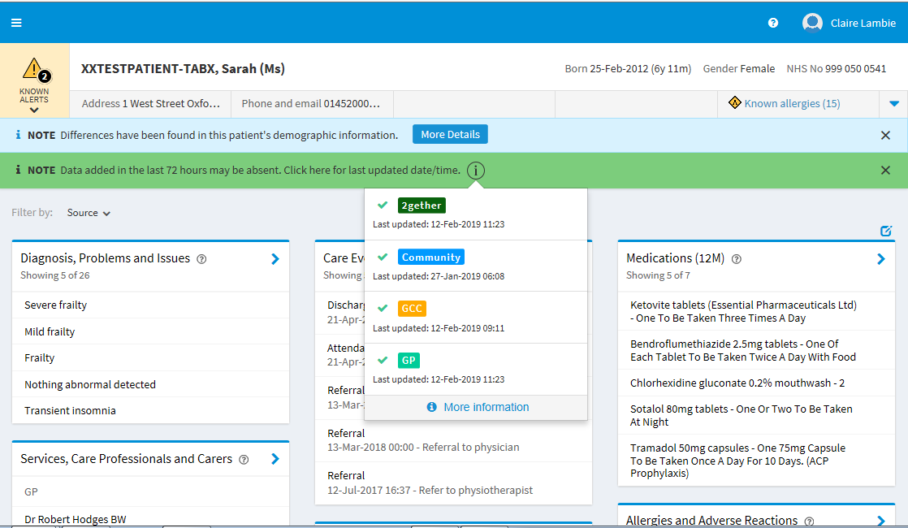
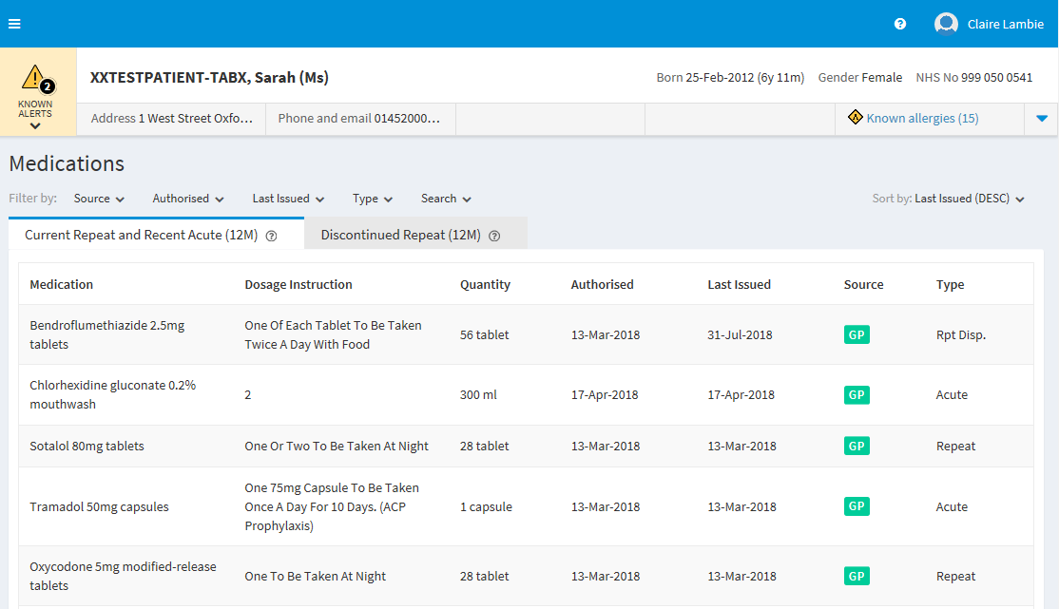
A bit about Gloucestershire’s Shared Care Record
Engagement
Governance
Business Case
Procurement
Development
Rolling go-lives and ongoing development
More users
More data
More functionality
Engagement
Governance
Business Case
Procurement
Implementation
2014-2016
2017-2019
2019+
2022-2023
Design principles
User experience principles
Real Time
Easy to Use
Retain structured blended view
Implementation not bespoke development
Replace and progress
Easy to Access
Easy to Configure
End User Led
2020-2021 COVID
Platform for the Future
What did we learn?
1. Importance of Partner Ownership
2. Source supplier willingness
3. Incremental change – do something
4. Data is messy

Slide 12
Back to me again!
NHS Digital Health Leadership Masters
What are the key components of an ICS Data Strategy and how can they be tailored to deliver a flexible ShCR solution for GICS?

Slide 13
So what next for your ShCR?
Tip 1: No matter where you are now, start planning for your next gen ShCR
Tip 2: Embed it in your ICS Digital and Data strategy, in detail.
Be clear on it’s purpose – what it is and what it is not
What direct care use cases it does/doesn’t cover
How does your data strategy support it and other data purposes – PHM, proactive care, research, planning…..
How does your EPR strategy tie into your integration strategy?
Tip 3: ShCR are big complicated, expensive beasts. Cost of change is high. If you’re considering significant change, plan plenty of contingency.

Slide 14
A Supplier’s View

Slide 15
Relevance
I have been a supplier to the NHS for 29 years! (for 6 different companies)
12 months ago, I took the decision to “Change Platforms”
I’ve now had direct involvement with 11 ICB regions as they selected, deployed, developed & maintained their ShCRs– and a Nightingale Hospital
I fundamentally believe in the power and mutual benefit of true partnership

Slide 16
Thoughts & Principles
It’s not a tech capabilities thing – it’s a culture thing
Potentially requires termination of good partnership working
We live in fast moving times – it is not an admission of previous error
Similar to EPR - complex and essentially business process project
Potential for unhappy users
Fear, Uncertainty & Doubt

Slide 17
Thoughts & Principles
It is good (and necessary) governance
It is an opportunity to learn and develop
Different models may better suit your organisation
It (should be!) easier than last time
You and your organisation are more educated and can “buy better”
https://youtu.be/YL9sNrOlK-I?t=39

Slide 18
Thank you
Andrew Haw Interoperability Programme Lead
Digital Notts at Nottingham and Nottinghamshire ICS
Andrew.haw@nottshc.nhs.uk Tel 07973 543721
Úna Rice Associate Director – Digital Transformation
One Gloucestershire
una.rice@nhs.net Tel 0707796 196 659
Paul Cook
Commercial Director
Synanetics Ltd
paul.cook@synanetics.com
Tel 07570 576534

