Slide 1
B4.2b Emerging Opportunities : Care Coordination and Care Planning David Grigsby, Graphnet Health on behalf of Evelyn White, Kent and Medway ICS

Slide 2
Background
The Kent and Medway Shared Care Record (KMCR) gives health and social care professionals access to key information about an individual at the point of care.
The KMCR includes data from a range of health and care providers and is integrated with existing clinical/citizen data management systems
GPs
Community Services
Deployed in 2021.
Mental Health Trusts
An average of 8,700 health and care professionals in Kent and Medway are using the KMCR each month with an average of 140,000 total patients viewed per month.
Local Authority
Social Care
In 2023 over 10,000 health and care professionals in Kent and Medway were accessing the KMCR and there were more than 4 million views of information contained within the KMCR.
Acute Trusts
Specialist Services

Slide 3
Who is part of the KMCR programme?
GPs | Consuming data | Feeding Data
All Kent and Medway practices
Local Authorities: Children & Adult Social care | Consuming data | Feeding Data
Kent County Council (KCC)
Medway Council
GP Federations | Consuming data
West Kent Primary Care
DGS Health Ltd
Medway Practices Alliance Ltd
Invicta Health Ltd
Channel Health Alliance
Thanet CIC
Herne Bay Health
Acute trusts | Consuming data | Feeding Data
Dartford and Gravesham NHS Trust (D&G)
East Kent Hospitals University NHS Foundation Trust (EKHUFT)
Maidstone and Tunbridge Wells NHS Trust (MTW)
Medway NHS Foundation Trust (MFT)
Hospices | Consuming data | Feeding Data
Hospice in the Weald
Pilgrims Hospice
The Heart of Kent Hospice
Ellenor Hospice
Wisdom Hospice
Demelza House Children's Hospice
Marie Curie Hospice (outreach care)
Community trusts | Consuming data | Feeding Data
Kent Community Health NHS Foundation Trust (KCHFT)
Medway Community Healthcare (MCH)
HCRG Care Group North Kent Community Services
Access to the KMCR is being extended to the following organisations:
Kent and Medway Community Pharmacies
Out of Hours service providers
Remaining GP Federations
Other clinical | Consuming data | Feeding Data
South East Coast Ambulance Service NHS Foundation Trust (SECAmb)
Medway on Call Care (OOH)
IC24 (OOH)
Mental Health trusts | Consuming data | Feeding Data
Kent and Medway NHS and Social Care Partnership Trust (KMPT)
North East London NHS Foundation Trust (NELFT)

Slide 4
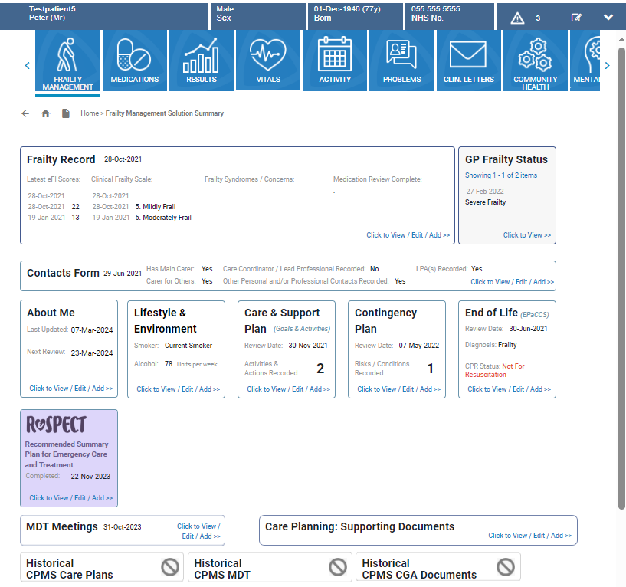
KMCR Care planning modules (E forms)
Care planning modules (E forms)
Frailty Record
Contact form
About you form
Lifestyle and Environment Record
Care and support plan
Contingency plan
End of life (EPaCCS)
ReSPECT Form (Recommended Summary plan for Emergency Care and Treatment )
MDT meeting records and MDT meeting referral
Care planning Supporting documents and images
Assessments
Cognition assessments
Mood and wellbeing assessment
Nutrition assessment
Vital Signs quick observations
Functional assessment
Falls assessments
Skin assessment
Moving and handling
E form principles
Single source of information
Updated and held solely in the KMCR
Completed and updated by multiple professionals from range of organisations
Audit trail

Slide 5
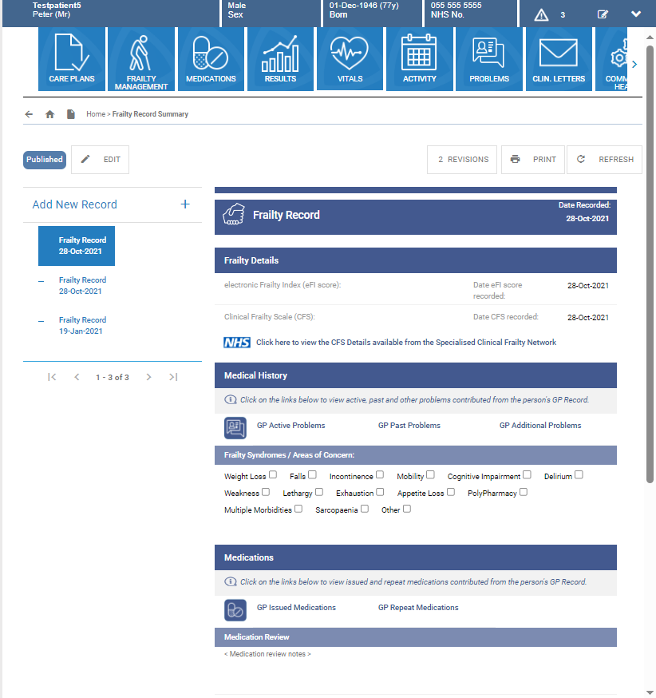
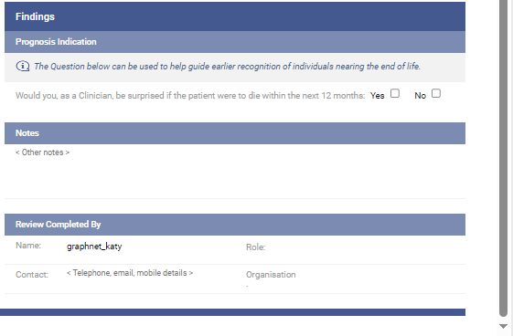
KMCR Management of Frailty
Frailty record summary includes a list of all Frailty Records recorded with the latest one on the top.
The form can be updated as required and includes:
Frailty details including current status and scale
Medical history
Medication and medication reviews
Findings: prognosis indication and notes
Name of the heath professional that completed the form.

Slide 6
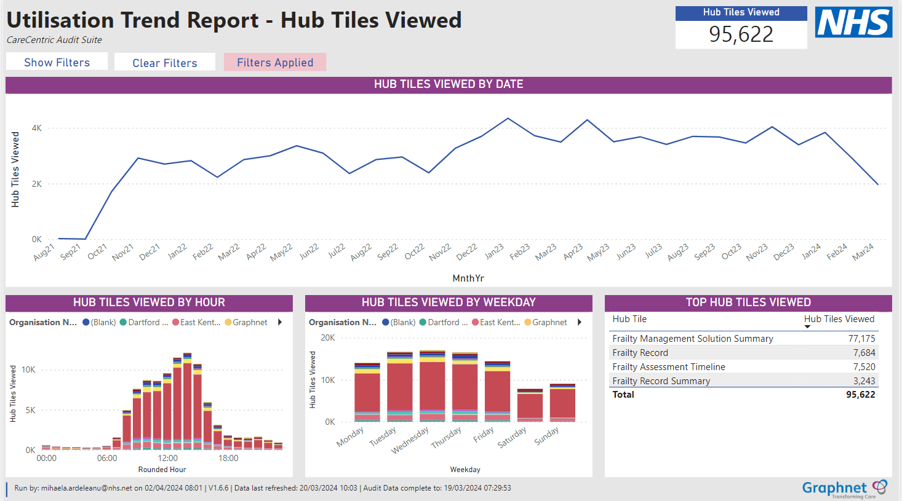
KMCR Utilisation of frailty data
Organisation | Sum of Hub Tiles Viewed
Community Trusts
Kent Community Health NHS Foundation Trust | 64,278
Medway Community Healthcare | 1,605
HCRG Care Group - Adult Community Services | 673
Acute trusts
Dartford and Gravesham NHS Trust | 2,175
East Kent Hospitals University NHS Foundation Trust | 7,870
Maidstone and Tunbridge Wells NHS Trust | 5,733
Medway NHS Foundation Trust | 3,379
Acute trusts
SECamb | 3,181
Kent and Medway ICB | 2,736
Mental Health trusts
Kent and Medway NHS and Social Care Partnership(KMPT) | 1,570
North East London NHS Foundation Trust (NELFT) | 58
GP Federations
West Kent Health Federation | 3
West Kent Primary Care | 1,002
Local Authorities: Children & Adult Social care
Medway Council | 660
Kent County Council | 212
Hospices
Heart of Kent Hospice | 132
Hospice in the Weald | 71
Pilgrims Hospice | 35
Grand Total | 95,373

Slide 7
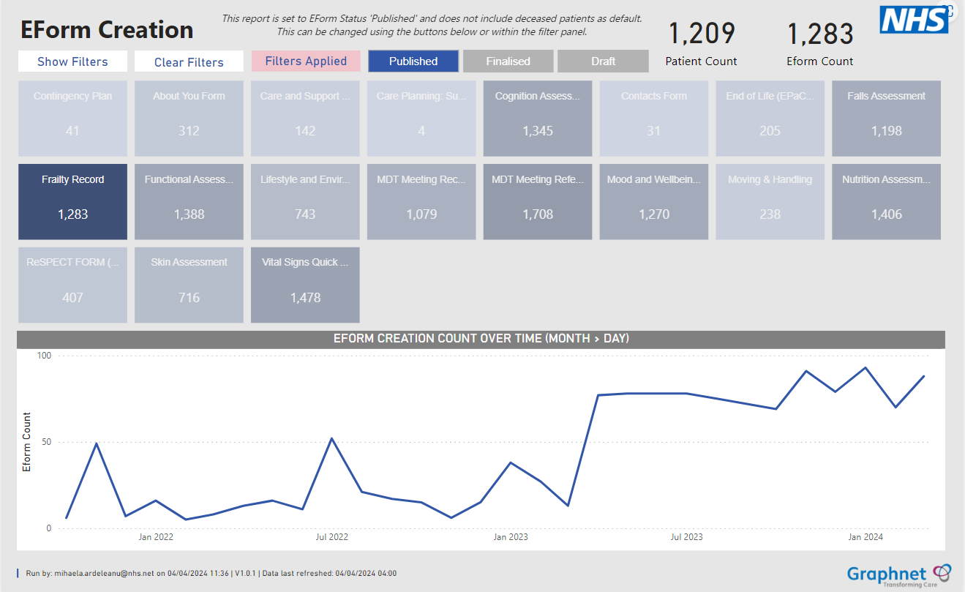
KMCR Care planning module utilisation - Frailty

Slide 8
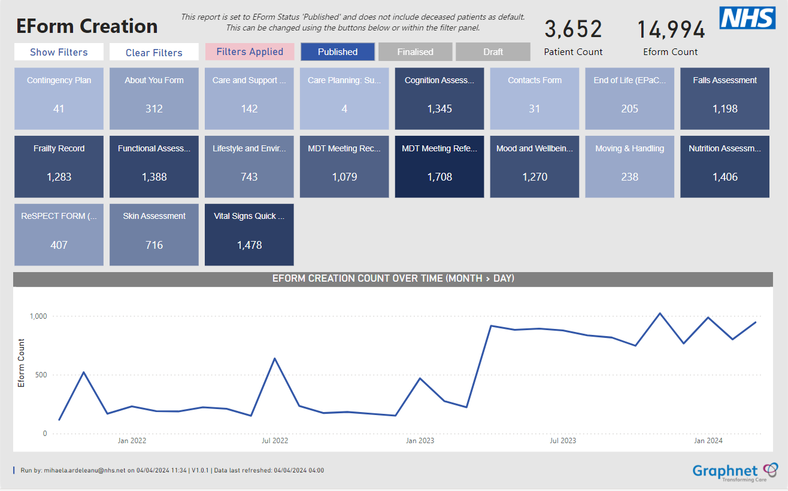
KMCR Care planning module utilisation - all E forms

Slide 9
Integrated Care Planning: Lessons Learnt
Time taken to plan and engage is time well spent
Integrated working requires time and patience
All key leads need to be actively engaged and listened to
Compromise is key
Clinicians and professionals need to co design
Clinicians and professionals need to lead deployment/roll out
Include time to review and evaluate
Mandating new process expedites take up

Slide 10
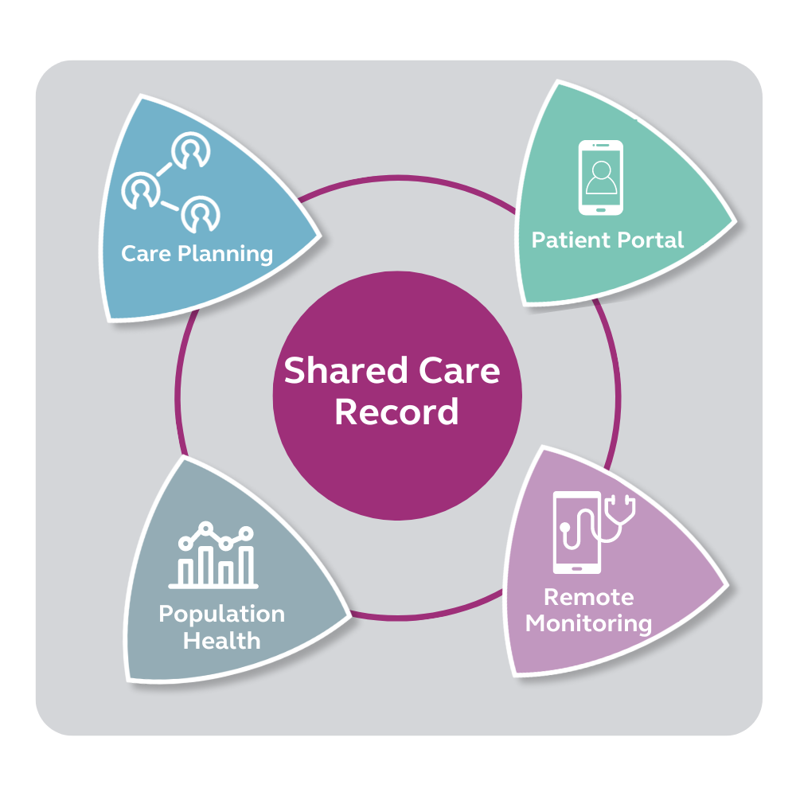
Building on SCRs and their data
2.5m Population
52,569 patients in Patient Need Group 10 or 11
These patients represent 40% of bed days
Customer A
2m population
11,605 patients generate:
52,136 A&E attendances
1.1m GP encounters
47,330 emergency admissions
Customer B

Slide 11
Questions/comments
Or further information or discussion contact:
Evelyn White Programme Director, KMCR
Kent Community Health NHS Foundation Trust
evelyn.white@nhs.net

