Slide 1
B4.2a Care Planning and Digital ReSPECT in BSW ICS Jason Young, Assistant Director of Digital Transformation, BSW ICB

Slide 2
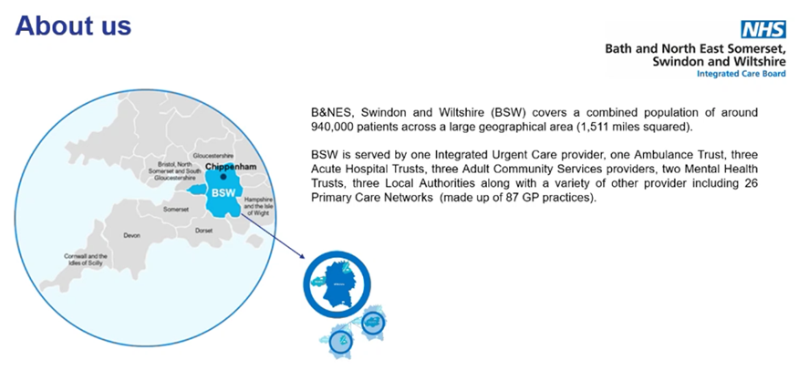
Care Planning and Digital ReSPECT in BSW ICS

Slide 3
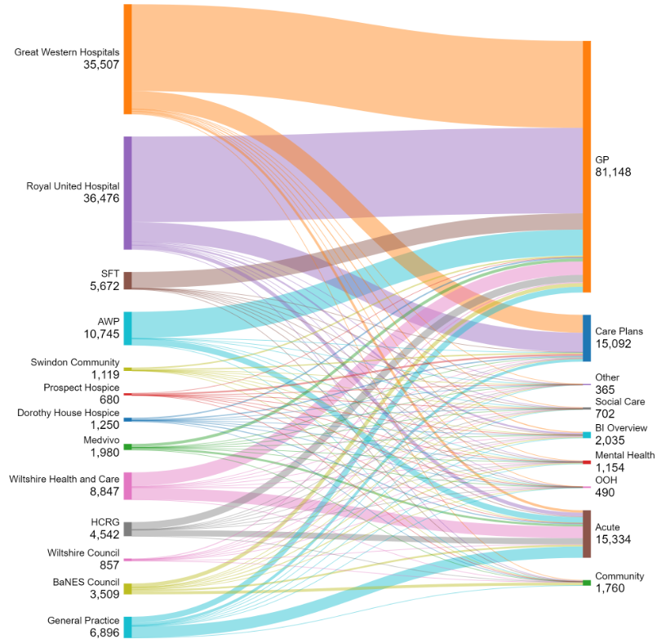
Care Planning and Digital ReSPECT in BSW ICS
Sankey diagram showing Integrated Care Record usage
WHO is viewing WHAT
Data from GP record most ‘popular’
Acute data viewed by all
Care Plan & ReSPECT third in list

Slide 4
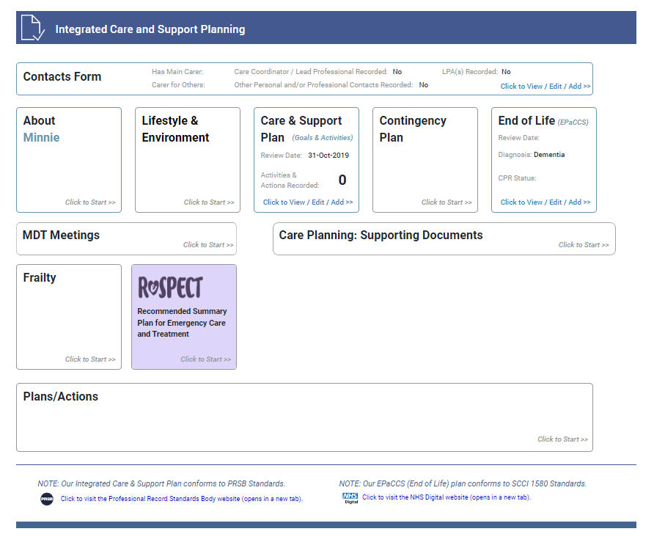
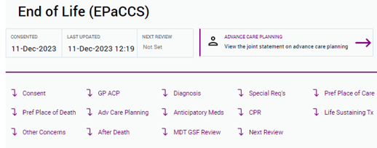
Care Planning and Digital ReSPECT in BSW ICS
The ReSPECT process creates personalised recommendations for a person’s clinical care and treatment in a future emergency in which they are unable to make or express choices.
ReSPECT | Resuscitation Council UK
(EPaCCS) is a means to capture and share information electronically from people’s discussions about their care. The aim of this is to ensure that any professional involved in that person’s care has access to the most up to date information, including any changes to their preferences and wishes and personalised care plans
NHS England

Slide 5
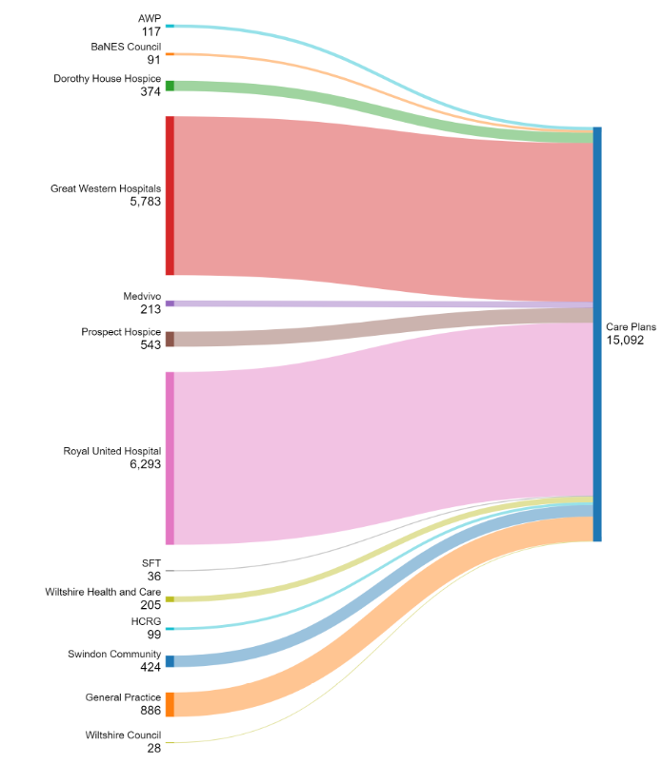
Care Planning and Digital ReSPECT in BSW ICS
Sankey diagram showing Care Plan and ReSPECT views
WHO is viewing WHAT
Most views from two of our acutes
Big proportion of all hospice views
10% of all OOH views

Slide 6
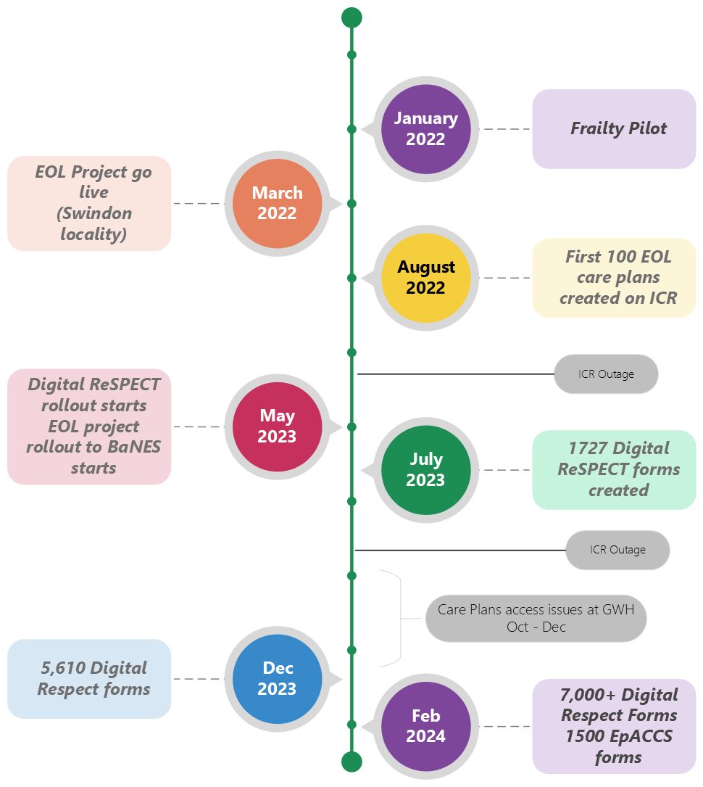
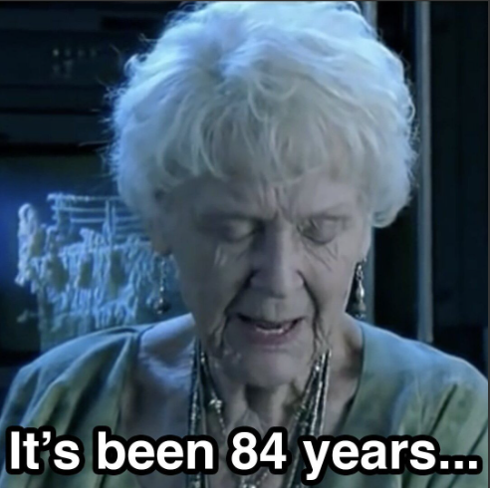
Care Planning and Digital ReSPECT in BSW ICS
In 2021 we started work with Graphnet to share care plans (and in 2023 ReSPECT) via the National Record Locator.
This would give our local ambulance service (SWAST) access to this key information digitally for the first time…

Slide 7
Care Planning and Digital ReSPECT in BSW ICS
What have we learnt?
“Clinically led” isn’t enough, “Clinical delivery” with boots on the ground made a difference
It’s not just rolling out a digital form. Change process about why & when ReSPECT
Business continuity plans. What happens when it breaks (because it will)?
Everyone has an opinion on formats and UI
Governance. Where in the organisation is each decision made?

Slide 8
Thank you
Jason Young Assistant Director of Digital Transformation
Bath & North East Somerset Swindon and Wiltshire ICB

