Slide 1
National Update 2024
Connecting Care Records
Presented by: Dermot Ryan, Minal Patel
Notes:
Standard title slide

Slide 2
What is a Shared Care Record?
Shared Care Record definition:
A shared care record is a safe and secure way of bringing electronic records from different health and care organisations together digitally in one place. It joins up information based on the individual rather than the organisation.
Connecting Care Records (ConCR) Programme Vision :
Every individual and authorised health and care professional has safe, secure and ready access to the person-based records and plan information that they need to provide high quality care for people in the right place, at the right time and in the form they need it.​

Slide 3
It is estimated that 20% of all acute care is delivered outside the patient’s ‘home’ ICB
Notes:
Plain slide with subhead and bullets

Slide 4
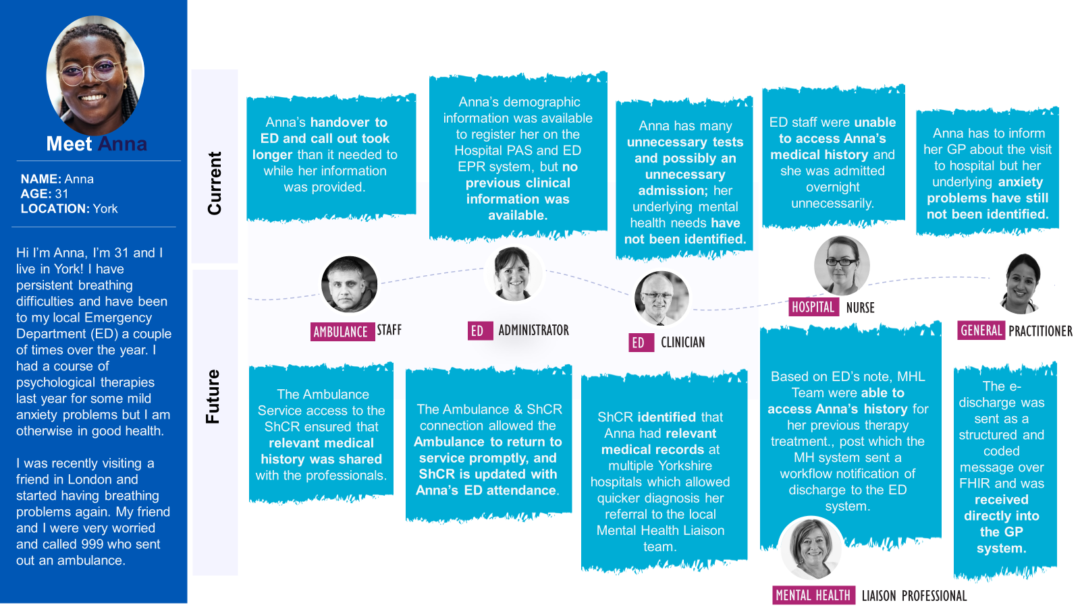
Anna’s Story

Slide 5
Notes:
Plain slide with subhead and bullets

