Slide 1
C3.3 Engaging professionals and communities in the GM Care Record and data sharing Peter Richards – Health Innovation Manchester

Slide 2
The role of Health Innovation Manchester
Health & Care
Our vision is to become a recognised international leader in accelerating innovation that transforms the health and wellbeing of our population.
Academia
Industry
We work with innovators to
discover, develop & deploy
new solutions that improve the health and wellbeing of people who live in Greater Manchester.
The needs of GM citizens
Notes:
We also run the Digital Transformation Office for NHS Greater Manchester

Slide 3
The GM Care Record

Slide 4
Notes:
In response to the COVID-19 pandemic, health and care organisations in Greater Manchester established the GM Care Record (GMCR), a shared care record which amalgamates essential information for the city-region's 2.8m citizens from across health and care.
This enabled more informed direct care, digital transformation of care pathways and use of deidentified patient information for COVID-19 research and other secondary uses – supported by the COPI notice.

Slide 5
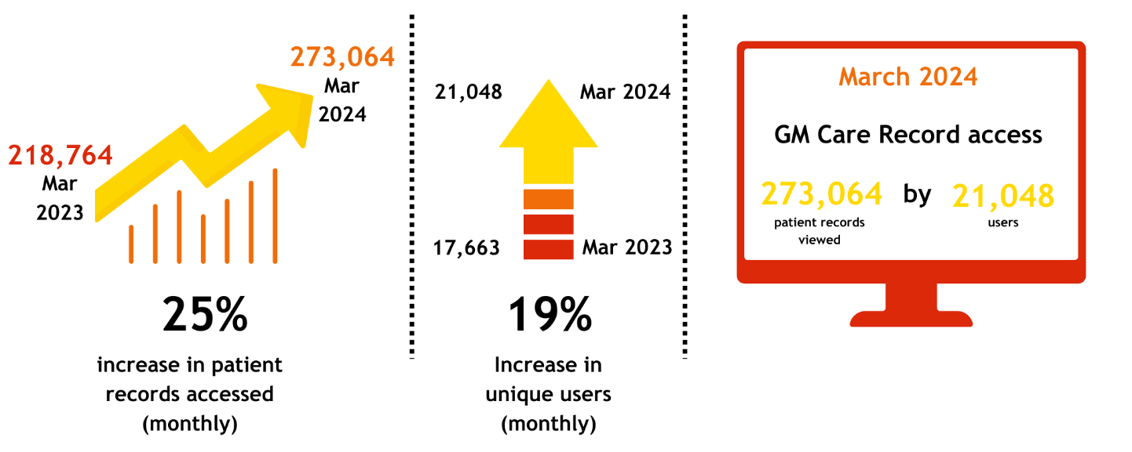
Notes:
Usage increasing professionally… how have we achieved this?

Slide 6
Realising the potential of the GMCR in Secondary Care Project
July 22- April 23

Slide 7
Background and context
Early work during the pandemic identified
1. Not all clinical staff understood the benefits of GMCR
2. Some / most staff didn’t know how to access it
3. Lack of training and other factors were contributing to low usage in some areas
Digital maturity score for shared care record use across GM Acute Providers was low
National drivers to increase use of shared care records
Regional funding available - allocated by GM to be used to develop the use and functionality of the GMCR in Secondary Care organisations
Focus in urgent and emergency care and hospital ward discharge

Slide 8
Primary Objective
20,000 staff
To understand the current use of the GMCR by frontline staff ensuring that any future changes to functionality are clinically led.
Professionally registered staff in Secondary care

Slide 9
Methods
1. Rapid evidence synthesis
2. User data analysis
3. Data feeds mapping
4. Mapping of GMCR data to the PRSB’s Core Information Standard
5. E-survey (direct care and secondary uses)
6. Staff engagement virtual workshops (direct care) UEC and hospital discharge
7. Staff engagement virtual workshops (secondary uses)
8. Interviews with GMCR leads across the 10 localities

Slide 10
Rapid Evidence Synthesis
Domain areas
System quality
Service quality
Information quality
User satisfaction
Use
Productivity (efficiency, care coordination, net cost)
Quality (safety, appropriateness, health outcomes)
Access

Slide 11
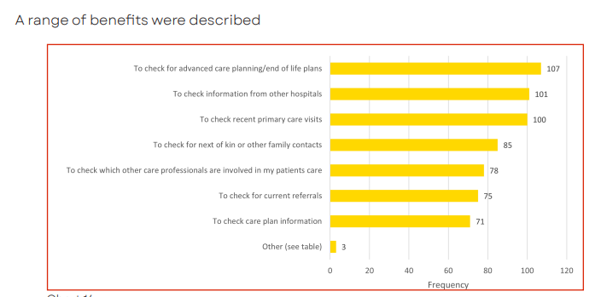
E-survey results
Open 1st Sept – 3rd Oct 2022
157 staff responded:
80% doctors, nurses and pharmacists
Acute medicine, UEC, hospital wards
Adults and children's services
78% reported using the GMCR - usually as part of an initial assessment
Features of past medical history & medicines were most often accessed

Slide 12
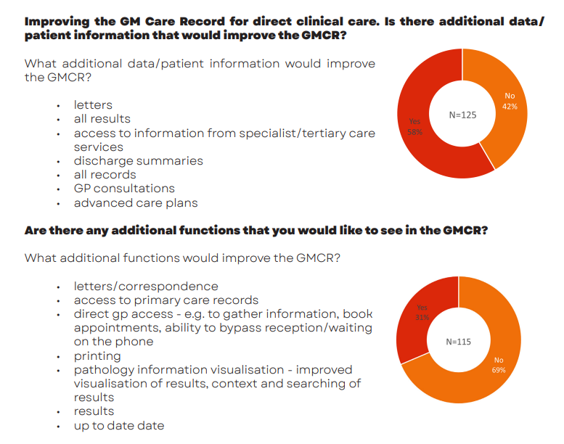
E-survey results
Most staff had not had training
Intuitive to use
Technical problems with access
“Slow"
Don't know how to access it

Slide 13
Virtual Workshops
46 staff
To understand the current use of the GMCR by frontline staff ensuring that any future changes to functionality are clinically led.
EDs, Acute Medicine, Ward Pharmacists. Hospital discharge teams

Slide 14
GMCR is good for ascertaining past medical history and current prescriptions from GPs.
- Paramedic, Bury
I use GMCR for new patients where we need baseline blood results i.e. creatinine.
-Trainee Doctor
GMCR could potentially stop patients from being transferred to ED (if updated care plans are available)
- Lead ACP, Rochdale Infirmary
It is particularly useful in cases where a patient cannot give a medical history or if they did not bring a list of medications with them.
- Nurse, Fairfield Hospital, Bury
GMCR is invaluable. We often get patients who cannot share their medical history or medication lists.
- ED Nurse, Rochdale
GMCR is used to view up to date patient information in the community. GMCR helps to identify gaps, review what provisions are already in place, and provide holistic planning for discharge
- Community Nurse, Discharge Services
I use it for every patient I see. It’s an excellent system.
- Emergency Medicine Consultant, Salford Royal
Without access to the GMCR and neurosurgical information, it’s likely I would have had to refer the patient to ED, which both she and her family were so keen to avoid. I was able to coordinate her care with the out-of-hours team and increase her palliative provision at home
- Hospice
GMCR is used across all consultations in emergency medicine. It works.
- ED Consultant and Emergency Medicine, Royal Oldham Hospital
GMCR is used for all patients and palliative care
- Physiotherapist Team Lead, Discharge to Assess, MFT

Slide 15
Workshops results
The GMCR is an invaluable time saving and patient safety tool
Staff don’t know about the GMCR or how to get access
Incomplete information reduces the usefulness of the record for direct care
Training is not available for most staff
Care planning information e.g. advanced care plans – if consistently present - would be highly beneficial

Slide 16
Conclusion
Barriers
Enhancements &
Enablers
High quality shared care records increase:
Safety
Effectiveness
Efficiency
Quality
Knowledge
Access
Reliability
Training
Care planning
Clinical documents

Slide 17
Next steps
System performance
GM-wide training
Comms campaign
Complete data feeds
Scope alignment to PRSB standards
Share clinical “docs”
Adoption and use of care plans
Scope increasing granularity of usage data

Slide 18
What’s coming up?
Product developments
Care plans
EPaCCS - live
Dementia - pilot
Heart failure - pilot
Person Held Record app
6-month pilot live in Tameside
Community Pharmacy
400 pharmacies going live with access to read-only GM Care Record in April

Slide 19
Community Engagement and the GM Care Record

Slide 20
Notes:
During the pandemic, the rules around sharing patient data were revised (known as a COPI notice), allowing health and care organisations to share data for research purposes around COVID-19.
On 30 September 2021, this temporary revision will lapse.
We need to promote the benefits of data sharing and the GM Care Record to the public including their right to object or opt-out of data sharing.
A public comms campaign has been developed to support this, and also to reassure data controllers that data is being used safely, legally and ethically.
This will help to support work to enable data sharing for research beyong COPI notice expiry.
To fulfil our Duty of Transparency in this use of patient information, a largescale public communications and engagement campaign was delivered between June 2021 -March 2022. Recently this was updated and a campaign was run earlier this year focusing more on secondary uises and research linking to the GM Care Record and Secondary Uses of Data

Slide 22
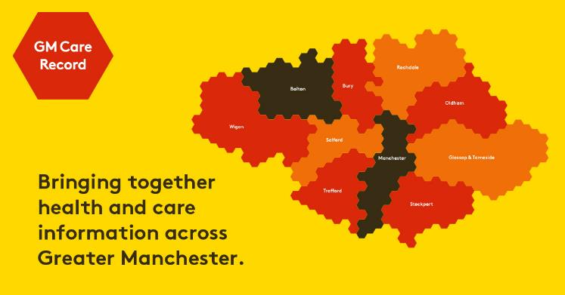
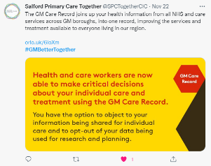
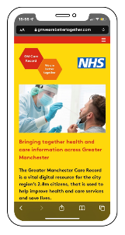
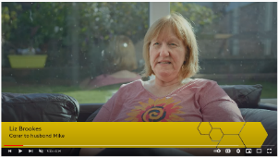
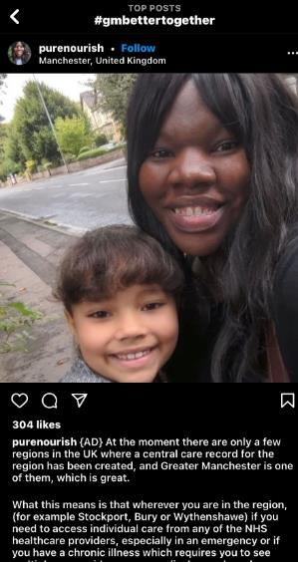
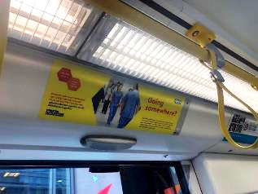
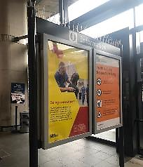

Slide 23
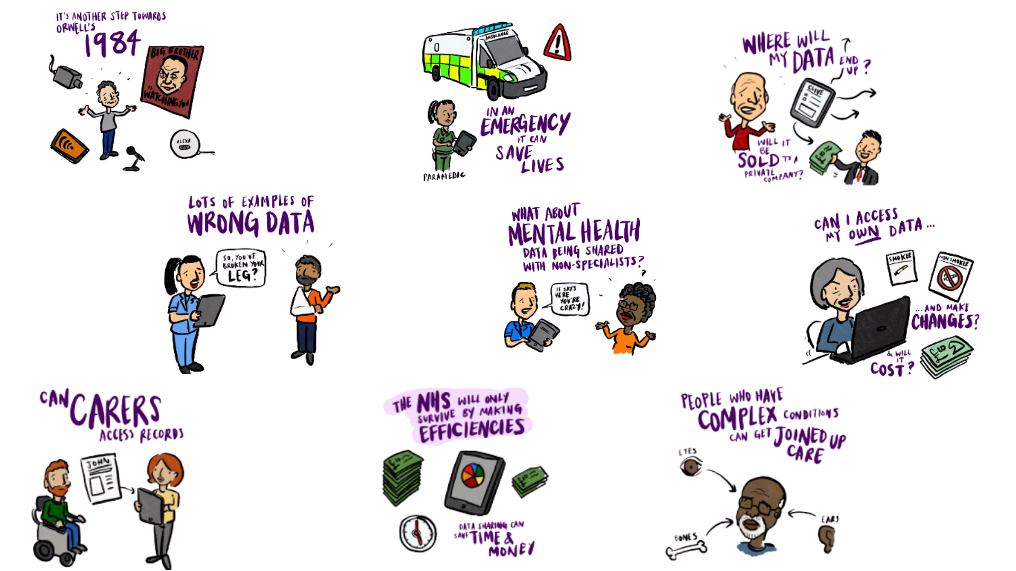
Public Engagement Feedback

Slide 24
Campaign Update 2023-24
Objectives:
To drive awareness of data sharing, GMCR and the SDE and role in direct care and research in GM
To reassure the public about the safe and transparent use of their data and mechanisms for opt-out if required.
To promote the outcomes of the research and its impact on care
Channels - Offline:
Adverts across the transport network on trams and at major interchanges
Toolkit for health and care organisations – patient leaflets and posters in a variety of formats and languages
Communications
Channels – Online:
Refreshed website: www.gmwearebettertogether.com
Toolkit for health and care partners – social media messages, film, infographics, website messages etc.
Facebook advertising through NHS Greater Manchester
Notes:
Central to the work with CAG and the approval for non-research uses and a future research application, is to ensure that citizens are engaged upon the use of patient information and communicated clearly about how to opt-out if they wish to do so.

Slide 25
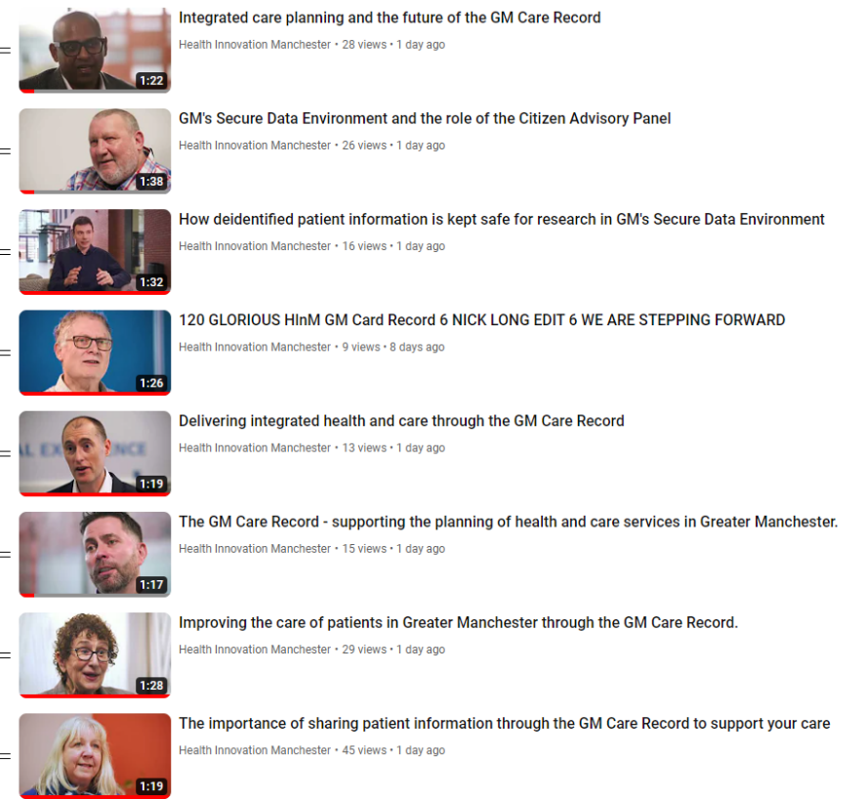
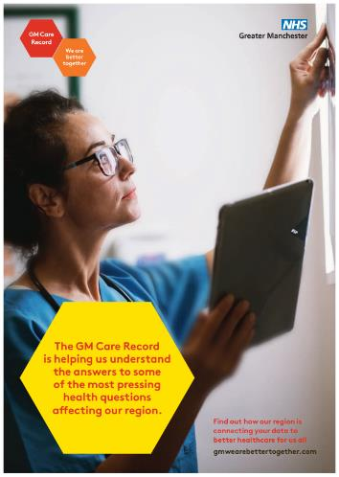

Slide 26
Clinical, Academic and Patient Films

Slide 27
Local “Influencers”

Slide 28
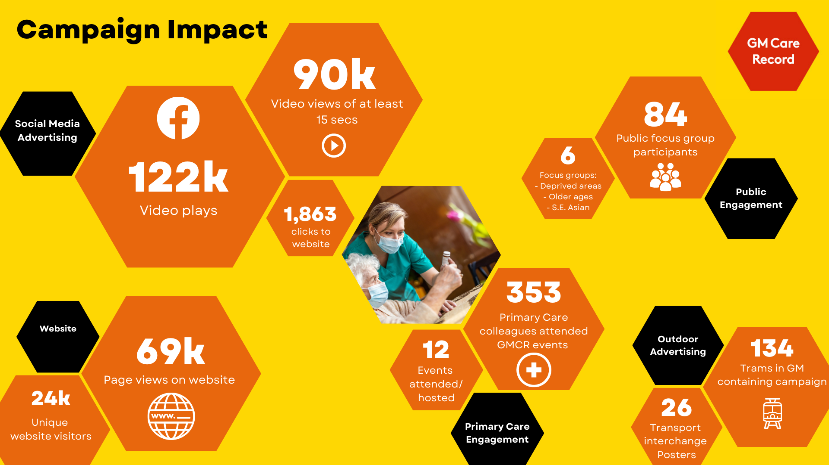
1.1m
1.8m
32k
265k
101k

Slide 29
Campaign Update 2023-24
Objectives: identifying attitudes towards
Deidentified information from the GMCR being used for research through SDE
Anonymised mental health data, children’s data and social care data being used for research
The specific process in place to deidentify patient information
Drop-In Sessions
GP practices:
Ancoats
Rusholme
Bolton
Engagement
Focus Groups
South Asian Communities
Black African/Caribbean Communities
Deprived Communities
Older Age Groups
Notes:
Central to the work with CAG and the approval for non-research uses and a future research application, is to ensure that citizens are engaged upon the use of patient information and communicated clearly about how to opt-out if they wish to do so.

Slide 30
Key Takeaway Findings

Slide 31
Thank you
Peter Richards
Head of Communications
Health Innovation Manchester
peter.richards@healthinnovationmanchester.com

