Slide 1
C3.1 Working in Partnership Jane Owens - Digital Transformation and Implementation Lead JUCD Ian Binks - Business Development Director, Orion Health

Slide 2
Definition
Definition of Partnership
They share resources and responsibilities and agree to work together in a co-operative and mutually supportive way. Partnerships are about sharing resources, experience and skills to achieve outcomes that benefit partner organisations and the communities they serve.

Slide 3
Partnership Working – What does this mean?
Working in partnership helps us to provide care and support to a diverse population in Health and Social Care.
Decisions are made together to enable the best outcome for all.
As an ICS we work with all our partners in health and social care in a collaborative way to provide the best we can to support our health and social care professionals and provide benefits to our citizens of Derbyshire. Our suppliers are partners and should be seen as such.
Solutions and issues are worked on together and relationships with our Shared Care record supplier Orion Health are built on honesty openness and transparency.
When working in true partnership it is possible to achieve greater equality, mutual respect and satisfaction and everyone is working towards the same aims and objectives.
It promotes a learning culture i.e. not all Acute Hospitals work in the same way and equally not all suppliers of IT systems work in the same way.
There must be a degree of flexibility on all sides whilst also working within contractual terms and adherence to standards is a key element.
Covid has shown us that we are capable of much more partnership working as we came together to find innovative solutions to new challenges. Barriers were removed and there was a ‘can do’ and a ‘what more can we do’ response from everyone.
We listened more and were prepared to consider all options. We learned from mistakes and innovated.
We communicated more.

Slide 4
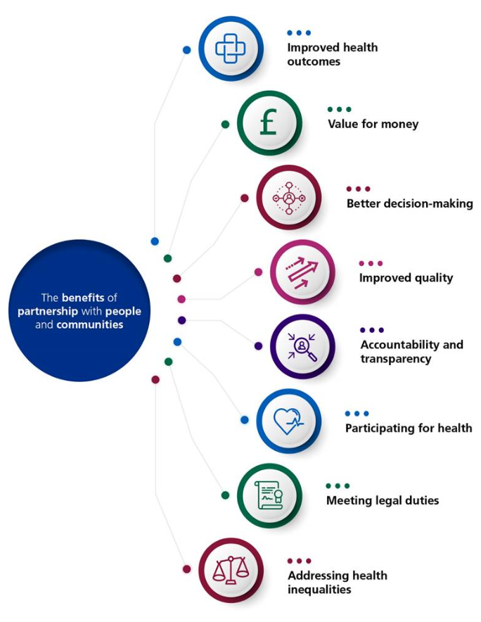
Partnership Working – Why?
There are many reasons why partnership working benefits those that undertake it.
We must not overlook how working in partnership with our suppliers also has many benefits and prevents the ‘reverting to the contract’ scenario when relationships start to breakdown.
By having open and transparent conversations with the right person quite often this will resolve issues and get everyone back on track working in support of each other.
At the end of the day, we are all working to benefit those that are receiving health and social care and those health and care professionals that are providing it.

Slide 5
How to keep things on track and learn lessons with all Partners
Everything has the possibility to go off track and needs to be put back on the rails. Working in true Partnership enables more expertise and resource to be available.
If you clearly set out what the expectations, aims and objectives are then nothing can go wrong…….right?
Wrong.
Governance – Information governance is key. Other governance is required for example terms of reference for meetings and how any issues should and can be escalated if required. Set the agenda and length of the meetings. Its ok if not everyone contributes sometimes you are there as an attendee to listen and feedback.
Always check that everyone has had the opportunity to speak.
Own it if you do not agree with anything but ensure this is for a valid reason.
Not everyone sees things from the same point of view. This is great as quite often new ideas will surface so see the positives. Remember many friendships/relationships develop in people that are opposites.
If you cannot achieve what is expected, then manage your own and your partners expectations. Be clear and concise. Transparency and openness is always the best course of action.
Communication and engagement is key along with a sense of humour. You are allowed to be a human as well as a professional.
We all have good days and bad days.
Support your partners/suppliers if they hold annual conferences etc.
Learn lessons from others. Are there documents to share i.e. Case Studies, Benefits materials

Slide 6
The view from the supplier

Slide 7
The view from the supplier vendor

Slide 8
The view from the supplier vendor partner

Slide 9
What’s the difference between a vendor and a partner?
Transactional
Investment
Partnership
Who is cheapest?
Money
How do we best address the needs of the population?
Who is quickest?
Time
How do we get this right first time?
Who needs the least input from me?
Effort
How do we optimise our workflows?
Change
Transformation

Slide 10
What are the challenges?
Failure to understand the challenges of other parties
Lack of clear communication
Funding issues (capital vs revenue)
National direction vs regional autonomy
Innovation vs simplicity

Slide 11
In Conclusion
Communicate and Engage with your Partners
Learn from Others – do not reinvent the wheel
Draw on your Partners expertise and resources
Manage your own and other’s expectations
Be clear about what you need from the partnership and your expectations
A B C
Always Be Communicating!

Slide 12
07385 343632
07385 343632
Thank you
Jane Owens Transformation and Implementation Lead
Joined Up Care Derbyshire
Jane.owens4@ nhs.net Tel 07385 343632
Ian Binks Business Development Director
Orion Health
Ian.binks@orionhealth.com Tel 07827 833794

