Slide 1
C2: Accelerating Implementation
Stacey Cairns – Norfolk and Waveney ICS Matthew Douglas – Cambridgeshire and Peterborough ICS Matthew Hutton – Northamptonshire ICS

Slide 2
Norfolk’s Journey on Shared Care Records

Slide 3
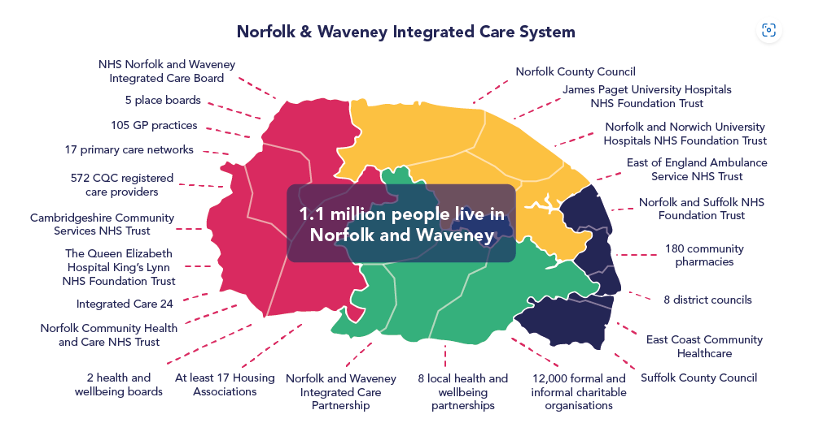
The Norfolk and Waveney Integrated Care System
1 in 4
Aged 65+
1 in 30
Aged 80+

Slide 4
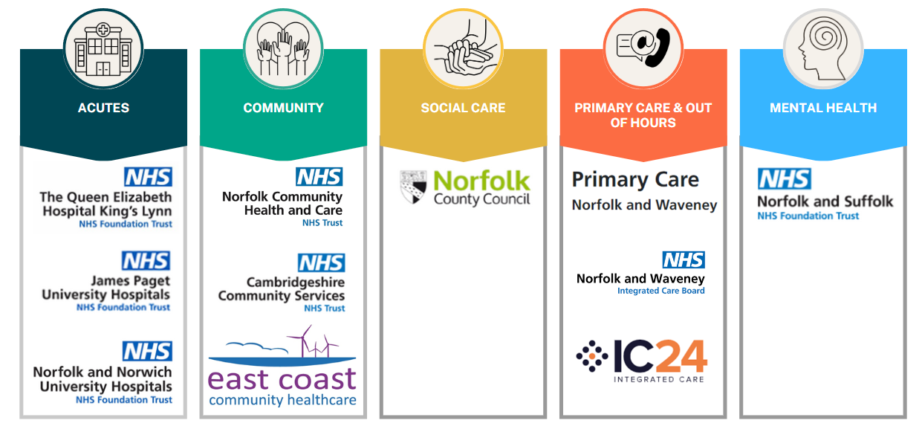
The Norfolk and Waveney Shared Care Record

Slide 5
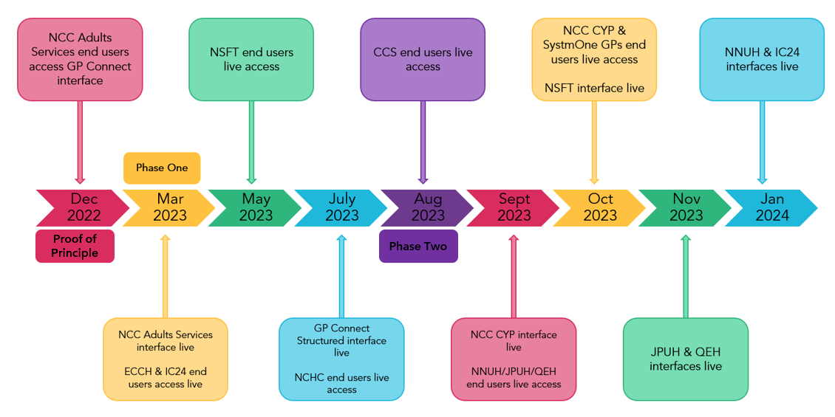
The N&W ShCR Journey…so far!

Slide 6
N&W ShCR Usage
NHS England Baselining
100 Record views per 1000 population
Data presented in these charts represents a cumulative total for each month

Slide 7
Cambridge and Peterborough Delivering Care Closer to Home

Slide 8
Cambridgeshire & Peterborough ICS
Acute
Primary
Comm / Mental
Social
22 Primary Care Networks
87 GP Practices
Integrated Neighbourhoods – North & South

Slide 9
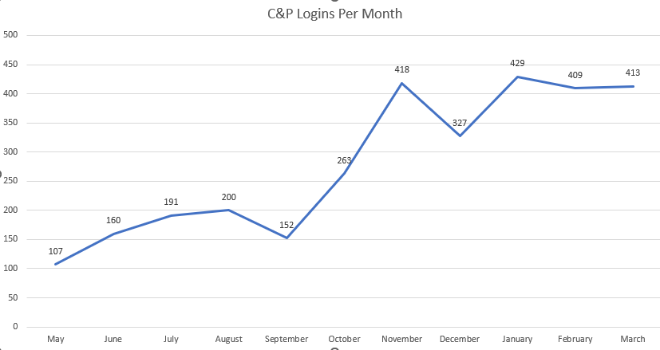
C&P ShCR Usage

Slide 10
Northamptonshire Zeros to Heroes

Slide 11
Top Trumps Team
Northamptonshire Top Trumps Team
Our constituent parts mean we bring different skills to ensure we maintain good working relationships with our provider organisations, suppliers and the public.
Big things can happen in small teams if you get the balance right.
We set our values to always act with kindness and passion for better care with everyone we work with.
Tech Wizard
Steve Hulligan
Master Planner
Katie Di Stefano
The Mouth
Matthew Hutton
The Guv’nor
Kirstie Watson
The Connector
Efua Owusu-Antwi
Data skills | 90
Testing | 80
Onboarding | 99
Projects | 95
Teambuilding | 80
Report building | 99
Roadmaps | 80
Relationships | 90
Communications | 99
Leadership | 99
Strategy | 90
Vision | 99
DPIAs | 457
Protection | 80
Enabling | 99

Slide 12
The Northamptonshire Care Record
Kettering General NHS FT
Northampton General Hospital NHS Trust
Northamptonshire Healthcare NHS FT
North Northamptonshire Council
West Northamptonshire Council
Northamptonshire Children’s Trust
E-forms
GP EMIS
GP TPP
18 GP Practices using EMIS Web
53 GP Practices using TPP SystmOne
MH
C
LA
LA
LA
Acute Trust using SystemC
Acute Trust using CAMIS
MH & Community Trust using TPP
Local Authority using Eclipse OLM
Local Authority using Liquid Logic (2024)
Local Authority using Eclipse OLM
Graphnet CareCentric
East Midlands Ambulance Service
100 per cent of GP data flows into the Northamptonshire Care Record
Our Acutes, Mental Health and Community Trusts are all connected
Our Councils went from 1 to 3 organisations in contract and have been procuring new systems over the past year.
EMAS have built their own shared record and we are looking to share via National Record Locator
We have connected Remote Monitoring (Docobo), Orthotics and Wheelchair Services with ReSPECT, EPPACS and Learning Disability and Autism Dynamic Register in development.
Pop Health
ES
Ambulance Service using Siren

Slide 13
Sadness
Disgust
The NCR Journey…so far!
October
2023
November
2023
December
2023
January
2024
February
2024
Sadness is literally the very definition and being of sorrow and gloom. She was hardly ever used because Joy is the dominant emotion and didn't want Riley to ever be sad. Because of this, Joy treated Sadness poorly.
Clips

Slide 14
NCR Month 1
October
2023
Users
85
NCR is launched across the county
Online launch event held for GP Practices
Patient Records Viewed
508

Slide 15
NCR – Month 2
November
2023
Users
657
Onboarding of GP Practices commenced with high initial uptake rate
Access granted to pilot user group in pharmacy at Kettering General Hospital
Patient Records Viewed
3,553

Slide 16
NCR Month 3
December
2023
Users
1,079
Pilot user access granted to pharmacy at NGH
User access granted to all NHFT staff
Patient Records Viewed
12,774

Slide 17
NCR Month 4
January
2024
Users
1,920
Wider rollout across UHN
Work underway to add Remote Monitoring feeds to NCR
Patient Records Viewed
17,649

Slide 18
NCR Month 5
February
2024
Users
1,547
A total of over
50,000
patient records have been viewed
Patient Records Viewed
17,036

Slide 19
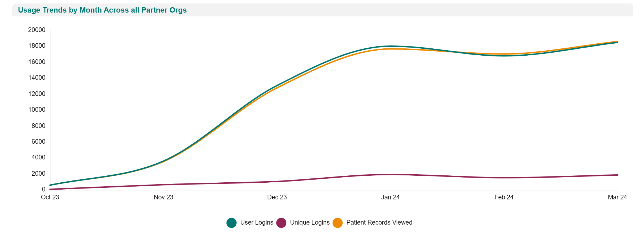
Northamptonshire Care Record Usage (Oct 23 – Mar 24)
User Logins
75,161
Unique Logins
3,647
Patient Records Accessed
74,700
Data for period 0/10/23 to 09/04/244
Live usage dashboard (updated monthly)
www.connectingyourcare.net
Northamptonshire Digital Strategy 2022-2025
ICN Joint Five-Year Plan
ICS Digital Programme Status
ICB Benefits - Digital Programmes

Slide 20
N&W ShCR Project Wins

Slide 21
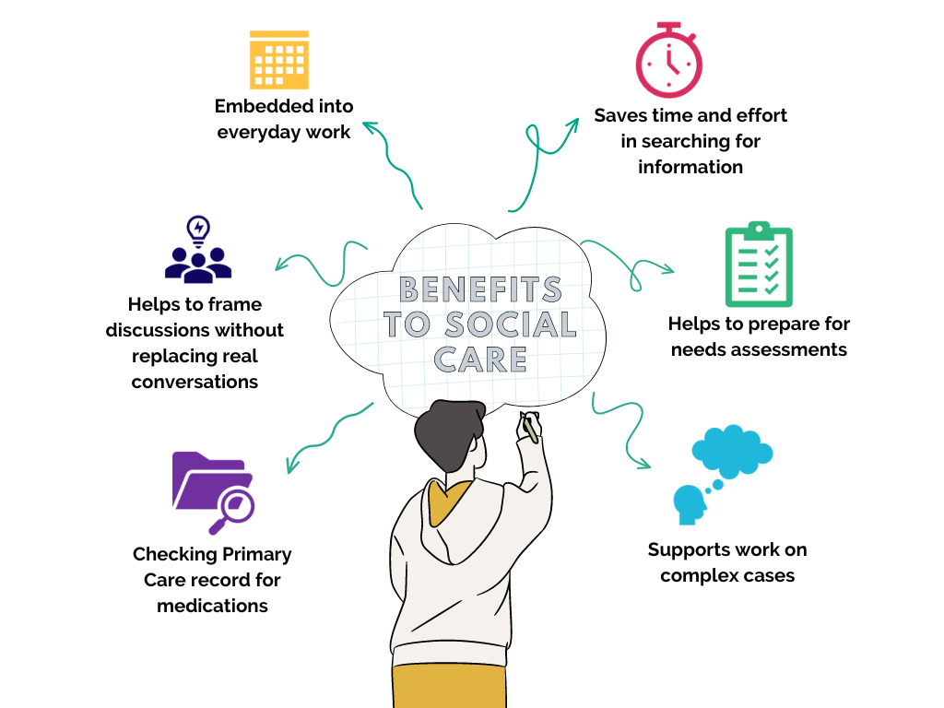
Social Care Use Case

Slide 22
Norfolk Social Care Usage of the ShCR

Slide 23
NCC End User Feedback
‘On days if service is a little glitchy, I find it has a detrimental effect on my work practice and I feel a little lost without it!’
‘Finally, we can gain information on prescribed medications and allergies which can again be a good tool when we are with a service user that we have little information for.’
‘I use the shared care record for new referrals and for existing service users. It’s useful to check medical information to inform a care act assessment, to check medication that is prescribed, and to check for recent GP involvement. It saves having to contact the GP Surgery for information.’
‘It has allowed us to see what referrals and encounters an individual has had and any planned referrals or encounters that we may need to integrate with to enable person centred and appropriate support.’
Quotes from Norfolk County Council Adult Social Services practitioners in 2023-24

Slide 24
NCC End User Feedback
‘I can say that this is really useful when cases have the NHS number, as it helps as a team manager to inform quickly some information which helps with planning and support,’
‘It is also useful around attendance at GP, medications etc, as this is not always as parents inform us. I really value this, and I know that social workers also find it helpful when the NHS number is known.’
‘Has been helpful to look where we are unclear about parents or children’s health – sometimes records can help us see things quickly or if parents have been honest .’
Quotes from Norfolk County Council Children’s Social Care practitioners in 2023-24

Slide 25
C&P ShCR Project Wins

Slide 26
C&P Wins
Social Care access to GP Data
Safeguarding

Slide 27
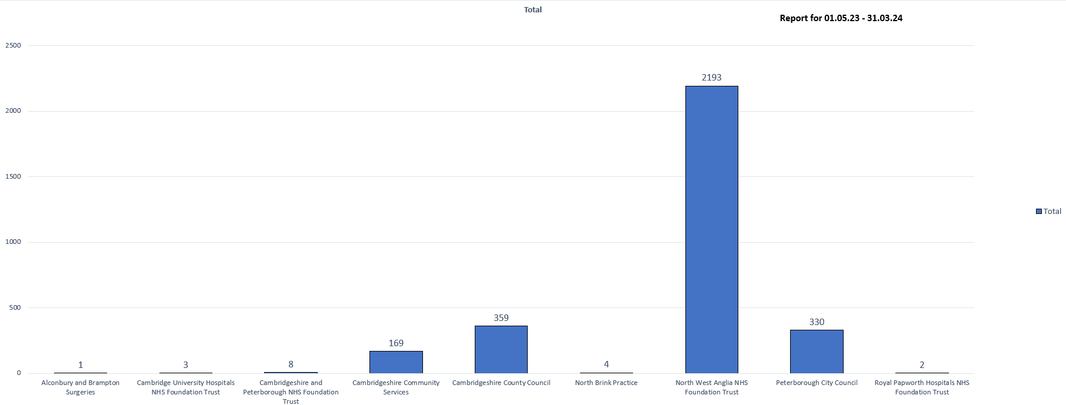
C&P Usage

Slide 28
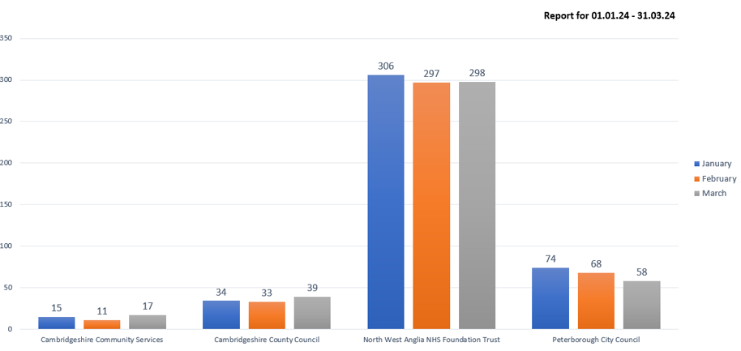
C&P Usage – last 3 months

Slide 29
NCR Project Wins

Slide 30
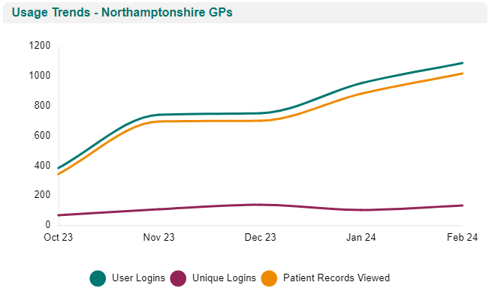
Successes
Limitations
Roadmap
NCR has been extremely beneficial in our practice. It has already saved significant time for admin staff who can now access the NCR for example to confirm forthcoming appointment dates and times”
Dr Naomi Caldwell, GP Senior Partner at Langham Place Surgery
All 67 GP Practices are sharing data into the NCR
Patient timeline tool for navigating care journey
GPs able to view hospital information including admissions
Acts as a secondary source for information such as allergies
Persistent data from all registered patients allows us to do population health analysis on a county wide scale
Risk Stratification now working to help triage
Not all GP Practices have set up their access to take advantage of the benefits of viewing data
Limited data feeds in some areas
Single Sign On not yet available at NGH
Currently no access to users outside of acutes, NHFT and GP Practices
To increase datasets to bring value and increased benefits to users including Social Care data, Path & Rad results from acutes and Remote Monitoring Data
To increase adoption across a wider range of healthcare settings
To work with GP Practices to set up access
To use NCR as the digital solution for ReSPECT Forms

Slide 31
Digital Maturity over the past 12 months in Northamptonshire
Digital Maturity Assessment for ICS | 2023 | 2024
Do you use your shared care record for the purpose of direct care? | No | Yes
Do you use data from your shared care record for the purpose of population health management? | No | Yes
Do you use data from your shared care record for the purpose of planning and operational management? | No | Yes
Do you use data from your shared care record for the purpose of research? | No | Yes
Private sector organisations connected to your local shared care record? | No | Yes
Over the past 12 months we have gone from bottom of the league in NHS to above average score.
“The progress in digital maturity over the past 12 months has made digital one of the key enablers in our ICB five-year strategy. We are already using the strong foundations set to use our Connected Care Record as a systemwide tool for end of life, the health of people with Learning Disabilities and Autism and ReSPECT.”
Kirstie Watson Digital Director, NICB

Slide 32
N&W ShCR Project Challenges

Slide 33
N&W Challenges to Delivery
Digital Maturity
Parallel Projects
Time Constraints
Technical Experience
Dedicated Operational Resource
Unknown Unknowns!
TPP Community Data
EuroKing Data Issues

Slide 34
C&P ShCR Project Challenges

Slide 35
Present Day
111
Pharmacy
AMB
Community/Mental
GP
Dental

Slide 36
Present Day
111
Pharmacy
AMB
Community/Mental
GP
Dental
Notes:
Silo’d working today – joined up inter-organisation working is difficult
16% year on year increase in demand – new hospitals won’t be big enough
Need to transform how we deliver healthcare
‘Better Integrated Healthcare Closer To Home’
The systems we are using today are not a good fit for the future
People and Process before Technology
Value for money (££ per patient for digital)

Slide 37
Present Day
111
Pharmacy
AMB
Summary Care Record
Community/Mental
GP
Dental
EPR
EPR
EPR
VW
@Home
Shared Care Record
EPR
Patient-centric
Longitudinal
Secure
Role Based Permissions
Order Comms / Task Management
ePrescribing
Clinical Notes
EPR
Maternity
Social
Independent Sector
Voluntary
Hospice
Notes:
Silo’d working today – joined up inter-organisation working is difficult
16% year on year increase in demand – new hospitals won’t be big enough
Need to transform how we deliver healthcare
‘Better Integrated Healthcare Closer To Home’
The systems we are using today are not a good fit for the future
People and Process before Technology
Value for money (££ per patient for digital)

Slide 38
Present Day
111
Pharmacy
AMB
Summary Care Record
Community/Mental
GP
Dental
EPR
EPR
VW
EPR
RM
@Home
Shared Care Record (EHR)
Complex Discharge
EPR
Patient-centric
Longitudinal
Secure
Role Based Permissions
Order Comms / Task Management
ePrescribing
Clinical Notes
EPR
Maternity
Social
Independent Sector
Voluntary
Hospice

Slide 39
C&P Strategy for 2024-25
111
Pharmacy
AMB
Summary Care Record
GP
Dental
EPR
Community/Mental
APP
VW
EPR
RM
@Home
Shared Care Record (EHR)
Complex Discharge
EPR
Patient-centric
Longitudinal
Secure
Role Based Permissions
Order Comms / Task Management
ePrescribing
Clinical Notes
APP
APP
APP
APP
APP
EPR
Maternity
Social
Independent Sector
Voluntary
Hospice

Slide 40
NCR Project Challenges

Slide 41
Successes
Limitations
Roadmap
Not all GP Practices have set up their access to take advantage of the benefits of viewing data
Limited data feeds in some areas
EMAS do not yet have access to NCR
NCR is a read-only system
Practices with access: 43 Practices without access: 24
All 67 GP Practices are sharing data into the NCR
Available to all clinical and admin roles at both acutes, NHFT and at GP Practices
Access is via Single Sign On at KGH, NHFT and GPs
GPs able to view hospital information including admissions
Acts as a secondary source for information such as allergies
Persistent data from all registered patients allows us to do population health analysis on a county wide scale
NCR has been extremely beneficial in our practice. It has already saved significant time for admin staff who can now access the NCR for example to confirm forthcoming appointment dates and times”
Dr Naomi Caldwell, GP Senior Partner at Langham Place Surgery
To increase datasets to bring value and increased benefits to users including Social Care data, Path & Rad results from acutes and Remote Monitoring Data
To increase adoption across a wider range of healthcare settings
To work with GP Practices to set up access
To use NCR as the digital solution for ReSPECT Forms

Slide 42
Northamptonshire Challenges to Delivery
The launch and usage of both the Share Record and the Population Health Tool have sparked the imaginations of our county
We have gone from business case to cost pressure for NICB
Implementing new tools with large sets of stakeholders like the optometrist and community pharmacists is labour intensive and requires a lot of relationship building for a small team
Getting the USPs right for each user group and increasing adoption
We are looking at system boundaries and how we support/break them down
Making our work truly data driven – we have learned a lot from those doing it well
And just new adding on new systems – like a new EPR, new Social Care System and bringing voluntary, charity and private providers in.

Slide 43
Next Steps for Norfolk and Waveney

Slide 44
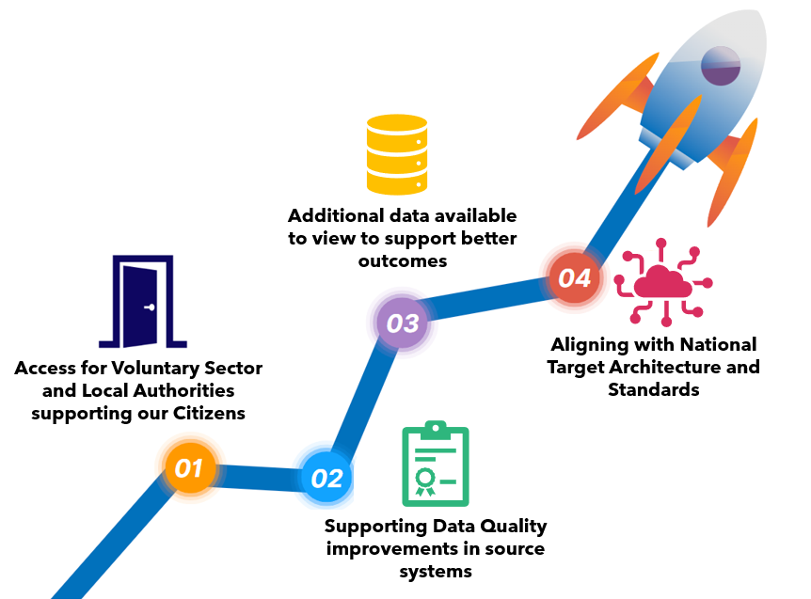
N&W ShCR Next Steps 24-25

Slide 45
Next Steps for Cambridge and Peterborough

Slide 46
C&P Next Steps
Tender process for Complex Discharge (@Homefirst)
Addition of Virtual Wards
Addition of Remote Monitoring with central monitoring
Community and Outreach – matrix working
Shared Services (multi-ICS)

Slide 47
Next Steps for Northamptonshire

Slide 48
Successes
Limitations
Roadmap
To increase datasets to bring value and increased benefits to users including Social Care data, Path & Rad results from acutes and Remote Monitoring Data
To increase adoption across a wider range of healthcare settings
To work with GP Practices to set up access and add on Population Health tools for their prioritisation
To use NCR as the digital solution for ReSPECT Plans
To work with EMAS to provide access to relevant information via the National Record Locator
All 67 GP Practices are sharing data into the NCR
Available to all clinical and admin roles at both acutes, NHFT and at GP Practices
Access is via Single Sign On at KGH, NHFT and GPs
GPs able to view hospital information including admissions
Acts as a secondary source for information such as allergies
Persistent data from all registered patients allows us to do population health analysis on a county wide scale
Not all GP Practices have set up their access to take advantage of the benefits of viewing data
Limited data feeds in some areas
Single Sign On not yet available at NGH
Currently no access to users outside of acutes, NHFT and GP Practices
NCR has been extremely beneficial in our practice. It has already saved significant time for admin staff who can now access the NCR for example to confirm forthcoming appointment dates and times”
Dr Naomi Caldwell, GP Senior Partner at Langham Place Surgery

Slide 49
The goal is to support everyone to make good decisions
Patients/citizens
GP surgeries
Secondary care
Social Care
National data
Appointments
Letters/Questionnaires
Hybrid mail
National
data sources
Appointments
Letters/Questionnaires
Medicines
Records
EMIS
TPP SystmOne
System C EPR
CAMIS PAS
OLM
Liquid Logic
Various inc. SUS
Benchmarking information
PID every 24 hours
PID live from Acutes
PID every 24 hours
Healthcare Comms App
Northamptonshire Care Record
(NCR)
Northamptonshire Analytics & Reporting Platform (NARP)
EPACCS
Respect
LDA DR
Monitored by Secondary Care
PID for Clinicians
Pseudonymised/Deidentified
NHS App
Remote Monitoring
PID for Clinicians
Patient decisions about their own health
Clinical decisions
Operational decisions, Pop Health, Planning
Research-led
decisions
Operational decisions

Slide 50
Thank you
Stacey Cairns Digital Project Manager
Norfolk and Waveney ICB
stacey.cairns@nhs.net
Matthew Douglas Director of Digital
Cambridgeshire and Peterborough ICB
matthew.douglas5@nhs.net
Matthew Hutton ICS Digital Lead
Northamptonshire ICB
matthew.hutton3@nhs.net

