Slide 1



C1.3 SWAST Access to Clinical Information
Claire Jones – Clinical Lead – Digital Transformation, NHSE SW
Tom Hart – Clinical Lead – Clinical Information, Paramedic
South Western Ambulance Service NHS Foundation Trust

Slide 2


Overview of South West

Slide 3

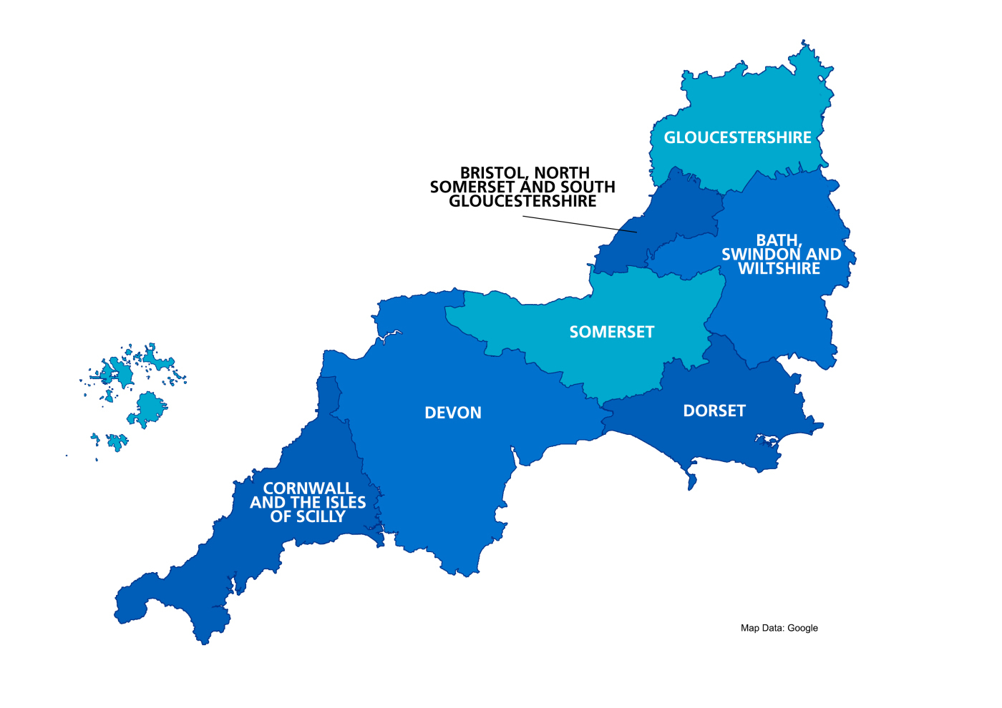

Shared Care Records in South West
Connecting Care (BNSSG)
JUYI (Glos)
Orion
Orion (migrating from Kainos)
SiDER (Somerset)
Integrated Care Record (BSW)
Black Pear
Graphnet
Dorset Care Record
Orion
Devon & Cornwall Care Record
Orion
Access to Summary Care Record (meds and allergies till 2020)

Slide 4
National Record Locator (NCRS)
Connecting Care (BNSSG)
JUYI (Glos)
Digitial ReSPECT+
MHCP available in JUYI
ReSPECT+ via NRL
NRL written into ShCR procurement requirement
Orion & Black Pear
Orion (migrating from Kainos)
SiDER (Somerset)
Integrated Care Record (BSW)
Several Digital Care Plans
End of Life and ReSPECT..
EoL plan via NRL
EoL plan NRL
Black Pear
Graphnet
Dorset Care Record
Digital care plans created in TPP
Devon & Cornwall Care Record
Unable to surface care plans via NRL at present.
Building Treatment Escalation Plans in the Shared Care Record
Cornwall Partnership
Mental Health Crisis Plans
Orion
NRL integration in progress
Surfaced to SWASFT via NRL
Orion
Key:
Shared Care Record (ICS)
Digital Care Plan Activity
NRLS Activity
Supplier(s)
Rio

Slide 5
What are SWAST doing to enable access?

Slide 6

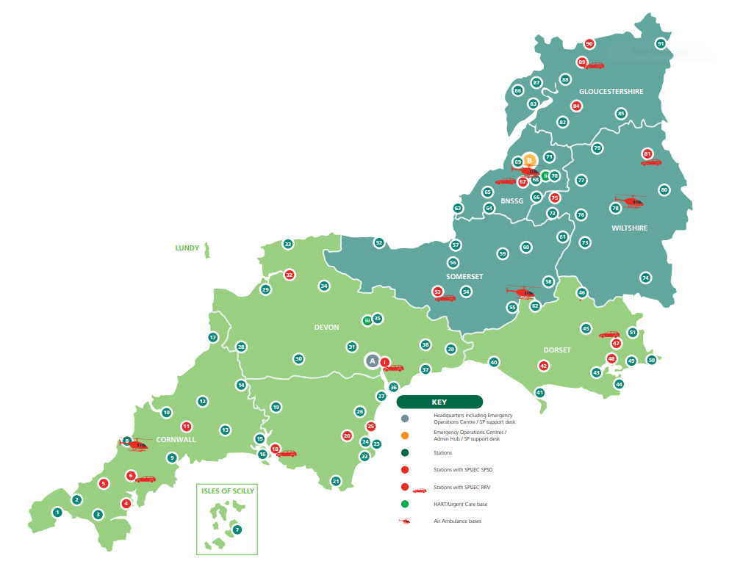
The importance of a single point of access…..

Slide 7
The importance of a single point of access…..
Paulton Ambulance Station

Slide 8
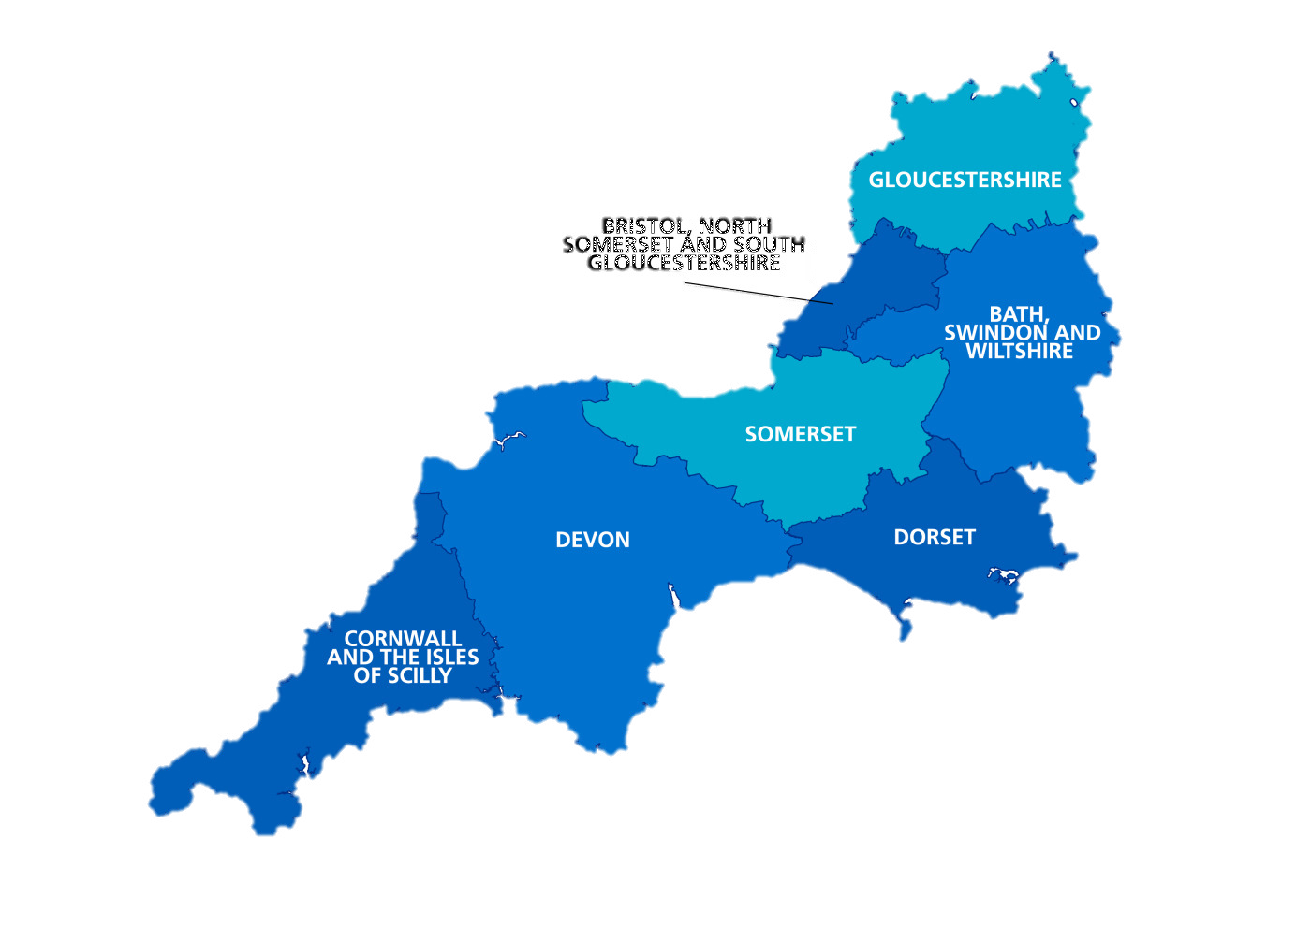
The importance of a single point of access…..
JUYI (Glos)
Connecting Care (BNSSG)
Paulton Ambulance Station
SiDER (Somerset)
Integrated Care Record (BSW)
Devon & Cornwall Care Record
Dorset Care Record
Cornwall Partnership

Slide 9



The importance of a single point of access…..
JUYI (Glos)
Connecting Care (BNSSG)
Paulton Ambulance Station
SiDER (Somerset)
Integrated Care Record (BSW)
Devon & Cornwall Care Record
Dorset Care Record
Cornwall Partnership

Slide 10
The importance of a single point of access…..
JUYI (Glos)
Connecting Care (BNSSG)
Paulton Ambulance Station
SiDER (Somerset)
Integrated Care Record (BSW)
Millions of visitors every year
Devon & Cornwall Care Record
Dorset Care Record
Cornwall Partnership
Notes:
Overnight trips to SW 2023 – 15.9 million – stayed 3 nights – 45 million overnight stays.
101 million day visitors a year.

Slide 11
Clinical driven design

Slide 12


Patient Centred – Right Care
Ease of use
Feedback
ICS
GP Surgery

Slide 13
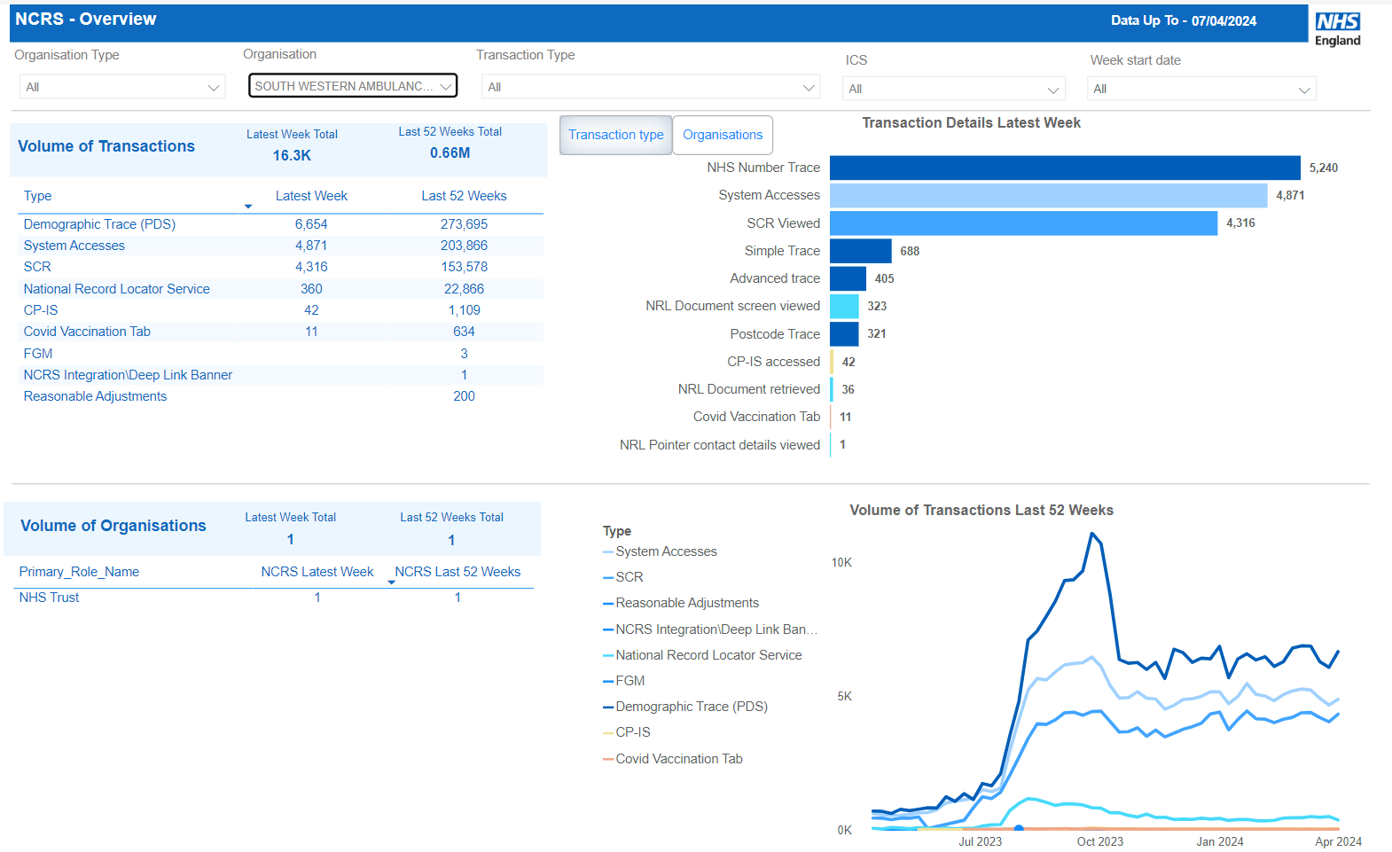
NCRS Views

Slide 14
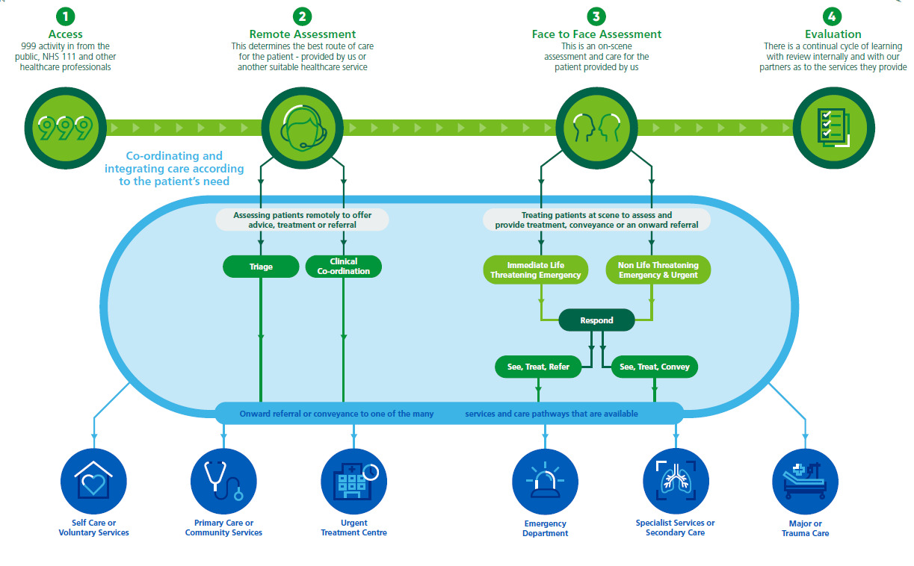
The Future…

Slide 15

The Future…

Slide 16
National ambulance overview

Slide 17

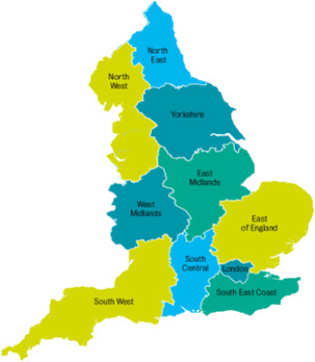
Ambulance Trusts / Shared Care Records
42 ICSs , 32 Shared Care Records, 10 Ambulance Trusts
 | ShCR’s
EEAS | 6
EMAS | 5
LAS | 1
NEAS | 1
NWAS | 3
SCAS | 2
SECAMB | 3
SWAST | 6
WMAS | 4
YAS | 1
Population movement
borders
Escalation of care transfers
borders
borders
Resilience

Slide 18
Thank you
Claire Jones
Clinical Lead – Digital Transformation
NHS England - South West
claire.jones230@nhs.net
Tom Hart
Clinical Lead – Clinical Information, Paramedic
South Western Ambulance Service NHS Foundation Trust
tom.hart@swast.nhs.uk

