Slide 1
C1.2 Shared Care Records Ambulance Service Benefit Ola Zahran Chief Technology Officer - Yorkshire Ambulance Service NHS Trust John Mitchell Associate Director of Digital - Humber and North Yorkshire ICB

Slide 2
Ambulance Service – Integration with YHCR

Slide 3
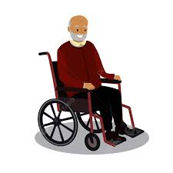
EoL plan & DNACPR Agreed
Died in ED
79-year-old discharged from hospital following a prolonged stay
Responded
Responded
Responded
1 week later
Found by LA
Collapsed at home

Slide 4
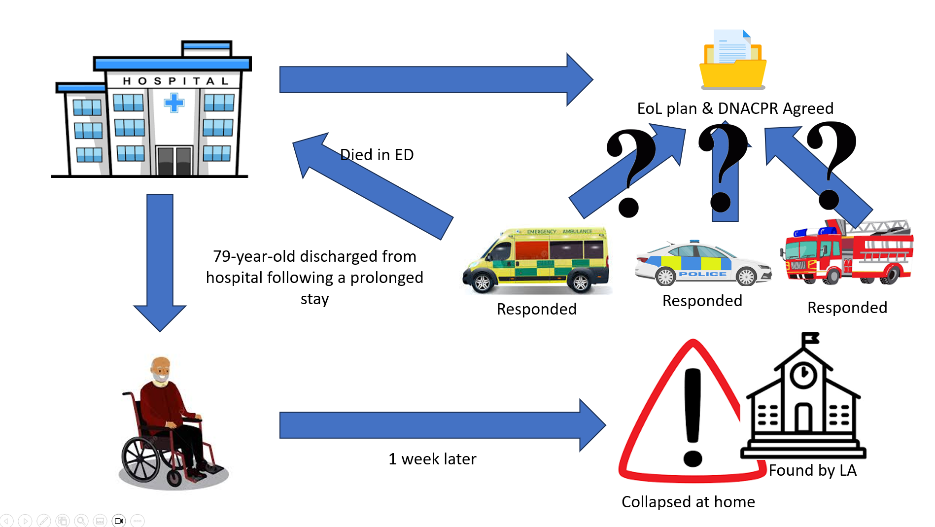
In this Scenario the patient was resuscitated against their wishes
Disjointed System
Lack of Visibility
Impacts on Decision Making
Reduces Empowerment
Doesn’t support Positive outcomes

Slide 5
YAS Digital ePR Journey
We established ePR user Centred design group. Clinical team, paramedics, Developers, change management team, IG, Digital team, Champions.
Market exercise to review What is out there.
Used the existing hardware
Prototype
Seek for board approval for trial
Trial run for one Ambulance station and one friendly hospital
Increased the scope 3 more stations
Regional engagement/workshop with all stakeholders across the region.
Manged to secure national fund £1.6M
Set up Deployment team to roll it out to the 83 stations.
Received 2 awards regionally and Nationally

Slide 6
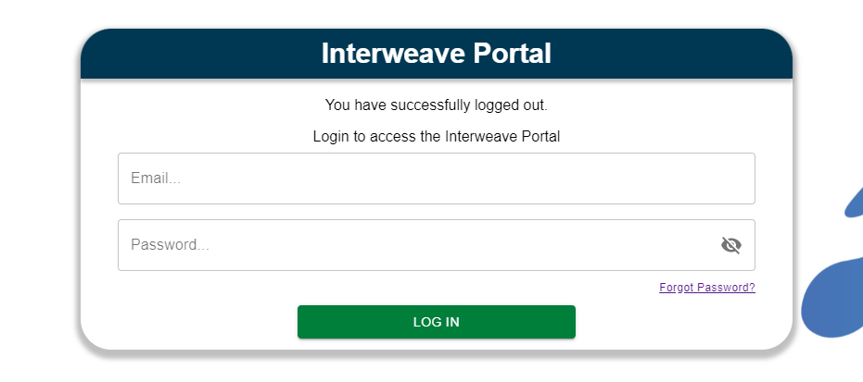
Providing Access to the YHCR
Providers
Health and care data
Consumers
Person held data
Hospitals
GPs
Social Care
Community
Mental Health
Ambulance
Exchange
Interweave Portal
Aggregates data in real time on demand from consumers

Slide 7
ePR Collaboration and Integration
Integration
999
&
Defib
GP-connect
Handover time to CAD
NHS Number
End of life EOL
Safeguarding referral requests to clinical hub
Post event message to GP
Transfer of care TOC
Patient observations from Defib
National Ambulance data set (999 & ePR)
Access to YHCR portal
YAS act as a provider
YAS provide YAS ePR/999 provision data to YHCR
Key
YAS act as a consumer

Slide 8
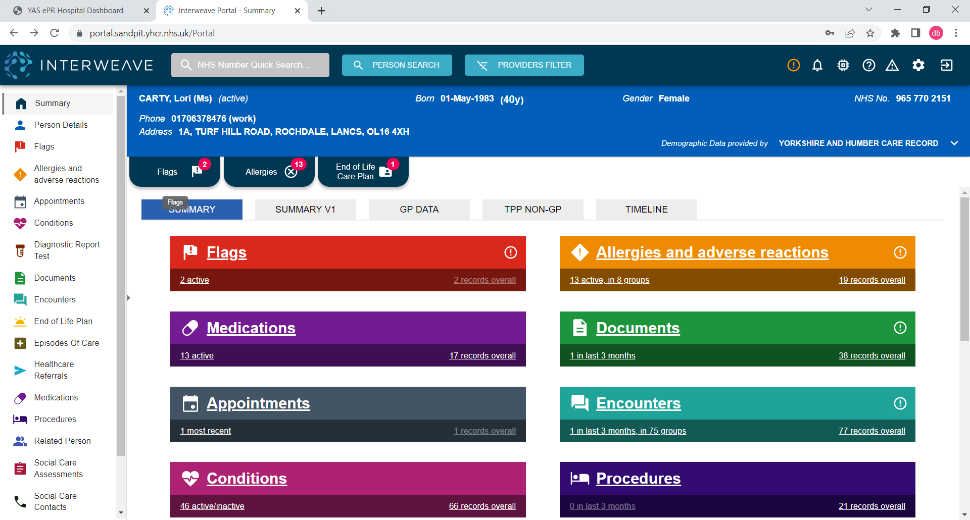
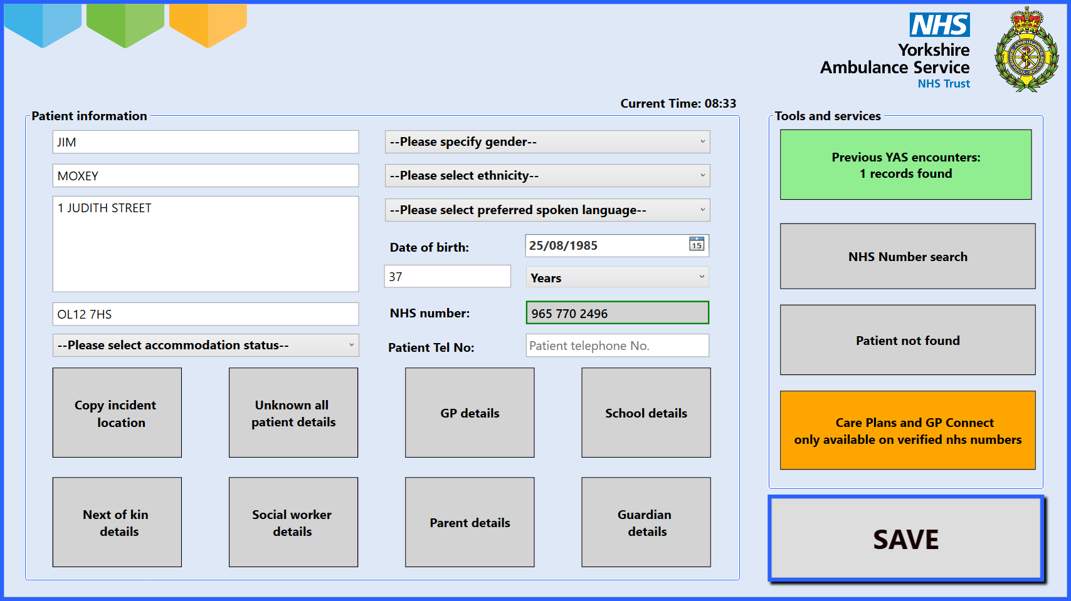
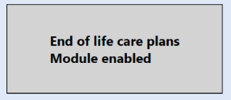
YAS ePR Integration with YHCR

Slide 9
Benefits To Transfer of Care

Slide 10
Transfer of Care (TOC) enhancing efficiency and improved patient care
The TOC system automates patient pre- and post-admission handover information to ED systems without any manual intervention, resulting in an efficient and seamless TOC process that enhances patient care.
Benefits
Reduce the registration time for ED and YAS by a minimum of 6-7 mins.
Improved patient care and safety due to the availability of complete, accurate and timely information.
Hospital | No of calls | No of Hours saved a year
Leeds LGI&STJ | 61213 | 15,378
York +Scarb | 46929 | 11,732
Rotherham | 19986 | 4,996
Hull | 29330 | 7,333

Slide 11
Transfer of Care (TOC) enhancing efficiency and improved patient care

Slide 12
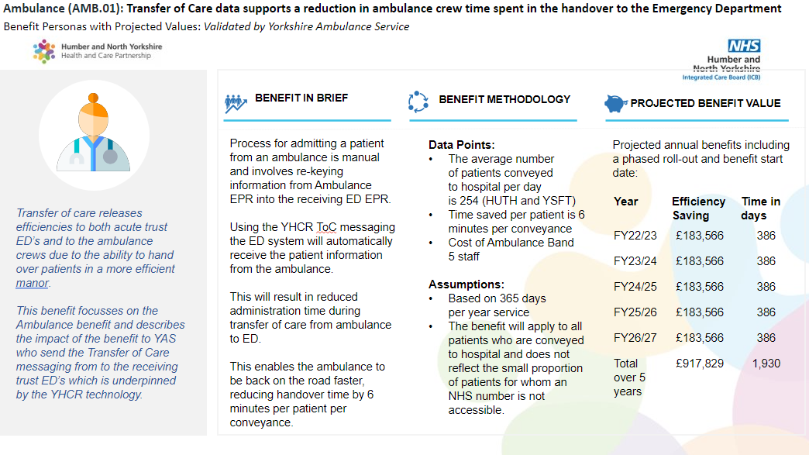
Transfer of Care (TOC) enhancing efficiency and improved patient care

Slide 13
A focus on EOL

Slide 14
The Case for Change
In Northern Lincolnshire, Available data indicates that patients dying in their preferred place has increased from around one-third to over half.
We needed a solution that could be viewed and updated (where appropriate) by different health and care providers: GPs, hospital, community, OOH, 999, 111, adult social care
At the outset of the project, a benefits baseline survey was conducted with
key stakeholders.
Many of the organisations reported difficulty in obtaining data
as it was not systematically recorded,
but despite the small numbers
the results provided an indicative baseline against
which the EPaCCS solution could be measured.
In this modern digital age these figures are unacceptable and the focus throughout has been to ensure that patients preferences can be shared in real-time,
so that their wishes can be respected
Patient choices are not static
and often change during the last weeks and months of life.
Typically, preferences for end-of-life care are collected by GPs and inputted
into their GP system.
However, this may not always reflect the latest wishes of the patient
and may not be available
to all of a patient’s health and care providers.

Slide 15
This is not a Digital Project…It’s Transformation
Clinically Led
(Clinical Design Authority)
Partnership based teams
(clinicians, digital and supplier)
Partnership based teams
(Clinicians, IG, Digital and Supplier)
Change the processes not just the technology
(baseline the starting point and remember change is hard)
Continuous feedback and improvement loop
(We couldn’t meet all requirements from day one )

Slide 16
How it Works?
Real Time Access
to EPACCS Data Set
Direct Integration
Patient Context Launch
Direct Integration
Partners

Slide 17
The Impact of Sharing EOL information
Analysis Shows that Patients with EPaCCS More Likely to Die Out of Hospital
'Early data gathered in Northern Lincolnshire from closed EPaCCS records is encouraging as it shows that only 14% of this cohort of patients die in hospital compared to a national average of 42-45% and a northern Lincolnshire average of between 36-40%. It suggests that the whole process of advance care planning and subsequently recording a patients wished and preferences in a EPaCCS record in combination makes a significant difference to a patients end of life care journey and ultimately where they die.
We are aware that although take up and use of EPaCCS records is gradually increasing, closing down a patients EPaCCS record when a patient dies is very inconsistent. To give us greater confidence in the data and impact that this process is having we need all patients who have died with an EPaCCS record in place to have their records closed down so that we are capturing the outcomes for all of these patients.’
Dr Yousef Adcock, Consultant in Palliative Medicine at Northern Lincolnshire and Goole NHS FT

Slide 18
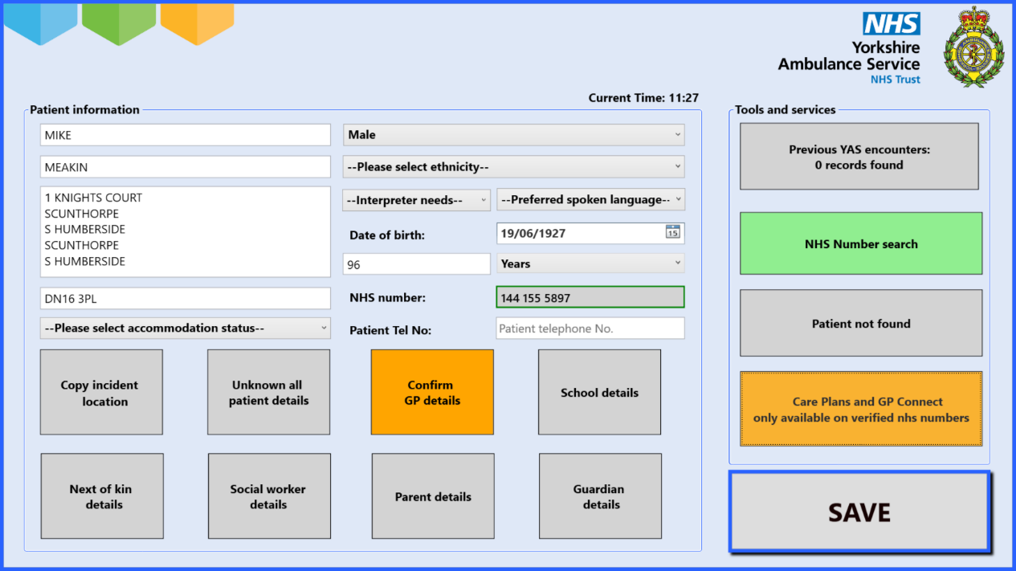
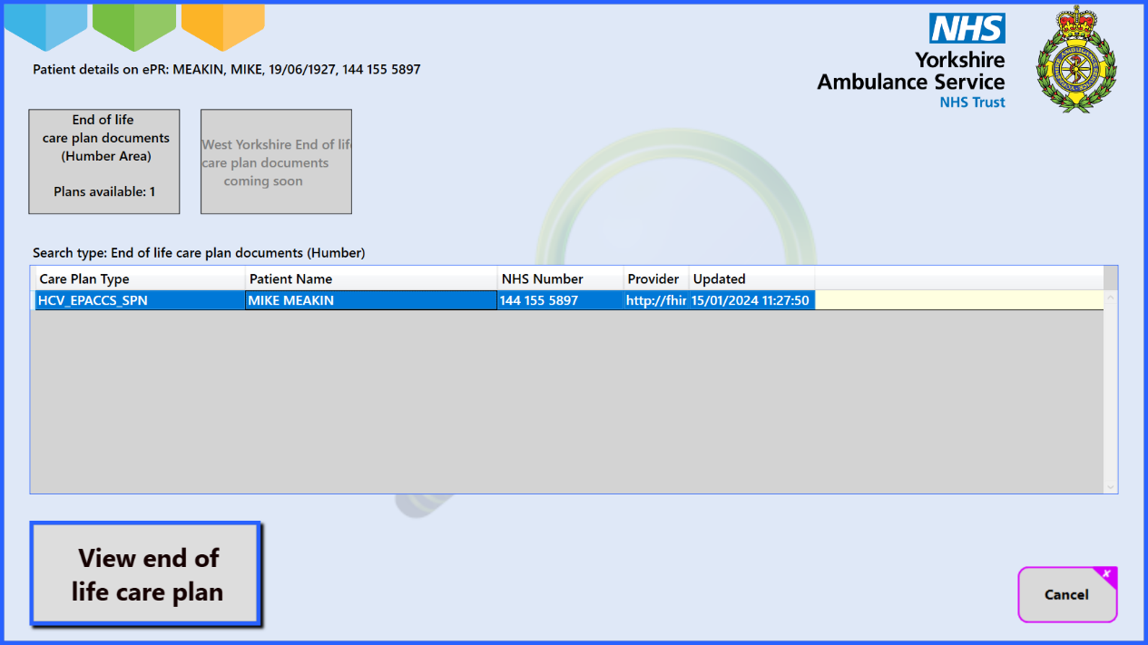
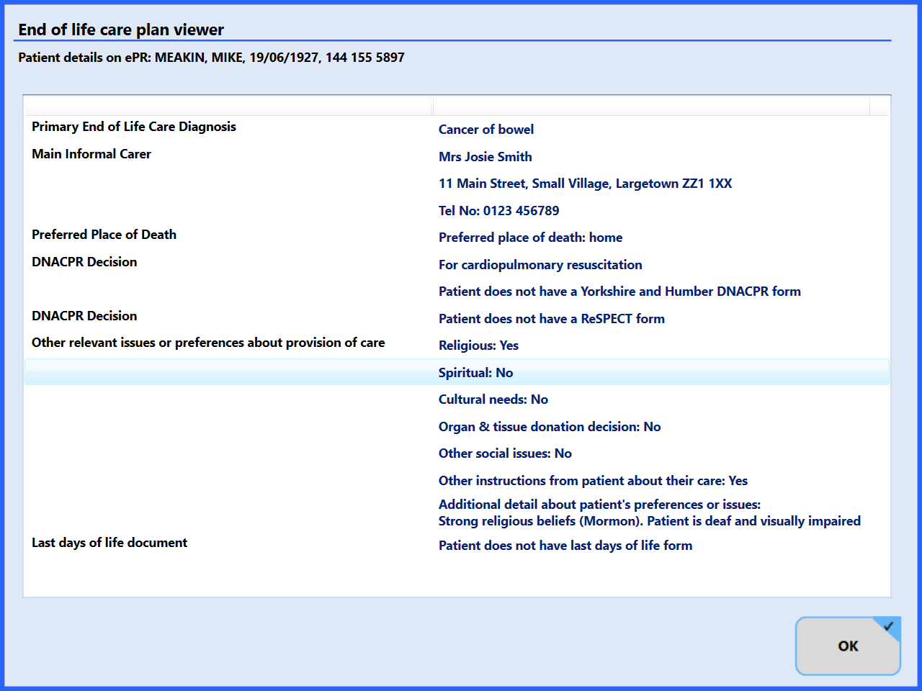
ePR End of Life Care Plan

Slide 19
Benefits for the End of Life Pathway

Slide 20
Feedback from YAS staff on EOL Care plan
“Gives extra confidence when making decisions around non conveyance and best interest treatment“
“This enabled us to access the appropriate information to give the appropriate clinical decisions and pathways. It was extremely useful tool to enable good patient care.”
“Often patients cannot recall or are unable to state their wishes/plans, family are not always available for info. This feature helps inform care pathway!
“Excellent in being able to provide the correct care and pathway for the patient especially if they are unable to communicate or family do not recall”
“The EOL care plans gave access to numbers to call and RESPECT form information so very useful”

Slide 21
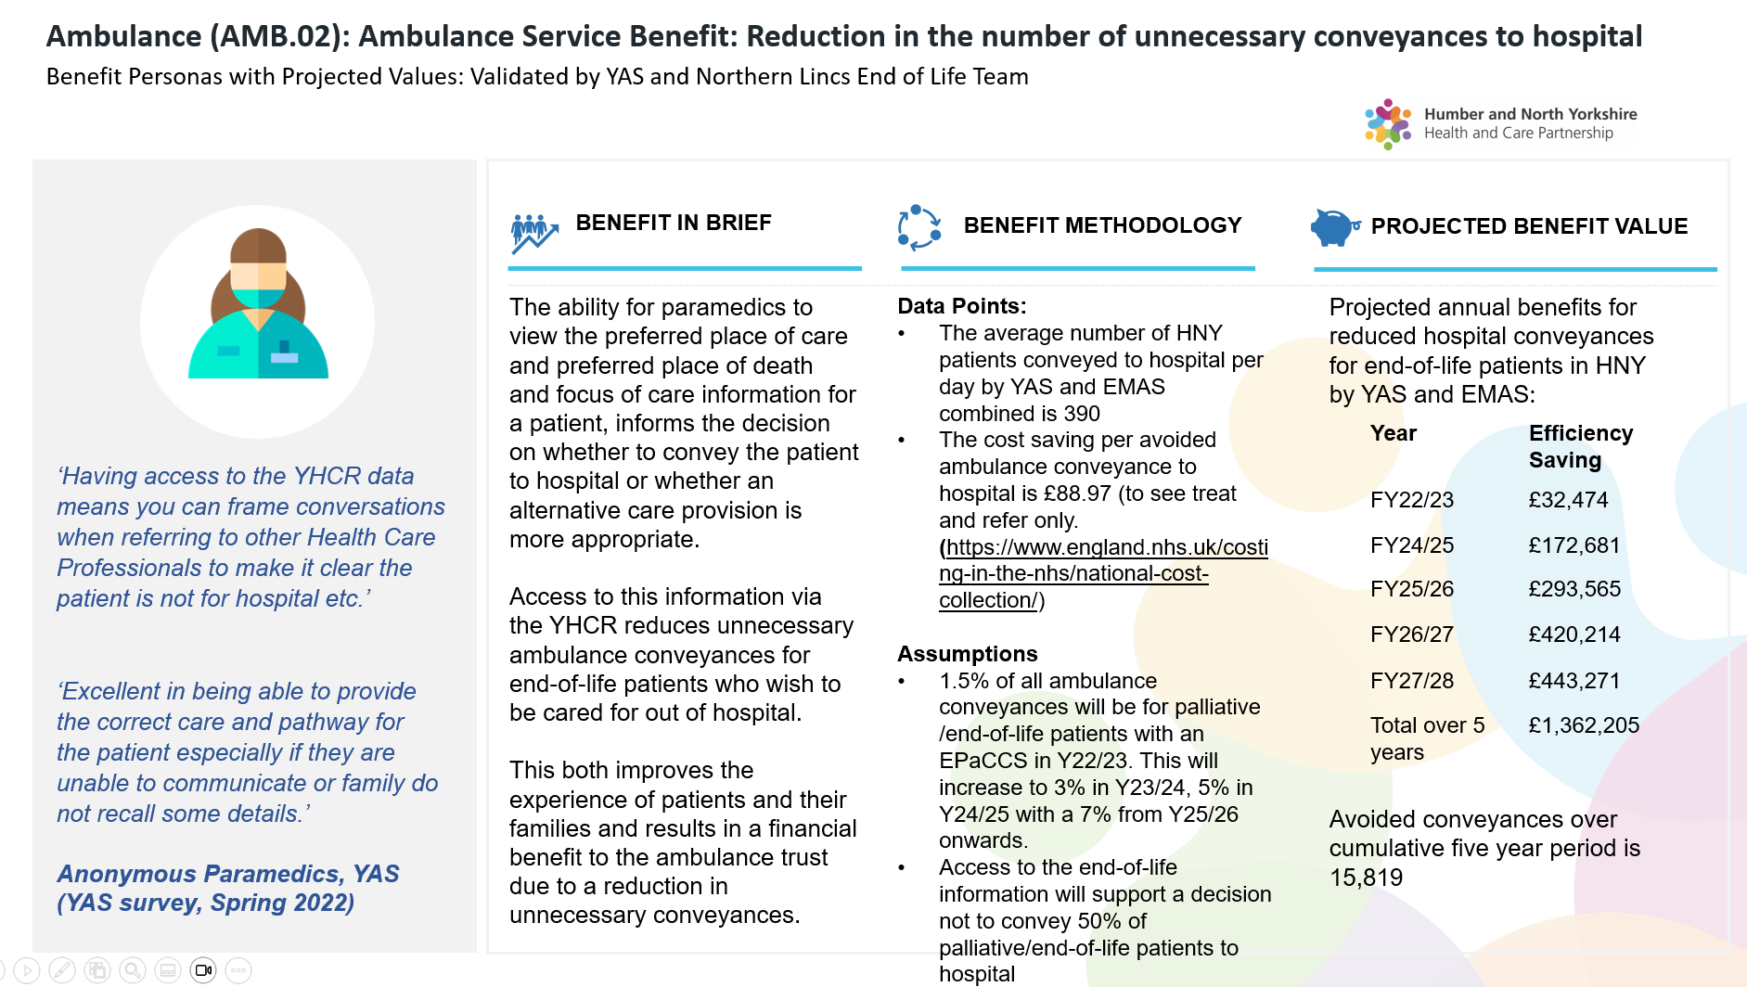
EOL - enhancing efficiency and improved patient care

Slide 22
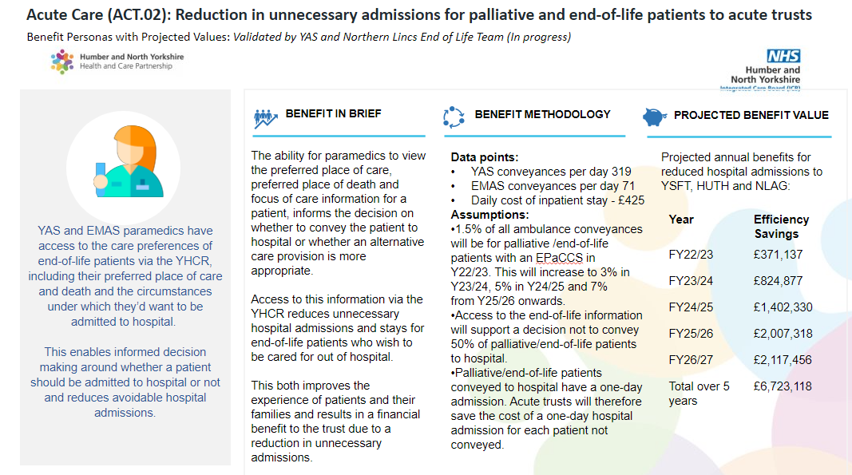
EOL - Transfer of Care (TOC) enhancing efficiency and improved patient care

Slide 23
Thank you

