Slide 1
C1.1 The Pan-Regional Information Sharing Mechanism (PRISM)
Max Hughes – NWAS CCIO
Gareth Roberts – Hilltop Digital Labs
Dan Perrin – NHS England

Slide 2
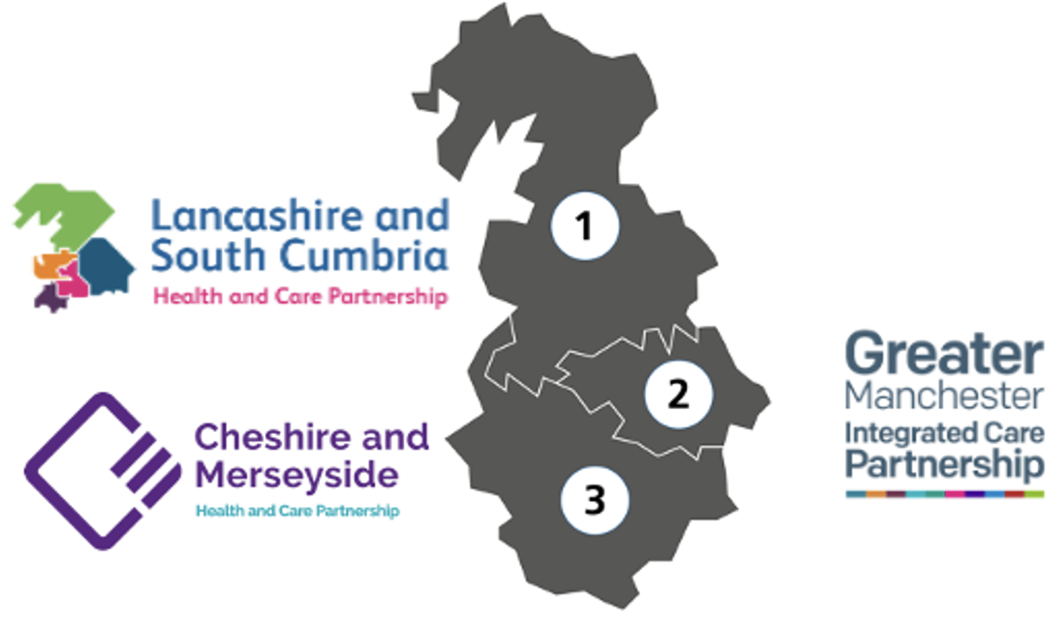
Meet the North West
NWAS
Caring for a population of over 7 million people spread across 5400 square miles
1000 vehicles
7000 staff
1.7 million 999 calls and over a million responses
The North West ICBs
Cheshire & Merseyside
Lancashire & South Cumbria
Greater Manchester
The PRISM programme team is a collection of NWAS, ICS and NHSE staff with a shared objective to enable regional Shared Care Record data to be used more widely.
Notes:
Our headquarters is based in Greater Manchester but we’re spread all over the region with
1 support office
2 Hazard response teams
3 emergency operations centres,
3 area offices,
5 NHS 111 sites
100 ambulance stations
1000 vehicles
7000 staff
The geography encompasses the ICBs of
Greater Manchester – Population 2.8 million
Cheshire and Mersey – Population 2.7 million
Lancashire and South Cumbria - Population 1.8 million
North East and North Cumbria - Population 3.1 million

Slide 3
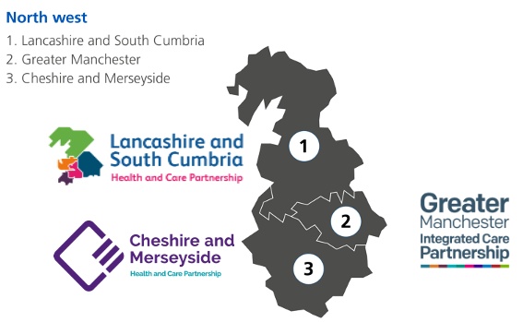
ShCRs – The barrier to entry
ShCR access by NWAS clinical staff is not cohesive, with multiple methods or systems required to access the totality of information that is nominally available from regional Shared Care Records.
Relevant information is fragmented and extracting critical information quickly remains a challenge.
As a result, paramedics cannot access information that could be used to provide more timely, appropriate care at scene, or conveyance to a more appropriate setting.

Slide 4
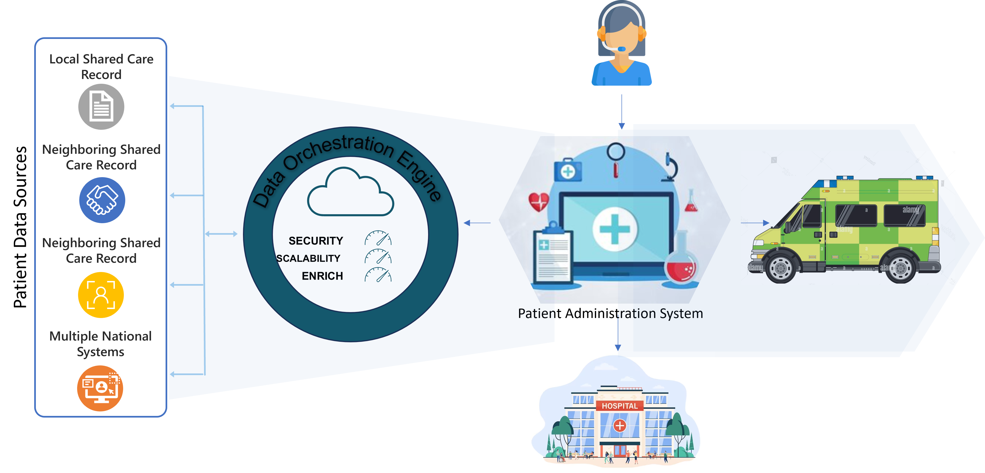
How to give a good user experience where data is held on multiple systems in different formats seamlessly
To make integration as a service which can be consumed by the users system – not another app!
Ambulance Service Requests Patient Records in response to an Emergency Dispatch request
Data Orchestration engines manages multiple requests in parallel to different record providers
Structured and unstructured (document links) data returned in a single message to the requesting system and presented to the user

Slide 5
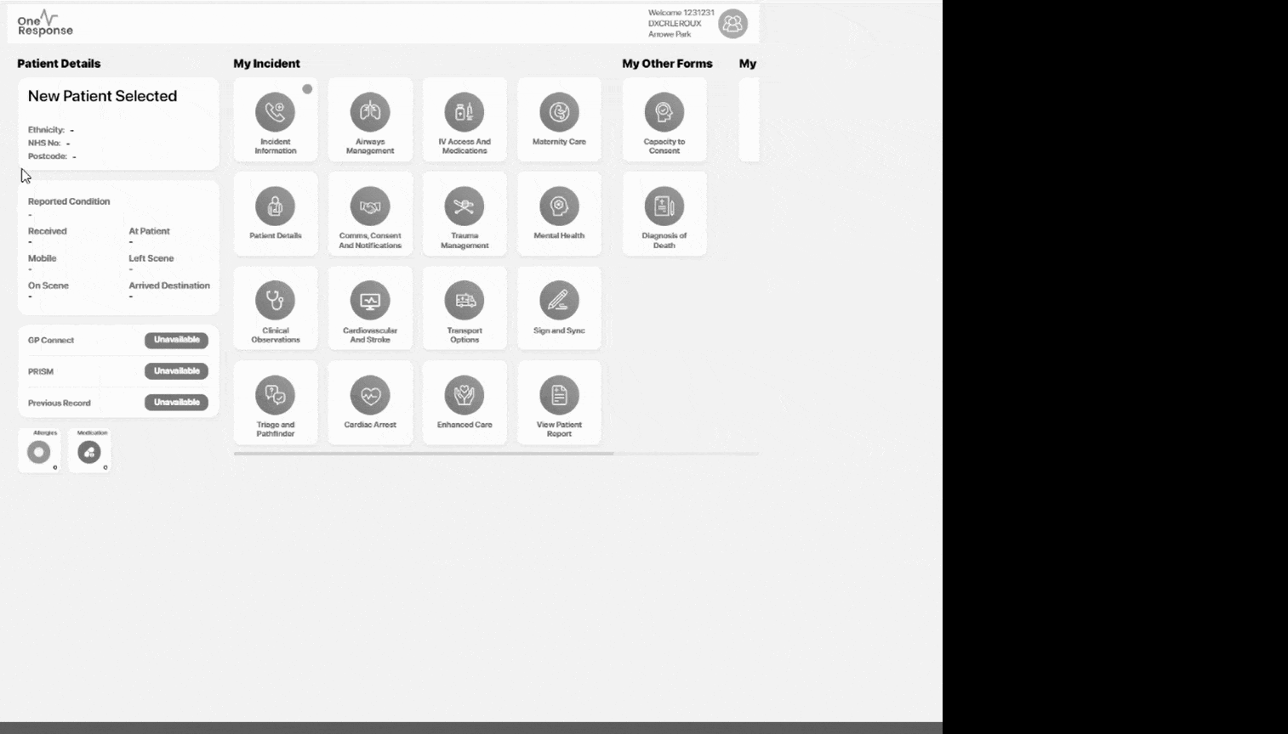
Interoperability means bridging the different shared care record philosophies
PRISM is able to navigate the different philosophies of IHE /FHIR / OpenEHR and bespoke and present the structured alongside the unstructured
Notes:
IHE - The Network Approach
If you want to build a network and have a Vendor Neutral approach to who can join the network, then IHE is for you. It brings the advantages that it deals with structured blobs (like CDAs or FHIR payloads of data and unstructured (like pdfs). It is a 'publish subscribe' model that also has a structured way to build vendor neutral workflows (if the vendors will play ball). And it brings an explicit privacy and consent model, that enables the network rather than the applications to take control of data flows. But XDS is clumsy when it comes to detailed use of data elements, and uses an older Web Based API technology called SOAP (SOAP has an extra message that needs to be implemented to make it work - but then this is part of the publish subscribe approach. Importantly, IHE now uses FHIR messaging n parts of the standard - and IHE and HL7org have signed a collaborative agreement to work on convergence and mutual use of the two standards over the coming years.
Large EPR companies can be resistant to the Vendor Neutral Network approach, and instead prefer a systems integration approach. This means the systems themselves control the granular data elements and who can access them (and share only what is necessary to share). Concepts such as a network wide Audit, or a network wide Privacy/Consent model, embodied in the IHE approach, do not figure highly in the systems approach.
FHIR - The Systems Approach
If you have a Systems approach to building interoperability then you will lean towards FHIR. FHIR is specifically designed for fast and easy systems integration. If uses the more modern RESTful web API interface and is well aligned with the systems integration experience in large companies and NHS-Digital. It also keeps Privacy/Consent and Workflow inside the systems/applications - meaning these applications can carry more value as they manage this tricky area.
The real technical advantage of FHIR is that you can easily access structured data and share structured data. But this requires agreement between the vendors of the systems. This agreement can be hard to achieve. However, as a stratategy, NHS Digital and NHS England are busy defining the UK / NHS specific flavour of FHIR for everyone to work with and enforcing these UK standards. Healthcare systems suppliers cannot sell in the UK unless they sign up to deliver the NHS CareConnect Interfaces. The development of the CareConnect interfaces is handled by INTERopen.
The disadvantages of FHIR are in "herding the suppliers together" to play ball (and follow the CareConnect APIs). And, technically, no central index, no workflow tools. These, together with privacy/consent, have to be managed by the systems/applications.
openEHR - The Data Approach
If you have a data driven approach, and you have the appetite to develop and manage your own systems, there is a ground up healthcare data management paradigm called openEHR. It is very much seen as an outlier in the UK because it requires strong ownership from the implementing organisations. Not many UK Healthcare Providers have the capacity to build the required strong technical team. It is implemented in Slovenia, Moscow and rumor has it that Brazil will now start to use this technology nationally. In the UK, the 100,000 genome project uses this as an information data source for healthcare information to support the 100,000 genome project in at least 2 locations. Every data element (and groupings of data elements, and groupings of groupings ..) is defined and added to the growing international templates. A hierarchical structure is produced, and APIs can give access to any data element or group. It is the 'holy grail' of interoperability, BUT the hardest to make the suppliers play ball. Every healthcare systems provider has considerable IP locked up in the way they manage data. Also, there is no central index, and no privacy and consent model built in. Also there is no workflow part to this standard (though work on this is starting).

Slide 6
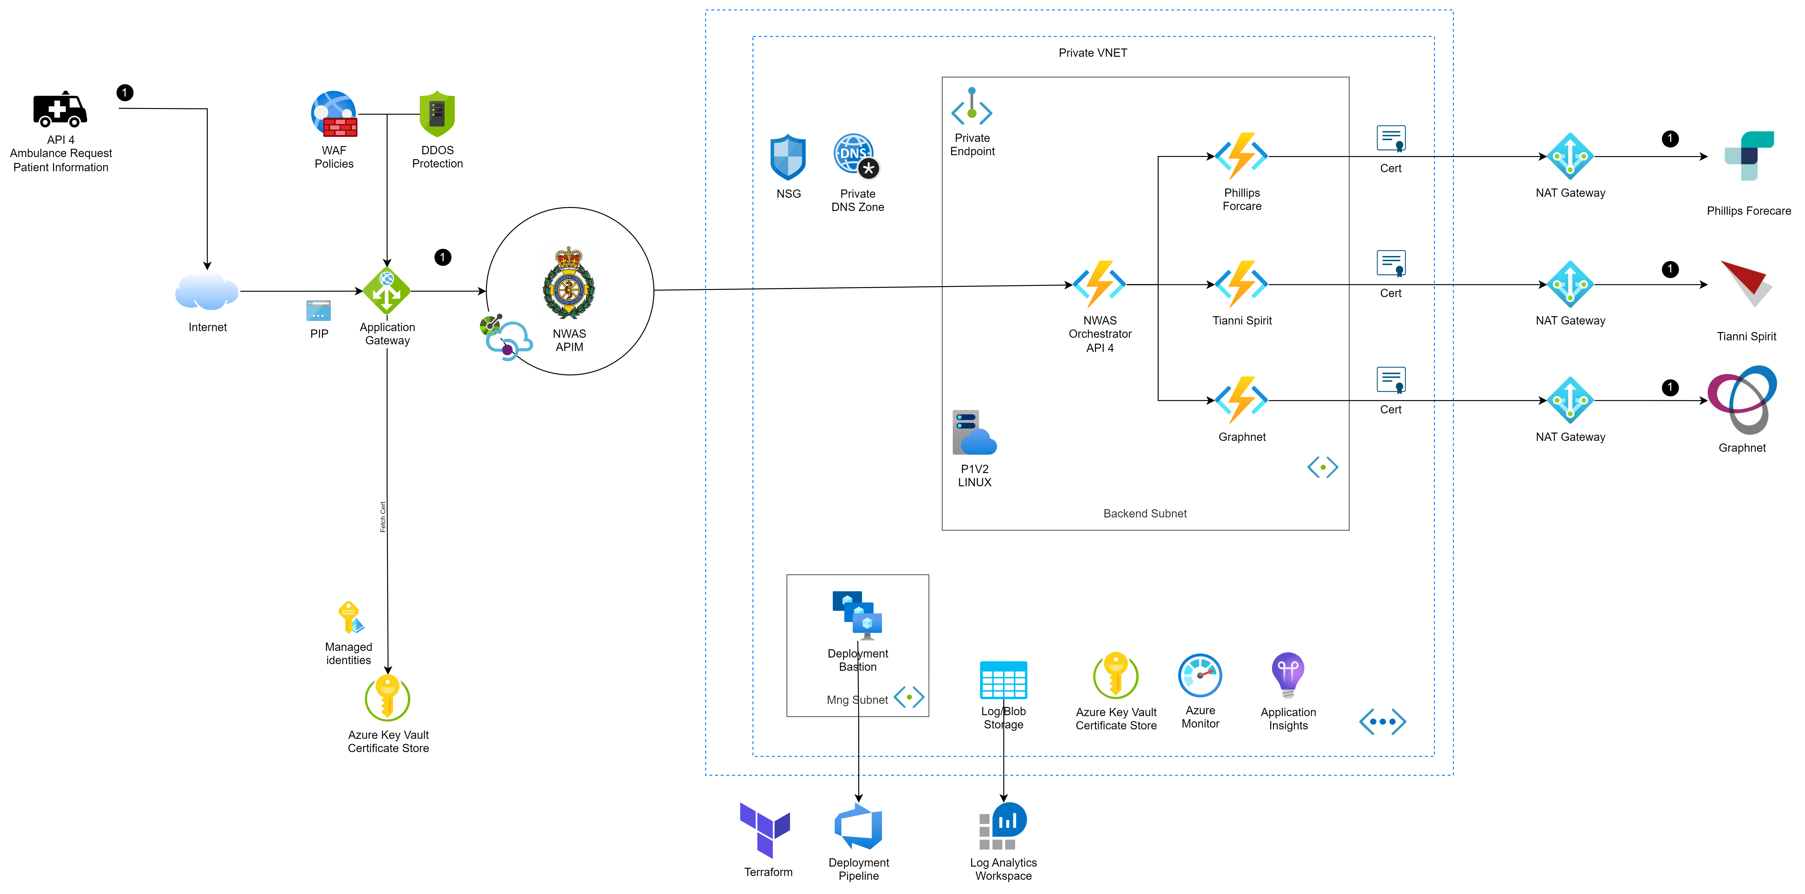
Secure, Scalable and supportable architecture is key to sustainability
At the heart of the NWAS orchestration service architecture is a private VNET hosted within the NWAS Azure cloud with serverless V2 durable functions.
PRISM is a technical service platform that sits in the background and is not used directly by any service user, nor does it require the use of any new logins or passwords.
It pushes out a request for any patient searched for within Dedalus EPR to other regional Shared Care Records, and displays the information returned in a single location within the EPR.
There are four core interfaces in operation:
Dedalus OneResponse EPR
Tiani Spirit – (Lancashire and South Cumbria ICB)
Founda (formally Philips) Forcare – (Cheshire and Merseyside ICB)
Graphnet CareCentric – (Greater Manchester ICB)
Dedalus OneResponse EPR sends a request to the PRISM Platform which then marshals the subsequent requests to the three api interfaces of Tiani, Forcare and Graphnet. On receipt of a response aggregates each dataset to return a single response to the Dedalus EPR.
Notes:
At the heart of the NWAS orchestration service architecture is a private VNET hosted within the NWAS Azure cloud with serverless V2 durable functions.
Key Development principles followed through the build have centred around
Infrastructure as code
Deployment pipeline
Principle of least privilege (POLP)
Automated tests (mocking API endpoints)
Component based approach
Shared Services managed through Azure Service Principles
This solution offers the best level of security while also delivering a service that scales automatically in response to demand. Monitoring alerts provide a continuous observation for each service that will raise operational alerts if either the service or one of its dependencies are no longer available. Ingress and Egress is delivered through shared service architecture.
All infrastructure and code is defined, deployed, and managed through Terraform and Azure DevOps.
Connection to the shared care records of Cheshire and Mersey ICB and for Lancashire and South Cumbria have to be undertaken via an HSCN network connection as public connection routing is not available, for Greater Manchester ICB connection is via public facing internet routes.
The solution utilises the already existing Azure components present in the NWAS Azure cloud infrastructure including the Azure API gateway and WAF this also ensures that the same policies are applied across the application and as per NWAS control as well as avoid duplication of components and therefore instance costs, shared services include
WAF and public IP routing (Application Gateway or Azure Front Door)
DDOS Protection
API Management
Vulnerability defence
NAT gateway0 for external routing
Perimeter services govern the flow of traffic into and out of the NWAS VNET.

Slide 7
PRISM as an asset owned and extended by NWAS
Central to the objective of sustainability is the ability for the PRISM asset to be owned and managed by the NWAS teams
Transfer takes place over the duration of the pilot period to ensure that the receiving team have fully grasped the working of the platform and project
Knowledge transfer would take place across multiple channels. While face-to-face communication such as over a meeting online or in person is the most common, channels such as video guides, resource lists, workarounds and the sharing of previous obstacles and their corresponding solutions aid the process.
Identifying suitable change request and shadow (peer review) the development of the change carried out by the NWAS team.
Notes:
IHE - The Network Approach
If you want to build a network and have a Vendor Neutral approach to who can join the network, then IHE is for you. It brings the advantages that it deals with structured blobs (like CDAs or FHIR payloads of data and unstructured (like pdfs). It is a 'publish subscribe' model that also has a structured way to build vendor neutral workflows (if the vendors will play ball). And it brings an explicit privacy and consent model, that enables the network rather than the applications to take control of data flows. But XDS is clumsy when it comes to detailed use of data elements, and uses an older Web Based API technology called SOAP (SOAP has an extra message that needs to be implemented to make it work - but then this is part of the publish subscribe approach. Importantly, IHE now uses FHIR messaging n parts of the standard - and IHE and HL7org have signed a collaborative agreement to work on convergence and mutual use of the two standards over the coming years.
Large EPR companies can be resistant to the Vendor Neutral Network approach, and instead prefer a systems integration approach. This means the systems themselves control the granular data elements and who can access them (and share only what is necessary to share). Concepts such as a network wide Audit, or a network wide Privacy/Consent model, embodied in the IHE approach, do not figure highly in the systems approach.
FHIR - The Systems Approach
If you have a Systems approach to building interoperability then you will lean towards FHIR. FHIR is specifically designed for fast and easy systems integration. If uses the more modern RESTful web API interface and is well aligned with the systems integration experience in large companies and NHS-Digital. It also keeps Privacy/Consent and Workflow inside the systems/applications - meaning these applications can carry more value as they manage this tricky area.
The real technical advantage of FHIR is that you can easily access structured data and share structured data. But this requires agreement between the vendors of the systems. This agreement can be hard to achieve. However, as a stratategy, NHS Digital and NHS England are busy defining the UK / NHS specific flavour of FHIR for everyone to work with and enforcing these UK standards. Healthcare systems suppliers cannot sell in the UK unless they sign up to deliver the NHS CareConnect Interfaces. The development of the CareConnect interfaces is handled by INTERopen.
The disadvantages of FHIR are in "herding the suppliers together" to play ball (and follow the CareConnect APIs). And, technically, no central index, no workflow tools. These, together with privacy/consent, have to be managed by the systems/applications.
openEHR - The Data Approach
If you have a data driven approach, and you have the appetite to develop and manage your own systems, there is a ground up healthcare data management paradigm called openEHR. It is very much seen as an outlier in the UK because it requires strong ownership from the implementing organisations. Not many UK Healthcare Providers have the capacity to build the required strong technical team. It is implemented in Slovenia, Moscow and rumor has it that Brazil will now start to use this technology nationally. In the UK, the 100,000 genome project uses this as an information data source for healthcare information to support the 100,000 genome project in at least 2 locations. Every data element (and groupings of data elements, and groupings of groupings ..) is defined and added to the growing international templates. A hierarchical structure is produced, and APIs can give access to any data element or group. It is the 'holy grail' of interoperability, BUT the hardest to make the suppliers play ball. Every healthcare systems provider has considerable IP locked up in the way they manage data. Also, there is no central index, and no privacy and consent model built in. Also there is no workflow part to this standard (though work on this is starting).

Slide 8
The progress to date
Initiation and mandate
Discovery and BA
Technical deep dives
ShCR feed development
Technical Proof of Concept
Options appraisal
Re-platforming into NWAS
UAT
Pilot

Slide 9
The positives we have identified
Strategic, pan-ICS programmes are viable
Information Governance at scale really is possible
Structured and Unstructured data can be presented and utilised simultaneously
ShCR-focused interoperability is critically needed
Existing digital capabilities now enable innovation
LHCRE-developed technology is still cutting edge

Slide 10
The challenges encountered
ShCR content is inconsistent and incomplete
Complex process to agree on “Who Pays For What”
Further work required to truly understand operationally relevant information and data
Unaligned governance structures
“What’s In It For Me?”
Obtaining, holding, and distributing funds

Slide 11
The PRISM North Star
“PRISM means staff will have a single route to the information we need to make the best decisions about patient care and ensure patients have the right care, in the right place at the right time.”

Slide 12
The Pan-Regional Information Sharing Mechanism (PRISM)
Max Hughes – NWAS CCIO
Gareth Roberts – Hilltop Digital Labs
Dan Perrin – NHS England

