Slide 1
B3.3 Spreading Involvement Angela Poland South East London ICS

Slide 2
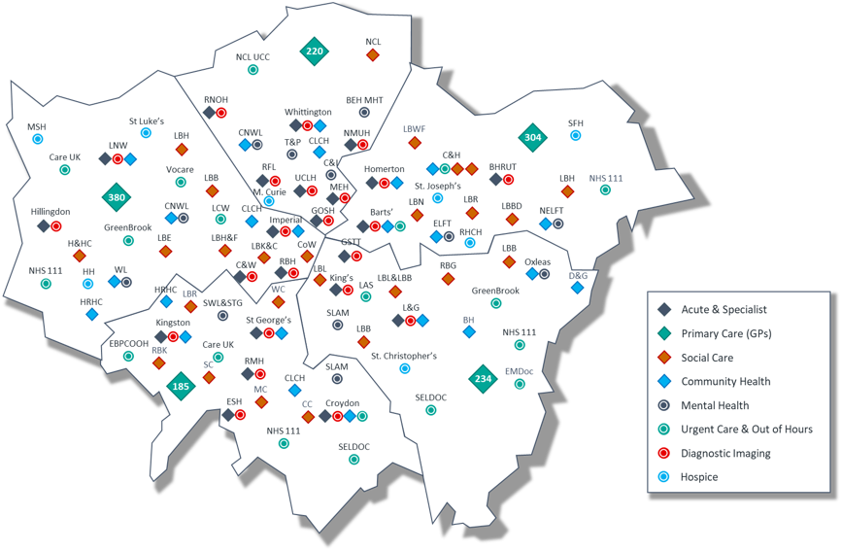
OneLondon and the London Care Record
The work of OneLondon is part of the ambition for London to be the healthiest global city.
Ambition to be best global city to receive health and care services.
Almost 10 million population
5 Integrated Care Systems
40+ NHS Trusts, 1,400 general practices, 33 local authorities
About 30% of Londoners receive care in an ICS that is not their ‘home ICS’
4 of 5 of London ICS have at least one NHS Trust where more than half the patients they treat live outside it's ICS

Slide 3
Expectations of Londoners
From the public recommendations formed through large scale deliberation on the uses of health and care data (when OneLondon started) through to patient and public contributions to our work today.

Slide 4
How the London Care Record Helps
Better Patient Experience
Patient doesn’t have to repeat their story
Doesn’t have to undergo unnecessary investigations
Safer and More Joined up Care
Frontline staff save time and delays by not having to phone or email GPs, hospital and social care colleagues
Helps prevent delays in diagnosis
Safer transfer of care between health and care providers
Full medical history, allergies, medications and appointments all easily accessible
“I can see quickly if a safeguarding assessment has been carried out by social care services…”
GP, London
“I was able to give him the best support and treatment and freed up an ambulance to treat patients elsewhere.”
Advanced Clinical Practitioner
“It helps me quickly find out which hospital or ward …when and why they’ve been admitted, as well as their discharge summary. This helps ensure all health partners are working together to complete a safe discharge.”
Hospital Discharge Officer, Hospital Social Work Team
“When patients are transferred to our stroke unit, our stroke team can immediately see what investigations have already been carried out and can access the results.”
Consultant Geriatrician
“In pre assessment the care is improved, more time spending with patients, less time chasing results… because it's easily obtainable from the LCR.”
Specialist Nurse, South East London
“Having access to pathology investigations that the hospital has done means that duplication is avoided.”
GP, South London

Slide 5
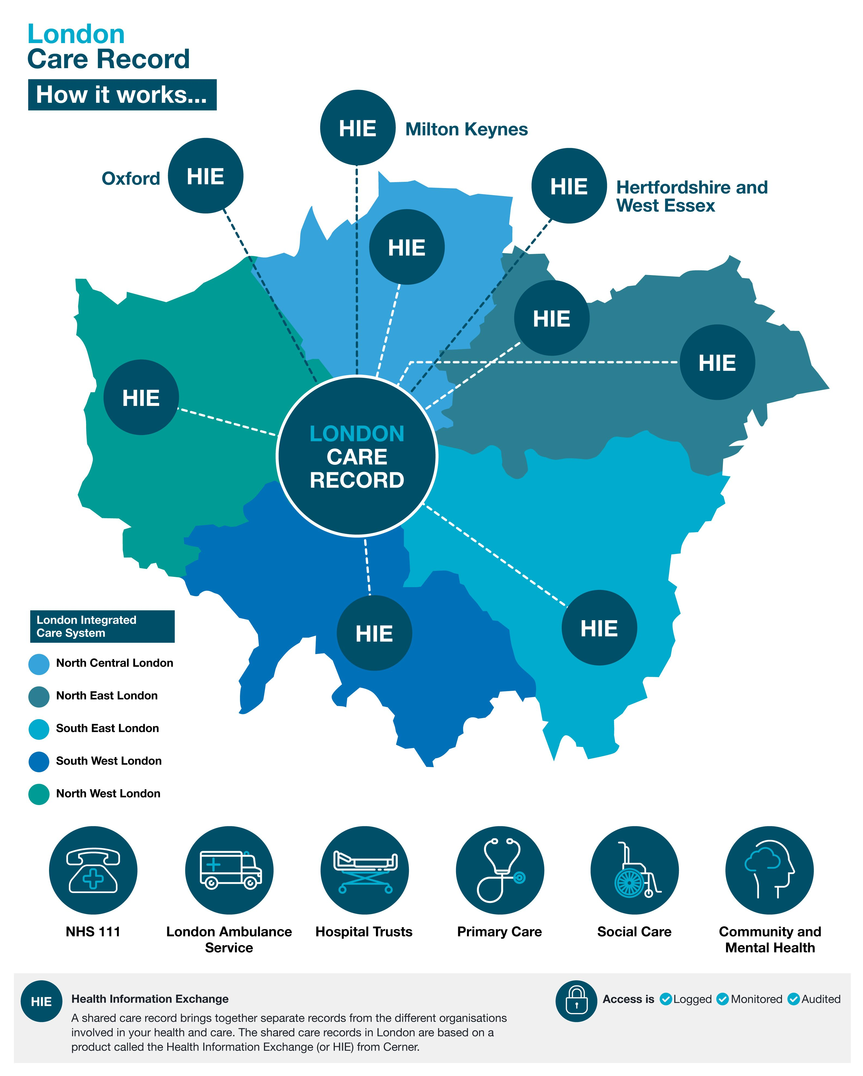
How the London Care Works
We have a ‘federated’ approach – each ICS has their own local hub (HIE) ​
The OneLondon ‘hub’ connects London up
25,152 South East London frontline staff used the London Care Record last month, March ‘24
Over 1.5 million views a month, almost 600,000 a month are South East London staff accessing the record at point of care-and increasing

Slide 6
Useful, Well Used-Key factors driving SEL adoption
The importance of collaboration amongst all stakeholders is key for continued success
Communication campaigns to increase awareness amongst frontline staff across all SEL health and care settings
Real time data feeds from SEL acute & mental health hospitals, GPs, adult social care, LAS and other partners across London
Robustly managed SEL service provision, with enhancements
Public & patient engagement and endorsement for their information to be used in this way

Slide 7
Spreading Involvement Further in South East London
Pioneering access for care homes, community pharmacy and voluntary sector
Extending into neighbouring shared care records, e.g. South East England (Kent and Medway)
Driving forward innovations like Role Based Access controls, data standardisation and interoperability collaboratively with London partners

Slide 8
Thank you
Steve Foreman Informatics Manager
Newcastle City Council
stephen.foreman@newcastle.gov.uk

