Slide 1
B 3.1 Spreading Involvement – Integrating Community Pharmacy Laura Godtschalk, LLR CR Programme Manager

Slide 2
Introduction
Role of Pharmacy
Extending LLR Care Record access to further sectors: Community Pharmacy
Key public-facing primary care service
Alternative first point of contact for minor ailments
Important to medication delivery and safety
Growing remit to relieve pressure on GP practices
200+ Community Pharmacies in LLR serving 1.1m people
Large and small chains, independents
Today: sharing the approach and learning
Collaborative approach including with other Interweave users – West Yorks Partnership
Building buy-in across a diverse sector and tuning into their needs
Finding an efficient route to connect, and solutions scalable beyond LLR
Working with suppliers
Accessible Healthcare​
​
Community pharmacies are accessible touchpoints for patients. Their integration into connected care records extends the reach of health and care services, particularly in underserved areas.​
Medication Management​
​
Community pharmacists are pivotal in medication management. Shared care records give them access to accurate and up-to-date information, enabling them to provide comprehensive pharmaceutical care.
Holistic Patient Support​
​
By being part of the shared care ecosystem, community pharmacists can contribute valuable insights and interventions to support holistic patient care, bridging the gap between primary care and pharmacy services.

Slide 3
Use Cases – developed with Pharmaceutical Committee and pharmacists, confirmed by trainee users

Slide 4
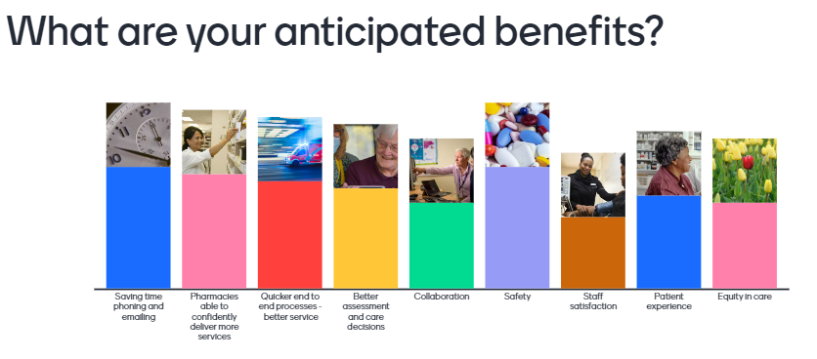
Benefits – Benefits and Insight Group feedback, and survey of trainee users

Slide 5
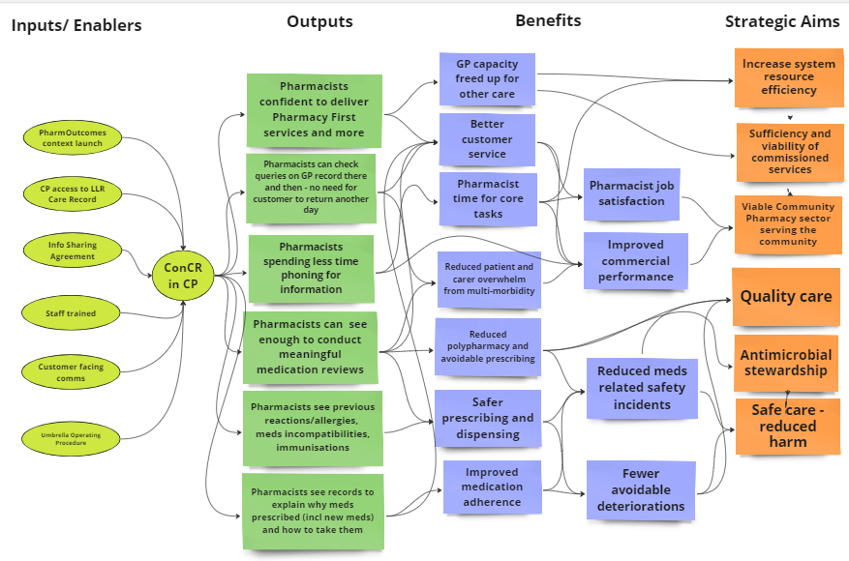
Logic model – developed using pharmacist and survey insights

Slide 6
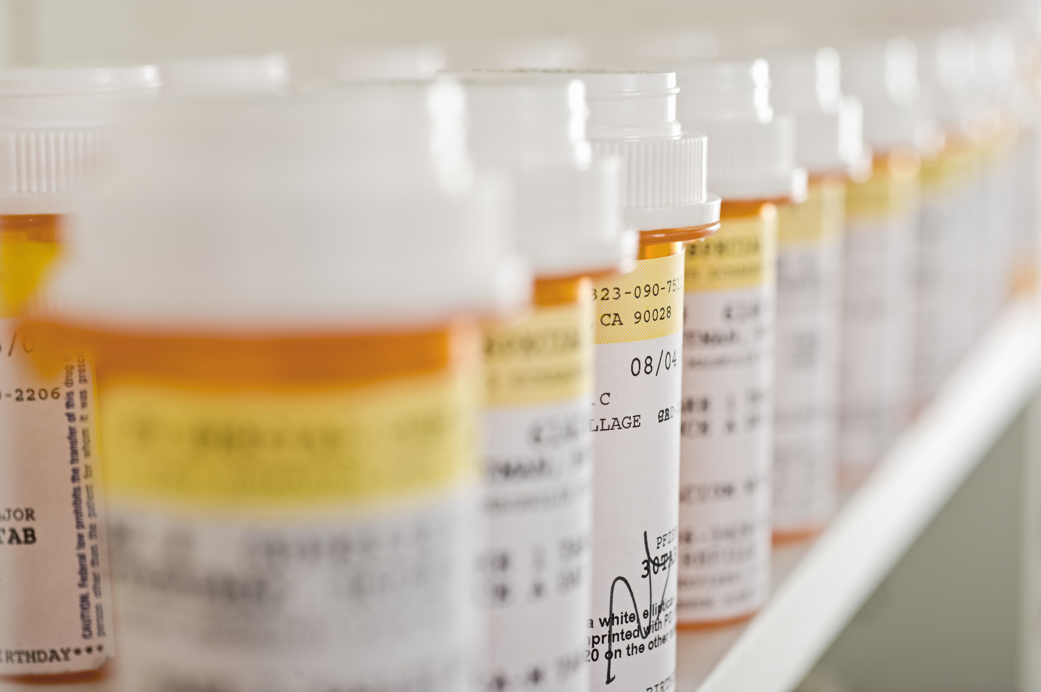
Opportunities - Leveraging Integration for Improved Patient Care
Enhanced coordination of care: Community pharmacies accessing patient records, leading to better-informed decision-making and safer medications management.
Seamless transitions of care: Improved communication between health and care providers facilitates smoother transitions.
Medication management: Pharmacies can assist in medication reconciliation and adherence, reducing errors and improving outcomes.
GP recovery plan: Reducing burden on primary care services, providing easier access to healthcare provision and advice.
Empowering patients: Allow people to engage more actively in their own care, leading to better health outcomes. Public awareness growing that pharmacies are an effective first port of call.

Slide 7
Challenges- Navigating obstacles
Resistance to change: Healthcare professionals may resist adopting new technologies or workflows.
Data privacy and security concerns: Safeguarding patient information is paramount, requiring robust security measures. Ensuring compliance with privacy regulations and safeguarding sensitive healthcare data. Maintaining public trust. The ‘consent’ discussion.
Interoperability issues: Compatibility issues between different systems can hinder smooth data exchange.
Training and education: Successful integration relies on comprehensive training and communication. Effective training and support to successfully navigate ShCRs, emphasising the need for user-friendly interfaces, data and language.
-Liability conversations – CPs required clarity in advance around risk and responsibilities
PharmOutcomes: Long journey, Understanding the resources available in PO and expectations for testing, release, assurance etc.
-Interweave or All approach
-Delivery delays due to approach change and PO competing priorities.
Sustainability & Scalability
Financial Considerations​
​
Community pharmacies need to evaluate the commercial implications of shared care records integration, including investment in technology, staff training, and ongoing maintenance, while assessing the potential return on investment.
Scalability​
​
Fostering scalable solutions that accommodate the evolving needs of ConCRs and community pharmacies, emphasising interoperability with other healthcare systems and the seamless exchange of data across care settings.

Slide 8
Collaboration - maximising benefits
Foster collaboration: Establish clear communication channels
Across the Community Pharmacy sector
Between the community pharmacy sector, healthcare providers, and system suppliers
Between system suppliers and ICSs
Between ICSs trying to solve the same task
Advocate for interoperability standards
Push for industry-wide standards to ensure seamless integration across different systems.
Training and support
Develop training and other materials informed by sector dialogue – sector-specific considerations, right language, maximising relevance
Provide ongoing training and support to community pharmacy staff to optimise system utilisation
Prioritise data security
Implement stringent security protocols to safeguard patient data and address privacy concerns.
High quality collaboration has been pivotal to our collective progress – avoiding assumptions, listening, building mutual understanding and plotting our course together.

Slide 9
How to proceed
Engage and involve stakeholders broadly, inclusively, early and ongoing
Involve sectoral groups – Leics Pharmaceutical Committee and the specially convened ‘Benefits and Insights Group’ were pivotal, also Community Pharmacies more generally
The public
System suppliers: Connected Care Record supplier and PharmOutcomes
Link to policy changes, sectoral ambitions/constraints and pain points
Tune in to motivations, language, and benefits that will resonate
Address Information Governance and common law duty of confidentiality
DPIA, joining existing system-wide ISA, DPA
Build confidence in explaining how data is shared for care using LLR CR
Encourage building ConCR into procedures for confident, consistent use
Providing a reference Standard Operating Procedure, and space for dialogue
Re-use existing integration patterns where possible - share knowledge
Request on-boarding requirements early, e.g. ODS linking to ASID codes
Engagement sessions
Benefits & Insights Group
Training Sessions
IG documentation sign off
ODS codes and ASIDS
Pre go live survey
SOP integrated with local procedures.
Switch on PO link in LLR
Monitor
Post Go live survey
What’s Next?
Community Pharmacy data provision?
Visibility of community pharmacy provision of services to all connected parties.
Collaborative Care Planning?​
​
Opportunities to leverage connected care records for collaborative care planning, enabling community pharmacists to actively contribute to care plans, medication reviews, and therapeutic interventions.
Emerging Technologies​
​
Exploring the integration of emerging technologies, such as artificial intelligence and predictive analytics, to enhance the functionality of connected care records and empower community pharmacies with advanced decision support tools.

Slide 10
​The patients win, the practice wins, the community pharmacist wins, and that’s where this
work has real value, it builds relationships.​
LPC vice chair, PEC pharmacist, 2004
We have patients from 24 GP practices! Once some of that additional information becomes available, we will be able to look at a patient a different way – there will be different levels of information that will be supportive of our day-to-day business.​
Benefits & Insights Group member, 2024
The public will get a more efficient, joined-up service, a better experience, and a lot of time saving. Patient safety is also an umbrella that encapsulates everything we’re doing here.
LPC Chief Officer, 2024

