Slide 1
B2.2 Shared Care Record adoption in Adult Social Care
The Derbyshire Shared Care Record
Andrew Muirhead, Head of Adults Commissioning, Integration and Market Development
16th April 2024

Slide 2
Outline
Background and context
Development and implementation
Use and application in social care

Slide 3
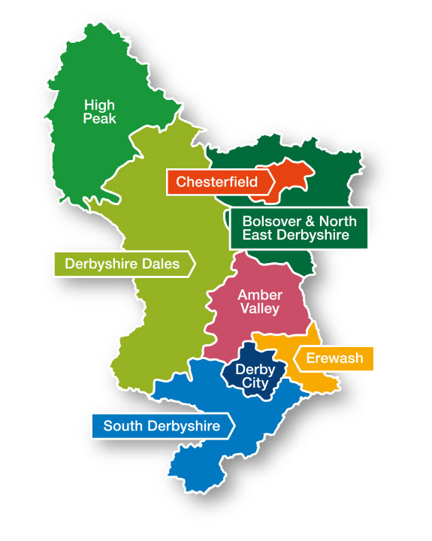
Joined Up Care Derbyshire (JUCD)
Integrated Care System
Derby City Council
Derbyshire County Council
Chesterfield Royal Hospital NHS Foundation Trust
University Hospitals of Derby and Burton NHS Foundation Trust
NHS Derbyshire Healthcare NHS Foundation Trust
Derbyshire Health United (DHU) Healthcare
East Midlands Ambulance Service
Derbyshire Community Health Services NHS Foundation Trust
NHS Derby and Derbyshire Integrated Care Board.

Slide 4
Local history of data and digital innovation
Digitising Social Care
Supporting the adult social care system to make best use of digital technology to improve the quality and delivery of care
Central to meeting the ambitions of the White Paper, ‘People at the Heart of Care’
… but need to get the basics right first!
Digital Social Care Records.
Launched a linked data initiative in 2014/15 to coincide with the introduction of the Better Care Fund, driving integration of health and social care that puts people at the centre of decisions.
Analytical tool developed in partnership with an external supplier, spanning 12 health and social care agencies in Derby and Derbyshire, including both Derby City and Derbyshire County Councils.
Laid some good foundations…

Slide 5
The journey
Intended benefits
April 2021 Benefits Workshop:
Why, who, how, ownership, and connectivity with strategic objectives.
For social care, doorway open to NHS records that would enable holistic decisions and minimise sourcing of information from multiple other professionals/ settings.
Centred on our Home First, Carelink (telecare), children’s residential, and customer call centre (Derby Direct).
IG and IT critical to realising all of the above.
July 2020 - JUCD Board approved an accelerated procurement to select a supplier and enable a proof-of-concept DSCR inc. analytics platform.
January 2021 - contract awarded to Orion Healthcare, but without the analytics…
Multiagency Board established to oversee delivery and implementation across multiple phases, inv. benefits realisation strategy.
Individual meetings held more frequently to pursue the technical development (weekly for DCC).
Ambitions for Social Care to be integrated in Phase 2 (possibly by Jan 2022).

Slide 6
Technical requirements
Derby City Council are users of Liquidlogic case management systems (LAS & LCS). Derbyshire County Council use Mosaic. Initially had to complete a detailed adults and childrens data exporter specification and set role-based access for SSO for workers.
Implementation was not without its hitches!
We made some local assumptions and initially completed the spec in a manner that made sense to us but caused duplicate/ unwanted data fields. We adopted the MESH mailbox instead of SFTP for transferring our daily updates, that provides additional monitoring. The DSCR opens as an I-frame rather than a new window, which resulted in us changing the way we publish our apps.
Essential that we tested every aspect, specifically with social care workers who are familiar with the system, know what to expect/ look for, and would recognise the value in new data availability.

Slide 7
Social Care Data Exporter
DATA FIELDS
Approx. 15,000 records in the initial Person Extract dataset…
- Referral - Related Person
- Alerts - Social Worker
- Disability - Care Plan details
- Demographics - Service Provision
- Events - Event Type
Derby City Council exports data to Orion Health via an exporter tool provided by Liquidlogic, on an overnight feed.
The exporter tool contains query builders that point to appropriate SQL tables in our data warehouses, and creates 10 individual csv files…
Event Types
DOLS
Assessments
Safeguarding (inc. Quality)
Hospital admission/ discharge
Events
Description
Start/ end dates
Reason for event
Status, and latest status change
Referral
Referrer
Responsible Team
Reason for referral
Description
Dates

Slide 8
Roll forward January 2023…
Demonstrations
Key message received from front-line teams was the importance of having drop-in sessions, to see the system first-hand and understand how to navigate around it.
Facilitated by the JUCD DSCR team over a couple of dates in the Council House…
Generated long queues!
GO LIVE - 26th January 2023 for adult social care, still progressing for childrens social care.
Used various comms channels to cascade messaging and give practical hints & tips, including via the JUCD delivery team who gave demos and talks.
Important that colleagues felt supported in accessing the DSCR and in being able to feedback on any issues, both technical and concerning information they were accessing/ reading, to the appropriate teams.

Slide 9
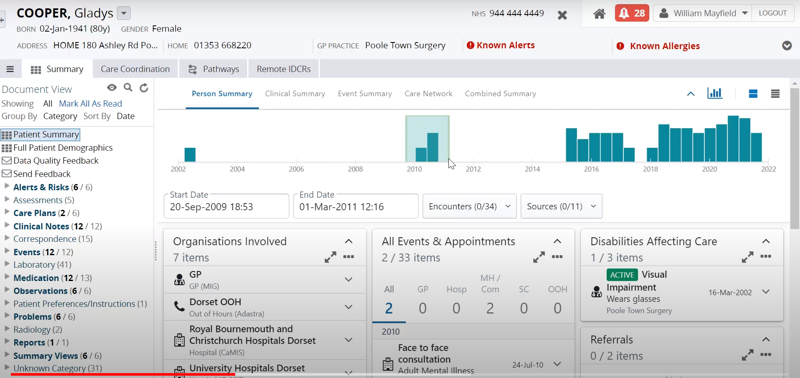
DSCR Dashboard

Slide 10
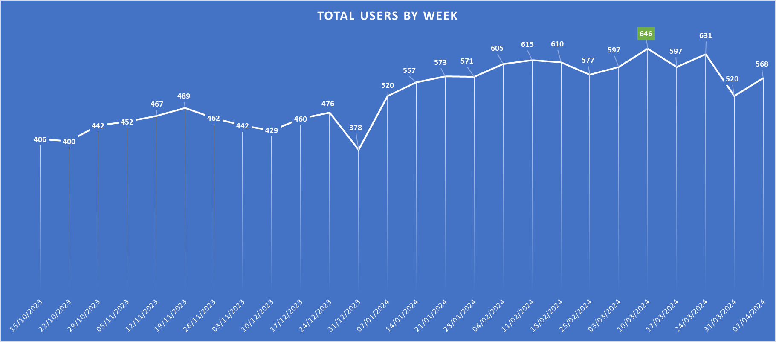
Usage Stats

Slide 11
Application in practice
Fundamentally, this is about normalising health content within our social care case management systems.
the rule, not the exception…
That said, the DSCR has provided opportunities in some significant areas of work:
Community Mental Health Transformation Programme
Support to Carers (Accelerating Reforms Fund for adult social care)
Integration - Home First and Reablement Services.
Whilst it is still an ambition, it has also provided a vehicle for a more considered conversation about supporting the local care market to adopt digital record solutions i.e. Digitising Social Care.

Slide 12
Any questions?
Thank you for listening.
Andrew Muirhead, Head of Adults Commissioning, Integration and Market Development
16th April 2024

