Slide 1
B1.3 Aligning SHCR with ICS priorities Lee Rickles : North Yorkshire & Humber ICB

Slide 2
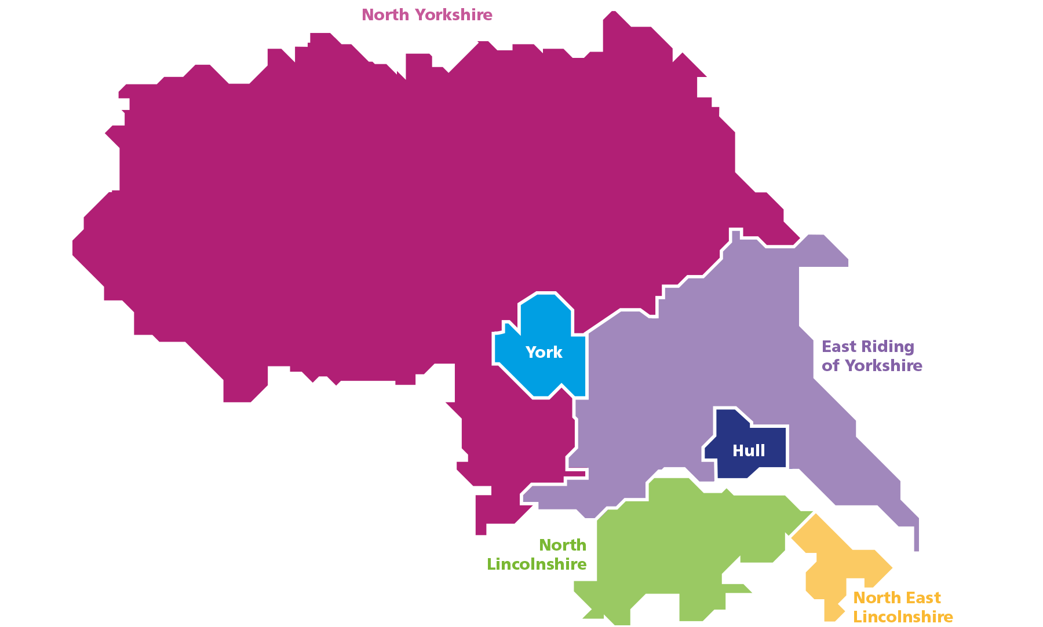
Humber and North Yorkshire
1.7 Million Population
6 Local Authorities
6 Places
4 CICs
7 Trusts
5 Collaboratives
2 Ambulance Trusts
Many Others

Slide 3
Understand NHS Priorities
Research: Familiarising yourself with the latest ICS priorities.
Engage Stakeholders: Talk to relevant stakeholders, such as clinicians, social care, managers, and patient groups. You need to understand their specific needs and challenges.
Technical Considerations: Only the digital teams are interested in technical impact and digital maturity. The rest of the systems thinks about costs and resources.

Slide 4
Our Aim
Narrowing the gap in healthy life expectancy by 2030
Increasing healthy life expectancy by five years by 2035
Our Outcomes
Start Well
Live Well
Age Well
Die Well
Our partnership ambitions
Enabling wellbeing, health and care equity
Transforming people’s health and care experiences and outcomes
Radically improving children’s wellbeing, health and care
Our person-centred and strengths-based approach means we:
Think Person
Think Family
Think Community
Our big 4 health outcome priorities
Reducing harm from cancer
Cutting cardiovascular disease
Living with frailty
Enabling mental health and resilience
Our drivers
LEADING FOR EXCELLENCE
1. delivery improvement
2. digital and data
3. an enhanced role for collaboratives
LEADING FOR PREVENTION
4. enabling population health
5. a new relationship with place
LEADING FOR SUSTAINABILITY
6. system workforce
7. sustainable estate / net zero
8. outcomes-led resourcing 5year pace of change plan
VOICE AT THE HEART 9. transformative public engagement;
10. a strong and impactful system voice (professional, political)
Let’s get better together

Slide 5
Investing in the drivers
LEADING FOR EXCELLENCE
1. delivery improvement
2. digital and data
3. an enhanced role for collaboratives
LEADING FOR PREVENTION
4. enabling population health
5. a new relationship with place
LEADING FOR SUSTAINABILITY
6. system workforce
7. sustainable estate
8. outcomes-led resourcing
VOICE AT THE HEART 9. transformative public engagement;
10. a strong and impactful system voice (professional, political)

Slide 6
Align your Goals
Map Goals: Once you understand the priorities, see how your programme's goals can directly address them.
Focus on Efficiency: Many priorities focus on improving efficiency and reducing waiting times. Consider how the SHCR can streamline processes or improve access to services.
Patient Centricity: Ensure your programme prioritises patient experience and outcomes.

Slide 7
Benefit Personas with Projected Values: Validated by North Yorkshire Council, Hull City Council, & North Lincs Council
Adult Social Care (ASC.01): Time savings by removing need to phone GPs and Trusts for Client Information
BENEFIT IN BRIEF
BENEFIT METHODOLOGY
PROJECTED BENEFIT VALUE
Social Workers make an average of two telephone calls per day, to various health care settings, to obtain critical information about their clients.
For social workers, in ASC, access to the YHCR data via the Interweave Portal, removes the need to contact GP practices and NHS Trusts to find out important health information about the people in their care.
An average of 22.5 minutes is saved every time this information is required by removing the need to make phone calls and spend time waiting in call queues.
Data Points:
The average time spent on the phone each time information is required from a GP/Trust is 22.5 minutes
Two calls are made per day equals 45 minutes
Adult Social Care staff on Grade K average salary is £19.06 per hour (calculated from a mid-point in the pay scale)
An allowance has been made for Focus ASC to only apply 50% of the benefit to reflect existing SystmOne access
Assumptions:
The number of staff with access will start at 100 and increase every six months (capped at 1,000 users) this will apply for NYC
For the remaining five ASC the number of staff with access will start at 100 and increase every six months (capped at 200 users)
The percentage of staff who access the Interweave Portal twice daily will start at 10% and increase every six months by increments of 10% this will apply to all ASC
The combined projected annual benefits of all six ASC providers in HNY based on a phased roll-out and benefit start date: HCC, NYC, ERYC, NLC, CoYC and Focus Adult Social Care:
Year | Efficiency Savings | Time in days
FY23/24 | £685,920 | 4,800
FY24/25 | £1,714,800 | 12,000
FY25/26 | £3,018,048 | 21,120
FY26/27 | £4,595,664 | 32,160
FY27/28 | £6,447,648 | 45,120
Total over 5 years | £16,462,080 | 115,200
‘'I had a safeguarding case whereby the person was suspected of having an insulin overdose. We could see from the YHCR how often the nurses attended, and they had regular input, it also has the history of insulin abuse from the client in the past. Although a meeting had to be held and further conversations needed about this incident, access to the YHCR cut call times down as the information was readily available.’
Eleanor Namih - Team Manager – North Lincolnshire Council

Slide 8
Implementation and Evaluation
Pilot Testing: Pilot test your programme in a controlled setting before full rollout to identify and address any issues.
Change Management: Develop a change management strategy to ensure user adoption and minimize disruption to existing workflows.
Evaluation: Continuously monitor and evaluate the programme's impact on NHS priorities. Be prepared to adapt based on feedback and data.
Communication

Slide 9
Humber and North Yorkshire
Humber and North Yorkshire
Yorkshire and Humber Care Record MVS 2.0 Programme
Shared Care Record Showcase
Usage Stats
200-300
Patients benefitting from enhanced sharing across HNY
Month on month increase in Shared Care Record usage
New EPaCCs created each month
1.7m
103,595
GP Connect views per month via York & Scarborough Teaching Hospital, Harrogate District Foundation Trust, Northern Lincolnshire and Goole NHS Foundation Trust and Humber Teaching Hospital
5000
Health and Care IT systems interacting with the YHCR
User logins per month via the Interweave Portal
13
Patients dying in their preferred place of death increasing from
1/3 to over 1/2

Slide 10
Humber and North Yorkshire
Humber and North Yorkshire
Yorkshire and Humber Care Record MVS 2.0 Programme
Shared Care Record Showcase
Consumer Projects successfully delivered since April 21
GP
Practices
Local Authorities
Acute
Trusts
157
5
4
26
Police
Custody
Suites
Organisations interacting with the YHCR
Safeguarding
Team
Private
Hospitals
Care
Home
Hospices
3
1
2
5
1
FHIR resources live across Provider organisations since April 21
Community
Health Care
Service
Mental
Health
Trusts
Ambulance
Services
30
1
2
2

Slide 11
You need to get to Yes
Know the people, have a clear value proposition and be will to pivot as requirements change
Thank you

