Slide 1
B1.2 Discharge, Capacity and Flow
Dan Hughes, Yemisi Bakare and Sarah Farragher
Our Care Connected NHS Sussex

Slide 2
Agenda
The problem
What we did
Transfer of Care (ToC) Dashboard
How this supports Transfer of Care Hubs
Principles
ToC Dashboard Delivery
Successes and Challenges

Slide 3
The Problem- April 2023 (Discharge Frontrunner)

Slide 4
What we did...
Work to establish a ToCH was being undertaken simultaneously and the need for a digital solution was identified (pressure to do this at pace)
Explored off-the-shelf options and solutions elsewhere
Identified viable solution- Patient Vision from North Cumbria and worked collaboratively to understand technology behind it
Designed an MVP solution in the Plexus Shared Care record taking into consideration capabilities of each partner to share discharge information
User Centred Design process to understand the problem
Who are the users?
What information do they need?
What information can they share?
Where is the information stored? etc.

Slide 5
Tool should pull the relevant data feeds from the system(s)
Provide a mix of free text and filter options
Have functionality to filter by current location (acute, community bed, D2A bed, home)
Generate referrals and/or enable “pulling” of people into services
Transfer of Care (TOC) Dashboard
Acute patient record
Transfer of care dashboard
Community patient record
Adult social care customer data base

Slide 6
How this supports Transfer of Care Hubs (ToCH) 1
Track people from acute, though community beds and discharge to assess
Brings together prepopulated data and live planning tool
Functionality to look at patient level outcomes and feed data reporting
Replaces existing spreadsheets and not go out of date

Slide 7
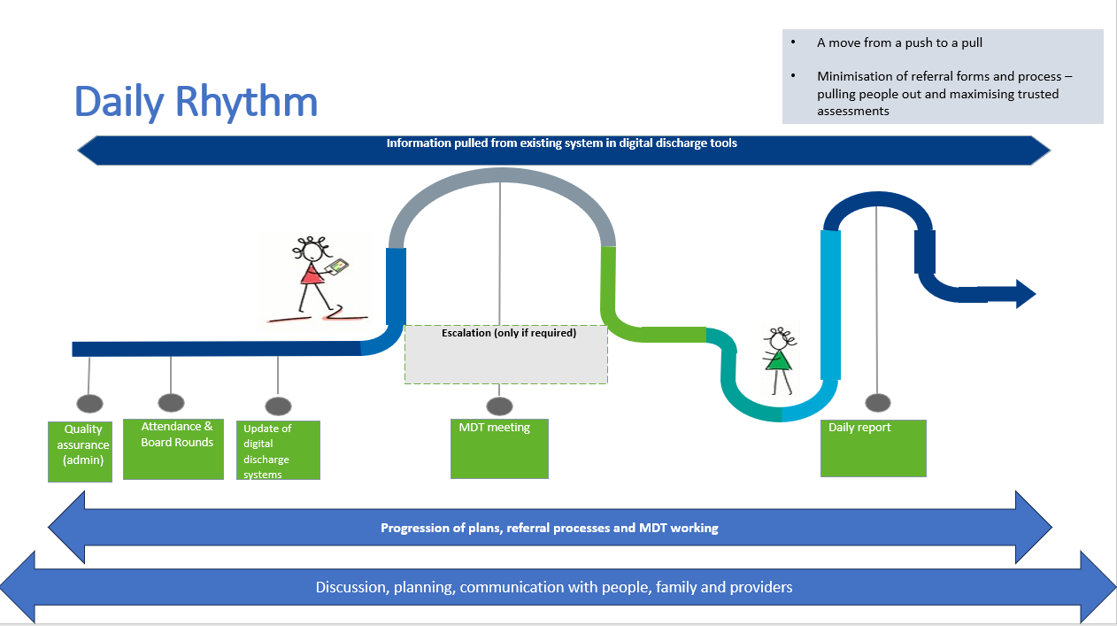
How this supports Transfer of Care Hubs (ToCH) 2

Slide 8
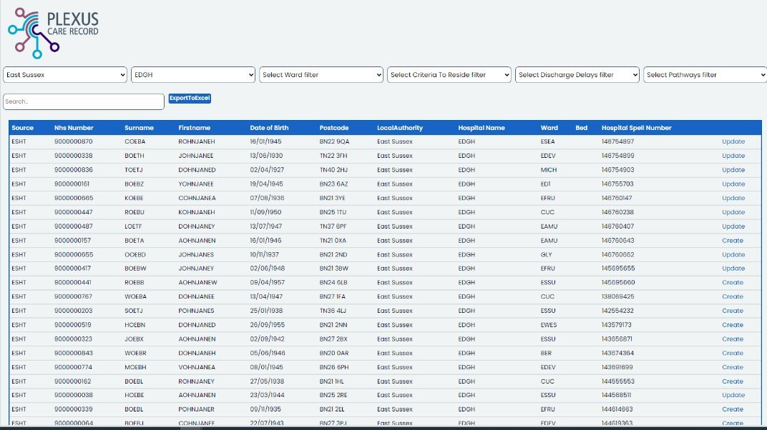
Principles
First iteration pulls from USHX, ESHT and SCFT – will look to pull from Local Authorities, D2A providers and SASH in future stages
Data is updated in source systems wherever possible – no write back but reporting to advise of MDT alterations
The ToC dashboard supports a new daily rhythm for discharge, this varies slightly by Place or site but is based on a single version of the truth
The process is iterative but replaces spreadsheet use!!

Slide 9
Delivery
Operational use commenced- 9th April 2024
Test version of dashboard- October 2023
Multidisciplinary team engagement- Every 2 weeks started Mid-October
Phased delivery of data from Trusts- November - February
ESHT data- November 2023
SCFT data- December 2023
UHSx data- February 2024
Onboarding of users- 300+ NHS and Social Care staff - February- March 2024
Discharge Frontrunner Programme commissioned dashboard April 2023

Slide 10
Lessons Learnt
Successes
Early engagement with partners around data sharing
Collaborative working amongst partners
Subject matter expert that had worked with a similar system
Daily call with partners technical team members
Communication of information through organisation hierarchy
Include example data in the data specification
Develop a feedback process for the product in live
Incurred extensive technical debt
Challenges

Slide 11
Thank you
Dan Hughes Programme Director
Our Care Connected
dan.hughes2@nhs.net

