Slide 1
B1.1 Transforming maternity services through shared records Lisa Sewell: Programme Director, Great North Care Record Alice Butler: Chief Midwifery Information Officer, NENC LMNS Dr Phil Stamp: Regional Clinical Safety Officer, GNCR and NENC ICS Jill Watson: Senior Project Manager, Great North Care Record
Notes:
Lisa – to introduce and open slides

Slide 2
Who we are
The North East and North Cumbria ICS is a partnership of organisations including local councils, voluntary and community services that provide health and care across our region. It is the largest ICS in England, supporting a population of 3.2 million people.
Led by the NHS Integrated Care Board (ICB) we are working collectively to join up resources and expertise to provide the best health and care for local communities.
An Integrated Care Partnership (ICP) is also being established. This is a committee of the ICB and the 13 local authorities from across the North East and North Cumbria.
Notes:
Lisa

Slide 3
Who we are
Notes:
Lisa

Slide 4
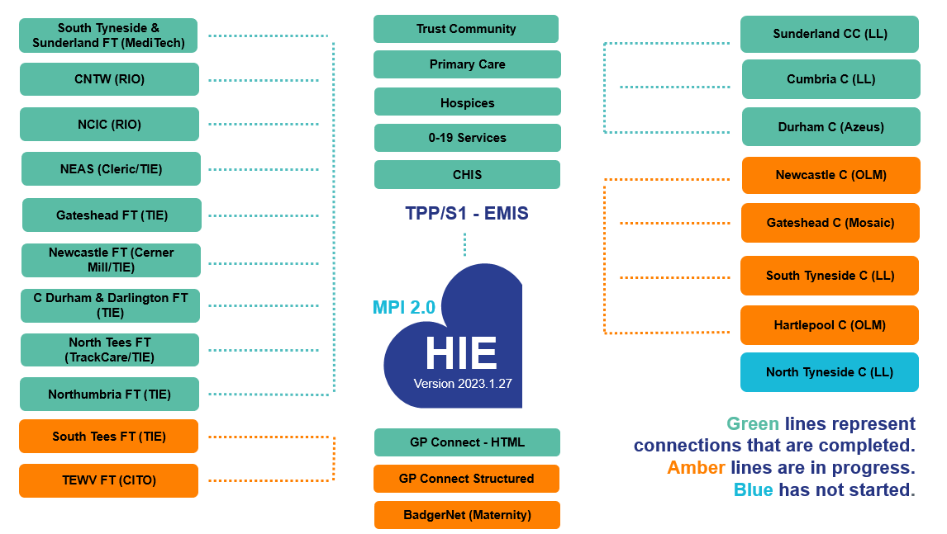
Who we are
Notes:
Lisa

Slide 5
Leaving your club colours at the door
Notes:
Lisa

Slide 6
Impact / Safety
What has been the impact of the GNCR?
How we did it
Safety of the system
What we did. Decisions we made. The output of it. Working with GNCR team support.
Best and safest way to display
Safety led co-design approach and rationale
Notes:
Phil

Slide 7
Who gets the value?
- Improved experience for citizens using different services in the region:
- specifically for maternity service users, wherever they receive care in the region - Enhanced, more efficient and effective staff experience: a holistic record available, so all professionals are informed – no need for service users to repeat themselves
- Clinical perspective, use case, outside of maternity
- Strength of digital midwives, CSO training and accreditation
Notes:
Phil

Slide 8
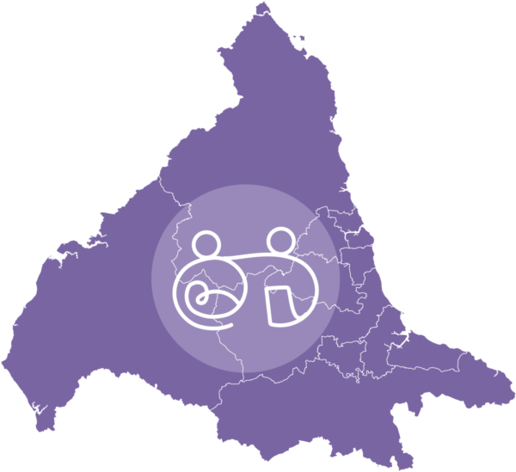
How do we work together to create a Learning Health System?
Do once.
Do well.
Do together.​
Notes:
Alice

Slide 9
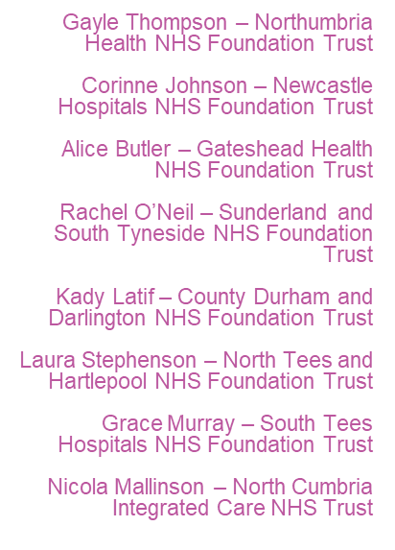
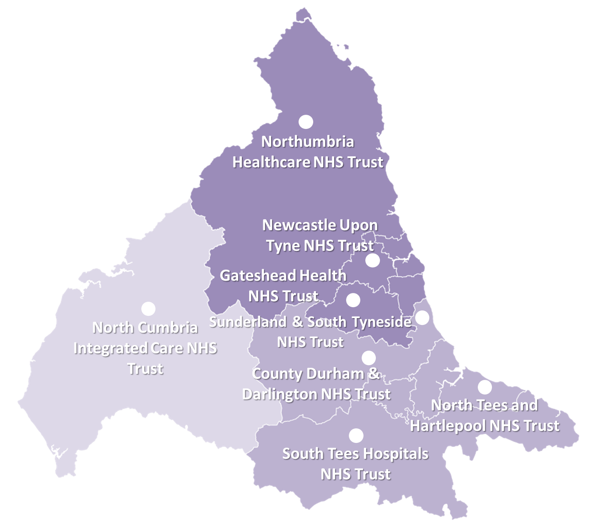
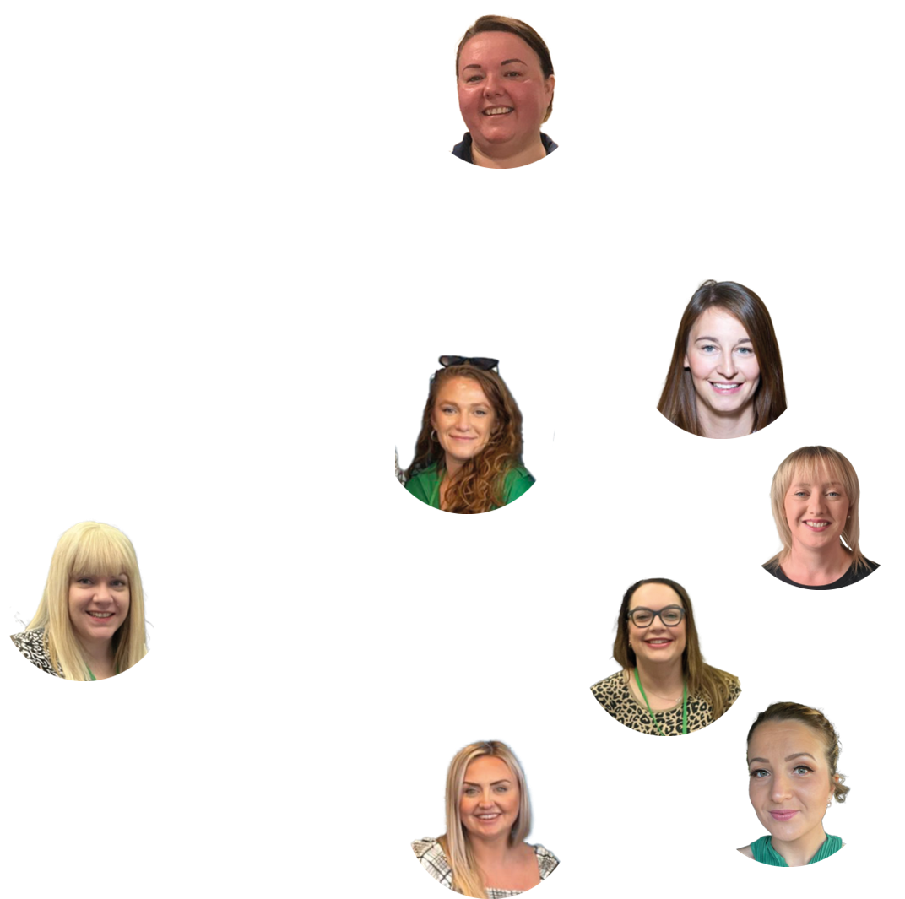
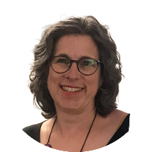
Our digital midwives community
Lou Wilson – LMNS Digital Strategy Lead
Notes:
Alice
Leave in – AB to check if any other relevant info

Slide 10
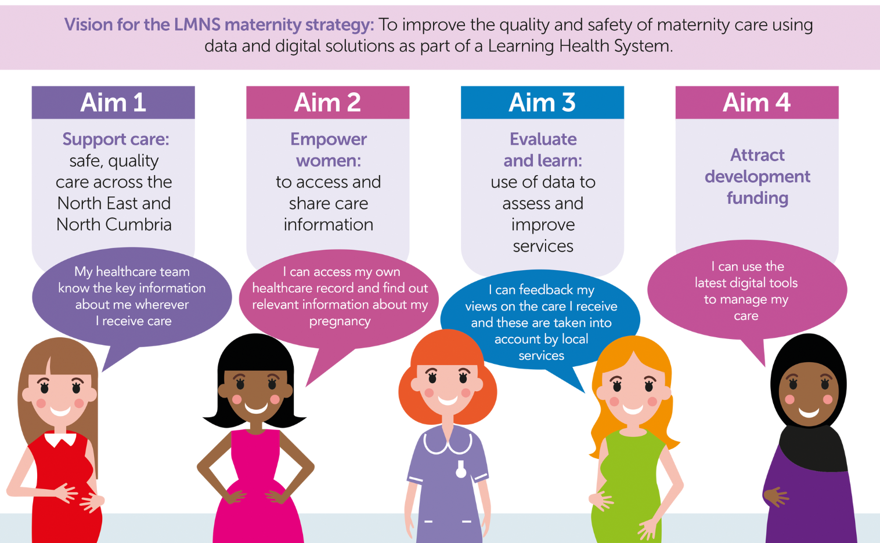
Digital maternity strategic aims
Notes:
Alice

Slide 11
Maternity health and care partners: A collaborative approach
The North East and North Cumbria ICS covers a large geographical area.
3 Ambulance Services
neonatal 1
parent advisory group
10 alongside/co-
located midwifery led units
26,000
births a year
7
local neonatal units
1
Single maternity EPR system across trusts
7
free standing/standalone midwifery led units
3
neonatal intensive care units
10 obstetric units
8 provider trusts
10 maternity voices partnerships
Notes:
Alice

Slide 12
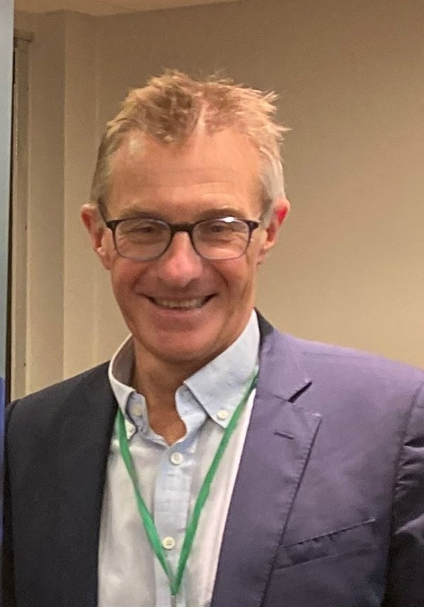
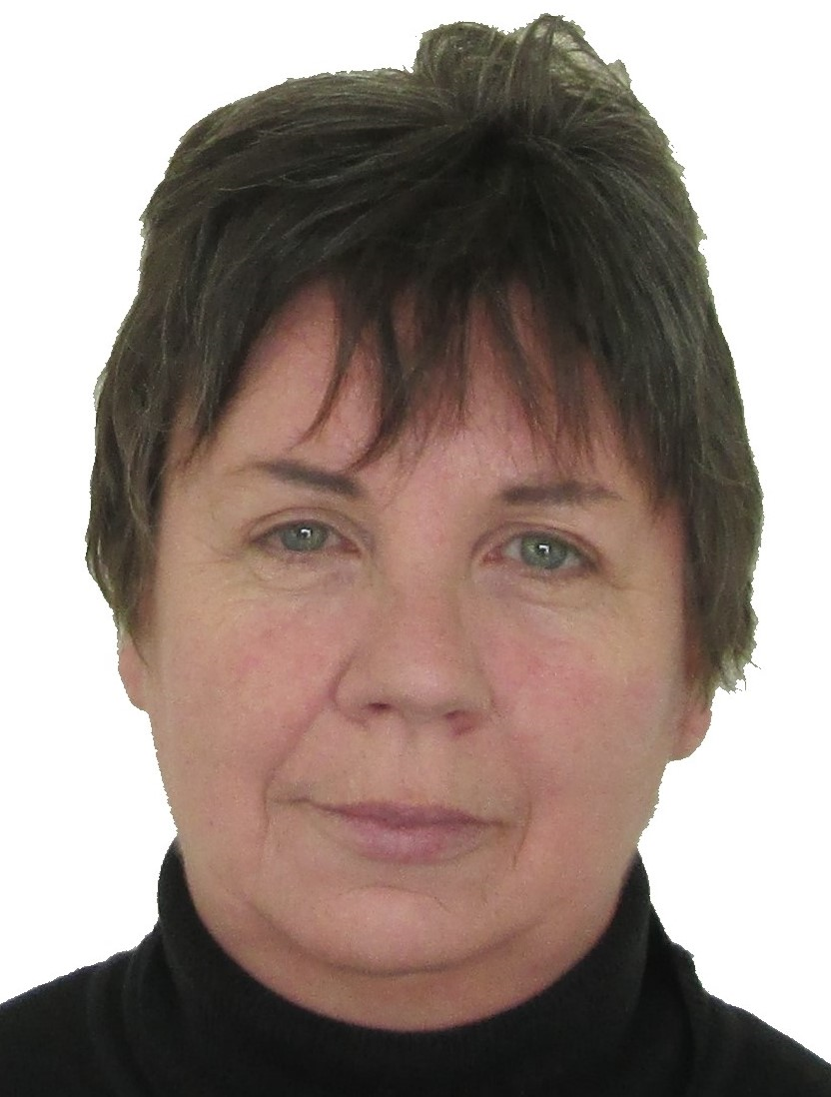
Working together with our service users
“Our North East and North Cumbria maternity and neonatal community is in a unique position to utilise the best of digital to improve clinical, relational and experience outcomes for women and families.
“By working together as a system, we can better collectively learn, understand and improve across pathways and organisations.”
Professor Steve Robson, Digital Strategy Steering Group Chair, NENC LMNS
“Service users were involved with designing the GNCR maternity record and easy read versions of the maternity records information. Another way we have kept our service user voices involved was through jointly briefing the NENC maternity engagement group about GNCR and maternity dataset work, as well as being involved in a digital inclusion workshop and a short film.
“Service user voices are key to making sure technology works for everyone.” Cathy Harvey, NENC Digital Strategy Steering Group Lay Rep
Notes:
Alice

Slide 13
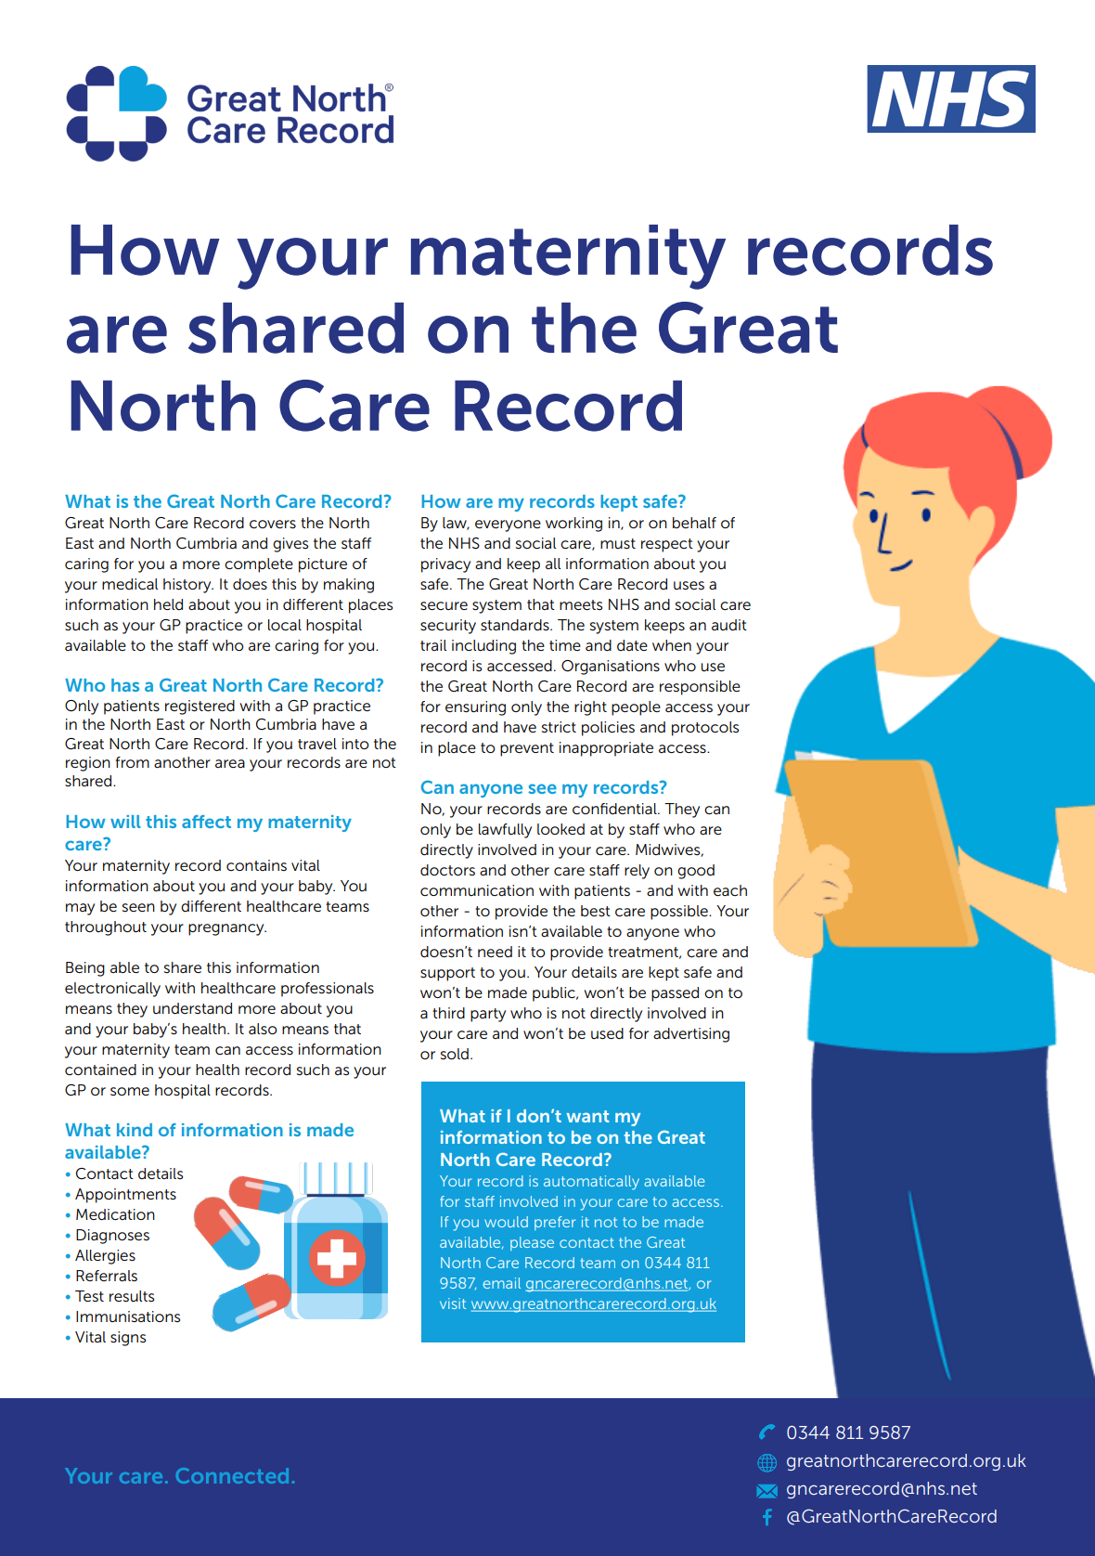
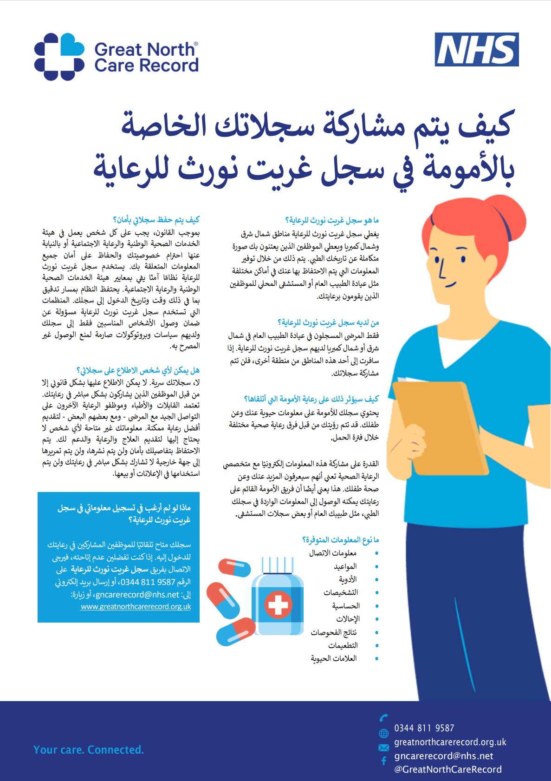
Inclusive public facing communications
Notes:
Alice

Slide 14
How did we do it?
Notes:
Alice. Phil. Lisa
Backroom staff. Technical side set-up. Jill – BadgerNet Maternity profiles, working with suppliers
Do once, do well, do together

Slide 15
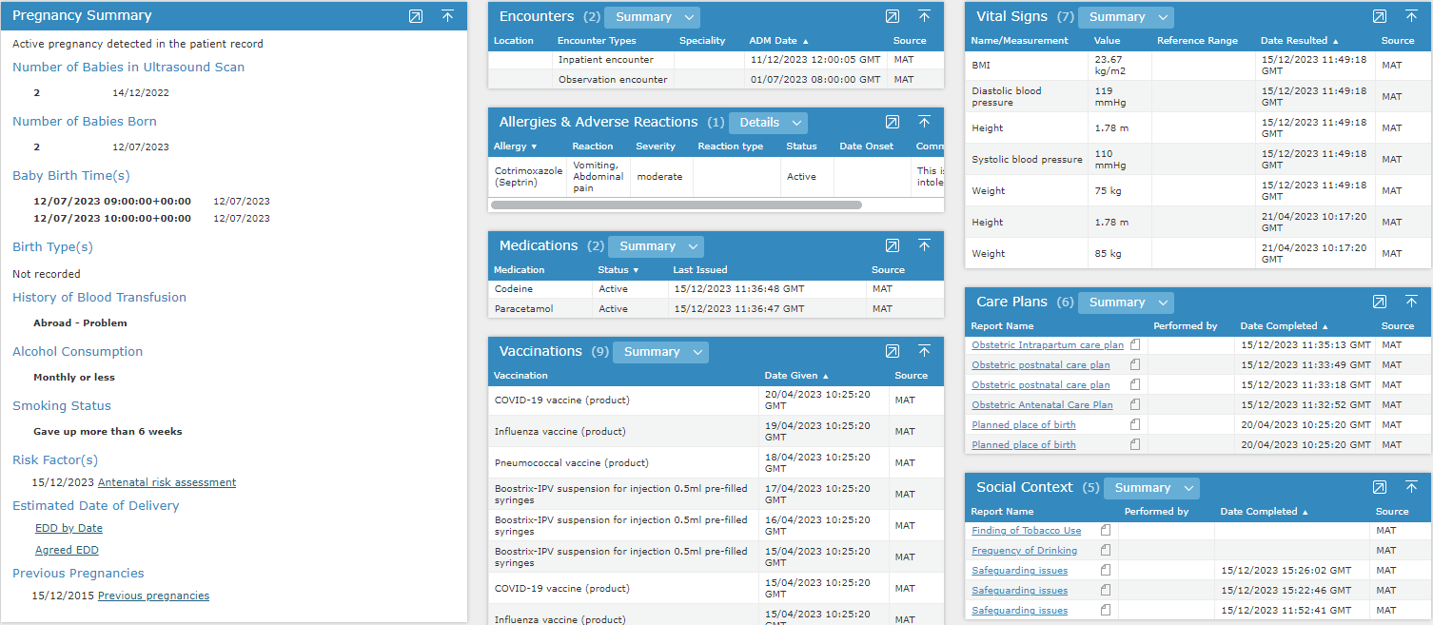
How it looks
Notes:
Jill – pregnancy front and centre. This appears instantly, big widget. Nice visual. Complex history.

Slide 16
Have we said something that could help you?
How to follow us
Blueprint: The plans and specifications we used
Happy to share how we did it and share the learnings
Email us:
nuth.gncr@nhs.net
Twitter / X: @GreatNorthCare
LinkedIn: Search Great North Care Record
Notes:
Lisa + Phil GNCR developing blueprint.
Team NENC. Have we said something which has helped you. Inspiring others. More of coach.

Slide 17
Thank you
Contact us: Lisa Sewell - lisa.sewell3@nhs.net Alice Butler - alice.butler4@nhs.net Dr Phil Stamp - phil.stamp@nhct.nhs.uk

