Slide 1
Emma Robertson
01/10/1981
6113857S

Slide 2
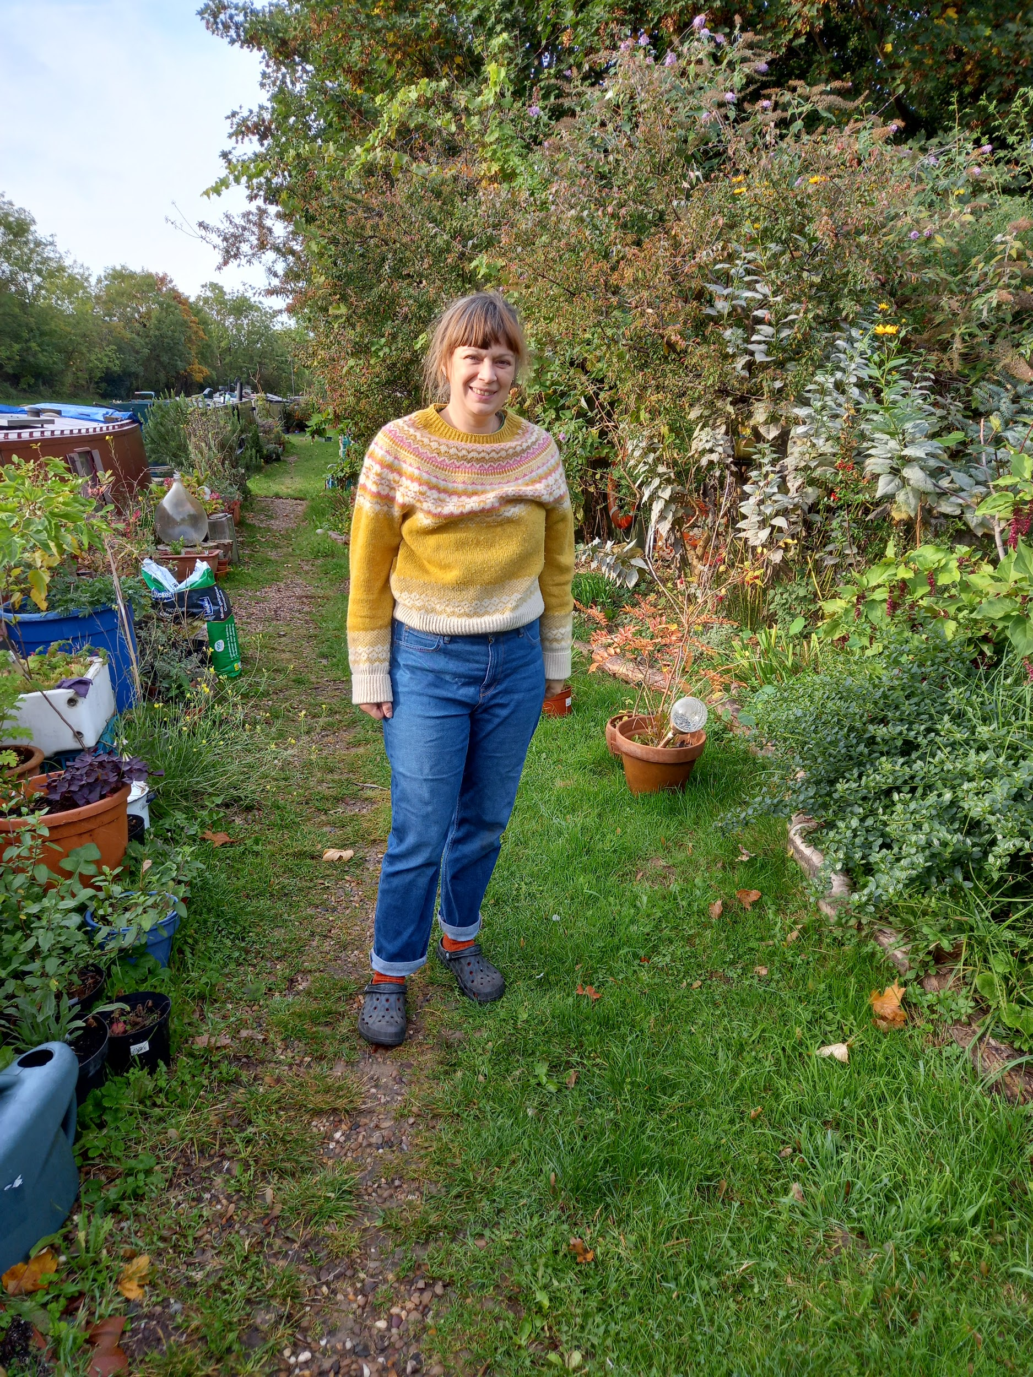
Hi! I’m Emma. And I am “just a patient”…
I live on an old narrowboat in West London.
I love gardening on our mooring.
I keep chickens and bees, and I am addicted to knitting…

Slide 3
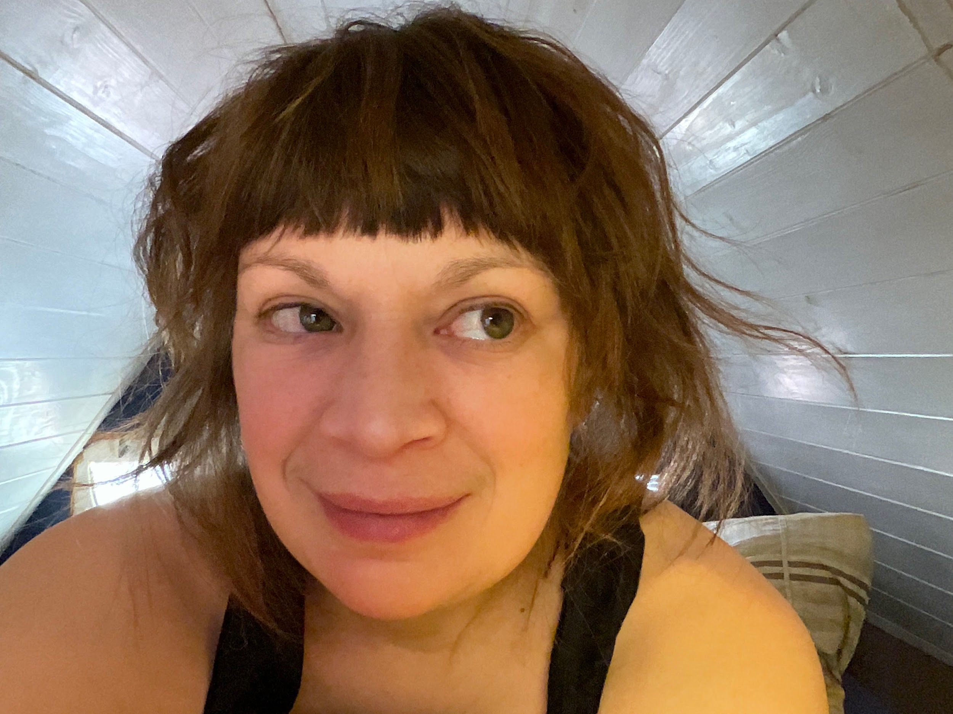
It’s the data
stupid!

Slide 4
Who put the spanner in the works?
Sod’s Law states that if a thing can go wrong it will go wrong.
Finagle’s Law adds that it will do so with the worst possible timing.
When this happens you need a brilliant nurse.

Slide 5
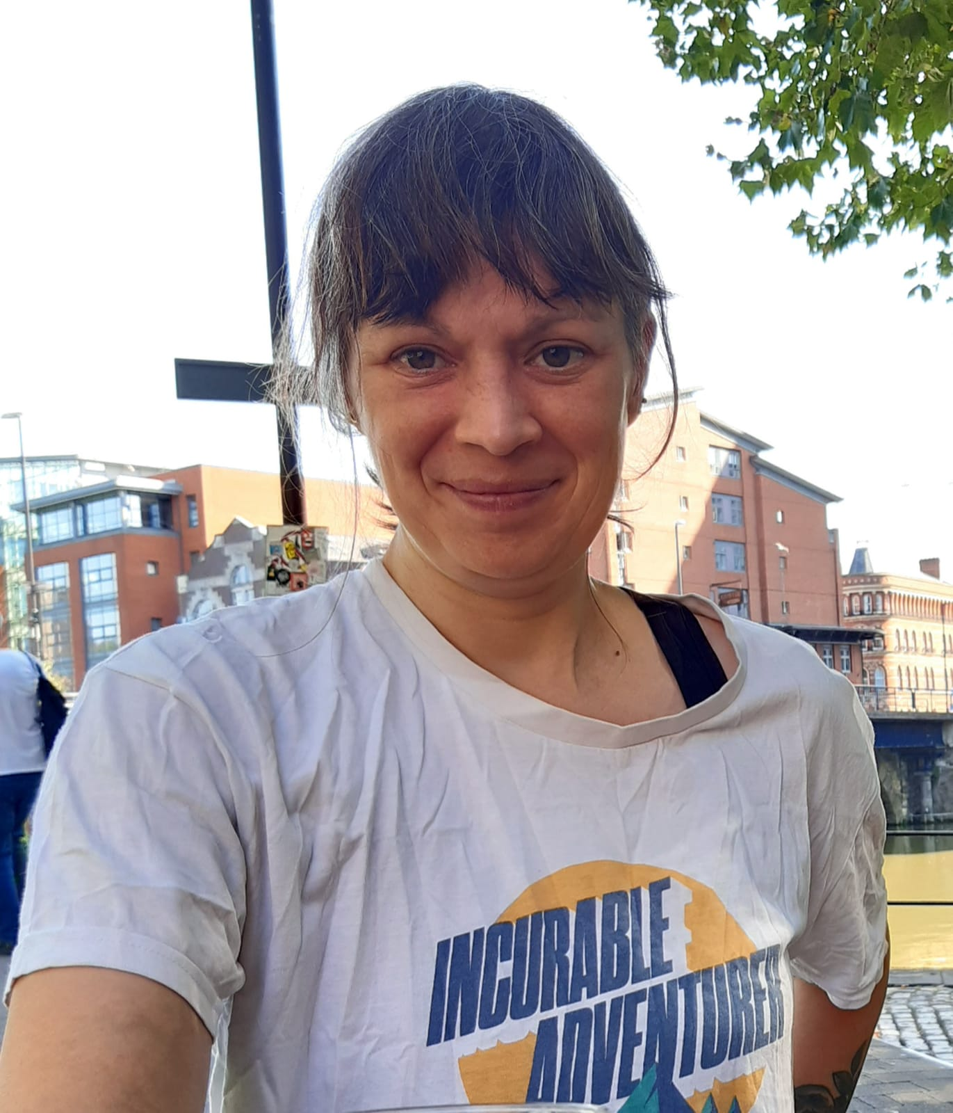
Keeping the smile on my face
I’m not curable.
I will always be a cancer patient.
Every member of my healthcare team is important to me.
If you smile, I’m gonna smile right back.

Slide 6
Thank you for listening to Patients!

