Slide 1
A3.2 Where are we at with the national architecture ? Gary McAllister

Slide 2
National Record Gateway (NRG)

Slide 3
The OneDigital Architecture

Slide 4
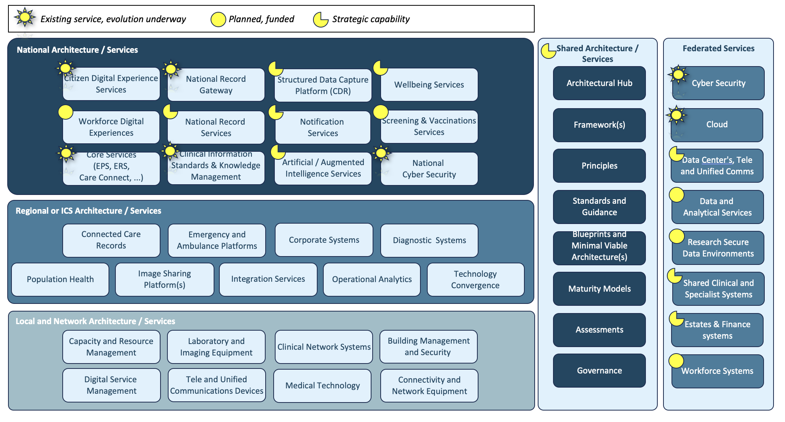
The Proposed National Architecture
Over the last 12 months I have been working with NHS-England on the ‘OneDigital Architecture’
This provides the capabilities needed across health and care and raises aspirations for the future.
Note, this has not been approved as yet – and may never formally materialise. I am happy to share the draft.
Politics ☹

Slide 5
The Proposed National Architecture – key for today
National Record Gateway – a national service that provides a single point of access to health records from known health and care settings. Provides a national solution to fully connect Shared Care Record solutions, imaging systems and other interoperability services. Also delivers federated systems to enable regional or local solutions to share information across boundaries. Delivers the National Health Information Exchange leveraging international standards.
National Record Services – the services that support capturing and storing elements of a patients’ record such as Appointments, Allergies, Procedures, Diagnosis, Treatments and Medications at a national level. Will form the core patient record into the future and will ensure simplification that delivers both new functionality and migrates existing services – for example, GP Connect, Transfers of Care, and the National Care Records Service.

Slide 6
Connecting Care – Together

Slide 7
But first, the debate – the National Record Locator
National Record Locator
A directory of pointers
1
2
Register a document
(pointer)
Query for a patient
(NHS Number)
Source System Document
Registration
Consuming System
Registration
Get document based on pointer registration
3

Slide 8
Why is it like this?
The current challenge
There is no national architecture to connect ShCRs
The old view of the centre was to not store clinical data – this needs to change
NRL was a quick win – in 2016 to enable the sharing of information.
There is ~300k document pointers in NRL.
There is no consensus (and way too many voices) in the centre as to how best progress interoperability.
The issue
It’s a registration approach for pushing single documents – it was not designed for record sharing.
It is not compliant with international standards (although it is not far off) – but uses FHIR – and is still document centric.
‘Older’ IHE compliant systems (XDS) cannot interact with the approach as it’s a different architectural pattern.
There is not a single information model for the sharing of health records – although the International Patient Summary is a good place to start.
We need a pattern that support dynamic availability of data across ShCRs so as local services evolve this data is available everywhere.
The opportunity
The ShCR community should take on this challenge and look to join all of the ShCRs together, together.

Slide 9
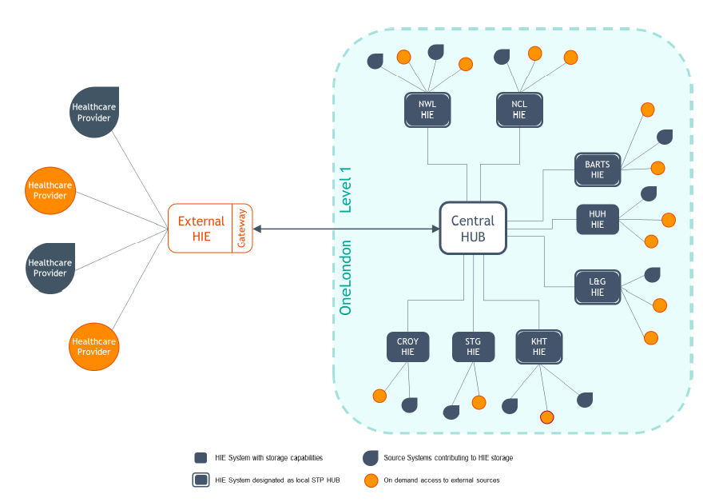
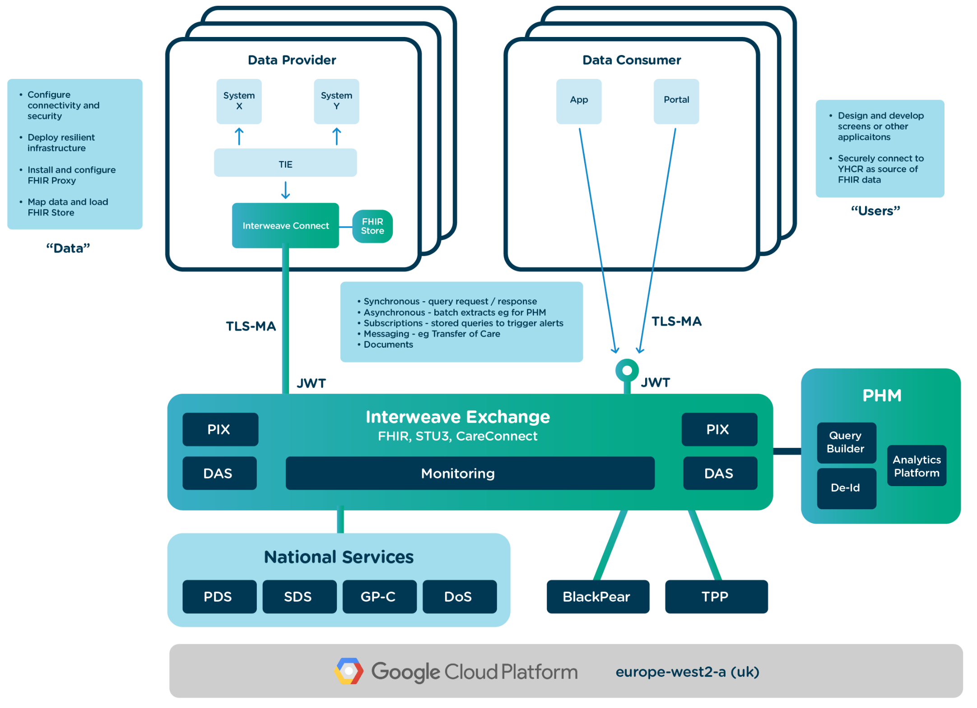
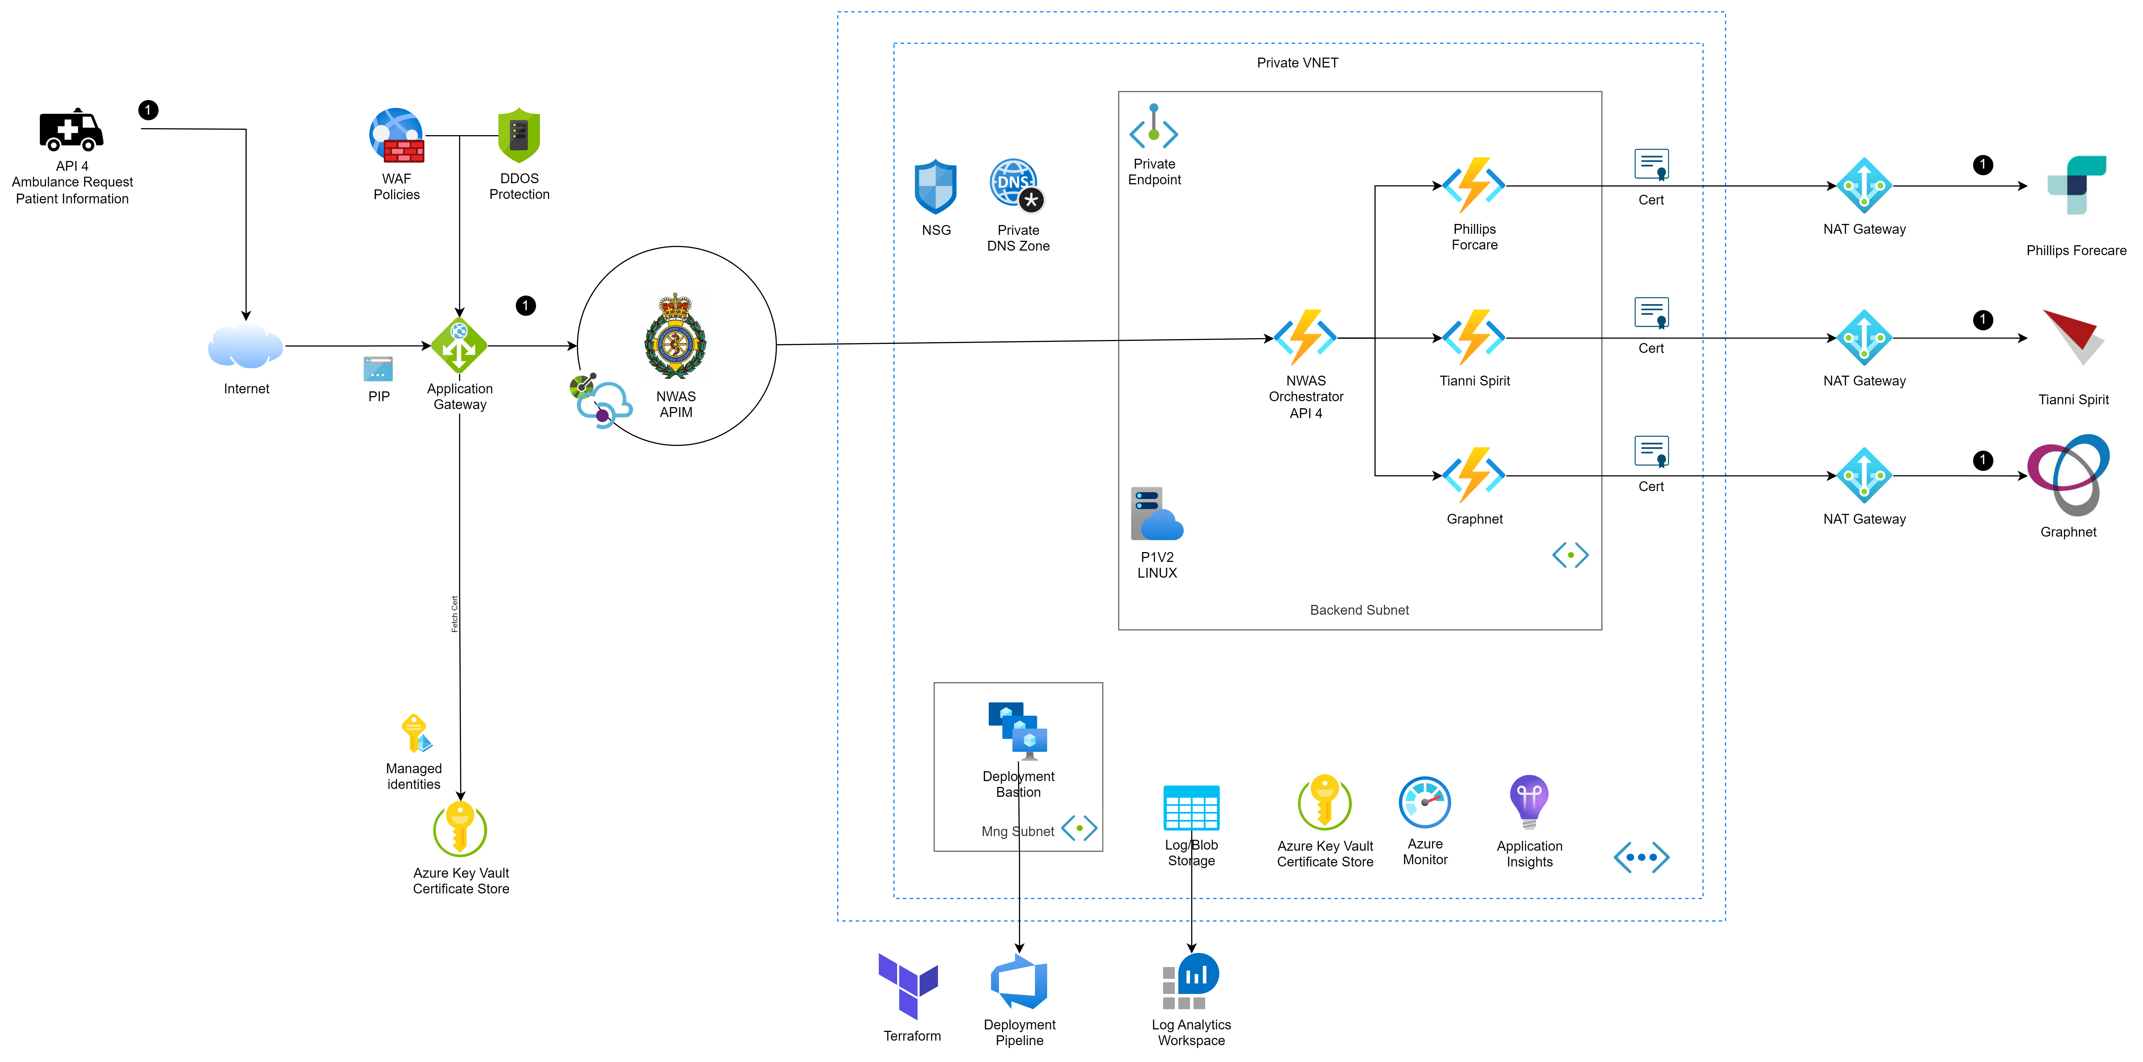
Why is it like this?
The real challenge…
No single Shared Care Record works the same, three examples.
InterWeave
FHIR Hybrid
OneLondon
IHE+
PRISM
Lots of things ☺

Slide 10
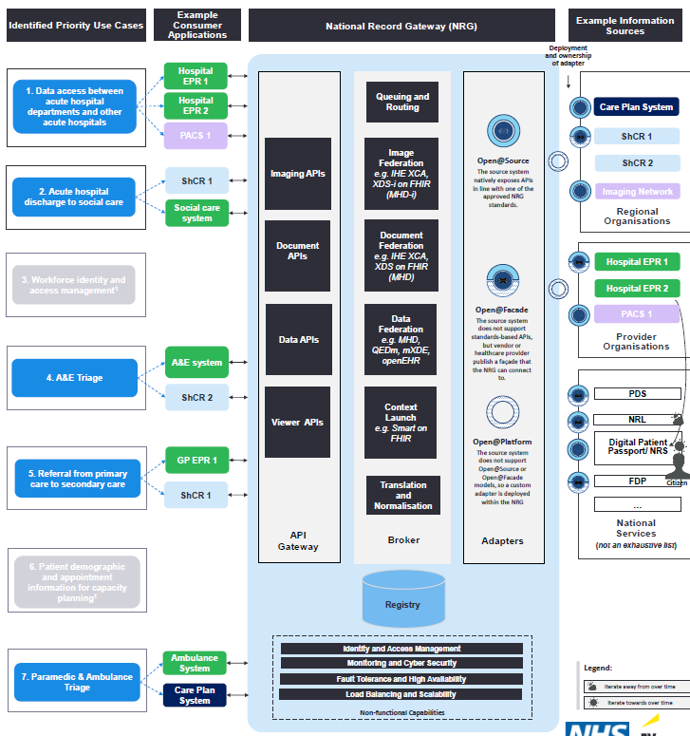
The EY Review
EY have been reviewing a sensible architectural approach to bringing this together using adapter patterns…
The outcome…
Leveraging use-cases, to create a national record gateway that enables all existing ShCRs to interconnect, sharing data on a ‘best endeavours basis’ – Making data available at the point of care.
Design a standardised output from the ‘adapters’ within the platform to connect all ShCRs together and provide data to clinicians to support their decision making.
Support both ‘discovery’ and ‘registry’ models of obtaining access to Shared Care Record data – so that all are onboarded.
Converge overtime to a National Record Service. A core central record store.
This is the most sensible way forwards based on the current market, landscape and standards based ecosystem in use.
Multi-standards compliant!... But this is not a build project!

Slide 11
Call to action
the shared care record community should work together to procure and deliver the infrastructure to connect the country
I propose an open letter the NHS-England outlining a programme and approach to delivery, leveraging leaders from this community.
Gary McAllister Ex National CTO
CIO – GSTT,
CTO - London

