Slide 1
A3.1 Standards and why we need to stick at it! Lorraine Foley, CEO PRSB

Slide 2
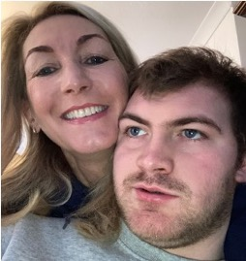
Why this matters
"For parent carers like myself, the About Me standard is the difference between care staff giving essential care and excellent, personalised-care, that sees the person for the individual they are."
Sam Goncalves, parent and carer
"Access to the community mental health team’s notes for patients with serious mental illness has been a game-changer. I can now tailor my support to complement specialist teams’ plans, which has improved outcomes for patients and allowed me to provide more effective therapeutic care."
Dr Nilesh Bharakhada, GP, NW London
“A big part of being able to implement care planning across multiple ICSs at pace has been aligning to a common understanding of the clinical data to be captured and shared. As a PRSB partner, we can further our collaboration with clinical experts that are curating these standards and validate our assessments of compliance to the standards.”
Ian Bennett, product specialist at Better
Notes:
Easy to forget the fundamentals of why we need to get this
First and foremost – Sam who wants to be sure that things that matter so much in Shanes care, will be known and acted on after shes not around to look after him
Clinicians want whole story so they can provide best care for their patients and not waste time chasing
Really important for suppliers enabling them to be effective and know that they’re building the right thing

Slide 3
Standardised data – the golden thread
Safety and data quality
Integration and shared care records
Innovation, insight and prevention
Notes:
Focus has been individual standards and that’s fine but big prize is a learning health system where data is the liquid gold
We can't allow all the incredibly powerful data to remain locked in silos
Implementing standards gradually unlocks data and dismantles the silos – and enables improvement in:
Safety – safe handover of care
Integration – ShCR and care plans – if want them to work within and across any ICS
Research, FDP – gaining new insights and feeding that back in at source
The tech it uses is more prone to change but the right data is the bedrock
That is a prize worth striving for – and it will happen and join up as we start to have more and more dots implementing standards and filling in the picture
If don’t follow, only ever have sets of disparate systems and silos of valuable patient information that can’t be joined up

Slide 4
Delivering on the promise of integrated care
“Getting the basics of information right is just the beginning.
As a health and care system we should aspire to use information to make the shift from reactive services to predictive and preventative services
Lyn Romeo, Chief Social Worker (England)
Notes:
As lynn says, how do we move to predictive and preventative ?

Slide 5
Why is it so hard to achieve?
Hard
Getting everyone to agree
We need national consensus and genuine buy-in from all
Harder
Changing software
Getting suppliers on board, legacy systems, procurement, incentives
Hardest
Changing clinical pathways and working practices
Changing clinical pathways and working practices
Notes:
The journey we are all on
Its hard because its hard – most worthwhile endeavours are
Analogy to climate change
Anyone can develop a standard
Users have to agree – clinicians, care professionals and people
Or standard is meaningless
Getting everyone to change
Then we all have to profoundly change our habits
The great opportunity of standards and interoperable data is reinventing how work is done
Lost opportunity if we just digitise the paper-based approach
Where great leaps forward can happen empowered by data
But it will ONLY happen with the willing consent of those using it
And making time to train and educate and embed change – in current context that feels very hard indeed
Endless reviews and reports say the failing is only focusing on the tech

Slide 6
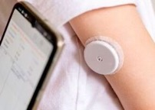
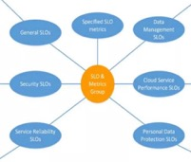
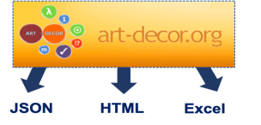
Important progress in standards and spread
CIS V3
Core Information Standard uplift
Pilots, SNOMED, templates
Standards easier to implement
Important standards in key areas – diabetes, maternity, social care
Common model to underpin standards for care, research and FDP
72
1
st
Partners
Provider conformant with Pers. Care and Support Plan
>40
Direct support to implement
Conformant
Notes:
Progress made by you is phenomenal – every ICS has access to Shcr, according to DMA, xx conformant – Rachel working to join them up across ICS, focusing on proper care planning – key standard for driving change (if can get that right), progress on architecture, fighting the battle for funding for ShCR – inconceivable that we don’t stick with that
Celebrate your success – standards are one part of your challenge
We are doing our bit to support you – listening to what you said last year and considering how we can improve and support you
Key standards in important areas – inc social care
Common model – components – extend to same model for 2ry uses, OMOP – everything based on same set – make more transparent
CIS refreshed – in contract – published in June – key changes – MVS 2
Easier to implement
Suppliers
Working with providers – Suffolk and NE essex, one London – first conformant provider in MH
People don’t use the support available nearly as much as they could – if question or issue or stuck – mail our support box on web site

Slide 7
Correcting common misunderstandings
PRSB standards are large and unwieldy, difficult to implement
The international patient summary is an ‘easier’ alternative to the Core Information Standard
PRSB standards are not internationally based
The technical message formats are enough on their own
It is hard for local organisations to exert any control and influence suppliers/ the system
Notes:
Gary Mcallister
“not implemented at scale”
“translation into practice, lacking national guidance”
“outputs are document centric not specification centric”
“implementation specifications and bindings are needed to make implementation successful”
“defining models without relationship to interoperability is unhelpful”
openEHR

Slide 8
Meeting the requirements for conformance
The ‘best practice’ standard (Core Information Standard)
Minimum safe implementation (MVIS)
1,842 items
40 business rules
149 items
18 business rules
Notes:
Bust one myth frequently hear, feasibility of implementing standards – don’t apologise for ‘best practice’,
But recognise journey – clinically validated MVIS or ‘the must haves’
CIS– much smaller and eminently achievable – Orion, Interweave working on it
Last year you said
Same for all standards – not published but ask

Slide 9
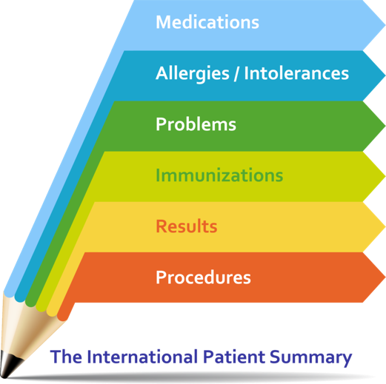
International Patient Summary and CIS
GP
Ambulance
Pharmacy
Care home
Communityy
Hospital
Hospice
Mental Health
111
IPS is a minimal set of basic clinical data of a patient, usable by all clinicians for unscheduled (cross-border) patient care.
The Shared Care Record is a comprehensive but constrained set of data for sharing with only the data relevant for the particular need used at any one time.
Mental
health
Notes:
IPS is valuable and we support it – but has different purpose to a ShCR

Slide 10
Relationship to international standards
PRSB core reference model: PRSB represented on BSI IST35 and takes account of CEN and ISO standards such as ISO 13606, CONTSYS and the International Patient Summary
Information record standards: our discovery work for any standards includes consideration of any international models for similar use cases or for reference architecture e.g. diabetes was informed by i. international consensus on time in range ii. International literature on insulin pumps/pens (not standard but peer reviewed papers iii. iCode US standard for Continuous Glucose Monitors
Terminology: SNOMED CT and dm+d – using international and UK extension
FHIR: PRSB has worked closely with national efforts to establish HL7 FHIR UK profiles - both with NHS Digital / England, and the wider FHIR UK Core initiative.
International Suppliers: PRSB works with international suppliers (EPIC, Cerner etc) in the Partner Programme, and also through INTEROPen, techUK and CASPA making the case for international standards alignment
UK has made substantial advances and have the opportunity to be influencing/setting international standards as well as following them where an appropriate standard exists
Notes:
Of course we should work to international standards where we can – not sure we even manage to agree across UK but principle is right
And we do it – ISO, SNOMED, HL7, diabetes research
Myth is partly that we already are
And partly that the UK is making substantial advances and in many cases leading thinking – we should recognise that and step into it rather than poor relation

Slide 11
We need the right water in the pipes
PRSB’s information record standard ensures the ‘right’ water is in the pipes before it is distributed around the system.
We need the water and the pipes to be right for interoperability to be successfully achieved.
Notes:
Lot of focus on technical message formats and not enough focus on the clinical content and use cases
They are both essential and must work together
Right water in pipes
Clinician cant easily understand a FHIR profile and a software supplier cant design from it

Slide 12
Why is evidence of conformance important?
PRSB’s information record standard ensures the ‘right’ water is in the pipes before it is distributed around the system.
We need the water and the pipes to be right for interoperability to be successfully achieved.
Standards should be testable and tested
Conformance assurance provides predictability and trust
Suppliers can be clear when they have done enough
Removes the fear and uncertainty from buying clinical software
A conformant system makes implementation more straightforward
Health and care systems need consistent implementation of standards
A learning health system – data, evidence, practice
Notes:
On to conformance and why important
Why?
Without properly testing conformance, standards are not worth very much
IF we are sure, predictable and builds trust – takes the fear and uncertainty out of procurement
Simplifies s/w development
Suppliers can be completely clear whats enough to meet customer needs (validated at scale) and cover liabilities

Slide 13
PRSB Partners
PRSB’s information record standard ensures the ‘right’ water is in the pipes before it is distributed around the system.
We need the water and the pipes to be right for interoperability to be successfully achieved.
8/10 EPR suppliers 5/6 ShCR suppliers 50% social care suppliers
Notes:
Suppliers Partners - signed up/commited to work with us on standards and when ready, prepared independently assessed - evidence
Stop press – very many suppliers are committed to standards and really up for this
If want more evidence of impact, look DSCR
IF want to provide solutions for digital s/care, assured suppliers list
To be on framework, part of assessment is PRSB assurance of conformance
Look at the results – that is market shift and systemic change

Slide 14
Legislation
PRSB’s information record standard ensures the ‘right’ water is in the pipes before it is distributed around the system.
We need the water and the pipes to be right for interoperability to be successfully achieved.
Health and Social Care Act 2022 Data Protection and Digital Information Bill
Applies to public and private health and adult social care providers
Makes compliance to information standards mandatory
Enforcement through financial penalties, public censure and accreditation
We don't need to wait for legislation to act
Notes:
UK wide legislation – into effect next year/get rolling – key points
Legislation requires objective, evidence based testing that can be defended in court of law if necessary
Welcomed – time is right to get more serious - Govts want a strong lever
Waiting for legislation is losing time, golden opportunity in current procurements and getting well prepared now, ahead of curve – if supplier or provider

Slide 15
Levers, incentives and legislation
Everything goes much faster when everyone is pulling in the same direction..
Peer pressure
Supplier market shift
Provider demand
CQC/regulators
ISNs
Financial incentives
Procurement
Legislation/penalties
Notes:
Conviction is generally more effective than compulsion
There are a lot of hard and soft levers available nationally and locally
Definitely a national role in getting everything pulling same way
We can influence this much more effectively than we do currently – just asking suppliers for evidence of conformance has big impact
Legislation and penalties should be the last resort, used by exception

Slide 16
Thank you
Lorraine Foley CEO
Professional Record Standards Body
info@theprsb.org @ProfRecordSB

