Slide 1
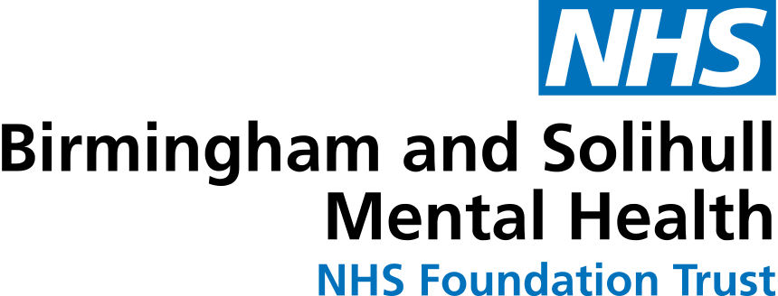
The Open Notes movement Rosie Bartel

Slide 2
Notes:
Rosie

Slide 3
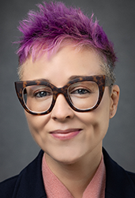
Open Notes
www.opennotes.org
Notes:
OpenNotes is an international movement spreading, studying, and teaching about transparent communication among patients, families, and clinicians. When clinical notes are shared with patients, we call these ‘open notes.’ We are motivated by evidence indicating that when health professionals offer patients and families ready access to clinical notes, the quality and safety of care improves.
Based at Beth Israel Deaconess Medical Center, a major Harvard Medical School teaching hospital, OpenNotes is not-for-profit and is funded entirely by federal and philanthropic grants and gifts
I think it’s important to state that OpenNotes does not develop software and is not a technology company. It is a movement.
The picture on the right is of Liz Salmi, the OpenNotes Communications and Patient Initiatives Director and the person who connected John and I together.

Slide 4
Good Communication
“I live 75 miles away from these providers so the ability to ask questions and send pictures makes me feel very secure. Also questions are answered and followed up on in a timely way.”
“Ability to communicate to any health care professional connected to patient (Physician Assistant, nurses, therapists including physical, mental, and spiritual).”
“Ability to see providers notes.”
“Emailing/communicating with my provider.”

Slide 5
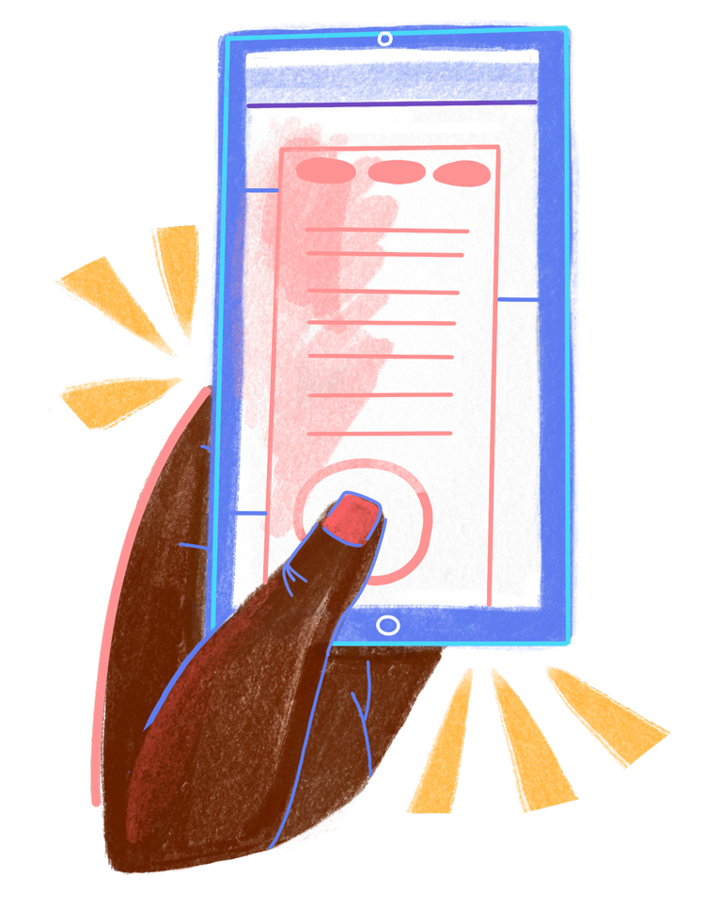
U.S. Federal Rule Mandates Open Notes
The federal rule on interoperability and information blocking mandates that healthcare providers offer patients access to all the health information in their medical records “without delay” and without charge.
21st Century Cures Act S.4004

Slide 6
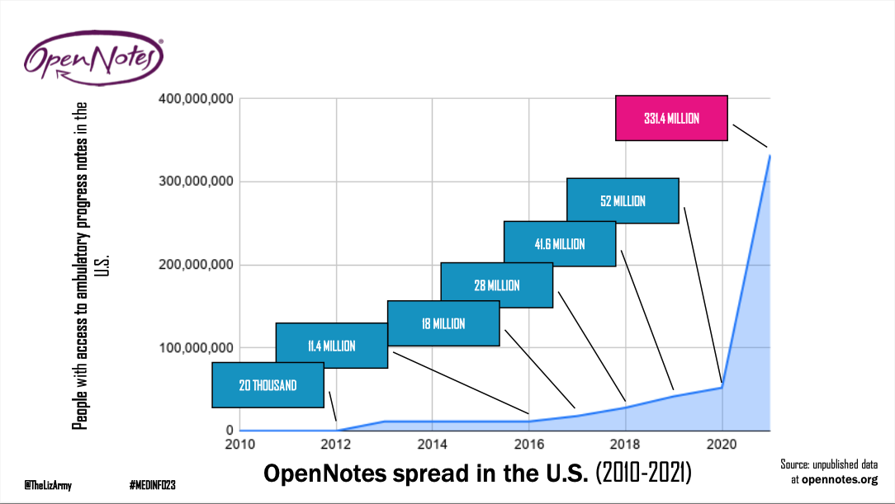
Impact of the 21st Century Cures Act
Notes:
This graph illustrates the number of people who have access to their ambulatory progress notes in the US
Although the Open Notes movement has been underway for over a decade, it was the 21st Century Cures Act that really exploded access

Slide 7
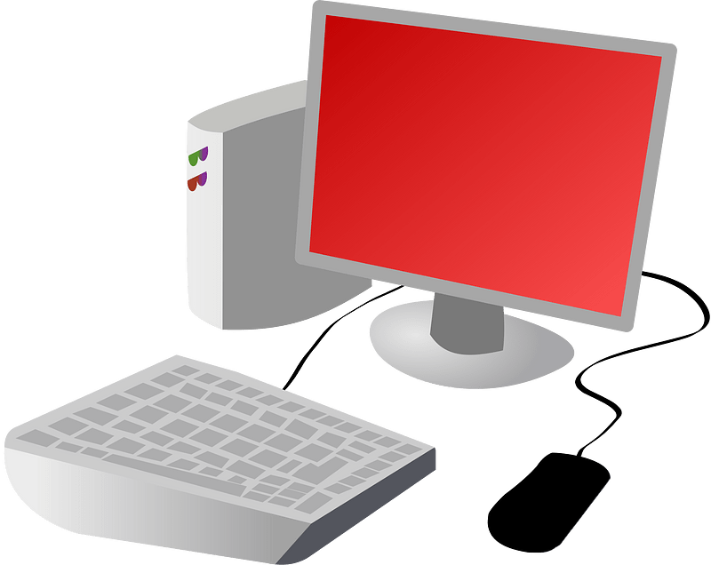
Most Likely to Benefit from OpenNotes
Less educated
Nonwhite
Older Adults
Unlikely to speak English

Slide 8
Patients & Care Partners Benefits
Better understanding of their health condition (s)
Feel more in control of their health
Better recall of the content of visits
Improved adherence to medications and care plans
Improved communication with clinicians and care partners
Increased trust of doctors
Being reminded of next steps, such as diagnostic and screening tests
Finding and reporting potential errors in the record

Slide 9
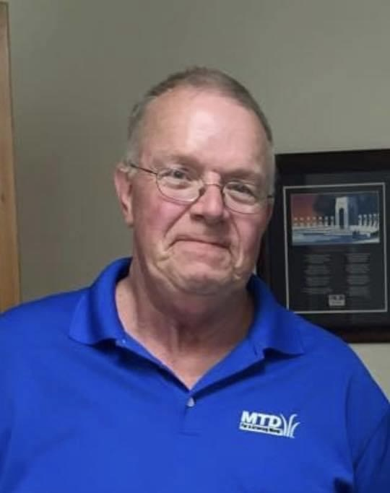
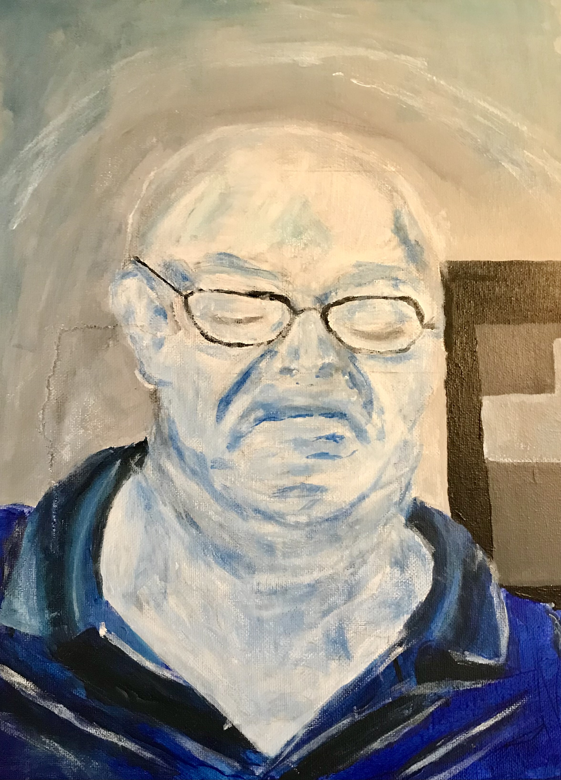
David

Slide 10
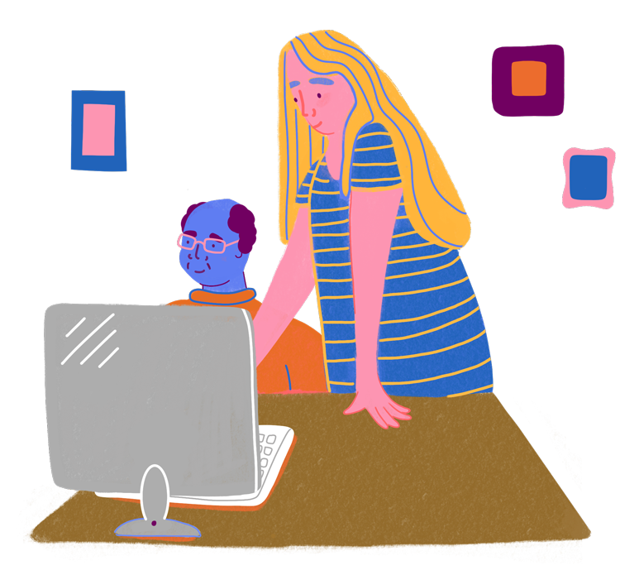
EHR Proxy (Shared) Access for Family Care Partners
e
Engaging family caregivers through shared access to the electronic health record

Slide 11
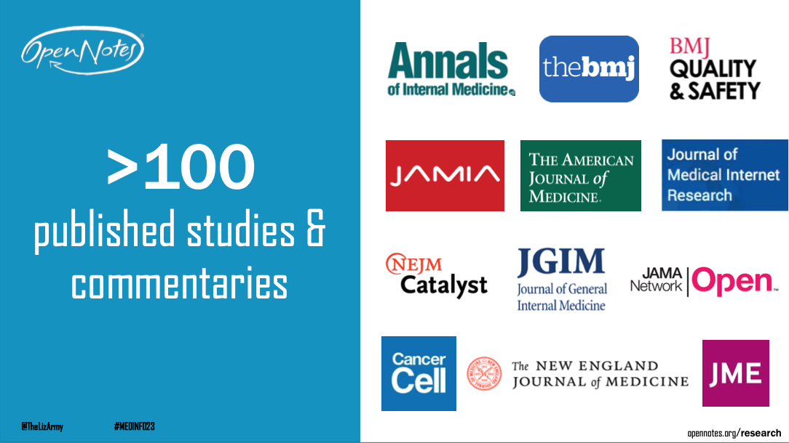
Open Notes – building the evidence base
e
Notes:
Open Notes has supported many published studies into the impact arising out of patients having ready access to their notes
You’ll see a reference on the slide to the British Medical Journal and it was an invitation to speak at their International Forum on Quality and Safety in Healthcare last week that brought me to the UK and why I am here today in person.

Slide 12
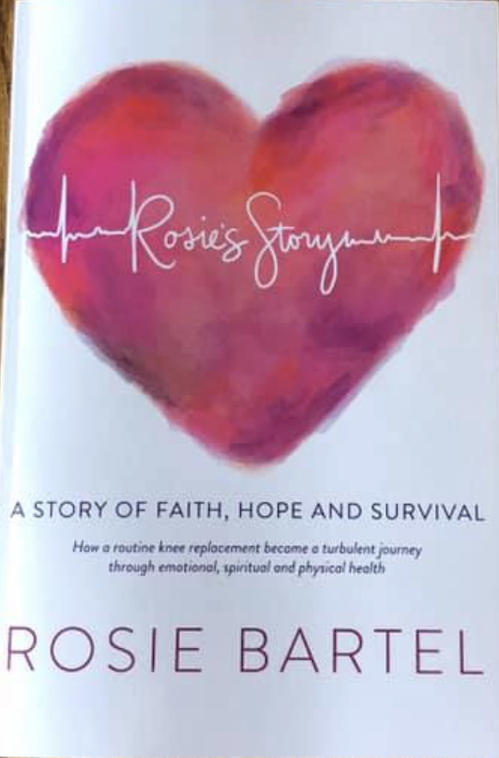
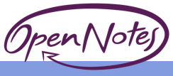
Contact Information
www.opennotes.org
Rosie Bartel bartel1949@gmail.com

Slide 13
Thank you
Rosie Bartel Patient Advisor
University of Wisconsin
bartel1949@gmail.com

