Slide 1
Journey to a single citizen record Jordi Piera Jiménez

Slide 2
Highlights of the Catalan Health System
8.000.249
940
Population in Catalonia in 2023.
Facilities that range from primary health care centers to hospitals and intermediate care center.
1
EMR for primary care
But huge fragmentation of HIT across the Catalan Health System
Universal coverage
> 29
EMR products in specialized care.
Free healthcare for all Catalonian citizens.
> 160
> 10
Health care entities to provide health care services.
Different systems for social care records.

Slide 3
The Catalan Digital Health Platform
Hospitals and intermediate care
29 products
Electronic Prescribing (SIRE)
416M prescriptions / year
37.000 health professionals as users
1.346M dispensing of medicines / year
Personal Health Portal (LMS)
> 5.7 M citizens
Central PACS System (SIMDCAT)
> 6,200 M images
Digital Pathology linked to SIMDCAT
Late 80's Early 90'
2000
2006
2023
2009
2022
2014
2007
2018
2020
Primary care EMR
1 product
National Patient Index (RCA)
Shared Electronic Health Record (HC3) >1.100M documents
> 70% structured information
Care Process Management (IS3)
> 50,6 M referrals / year
Remote consultations
> 50 M
Open platform
openEHR CDR CKM
New apps
PROMs
Medications
Immunizations

Slide 4
A fragmented ecosystem of health information technologies
It’s all about data silos
69 hospitals and 29 different EMR products.
Each tertiary hospital has around 800 silos of information.
Each secondary hospital has around 400 silos of information.
According to our prospects we have more than 16k silos of information.
The EMRs remain to be the biggest source of health-related information.
Huge heterogeneity of proprietary data models.

Slide 5
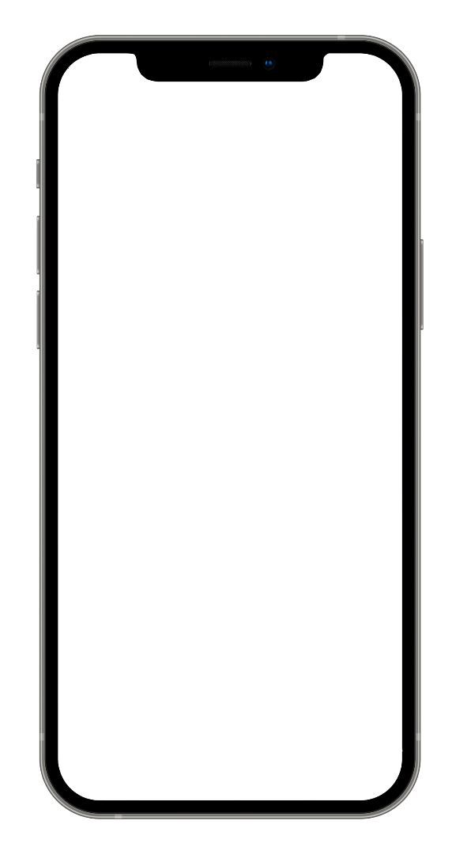
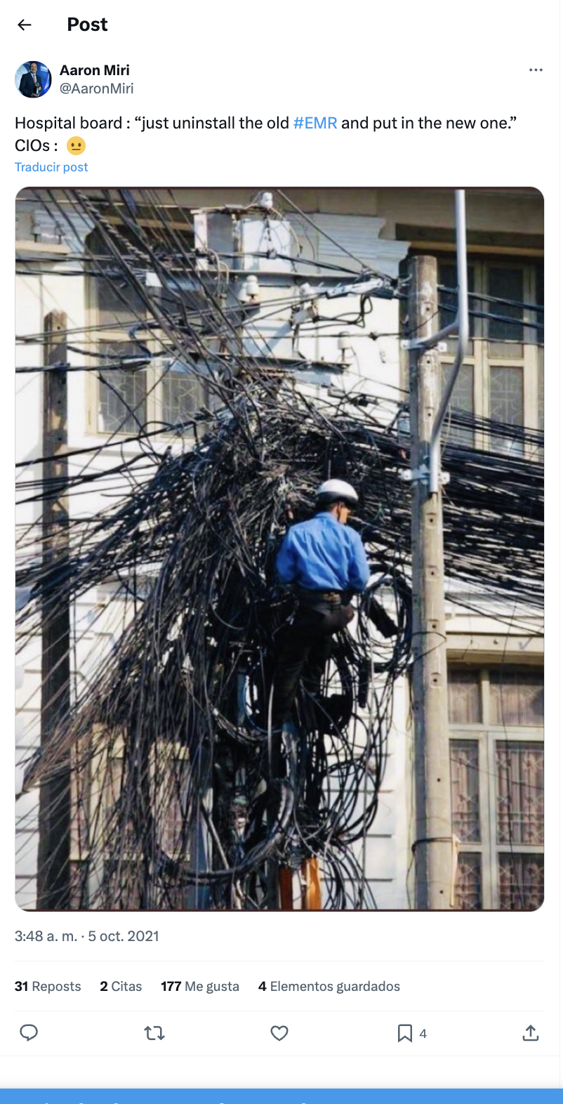
EMRs seen from the inside
The EMR is a complex system of systems

Slide 6
Trying to build a longitudinal EHR is a dream

Slide 7
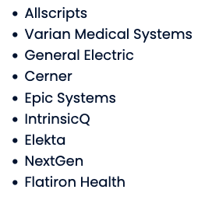
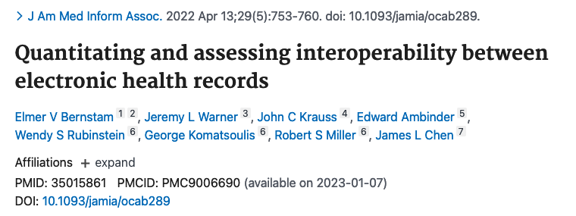
Data is not understood: limitations of the current model of interoperability
In contrast to data elements required for successful billing, clinically relevant data elements are rarely standardized, even though applicable standards exist.
As defined in the study, intra-vendor interoperability refers to the ability to share information between instances of the same vendor’s product (e.g. Epic > Epic). Inter-vendor interoperability refers to the ability to share information between instances of different vendor products (e.g. Epic > Cerner)
A recent study of EHR interoperability found that 68% of data was “understood” when exchanged across different sites using the same vendor, but only 22% was “understood” when exchanged across different EHR vendors.

Slide 8
Limitations of the current information systems model
Let’s stop and reflect about our current model of health IT
Broad ecosystem of applications with buried business logic and data models
Old-fashioned solutions and a dramatic increase in technical debt.
Communication between service providers and the NHS through static and incoherent interoperability solutions.
High costs for maintenance, corrective and evolutionary development.
Difficulties to scale-up innovations and best practices.
Rigid model that does not foster adaptation to change.

Slide 9
The Digital Health Strategy for Catalonia

Slide 10
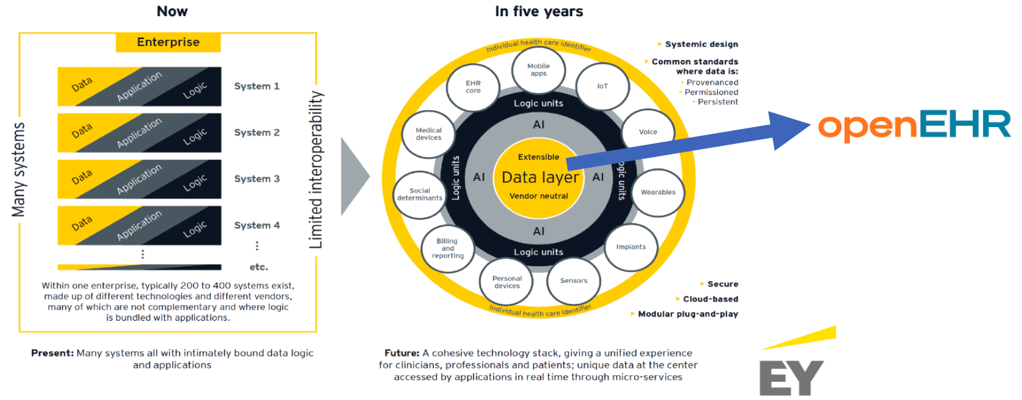
Current vs future view

Slide 11
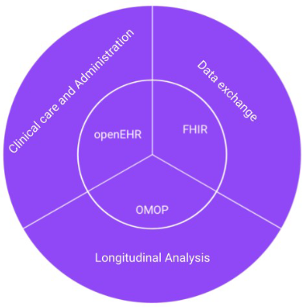
The open platform is standard agnostic
Data focused
Engineered for all care settings
Longevity of standardized data
Citizen focused
Lifelong health records
Orchestrated and modular
Tsafnat G, Dunscombe R, Gabriel D, Grieve G, Reich C. Converge or collide?
Making sense of a plethora of open data standards in healthcare: an editorial.
Journal of Medical Internet Research. 09/04/2024:55779

Slide 12
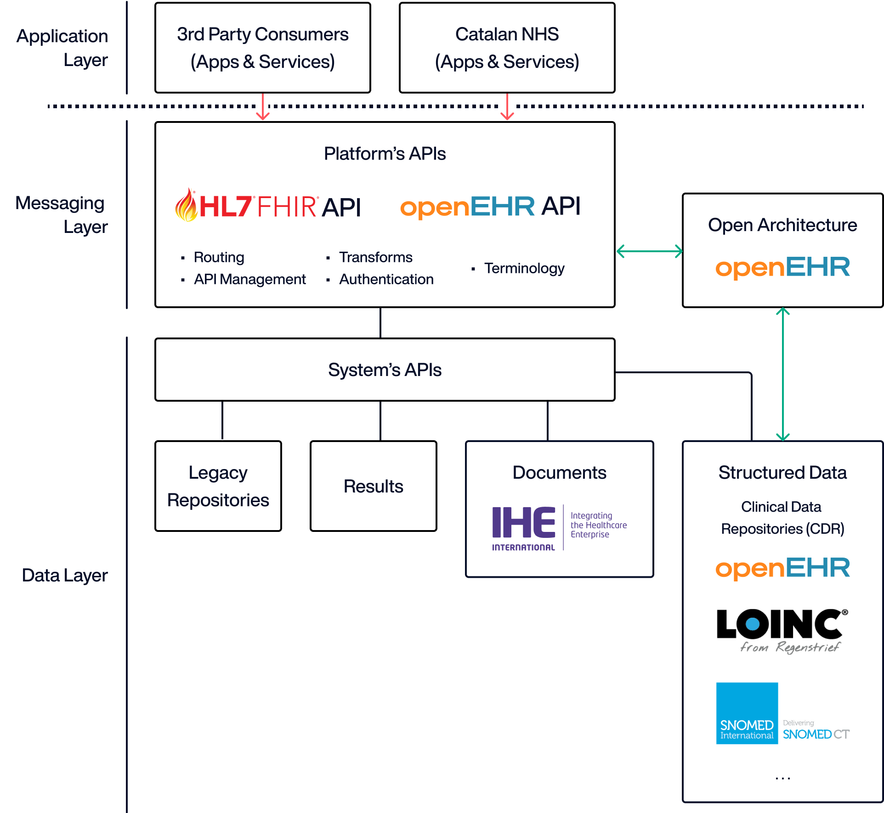
How the open platform looks like
Source: Adapted from the Apperta Foundation

Slide 13
Our view for an open future
We are building an INFOSTRUCTURE:
Care processes
Information needs
Applications
Technology
We are decoupling data from applications and storing it in an open format
This will foster better integration and collaboration
It will help scaling-up innovations across our ecosystem (and hopefully beyond…)
This will facilitate the systematic use of health data

Slide 14
A promise long term overdue
“..pushing information and knowledge to the point where health decisions are made, so the right decision can be made at the right time”.
“It is more important to know what sort of person has a disease than to know what sort of disease a person has”.
Source : Information for Health : A Strategy for Building the National Health Information Infrastructure. National Committee on Vital and Health Statistics (2001)
Source : Hippocrates (460 BC)

Slide 15
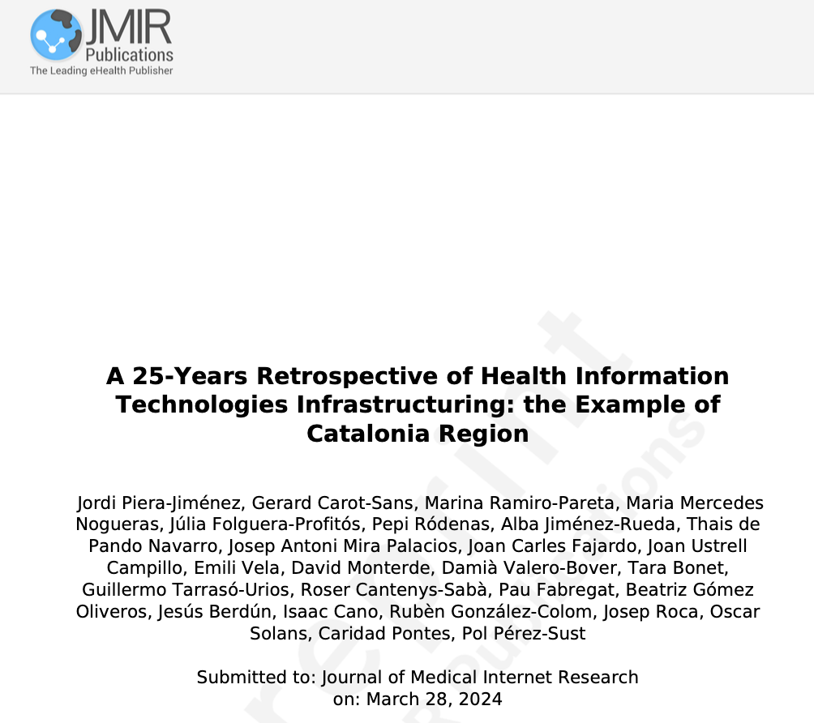
Thank you
Jordi Piera Jiménez Director of the Digital Health Strategy Office Catalan Health Service
jpiera@catsalut.cat @jpieraj

