Slide 1
Life in the Maze Sari and Ashley McKinnon

Slide 2
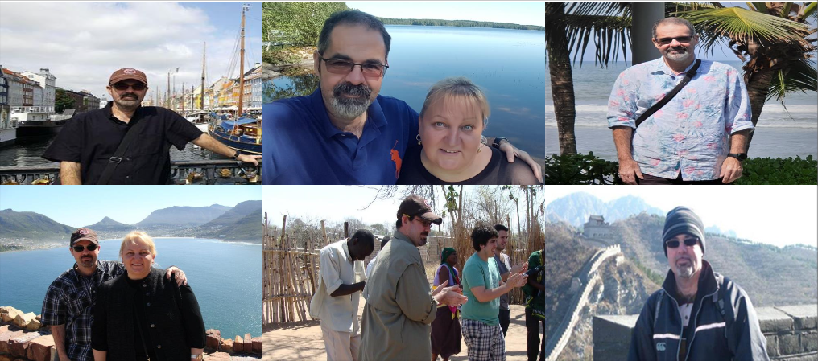

Slide 3
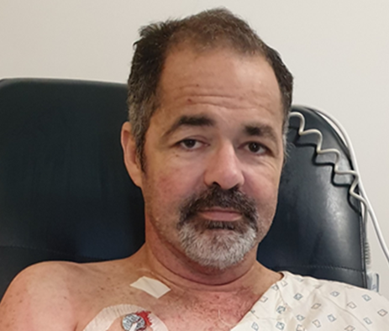
3rd December – Life Changed
3rd December 2019 - Life Changed
Blood tests, scans, x-rays, continuous monitoring +++
Admitted to Intensive Care Unit
A&E Physician, Nephrologist, Cardiologist, Endocrinologist, Intensivist, Nurses, Pharmacist +++
Acute Renal Failure =>
Pancreas and Kidney Organ Transplant

Slide 4
And it started
Test after test
Waiting for results constantly
Rounds of assessments, consultations, investigations, procedures
Growing list of medications with different instructions
Growing care team – specialists, nurses, pharmacists, dieticians, dialysis team, transplant co-ordinators
Increasingly complex care

Slide 5
Data collected at every turn – but where is it ?
Devices and monitoring at every level
Complex information systems, staff entering data
Paper records everywhere, at bedside, at handover
Home based care - dialysis every second day
Why do I have to repeat myself over and over ?
What can’t they share what they have ?
Why is it so hard to communicate ?

Slide 8
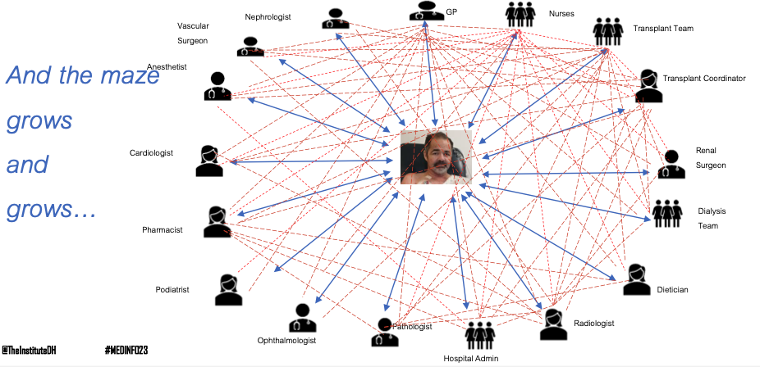

Slide 9
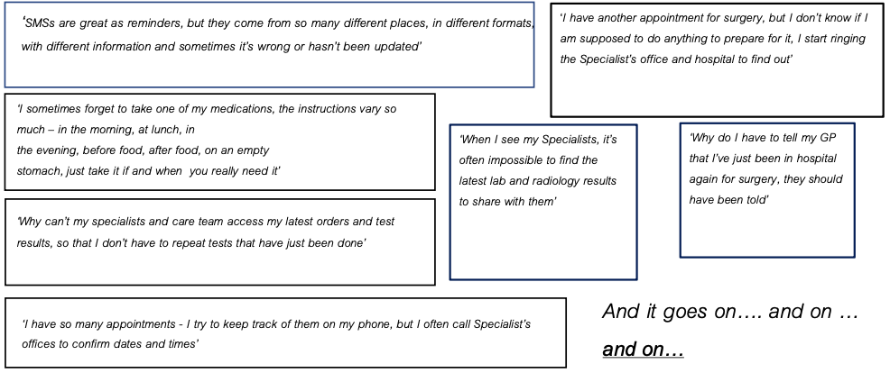
And it goes on … and on … and on …

Slide 10
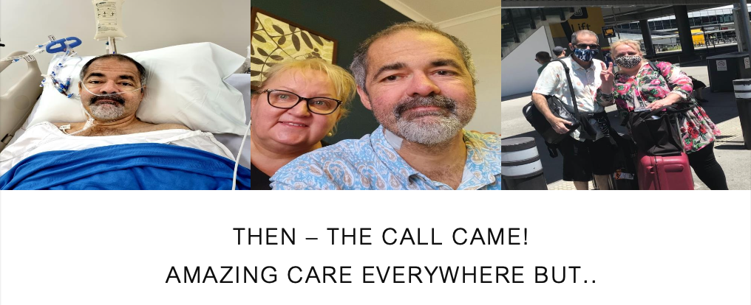
Then – the call came !
Amazing care everywhere but ..

Slide 11
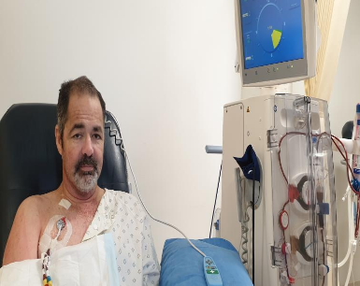
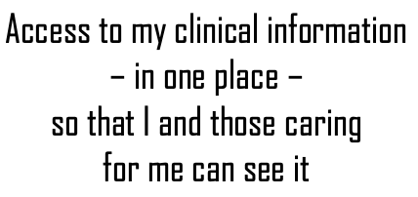
What do “I” want ?
Access to my clinical information
– in one place –
so that I and those caring for me can see it

Slide 12
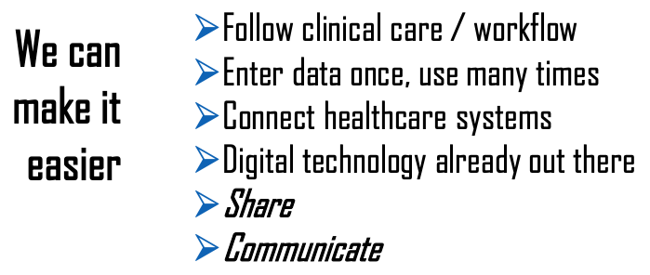
The potential of digital
We can make it easier
Follow clinical care / workflow
Enter data once, use many times
Connect healthcare systems
Digital technology already out there
Share
Communicate

Slide 13
Agreement – “Hearts and Minds”
And it can get complicated but…
It doesn’t have to
User friendly access
Consistent, standards-based data
Trust the data and the care
Connect and share

Slide 14
2 years on : Personally, the future is bright
However, the challenge to share and communicate continues – for all of us.

Slide 15
Thank you
Sari and Ashley McKinnon Digital Health Advisor & Patient
Sari@sarimckinnon.com Tel +61 428 975 970

