Slide 1
Welcome Carl Beet Director of Digital Services/Chief Information Officer Birmingham Community Healthcare and Birmingham and Solihull Mental Health Trust

Slide 2
Please pay attention at the back
Things you need to know
Fire alarms
Toilets
Help and assistance
Food and drink
Recording and Voxpops
Keeping to time
People I need to thank
Organising committee
Lou Sinclair
Mandy Fletcher
Speakers
Sponsors
All the support staff
All of you

Slide 3
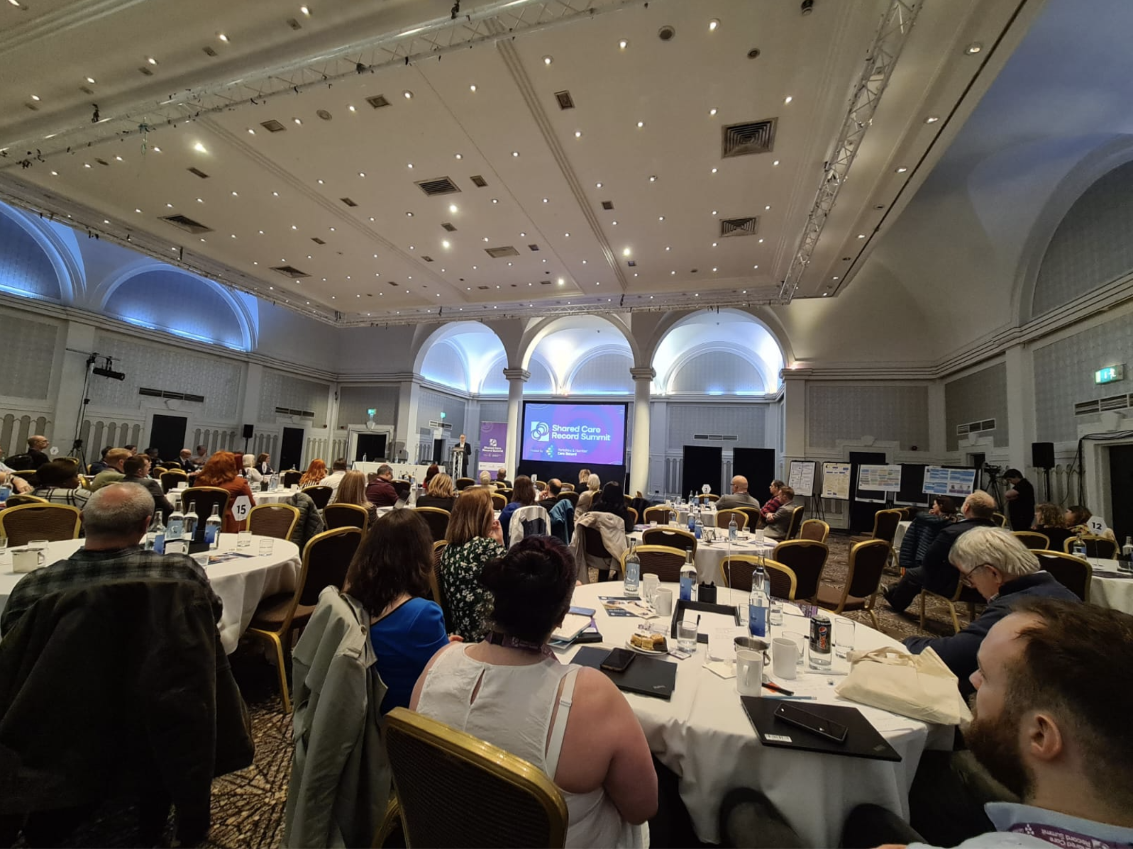
This was then – Leeds, March 2023

Slide 4
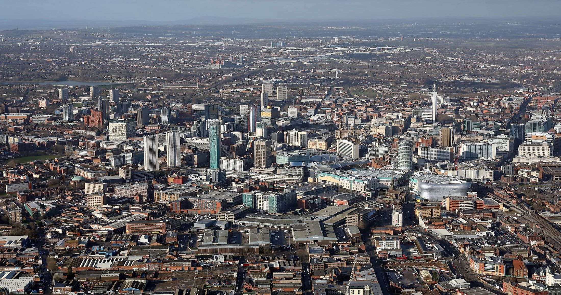
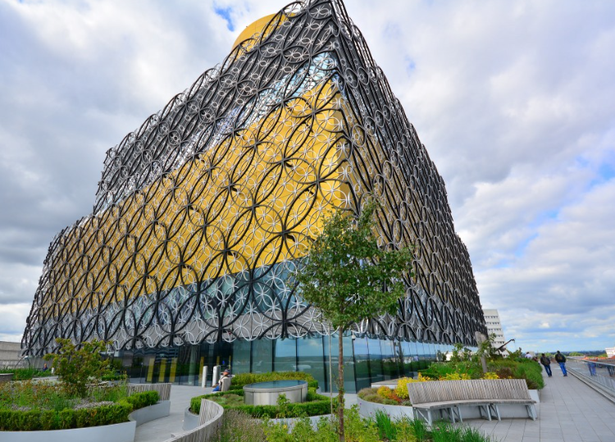
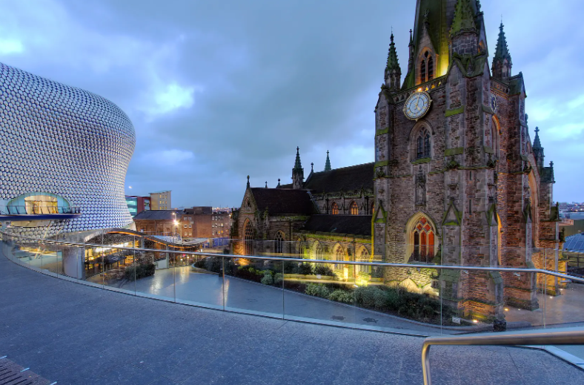
This is now – Welcome to Birmingham, April 2024

Slide 5
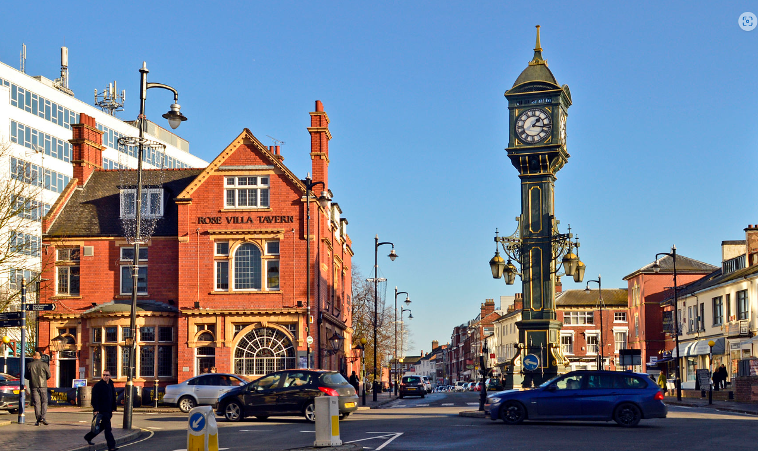
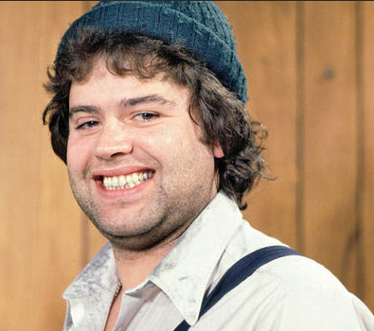
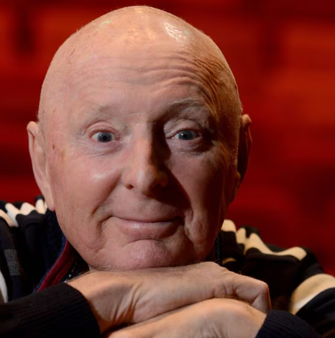
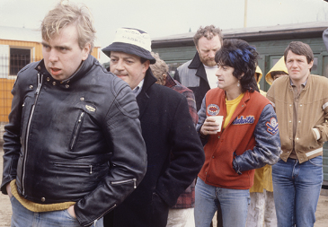
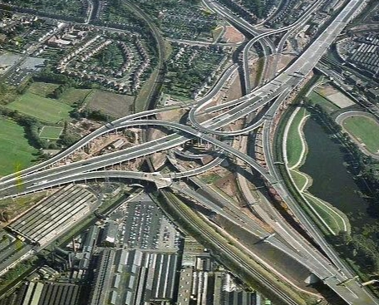
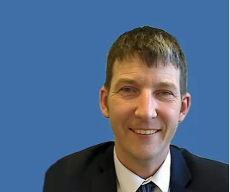
Birmingham, April 2024

Slide 6
Birmingham, April 2024 - Aide Memoire
Aer Kid/ Our Kid – A family member or friend, usually younger.
Bab – Nice and simple, bab is a word similar to ‘love’, or ‘dear’. It’s a term of endearment
Bost – Broken.
Bostin’ – Great, super etc
Bost-up – A fight.
The cut – The canal. We have more canals than Venice, you know
Gizzit-ere – Give it to me.
Oss – A horse.
Shrapnel – Loose change
Tara-a-bit – ‘see you later’, often shortened to ‘tara’.
Wag – To skip school or bunk off, deliberately.
Yampy – Someone who is a bit daft.
Yowm/ Yow-am – You are

Slide 7
Our agenda – Day 1
10:00
Day 1 Opening and keynote
10:45
A1 – Onwards and Upwards
B1 Transforming Services
C1 Help call an ambulance
Lunch and network
13:00
A2 – Around the world in 90 minutes
B2 Social Care
C2 Accelerating Implementation
Grab a coffee, network and move
14:45
A3 – The thing about standards ..
B3 Spreading Involvement
C3 Professional Engagement
16:20
Day 1 Close and keynote

Slide 8
Our agenda – Day 2
10:00
Day 2 Opening and keynote
10:25
A4 Emerging Opportunities
B4 Benefits and Sustainability
C4 Public Engagement
Time to move
11:30
A5 Changing platforms
B5 Care Planning
C5 Secondary uses
12:35
Day 2 Close and Panel
13:00
Coffee and pastries to go….

Slide 9
A Patient Perspective Sam Bergin Goncalves, parent carer

Slide 10
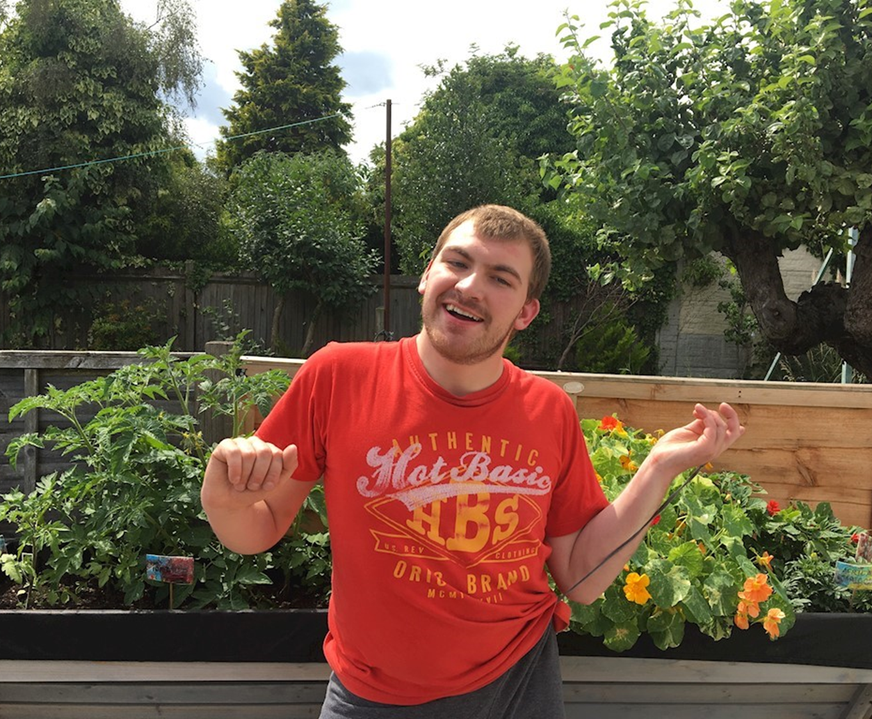
About Me
It’s about Me the Person rather than
You the Organisation

Slide 11
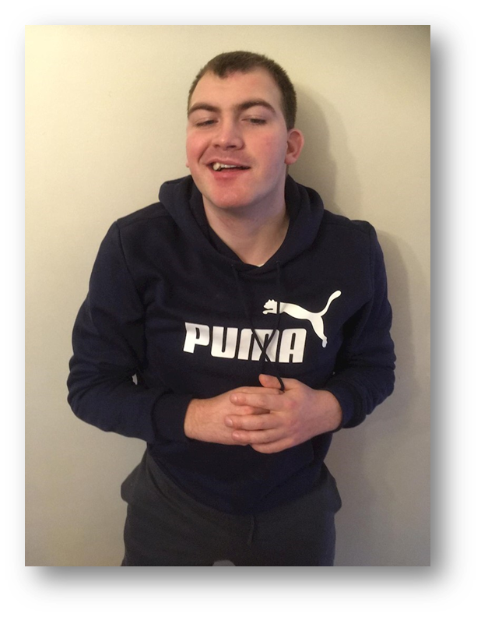
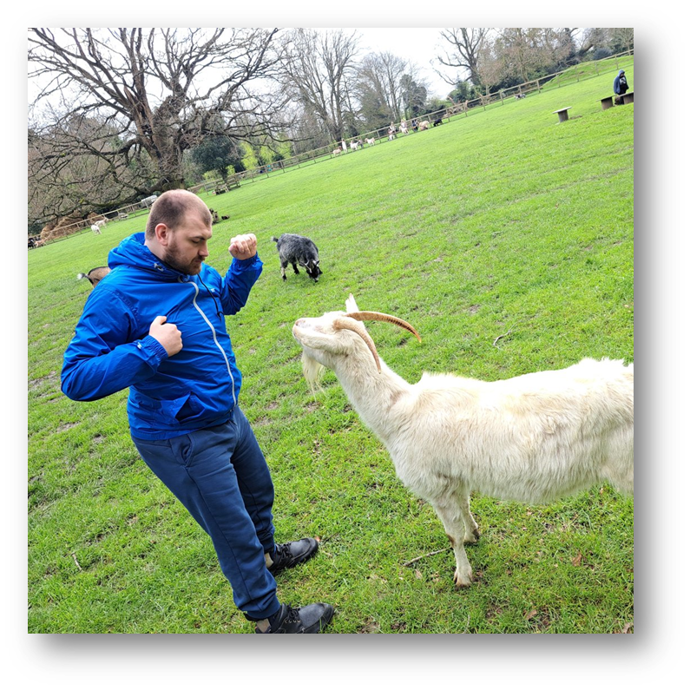
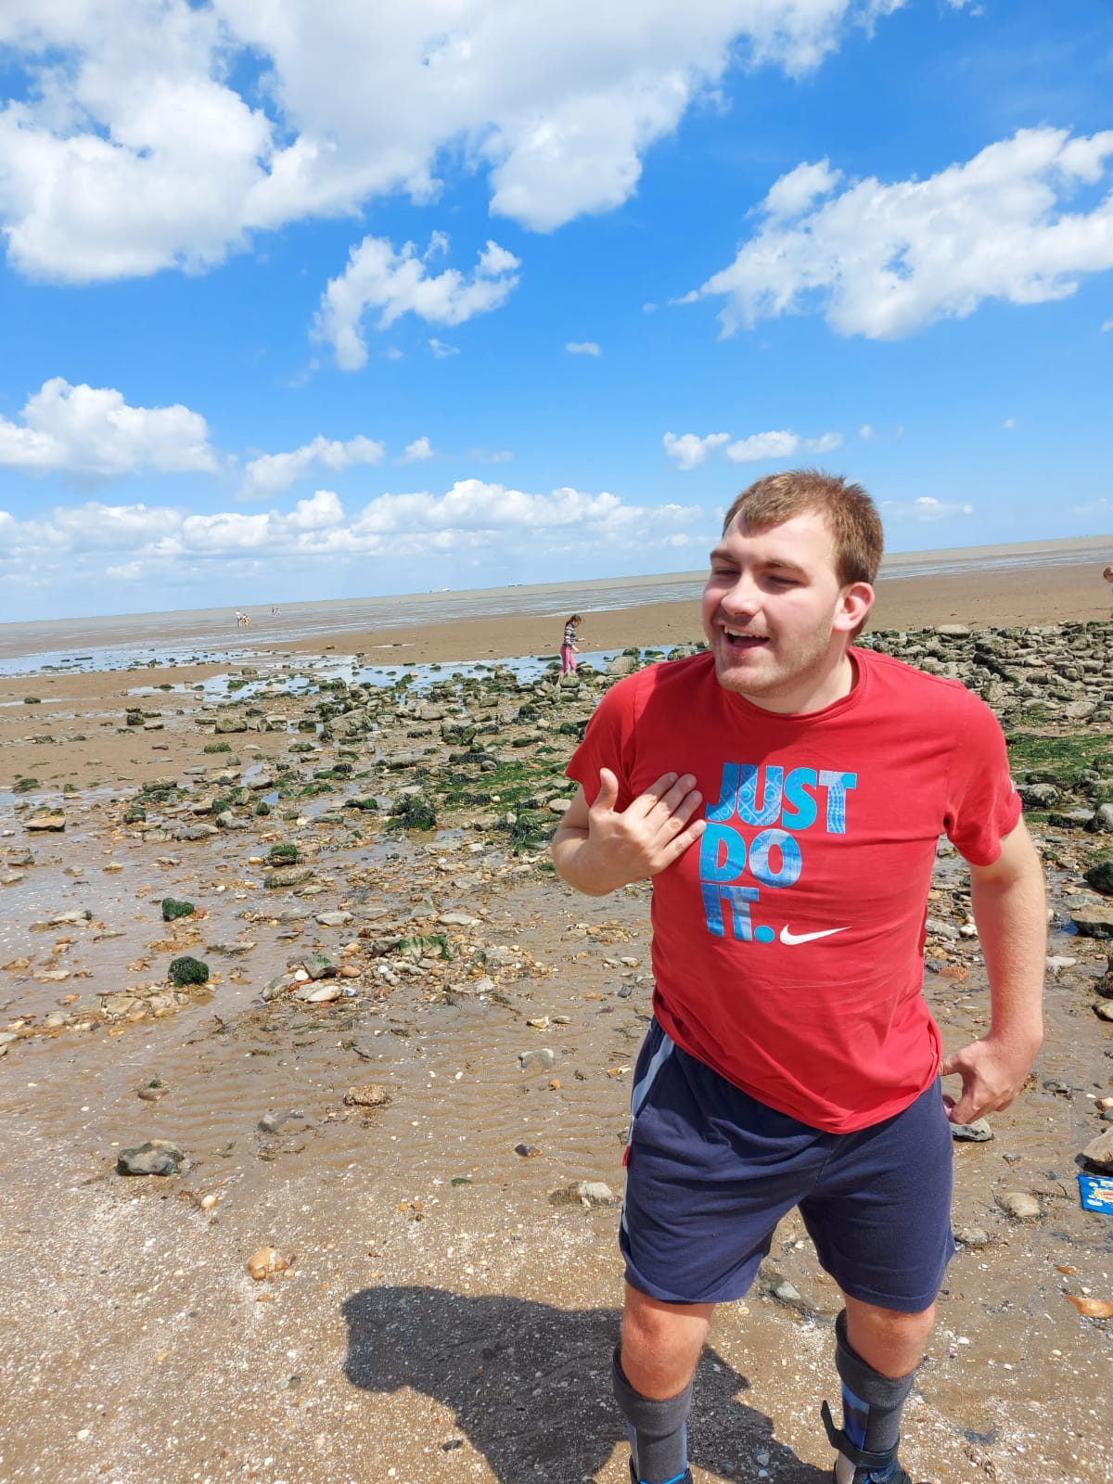
Shane's Story

Slide 12
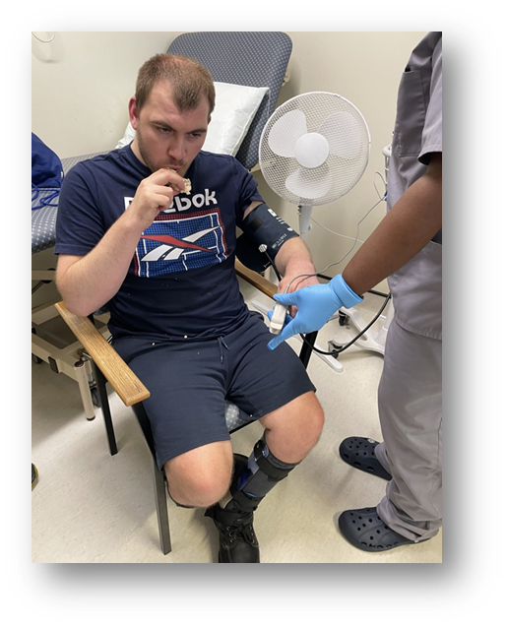
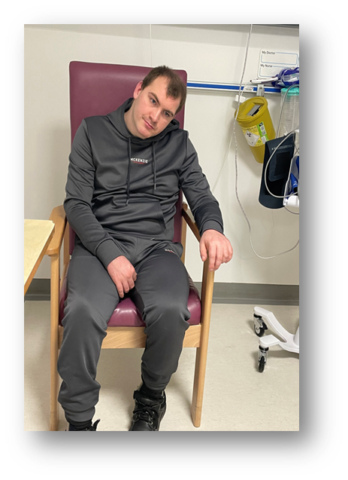
Reasonable adjustments
Pre-operative assessment
Post-operative success

Slide 13
What’s important for the future
“It’s just what I want to do only Shane needs
everyone’s help for this to happen” Daniel, aged 11

Slide 14
Thank you
Sam Bergin Goncalves
Parent carer

