Slide 1
JOINING UP INFORMATION ACROSS BOUNDARIES
Lisa Sewell
lisa.sewell3@nhs.net www.greatnorthcarerecord.org.uk
Joss Palmer
jocelynpalmer@nhs.net www.onelondon.online
Shared Care Record Summit 20th – 21st March 2023 The Queens Hotel, Leeds

Slide 2
OneLondon – London Care Record Joss Palmer
jocelynpalmer@nhs.net www.onelondon.online
@OneLondon4
Shared Care Record Summit 20th – 21st March 2023 The Queens Hotel, Leeds

Slide 3
Introductions
Who we are
What we’re sharing today
What is OneLondon?

Slide 4
Introduction
Almost 10 million population
5 Integrated Care Systems
40+ NHS Trusts, 1,400 general practices, 33 local authorities
About 30% of Londoners receive care in an ICS that is not their ‘home ICS’
4 of 5 of London ICSs have at least one NHS Trust where under 50% of their patients are from that same ICS.

Slide 5
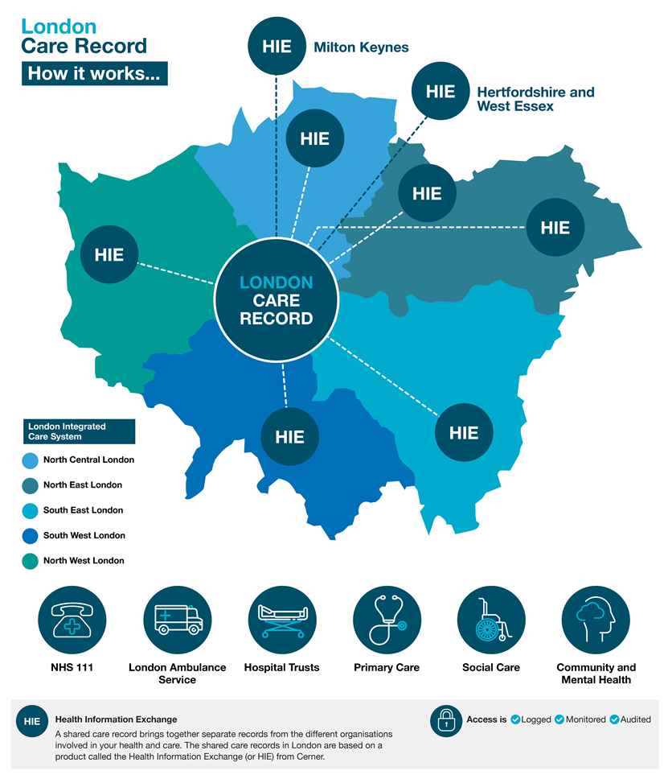
Introduction - the London Care Record
London Care Record is based on the Cerner HIE system
We have a ‘federated’ approach – each ICS has their own HIE (NEL have 2 HIEs)
The OneLondon ‘hub’ connects London up
Over 55,000 staff use the London Care Record each month
Over a million views a month (1.3 million in Feb 2023)

Slide 6
The London Care Record – the positives & our progress
Shared Care Records developed across London
Positive collaboration & relationship-building across London
Good progress sharing information across 5 London ICSs (and 2 outside London)
Public engagement (Citizen’s Summit)
Wider context & integration of the London Care Record – e.g. The Universal Care Plan (Better), London Ambulance mobile viewer and ToC…

Slide 7
The London Care Record – our priorities
‘Completing’ the London Care Record – ensuring equity across London
Robust service and operational framework across London and beyond
Sustainability
Evolve together with other key priorities – London Health Data Strategy, data for research, personal health records…
Sharing along patient/care pathways in & out of London

Slide 8
The London Care Record – challenges we still face / are working on…
ICS or London region? Prioritisation and equitable experience for Londoners
Information governance – alignment and assurance across London
Wider context – national products, services & strategy
Sustainability of the shared care record service
Funding

Slide 9
Thank you
You can follow the OneLondon journey here:
www.onelondon.online
@OneLondon4

Slide 10
Great North Care Record Lisa Sewell
Lisa Sewell greatnorthcarerecord.org.uk @GreatNorthCare
Shared Care Record Summit 20th – 21st March 2023 The Queens Hotel, Leeds

Slide 11
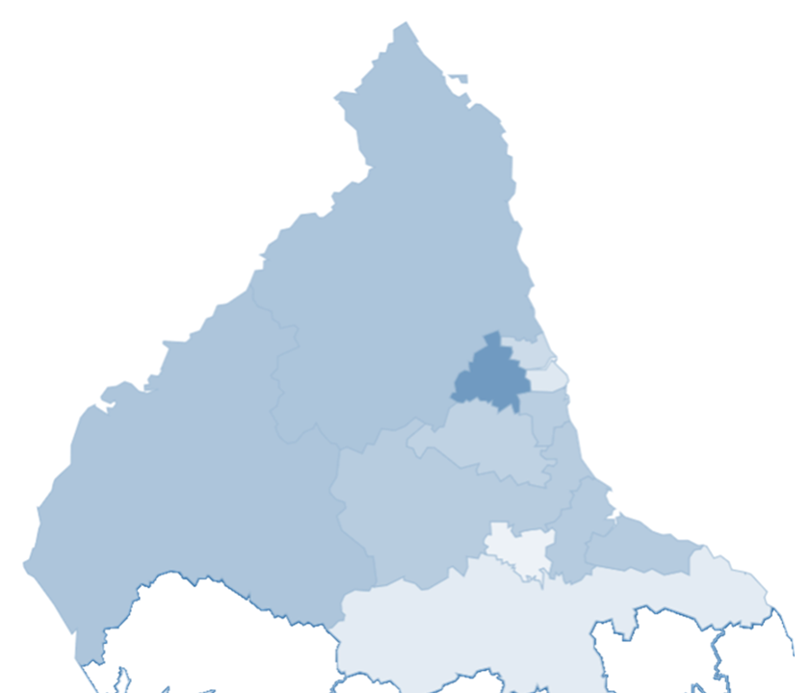
Introduction – Great North Care Record
Covers a population of 3.2 million
Over 10,000 active users
10 million views since launch in 2020
Recently marked its 3rd year live
The largest ICB geographically
Nationally – highest usage
Connects patient information across 13 Trusts, 430 GPs and 14 local authorities, 8 OOH and our ambulance service
Notes:
Connects patient information from GPs, local hospitals, the North East Ambulance Service, social care, community, out of hours and mental health teams together
Alerts
Appointments
Allergies
Cellular pathology
Clinical correspondence
Diagnosis
Family history
Immunisations
Lab results
Maternity reports
Medications
Microbiology
Physical exams
Problems
Procedures
Radiology / scans
Referrals
Social history
Test results
Visits
Vital signs

Slide 12
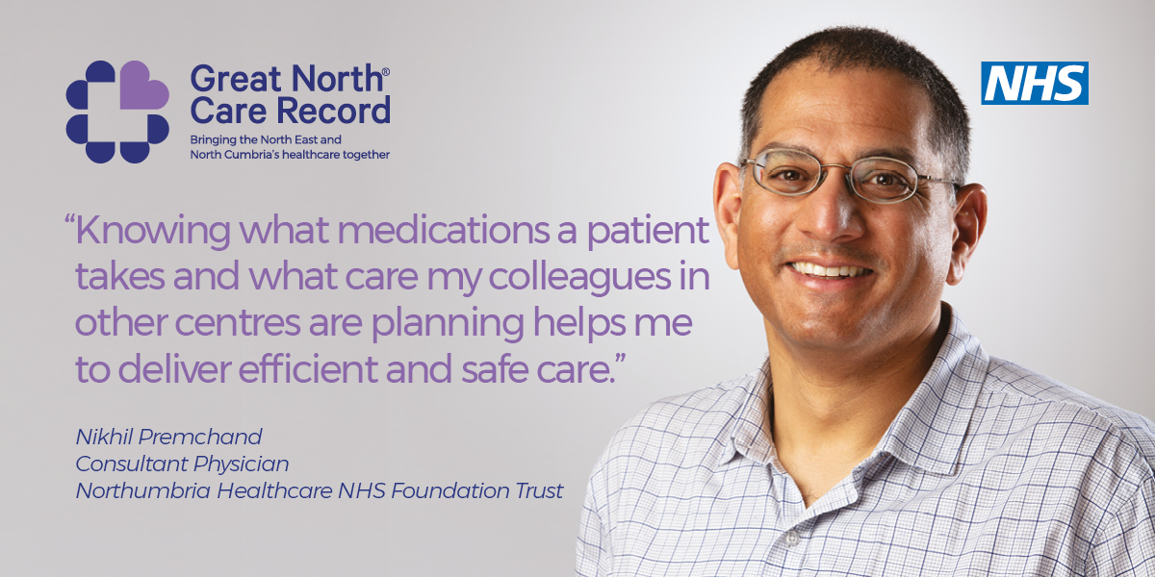
Great North Care Record the positives & our progress
"I was able to see documentation from mental health services. Access to the assessments significantly improved my understanding of the patient's background and trauma. This meant we were able to tailor how we supported the individual with their physical health needs in a way we wouldn't have been able to otherwise."
"GNCR saves lots of valuable time during emergencies. It's became easy to provide care to elderly patients, patients with background of Dementia and care home patients."
Notes:
Benefits
GNCR Ambassador programme

Slide 13
Great North Care Record the positives & our progress
Positive IG engagement
Single Vision
2016 foundations
One Pitch – Dec 2018
March 2020 Live
Subscription Model
GNCR Team
Bite Size Training
Adoption

Slide 14
Great North Care Record the positives & our progress
Both mental
health Trusts
Out-of-hours
providers
Social care
93% of Trust data
Hospices
100% of GP primary care data
North East Ambulance Service
Notes:
100% of GP primary care data is being shared. All GP practices are able to see data from Community Services, Acute Trusts, Mental Health Trusts, Ambulance Service and Council data
93% of Trust data is being shared. All Trusts are able to see data from Community Services, Acute Trusts, Mental Health Trusts, Ambulance Service and Council data
Out-of-hours providers also have access to the GNCR
Both Mental Health Trusts view and 1 (CNTW) share data
Over 250 Community Units are both viewing and sharing data
The North East Ambulance Service view (crews and service centre) and crew reports shared into GNCR
6 Local Authorities view the GNCR with 3 also sharing information

Slide 15
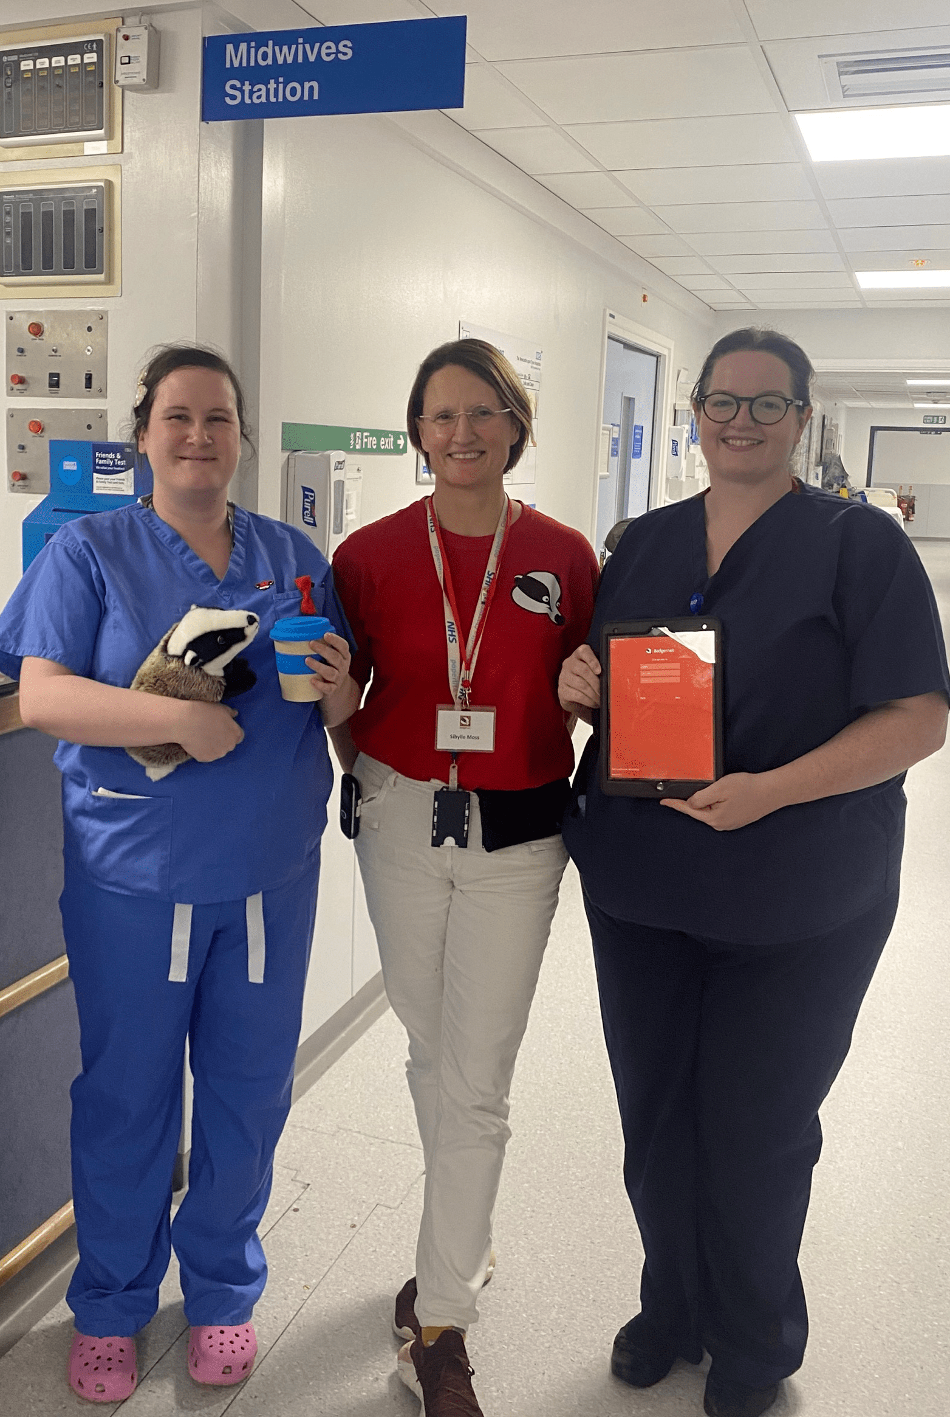
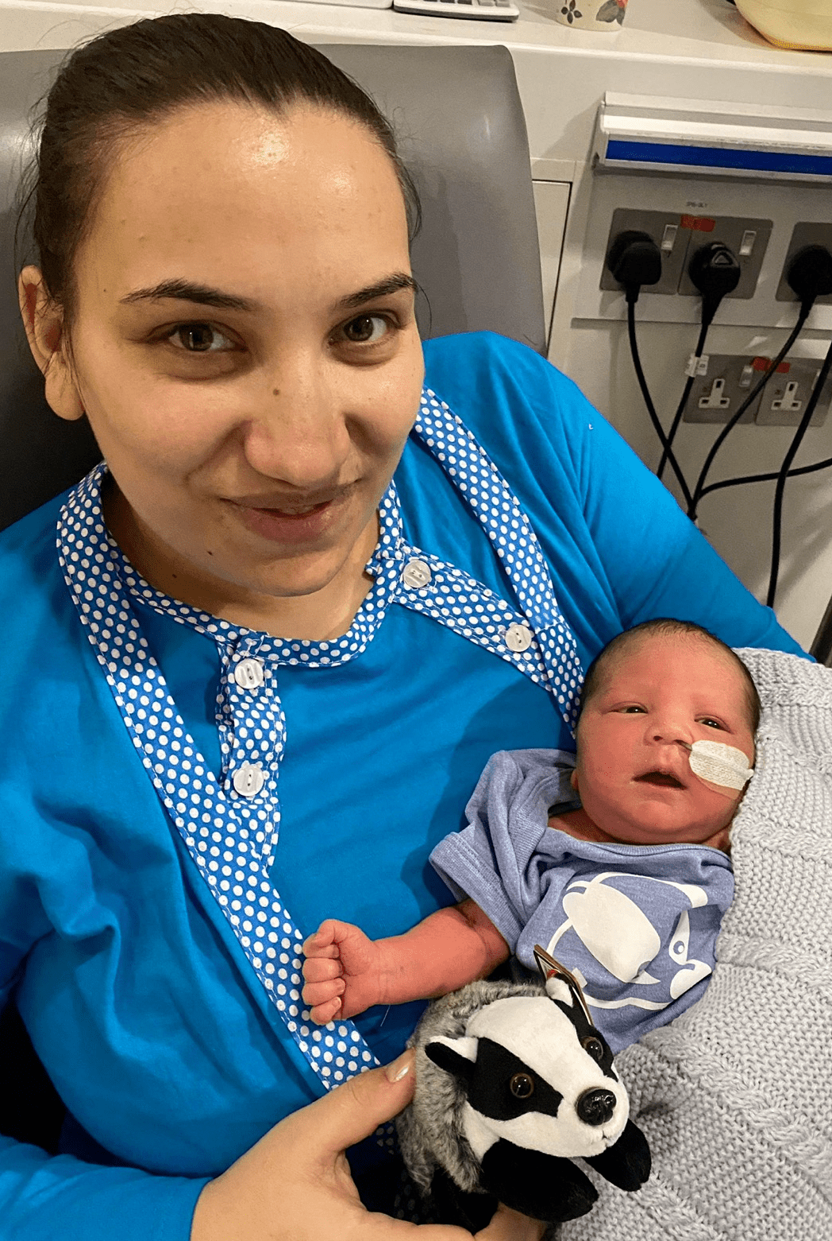
Great North Care Record the positives & our progress
Maternity implementation
Regional digital solution
Supported by the LMNS
Notes:
100% of GP primary care data is being shared. All GP practices are able to see data from Community Services, Acute Trusts, Mental Health Trusts, Ambulance Service and Council data
93% of Trust data is being shared. All Trusts are able to see data from Community Services, Acute Trusts, Mental Health Trusts, Ambulance Service and Council data
Out-of-hours providers also have access to the GNCR
Both Mental Health Trusts view and 1 (CNTW) share data
Over 250 Community Units are both viewing and sharing data
The North East Ambulance Service view (crews and service centre) and crew reports shared into GNCR
6 Local Authorities view the GNCR with 3 also sharing information

Slide 16
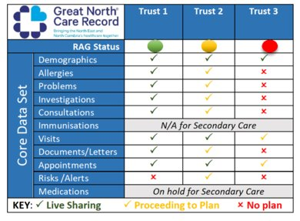
Prioritisation
Secondary care
Medications Community Pharmacy
Acute + community
dentistry
Prison services
Notes:
•Secondary Care Medications (ON HOLD)
•Prison Services - On HOLD UNTIL May 2024
•HealthCall App Integration within NE Care Homes (Initiation Stage)
•Acute Dentistry (OOH) (Initiation)
•Community Dentistry (Initiation Stage)
•Community Pharmacy (Initiation Stage)
•HIE Forms (Multi Author Documents in GNCR) (Initiation Stage)
•IAPTus Integration (Concept)
•Seamless Exchange with Cerner Millennium (Concept)
•PRISM (Pan-Regional Information Sharing Mechanism) NWAS (Concept)
•Two Factor Authentication (Concept)
•Mobile Application Version of GNCR (Initiation)
•Information Sharing with Scotland Shared Care Record (Concept)
•Information Sharing with Yorkshire & Humber Shared Care Record (Concept)

Slide 17
Challenges & Solutions
• Managing expectations
• Sustainable Financial and Support Model
• Insight into ACTION

Slide 18
Thank you
Great North Care Record
greatnorthcarerecord.org.uk
@GreatNorthCare

Slide 19
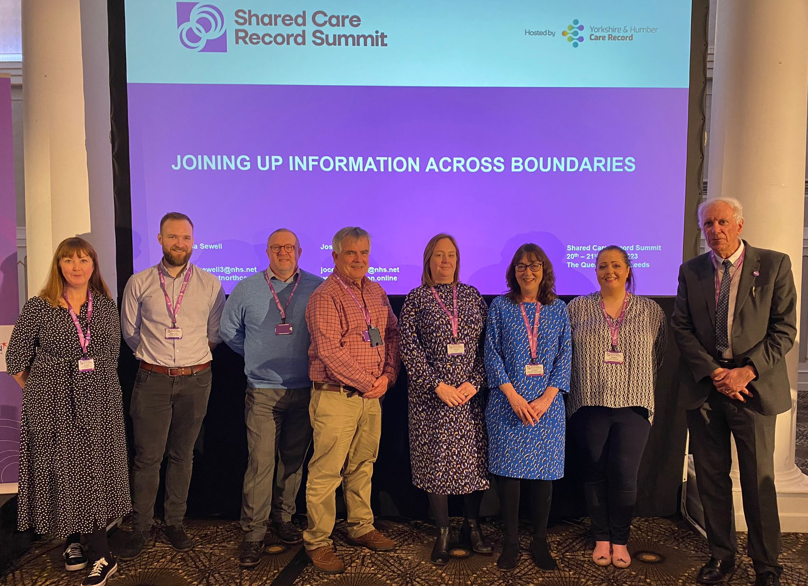
Summary
@GreatNorthCare
@OneLondon4

Slide 20
Challenges + Solutions: Group discussion

Slide 21
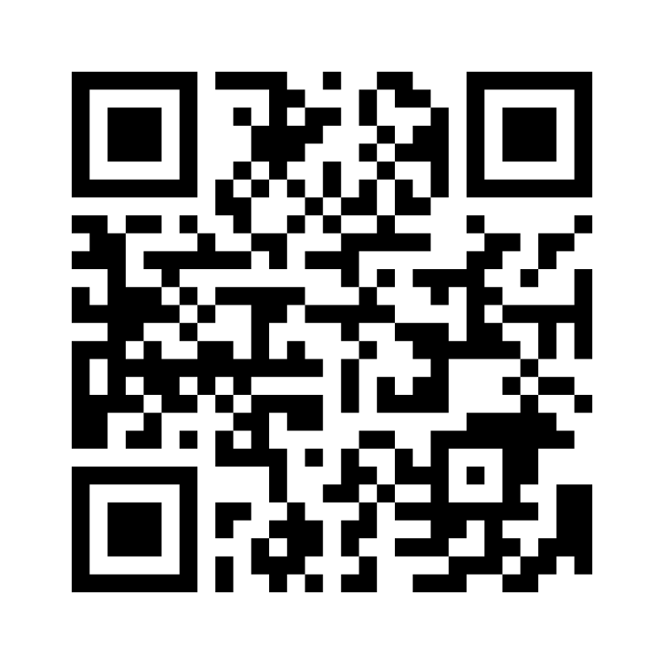
Challenges + Solutions: Group discussions
What are the biggest barriers and challenges you face at a regional level?
What potential solutions have you learned of during the Shared Care Record Summit?
*Spend 10 minutes on each point, discussing with peers on your table *Prepare to feedback one challenge and 1 solution per table (60 seconds)
*Menti 6803 1149

Slide 22
Lisa Sewell
lisa.sewell3@nhs.net www.greatnorthcarerecord.org.uk
Joss Palmer
jocelynpalmer@nhs.net www.onelondon.online

