Slide 1
Outcomes and actions for… Joining up information across boundaries
20th – 21st March 2023, The Queens Hotel, Leeds
Workshop Leads:
Lisa Sewell Great North Care Record
Lisa.sewell3@nhs.net
Joss Palmer One London
Jocelynpalmer@nhs.net

Slide 2
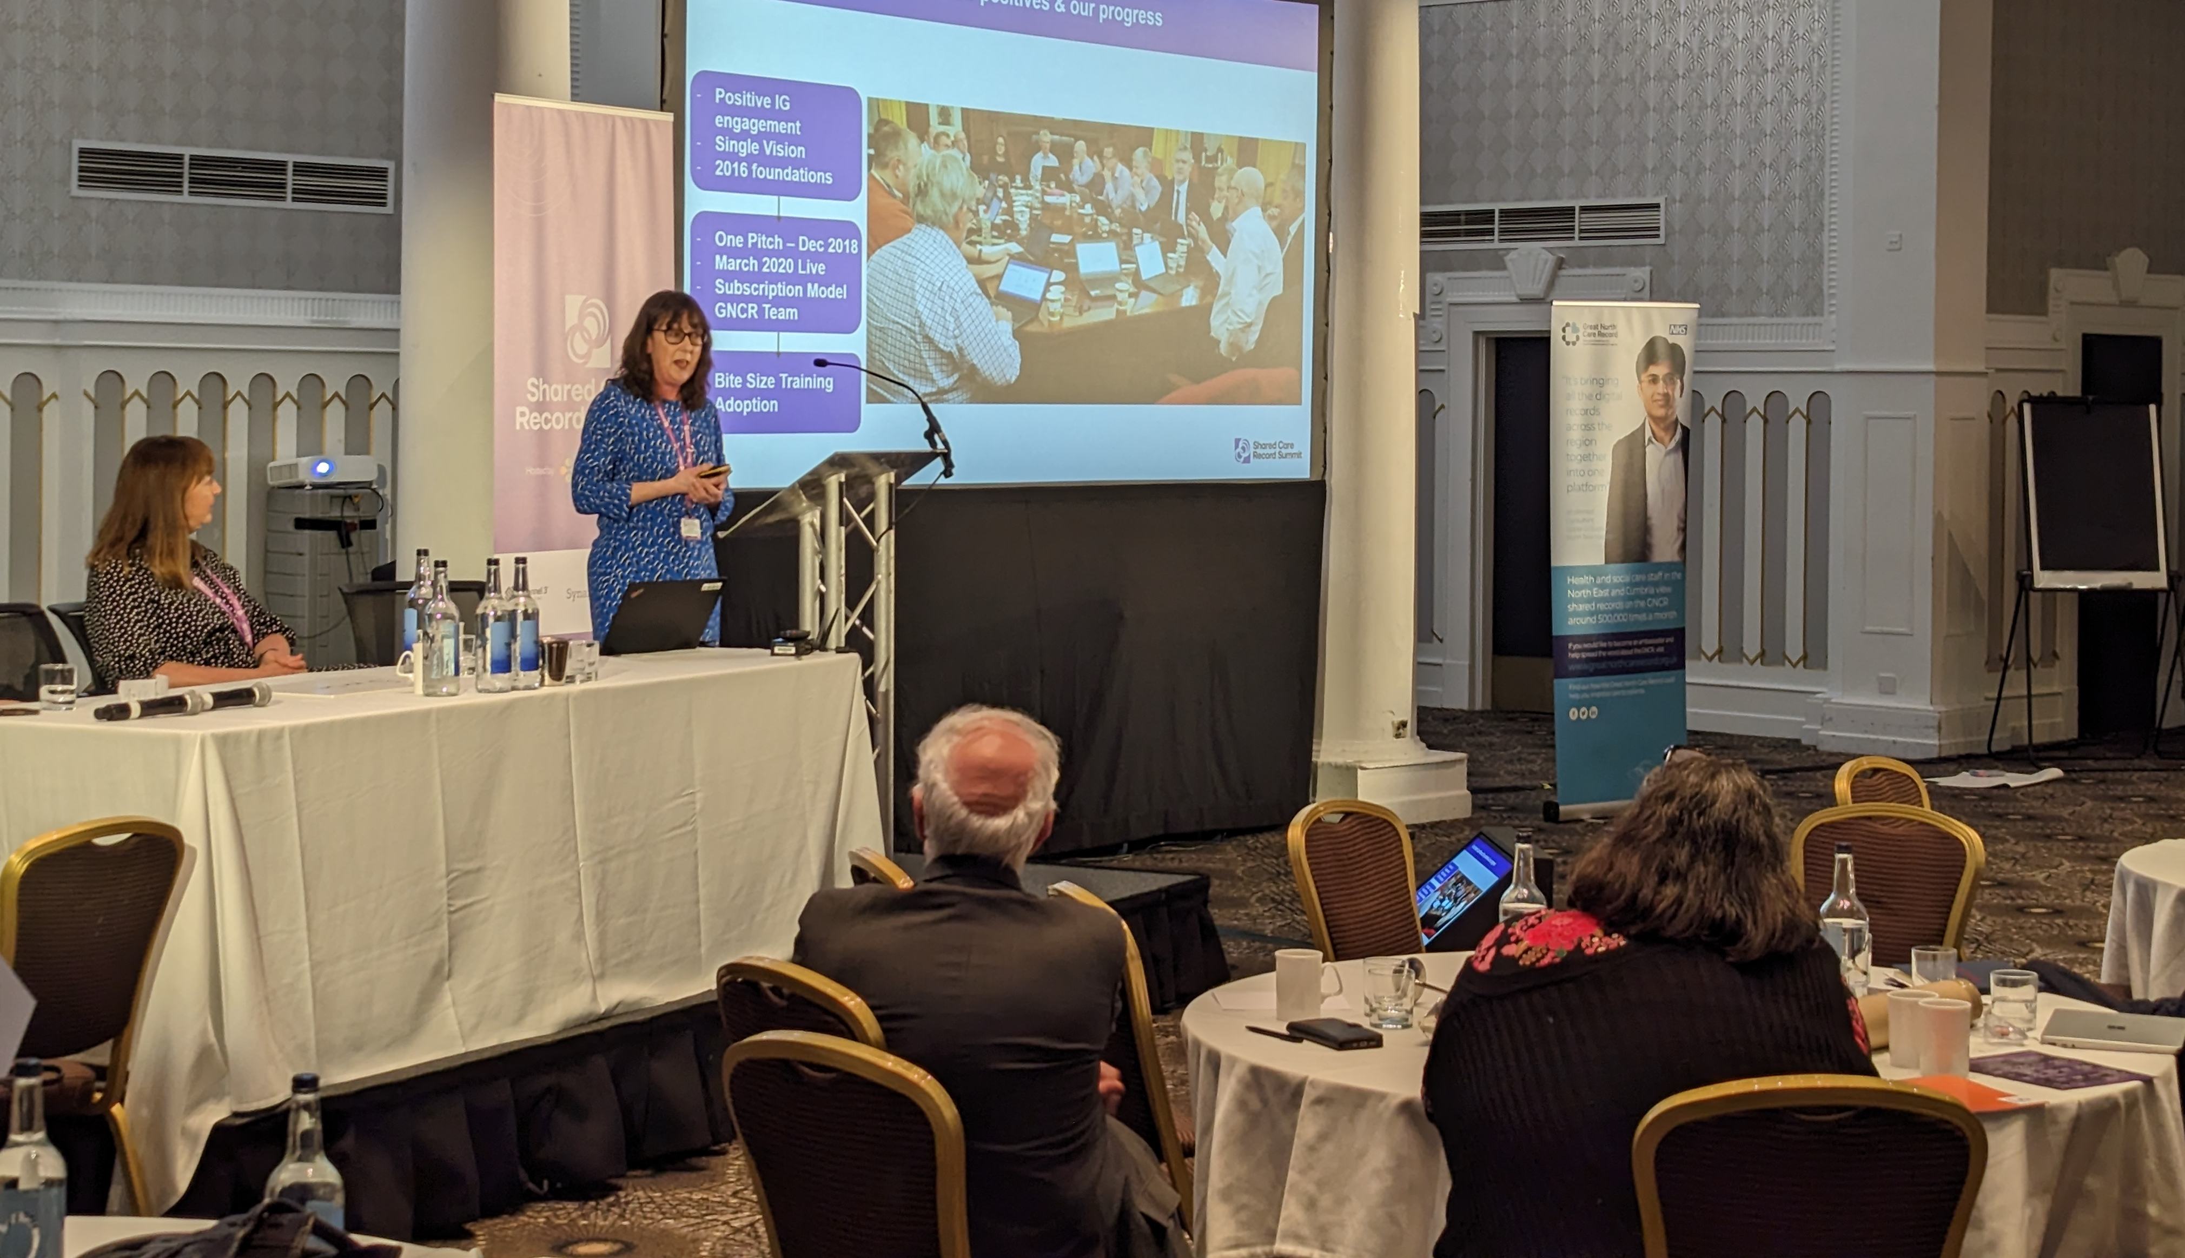
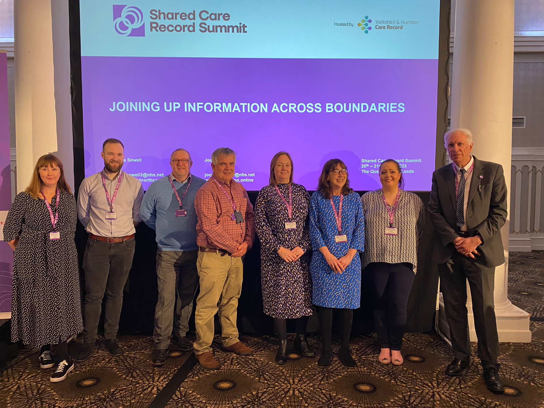
In summary:
The Great North Care Record and OneLondon hosted a joint session to share an update on their respective backgrounds and progress.
They provided an overview on how they work collaboratively across a region (multiple Integrated Care Systems.)
This session covered the solutions in place, current priorities and challenges faced by both Great North Care Record and OneLondon. Whilst many of the challenges are common to an ICS-based shared care record, this session had a very regional perspective.
After the presentation, delegates were invited to ask questions – and shared their biggest barriers and what they've learned at the Shared Care Record Summit.

Slide 3
Goals:
Please list the top 3 goals to take forward from your workshop
1.Develop ways to connect the talent, expertise and determination to get each shared care record to the same level of maturity
2. Continue to develop collaborative, regional decision making with the aim of ensuring sustainable commitment across multiple ICSs
3. Build upon the connections made at the Summit to continue to share solutions to common problems faced

Slide 4
Detailed Outcomes & Actions
Action/Outcome | Who is involved? | Check in Date
Develop ways to connect the talent, expertise and determination to get each shared care record to the same level of maturity GNCR and OneLondon will continue to share our progress, learnings and findings with NHS England Shared Care Record Team who will share as appropriate with wider ICBs (e.g. via ‘Learning From Local’) | GNCR OneLondon | End June 2023
Continue to develop collaborative, regional decision making with the aim of ensuring sustainable commitment across multiple ICSs GNCR and OneLondon will continue to share our progress, learnings and findings with NHS England Shared Care Record Team who will share as appropriate with wider ICBs (e.g. via ‘Learning From Local’ | GNCR OneLondon | End October 2023
Build upon the connections made at the Summit to continue to share solutions to common problems faced GNCR & OneLondon will collaborate, share and respond to issues that we both face as regional programmes. GNCR & OneLondon to provide ongoing active input into the national Shared Care Record Programme Directors Group – and any future Shared Care Record national events. GNCR & OneLondon will also continue to share through the National Team's Comms and Engagement Group | GNCR OneLondon | End May 2023

