Slide 1


How we share data across an ICS
IG success in the delivery of a shared care record
01234 56789
emails@address.com
www.webaddress.com
Shared Care Record Summit
20th – 21st March 2023
The Queens Hotel, Leeds

Slide 2
Good Morning Everyone
We are Information Governance
Who | Where | What
Johnny Chagger | Leeds Teaching Hospitals NHS Trust | Associate Director of IG and Data Protection Officer
Sue Meakin | Northern Lincolnshire and Goole NHS Foundation Trust and Hull University Teaching Hospitals | Information Governance Lead and Data Protection Officer
Derek Stowe | The Rotherham NHS Foundation Trust | Head of Information Governance and Data Protection Officer
Jenny Pope | Airedale and Bradford Teaching Hospitals NHS Foundation Trust | Head of Information Governance and Data Protection Officer
Becky Bradley | York and Scarborough Teaching Hospitals NHS Foundation Trust | Head of Information Governance and Data Protection Officer
Notes:
5 minutes
86 years

Slide 3
Workshop Outline
How IG were involved in the creation of the YHCR
Create a template for IG engagement
Experience working with IG
Notes:
1 minute
BB

Slide 4

What is the Yorkshire & Humber Care Record?
Joined-Up Care
Our ultimate goal is to enable us to collectively manage the delivery of safe, effective and patient-focused care to the whole person through collaboration across our health and care economy.”
Notes:
2 minutes

Slide 5


Why?
Query
Response
Data providing organisation A
Request
Internet
Response
Internet
Query
Internet
Response
Data consuming organisation
The Data Consumer organisations is looking to view patient/person information from another organisations
Internet
Data providing organisation B
Query
Response
Any Acute, GP, Mental Health, Social Care orgs etc., in HCV can be a data consuming and/or data providing organisations.
Data providing organisation C
Notes:
2 minutes
IG enables the purpose so it is legally and ethically sound
Health and care data can protect individuals when they are most vulnerable, can be used to prevent people becoming unwell in the first place, and can help them to live independently and connected to their community. It helps our health and care services continually improve the treatments and care they deliver, ensures that care is tailored to the needs of each individual, and it can empower people to look after themselves better and to make more informed choices about their own care

Slide 6

Our Journey
Notes:
10 minutes
IG and the YHCR
Initiation with IG – JC (central IG support for this) + start of supplier engagement and documentation, sorting the legal basis (challenges?), privacy by design
Communicating with internal teams
Providing a consistent explanation of what is meant by direct care and secondary uses
Reassuring the public that data from the NHS and its partners is available only to the right people, at the right time, in the right place – and that it is always shared securely and lawfully,
Assisting in gaining access to data by understanding and describing the scope of secondary use intelligence and data requirements and how to map the associated data flows.
Enabling identification of statutory functions for the use of the data.
Providing an understanding of the statutory constraints and other legal requirements such as the Common Law Duty of Confidence
Providing standardised Information Governance templates for organisations.
Defining standards for risk mitigation and highly controlled environments when using data which is anonymised in line with the ICO code for limited access.
Ensuring the regional IG framework is aligned to other national data standards, policies and legal obligations
Looking in to the future and acknowledging any potential requirements for the use of data for individual and secondary use purposes in a landscape of evolving public service delivery
Encouraging consistent, digitally enabled approaches to information governance practices in line with the interoperability agenda.

Slide 7
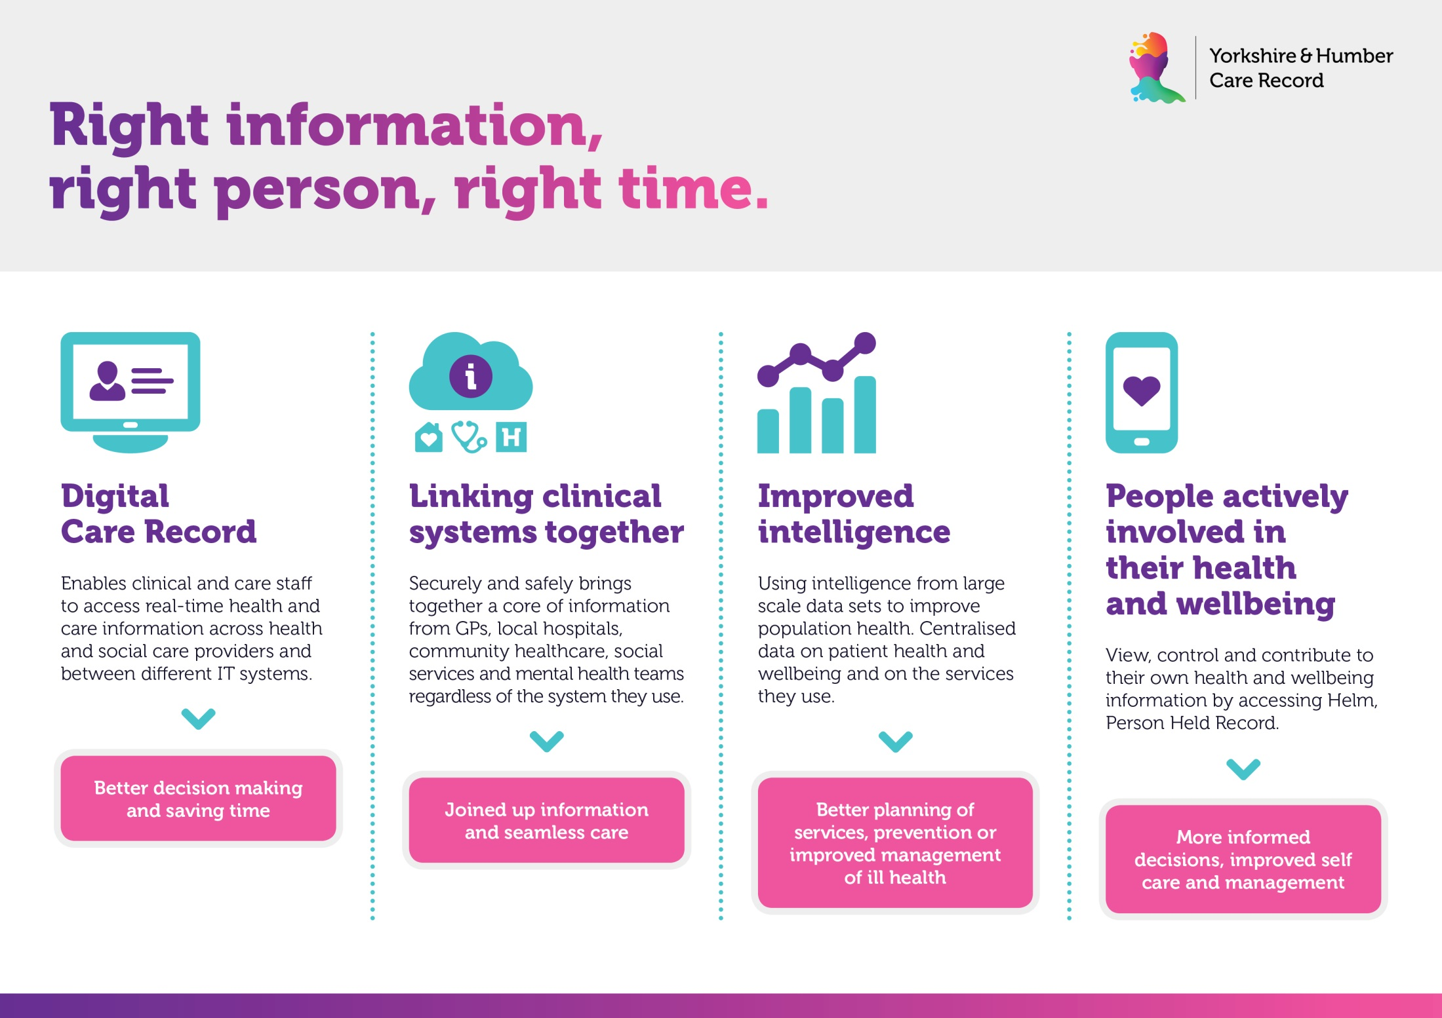
Data Processors
Notes:
Johnny and Derek’s experience
Challenges, positives

Slide 8

Shared Care Record
Shared Care Plans
Controller
Controller
GP
Trust
Controllers
(in common)
Controller
Black Pear
CCG
GP
Controller
Processor
?
ShCR
CCG
Controller
Black Pear Core
CCG
GP
Controller
Controller
Trust
GP
Notes:
Real world use case
ShCR surfacing information from different sources (YHCR)
ShCP in part of the region providing information about patient preferences (Black Pear Core, contracted by HCV/HNY)
Clearly, it would be beneficial for the ShCR to include information about patient preferences.
Option 1:
ShCR existing model.
Data sharing agreement between the ShCR and the operator of the technical endpoint.
As a supplier we’re processing data on behalf of the controller, so we don’t have the authority to share it.
Rejected as not lawful.
Option 2:
ShCP existing model.
Data sharing agreement between the individual GPs and the new Controller.
This would work but would require many agreements (7CCGs, each with many GPs)
Rejected as not practical.
The models used wouldn’t work so all the stakeholders were forced to look

Slide 9
Shared Care Record
Shared Care Plans
Controller
Controller
GP
Trust
Controllers
(in common)
Controller
Black Pear
CCG
GP
Controller
Processor
ShCR
CCG
Controller
Black Pear Core
CCG
GP
Controller
Controller
Trust
GP
Notes:
Solution
IG teams at the CCGs (i.e. Controllers in common for the ShCP) worked together to decide what authority they had as a group.
They agreed to create a data sharing agreement between the Controllers (in common) and the ShCR Controller, so was lawful.
This option required only 7 signatories, so was practical.
The solution challenged both of the existing IG models.
Would have been tempting to take a shortcut and ignore the problem.
In the end, clear robust IG model.
Outcome
Shared Care Plan platform has had >10000 plans created since inception
These were already shared with providers such as 111, local Acute Trusts, but not with ambulance service, so YAS not able to consider patients’ preferences when making decisions.
Solving the IG problem meant that there was legal basis to switch on the technical integration so that ShCP available to YAS

Slide 10
Black Pear
“We also pull through the patient end-of-life care plans shared by Humber & North Yorkshire and make these accessible to front-line ambulance crews through our electronic patient record application. Around 20-30 care plans are accessed each week and feedback from staff confirms that this information improves their confidence in treating end-of-life patients, and helps with clinical and conveyance decision making.”
[YAS 2022]
Notes:
Every week, 20-30 patients at a critical time are being treated in accordance with their wishes.
There is ongoing work to make the ShCP available within the YHCR viewer so that their preferences can be taken into consideration when they are care for in even more settings.

Slide 11

Communicating to the IG Network
National SIGN
Regional Strategic IG Networks
Local IG Networks
Newly formed ICS/ICB IG Groups
Notes:
JC provision of documentation and response
SM discuss SIGN
Challenges – back and forths on documentation
Expectations (people wanting individualised stuff)
Timescales
Individual DPIAs

Slide 12




External parties
Notes:
CAG approval
ICO approval

Slide 13
Patients
Notes:
Patient Engagement
Transparency
Complaints
How is it dealt with comms teams
How many opt outs have there been?

Slide 14
Feedback from Pilot Practices
“A GP could quickly view a clinical letter for their patient using the YHCR. This provided the most up to date and relevant data, making the consultation much more effective and allowing the GP to make accurate clinical decisions.”
“A GP wanted to confirm with the midwifery team if their patient had attended for a miscarriage at Leeds Teaching Hospital. The GP could easily use the YHCR to confirm the occurrence, saving clinical time, and was able to provide the best possible care.”
“A patient was complaining regarding the location of their medical records. The GP could physically show the patient their care record and was able to reassure that their information had been shared with the appropriate organisations in a timely manner.”

Slide 15
What is the key to Success?
Planning IG into the programme
Each organisation project plan
Long term IG engagement

Slide 16
Develop a plan – when do you need IG to be involved, what do you need from them?

Slide 17
Prompts
When should IG be involved?
Who initiates IG into the project (internal DPIA/CAB/PM meetings)
If there are suppliers how are IG involved with procurement and when (DTAC/DPIA)?
Are IG timelines considered (ICO consultation)?
Notes:
Gather in and pull together as an outcome – flipcharts pens

Slide 18
What has been your experience when working with IG teams?
Notes:
Initially ask this question, encourage both negative and positive experiences – open forum + post its if they want (could the menti work? – positive and negative poll?)

Slide 19
How can this be made positive?
Do you think earlier conversations with suppliers would make the process easier – how?
What can we request from suppliers for due diligence checks?
What do we expect suppliers to provide us with to ease IG due diligence?
Who in your organisation might need additional support understanding the IG side so it is considered at the start of projects?
Would specialist training be beneficial?
What is already in place?
Notes:
Gather up as an outcome

Slide 20


IG is a Barrier and Barrier’s Protect
Notes:
Jenny and Derek to close
IG is here to ensure that projects are data protection compliant, we want to enable this and it also challenges perspective and practical questions to ensure longevity of a project

Slide 21
Questions

