Slide 1
Outcomes and actions for Information Governance 4B How we share data across an ICS IG success in the delivery of a shared care record
20th – 21st March 2023, The Queens Hotel, Leeds
Workshop Leads:
Johnny Chagger Leeds Teaching Hospitals NHS Trust
Associate Director of IG and Data Protection Officer
Susan Meakin Northern Lincolnshire and Goole NHS Foundation Trust and Hull University Teaching Hospitals
Information Governance Lead and Data Protection Officer
Becky Bradley York and Scarborough Teaching Hospitals NHS Foundation Trust
Head of Information Governance and Data Protection Officer
Derek Stowe The Rotherham NHS Foundation Trust
Head of Information Governance and Data Protection Officer

Slide 2
In summary:
The workshop provided an insight on how Information Governance provided a key and pivotal role in making the Yorkshire and Humber Care Record (YHCR) a success. Key Points that were discussed are:
Providing a consistent explanation of what is meant by direct care and secondary uses
Reassurance to the public that data from the NHS and its partners is available only to the right people, at the right time, in the right place – and that it is always shared securely and lawfully
Assisting in gaining access to data by understanding and describing the scope of secondary use intelligence and data requirements and how to map the associated data flows.
Enabling identification of statutory functions for the use of the data.
Providing an understanding of the statutory constraints and other legal requirements such as the Common Law Duty of Confidence
The Provision of standardised Information Governance templates for organisations.
Defining standards for risk mitigation and highly controlled environments when using data which is anonymised in line with the ICO code for limited access.
Ensuring the regional IG framework is aligned to other national data standards, policies and legal obligations
Looking into the future and acknowledging any potential requirements for the use of data for individual and secondary use purposes in a landscape of evolving public service delivery
Encouraging consistent, digitally enabled approaches to information governance practices in line with the interoperability agenda.

Slide 3
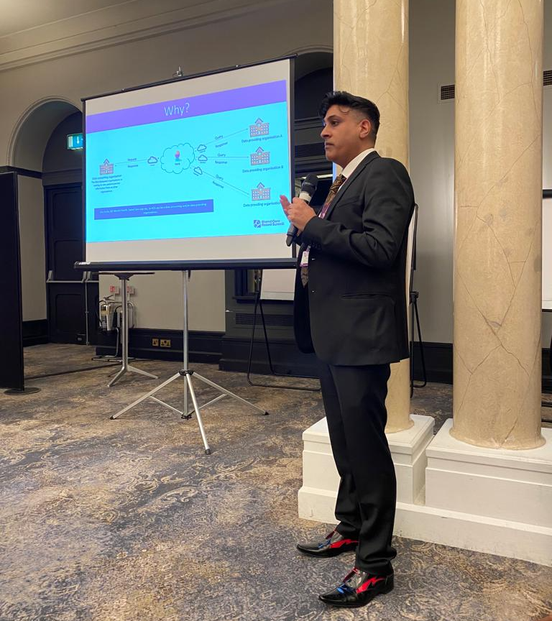
Goals:
Please list the top 3 goals to take forward from your workshop|:
Ensure Early Information Governance involvement
2. Standard IG Documentation
3. Let IG help build the concept and vision of the shared cared record.

Slide 4
Detailed Outcomes & Actions
Action/Outcome | Who is involved? | Check in Date
The Provision of standardised Information Governance templates for organisations. | Johnny Chagger | Summer 2023
The identification of statutory gateways for the use of data for direct care | Johnny Chagger | Summer 2023
The identification of statutory gateways for the use of data for population health management | Johnny Chagger | Summer 2023
Provide an understanding of the statutory constraints and other legal requirements such as the Common Law Duty of Confidence | Johnny Chagger | Summer 2023
Ensure that Information Governance Teams are consulted from the outset | Johnny Chagger | Summer 2023
Ensure that Information Teams assist with designing and developing IT solutions | Johnny Chagger | Summer 2023

