Slide 1


Designing for Excellent
Shared Care Record Adoption
Toby Page, Victoria Betton,
Gill Foley, Laura Godtschalk
Shared Care Record Summit
20th – 21st March 2023
The Queens Hotel, Leeds

Slide 2


Victoria Betton
victoria@peopledotcom.com

Slide 3
Human-centered design is an iterative design process in which designers focus on the people and their needs in each phase of the design process.
Design teams involve people throughout the design process via a variety of research and design techniques, to create highly usable and accessible products and services.
What is human-centred design?
Notes:
PR

Slide 4
Simon proposes an inclusive definition of a designer:
“Everyone designs who devises courses of action aimed at changing existing situations into preferred ones”
(Herbet. A. Simon, The Science of Design, 1969, p. 55)

Slide 5
Double Diamond
Design Principles
Challenge
Discover
Define
Develop
Deliver
Outcome
Methods
Bank
The design model is adapted
from UK Design Council

Slide 6
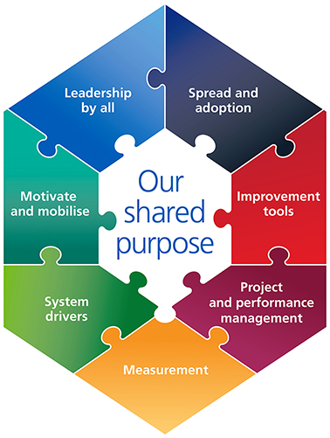
Quality improvement
Service
transformation
Patient & public involvement
Organisational development
Notes:
VB

Slide 7
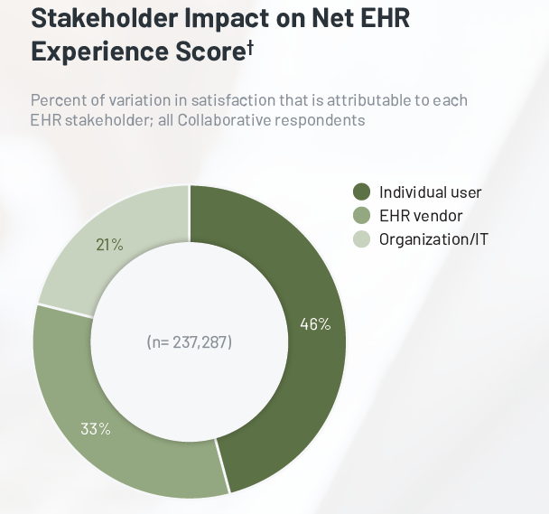
EPR usability - NHS England survey results 2022
73% of organizations have two physicians
of the same specialty using the
same EPR in which:
One physician strongly disagrees that the EPR enables them to deliver high quality healthcare.
One strongly agrees that the EPR enables them to deliver high quality healthcare.

Slide 8


Nursing in the Digital Age (QNI, 2023)
User experience
Connectivity
Overall, the nursing workforce has a high level of digital literacy - the poor user experience reported frequently appears to be around design and function rather than a lack of literacy or enthusiasm for
technology. The workforce also has an appetite for high functioning technology & can see the potential of new applications.
Systems were felt to be impersonal and not well designed, acting as a barrier
to interacting with patients. Work was intensified by repetition with dual entry on paper and into platforms required, often because of poor connectivity or design.
Usability issues
Lack of involvement
Systems are slow, with 74% reporting connectivity issues; issues with power, for example battery life; the suitability of both hardware and software, using old heavy laptops, authentication challenges, multiple platforms, little integration and repetition of data entry.
Nurses often stated that technology, particularly that which schedules work, is deployed without consultation, user experience trials or impact assessments.
The Queen’s Nursing Institute, 2023

Slide 9
Usability is…
Clinical safety issue
Data quality issue
Patient experience issue
Staff satisfaction issue
Notes:
VB

Slide 10
2. Case study:
Digital strategy for Salford community services

Slide 11

The brief
”
To develop and test a model for user-centred design through:
Workshops with key leadership groups to build knowledge & a mandate
A design group with OD, QI, digital & PPIE
Capability building sessions / training with a cohort of staff
UCD community of practice
Coaching for people in key roles
Designing job descriptions and business case for UCD
Develop case studies through projects.

Slide 12
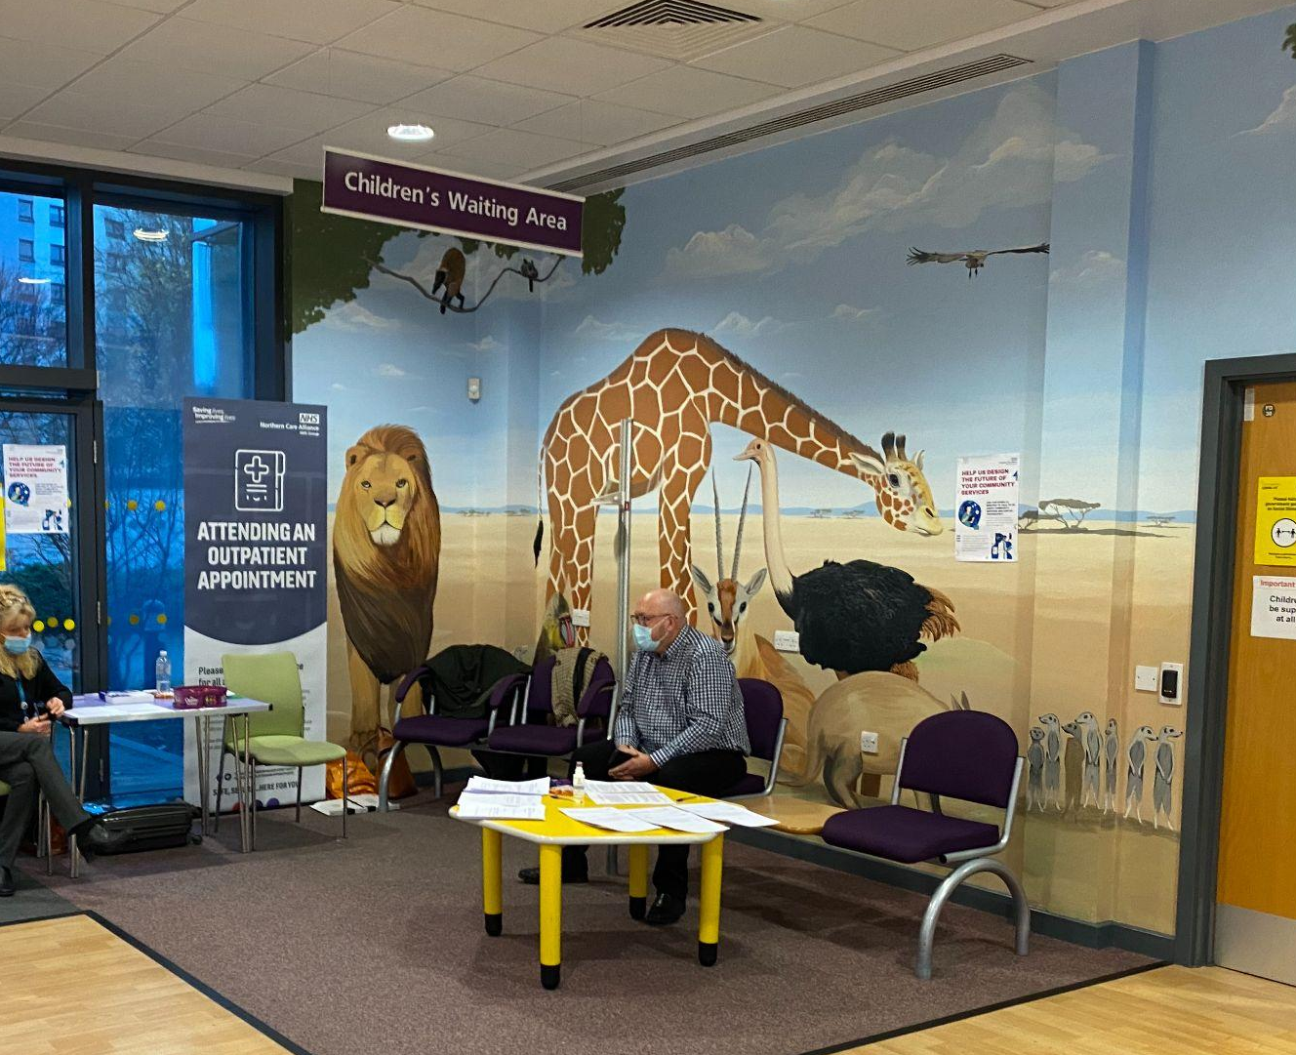
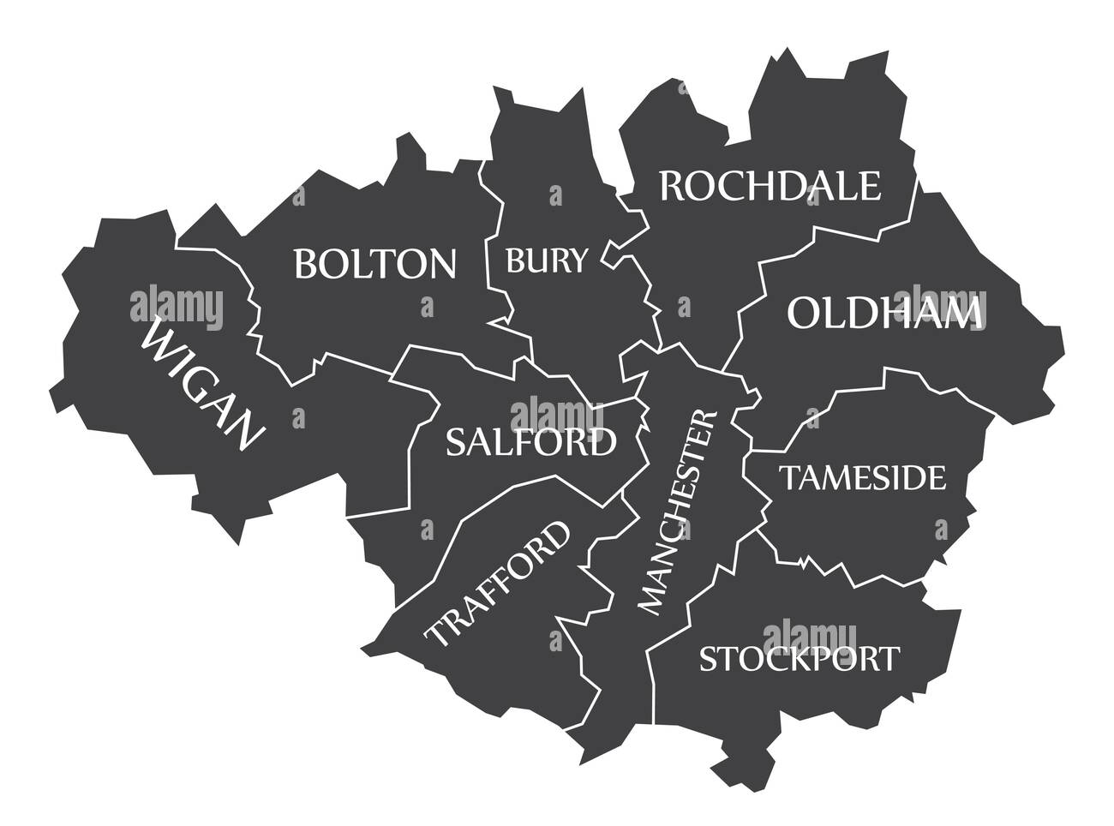
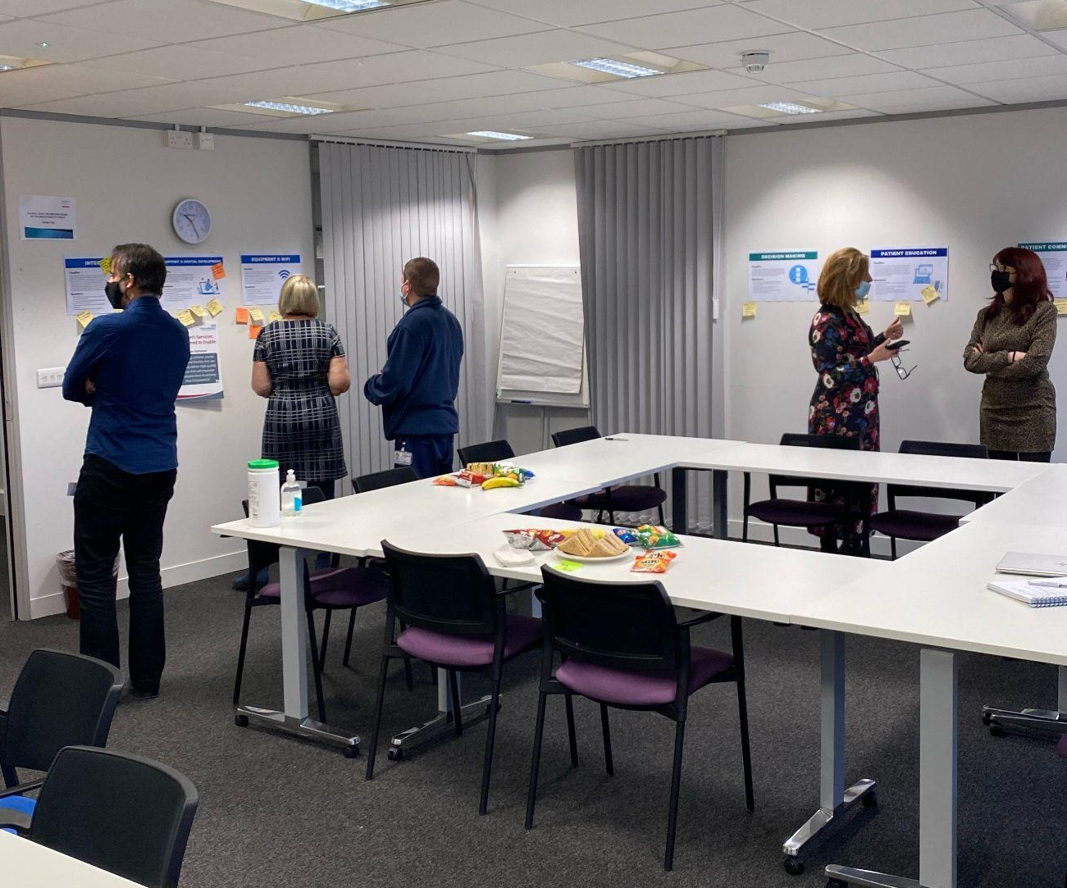
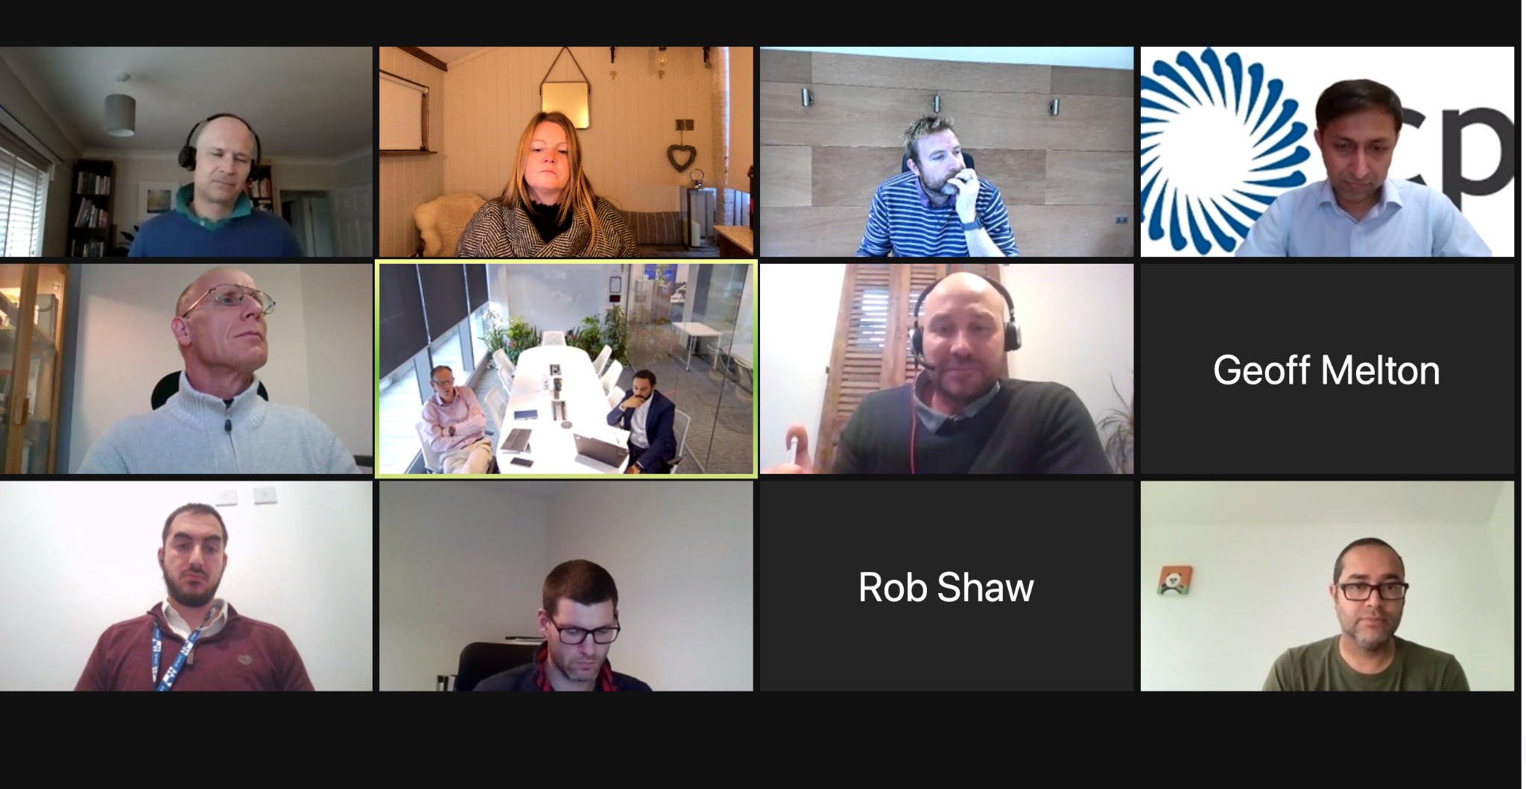
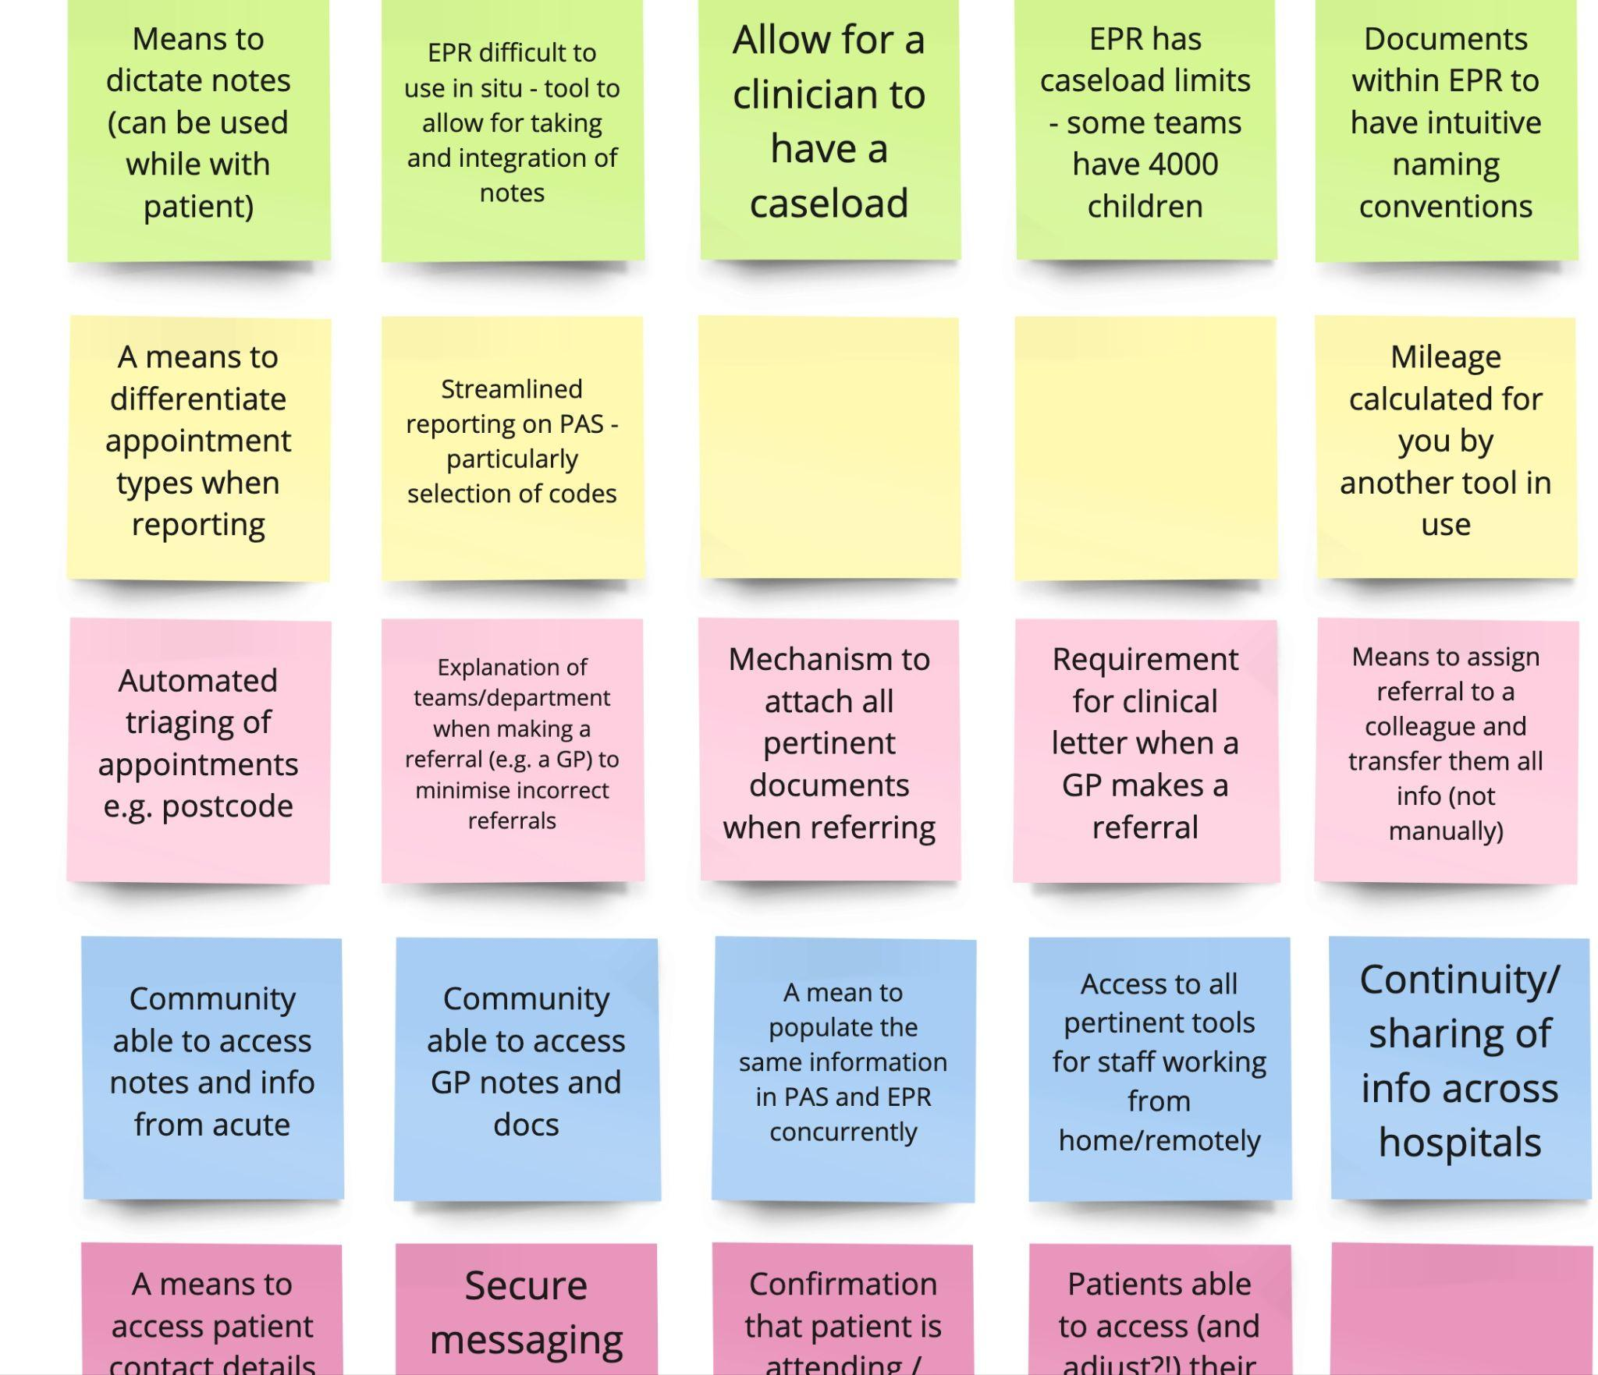
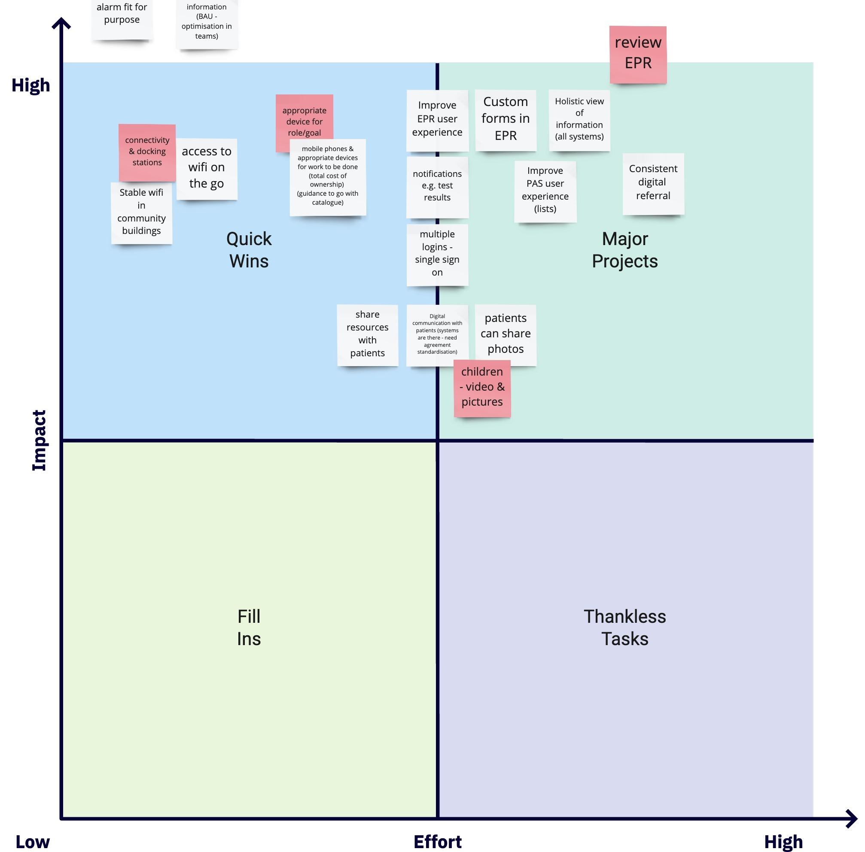
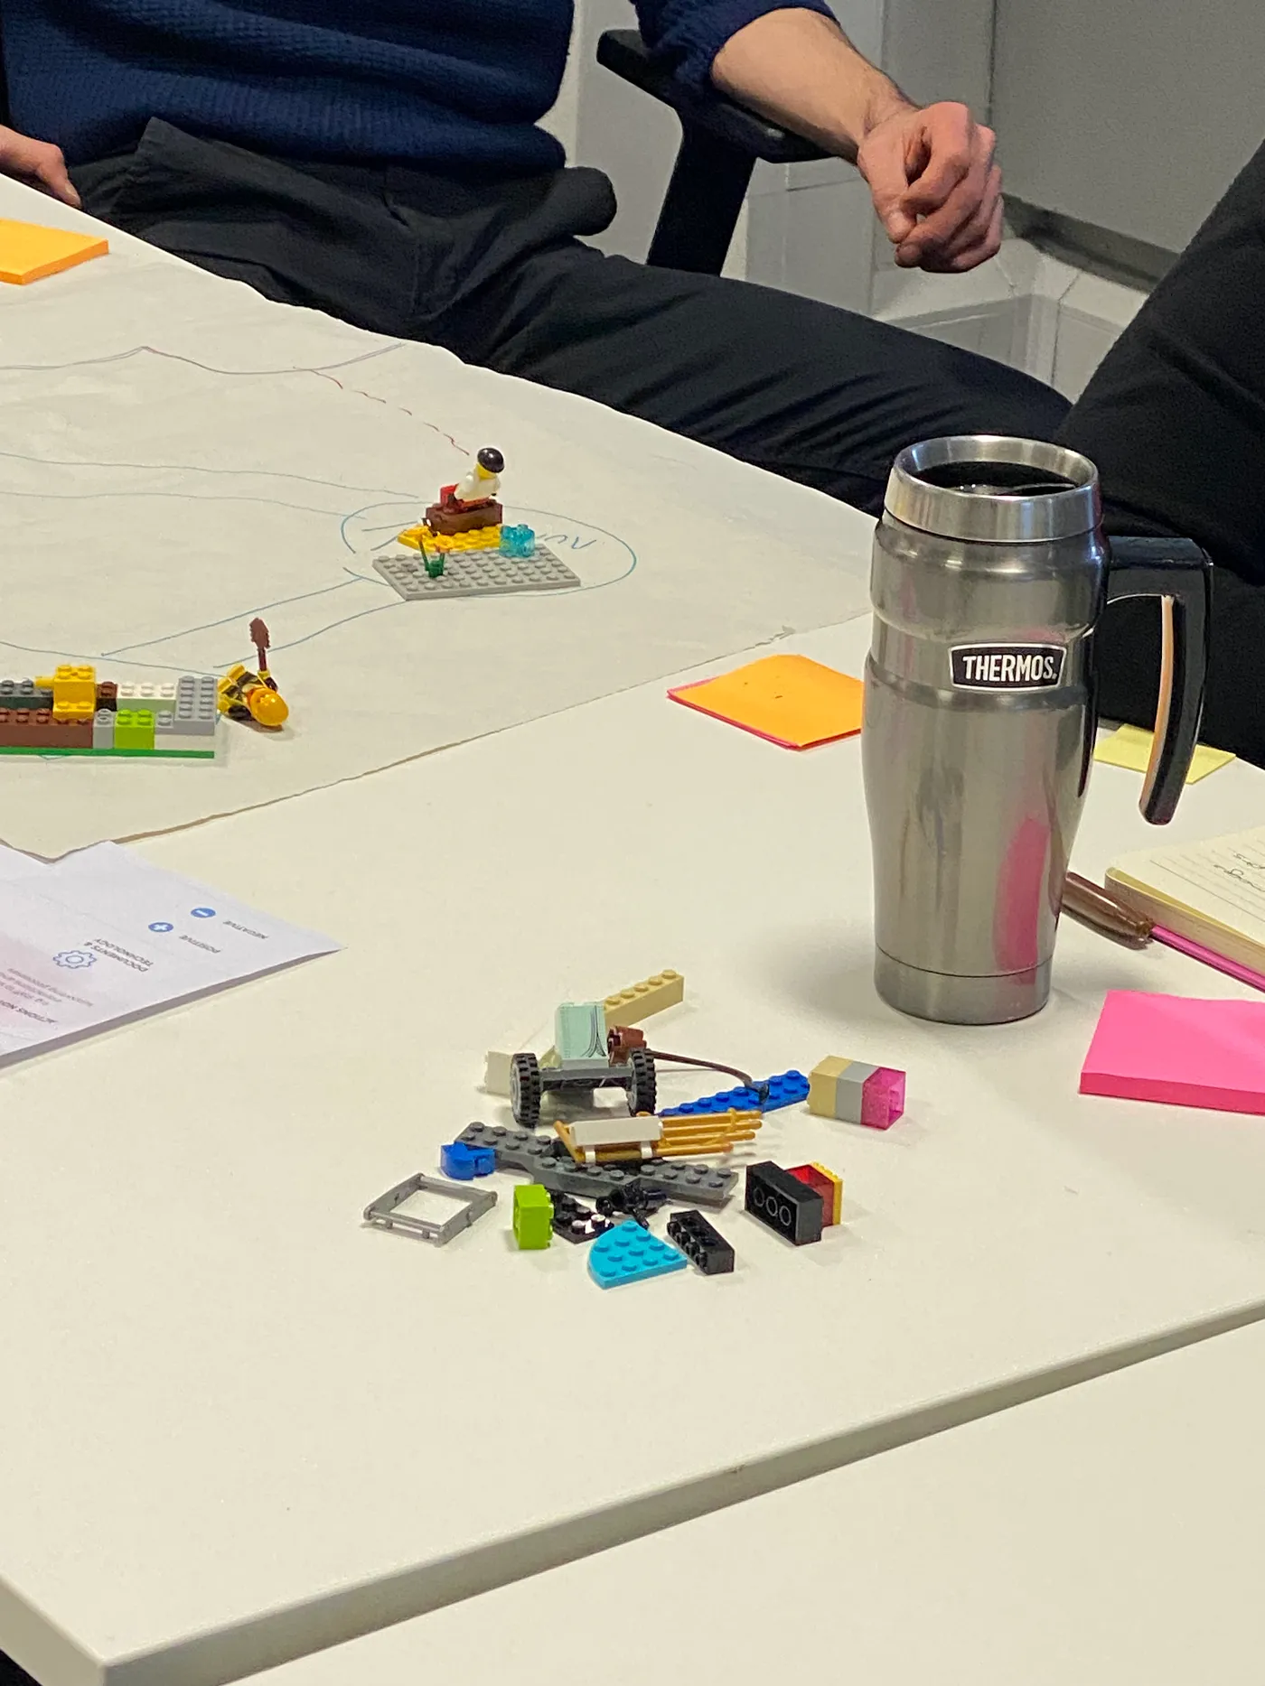
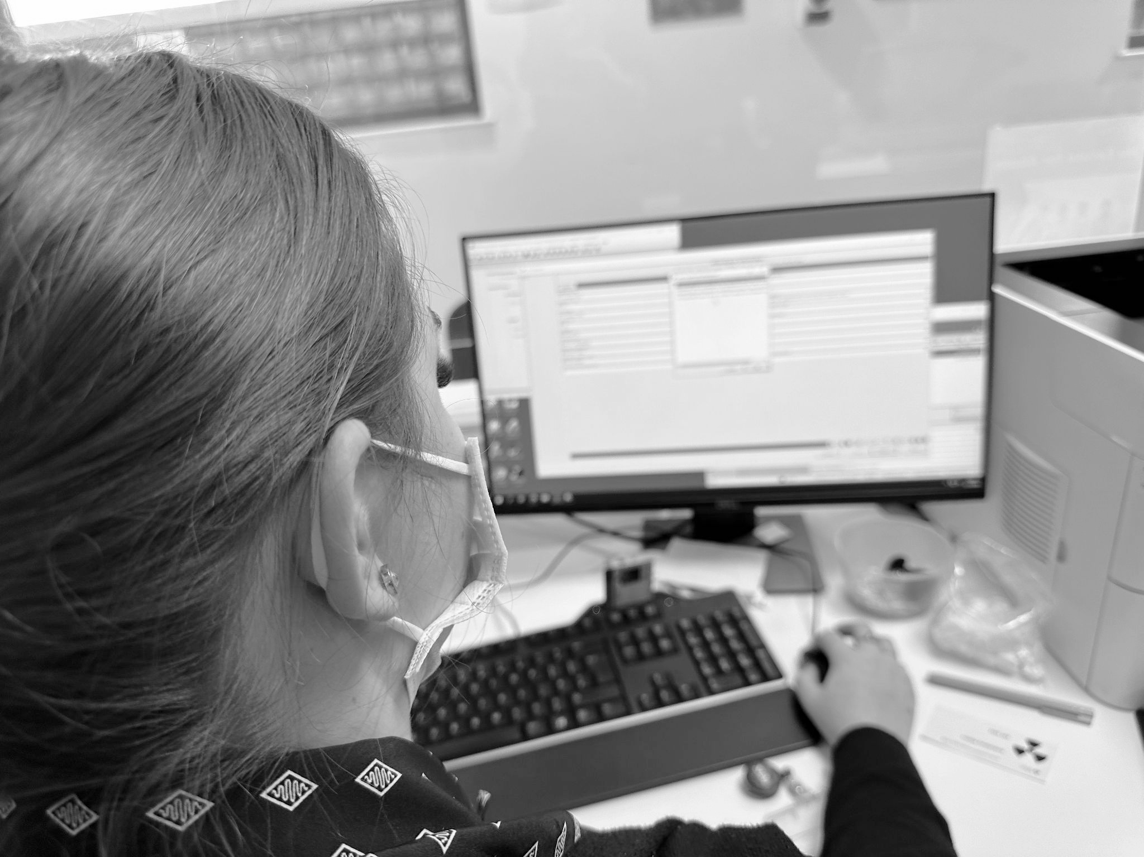
What we did - timeline
Mapped assets
Expert interviews
Design workshops
+ Show & tells
Ethnography
Pop up workshops
Strategic priorities
Delivery - (a) connectivity (b) devices
(c) photo sharing
Three initiatives - Discovery & user research
Testing - simulation & experimentation
Notes:
P
See slide 9 for timeline and numbers on slide 12.
User research front page / outlines of what has been done.
Who we’ve spoken to

Slide 13
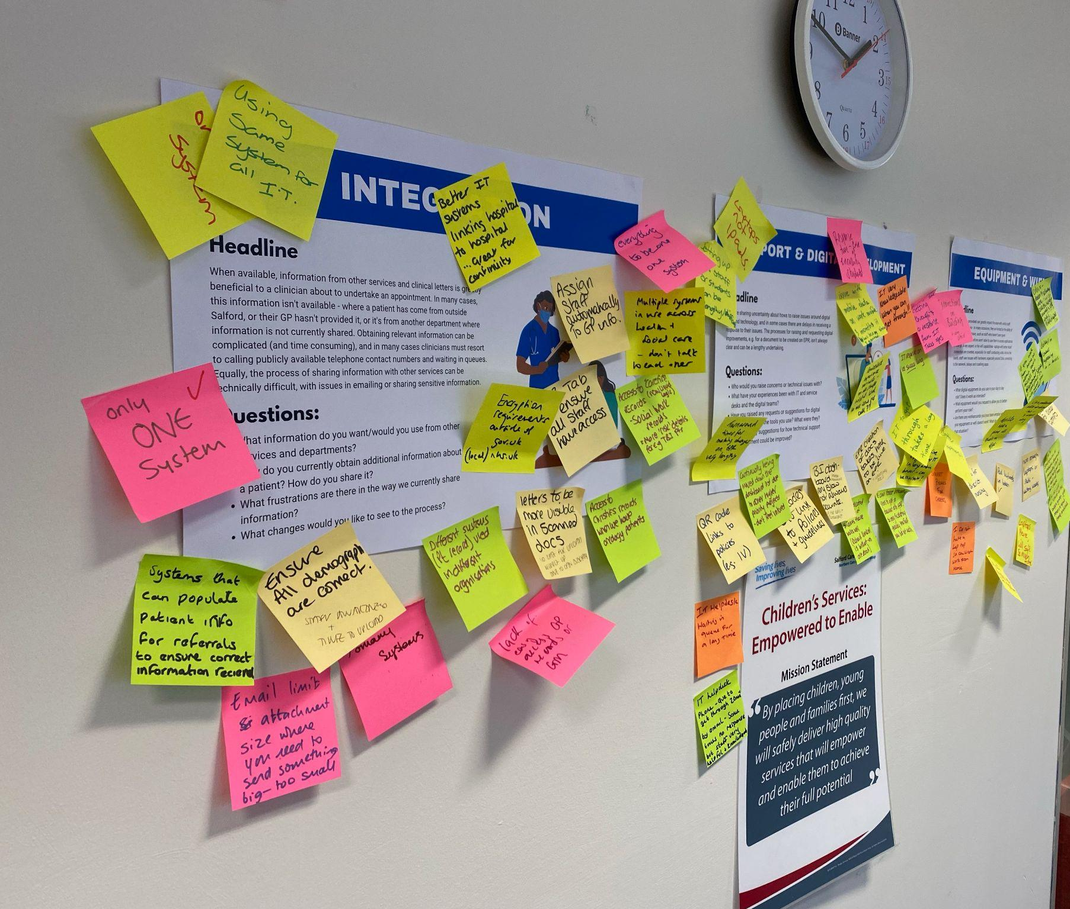
Salford community services digital strategy
Going to where people are

Slide 14
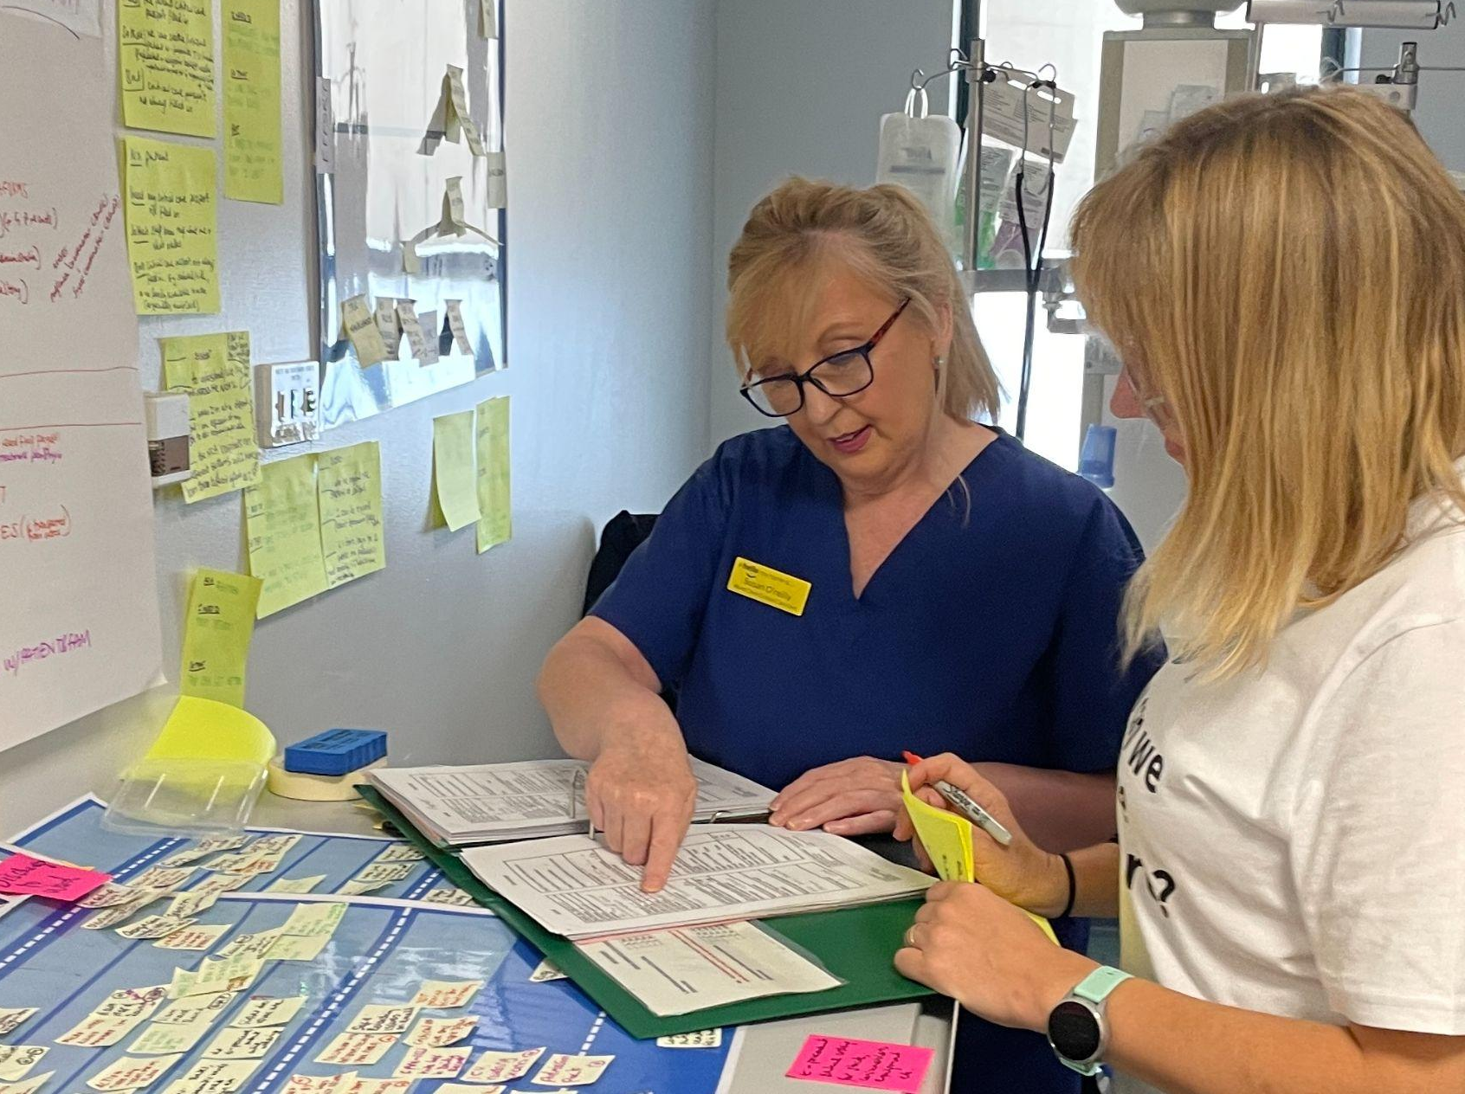
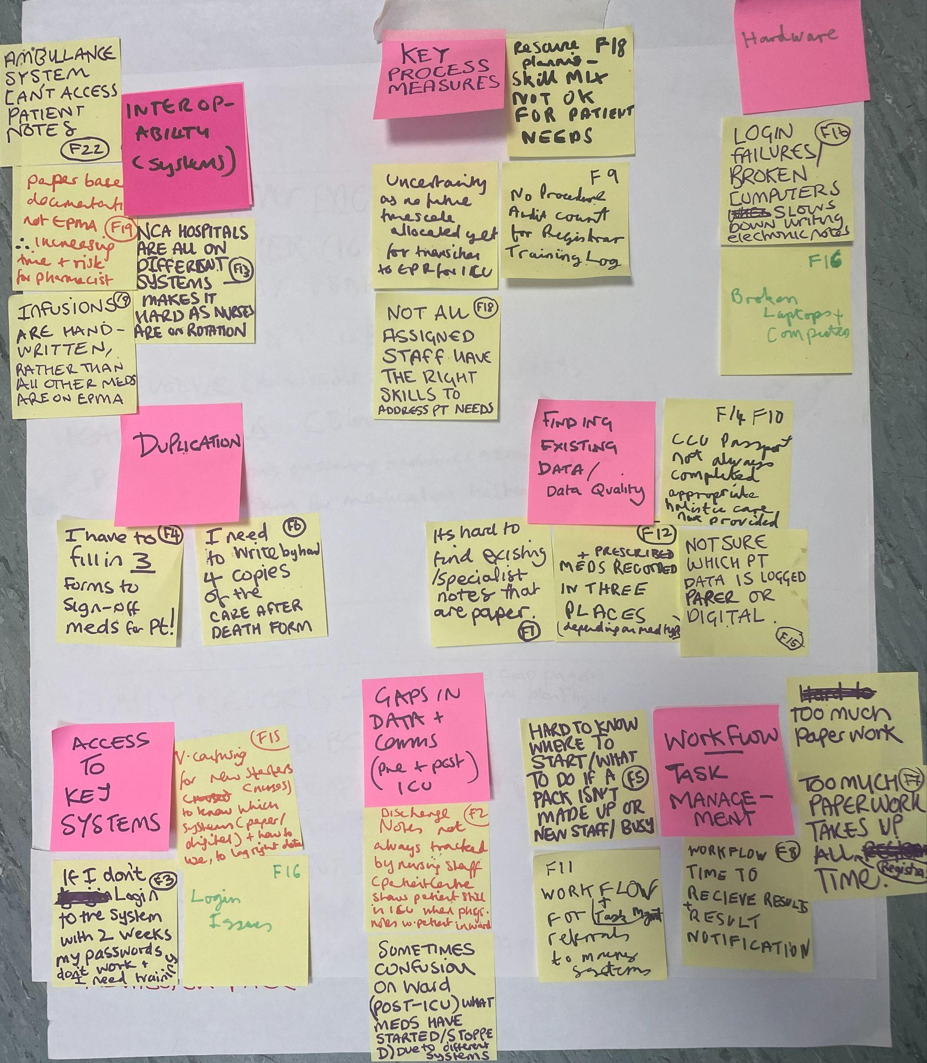
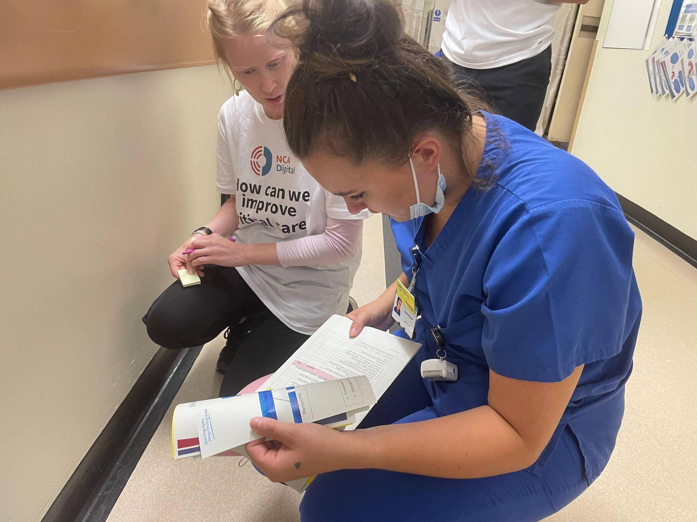
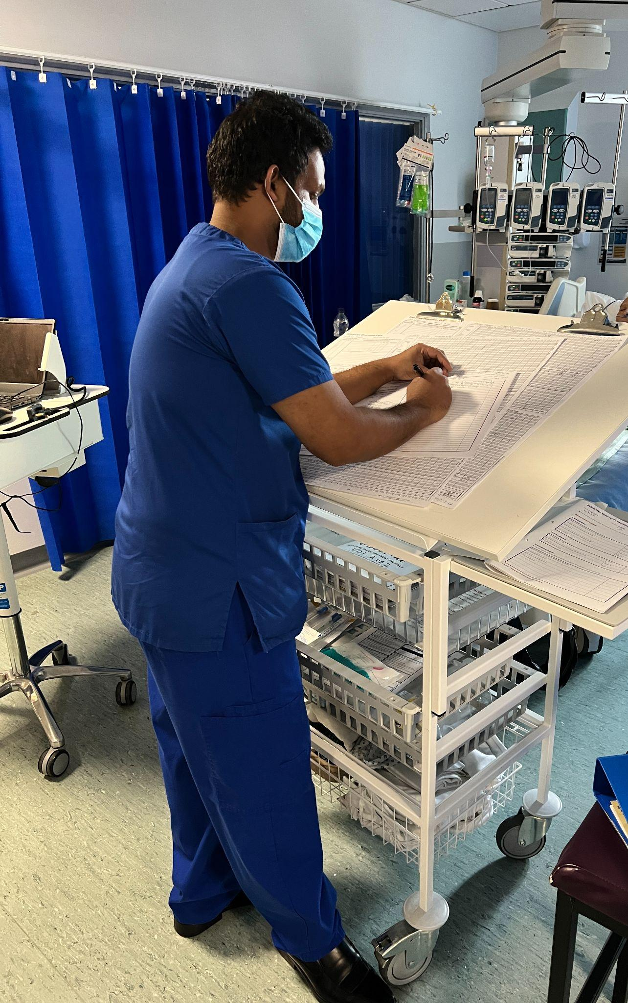
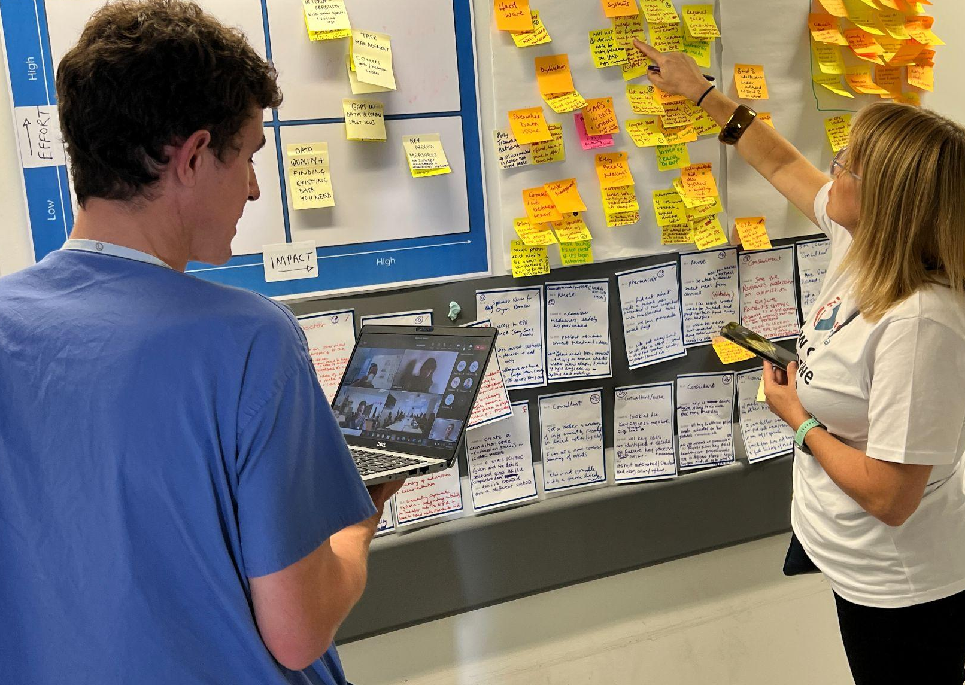
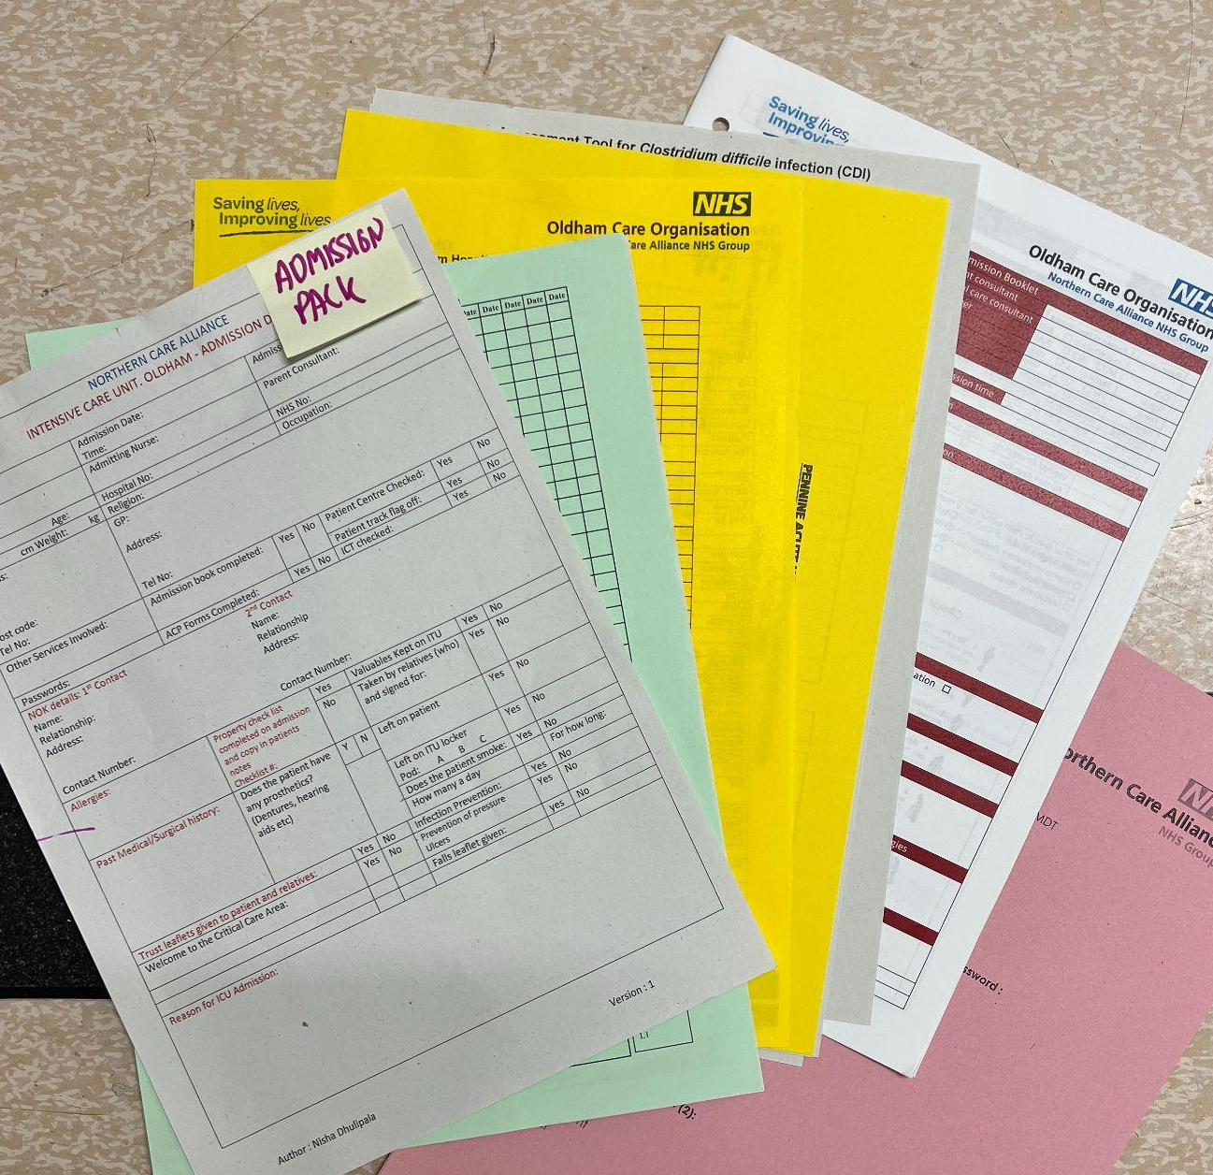
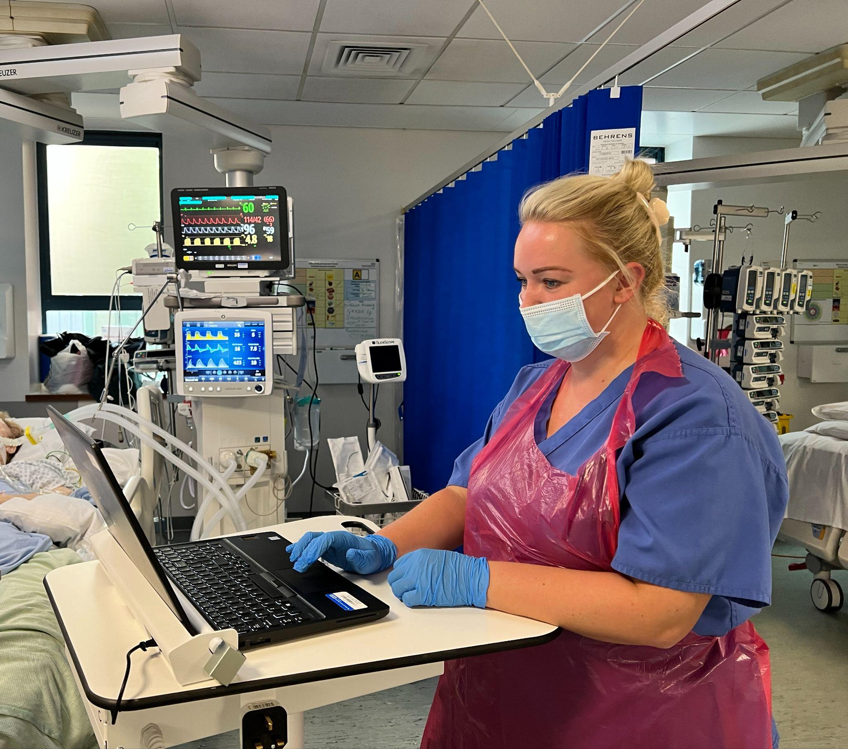

Slide 15
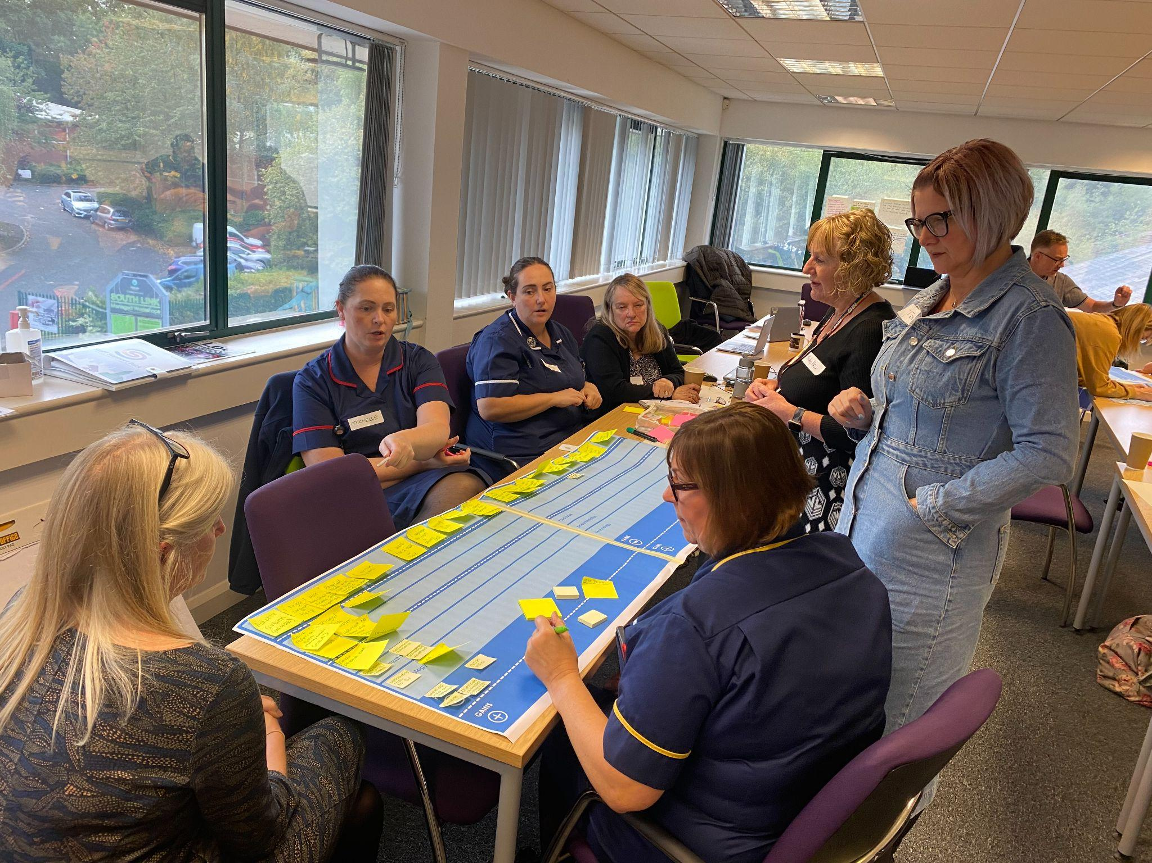
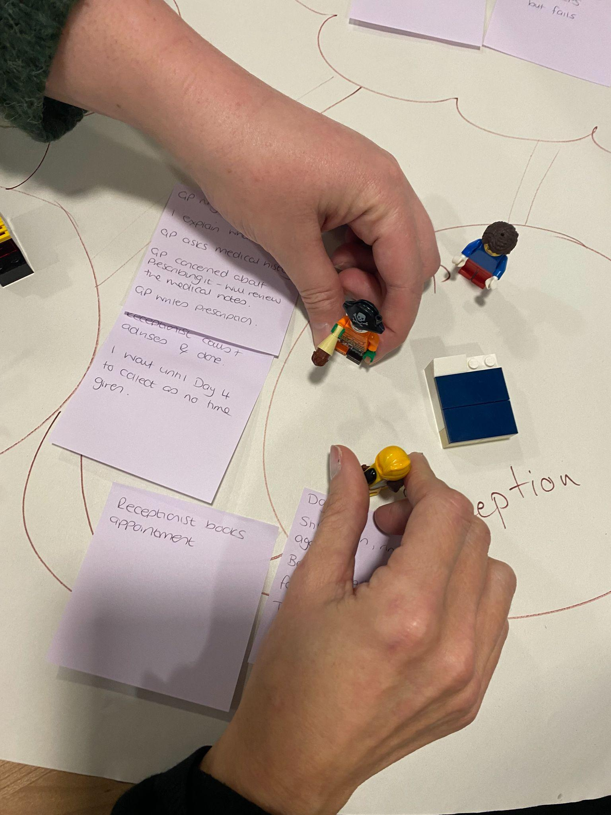
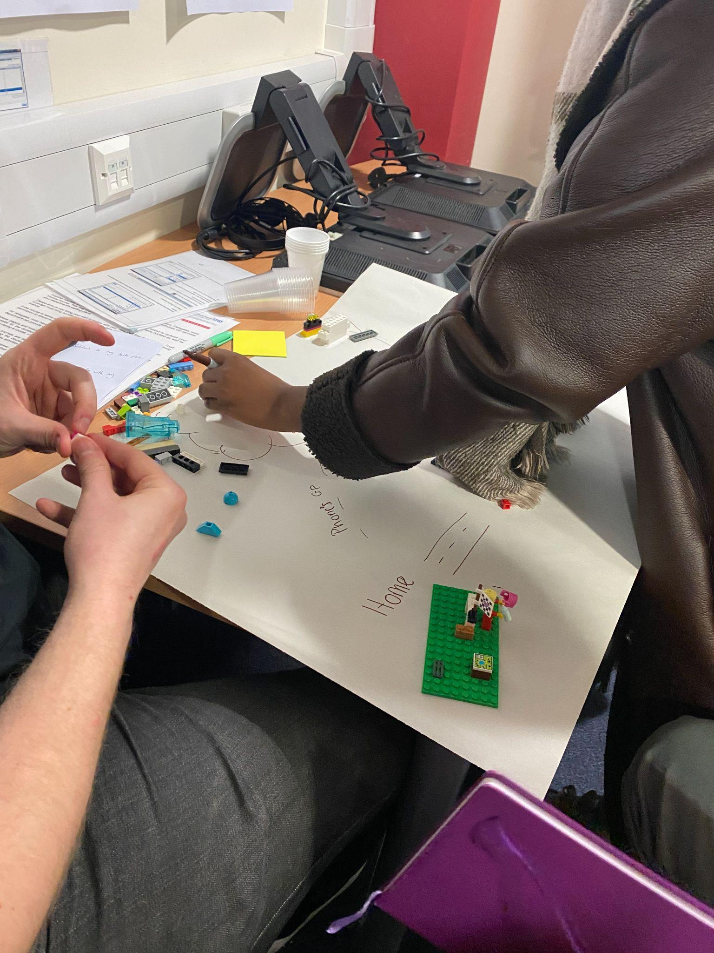
Simulation

Slide 16
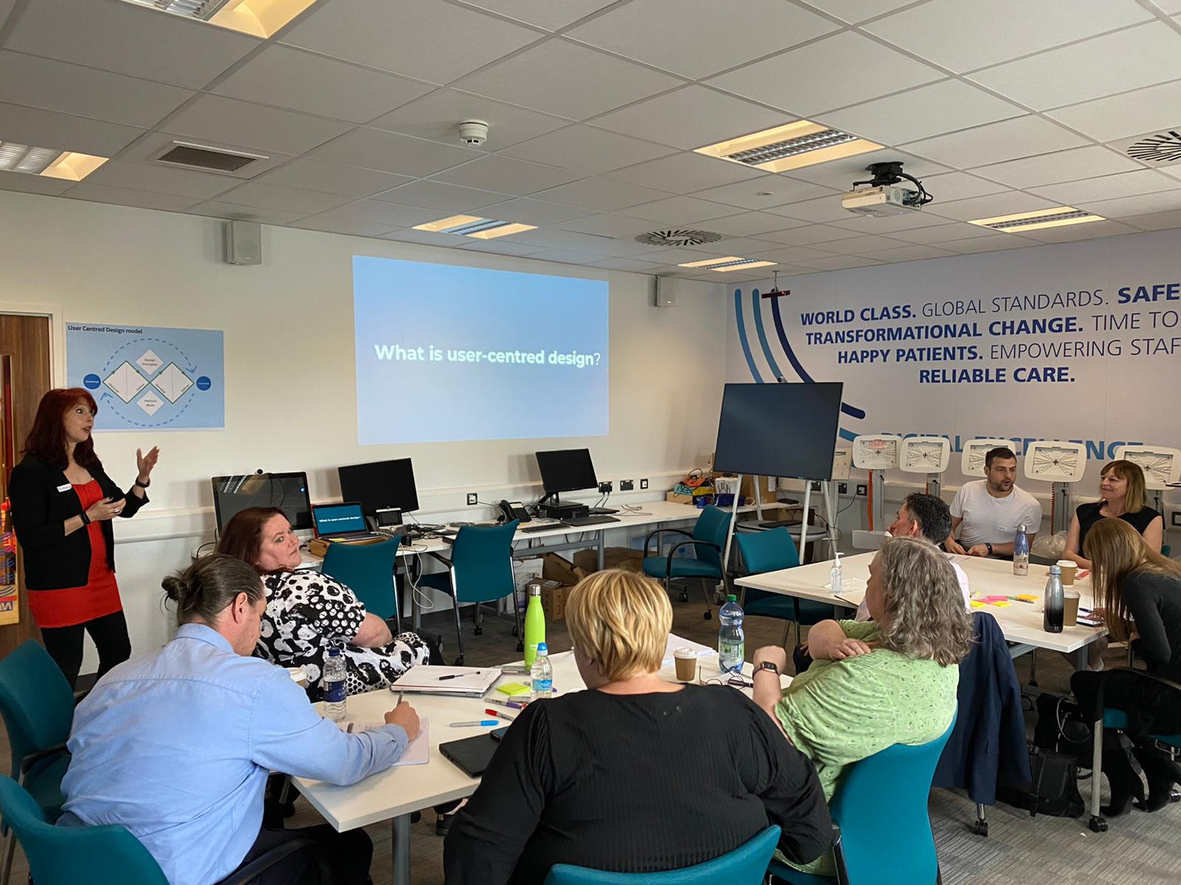
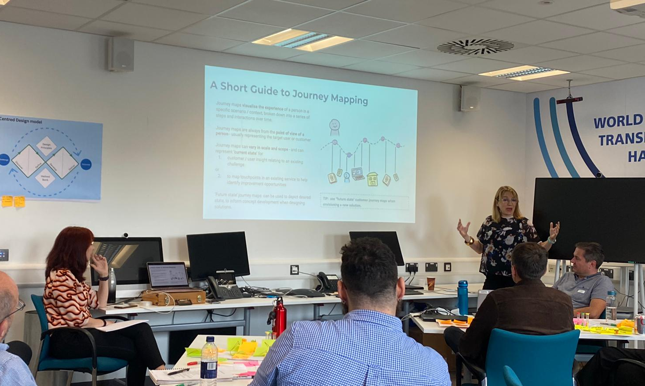
Onboarding & training

Slide 17
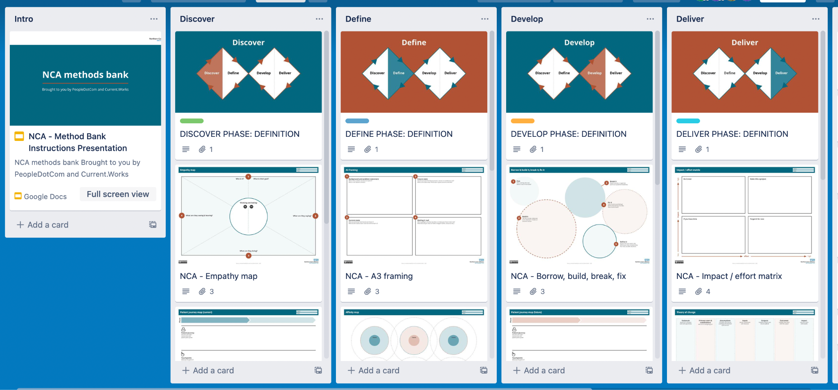
Methods bank
Photo of methods bank

Slide 18
So what…
A community digital strategy - orientated towards user needs
WiFi challenges - understood & resolved
Devices - tested with end users
Photo & video sharing - procurement with user needs + acceptance criteria
Case studies to build momentum - learning through doing
Capability of key digital colleagues - developed through training + coaching
Evolving user-centred maturity.
“The usability testing was really helpful - great to see and use. I think we can implement this as a team with new documents and being present to witness the comments and issues users face live would be really insightful.”
”

Slide 19
Gill Foley
Data and Clinical Content Standards Lead
NHS England
gill.foley@nhs.net

Slide 20
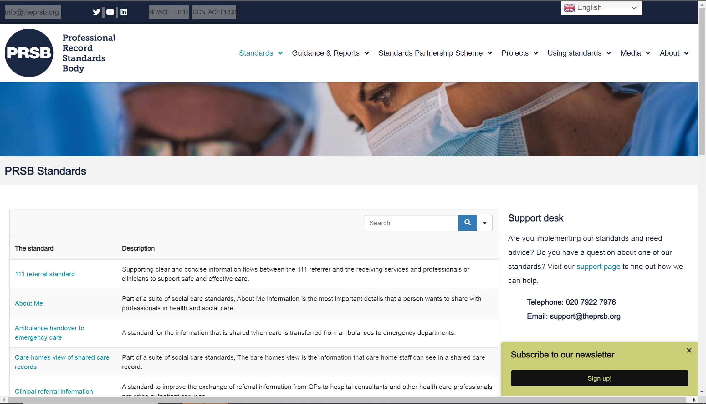
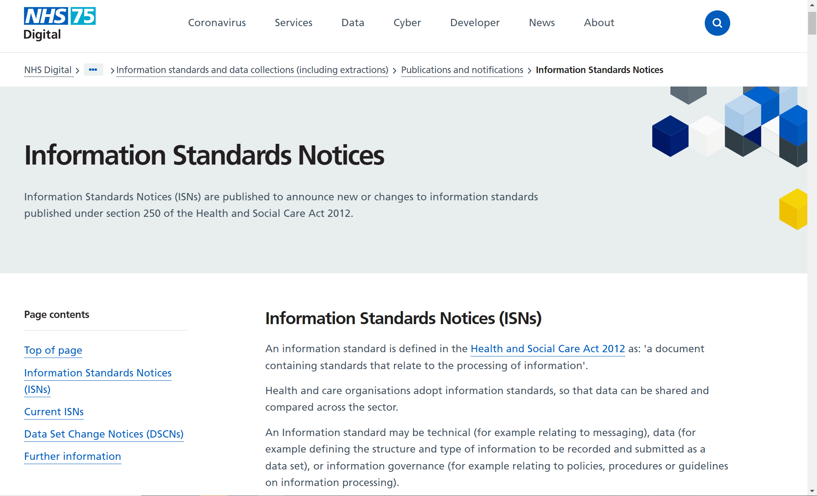
Using human-centred design to help people find information standards

Slide 21
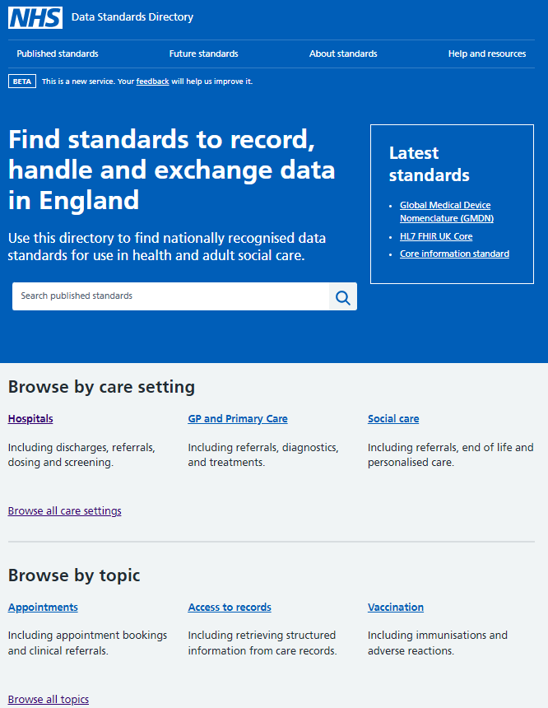
The problem being solved
Many sites and organisations contain standards you need to adopt but no official single source of truth.
The goal of the site
Increasing discoverability and understanding of what standards to use in health and adult social care through a one stop hub.
How we designed it
Named and designed by users over a year of discovery.
GDS Alpha and Beta assessed.
Using human-centred design to help people find information standards
Data Standards Directory public beta @ data.standards.nhs.uk

Slide 22
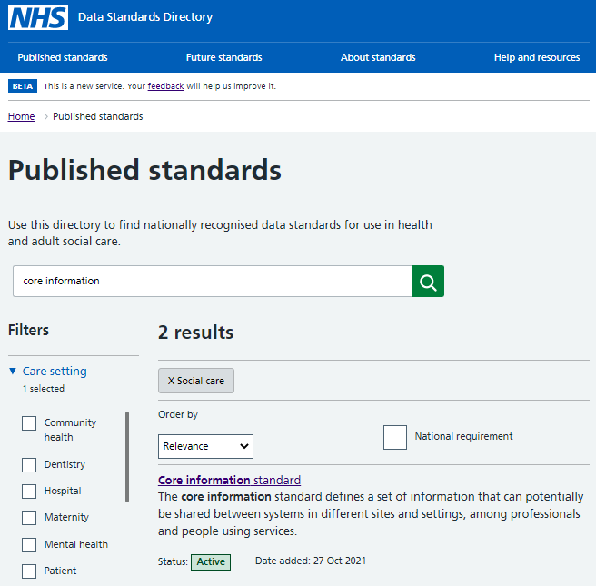
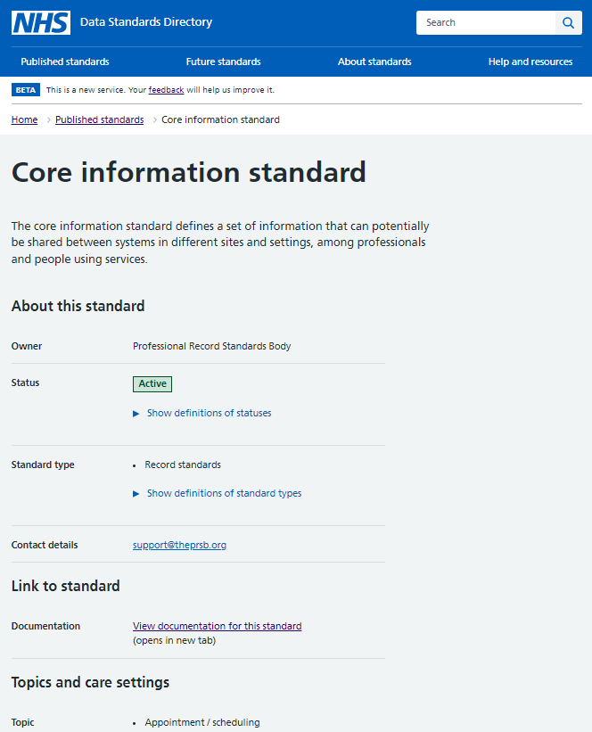

Using human-centred design to help people find information standards

Slide 23
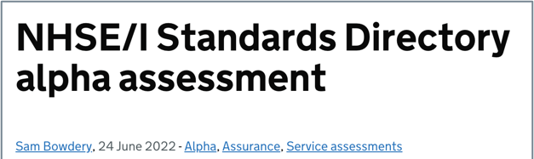
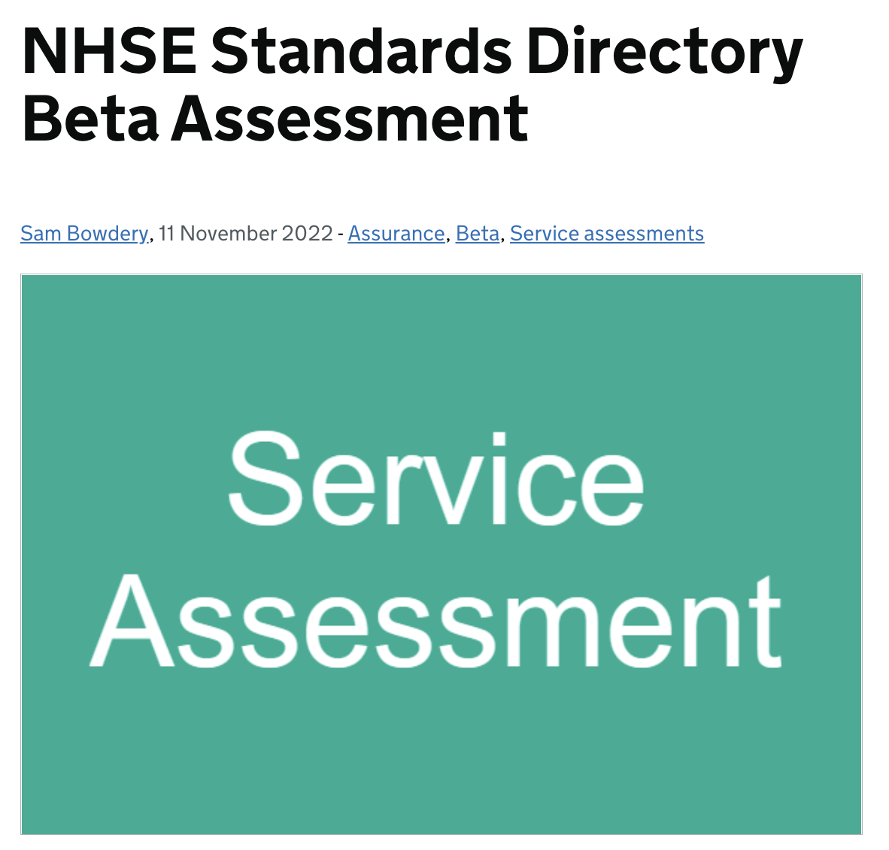
Using human-centred design to help people find information standards
Mar 2021
Discovery into user groups and needs around finding standards needed for interoperability.
First alpha to design and test prototypes and explore technical options for the live service.
Second alpha to explore how to maintain the directory and meet users’ needs to see standards that are in development.
Also started building the live service and back-end management tool and populating with real data.
Private beta to test the service with a wider range of users, carry out accessibility testing and set up security features.
Public beta launched for use and feedback
User research into conversations and applicability of standards
Looking into a new vision of bringing ‘Standards Together’ to meet user needs of those not as familiar with standards
How we started and how we continue to be human-centred
Sep 2021
Feb 2022
Jul 2022
Sep 2022
Dec 2022
Feb 2023
Today

Slide 24
Using human-centred design to help people find information standards
What our expert users told us at discovery
Interoperability – ‘the ability to exchange data between systems - relies on healthcare settings using the same standards to record, handle and exchange data across organisational boundaries.’
Currently interoperability is not happening, in part because it’s difficult for users to find the standards that are relevant to them. (#1 pain point – 2021)

Slide 25
Using human-centred design to help people find information standards
What our newer users told us after seeing the site at public beta
"Social care“:
A participant expected more granular social care settings: "Elderly, Learning Difficulties, Rehabilitation, Residential, Supported Living, Community" within the filters
Even expert users appeared to feel unconfident describing the difference between various 'Data Standard Types'
''One of the things I did like about the Data Standards Directory is, it must have saved me like 50 links on my favourites list.
Now it's you know one place to go for the data standards which is a fantastic idea rather than searching around. “ Dec 2022

Slide 26
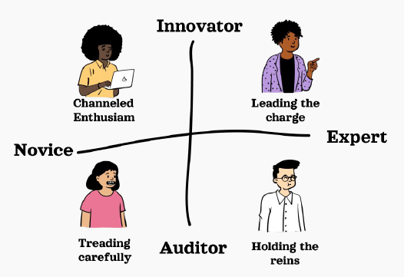
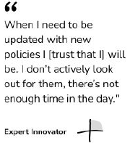
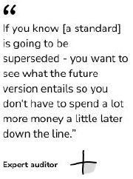
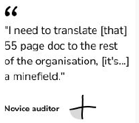
Using human-centred design to help people find information standards
Who are our users?

Slide 27
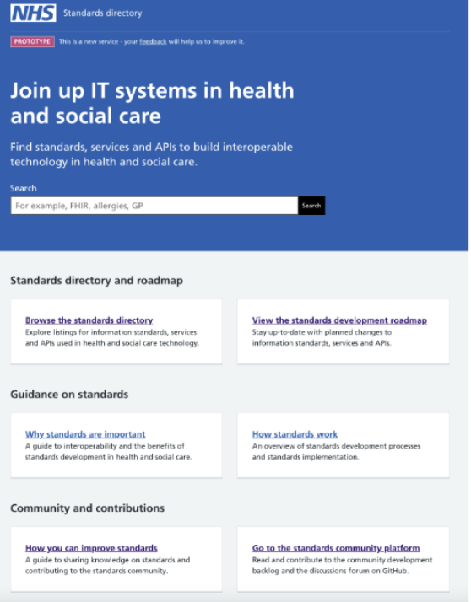
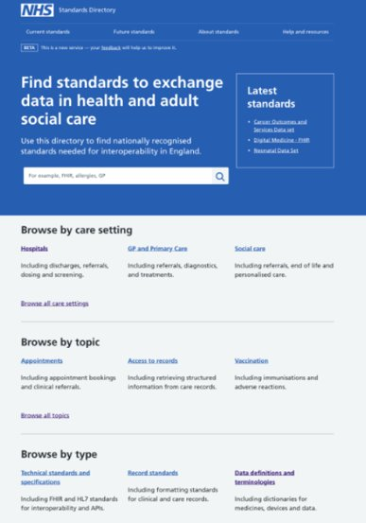
Using human-centred design to help people find information standards
"What does it mean? – To me it's saying that we can record certain things and exchange among other professionals“
"I don't like the main heading - it's confusing to me - "What is it that this site is actually offering“
2023 research
1) What is in a ‘GDS’ name? Does it do what it says?

Slide 28
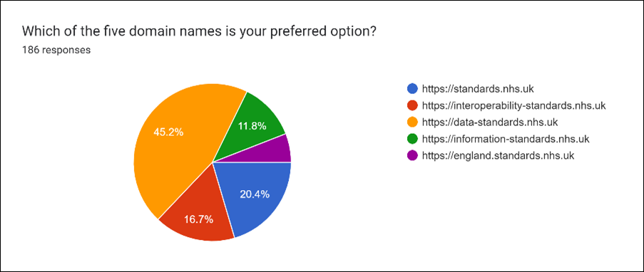

Using human-centred design to help people find information standards
2) Why * next to Data* Standards Directory?
The site was going to launch in beta as ‘standards.nhs.uk’
Our content was mainly ‘data’ standards’ at that time.
So we listened to what our users said via a survey.
And became flexible to adapt the site to our user’s needs.
As we broaden the standards we hold and become more than a directory, we can rightfully make a single starting home at standards.nhs.uk.
Bringing ‘Standards Together’ from across health and adult social care.
We decided to use ‘sub domains’ to future proof to allow us to personalise the site address and it’s services to our user’s needs…. as needed!
  data.standards.nhs.uk
  clinical.standards.nhs.uk
  carehome.standards.nhs.uk

Slide 29
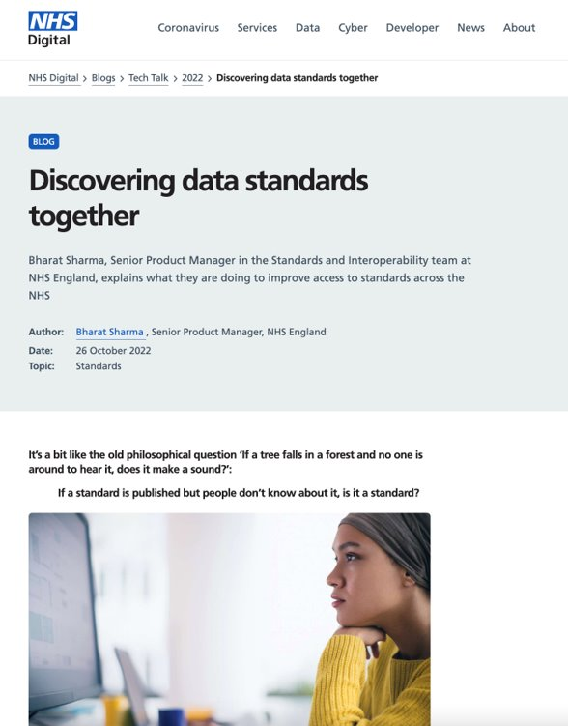
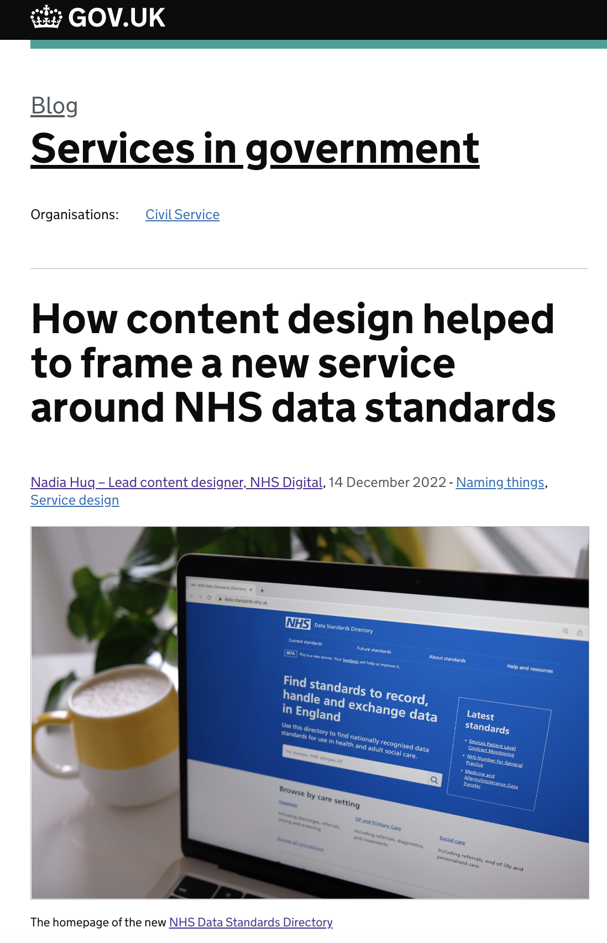
Listen
Hear what users are telling you via surveys and research
Meet user needs
Prove what you are doing is needed and removes pain
Know your users
Be aware if you ask only who you know, you are missing out
..and share your findings!
Using human-centred design to help people find information standards

Slide 30
Toby Page
Architecture Lead, LLR Care Record
toby.page1@nhs.net

Slide 31
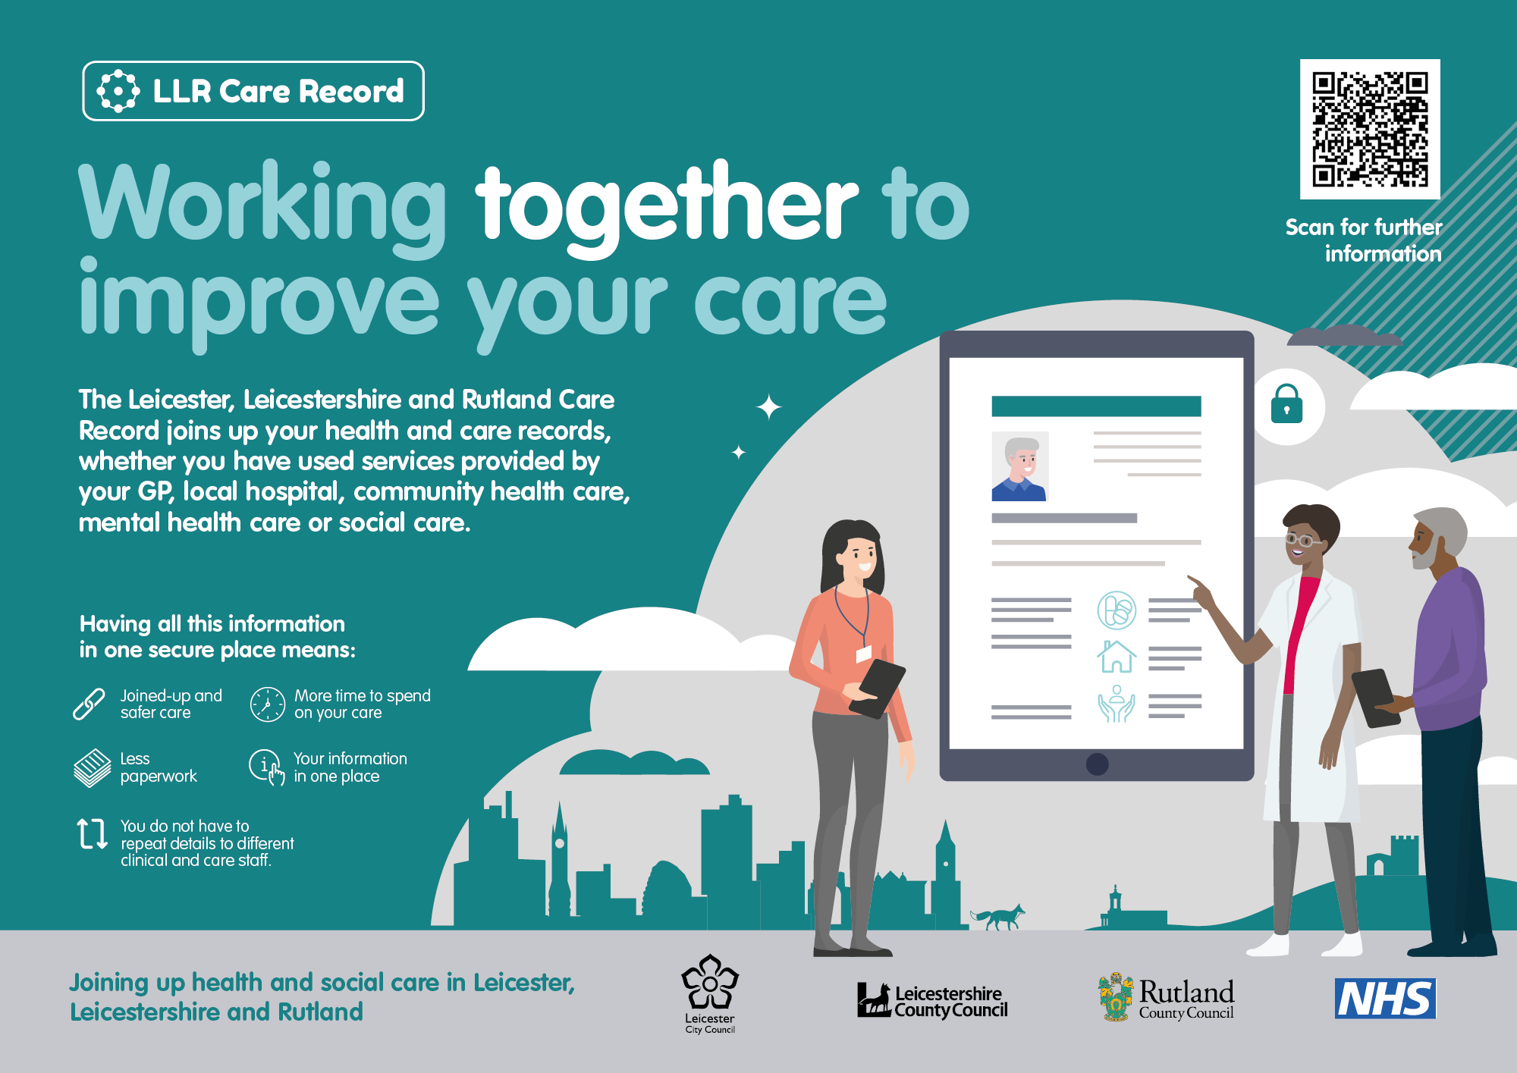
LLR Care Record – Human-centred delivery
Notes:
Relatively early in our life as a shared care record.
Interweave platform and product set
Federated architecture…

Slide 32
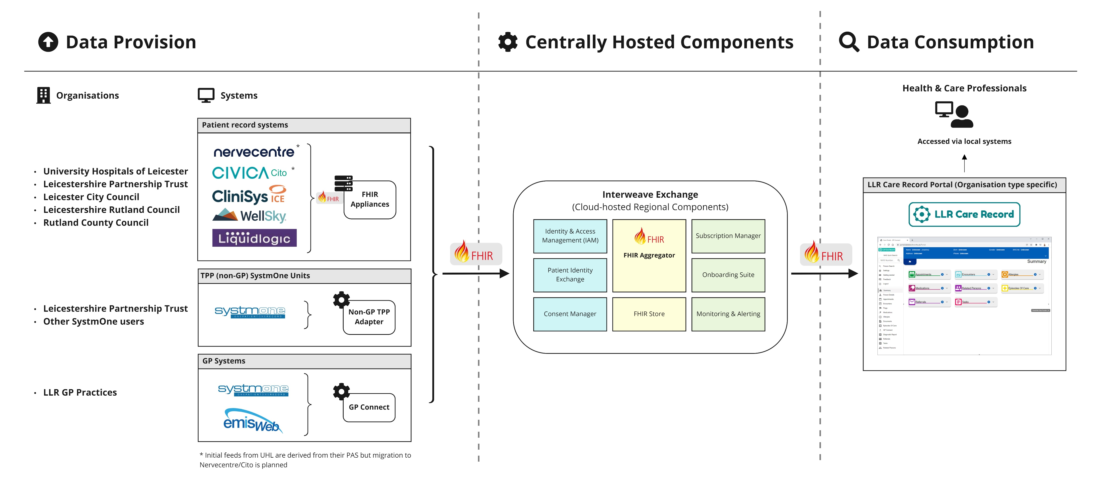
Architecture
Notes:
Information stays where it is authored
Connecting local organisations to share information with our care portal
MVP - Priority information
Data maturity projects following

Slide 33
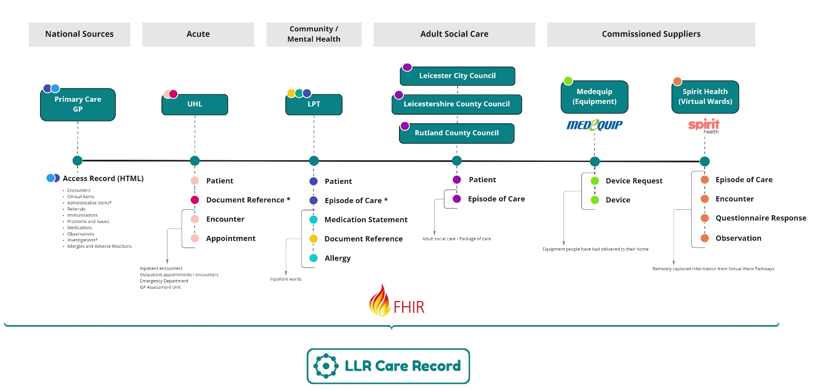
Data Maturity - MVS
Notes:
How do we go from here – to full data maturity? Discovery!
How do we best apply effort to deliver maximum benefits?
How do we promote innovation – protect time for creative thought?

Slide 34
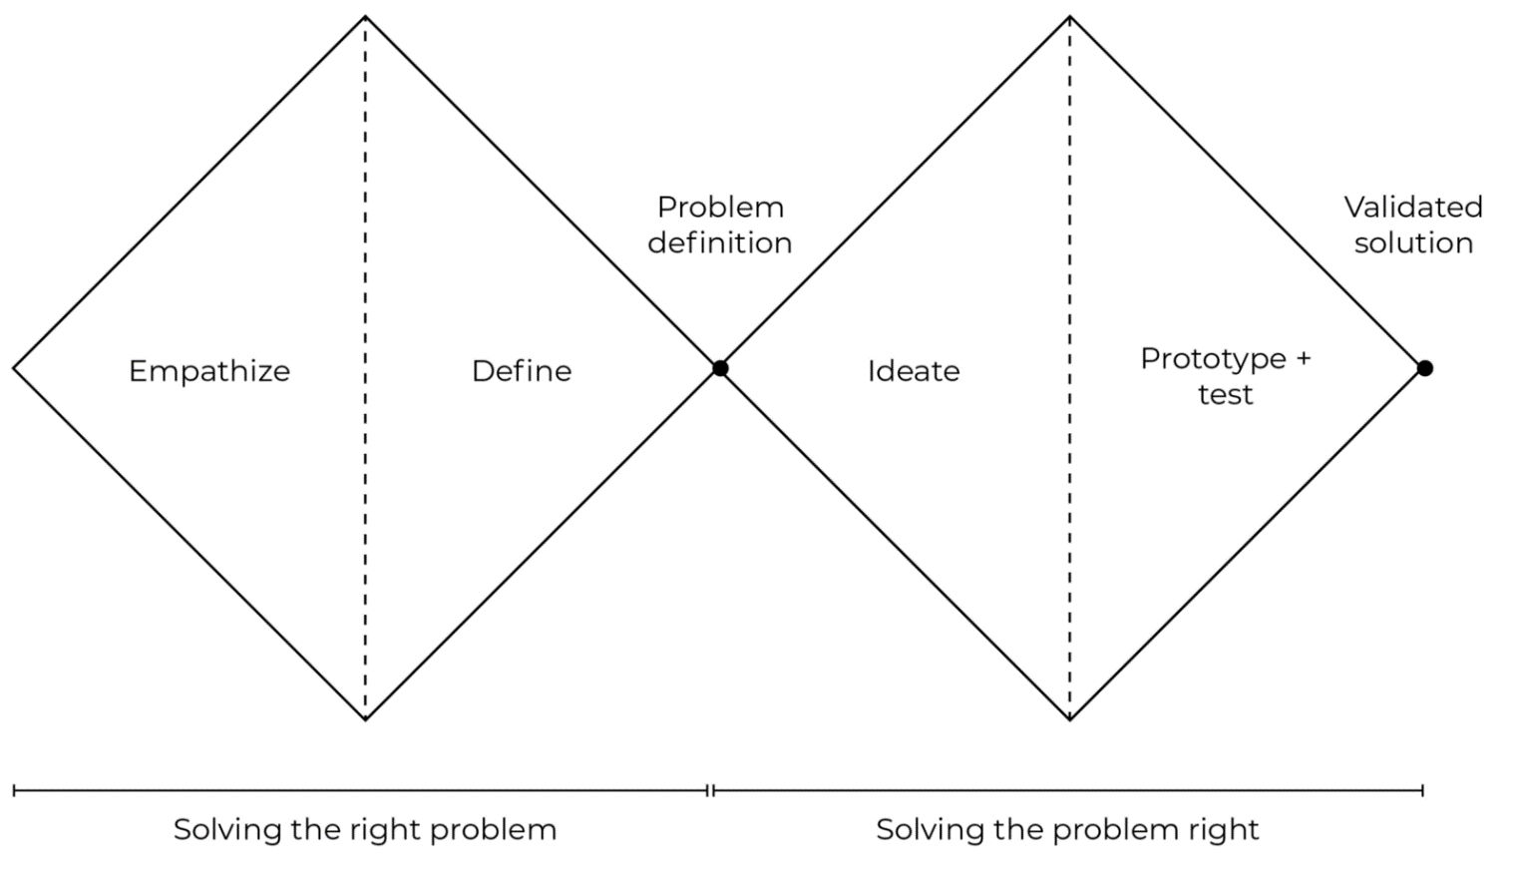
Divergence / Convergence
The double diamond
Notes:
Double diamond – we know the platform solution, but we don’t know required capabilities within it….
User research
Validation of pain points and solution scope
Ideate – Hypothesis driven design – benefits identified
Delivery phases

Slide 35
LLR Discovery
Notes:
Double diamond in practice
Tools from different methodologies – GDS, service design, HCD, Business analysis, Enterprise/Solution architecture and Agile software development

Slide 36
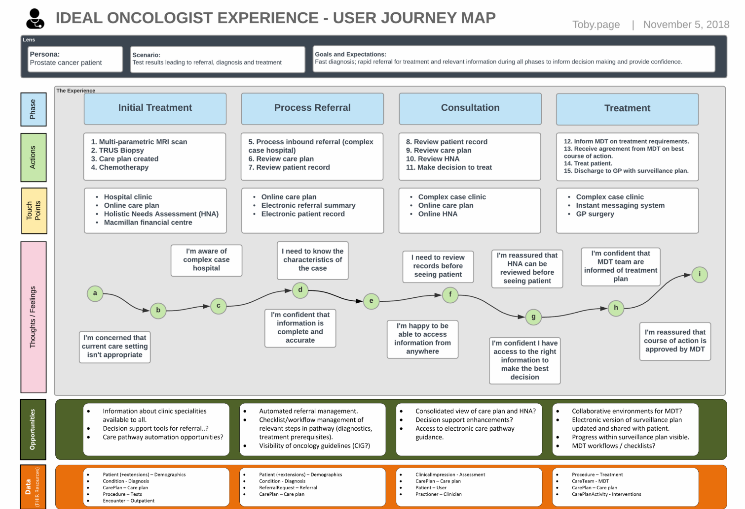
User research in practice
Notes:
For us aiming to deliver integrated care, this means:
Discovery activities driven by user research:
Professional information needs
Help them improve health and care of the person by freeing up their time and delivering benefits.
Example - Sarah is an Occupational Therapist working for a community trust
She embarks on research 'missions' to find out the picture of her patients
Involves ringing around a number of professionals across different care settings
Condition, baseline function to current function, acute therapy assessments, inpatient stays - goals, recent GP interactions, MH docs in S1, etc.
Not just UI, process too. “If you can’t draw the process you shouldn’t try to apply a digital solution”

Slide 37
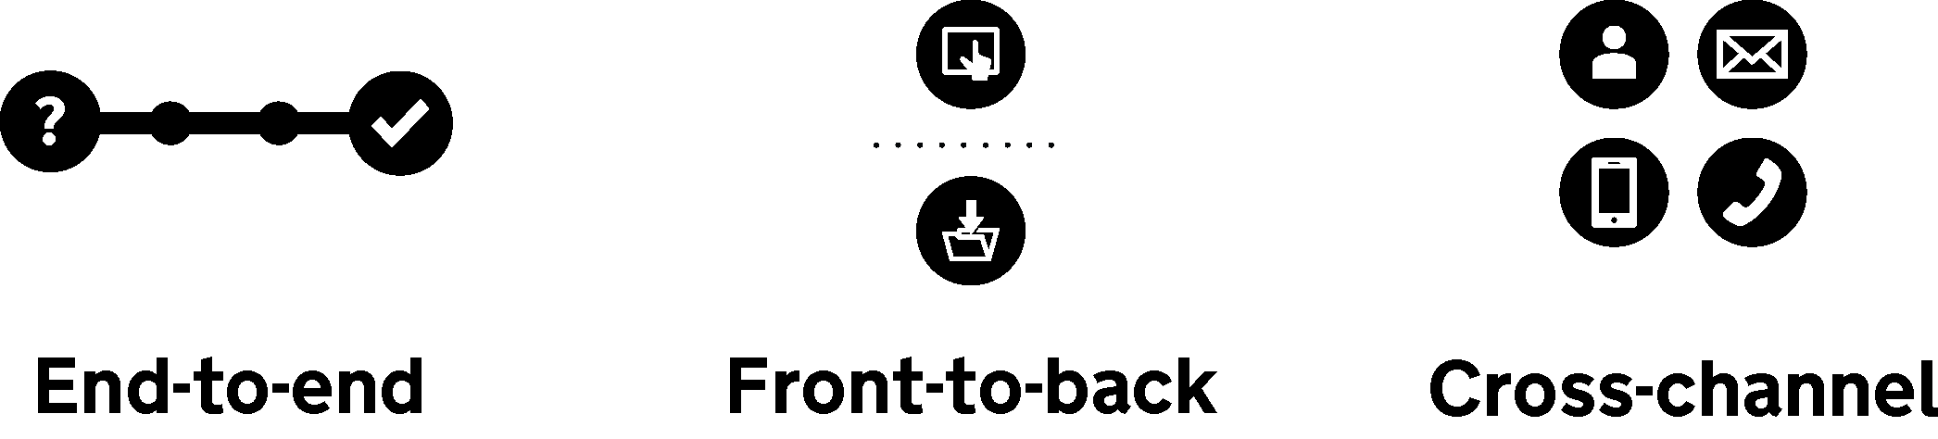
Service design in the Shared Care Record context
Journeys across
care settings
Backoffice workflows;
local, regional and national capabilitiesed
Acknowledge
non-digital channels
Notes:
Key part of shared care and integrated care 'Bridging the gap' - NHS Constitution - The NHS works across organisational boundaries to deliver integrated care
End-to-end - crossing the boundaries of care settings - recognising that we're often dealing with multiple-transactions. It's not like applying for a passport.
An example: Virtual wards - realise benefits beyond those directly involved. Discovery work to establish benefit of sharing with professionals behind those directly involved.
Conway's Law (+MIT extension) - Paraphrased:
An organisation that designs a system will produce a design whose structure is a copy of the organization's structure - for us in integrated care, the organisation spans multiple physical organisations and we have to ensure that we don't reinforce those silos when designing our systems
Front-to-back
Consider touchpoints but don't forget the backoffice workflows AND what workarounds mean. In service design terminology: "Backstage actions impact customer experience"
Acknowledge and align to national infrastructure and programmes of work - they can have a big impact.
Cross-channel
Acknowledge if they are valid, but investigate pain points that indicate waste - e.g. telephone calls are a good indicator of systems not providing a user with what they need.

Slide 38
Informing:
Solution architecture, roadmaps, benefits realisation, feature ideas…
Discovery log > Maximise the value of research
Organising and leveraging information we were collecting anyway
Turning it into a programme asset
Tables and pivot summaries on Excel
Relationships and analysis using Power BI
Frontline System
Organisation
Interweave Capability
Data Requirement
Use case
Benefit
Strategic objectives
Notes:
Started forming tables – what data have we published, what are our benefits?
Real power if we take the pain now to link this up.
Proposing a solution of least overhead -

Slide 39
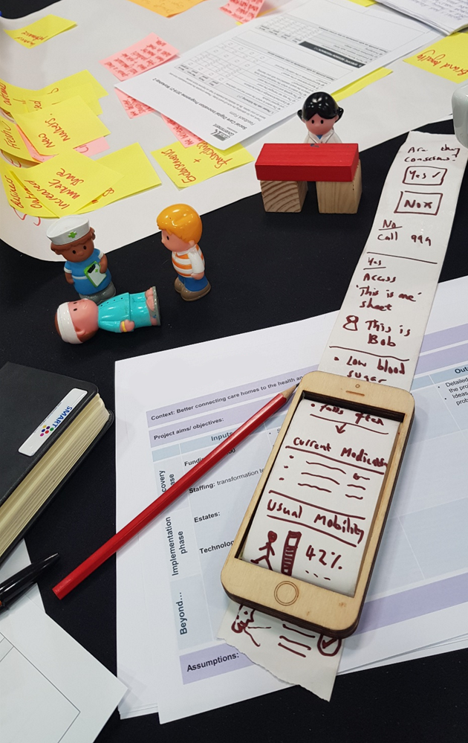
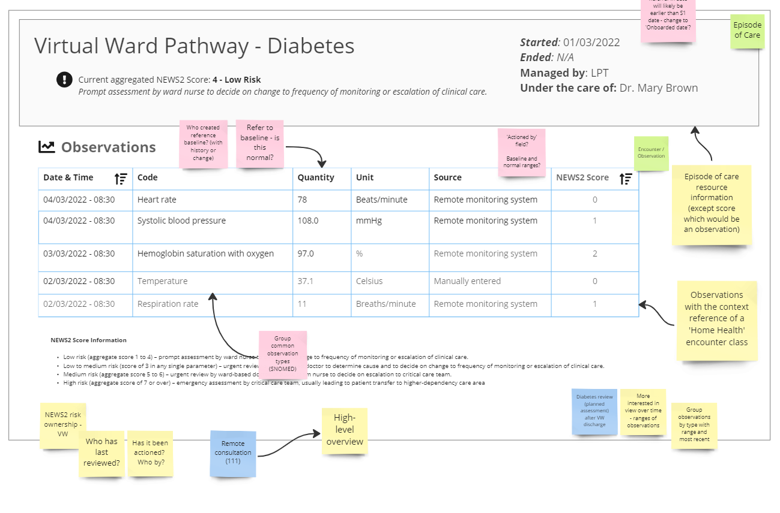
Low-fidelity prototyping
Notes:
Low-fi prototyping - Virtual ward UI, Care home lo-fi prototype and scenario modelling
Share and discuss with users
Fix a simple problem - Bank holiday website - GDS Gov.uk
Do they have equipment at home that they need?
Are they on a virtual ward?
Discovery helps identify multiple beneficiaries of a single capability

Slide 40
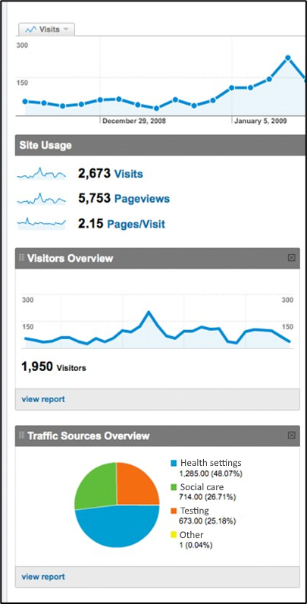
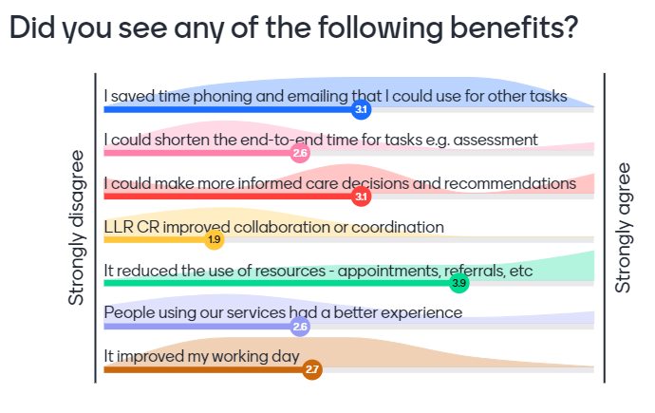

Test your hypotheses
We believe that:
  Giving discharge coordinators access to information about social care packages and equipment in place for a given patient (within an acute setting)
Will result in:
  Faster discharge from acute settings as discharge hub will be able to confirm arrangements more quickly
We know this to be true when we can measure:
  Reduced discharge delays from acute settings and less re-admission;
Secondary measures:
  An increase in the number of patients achieving the LLR Target to leave hospital within 72 hours of being medically fit to discharge;
  Fall in NHS Outcomes Framework indicators 3b, 3.6.i
We believe that:
A Feature
Will result in:
Benefits
We know this to be true when we can measure:
Outcomes
Notes:
Address the possible disconnect between expected benefits and realised ones:
Hypotheses from user stories
Identify measures
Use analytics and user feedback to “close the circle” and indicate refinements or areas to develop.

Slide 41



Throughout my experience in health and social care, what the service user is missing is time to talk with us… at the moment I spend more time gathering information.
Social care and physiotherapy
LPT older people's mental health
It frees your time up to allow you to do the problem-solving part of the case quicker… it frees your mind a little bit more to allow you that time to actually think about it. The service user gets a much better outcome.
UHL renal
outpatients
The more salient information shared the better between all agencies – as we spend countless hours trying to access info via the phone / emails etc.

Slide 42




Collaboration by default
Notes:
Collaboration with other regions - sharing our learning with each other and inform product roadmaps together- YHCR (EoL), Notts (About Me/Social Care)
Data standards collaboration (Social Care particularly) - include local domain experts and engage them in the right way (not technical)
Engage with national teams - E.g. NHSE Virtual Wards Interop discovery group
Design decisions are transparent - lunch and learns, comms packages and product roadmap collaboration.

Slide 43
Activity

Slide 44



Problem statement
What is it?
A problem statement is a carefully crafted and actionable question, to redefine your purpose and direction. IT combines previous insights on the challenge, who you are designing for and the desired impact.
What do we need to use it for?
It is a bridging activity, to help reframe the issue/challenge identified. It is structured as an open question or opportunity, as stimulus to draw on when identifying future opportunities or solutions.
Who needs to be involved?
Key players and stakeholders.
concise | purpose | direction

Slide 45

Problem statement
Follow the sentence structure to create a fully formed problem statement.
Tips per section:
‘Given that’: outline current issue/challenge
‘HMW help’: identify who we are designing for
“Do / be / achieve / feel’: identify immediate actions and enablers
‘So they can’: describe the desired impact.
This template has two problem statements but you may find you need more to cover all aspects of your project.
concise | purpose | direction

Slide 46
Toby Page
Architecture Lead, LLR Care Record
toby.page1@nhs.net
Tel 0776 6331074

Slide 47
Activity - Problem statements
Who is affected by the problem?
What is the problem?
Where does this problem occur?
When does the problem occur?
Why does the problem occur? Why is the problem important?
Staff related
Health and care professionals may lack access to all the information they need about an individual and their history to inform timely, appropriate, safe and effective decision-making.
[ASK GROUP TO ELABORATE/REFINE?]
E.g. This can lead to dysfunctional workflows, time wasted, mis-applied resource, sub-optimal care and introduction of clinical risks.
Patient related
Patients may be asked the same question by multiple health and care providers meaning they have to act as 'the memory' between services.
[ASK GROUP TO ELABORATE/REFINE?]
E.g. The burden of illnesses can be worsened by the lack of coordination and knowledge sharing between related health and care professionals.

