Slide 1
Outcomes and actions for… Workshop 3A: Designing for Excellent Shared Care Record Adoption
Toby Page, Victoria Betton, Gill Foley, Laura Godtschalk
Shared Care Record Summit 20th – 21st March 2023 The Queens Hotel, Leeds

Slide 2
In summary:
The workshop included three presentations describing best practice and real-world experience of human-centred design approaches.
This included reference to Discovery approaches taken by the LLR Care Record; Salford community services digital strategy case study and NHS England data standards product development using human-centred design.

Slide 3
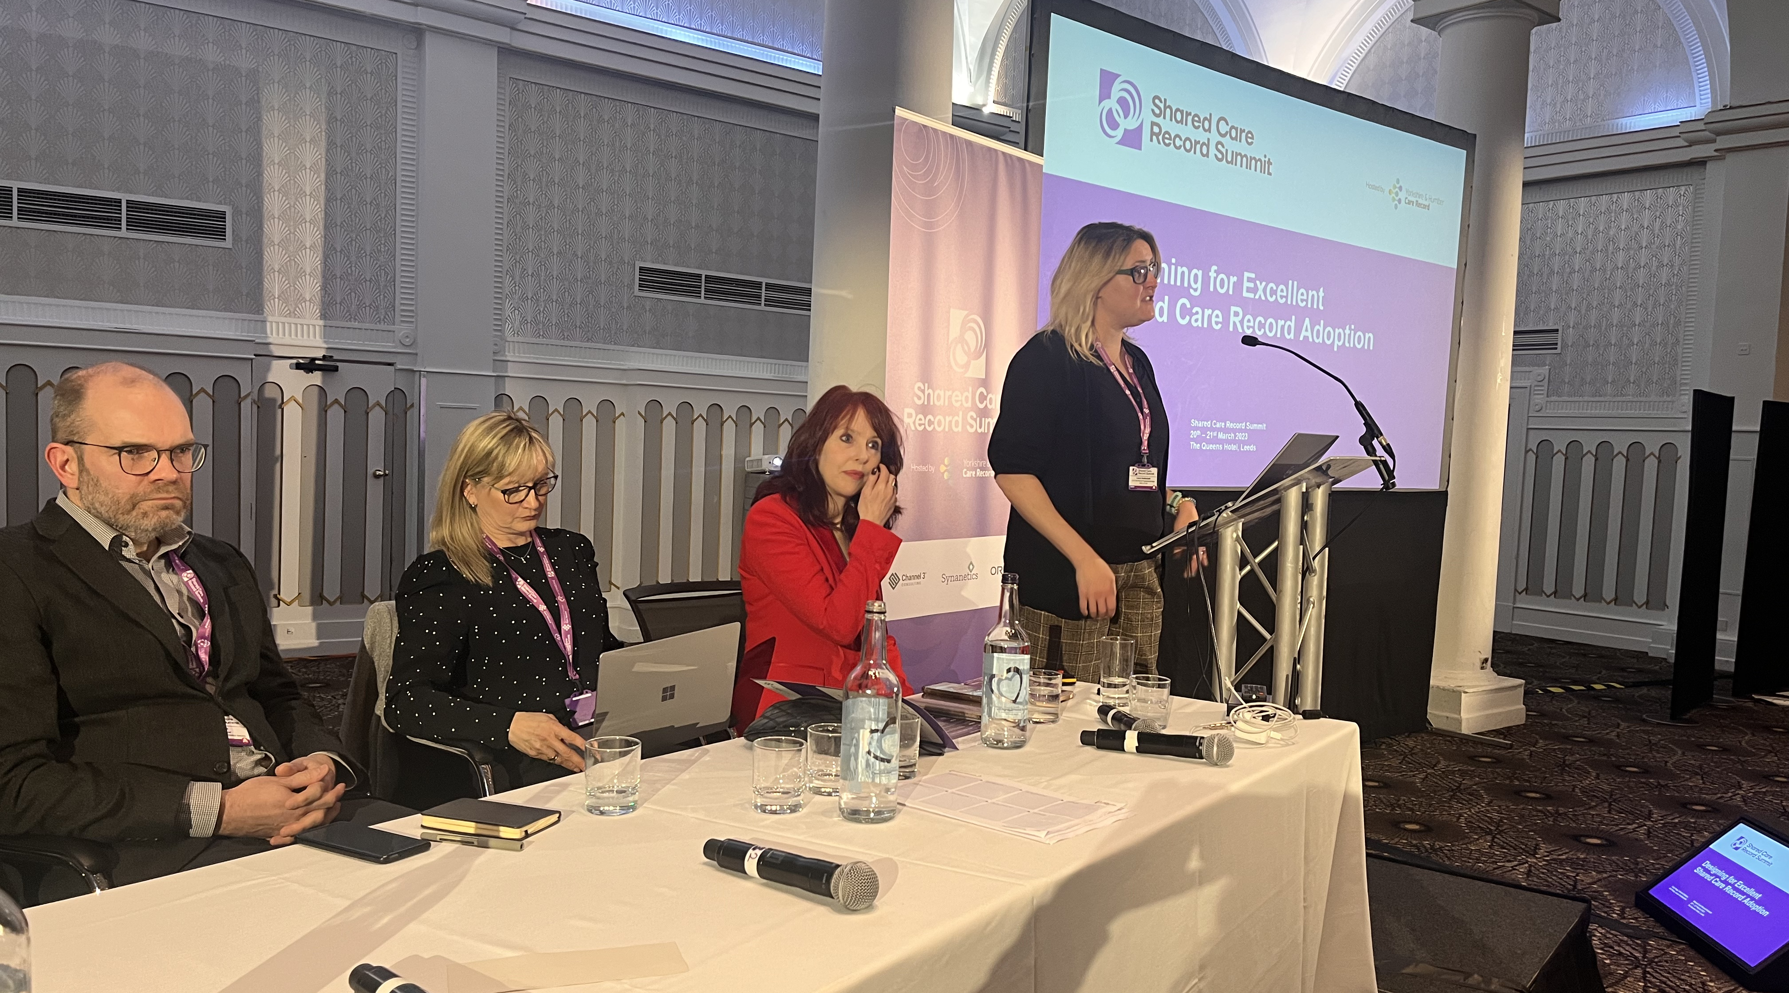
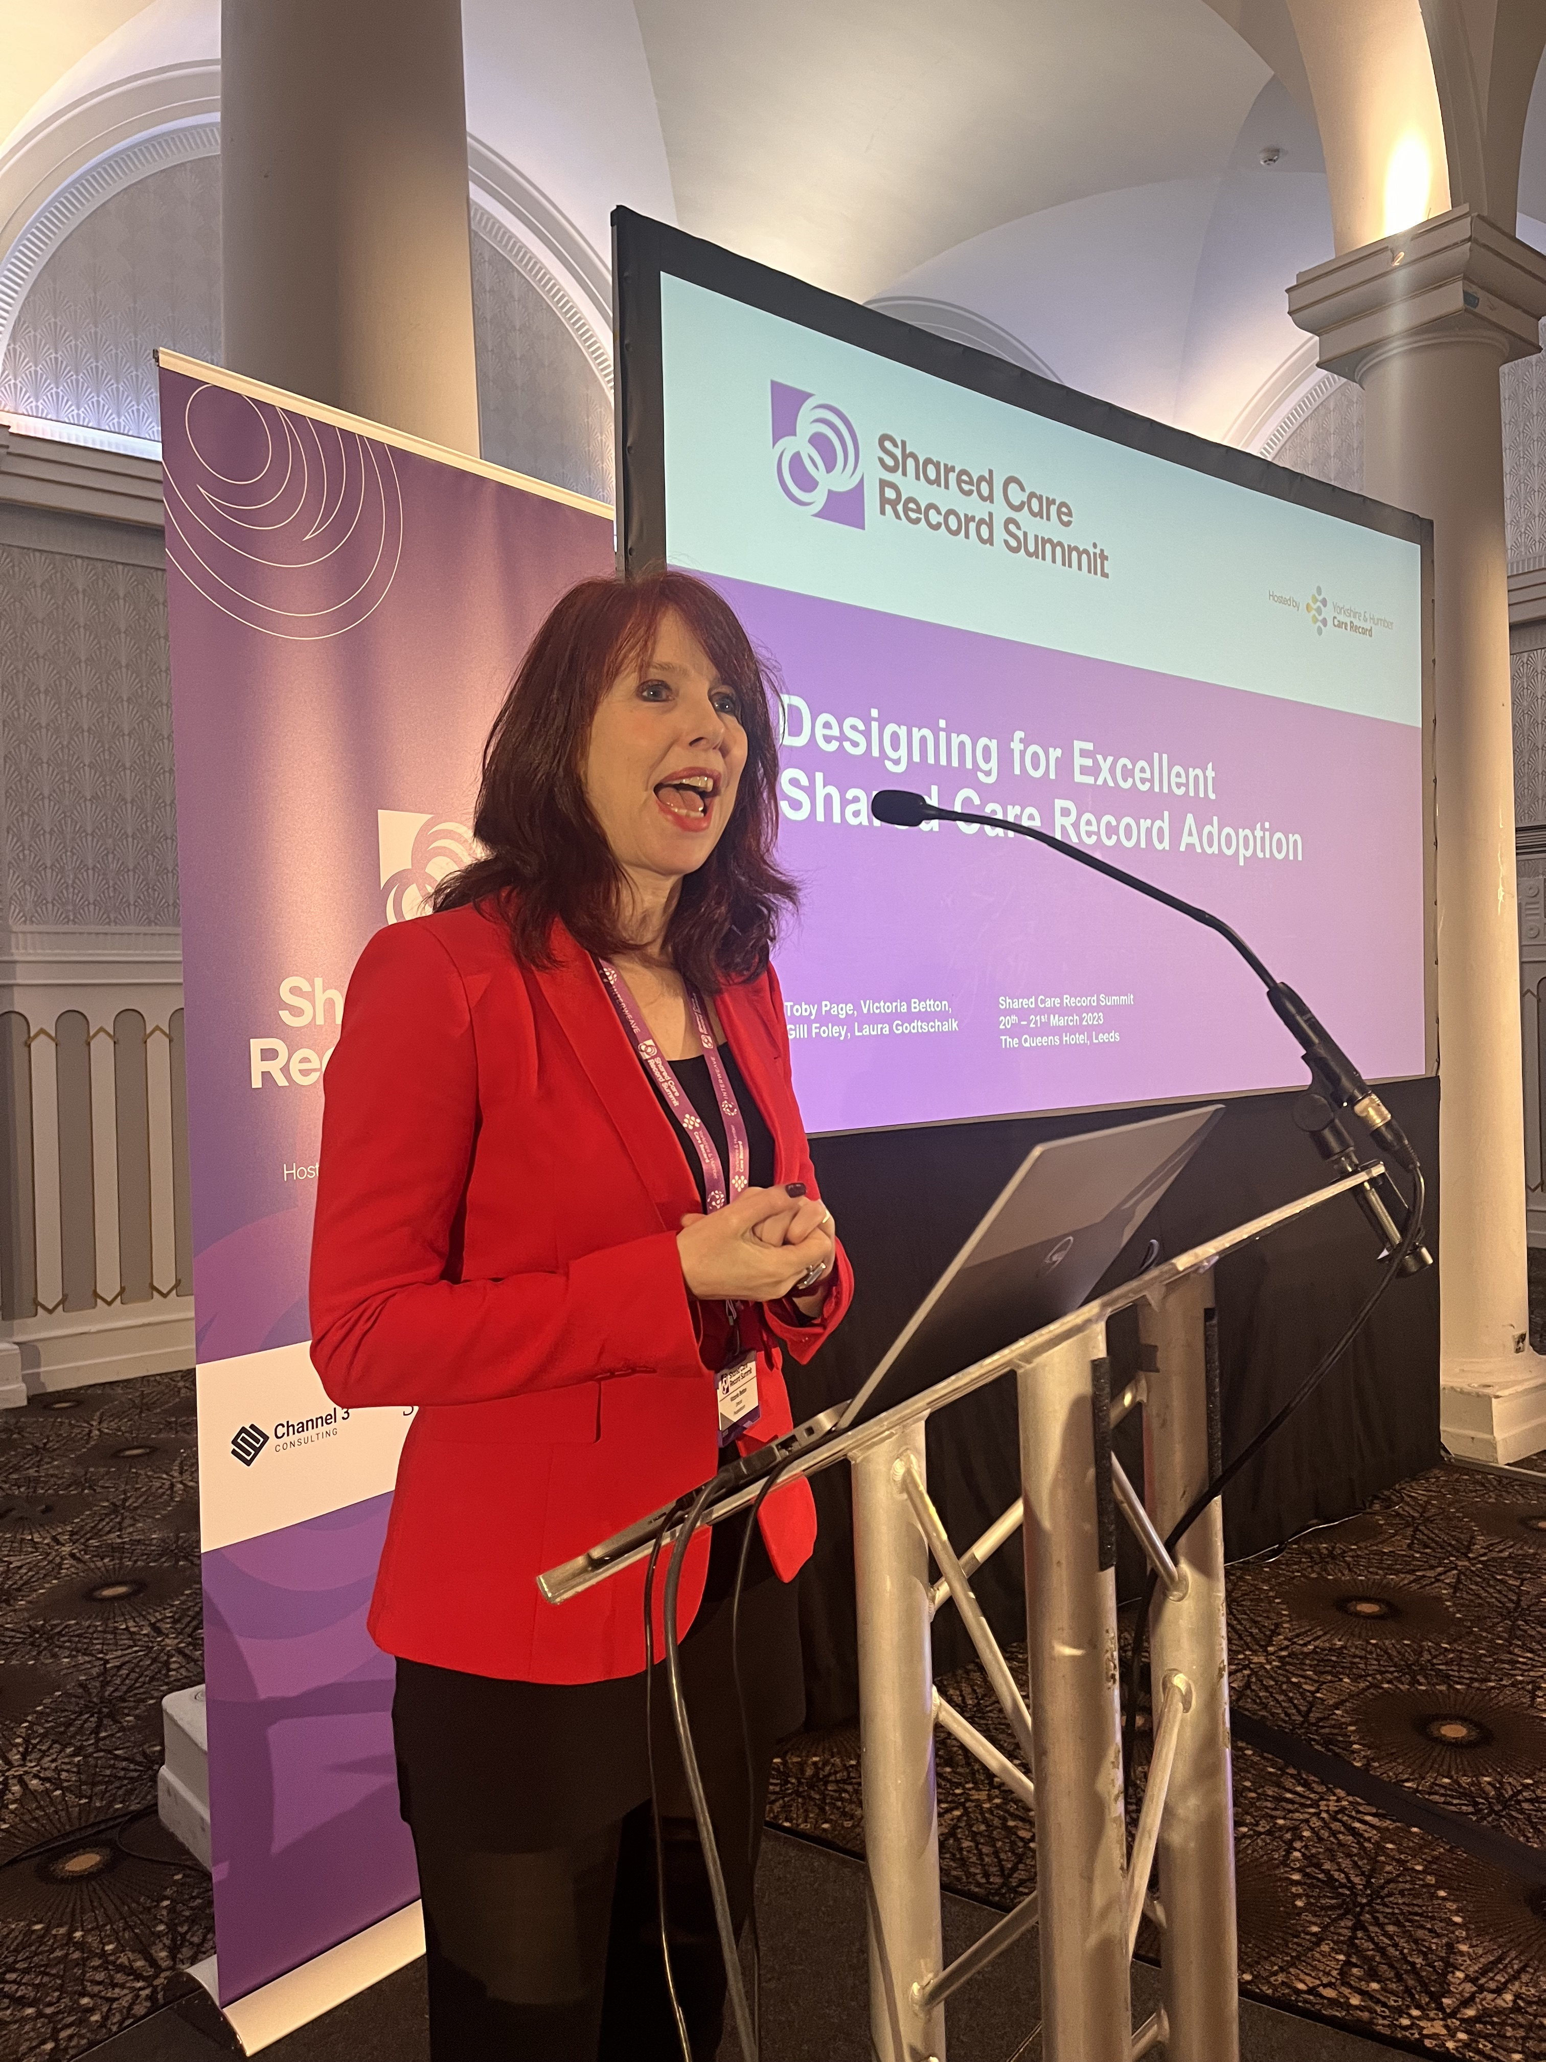
Goals:
Please list the top 3 goals to take forward from your workshop
1. Share problem definitions from workshop
2. Engage across ShCR community (i.e. National T&F Group) to share discovery outputs and approaches
3. Share approaches to capture, analyse and visualise use cases alongside benefits realisation work.

Slide 4
Detailed Outcomes & Actions
Action/Outcome | Who is involved? | Check in Date
Share problem definitions from workshop. Teams to familiarise themselves with NHS Digital Service Design standard & manual view a view to incorporating mindsets and methods into Shared Care Record optimisation | ShCR wider community, workshop faciliators | 1/7/23
Engage across ShCR community (i.e. National T&F Group) to share discovery outputs and approaches. Teams to consider skilling up Shared Care Record teams in user-centred design as well as creating user researcher roles into multidisciplinary digital teams | National ShCR Task & Finish Group | 1/7/23
Share approaches to capture, analyse and visualise use cases alongside benefits realisation work. Teams to consider how they engage with other change functions/capabilities such as organisational development, patient and public involvement, patient experience and quality improvement to assess how they can be better brought together to maximise adoption of digital technologies. | National ShCR Task & Finish Group | 1/7/23

