Slide 1


Clinical Safety
Rebecca Wilson Clinical Safety Lead
Ola Zahran CTO
Vicky Faint CSO
Dean Mawson CSO
Shared Care Record Summit
20th – 21st March 2023
The Queens Hotel, Leeds

Slide 2




Welcome & Introductions
Rebecca Wilson-
Senior Clinical Safety Officer
YHCR Clinical Safety Lead
Senior Pharmacy Technician
Dean Mawson-
Clinical Director & Clinical Safety Officer, Fellow Faculty of Clinical Informatics.
Vicky Faint –
Digital Patient Safety Nurse, Clinical Safety Officer-Leeds Teaching Hospitals
Ola Zahran Digital Chief Technology Officer- Yorkshire Ambulance Service

Slide 3
Clinical Safety- Aims
Provide a overview of Clinical Safety Standards and Requirements
Detail the Risk Management Process and who it involves
How the YHCR ensured a Safe Shared Care Record
Shared experiences and best practice from the providers & consumers
Open session to discuss Hazards/Risks and challenges
Questions
Take away …

Slide 4

Activity- Lets Talk Hazards
1- Use post its to document hazards you identify in your area
2- Stick them in the relevant columns on your sheet (per table)
Think about…
The HAZARD
CAUSES
WHATS NEEDED? (Controls)
Predicted Challenges & Success???
We will revisit this for the interactive session and take away for further
considerations
Also document any other comments/feedback/questions

Slide 5
Clinical Safety- the need
Mandated Clinical Safety standards under the Health & Social Care act 2012, DCB0129 and DCB0160 govern Health IT. This includes software and apps which are being manufactured and deployed in Health & Social Care environments.
The overall aim of the standards are to ensure safe deployment, use and ongoing maintenance of such products or systems. Certain activities must be completed to satisfy and mitigate against any potential hazards which could lead to harm. Harm which may occur from the use of products or systems, by which the end users deliver care to their patient(s)/person(s).
DCB0129: Clinical Risk Management: its Application in the Manufacture of Health IT Systems
DCB0160: Clinical Risk Management: its Application in the Deployment and Use of Health IT Systems

Slide 6
Clinical Safety- the need
Shared Care Records require the same if not more governance, attention should be focussed on the clinical safety requirements and related activities as well as other out of the box processes.
The ShCR involves numerous providers from various care environments using different systems, terminology & end users from varied professional backgrounds.
Providers are providing many and varied data resource fields, they are continually connecting their patient/person data into the YHCR and other ShCR’s, there are many consumers of that data which can lead to Risks and Hazards.
Identification, control, visibility and engagement all feed into the assurance process and governance framework(s)
Lets think about Risk…

Slide 7
Risk Management Process
Clinical Safety- Risk Management Process
  The risk management process will serve to provide answers to the following questions supported by documented evidence:
What can go wrong?
DCB 0129/0160 Standard Requirement
Clinical Risk Management Plan
How serious would it be?
Risk Analysis
Hazard Log
How likely is it?
Risk Evaluation
Clinical Safety Case Report
What should we do about it?
Safety Incident Management Log
Risk Control

Slide 8
Clinical Safety – Key Roles
THE PATIENT!
Clinical Safety Officer (CSO) – experienced individual who oversees and has ultimate responsibility for the sign off of all safety documentation. They will be able to advise and guide all CRM activities and escalate any issues that may arise to top management
CNIO/CCIO – these roles have significant importance in establishing robust CRM process to be able to support any digital health project and maintaining communication with the digital workforce and beyond. They are the middleware between the project team and executive team members which will influence change management and transformation where it is needed.
Subject Matter Expertise (SME) – those individuals who have the working knowledge of the clinical and non-clinical workflow and processes involved in the project which the digital health system is supporting. These team members are priceless with the skill sets and experience to be able to inform the CRM process and assist with Hazard Identification, Risk Analysis & Evaluation, Supporting evidence gathering and supporting the project team with CRM activities
Users – maybe the most important team members who will have valuable knowledge and experience that can be utilised to inform the CRM process and identify those common risk factors and areas of concern which will influence the Clinical Risk Management Plan and the project deliverables.

Slide 9
Clinical Safety- Governance Framework
Notes:
Establish a structured governance framework which allows for the CRM process to be followed with clear roles and responsibilities documented as part of this process.
Appoint a CSO with experience in digital health projects and use in clinical practice
Make sure the supplier has given you access to their DCB0129 safety documentation and that this has been reviewed with the supplier, they should be able to give you are clear summary and handover
Maintain regular clinical safety reviews that are commensurate with the project size, these can be incorporated into your project meetings
Hazard Workshops are an essential part of the CRM process and the outputs from these workshops will inform your hazard log which is the backbone of any CRM process
Assign owners for all identified hazards with actions to supply the required supporting evidence for the mitigation of risk where required
Post deployment monitoring should maintain CRM activities in support of the go live and beyond
Safety Incident Log (Datix) is essential for the post go live management of issues with ongoing support from the supplier

Slide 10
Clinical Safety- Governance Framework
Builds on established NHSE Digital Health Clinical Risk Management (CRM) requirements:
Process must be simple and needs to be understood by all and therefore is not a burden or created industry
Process is inclusive, provides integrity; fosters collaboration, partnership, honesty, transparency and shared learning
Levers both Manufacturer and Health Organisation provenance and experience
Provides assurance to interested parties that the Digital Health System is safe for the purpose designed and intended use;
Staff, Patients, Project, Executive, Regulator (i.e. CQC, DTAC) etc.
Clinical Safety Case Report needs to be summarised, presented and understood by being relevant to the audience (otherwise what’s the point?)
… and references evidence contained within the Risk Management File to support the safe and effective implementation
CRM is therefore all about good governance, and sharing evidenced based common sense with …. ‘no surprises’

Slide 11

Clinical Safety- not just documentation
Key documentation mentioned needs to completed to comply with the standards, HOWEVER, this should not be seen as a tick-box exercise, it requires the right people involved in the process to enable the early visibility and identification of hazards/risks.
The three core documents are:
Clinical Risk Management Plan (details risk activities)
Hazard Log (documents hazards, controls, recommendations)
Clinical Safety Case Report ( evidences the safety position of the product/system)
Techniques used to identify hazards include SWIFT :
What can go wrong
What happens if
Can a user
And so on…
Connecting organisations/third parties should perform hazard workshops –with the right people!
Document BUT implement
Gives opportunity to assess high scoring risks which require further controls.

Slide 12
Clinical Safety- the YHCR process
Over the years, YHCR have been fully engaged and empowered by the clinical safety standards thus, informing the assurance processes. The first assurance process started in 2019 with early adopters completing end to end testing and sign off with many CSO’s involved in the testing and Go-Live process.
Fast forward to 2021 the assurance process became more streamlined, with the evolving programme launching at scale the processes changed. HOWEVER, the key was and is to ensure the safe and accurate display of patient/person data.
With the development of the Interweave Portal launching via a web browser , in-context launch and consumers developing their user Interface to display the data available in the YHCR. We and the region had to ensure a clear, governed and repeatable process.
However, this doesn’t come without challenges of the Clinical Safety Standards and how the YHCR tackled them working regionally to address the need, embed process while engaging with key people to ensure the safe sharing of useful data for direct care purposes.

Slide 13
Clinical Safety- YHCR DCB0129
The YHCR decided to take the DCB0129 responsibility and approached the ShCR working together with the manufacturer Synanetics to design, develop and build the Shared Care Record.
What we share-
Hazard Log which contains 5 main key groups :
1- Does not receive data
2- Incorrect or Conflicting
3- Delay
4- Design
5- End User
Defined hazards for the YHCR as a middleware
Defined hazards for the Interweave portal – per panel/resource/data display
Hazards identified by providers from their provision of data
All detailed in the Clinical Safety Case Report
Shared with all- providers and consumers for Open, Transparent, Visibility.
Notes:
How have we managed our hazards –
Examples include:

Slide 14
Providers
Scope, align to data standards, test, assure- provide Data Quality Report to YHCR.
Project Team, Technical Team, CSO/Lead.
YHCR
Review, assess, recommend or assure.
Project Team, Data Standards, Test Manager, CSO.
Consumers
Review, assess, comply or design, build, test, assure.
Project Team, CSO/Lead, Technical Team.
The CSO/Social Care Lead and team at the consumer site MUST complete their own Clinical Safety Assessment and are responsible for their Clinical Safety Activities to comply with the DCB0160
requirements.
Clinical Safety- the YHCR process
Provider
YHCR
Consumer
Notes:
Over the years, YHCR have been fully engaged and empowered by the clinical safety standards thus, informing the assurance processes. The first assurance process started in 2019 with early adopters completing end to end testing and sign off with many CSO’s involved in the testing and Go-Live process.
Fast forward to 2021 the assurance process became more streamlined, with the evolving programme launching at scale the processes changed. HOWEVER, the key was and is to ensure the safe and accurate display of patient/person data.
With the development of the Interweave Portal launching via a web browser , in-context launch and consumers developing their user Interface to display the data available in the YHCR. We and the region had to ensure a clear, governed and repeatable process.
However, this doesn’t come without challenges of the Clinical Safety Standards and how the YHCR tackled them working regionally to address the need, embed process while engaging with key people to ensure the safe sharing of useful data for direct care purposes.
Team and CSO/Social Care Lead at provider site ensures they are providing correct information by completing various testing aligned to data standards. A Data Quality Report should be completed to evidence compliance at each environmental stage, sign off by the site is completed and sent to the YHCR CSO to assure and approve. Where required additional testing will be completed or recommendations provided. Existing hazards should be reviewed and any additional hazards identified forwarded to the YHCR.
The CSO(s) and team review testing, Data Quality Report(s), Hazards to ensure the safe and accurate provision of data. The CSO assures the provision for production once all other environments have been satisfied. The Interweave portal has undergone design, test, release phases with clinical oversight to enable a clear display of the provided data accurately. Product design, developments and releases are reviewed and approved and recommendations provided where required to satisfy governance and assurance process. Any new hazards are documented in the ‘Master hazard Log’
Once consuming sites start to consume the data either via the Interweave Portal or in their own User Interface it is CRUCIAL that activities take place at the consumer site to ensure data transfer is pulled and displayed correctly.

Slide 15
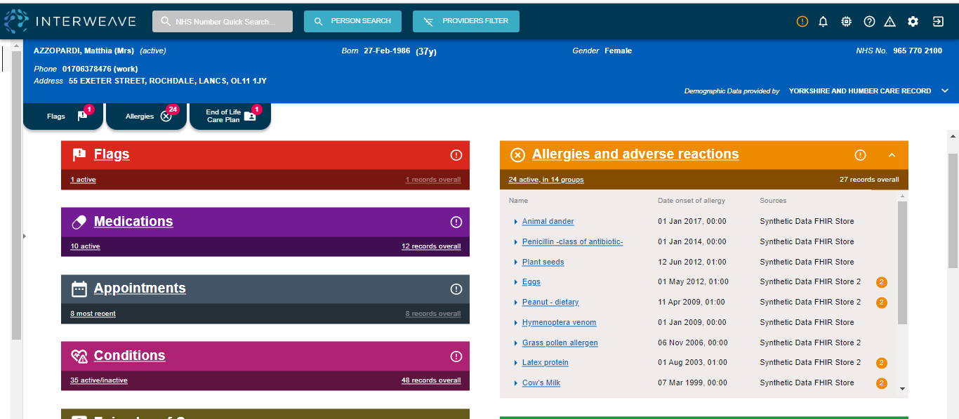
Clinical Safety- Portal Assurance
Notes:
Assured for consumption, Design version 1 with user groups and experts, design version 2 with feedback, assessment's, input across icbs, ideas,= planning,review,build, testing, sign off release, testing= assurances for consumers.

Slide 16
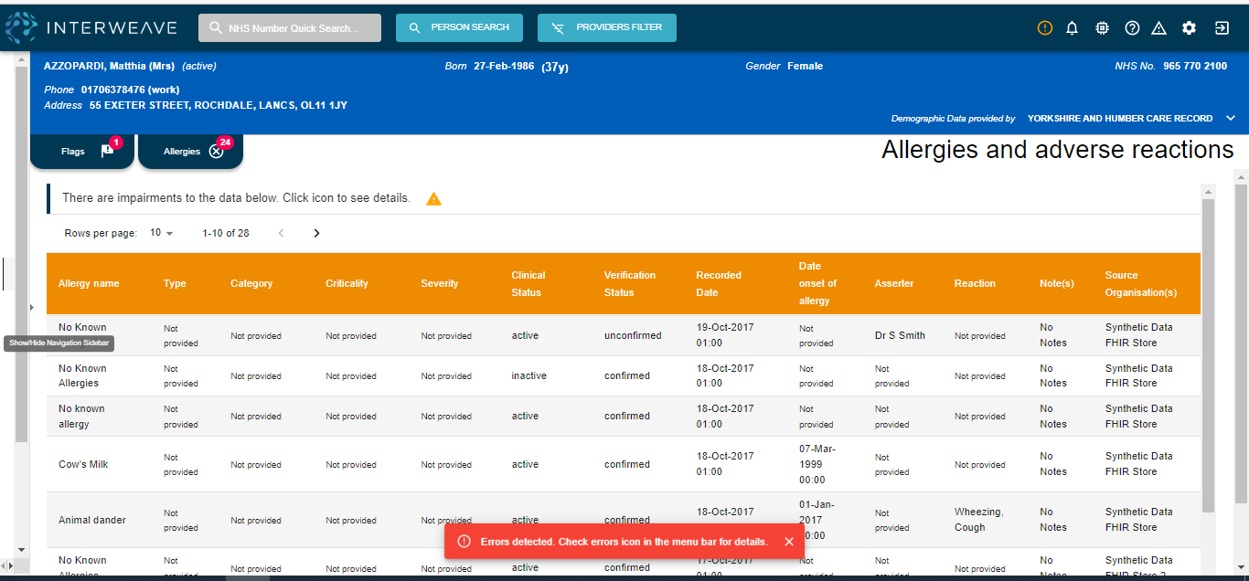
Clinical Safety- Portal Assurance
Notes:
Labels terminology considered

Slide 17
Clinical Safety- What does it look like
Provider A
Provider B
Provider C
Provider
N…
Providers provide DQR including hazards
YHCR/IW DCB0129 Hazard Log and CSCR provided to Consumers and Third Parties.
Consumers required to complete DCB0160.
Third Party- Complete own DCB0129 and pass to consumers for DCB0160.
DQR
YHCR DCB0129
Interweave Portal DCB0129
Third Party DCB0129
Consumer DCB0160
CSO
CSO
CSO/Social Care Lead.
Consumer UI
Consumer DCB0160
Browser Launch
In system Launch
CSO/Social Care Lead.
Third Parties not only consume the portal they also can provide their data.
Third Party DCB0129
CSO

Slide 18


Yorkshire Ambulance Service (YAS) Process

Slide 19
Clinical Safety Process
Ola Zahran
CTO
Yorkshire Ambulance Service
March 2023

Slide 20













Shared Care Record
Providers
Health and care data
Person held data
Consumers
Hospitals
GPs
Social Care
Community
Mental Health
Ambulance,111,PTS
Data
FHIR / Docs
Interweave Exchange
Interweave Portal
Displays data
Different models: - Fully integrated
- Contextual launch
- Standalone portal
Aggregates data in real time on demand from consumers
Interweave Connect
Converts provider data to FHIR resources
(also retrieves unstructured data)

Slide 21
YAS is acting as a provider and a consumer with YHCR
YAS as a Consumer
YHCR
YAS as a Provider
YAS as a Consumer
TOC through ePR
Access to care plan
Live in Hull, York, Leeds, Rotherham. In discussion with Bradford, Mid-York, Sheffield
EOL with Humber, mental Health Hull
Sharing YAS care record
YHCR Portal
Provide access to YAS care record (999/ePR) to Y&H region
Access to the YHCR portal
Contextual lunch
GP access <- >ePR
Access to YHCR though ePR system
GP post event message
YAS access to GP connect
Notes:
Service Line
2022/2023
Avg per Day
999 Calls Answered
1,107,599
3,316
PTS Calls Answered
316,250
947
IUC Calls Answered
1,381,661
4,137
2,805,510
8,400

Slide 22
YAS Clinical Safety Process
The process for our own development is as follows:
Requirements Gathering
Clinical safety is considered as part of initial requirements.
Design
Solution designed to minimise/mitigate clinical safety hazards.
Clinical Safety Hazard Identification Workshop
Held once the product can be demo’ed. Lead by the CSO.
Clinical Hazards and Mitigations Reviewed
Mitigations may include technical changes, enhanced user documentation, training or procedures.
YAS Testing
Ensures that agreed changes have been made. Test report signed-off by CSO.
YHCR Testing Assurance
YHCR oversight and assurance for shared care record projects. Additional clinical safety tests may be undertaken by partner organisations where appropriate.
The Clinical Safety Officer leads the clinical safety process
Clinical safety embedded in the development and deployment from the beginning
Clinical Safety Standard DCB0129/DCB0160
Notes:
Clinical safety is considered during the initial requirements gathering stage. Any clinical aspect or potential patient safety hazards are identified and catalogued. These are held on the Hazard log by the CSO.
During the design phase, development tasks with clinical safety hazards are recorded on TFS. Any potential clinical hazards are flagged as “Hazard Log applicable”. At any point during the lifecycle of development, any additional hazards are also catalogued.
Once the developers have a product to demo, the CSO hold a clinical safety hazard identification workshop attended by Clinical team& Ops end users, BA, PM lead Developers and Testers.
All potential clinical hazards together with mitigating actions are reviewed. Changes to mitigate a clinical safety risk are generally “must do”. Types of mitigations may include technical change, non-development actions such as user documentation, training or procedures.
The Testers include checks in their tests plans to ensure that the must-do changes agreed have been made. Results are included a test report which is sent to the CSO for sign-off.
In some developments, additional clinical safety tests are performed by independent YHCR testers/CSO’s, working with YAS testers and developers when appropriate.

Slide 23
YAS Clinical Safety Process
Continual clinical safety review of the UAT feedback, with ongoing opportunities to identify anything raised that may impact on clinical safety and put in place mitigating actions.
The CSO updates the Clinical Hazard Log and Clinical Safety Case.
The CSO is a mandated signatory on the change control.
Post go-live, the CSO updates the Clinical Hazard Log and Safety Case with any emergent issues. The process is a continual process throughout the life cycle of the software from design to decommissioning.

Slide 24

Risks & enhancement
Biggest issue is Patient Identification.
Through the YHCR, our data is integrated or viewed by other trusts. If there is a misidentification/non-identification at the pre-hospital phase this can lead to a cascade of issues throughout the healthcare system
Clinical Safety case provides a platform for mitigation including design, training and processes.
The risk has been reduced but still remains.

Slide 25
Leeds Integration

Slide 26



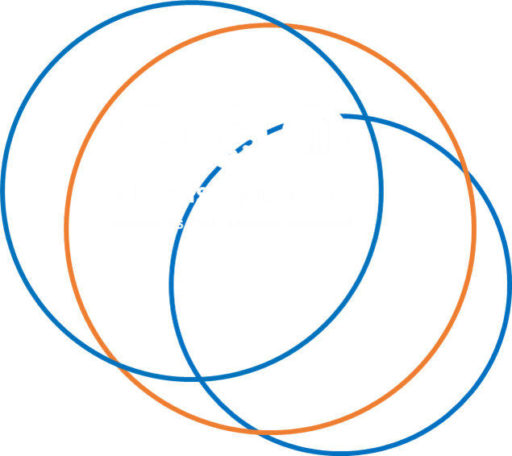
Integrating the YHCR into PPM+:
Clinical Safety Considerations

Slide 27


PPM + Development Approach
First Stages:
Review of Safety Case and Hazard Log from YHCR
Design sessions with the Business Analyst, Developers, Clinical staff
Identified Areas of focus for Hazards:
Demographic matching
Integration
User Interface
PPM+ Show and Tells to wider Trust during development
Small pilot for clinical feedback
Constantly questioning safety – So What If approach

Slide 28

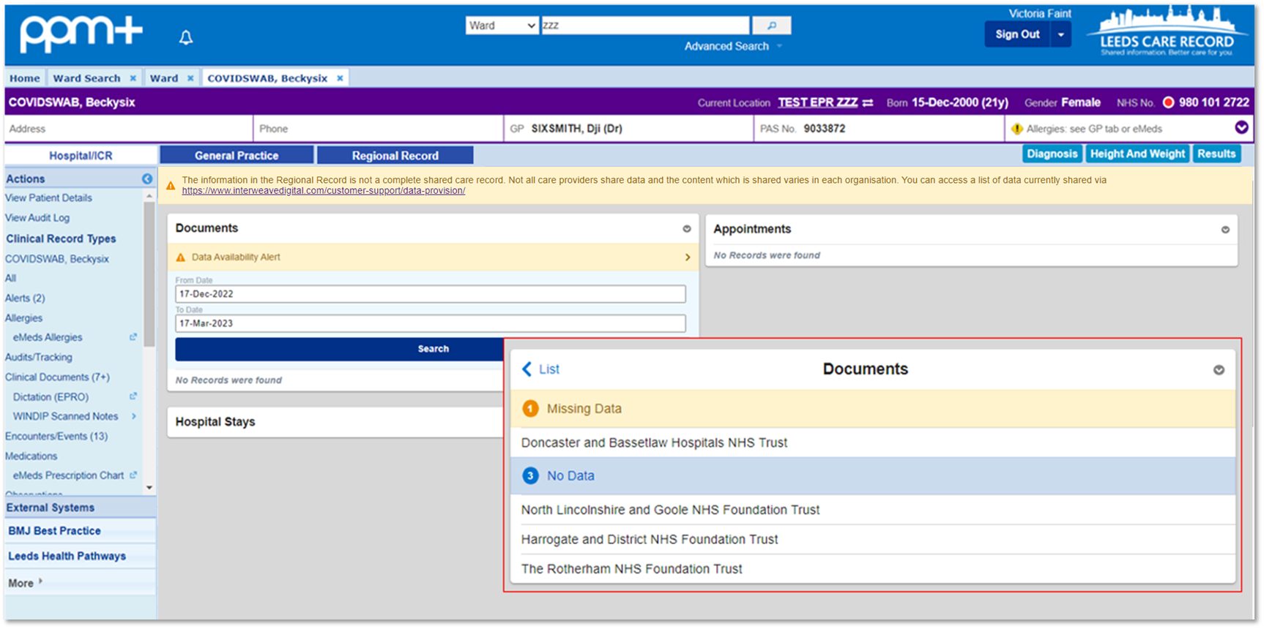
Concerns raised around the availability of Data
What if Data should be available but is not visible?
What if only some Data is missing?
Alerts developed
No records found
Missing Data
No Data

Slide 29

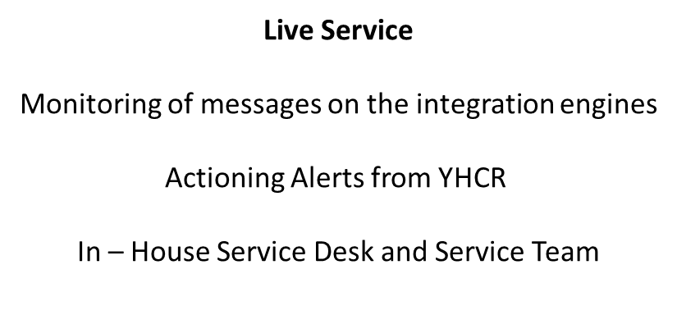
Trust-wide Adoption
Guidance for Staff
Implementation Team
User guides and posters
Dedicated hospital intranet page

Slide 30
Activity

Slide 31
Activity- Lets Talk Hazards
1- Use post its to document hazards you identify in your area
2- Stick them in the relevant columns on your sheet (per table)
Think about…
The HAZARD
CAUSES
WHATS NEEDED? (Controls)
Predicted Challenges & Success???
We will revisit this for the interactive session and take away for further
considerations
Also document any other comments/feedback/questions

Slide 32
Clinical Safety ShCR- the challenges we’ve faced
Lack of CSO support especially in Social Care, GP practices and ICB/S’s
Lack of understanding of standards and requirements
No defined framework for ShCR’s in relation to what good looks like
Engagement from sites - challenging to have the correct level of clinical/social input into project teams
Sites processes not aligned to YHCR process
“ It is not just a tick box exercise to satisfy a project checklist, it’s the importance of thorough understanding of the scope for the YHCR/ShCR, the CS requirements, the responsibilities, internal vs external process and the people, engagement is key”

Slide 33
Clinical Safety- the success
GPC consumption via portal
Transfer of Care YAS provision
Joined up care across the ICB’s
Collaborative working across organisations.
Embedding process with the people
24 data providers
24 + data consumers
Knowledge sharing and Best Practice
End of Life Care Plan Blackpear Provision
Better Quality of Care Delivery

Slide 34
Take Away…

Slide 35
What do you need to do?
Identify a CSO or suitable person such as a Occupational Therapist in Social Care who can take the CSO role
Manufacturers- ensure own DCB0129 up to date with integration and visible to end users
Map out internal process and align to YHCR/ShCR:
Data Quality Report for provision
DCB0160 for consumption
Testing, Training, Business Change Process
Prepare for Hazard workshops
Future proof your product/UI- not just here and now how will it look when ShCRs join up or at scale.
Ensure Incident management embedded
Communicate to users
Hazard Workshop- right people- technical, clinical, social, end users, experts.
Outsource for Clinical Safety expertise or complete the training – this is needed in all Health IT products/Services
Have the right people involved in the team, involve the users for testing, feedback, transparency!
Set expectations

Slide 36

Questions

Slide 37
Thank you, keep safe.

