Slide 1
Outcomes and actions for… Clinical Safety Workshop
20th – 21st March 2023, The Queens Hotel, Leeds
Workshop Leads:
Dean Mawson
CSO
Ola Zahran
CTO YAS
Rebecca Wilson
YHCR Clinical Safety Lead
Vicky Faint
CSO Leeds

Slide 2
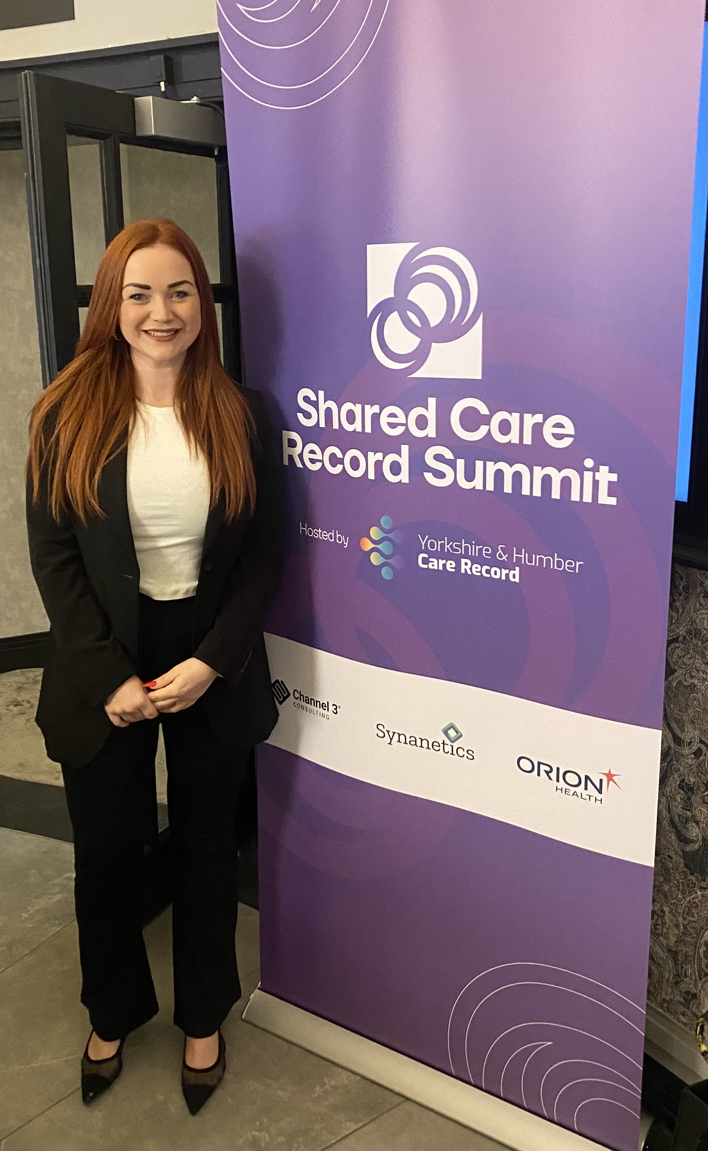
In summary:
Workshop focused on brief overview of mandated standards and requirements. How they link into the ShCR and importance of governance. Key message were to embed the process with the people. Engagement is crucial from the right people from the start, explained our assurance processes and what good looks like, addressed the challenges and celebrated the success. Heard the journeys from Leeds and YAS and how they adopted their own process and aligned it to ours. Asked candidates to document any hazards and place on the boards, relucent but encouraged and got some good feedback. No surprises though- all common themes we are already aware of.

Slide 3
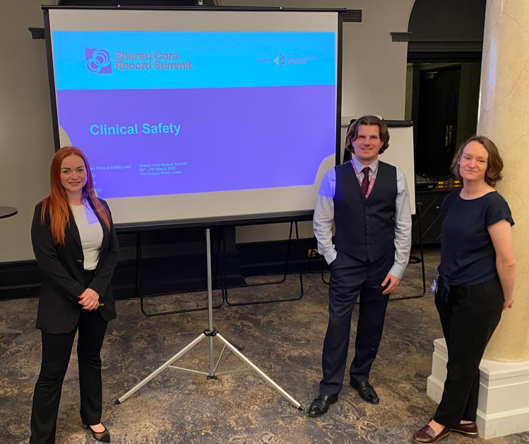
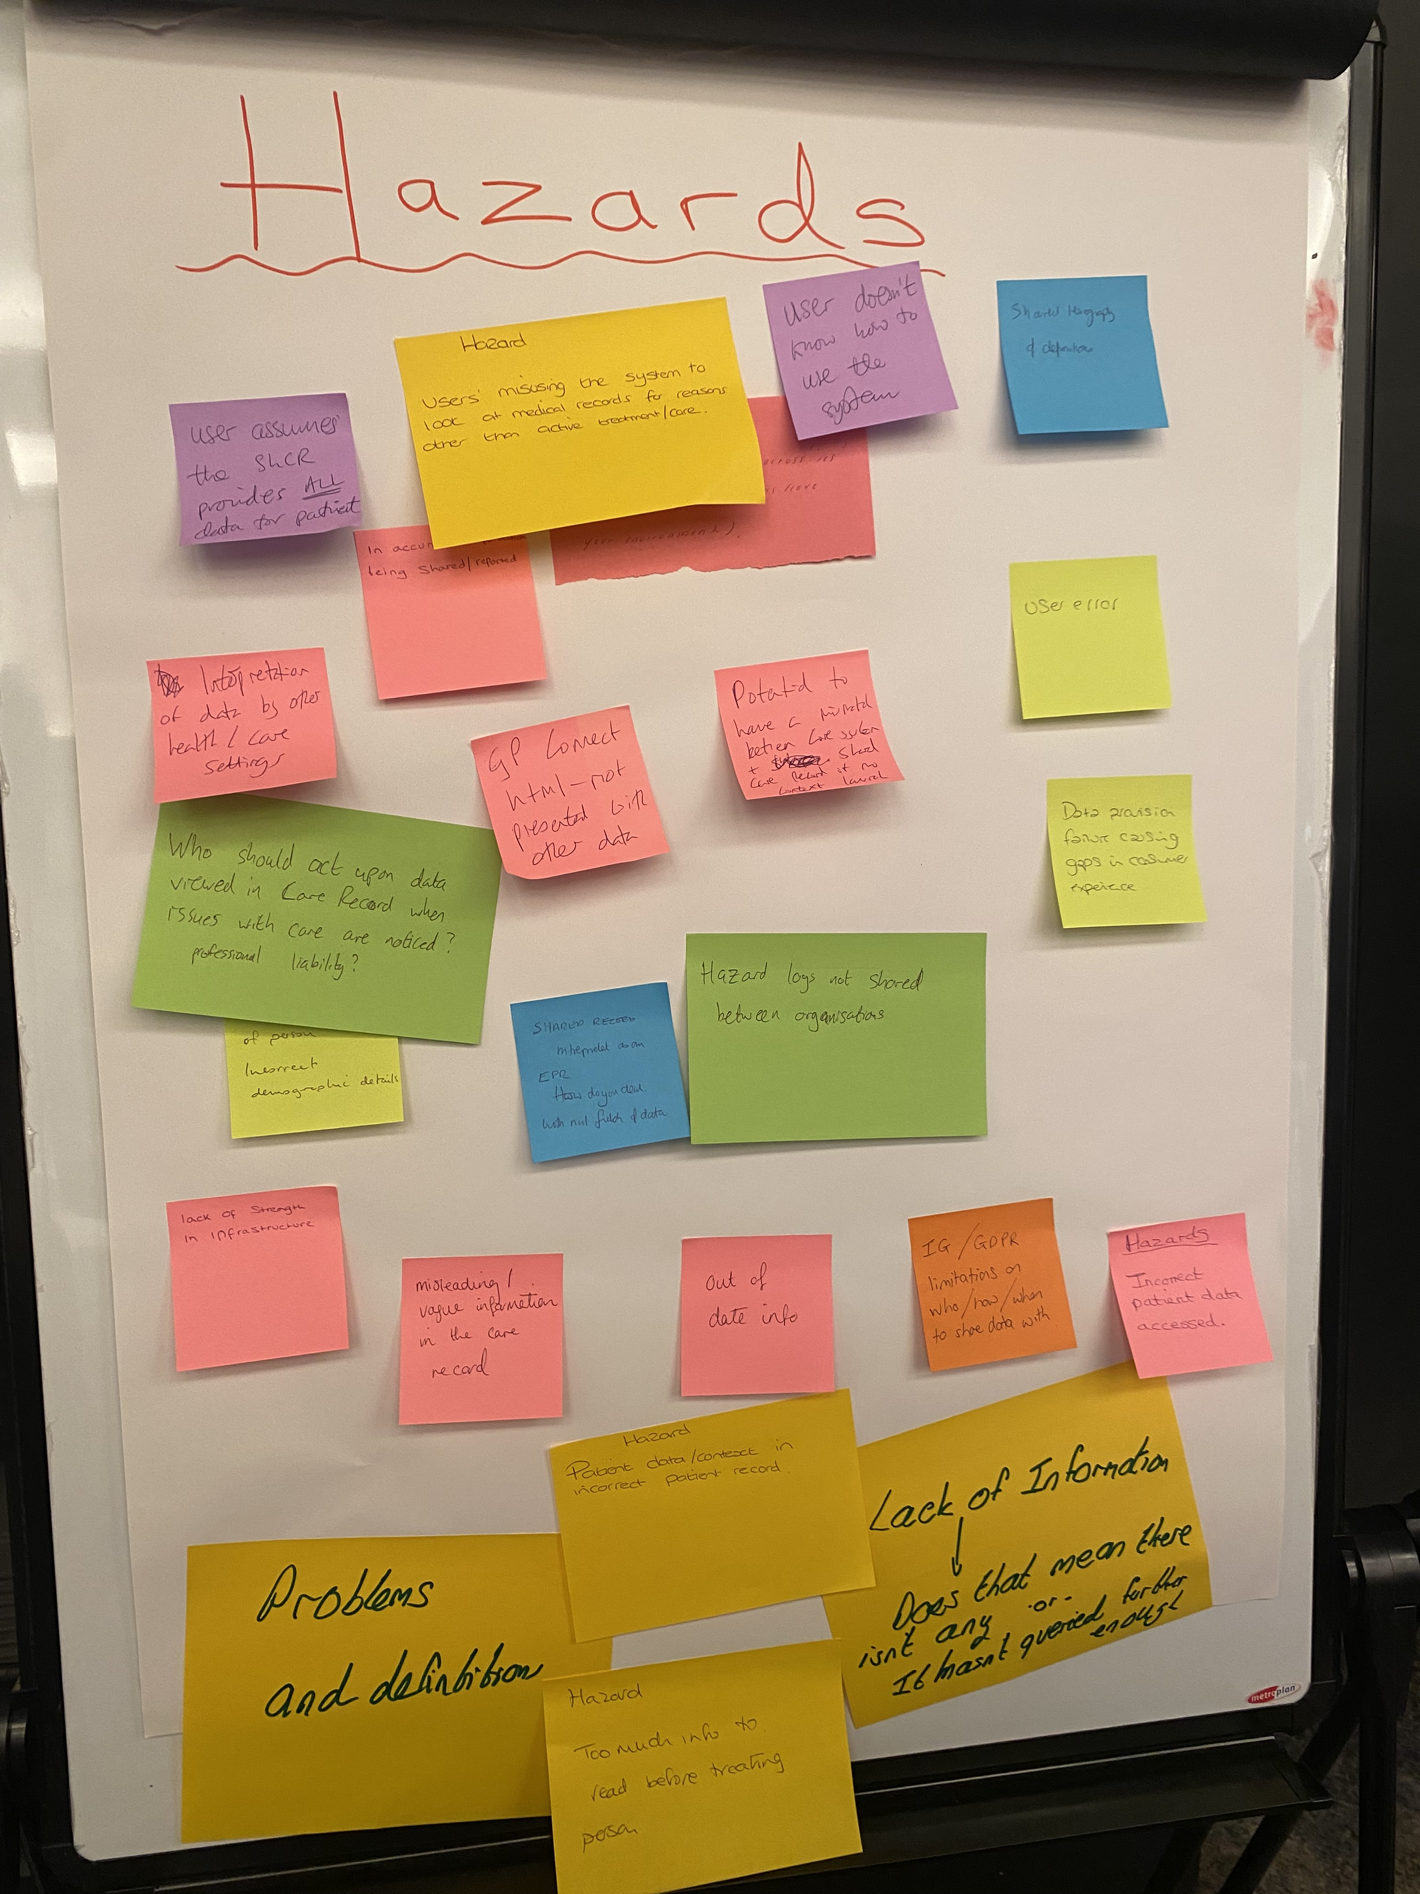
Goals:
Please list the top 3 goals to take forward from your workshop
1. Build a national ShCR framework
2. Connect with Social Care and ICB’s more for transparency of CS and link together
3. Be transparent and share materials

Slide 4
Detailed Outcomes & Actions
Action/Outcome | Who is involved? | Check in Date
ShCR’s need the resource from CSO experts to help shape their frameworks and guide them on their journey | Everyone – SchR’s, NHSE, end users | 6 Months – 12 Months
YHCR CS129 documentation to be shared for an example of how it can be done | YHCR | ASAP
NHS Retrospective Safety Assurance checklist to be shared | YHCR | ASAP
Slides to be shared along with hazards identified | YHCR | ASAP
Hazard Log or Blog write up to be produced containing all detail captured on day and shared | Rebecca Wilson CSO | ASAP
Network for CSO’s and Social Leads to come together in a ShCR forum to share knowledge, best practice etc. | Everyone | 6 months

