Slide 1
Information Sharing: Putting the citizen at the centre of health and care (including care homes and children’s services)
Tracey O’Brien – traceyo’brien@nhs.net
Richard Greaves –richard.greaves1@nhs.net
Shared Care Record Summit 20th – 21st March 2023 The Queens Hotel, Leeds

Slide 2
Connecting Care: Bristol North Somerset & South Gloucestershire
“I got the nurse to do it the old fashioned way and then the same through Connecting Care, the old way took 4 hours and 20 minutes, the new way 105 seconds…. Multiply that by 15,000 patients a year, that’s a huge amount of nursing time we’re saving.”
Alastair Johnstone,
Anaesthetic Consultant,
University Hospitals Bristol

Slide 3
Connecting Care: Bristol North Somerset & South Gloucestershire
Connecting Care – nearly 10 years old
Is an essential part of our information sharing culture and ambition to ensure that individuals receive better care
Connecting Care has over 25 IT systems contributing data to the shared record some real time / some on demand via MIG
Connecting Care has over 9000 users with appropriate role based access viewing over 110K records per month – one of the most successful shared record in our region. On average staff are viewing 15 records per month.
One of the few shared records that includes children's social care information to share with health colleagues and community services (Cheshire and Merseyside led the way!)

Slide 4
Connecting Care: Bristol North Somerset & South Gloucestershire
We have 3 Local Authorities in our ICS including Bristol City Council
When we began the Connecting Care Programme we had a history of high profile Serious Case Reviews – particularly in Children's Services but also in Adult Services
Lack of information sharing was cited in many of the reviews and we had a strong ambition to improve the way we work
We are now bringing Care Homes and Domiciliary Care Providers into our programme of work – with 60 Care Homes and 2 strategic Domiciliary Care Providers already viewing Connecting Care
We are piloting displaying medicines for “temp registered patients” for our Homeless cohort. We are concerned that national solutions often assume that citizens are registered with a GP

Slide 5
Connecting Care: Bristol North Somerset & South Gloucestershire
Care Homes

Slide 6
Connecting Care: Information shared … so far
Hospital
Appointments / contacts including emergency attendances
Documents (discharge summaries, clinic letters, care plans)
Radiology reports UHB/NBT
Pathology results –All Acutes
Community Providers
(including Health Visitors & School Nurses)
Consultation notes
Appointments / contacts
Vaccinations
Medications / Allergies / Diagnosis
Mental Health (AWP)
Contacts / events
Crisis, relapse, peri-natal and contingency plans
Core health information and Alerts
Discharge summaries
Care Co-Ordinator information
Mental Health (Vitaminds) Over 16
Episodes of care and Appointments
Outcome questionnaires
Care Homes
e-Red Bag /hospital pack information
111/ Out of hours
Contacts / events
PEM (Out of hours discharge summary)
Social Care
Appointment and contacts / dates of assessments & reviews
Support reason
Safeguarding flags and Alerts
Team around the child, including social worker details
Disabilities
Placement address
Immediate family members (children’s records only) and legal relationships
GP practices
Consultation notes
Appointments / contacts
Vaccinations / Medications / Allergies / Diagnosis
Severe Mental Illness Physical Checks
End of Life Alert and ReSPECT info
Frailty Score and Covid-19 Risk Category

Slide 7
Connecting Care: Capability implemented to share documents
Uses supplier (Liquid Logic) API
In the first phase our documents include:
CHILDREN’S DOCUMENTS
Child Protection Initial Conference Outcome
Child Protection Plan
Child Protection Review Conference Outcome
Record of Strategy Discussion
ADULT DOCUMENTS INCLUDING
Mental Health Assessment (AMHP)
Social Care Assessment
Social Care Support Plan
Social Care Contact / Referral
Social Care Support Review
Reablement Plan
Reablement Assessment
Reablement Referral Form
Occupational Therapy Assessment
Independent Living / Adaptive Equipment Closure
Technology Enabled Care Referral Form
Technology Enabled Care Uninstall Form
Vision Rehabilitation Assessment

Slide 8
Connecting Care: Information NOT YET shared … and on our roadmap
Hospitals
On-going sharing of correspondence and care plans as departments brought onto corporate document sharing systems
Radiology Visuals UHBW/NBT
Medications (apart from discharge summary TTAs)
Community Providers
Documents
Mental Health
Medications
Consultation notes
Assessments
SMI Physical checks from mental health provider
CAMHs information
Social Care
More Documents
GP practices
Documents
Other organisations not sharing
Ambulance
Extending 111 information
Prisons
Dentistry
Shared Care Plans
Frailty
Long Term Conditions

Slide 9
Connecting Care: IG Lessons Learnt – a personal reflection
’
Culture
Safeguarding Reviews heightened awareness of importance of information sharing
Running workshops to ask the social care professionals and early help teams what information they shared and why – and really listening and learning. There were some surprises!
Going at the pace of each organisation …. lots of incremental changes add up to a lot of information over time
Building trust that we have a duty to share – on the whole we have not had IG debates
Having confidence that in-context launch helps to prevent inappropriate access and that audit processes work – e.g. in Connecting Care we have put on the individuals record in the Shared Care Record “who has viewed this record”. This enables professionals to see who else is working and making enquiries about the individual but also acts as “peer pressure” to prevent inappropriate access. We have audit reports e.g. same name access
Spending time to agree that all records will be shared – e.g. taking time to agree that “Locked Records” in social care would be shared (including celebrity and staff records)

Slide 10
Connecting Care: IG Lessons Learnt – a personal reflection
’
Culture
Flexing and changing RBAC over time
Building up to 10 RBAC roles and then reducing again to 2 clinical and professional roles
Understanding the difference between “admin” and “business support” and “brokerage” – and the information they need to enable direct care to be provided
Understanding the LA “red lines”
Purging and the importance of retention of record policy to LAs and how Connecting Care would handle social care processes to merge and delete duplicated records
Looking to delete the “copy of record” after 8 years
Agreeing backloading/ how long we need historic information
Generally we agreed two years

Slide 11
Connecting Care: IG Lessons Learnt – a personal reflection
’
Culture
Continue to push boundaries and challenge others: when the LAs and Social Care providers are confident they have legal basis for sharing
Ensuring that decisions about what to share are made by the controllers: (and not data processors / IT suppliers / those that provide central digital services)
Continue to review role based access: as information gets richer we need to continue to review that access to record is legitimate e.g. who needs to see Social Care Assessments and Strategy Discussions and DOL documents to provide the correct care, who needs to see IAPT information
Ensuring that information sharing supports new models of care – and that providing data digitally is more timely, safe, secure and can be audited:
Should we share information where the service threshold has not been met e.g. NFA / domestic abuse information?
When is the right time to start exploiting telehealth and internet of things information to support “Triage/Assess/Decide” in Connecting Care?
Deciding which citizen entered information should be included in the shared care record

Slide 12
SIDeR: History
Lack of information sharing was cited in many of the reviews and we had a strong ambition to improve the way we work
We were hearing of incidents across health and care that could have been avoided
Our End of Life system held orphaned data
We saw an opportunity to set a foundation by sharing our GP records, via a single solution
We wanted to create an equal partnership that included the LA and hospice from the outset

Slide 13
SIDeR: Background
Somerset population of circa 580,000, with 1 ICB, 2 Acutes, 13 Community Hospitals, Mental Health, 1 Adult Hospice, 62 GP practices and 1 Local Authority
SIDeR– is 5 years old
Is an essential part of Somerset’s information sharing culture and ambition to ensure people receive better care
For direct care only
On demand shared care record with 6 systems across health and care, all contributing data
Over 3,000 users with appropriate role based access viewing 20,000+ records per month
Stores a suite of persisted Care Plans that can be created, updated and viewed by any professional providing direct care, as well as digitally shared with some health systems
logo

Slide 14
SIDeR: Shared care plans
End of life care coordination
Advance care plan
Open mental health (referral, assessment and outcome
Treatment escalation plan
Comprehensive assessment form
Personalised care and support plan
About me
Acute respiratory infection

Slide 15
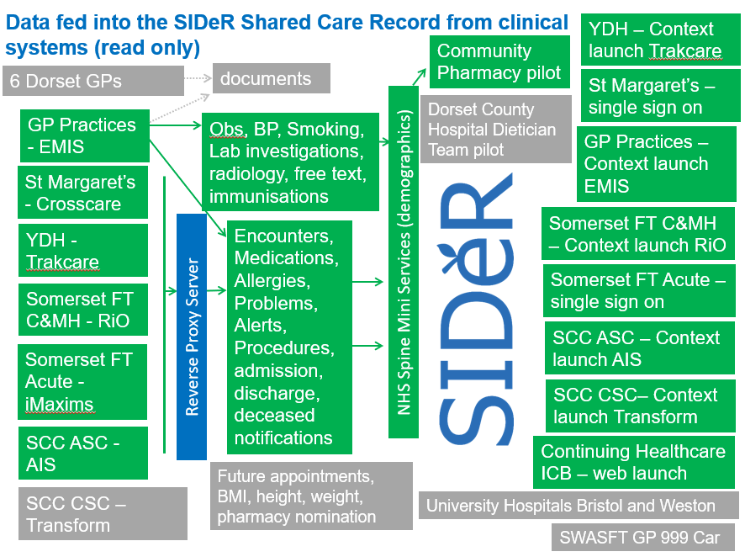
SIDeR: Information shared … so far

Slide 16
SIDeR: To do list
Provide access and / or connect other organisations
Children’s social care, education and SEN information
Public health
Ambulance
111 / OOH
Care homes
Trusts across the borders
Pharmacies
Optometrists
Dentists
One South West
Develop and launch new functionality
Already started first of type work with PCNs and local Care Homes (linked to our DISC programme) and the NRL with SWASFT
Expose GP documents flowing in from other care settings
Pull and push care plan extracts to local systems
NHS tends to focus on the individual, Social Care think about the family, we need to consider how we can extend support

Slide 17
SIDeR: Mantra and culture
Mantra
Clinically / care led and designed, digitally enabled
Go where the energy is
Bust the myths
Join the DOTs
More time to focus on the person
Culture
Inform the person - ensure system supports professionals with a process
Design information sharing to support multi-disciplinary teams
Engage, promote and engage – use story boards and real life stories
Relationships – treat all providers equally, work closely with LMC etc
Sponsor access where we can – e.g. Care Homes
Keep role based access simple
Contextual launch is key to usage
Establish an ISA and expand with use cases

Slide 18
SIDeR: Challenges
Challenges
Public perception / trust
Relationships
System pressure
Organisational mergers
Digital literacy and confidence
Conflicting priorities
Change!

Slide 19
Time to “IG Speed Date”
’
Menti code 52435164
Tables will be split into interest areas:
DSA / Legal Basis / Technical & Business Controls RBAC
How to improve culture and make staff more confident about accessing records and using information
Solve the more difficult stuff! Care Homes / Coroners / Schools
How to get better at informing citizens about what we are doing with their data
Imagining what good looks like e.g. sharing with those that also support the citizen e.g. Alzheimer’s Society
What are you finding difficult to solve?
Who is willing to support some IG show and tells? What on?
What do we need the National Shared Care Record Team to do for us to reduce the IG Burden?
What do we need the NHS England IG Team to do for us?

Slide 20
Tracey O’Brien: Digital Consultant SCW
Traceyo’brien@nhs.net
Richard Greaves: Head of Digital Transformation, NHS Somerset ICB
Richard.greaves1@nhs.net

