Slide 1
ShCR: Maximising the benefits
Shared Care Record Summit 20th – 21st March 2023 The Queens Hotel, Leeds
Sandra Taylor sandra.taylor50@nhs.net
Astrid Grant astrid.grant@channel3consulting.co.uk
Laura Godtschalk laura.godtschalk@nhs.net

Slide 2
It’s all pointless

Slide 3
…unless Shared Care Records deliver change
that’s relevant to front line services
that’s beneficial, operationally and strategically
whose benefits are commensurate to the investment

Slide 4
Intuitively – ShCRs must be beneficial!
Benefits realisation
Proving the value of the investment
Enabling and driving up that value

Slide 5
Maximising the benefits
Driving the value
Rich experience in the room
Everyone is different
Opportunity to
Reflect on your system’s strengths and challenges
Share your experience to benefit others
Come away with fresh ideas
Agenda
Mentimeter survey
Illustrations
Leicester, Leicestershire and Rutland Care Record
Experience exchange
Your challenges and strengths
Ideas responding to challenges, and follow up actions
Looking ahead
Credit: Kenneth Field: http://cartonerd.blogspot.com/2018/09/the-united-kingdom-of-cheese-on-board.html

Slide 6
Audience Benefits Realisation Survey

Slide 7
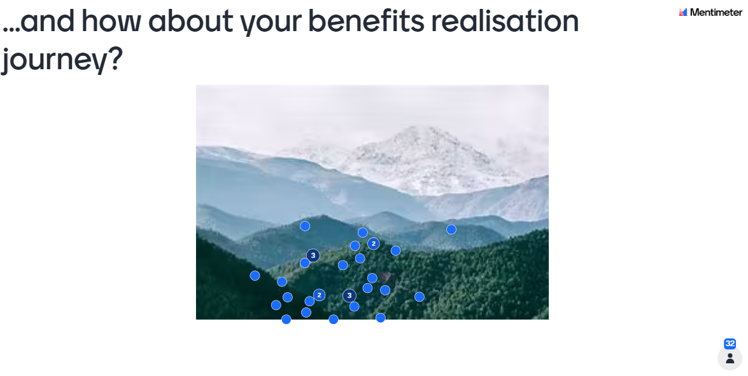
Audience Benefits Realisation Survey

Slide 8
Audience Benefits Realisation Survey

Slide 9
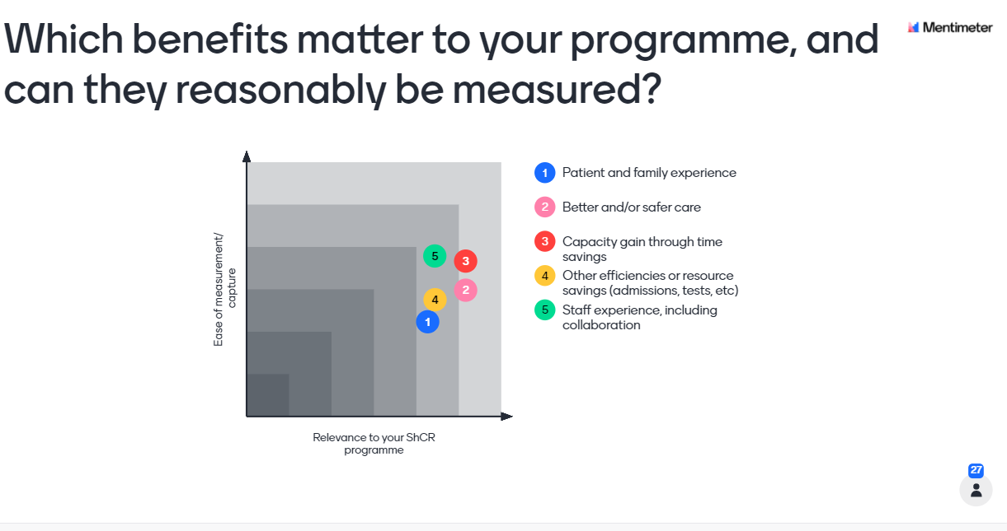
Audience Benefits Realisation Survey

Slide 10
Being benefits led in Leicester, Leicestershire and Rutland
LLR Integrated Care System
1.1m people
Strong, inclusive partnerships
LLR Care Record
Interweave – partnership approach
Later ShCR round – pilot teams live now, lining up for wider rollout
3 benefits related illustrations
Using local intelligence for benefits led rollout
Quantifying benefits – without forgetting the bigger picture
Understanding the user base
Urban, diverse Leicester, more rural Leics and Rutland

Slide 11
1. Joined up intelligence for benefits-led rollout
Relevant capabilities -> purposeful use -> beneficial change
Strategic contribution
Data, capabilities
Use cases
As a…
I want to access…
In order to…
Operational benefits
Strategic Benefits
Capability

Slide 12
1. Joined up intelligence for benefits-led rollout
As a [role]
I want access to [info]
In order to [task]
With the effect that [benefit]
Organisation/team
Usage
Platform
LLR CR Capability
Use case
Benefit
Strategic objectives
Data

Slide 13
Benefits-informed programme
Roadmapping
What are our gaps in understanding needs?
What are the development priorities?
Requirements capture
New use cases to add to the catalogue and keep everyone in the loop.
Testing
What are some realistic test scenarios?
Benefits management
Which use cases is LLR CR enabling, and for whom?
What benefits are resulting?
Piloting
Reflecting pilot teams’ use cases back to them
Which are achievable now and which later?
Tech architecture
Which data provider systems need to be integrated?
What portal functionality is required?
Training
Usage examples for trainees
Communications
Vivid progress reporting
LLR CR benefits for different stakeholders.
Stakeholder engagement
What is each user gaining?
Which services/ tasks are data providers facilitating?

Slide 14
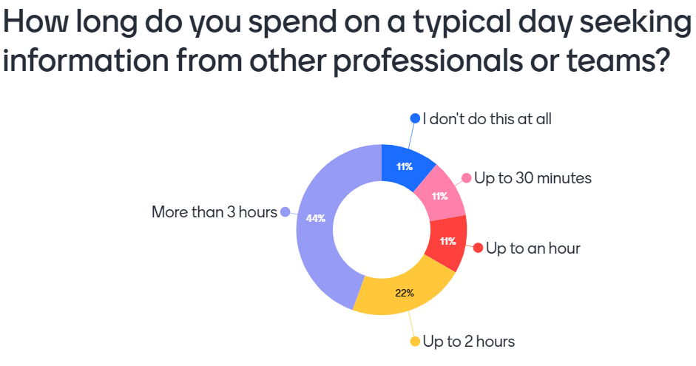
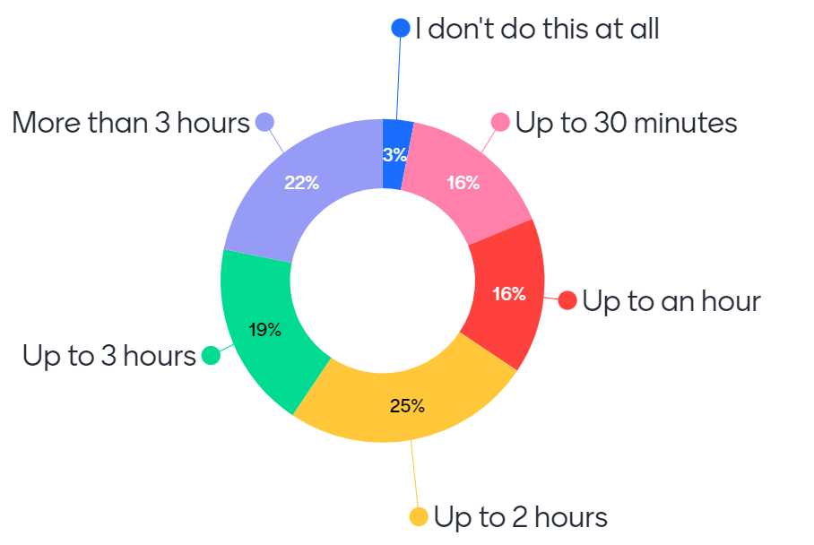
2. Quantifying the most attributable benefits …but not at the expense of the rest

Slide 15
2. Quantifying the most attributable benefits …but not at the expense of the rest
The more salient information shared the better… – as we spend countless hours trying to access info via the phone / emails etc.
It frees your time up to allow you to do the problem-solving part of the case quicker…
it frees your mind a little bit more to allow you that time to actually think about it.
The service user gets a much better outcome.
What the service user is missing is time to talk with us… I spend more time gathering information.

Slide 16
2. Quantifying the most attributable benefits …but not at the expense of the rest
Pilot Teams | Use cases | Time savings | Resource sustainability | Better care | Safety | Patient experience | Staff experience | Collaboration | Equity
All settings | 3 |  | 1 |  |  | 3 | 1 |  | 2
Adult Social Care | 12 | 10 | 3 | 6 | 3 | 3 | 2
ASC Occupational Therapy | 1 | 1 | 1 | 1
General practice | 7 | 7 | 4 | 2 | 3 | 2
LOROS | 2 | 2 | 1 | 2 | 1 |  |  | 1
LPT mental health | 2 | 2 |  | 2
UHL | 2 | 2 | 1 | 1 | 1
UHL outpatient | 3 | 3 | 3 | 2 |  | 1
Discharge Hub | 2 | 2 | 2 | 1
Grand Total | 34 | 29 | 16 | 17 | 8 | 9 | 3 | 1 | 2

Slide 17
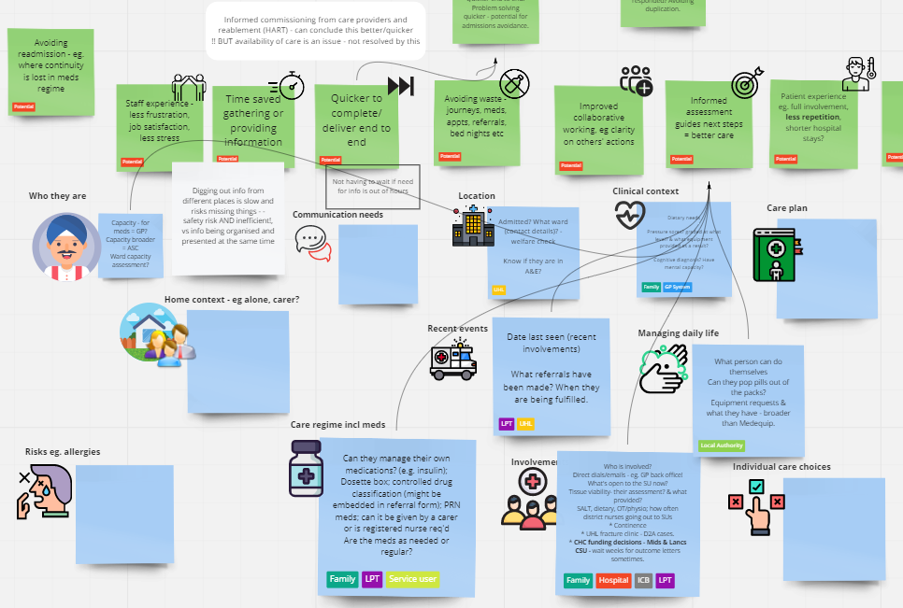
3 Solving the right problems with the user base
Not used = no benefits
Starting with the end in mind – what do we want to achieve?
Understanding when and why services will use the LLR CR
Ensuring everyone achieves the potential
Collaboratively identifying
what information services need
why
how to organise it
...and measure whether that helps
Helps to
Prioritise data additions and rollout sequence
Deliver value

Slide 18
Many more to engage and on-board
We know more about the needs of some groups
c100 use cases captured to date
1/3 in the pilots
2/3 still to activate

Slide 19
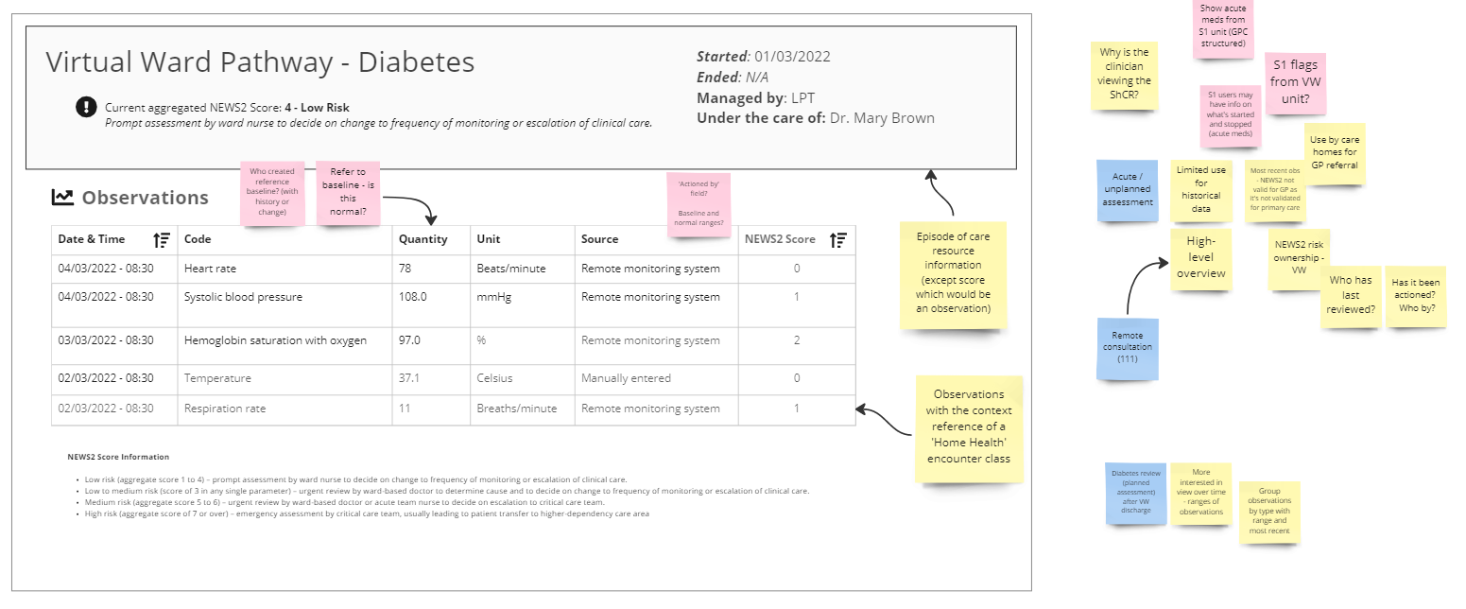
Design: Evolving what is presented and how

Slide 20
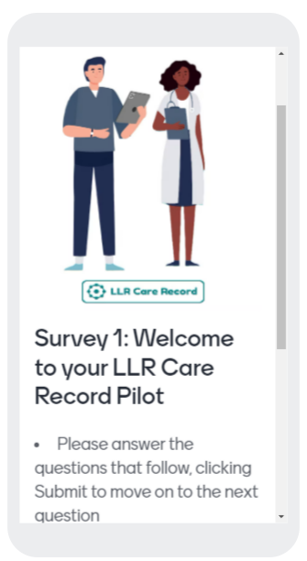
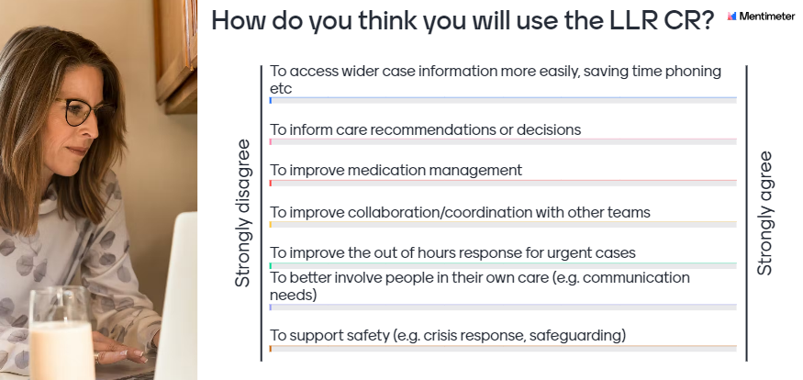
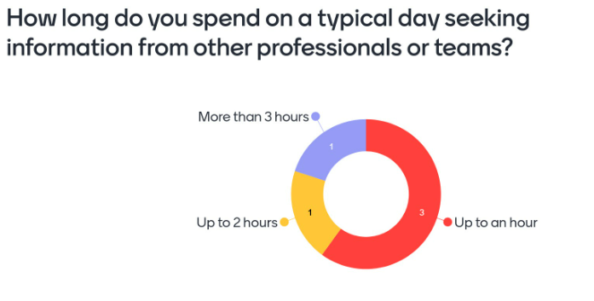
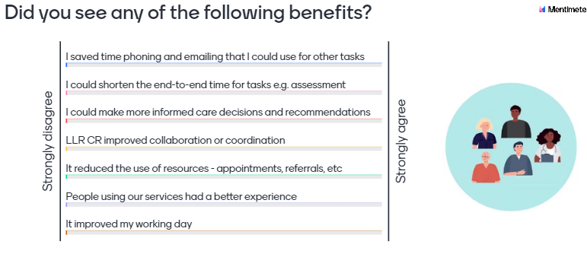
Supporting confident adoption – change management

Slide 21
Strengths and challenges
Driving local usage and benefits
Understanding requirements of more health and care domains
Meeting needs: presenting records in the best way
Benefits realisation choices
Deepening the benefits culture
Securing ownership of benefits
Leveraging wider BI metrics to capture impact
Innovating for strategic benefit
Promoting innovation
Wider ambitions for the sharing infrastructure
Capabilities beyond read-only sharing of records
Using communications and engagement

Slide 22
Audience Benefits Realisation Survey
What’s your next challenge in maximising ShCR benefits?
Sharing the benefits themes at high level and then the detail data which supports the benefits.
Complete our first benefits strategy focusing on one key benefit for each provider group
Identifying and quantifying local benefits and getting stakeholder buy in
Getting a variety of benefits, not just time savings
Sustainable Model, Prioritise What Next? What does it look like in 5 years
Stakeholder engagement - ensuring that understanding and capturing the benefits is just as important as delivering the project
Focusing on the right use cases - a balance between ease of delivery and impact
Making sure there’s enough data in the record for its users to see the benefits
Stakeholder engagement eg benefits workshops and securing benefit ownership
Working with the right frontline teams to understand how it may have improved the way they work
Ensuring our organisation provides timely accurate data and that our staff can consume the information

Slide 23
Audience Benefits Realisation Survey
What’s your next challenge in maximising ShCR benefits? (contd)
Demonstrating value and benefit Making our SCR sustainable
Getting board to look beyond cash saving Adoption of the system and measurement.
Getting buy in Stakeholders buy in
Peer ownership - clinical engagement Inter connectivity of data
Usage campaign with frontline staff Aligning technical capabilities to recognised benefits
Getting the right data into the care record Increase uptake
Getting baselines Regular reporting
Getting forecast Measuring benefits for collection and baselines
Measure the benefits correctly Supporting the ICS Benefits leads to share their learning
Measuring benefits Define a clear smart benefit management plan
Getting benefit resource - dedicated role Resource in the team to find and track use cases

Slide 24
Life lessons through tinkering

Slide 25
Benefits speed exchange - Match-making your challenges and solutions Outputs Menu of ideas Take-away actions
Join
Join into full tables, ideally with people you haven’t yet worked with
Group
Together, stick your post-its onto your table's flip chart, grouping related items together
Rank
Rank the themes you want to discuss together
Write
Write your programme’s main benefits strengths and challenges on post-its
STRENGTHS
Name – ShCR prog or product
CHALLENGES
Name – ShCR prog or product

Slide 26
Speed Exchange
CHALLENGES
OPTIONS/IDEAS
ACTIONS
For each challenge theme, run an ‘advice cycle’
Running out of fizz? Next challenge.
At the call
A minute to jot down your own ideas.
Identify take-away actions (what and who): Mentimeter
a. Individual, b. Joint, c. Requests of national teams
Asker listens and takes their own notes, then responds.
Share ideas, suggestions, options. Pros and cons?
…And repeat!
Ask any clarification questions about your chosen challenge
Facilitator captures on fresh flip chart: mindmap?
Facilitators and scribes stay where they are.
Capture any further actions (what and who) - Mentimeter
Everyone else please move to a fresh table
Review and add to the next table’s ideas

Slide 27
...where do we go from here?
Emerald
Shared Care Records
FDP
SCR
NRL

Slide 28
Making the best out of our ShCRs
Think outside of the box:
How can we use our ShCRs to transform how we deliver health and care services?

Slide 29
Thank you
Sandra Taylor LLR CR Benefits and Change Manager
Sandra.taylor50@nhs.net Tel 07808 864 371
Astrid Grant Principal Consultant
Astrid.grant@channel3consulting.co.uk Tel 07753 138 883
Laura Godtschalk LLR CR Programme Manager
Laura.godtschalk@nhs.net Tel 07920 847 594

