Slide 1
Outcomes and actions for… Workshop: Maximising the benefits of ShCRs
20th – 21st March 2023, The Queens Hotel, Leeds
Workshop Leads:
Sandra Taylor Leicester, Leics and Rutland (LLR) CR Benefits and Change Manager
Sandra.taylor50@nhs.net
Astrid Grant Principal Consultant, Channel 3 Astrid.grant@channel3consulting.co.uk
Laura Godtschalk LLR CR Programme Manager
Laura.godtschalk@nhs.net

Slide 2
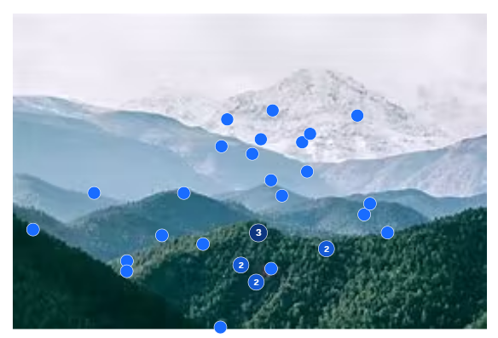
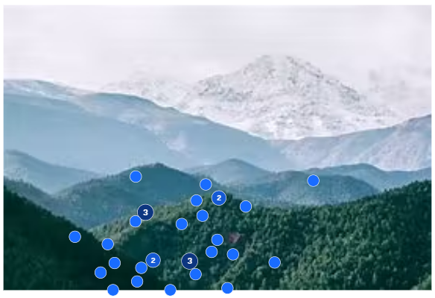
In summary:
ShCR programmes at very different stages
This workshop focused on the role of benefits realisation in measuring and maximising ShCR outcomes.
It used examples from the Leicester, Leics and Rutland Care Record to illustrate some practical benefit- led approaches to achieve value in implementation.
A Mentimeter survey reviewed where colleagues were with benefits realisation, and identified the next challenges colleagues intended to tackle.
Groups were invited to share ideas to help to tackle their current challenges and unblock progress.
Finally, we looked to the future, asking how the ShCR infrastructure could be capitalised on further to benefit health and care.
…with further to go on their benefits journeys

Slide 3
Goals:
Connect and exchange ongoing on ShCR benefits realisation – expertise, tools, capabilities
Quick wins via point to point exchange – many enabled directly in the workshop
Small groups addressing shared challenges
Catalogue of strengths/ expertise/ tools/ offers
National networks sustaining/ coordinating
3.

Slide 4
Illustrative Outcomes & Actions
Action/Outcome
Draw on existing business cases, benefits and approaches from other settings – don’t reinvent – ‘business cases in a box’, ‘do it once and share’. Share collateral such as comms and training materials. Build up pace of turnaround from ideas to benefits being achieved.
Stay connected with other ShCR teams on benefits, including sharing on how to get more from
Create a national story for the successes of the Shared Care Records – and a local story about inclusivity – tangible case studies that can be shared. Addressing practitioner fatigue, broadening exec view of value.
Secure dedicated resource for benefits realisation, including to source and track use cases, part of wider, skilled multidisciplinary teams
Open up to new sectors/business areas working with others – reduces front line burden, aligns approaches, accelerates
Align technical capabilities to enable identified use cases/benefits to be realised
Increase ownership of benefits by services – ensure understanding that achieving beneficial change is as important as delivering the project
Build up usage to build up benefits realised – address via drop in sessions, ambassadors, tailored comms and more, accessible training
Review with front line teams to understand their real benefits in practice, do it creatively
Tailoring the benefits story to different stakeholders, working effectively with comms. Emphasise trusted voices, media with immediacy.
Work together to harness more collaborative, ambitious, forward looking, cost effective approaches from common suppliers

