Slide 1
The future direction for shared care records.
Shared Care Record Summit 20th – 21st March 2023 The Queens Hotel, Leeds

Slide 2
Your Presenters
John Farenden
Robert Hickingbotham
Programme Director at NHS England
Founder and CEO of Synanetics
“Anyone know anything about microcomputers ? The Department of Health want to commission a project about them”
That was the ask in 1988 when I foolishly raised my hand and started my relationship with digital health informatics.
Since then, working in large global and small startup consultancies and most recently with NHS England, I’ve been fortunate enough to work in all four UK countries at national, regional and local levels.
It’s been 35 years of highs and lows. Mostly highs. Today is definitely one of the highest highs.
Having spent a career working in health and care technology in the UK, North and South America, I am now privileged to head up Synanetics and our involvement in the INTERWEAVE Shared Care Records.
INTERWEAVE is a new technical fabric which underpins regional interoperability projects. It is owned by the NHS and built by Synanetics.
INTERWEAVE has been all consuming for me for the last 5 years but looking back there have been some incredible moments involving some very driven people and big problems worth solving.

Slide 4
Going forwards by looking back

Slide 5
This time last year
21/22 H2
22/23 H1
22/23 H2
23/24 H1
23/24 H2
24/25
“Regional” Interoperability
National Interoperability
Local Government integration
- Adult Social Services
Local Government integration - others
Social Care Providers - Phase 1
Social Care Providers - Phase 2
Social Care Providers - Phase 3
Integration of Care Plans - EoL
Integration of Care Plans - Others
Integration of NHS-commissioned Community Health Services
Enable Patient Carer Access
22/23 Planning Guidance priorities
Enable POD Integration
Co-design assurance regime - IG, Cyber, Clinical safety
Enable VCSE Integration
Enable Private Sector Integration
Operate assurance regime

Slide 6
The magic money sink

Slide 7
The magic money sink

Slide 8
The magic money sink

Slide 9
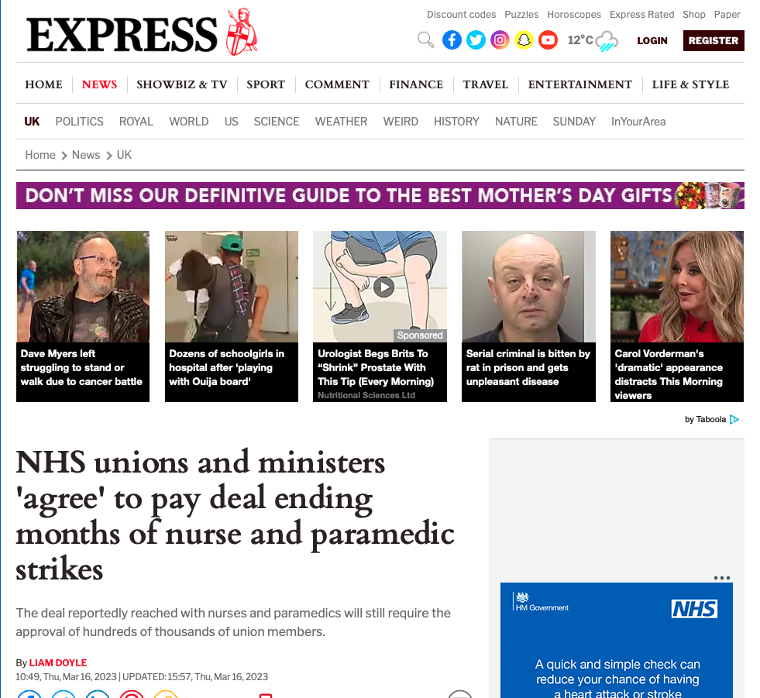
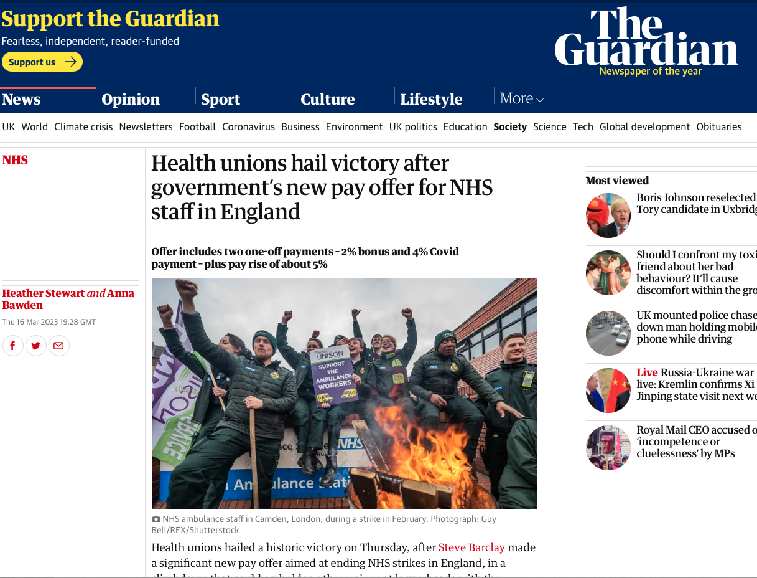
Good news ?

Slide 10
Some of your achievements
“I assessed a breathless patient over the phone who had significant palpitations and presyncope.
I was almost certainly going to arrange an ambulance but then on accessing the London Care Record it came to light he had a background of anxiety and was on propranolol.
He hadn’t taken his medication that morning.
I advised him to take it.
I eventually called the patient back to reassess and he was symptom free.
I was able to give him the best support and treatment and freed up an ambulance to treat patients elsewhere.”
Better outcome
Better experience
Better use of resources
Happy clinician

Slide 11
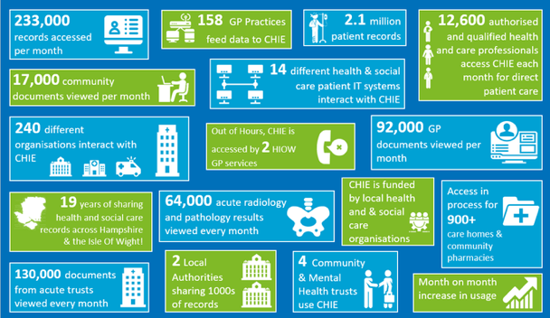
Some of your achievements

Slide 12
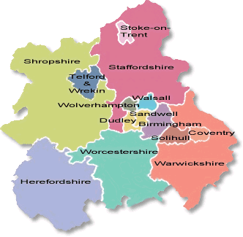
Some of your achievements
Two shared care record collaboratives in the West Midlands have confirmed the successful sharing of data between their two separate suppliers, boosting hopes for the region’s care vision
The Collaborative Care Record delivers shared care records covering Birmingham and Solihull, Coventry and Warwickshire and Herefordshire and Worcestershire and has successfully integrated information from six local authorities, giving it one of the largest number of social care records in the country. This has enabled social work professionals to gain a more complete picture of the people they’re supporting, allowing them to closely meet their needs
One Health and Care serves Shropshire, Telford and Wrekin, Black Country and Staffordshire and Stoke-on-Trent. It has been live for nearly a year and incorporates information feeds from the region’s GP practices, councils, acute trusts, mental health trust, ambulance trust, specialist trust, hospices and care homes.
Working with InterSystems and Graphnet they used test data to demonstrate interoperability between their own system and the one used by the adjoining shared care record. The shared care collaboratives now included data from a combined total of 848 providers, serving 6.1 million people in the West Midlands. There are now plans to now connect around 600 community pharmacies in the West Midlands to further the reach of the shared records.
“The improvement we could make in care, and the pressure that could be taken off the system in terms of cost, time and resources, would be just phenomenal. We can only do this by looking at the bigger picture and sharing data over a much wider area. For our populations, systems and patients, I have absolutely no doubt it’s the right thing to do.”
Dr James Reed, Chief Clinical Information Officer, Birmingham and Solihull Mental Health NHS Foundation Trust

Slide 13
Some of your achievements
440,110 views for the Great North Care Record in November. A record number!!!

Slide 14
Some of your achievements
“I regularly hear about the amazing difference that the DCR is having in the way in which professionals are able to care for patients efficiently and with the accuracy afforded by accessing information seamlessly which they would have previously found very difficult or indeed impossible.
We have now achieved close to 100,000 record accesses per month, which is a staggering accomplishment. I always think that it relates to, in this case, 100,000 moments of care that are better than before because of the DCR service.
I am immensely proud of what the dedicated, hardworking DCR team have achieved.”
Peter Gill, SRO for the Dorset Care Record

Slide 15
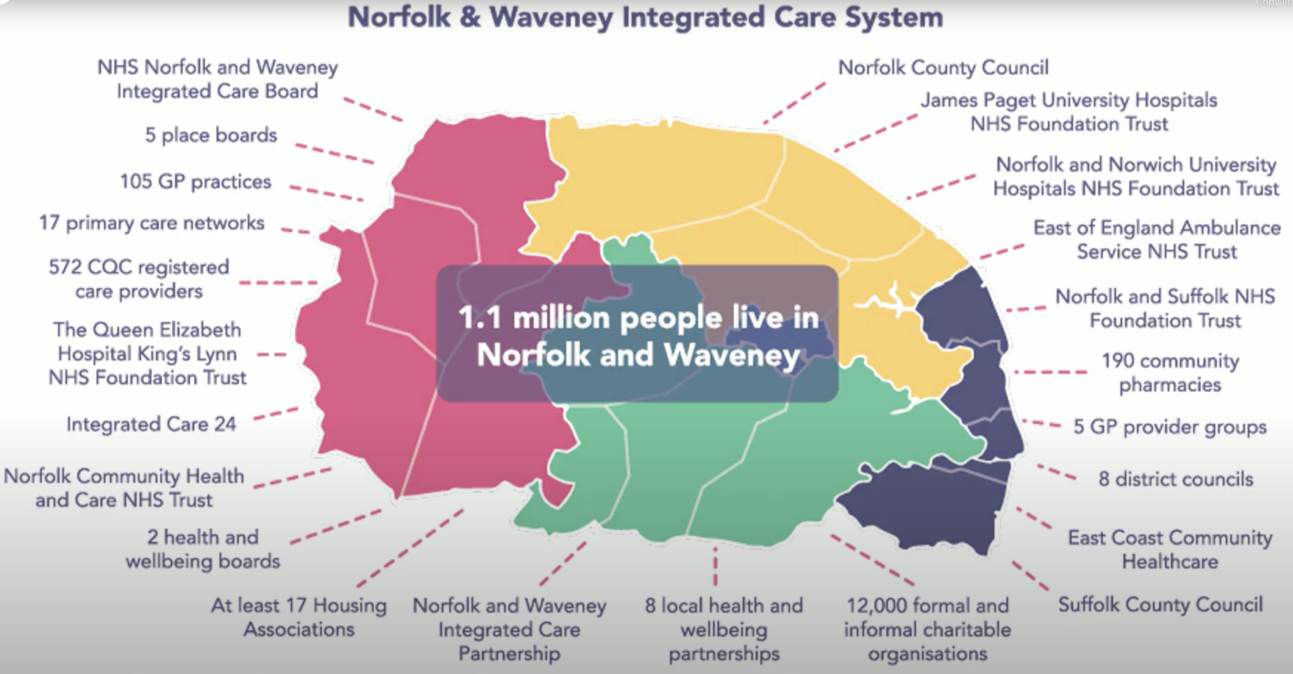
Some of your achievements

Slide 16
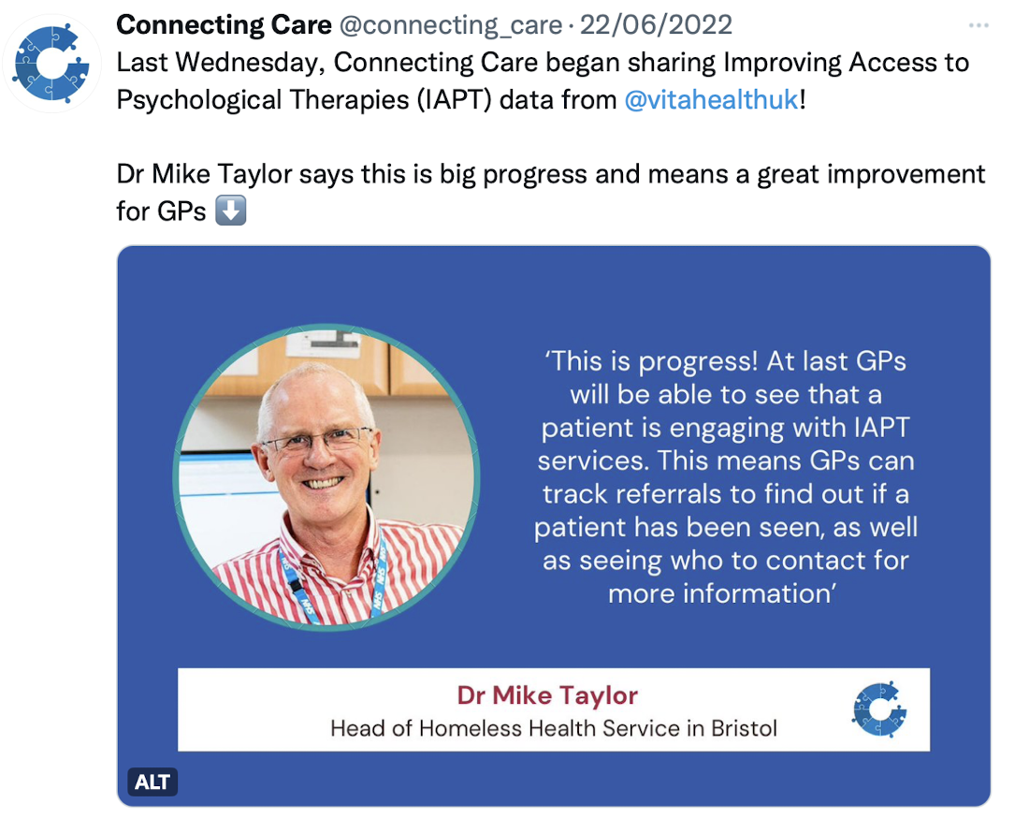
Some of your achievements

Slide 17
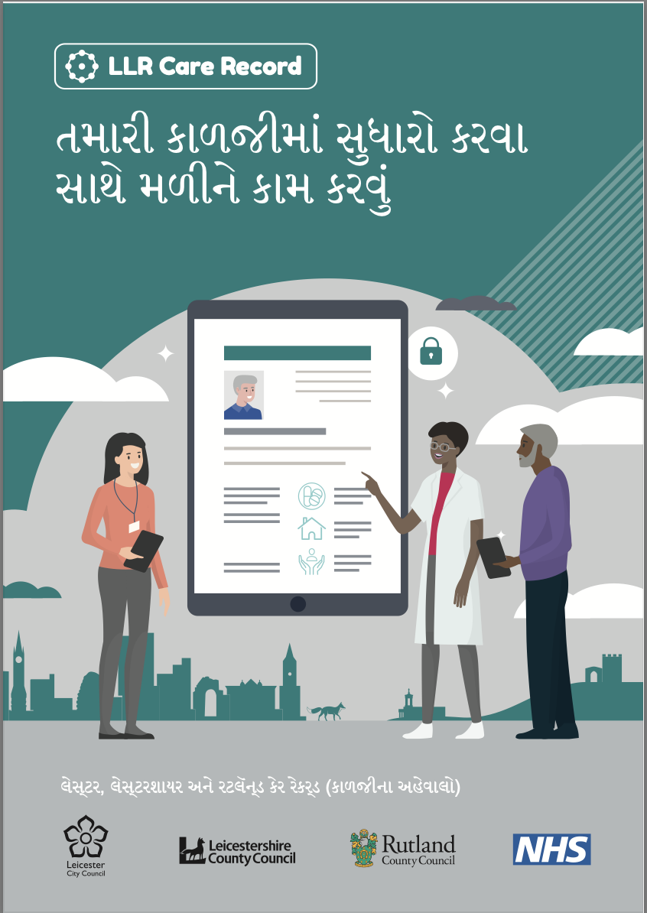
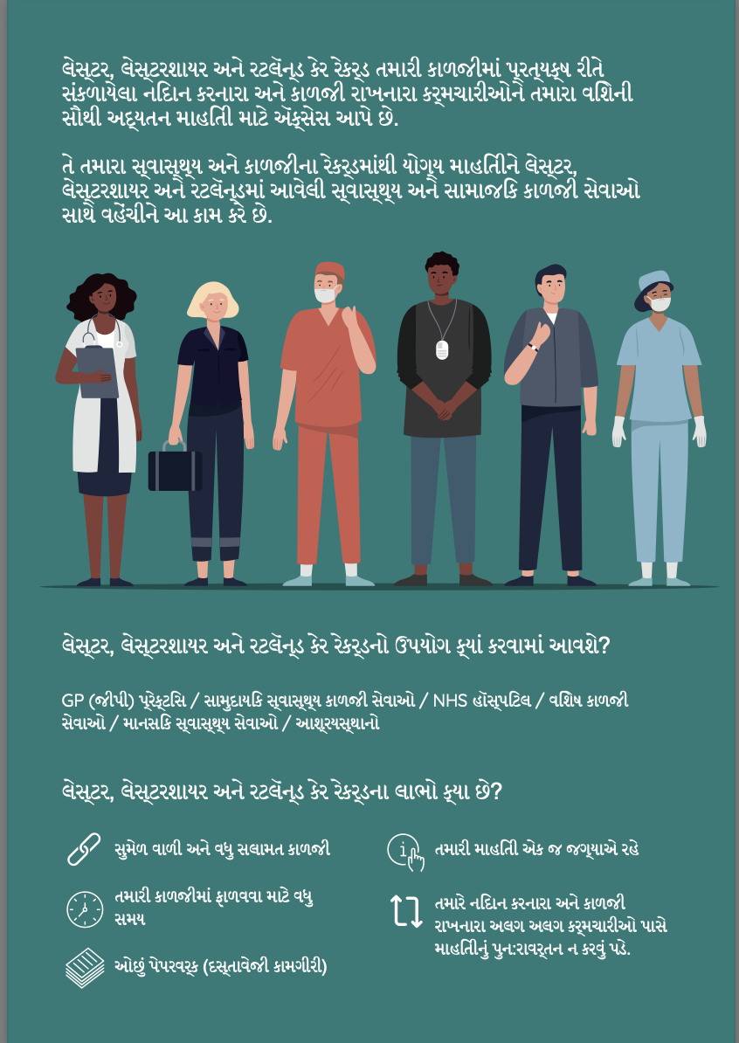
Some of your achievements

Slide 18
Some of your achievements

Slide 19
One of our achievements

Slide 20
So what else do you want to shout about ?
Tell the room … and beyond … what you are proud of having achieved this year ?

Slide 21
Going forwards by looking back
Heads up – where are we going ?

Slide 22
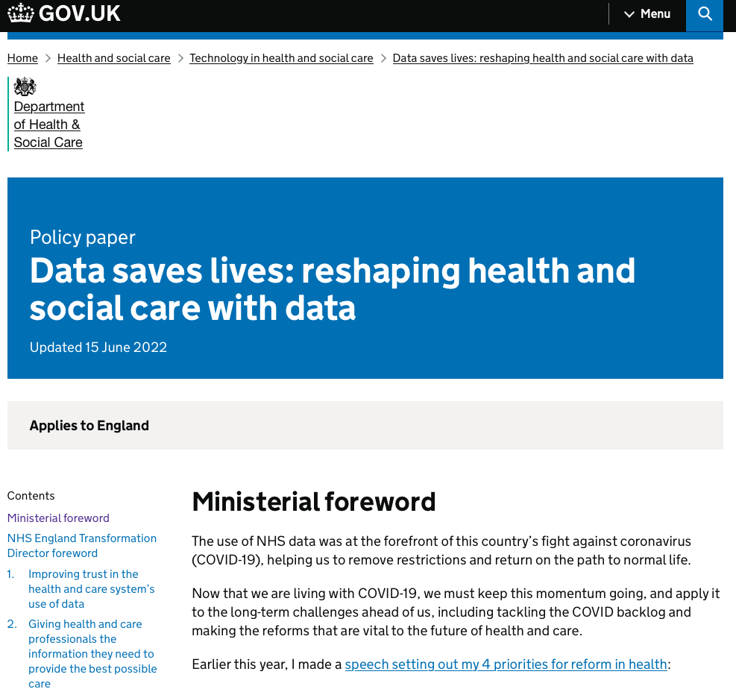
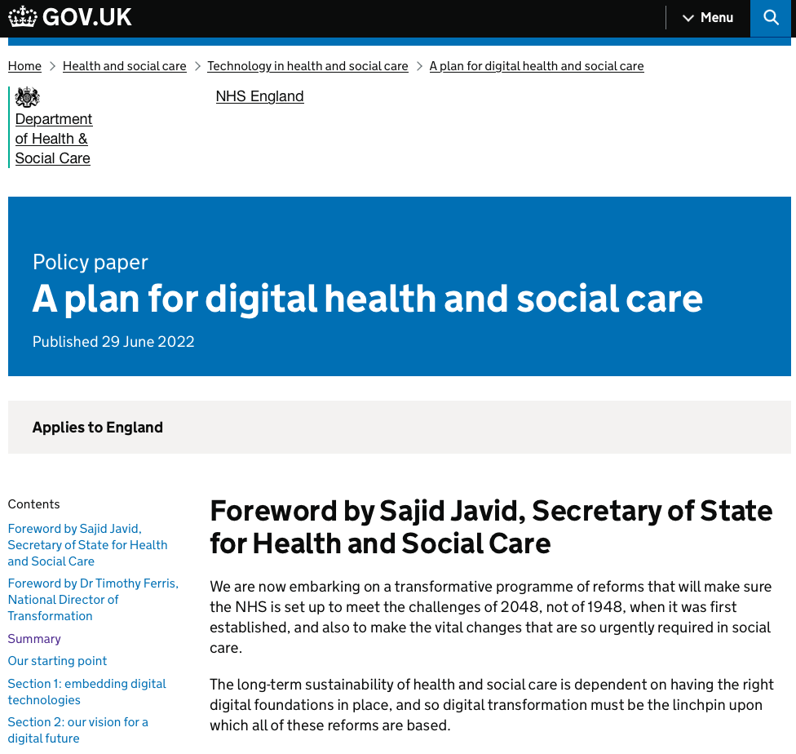
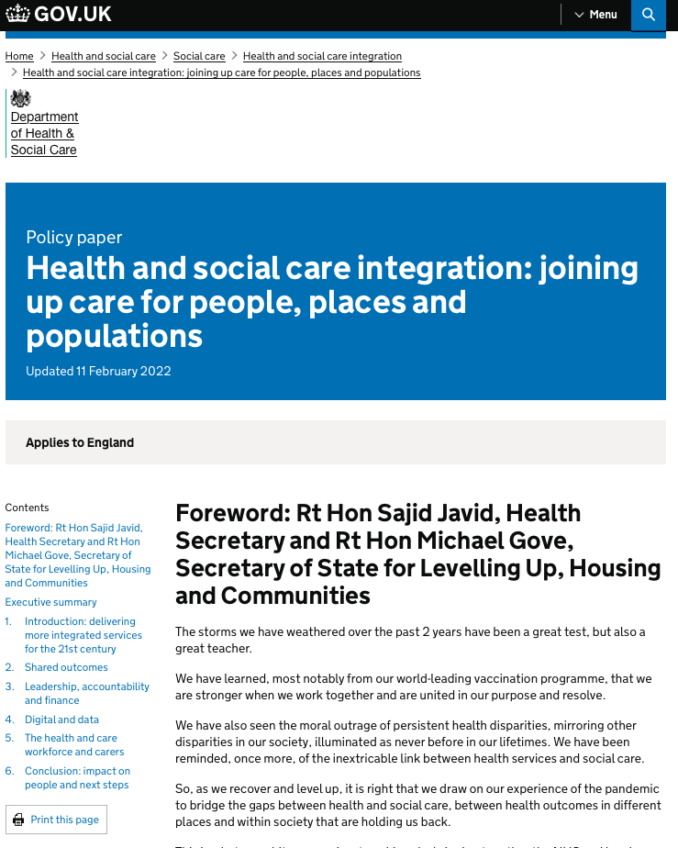
Policy Context

Slide 23
Public commitments
Constituent organisations of an ICS are connected to an integrated life-long health and care record by 2024, enabled by core national capabilities, local health records and shared care records, giving individuals, their approved caregivers and their care team the ability to view and contribute to the record
We will roll out integrated health and care records to all people, providing a functionally single health and care record that people, their carers and care teams can all safely access, enabled by a combination of nationally held summary data and links to locally held records, including shared care records​
Joining up data and information is central to integrating services. All citizens should expect to have access to their own shared care record and for it to cover their health and care journey, with full access, where appropriate, for all the staff they come into contact with
We will support every integrated care system to ensure that all organisations are able to access a shared care record that meets the requirements set out in the standards roadmap, enabling individuals, their approved caregivers and their care team to view and contribute to the record
Joining up data and information is central to integrating services. All citizens should expect to have access to their own shared care record and for it to cover their health and care journey, with full access, where appropriate, for all the staff they come into contact with
Health and adult social care providers within an ICS must reach a minimum level of digital maturity, and these providers should be connected to a shared care record. This will ensure each ICS has a functional and single health and adult social care record for each citizen by 2024, with work underway to enable full access for the person, their approved caregivers and care team to view and contribute to
Every ICS will need to ensure that all constituent organisations have a base level of digital capabilities and are connected to a shared care record by 2024 enabling individuals, their approved caregivers and their care team to view and contribute to the record
Systems are asked to ensure that local authorities with social service responsibilities within their footprint are connected to their local Shared Care Record solution by March 2023

Slide 24
Public commitments
We will ensure that each integrated care system has a basic shared care record in place to enable sharing of key information between GP practices and NHS Trusts
We will deliver comprehensive shared records in line with the commitments in the NHS Long Term Plan so that authorised staff for other care partners can easily and appropriately access data regardless of where care is delivered giving people better access to their own data through shared care records and the NHS App
We will continue to support local systems to roll out shared care records across England (subject to HM Treasury approval), providing the necessary data and API infrastructure to enable the public to access their records through national and local solutions
We will aim to have shared care records for all citizens by 2024 that provide a single, functional health and care record which citizens, caregivers and care teams can all safely access
We will ensure that, within 6 months of a care provider implementing a digital social care record, they are able to connect to their local shared care record
Social care records will be integrated into local shared care records within 6 months of a provider's digital system going live - based on current forecasts for digital roll out, this will mean 80% of providers will be integrated
We must ensure that shared care records cover the entirety of a person’s life and include both health and care. For adult social care, we will ensure that within 6 months of providers having an operational digital social care record in place, they are able to connect to their local Shared Care Record, enabling staff to appropriately access and contribute to the record
Systems are asked to ensure that by March 2023, all systems within a Shared Care Record collaborative can exchange information across the whole collaborative, with a view to national exchange by March 2024. Standards will be published to support this.

Slide 25
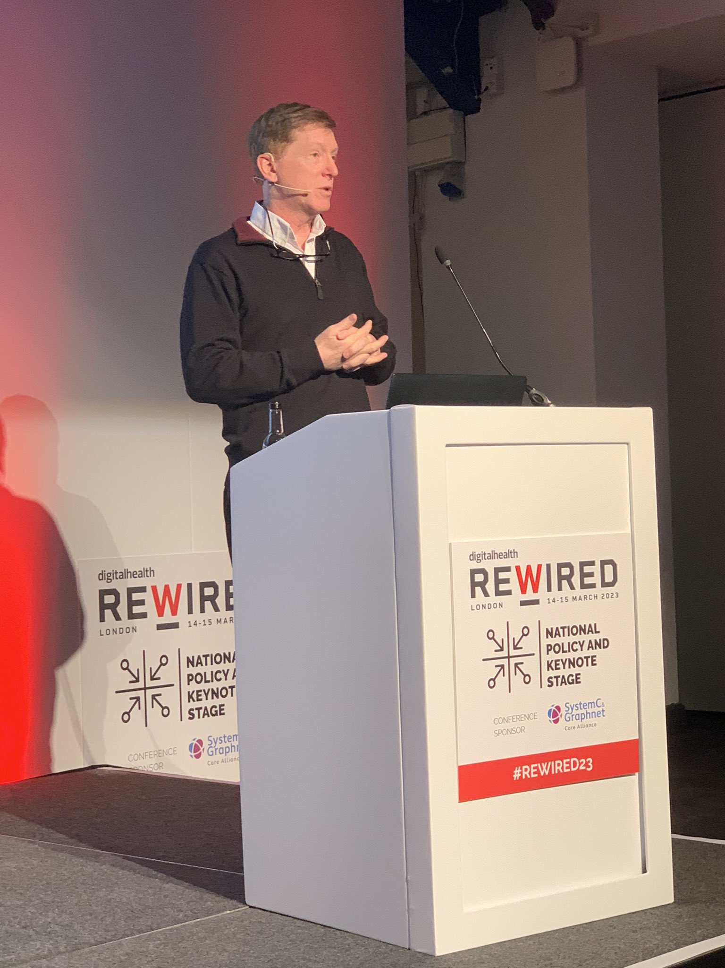
Tim @ Rewired
Today we publish the Who Does What framework that will support NHS England and Integrated Care System leaders.
It includes the National Service Catalogue and our first ever Draft Target State Architecture for consultation and feedback.
Tim Ferris

Slide 26
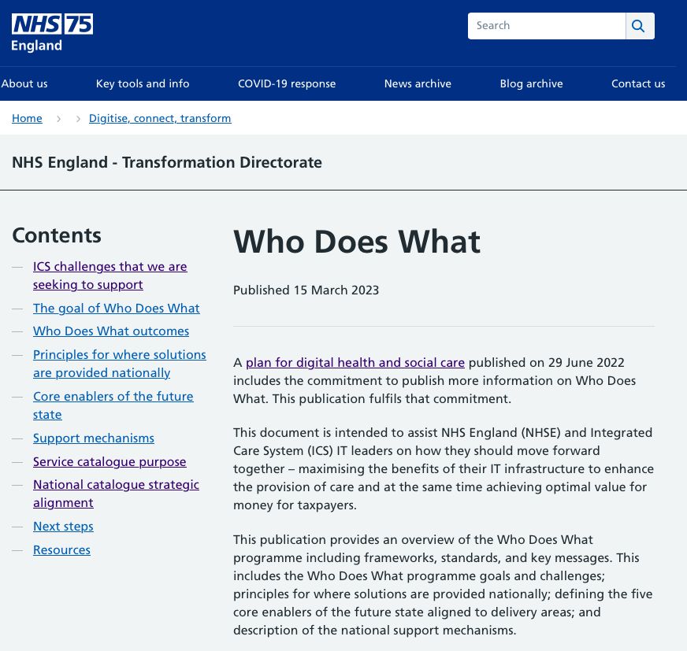
Principles for where solutions are provided nationally
Services and products will only be provided nationally where central provision meets strict principles and criteria.
NHSE will only provide services and products where national provision leads to:
better health and care outcomes
better patient and clinician experience
improved population health
value for money and reduction in costs per capita
Therefore, NHSE will be the Single Central Service Provider where
the need for scale and visibility is critical at a national level
standardisation nationally is critical for patient care, safety, experience, and cost optimisation
Where NHSE is not the Single Central Service Provider, we can provide support on
Market management
National standards
Delivery support and regional/local coordination

Slide 27
Hold true to the vision
Any authorised health and care professional has safe, secure and ready access to the person based information that they need to provide high quality care when they need it, where they need it and in the form they need it, and with confidence in its provenance.

Slide 28
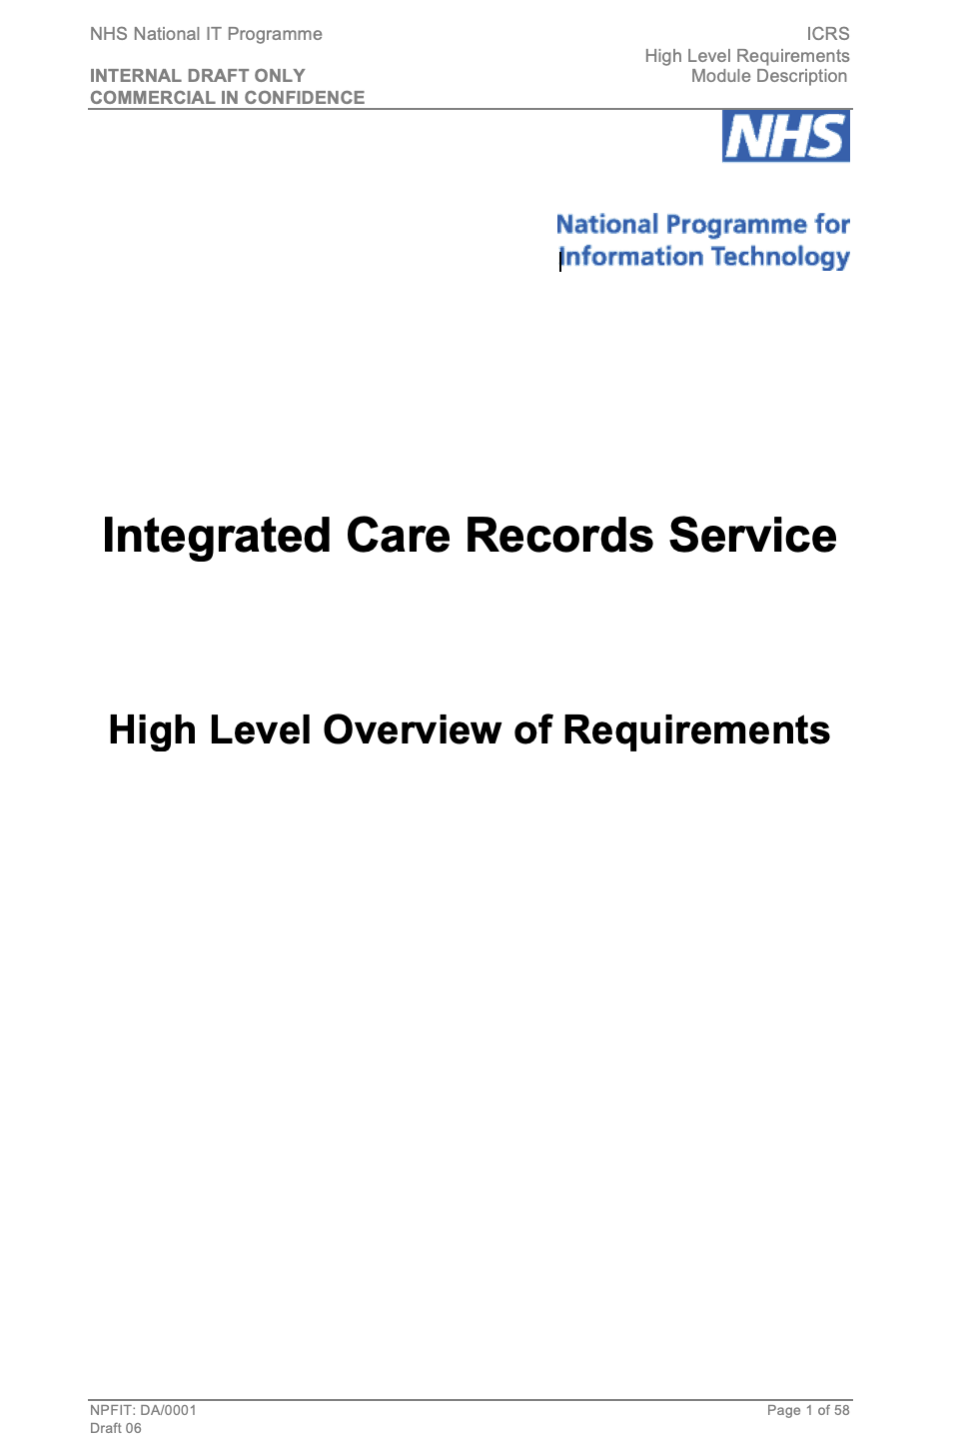
It’s not like we’ve not tried this before !
“The purpose of ICRS is to support the provision of high quality care across whole health communities, linked to national services and conformant to national standards.
ICRS is the:
Integrated, operating across the care continuum,
Care, covering both health and social care,
Record, single record based around the patient,
Service, to reflect a need to address not only the functionality required of the information systems but also the nature of the supporting services which will be required to effectively support professionals in the delivery of the care process.”
ICRS Requirement Specification 26th March 2003

Slide 29
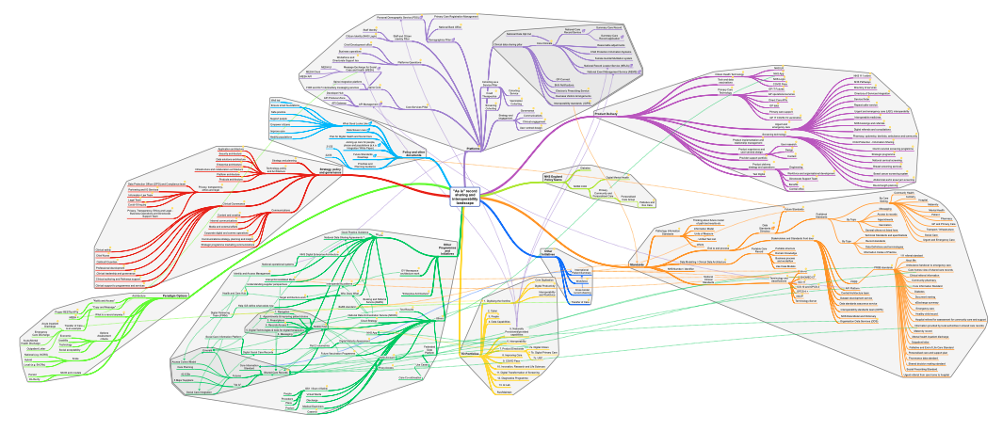
Our ”as is” starting point
An “asis” picture of existing national record sharing and interoperability initiatives

Slide 30
The seven wicked questions
What is our architectural paradigm ?
What is our view of “a record” ?
Centralise or distribute ?
How do we monitor and control ?
How do we make decisions ?
What problem does convergence solve ?
Do we direct or empower ?

Slide 31
1. What is a record anyway ?
Care Plan Record
Digital Child Health Record
Digital Health Record
Digital Personal Child Health Record
Digital Social Care Record
Electronic Health Record
Electronic Patient Record
GP Record
Health and Justice Digital Patient Record
Immunisation Record
Integrated Care Record
Local Health and Care Record
Local Record
Maternity Digital Care Record
Maternity Record
Medical Record
Paper Record
Patient Record
Person Held Record
Personal Health Record
Red Book
Shared Care Record
Summary Care Record
Vaccination and Immunisation Record
Just some of the terms used in the Long Term Plan and other key policy documents.

Slide 32
A logical view of “the record”
Personal demographics
Medications
Discharges / Transfer of Care
Test Results
#AboutMe
Referrals and Appointments
Primary Care
Secondary Care
OTC
Other
Care Plans
An individual’s health and care record is the aggregation of elements of their interactions with the health and care system, both what has happened to them in the past (Discharges, Transfers of Care, Test Results) and what is planned to happen for them (Care Plans / Appointments).
As an example, Medications are an important core element of a person’s overall “record” and themselves comprise a number of subsets (classes) – illustrated here as primary, secondary, OTC, other.
We will adopt a Person-centric model e.g., ISO 13606-1 / OpenEHR for the structure of the national care record, following consultation with wider stakeholders.

Slide 33
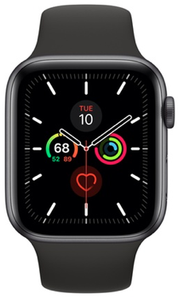
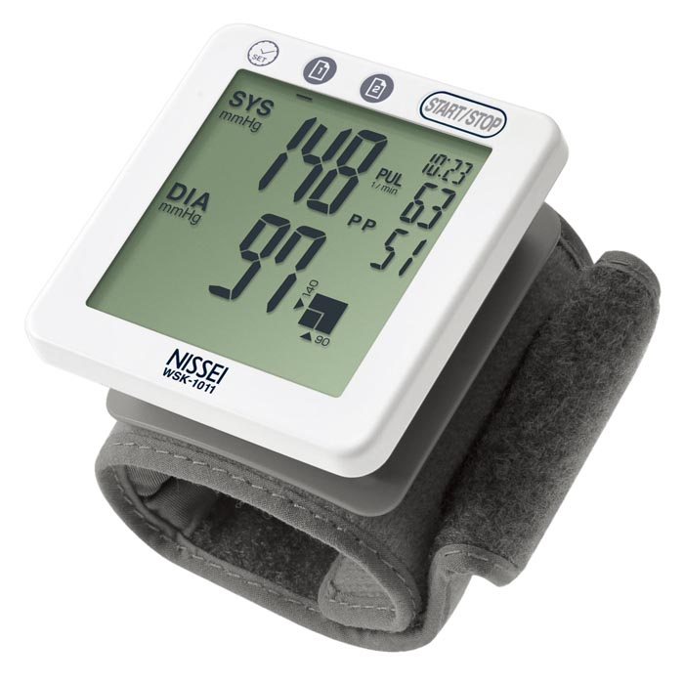
A physical view of “the record”
National | PDS – e.g. Name, DoB, NHS Number, address(es), NDOO, Reasonable Adjustment flags, preferred contact details / consents ?
Regional | ShCR – key elements (summaries) of a person’s records and plans from across local systems - e.g. care plans, “What matters to me”, imaging networks
Local | Individual provider systems – details of care provided - e.g. theatre notes, images, diagnostics, treatments. Manifested through EPRs, GP systems etc.
Personal | Person generated data from wearable devices etc.

Slide 34
2. Our architectural paradigm – To push or to pull ?

Slide 35
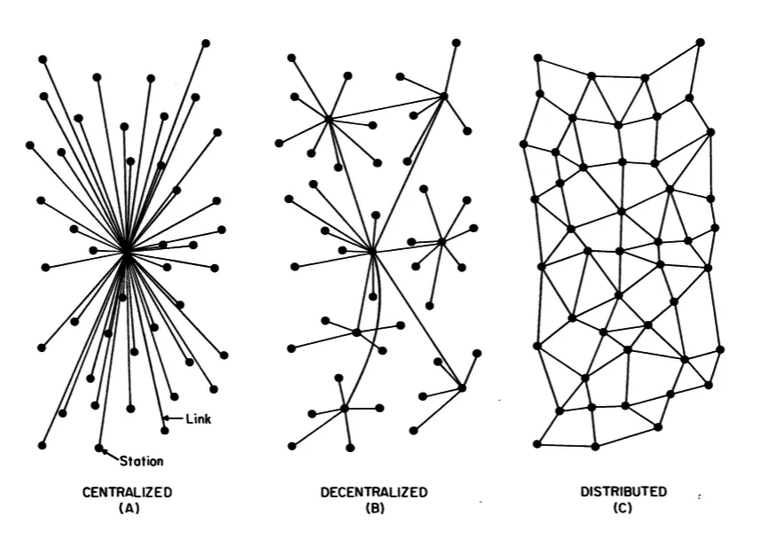
3. Centralise or distribute ?
Baran, P. (1964). On Distributed Communications, Memorandum RM-3420-PR

Slide 36
4. What problem does convergence solve ?
Conform to standards
Collaborate between providers
Consolidate systems
Coalesce around data

Slide 37
5. Make and take decisions
Notes:
What is the means of deciding and then communicating our strategic direction and operational decisions ?
Should we create – or reestablish or re-energise - a credible recognized, visible and authoritative Systems Design Authority for health and care ?

Slide 38
6. Direct or Empower ?

Slide 39
7. Monitor and control

Slide 40
Turning our thinking 90º
From Product
To Problem
Shared Care Record
Summary Care Record
GP-Connect
National Care Record Service
Social Care Record
EPR
“Safely and securely share records and plans”
From Providers of care
To Person receiving care
Trusts
GP’s
999/111
Pharmacies
Dentists
Care Homes
Hospices
Social Services
Domiciliary Care
You
Your granny
Your friend
Your neighbour
Notes:
Optometrusts

Slide 41
But what do we do about ShCR now ?
Scope
Resource
Time
Good, quick or cheap – pick two.

Slide 42
Our proposed themes
Aim
23/24 Milestone
24/25 Milestone
1. Record Sharing Strategy
A clear role for ShCR as part of an overarching record and plan sharing strategy
Agreed record and plan sharing strategy
Completion Date: 30/06/24
2. Interoperability between ShCRs and with social care
A fully interoperable ShCR capability to help individuals get the most appropriate and tailored care wherever they are in England
25% ICB’s (10/42) involved in inter-ShCR interoperability
Completion Date: 30/03/24
100% ICB’s (42/42) involved in inter-ShCR interoperability
Completion Date: 30/03/25
3. Levelling Up ShCR provision
Increased breadth & depth of ShCRs to a wider range of health & care settings also to include personalised care plans
Defined “level-2” breadth & depth standards for all ShCRs
Completion Date: 30/09/23
All ShCRs achieve “level-2” breadth & depth standards
Completion Date: 30/03/25
4. Convergence of ShCRs
Benefits associated with ShCR convergence identified and realised
Discovery and agreed supplier convergence strategy complete
Completion Date: 30/09/24
Supplier convergence strategy implemented
Completion Date: 30/03/25
5. ShCR Sustainability post 2025
All ICBs & ICB Collaboratives are locally sustainable
Confirmation of current funding status and plan for moving to local BAU funding for each ICB
Completion Date: 30/03/24
All ShCRs fully self funding as part of BAU covering at least the “level-2” standard of ShCR
Completion Date: 30/03/25
Notes:
onvergence

Slide 43
National strategy
Strategy - Is having a record sharing strategy statement something we should do nationally ?

Slide 44
National interoperability
Is leading on inter-ShCR interoperability something we should do ?

Slide 45
The commitments
Is leading on national interconnection of ShCRs to social care providers something we should do ?

Slide 46
The commitments
Is getting all local authority social services connected to their shared care record important to you ?

Slide 47
The commitments
Is getting independent sector community health service providers connected to their shared care record an important thing to do ?

Slide 48
Suppliers
Should we take a lead in working with the supplier community?

Slide 49
Local systems
Should we look to work with local systems to establish how we make record sharing an embedded function ?

Slide 50
The hard work starts now
What else would do you think we should do ?

Slide 51
Going forwards by looking back
Dare to dream

Slide 53
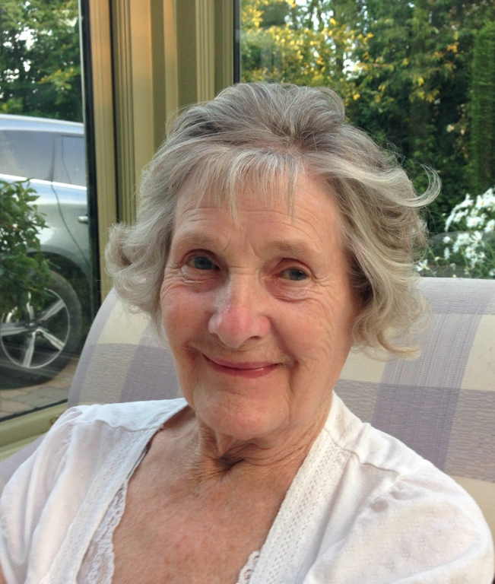
My late mother-in-law
Born Mary Clare Kelly, she passed away in November 2021 aged 94
She had
Advanced Alzheimer's
Type 2 Diabetes
COPD
High blood pressure
Notes:
She was a fairly typical frail older person with muti-morbidities - I think that very many of us have a Clare in our lives

Slide 54
Her carers
Over the 12 months she lived with us she had contact with
2 GP practices
2 Clinical Commissioning Groups
2 Local Authority Council Social Services teams
3 Community Pharmacies
2 Hospital Trusts
1 Mental Health Trust
1 Community Services Trust
1 Ambulance Trust
NHS 999
NHS 111
Out-of-Hours GP service
2 DWP departments
5 domiciliary care providers
Notes:
Clare became less independent so she spent more time living with us, but it wasn’t a sudden change, She’d spend a couple og days at first, then a week, then longer . Nut although he house was 14 miles away from ours, it was in a different Council area, a different CCG
She encountered 24 different providers of health and care services over 12 months
None of these providers of care had a complete picture of Clare. The only people who did were my wife and I and even then it was an opaque picture where we may have known the names of the medications she needed to take, but we didn’t know what purpose they served

Slide 55
Where might this all end up ?
If my record resides in many places
And if we know where those places are
And if we know how to access them when we need them
What else do we need ?

Slide 56
Where might this all end up ?

Slide 57
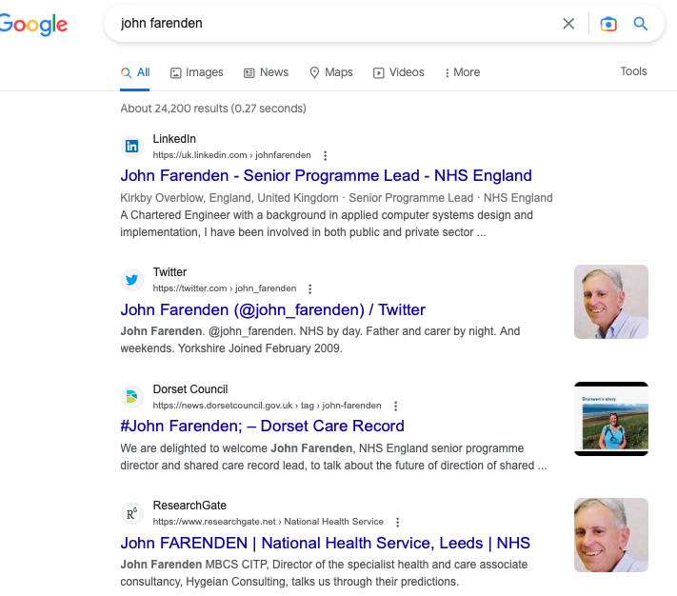
Where might this all end up ?

Slide 58
Crowdsourcing the strategy

Slide 60
John Farenden Programme Director, ShCR Programme, NHS England
John.farenden@nhs.net 07774 427278
Robert Hickingbotham
CEO Synanetics
robert@synanetics.com 07947 502896

