Slide 1
Outcomes and actions for… Future of Shared Care Records Workshop
20th – 21st March 2023, The Queens Hotel, Leeds
Workshop Leads:
John Farenden
ShCR (NHSE)
John.farenden@nhs.net
Robert Hickingbotham
Synanetics robert@synanetics.com
Hannah Wall
ShCR (NHSE)
Hannah.wall3@nhs.net

Slide 2
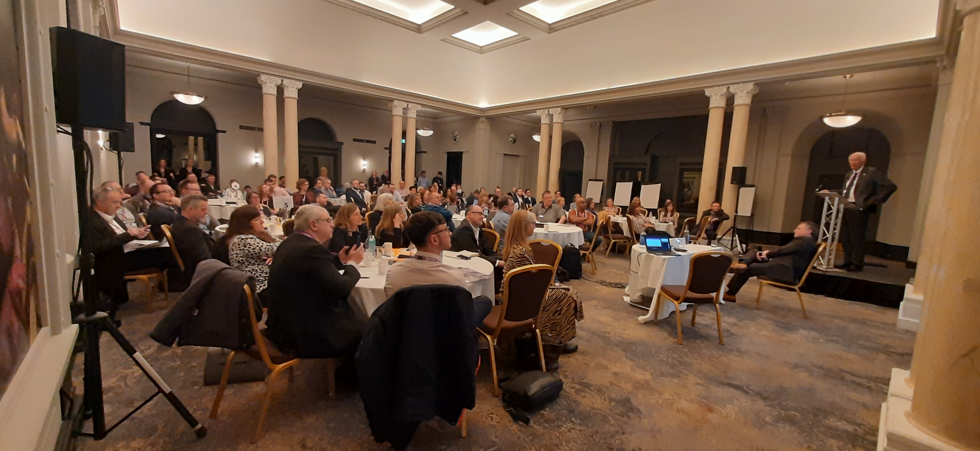
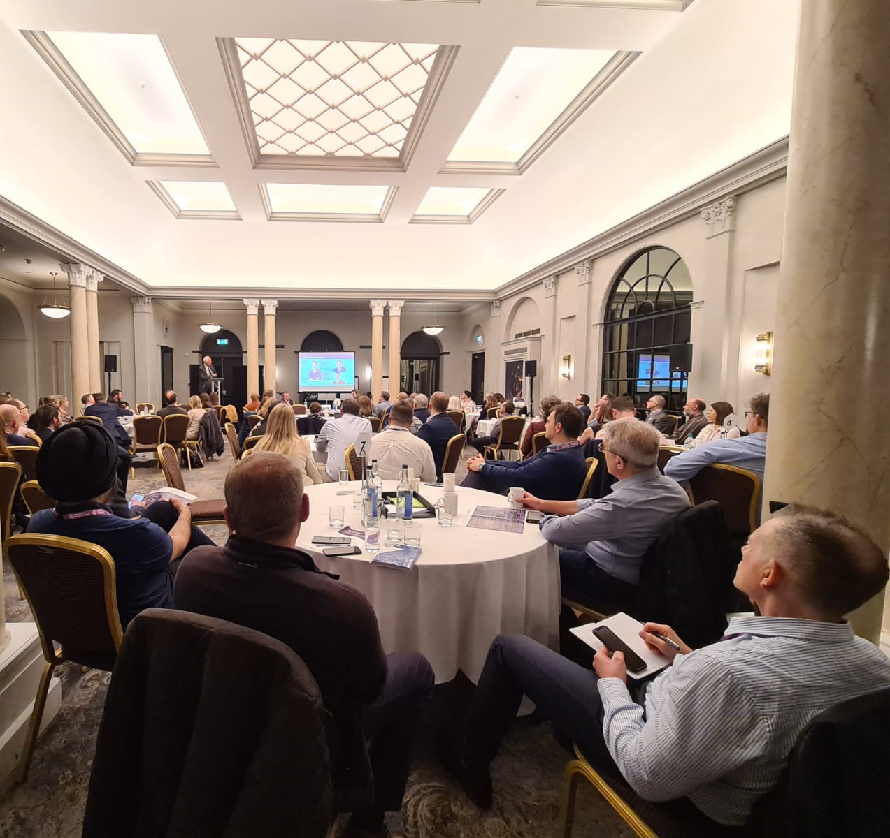
In summary:
A workshop to:
Reflect on the successes of the ShCR over the last year
Highlight achievements around the country
Establish the current political position of the ShCR as a national objective for the NHS
Put forward proposed themes for the ShCR over the next 1-3 years
Understand the current and future challenges facing delivery of the ShCR
Challenge the national commitments and understand local preferences for national support

Slide 3
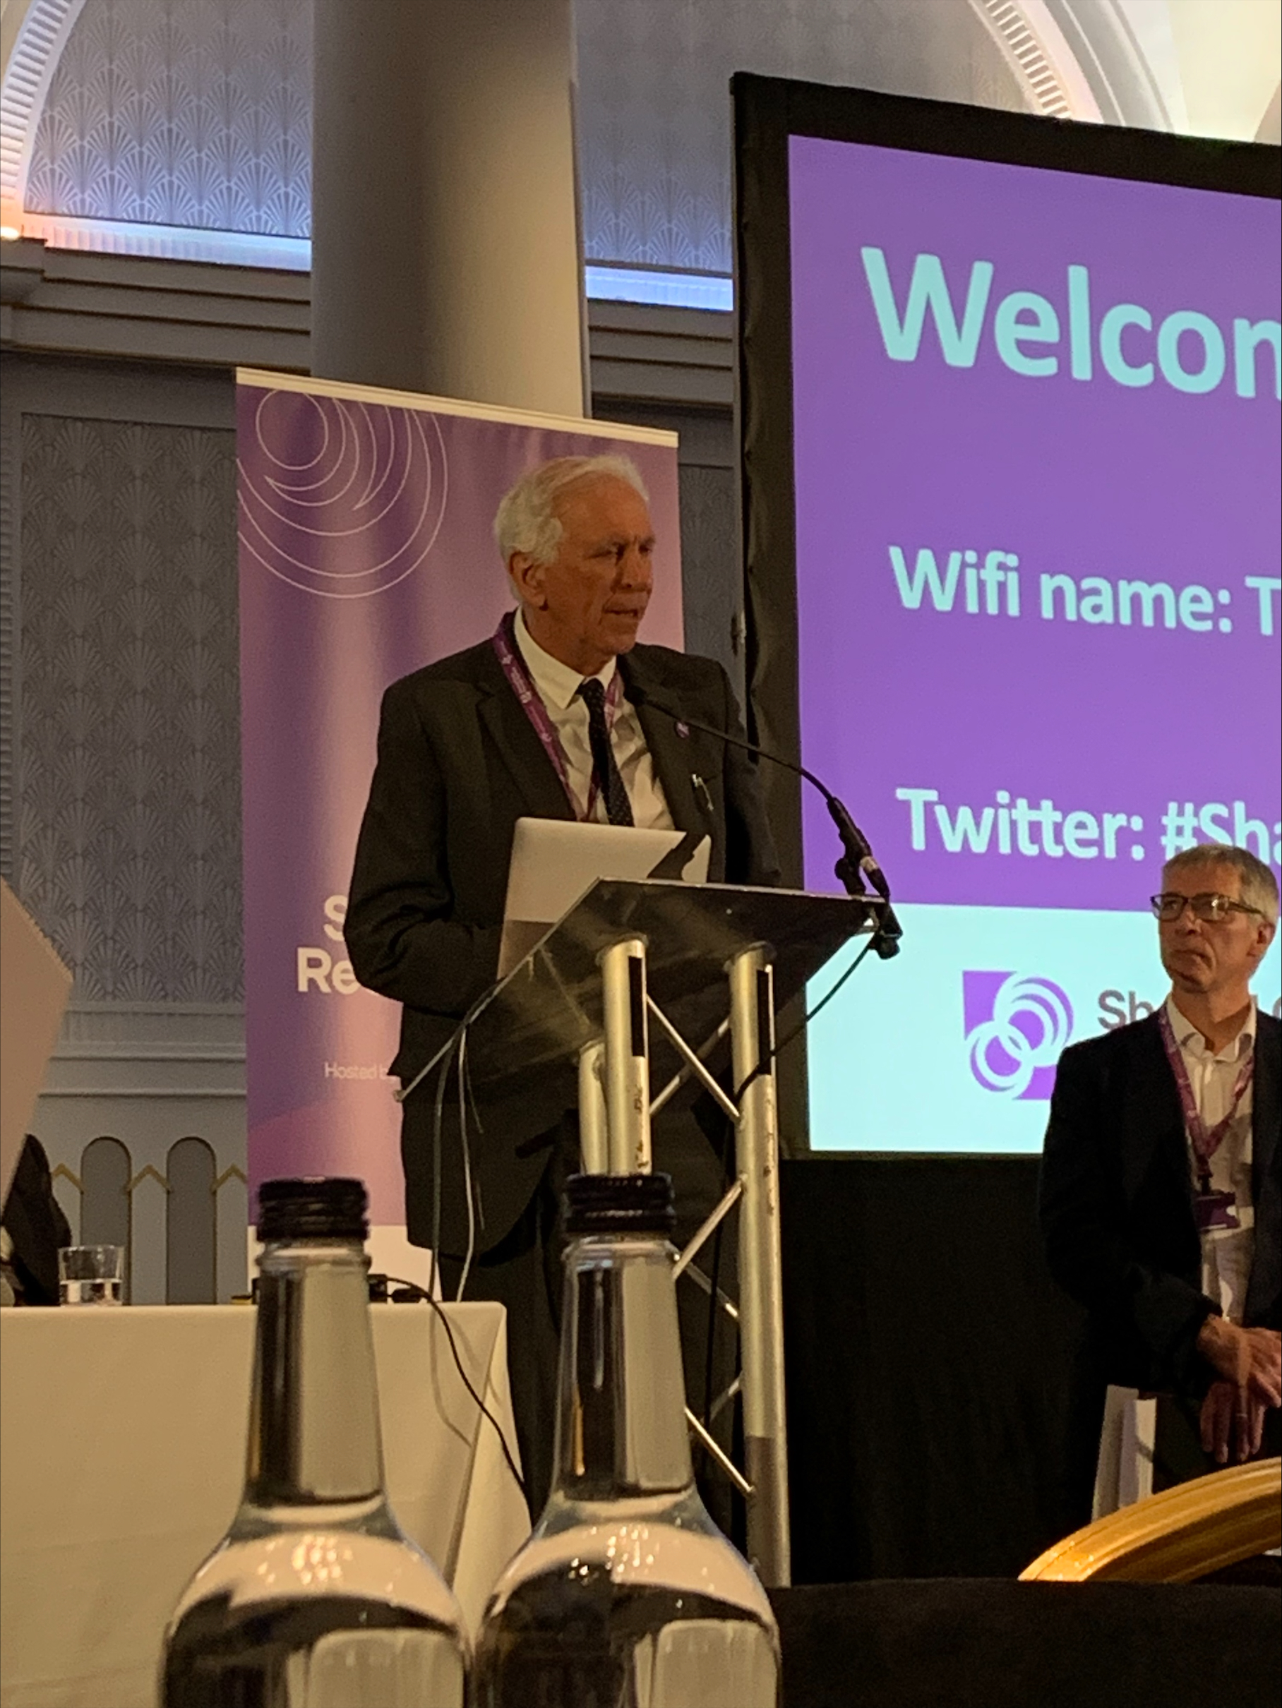
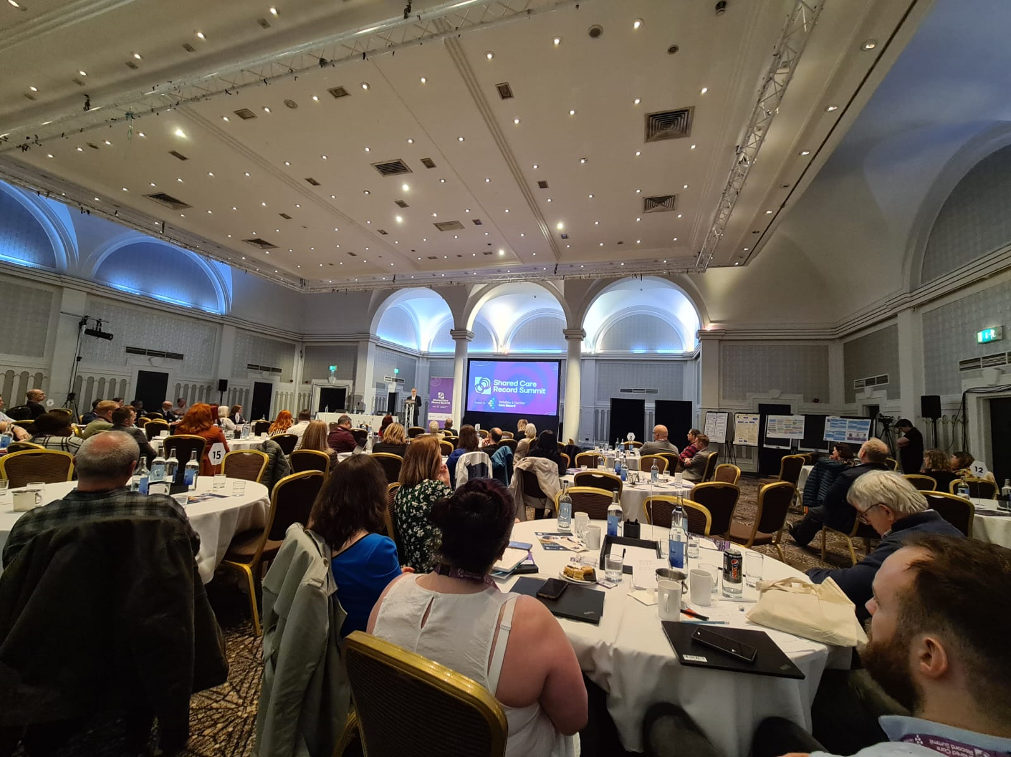
Goals:
Please list the top 3 goals to take forward from your workshop
1. Connectivity of wider providers
2. Interoperability and longer-term use of NRLS
3. Strategy and governance (e.g. IG)

Slide 4
Detailed Outcomes & Actions
Action/Outcome | Who is involved? | Check in Date
- Refine the ShCR problem rather than focusing on the product | NHSE ShCR, ICSs | Spring/Summer 2023
- Incorporate voted findings from Menti polls from summit session into work on themes for future of ShCR | NHSE ShCR Team | Spring/Summer 2023
Review of themes coming from free text Menti – Data standards Data sharing agreements National IG NRL National data set Engage with suppliers Provide vision for the next 10 years Level up and align | NHSE ShCR Team | Spring/Summer 2023

