Slide 1
How to get shared skin in the game Patient, Public and Stakeholder Engagement Workshop
Shared Care Record Summit 20th – 21st March 2023 The Queens Hotel, Leeds

Slide 2
Agenda & Facilitators
13.00 – 13.15 Welcome and setting the scene
13.15 – 13.30 Quick focus round (interactive session using Menti)
13.30– 13.50 Addressing the big challenges – tabletop discussion
13.50 – 14.25 Group feedback
14.25 – 14.30 Wash-up and close
Facilitators
Tara Athanasiou, HNY (Humber) Shared Care Record Programme Lead
Debbie Westmoreland, HNY (North Yorks) Shared Care Record Programme Lead Tammy Pike, Engagement Lead, National Shared Care Record Programme
Angela Poland, Head of London Care Record Programme in South East London
Jocelyn Palmer, Programme Director, OneLondon

Slide 3
Setting the scene
What do we want to achieve?
Get to understand the issues around obtaining and maintaining public and stakeholder engagement on a large, shared record deployment programme
Consider real life scenarios and collaborate on the approaches to delivering public and stakeholder engagement success
Share experience on what worked (and didn’t) for your programmes and why
Workshop format:
A quick focus round to get a sense of the big challenges, blockers and enablers to stakeholder and public engagement. We will be using www.menti.com so please have your smart phone at the ready
Group discussion at your table to focus more specifically on solutions to the challenges faced by shared record programmes in a very busy system

Slide 4
Quick focus round – Menti Survey Results

Slide 5
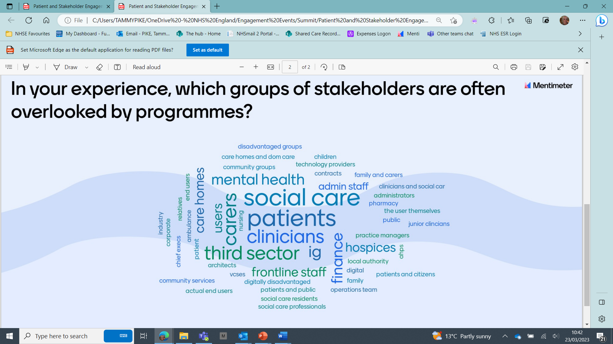
Quick focus round – Menti Survey Results

Slide 6
Addressing the big challenges – themed tabletop discussion
Tabletop exercise in groups to focus on solutions to the challenges faced by shared record programmes in a very busy system
Each table has a different challenge to consider. This can be found in the envelope on your table
You have 20-mins to consider this challenge, using the questions on the next slide to support your thinking
At the beginning, please agree a scribe and a spokesperson who will provide your table’s feedback to the challenge
Each table will have 3-4 minutes to provide their feedback to the wider group.

Slide 7
Addressing the big challenges – discussion questions
Where possible, we would like you to focus on examples of work you have delivered locally: what has worked well, what hasn’t worked so well and what could have been improved?
To help structure your discussion and feedback, please consider the questions below:
Why is this important?
What are the barriers?
Identify 2-4 activities that could be undertaken to address this challenge?
What 2-4 steps could programmes implement to take this forward?

Slide 8
Group Feedback

Slide 9
The challenges
TABLE 1: Strategies to ensure fair patient and public representation throughout your programme
Why is this important? | What are the barriers? | Identify 2-4 activities? | Next steps?
 | -Boring topic -Confusing language - Trust - Complex landscape - Time | - Go to the people - Use different channels - Make topics easy/interesting | - (JDI) Just Do IT !! - Involve at all stages - Be transparent - Use real life examples

Slide 10
The challenges
TABLE 2: Approaches to engaging and working with stakeholders on benefit identification, tracking and realisation
Challenges
Why is this important?
What are the barriers?
Identify 2-4 activities?
Next steps?
Why is this important? | What are the barriers? | Identify 2-4 activities? | Next steps?
- Funding - Focus of direction - Measure success | - Non-cash benefits not valued - Hard to attribute direct benefits and/or measure - Resource Intensive | - Actively engage users - Baseline activity at start - Make benefits core to project | - Create user groups - Identify stakeholder benefits & empower them to hold us to account to deliver

Slide 11
The challenges
TABLE 3: Harnessing engagement and communications approaches to maintain visibility and high prioritisation of shared care records with senior and executive stakeholderses
Challenges
Why is this important?
What are the barriers?
Identify 2-4 activities?
Next steps?
Why is this important? | What are the barriers? | Identify 2-4 activities? | Next steps?
-Maintain buy-in -Agree governance, funding model -Keep as top priority -To hold the vision -Remove barriers | -Sustainability -Governance cross-system -Relationship building -Benefits not recognised -Different standards | -Link to execs priorities -Develop user stories (elevate pitch from local experience) -Early involvement (champion) -Formal governance structure | -Share best practice -Measurable benefits -Step by step guide (inc skill mix/resource needed) -Tailored approach for each sector -Engage with ‘Place’.

Slide 12
The challenges
TABLE 4: Strategies to ensure engagement plans actively bring out seldom heard voices in your programme
Challenges
Why is this important?
What are the barriers?
Identify 2-4 activities?
Next steps?
Why is this important? | What are the barriers? | Identify 2-4 activities? | Next steps?
- Early engagement drives success and outcomes -Include VCSE & third sectors | - Knowing who is in the room? | -Understand specific community needs and audience -Use of data (e.g.Core20+5) - Mapping stakeholders | -Non-hierarchical/flat approach (equal power) -True partnership working - Accessibility standards

Slide 13
The challenges
TABLE 5: Approaches to ensure non-NHS partners are fully engaged throughout the programme
Challenges
Why is this important?
What are the barriers?
Identify 2-4 activities?
Next steps?
Why is this important? | What are the barriers? | Identify 2-4 activities? | Next steps?
-Capacity release social care -Support friends/family -Politics -Insight -Housing -Joined up care/partnerships | -Funding – by whom -Digital maturity (local & national/suppliers) -Priorities -Client identification -Sector to sector sharing | -Sharing best practice -Direct conversations - No assumptions - Mix up teams (different voices) | -Sharing best practice -Direct conversations - No assumptions - Mix up teams (different voices)

Slide 14
The challenges
TABLE 6 : How to engage effectively and embed shared care records with a highly pressurised health and care workforces
Why is this important?
What are the barriers?
Identify 2-4 activities?
Next steps?
Why is this important? | What are the barriers? | Identify 2-4 activities? | Next steps?
-To sell benefits & worth | -Funding & resources -Information sources -Structure of data -Prioritisation | -User engagement – demonstrate the worth -Deliver benefits -Change management | - Real user engagement - Deliver on benefits - Embed change – upfront training & on-boarding

Slide 15
The challenges
TABLE 7: Stakeholder engagement strategies and approaches to support financial and operational sustainability of shared care records after the end of the programmet?
What are the barriers?
Identify 2-4 activities?
Next steps?
Why is this important? | What are the barriers? | Identify 2-4 activities? | Next steps?
To show why it matters: -National requirements -Funding -Local strategy -User experience – empowering and highlighting use of care records | -On-going funding -Conflicting priorities -Generic comms -Miss-communication - IG -Operational pressures | - Floor walking & clinical buy-in -Champions – to drive -Communication – drip feed, must be on-going at front-line & execs | -Longer-term planning & funding -Align to pressure in a system and use case studies (get the message right for): *Overarching technology *Pathways (e.g EoL) -People Resourcing

Slide 16
The challenges
TABLE 8:During these very high-pressured times, what strategies could you deploy to ensure that the workforce is and remain engaged in the programme so it becomes embedded as business as usual.
Challenges
Why is this important?
What are the barriers?
Identify 2-4 activities?
Next steps?
Why is this important? | What are the barriers? | Identify 2-4 activities? | Next steps?
-Essential to get adoption -What’s in it for me ?? | -Message delivery -Needs to be adoptable -Needs personal touch -Data quality -Wrong coding -Information cascade -Trust (rumours v facts) | - Go out and engage -Be mindful of multifaith impact -Accessible information, for different communities -Robust feedback loop – lessons learnt | -Consistent contact point -Regular/reliable comms -Face to face & involvement -Knowledge sharing -First followers - Mandate

Slide 17
Wash-up and close
Thanked everyone for positive involvement and that menti results and flip charts will be typed up and shared, and plans for this feedback to influence further work and workshops.
Tara Athanasiou, HNY (Humber) Shared Care Record Programme Lead
tara.athanasiou@idealts.co.uk
Debbie Westmoreland, HNY (North Yorks) Shared Care Record Programme Lead dwestmoreland@nhs.net
Tammy Pike, Engagement Lead, National Shared Care Record Programme
tammy.pike2@nhs.net
Angela Poland, Head of London Care Record Programme in South East London Angela.Poland@gstt.nhs.uk
Jocelyn Palmer, Programme Director, OneLondon
jocelynpalmer@nhs.net

