Slide 1
Outcomes and actions for… How to get shared skin in the game Patient, Public and Stakeholder Engagement Workshop
20th – 21st March 2023, The Queens Hotel, Leeds
Workshop Leads:
Tara Athanasiou, HNY (Humber) ShCR Programme Lead. tara.athanasiou@idealts.co.uk
Debbie Westmoreland, HNY (North Yorks) ShCR Programme Lead. dwestmoreland@nhs.net
Tammy Pike, Engagement Lead, National ShCR Programme. tammy.pike2@nhs.net
Angela Poland, Head of London Care Record Programme in SE London Angela.Poland@gstt.nhs.uk
.
Jocelyn Palmer, Programme Director, OneLondon jocelynpalmer@nhs.net
Debbie Westmoreland, HNY (North Yorks) ShCR Programme Lead dwestmoreland@nhs.net

Slide 2
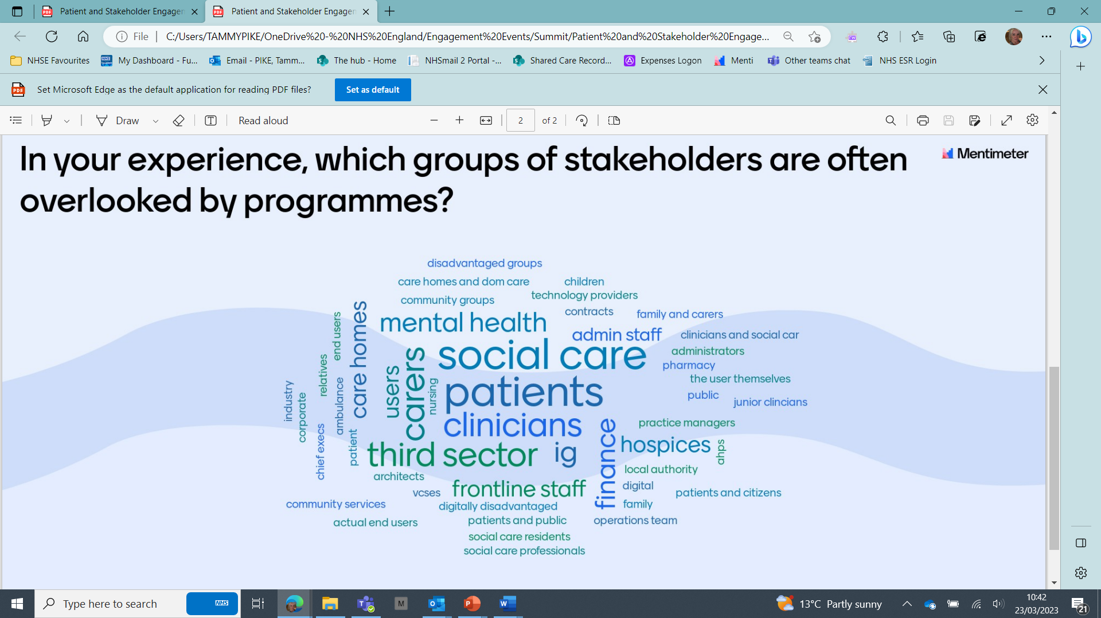
In summary:
Menti Survey:
Q1) Stakeholders to include to get best results
=Patients/clinicians, =IG/suppliers/executives
Q2) Which stakeholders get overlooked –
=Patients/Social Care, =Carers/clinicians/third sector,
Attendees split into eight challenges for engagement:
1)Why is this important 2) Barriers 3) 2-4 activities 4) Next Steps.
Headlines from feedback (covering barriers & activities)
Public: Boring & confusing topic Just Do IT/Involve
Benefits: Difficult & complex Embed it/Baseline
Execs: Relationship building Link to priorities
*SHG: Insight Data and mapping
Non NHS: Digital maturity/funding Share best practice
Workforce: Resource/funding User engagement
Sustain: IG/conflict in priorities Useful Use Cases
*BAU: Messaging & relevance Engage/mandate
*SHG (seldom heard groups) *Make business as usual for workforce

Slide 3
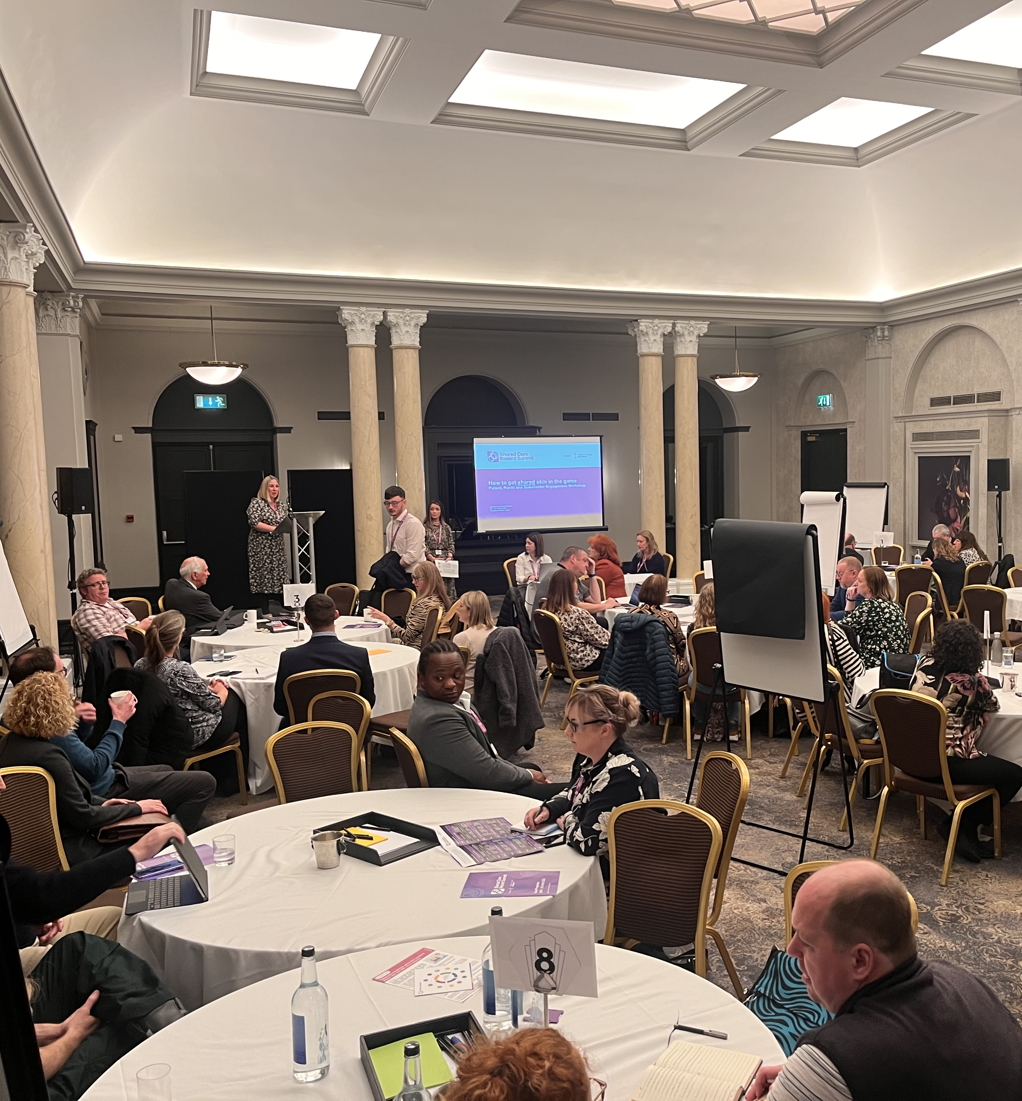
Goals:
Please list the top 3 goals to take forward from your workshop
1. Early & inclusive partnerships, using and evidence based app
2. Make messaging relevant to your audience and organisational priorities
3. Share best practice and case studies

Slide 4
Detailed Outcomes & Actions
Action/Outcome | Who is involved? | Check in Date
How do you establish true partnership working with key stakeholders including seldom heard groups, IG etc - Can we develop a robust programme engagement planner ?
Make the topic interesting, inclusive and tailored to various audiences (what’s in it for the person?) – centrally co-ordinated shared learning and bringing in subject matter experts
Make ShCR relevant to organisational and executive priorities (links to making benefits visible) - bring engagements and benefits together
Use of evidence/data to identify gaps in programme delivery plus specific community needs, using VCSE’s to deep dive the key issues – establish a best practice approach centrally and local level
Sharing learning, especially developing suite of case studies/use cases on real user engagement – set up series of workshop to bring these topics together

