Slide 1
Benefits – Regional and National View
Jackie Bell, Benefits & Evaluation Lead - Shared Care Records Programme, NHS England
Gareth Curt, Benefits Analyst - Shared Care Records Programme, NHS England
Jae Richardson, Business and Benefits Analyst – Share2Care, Cheshire and Merseyside ICS
Dr Paula Bennett, Chief Nurse/CNIO – Health Innovation Manchester
PLEASE NOTE – THIS SESSION IS BEING RECORDED
Shared Care Record Summit 20th – 21st March 2023 The Queens Hotel, Leeds

Slide 2
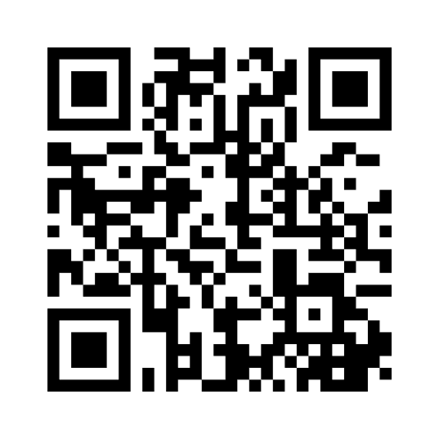
Workshop objectives & plan
Your benefits approach
Benefits management – Why? How to? Resources
GM – Realising potential and overcoming challenges
Overcoming a key challenge, group work – Raising the benefits profile
Share2Care – Benefits of Shared Care Records in End of Life Care
Menti.com - https://www.menti.com
Code - 8285 0117
Notes:
Objectives – Despite the name of the session we are not going to discuss National ShCR benefits; as these are still being pursued locally so we don’t have a complete picture. We don’t have time to explain how to work up your benefits in detail, you have Benefits leads who we are supporting with this. For more context, we’ve put some posters up, please review.
We want to use your time to work through the best methods to overcoming the challenges for benefits realisation and we are planning to make the session as interactive as possible using menti and there is some group work towards the end of the day where we hope to agree at least one key action for everyone to take back to their workplace.
If you haven’t already seen the flier on your table, please go to menti.com on your phones now…
We have a lot to share so we expect to be short on time – any questions please ask during the table work or grab one of us over lunch – Please log any important questions in menti and we will get back to the group with answers. Also 2 of us are hearing impaired so we may not hear your questions.

Slide 3
Menti

Slide 4
Menti
Notes:
.

Slide 5
Menti

Slide 6
Menti

Slide 7
Why?

Slide 8
Menti

Slide 9
Why do we need Benefits Realisation Management?
Without effective Benefits management you lose the ability to demonstrate RoI and achievement of objectives
“38% of respondents in one survey openly admitted to overstating benefits to get funding.”
“strategic misrepresentation”, “the planned, systematic, deliberate misstatement of costs and benefits to get projects approved”.
Would you trust a business case & invest in a new project if the last project showed little benefit?
Would you fund/resource a solution ongoing if there was no demonstrated benefit?
“It is only possible to be sure that change has worked if we can measure the delivery of benefits it is supposed to bring”
Notes:
Ward - Ward, John (August 2006) Delivering value from Information Systems and Technology Investments: Learning from Success. A report of the results of an international survey of Benefits Management Practices in 2006
0.5% Almost 12,000 projects were reviewed - Flyvbjerg- Bent Flyvbjerg, 2017, "Introduction: The Iron Law of Megaproject Management," in Bent Flyvbjerg, ed., The Oxford Handbook of Megaproject Management (Oxford: Oxford University Press), Chapter 1, pp. 1-18; URL for print version: http://bit.ly/2bctWZt
https://www.gov.uk/government/publications/guide-for-effective-benefits-management-in-major-projects

Slide 10
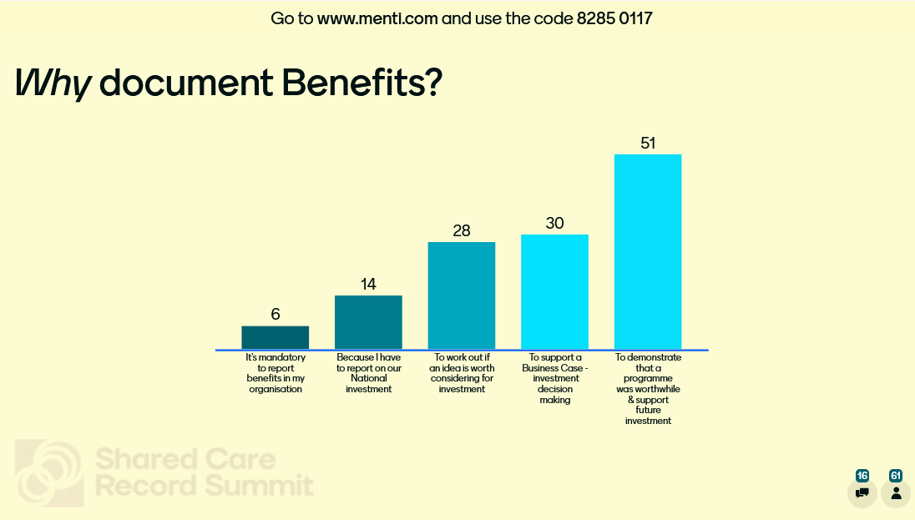
Menti

Slide 11
Menti

Slide 12
How? Start with the end in mind

Slide 13
What is a Benefit?
“the measurable improvement resulting from an outcome, perceived as an advantage by one or more stakeholders, which contributes towards one or more organisational objectives.”
Notes:
Cabinet office definition –
A gain which contributes to organisational objectives, that can be measured.
Benefits are realised by stakeholders due to the project deliverables and the resulting outcomes and capabilities.
Benefits are not the outcome or output in itself.

Slide 14
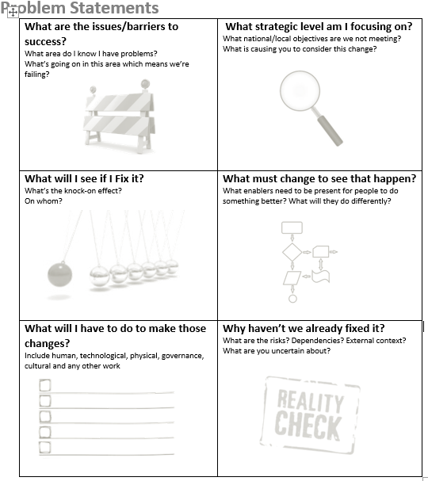
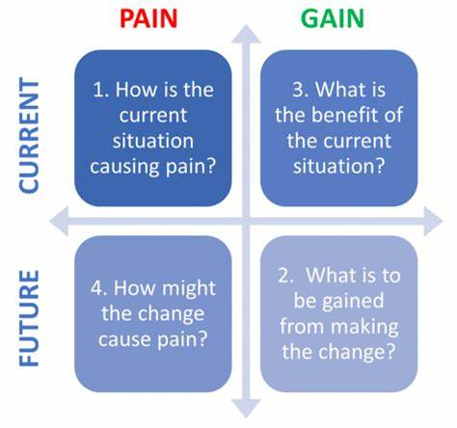
Problems and opportunities
Notes:
Identify problems, not solutions - generate benefits and requirements
Don’t focus on the shiny thing – what do you need? What are your requirements? How are you going to solve your problem?
What is the current problem/ situation?
What current and future challenges could the project resolve?
What are the opportunities and the anticipated future vision?
Could you;
do new things?
do things better?
stop doing things?
Problem statements, helps you to think through all of the possibilities & work through from problems to solutions

Slide 15
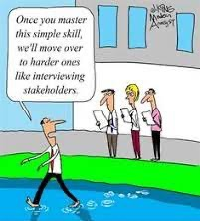
Engage stakeholders
Once you master this simple skill, we’ll move over to harder ones like interviewing stakeholders!
Notes:
Who are the stakeholders?
Do you have executive endorsement? – this will make it much easier to engage busy stakeholders
What are the stakeholders aims, expectations?
What are the stakeholders concerns/ fears?
What difference will the project make to them?

Slide 16
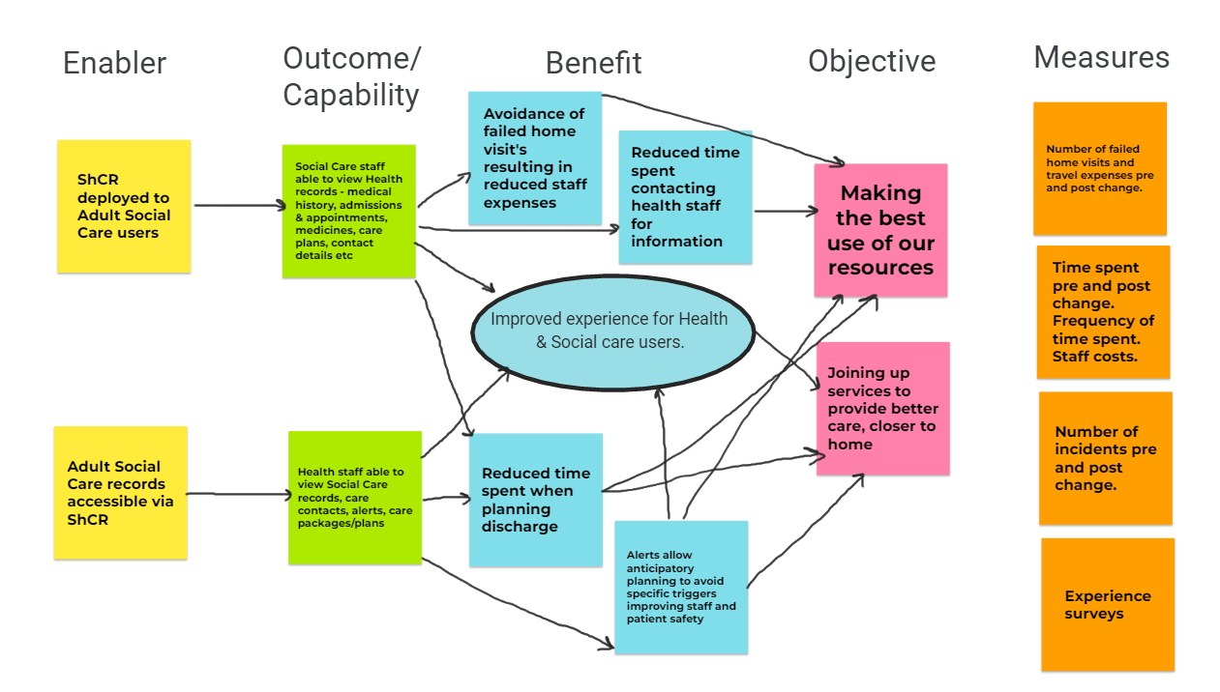
Benefits map – cause and effect
What has to be done
What you can do/ what you achieve
What you gain, the impact
Why you need to do the project
Notes:
Mapping helps you to visualise the cause and effect of your project benefits & the linkages from enablers to objectives.
What are the organisation’s objectives?
How will your project directly/indirectly help achieve these objectives & KPI’s?
Identify Benefit Owners
Identify baseline and ongoing measures
Enabler without a Benefit, Benefit without Objective – do you need to do this? If you can’t measure it, is it really a benefit?
Map for every change:
New functionality
New content
New deployment user group
If there are no benefits – why spend your scarce resources making the change?
Also can use at the concept/idea stage, use in the other direction. From Objectives, measurable gains, what needs to be different and what has to be done/what changes are needed.

Slide 17
Reporting – telling the story
Baseline & forecast benefits
Prioritisation
Ongoing tracking of actual (realised) benefits
Notes:
Baseline & forecast benefits
Make sure your measuring against the baseline problem.
Use appropriate, repeatable, measures e.g. KPI’s & system data
Realism about what you will be able to report at realisation
Prioritisation
Fewer benefits, higher value
Don’t lose sight of qualitative benefits and anecdotes
Ongoing tracking of actual (realised) benefits
Think about how & to whom you will tell the story of your programme benefits in your programme reporting.
How & Whom you’re reporting to will influence how you record and report benefits and tell a story of interest to your audience

Slide 18
Support mechanisms

Slide 19
Support mechanisms
Engagement
National
Regional
Sharing
FutureNHS, Learning from Local (LfL)
Notes:
National - Monthly networking meeting, 1:1 meetings, feedback on submissions
Regional - Show & Tell, Worked up Benefit Registers, Benefits buddies, Forum posts, Uploads to LfL
FutureNHS, Learning from Local (LfL) - Tools, Templates, Guidance, Forum
In 2022 – FutureNHS, Learning from Local, Benefits section we added nearly 300 bits of content, with that being accessed 14 times a working day! (~3,600 times)
There are lots of other resources on LfL (it’s not just for benefits) so if you’re not signed up please search for the workspace and request to join.

Slide 20
Overcoming challenges
Dr Paula Bennett

Slide 21
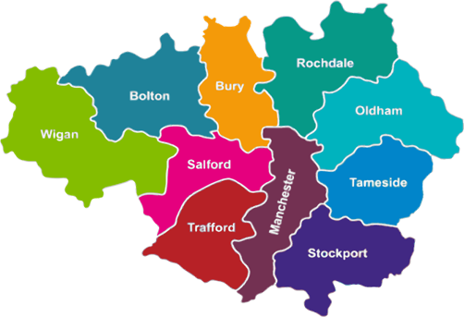
Greater Manchester in context
GM Care Record:
Pre-Pandemic: Now:
10 locality records 1 GM record
5k 19k
69k 179k
2.2m 3.1m
>500 1 DPIA
Health & Providers:
444 GP practices
10 councils
6 acute trusts
7 community services
2 mental health trusts
1 specialist (The Christie)
10 localities
2.8m population

Slide 22
The context

Slide 23
Realising the Potential of the GMCR in Secondary Care ​
Problem statement
Previous benefits realisation work has highlighted that:
Not all staff understand the benefits of GMCR
Some/most staff don’t know how to access it
Lack of training and other factors are contributing to low usage in some areas
To understand the current use of the GMCR by frontline staff (UEC and ward discharge) and the potential for improving functionality to make care better for patients and easier for staff to deliver
To understand the data needs of staff involved in service improvement/redesign or commissioning and understand the potential GMCR data has to support these requirements
Purpose of the GMCR Realising Potential Programme

Slide 24
Overcoming challenges
Programme Methodology
Understand
Re-Imagine
Implement
July 2022 – December 2022
January 2023 - February 2023
April 2023 – October 2023
Information source
Rapid Evidence Synthesis
Usage data
Data feeds
PRSB mapping
E-survey
Staff engagement workshops
Locality Lead Interviews

Slide 25
Overcoming challenges
Top down
Bottom up
“What's in it for me……………….?”
Steering Group
ICS wide governance group “seek permission” and gain support
Existing forums
Friends and colleagues “can you help?”
Focussed on key priority areas; UEC, hospital
Flexible timeframes (where possible)
Formal reporting structures and key groups
Who are the key people that will release staff to attend workshops
Trust comms leads
Feedback, feedback, feedback

Slide 26
Working groups
Notes:
Coming back to the results of importance - you said blah…. If you had Exec sponsorship perhaps you would have answered differently

Slide 27
Group work - 20 minutes
As Digital Leaders how do we make sure that Benefits work is close to the Executives heart (high on their agenda)?
If you have good Executive engagement:
What are you going to do to increase the profile of Shared Care Records Benefits across your ICS?
Brainstorm in your group and add your ideas into Menti
Notes:
Log in menti as you discuss, to avoid a frantic jotting down of ideas at the end

Slide 28
Working group feedback
Understanding strategic priorities, national planning guidance, organisational and system wide objectives efficiencies and their personal motivation
Demonstrating delivery of the benefit - releasing money, allocating freed up resources etc. demonstrable improvement.
Executives should already have benefits at the heart of what they do. Sponsor owns benefits - and we have to often backward engineer benefits based on the project already rolling being delivered
Focus and narrow your benefits
Relate use cases to real life scenarios
Benefits often get duplicated by multiple projects delivering the same thing
Engaging at numerous forums to demonstrate benefits to bring benefits work close to the executives heart
Shorten time description of benefits in Business Case to realising benefits
Shared responsibility for benefits - clinical, operational and digital. We can't just leave it down to digital teams once finding is agreed
Increase profile of ShCR at board level
Evidence existing work in other areas, get buy in from champions
Vision statements can lead to work without understanding benefits - interpretation can get lost and it’s important to collate benefits across the whole strategy
Know your audience, ROI for Finance Directors, Virtual Wards (currently) for transformation Heads. Work benefits into this.
To not just submit the use case, but the scrutinise the benefits of the 'ask' proposed prior to business and procurement. We are taking a 'pause' to relook where we are and 'reimaging' current situ.
My problem is not with exec buy-in it's that the commissioning model does not support a pop-health approach. Providers get paid for being reactive, not proactive
Financial benefits can be challenging to evidence, pathways may need to be embedded with the shared records for this to be realised
Notes:
Objectives – Despite the name of the session we are not going to discuss National ShCR benefits; as these are still being pursued locally so we don’t have a complete picture. We don’t have time to explain how to work up your benefits in detail, you have Benefits leads who we are supporting with this. For more context, we’ve put some posters up, please review.
We want to use your time to work through the best methods to overcoming the challenges for benefits realisation and we are planning to make the session as interactive as possible using menti and there is some group work towards the end of the day where we hope to agree at least one key action for everyone to take back to their workplace.
If you haven’t already seen the flier on your table, please go to menti.com on your phones now…
We have a lot to share so we expect to be short on time – any questions please ask during the table work or grab one of us over lunch – Please log any important questions in menti and we will get back to the group with answers. Also 2 of us are hearing impaired so we may not hear your questions.

Slide 29
Working group feedback
Commission independent evaluation of benefits realised to date & publish. Re-Commit to ambition at a ICB and National Level Turn insight into ACTION Transparent Measures (National? Maturity?)
Ensuring there is adequate resources to evidence the benefits.
High level support is straightforward overall. Challenges of buy-in are at a more granular level - different stakeholders. Local drivers can be at odds when it comes to it.
If digital systems are implemented well & the system is clinically useful, in practice change will happen & benefits delivered
Strong vol sector interest. Challenge is tailoring appropriate sharing for them.
Clear defined benefits management plan , approved by execs
Utilising data and information which outlines with their strategy and objectives.
Sometimes it is hard to quantify some benefits are purely as a result of a ShCR
Finding clinical and care champions to share the benefits with colleagues, patient journeys and case studies, comms and engagement activities
Avoid doing benefits work in isolation
To influence execs you need to demonstrate that it is useful, usable and used
If a clinical system is excellent, benefits may be delivered well in excess of estimates in b/c stage - this might drive transformational change in ways not predicted
Notes:
Objectives – Despite the name of the session we are not going to discuss National ShCR benefits; as these are still being pursued locally so we don’t have a complete picture. We don’t have time to explain how to work up your benefits in detail, you have Benefits leads who we are supporting with this. For more context, we’ve put some posters up, please review.
We want to use your time to work through the best methods to overcoming the challenges for benefits realisation and we are planning to make the session as interactive as possible using menti and there is some group work towards the end of the day where we hope to agree at least one key action for everyone to take back to their workplace.
If you haven’t already seen the flier on your table, please go to menti.com on your phones now…
We have a lot to share so we expect to be short on time – any questions please ask during the table work or grab one of us over lunch – Please log any important questions in menti and we will get back to the group with answers. Also 2 of us are hearing impaired so we may not hear your questions.

Slide 30
Jae Richardson
Benefits of Shared Care Records in End-of-Life Care

Slide 31
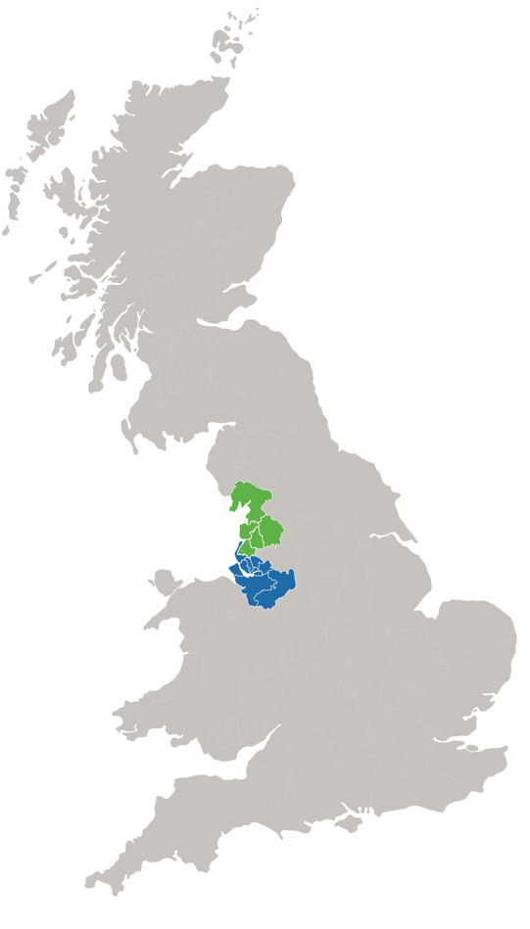
Share2Care
2019
Share2Care Established
2
ICSs
14
Places
5
Local Shared Care Records
4.4m Population
39 Organisations connected

Slide 32
Share2Care Local Approach to Benefits Management
Close links with National ShCR Benefits Team use existing support mechanisms
Empower local benefits leads
provide support, tools, templates, workshops, communications media
Keep it simple
ONE local high value benefit, to a high standard

Slide 33
Share2Care - Benefits Convergence Model
Successful Benefits Realisation Management (BRM)
Data/
Performance Management
Communication & Engagement
Change Management
Financial Management
Portfolio/
Programme Management
Strategy

Slide 34
End-of-Life Information in Shared Care Records
Notes:
A person who is coming towards the end of life commences on a journey and Health and Care Professionals need to be able to navigate to help them achieve their goals along the way.
End of life information stored in EPaCCs – which is the Electronic Palliative and Care coordination system – is a crucial system that supports sharing of information for people in their last 12 months of life in regards to their preferences for care and decisions.
This information is now available in the shared care records

Slide 35
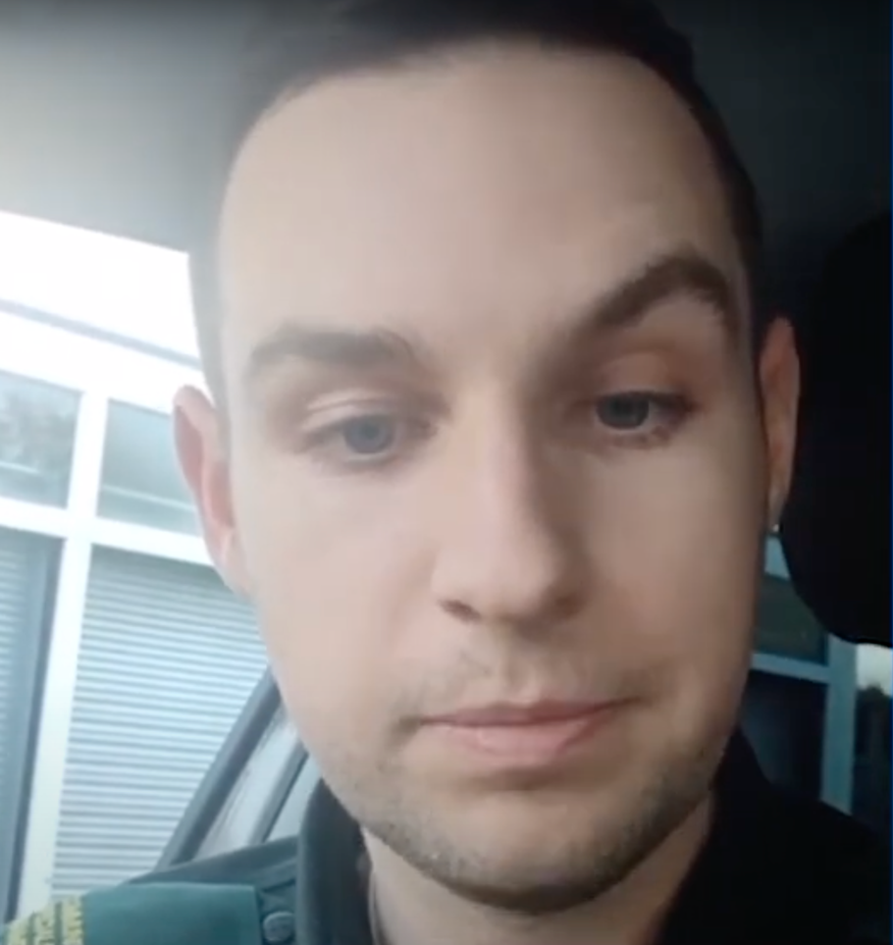
Share2Care Paramedic Benefits
Kieran Potts, a Paramedic for North West Ambulance Service, talks about his End of Life care for patients here.
Notes:
My name's Kieran Potts, I'm a community paramedic working for North West Ambulance Service based in South Lancashire area.
For the last number of months we've had access to Share2Care for our frontline staff within our area and one of the key things that I've
noticed and one of the key things that we've looked at as a trust is access to the electronic palliative care coordination system.
This provides us access to patient records regarding end-of-life wishes and palliative care wishes, as well as current treatments, ongoing treatments, and also allows us to see any preferred place of care, preferred place of death, as well as any resuscitation decision documentation and so it's provided us some really useful access and insight into that patient's wishes and what they would want should they not be able to communicate this to us

Slide 36
Share2Care EPaCCs Data Analysis
Notes:
When our colleagues, such as Keiran, access EPaCCs information within the shared care record, this data is captured in a local audit and analysis tool.
This type of data plays an important part in performance management, a key principle to effective benefits management – and we are very lucky in Cheshire and Merseyside and Lancashire and South Cumbria to have partnered with Maywoods, who we have collaborated with, on the development of an excellent shared care records analysis tool which you can see in the image which shows just one of the functions available
This tool enables us not only to track the number of documents published and viewed, information flow across organisations, information usage and trends, activity across ICSs and across the existing local shared care records. The tool also provides us with a robust audit tool which is used to investigate clinical incidents and freedom of information requests.
The primary care activity function has been particularly useful with our end of life programmes, it allows us to drill down to see what types of information are being viewed within the GP records, including the EPaCCs information.
This data shows that in the month of January 23 over 1200 views of the EPaCCs information within the GP record was viewed by Merseyside organisations.
Having access to this kind of data supports performance and benefits management, we can identify areas that are utilizing the shared care record well and target these organisations to determine what benefits they are realising. It also highlights areas where support may be need to improve the uptake of the shared care record.

Slide 37
Share2Care End of Life Data
Notes:
A quality marker for end-of-life care is that individuals should be able to die in their place of choice.
Continuing with the theme of data, a baseline study in one of our ICS’s was undertaken in October 2021 to measure the % of people with an EPaCCs who actually died in their preferred place of death
The baseline data showed this was 28% . In other words 72% of people did not die where they wanted to.
Share2Care supported the End of Life teams in their benefits journey, with a particular focus on clinical staff engagement, awareness and education.
As a result of targeted education and engagement we have seen an increase in the % of patients dying in their preferred place of death, to 60% by August 2022.
Although we have seen a significant advancement the data shows us that there is still room for improvement.
It should be noted that a key challenge for us with this benefit at the beginning was accessing relevant and real time data, an issue not uncommon in benefits management, so developing relationships with your business intelligence and data analysts teams to support with this.
It is not just about collecting data, and number crunching, it is about using that data to answer the 'so what?' questions – So What? What does the data show? The data shows that more people are now dying in their preferred place of death, it is having a positive impact on families at very challenging times.
Data can help tell our benefits story in a visual way and it can also identify areas for improvement.

Slide 38
Share2Care Community Teams Benefits
Annamarie Ratcliffe, Registered Nurse, Head of Service and Practice Development for Cheshire End Of Life Partnership, talks about benefits for community teams – click on the play link below
Notes:
Annamarie, a registered nurse and head of service and Practice development for Cheshire End of Life Partnership has many anecdotes about how having access to the EPaCCs information within the shared care record has revolutionized how community teams are working with patients and their families at end of life, listen to her share one of these

Slide 39
Share2Care Communications & Engagement
Notes:
To support the education and training, we have developed communications tools which highlight the benefits.
We use information gathered at stakeholder events and have created a series of communication media including posters, video’s, blog postcards and user stories on a page, these are made available to organisations to use to drive further utilitisation
End of life programmes across the region have been working hard to educate and train health and care workers about accessing the EPaCCS information in the shared care record and around having conversations about end of life care planning – if people are not confident in initiating the conversation this can impact on outcomes. These communication tools can support the education process.
In the last 6 months over 200 staff have been trained across our region and benefits is a key focus during these sessions.
These communication tools are invaluable in telling the story and raising awareness, indeed this particular tool shown was used across both of our ICSs in training and education programmes and has been adopted by other ICSs across the country.
Request full version of this media resource to jae.richardson@alderhey.nhs.uk

Slide 40
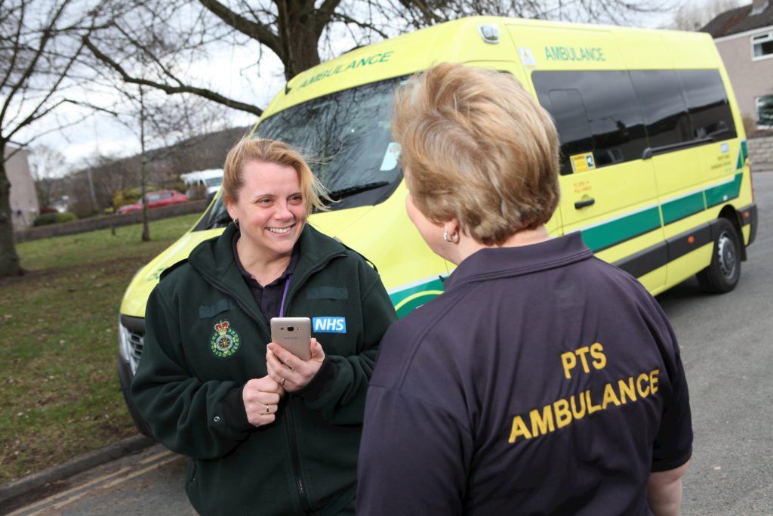
Share2Care Summary
Notes:
We have heard first hand from those delivering direct care how having access to end of life information within the shared care record has revolutionised how they are working ​
We have looked at the importance of the data we analyse and how we can translate the findings and use this to create benefits resources, such as the user story on a page, which enables the data to come alive and to see the impact it is having on peoples lives. ​
Benefits resources can be used to further promote the shared care record so that we can continue to make a positive impact on patients lives
There is still however work to do…
Need to continue to analyse the data and promote the benefits to drive further utilisation of the shared care record
We need to make it a priority to ensure all ambulance crews are able to access the shared care record – they are a key staff group to maximising the benefits
We need to use the benefits work stream to identify further areas for improvement ​
You have heard me talk about the benefits of end of life information in the shared care record, you heard me start with the quote ‘only one chance to get it right” now I am going to wrap up and hand you over to Carolyn, who will bring what all this means together...

Slide 41
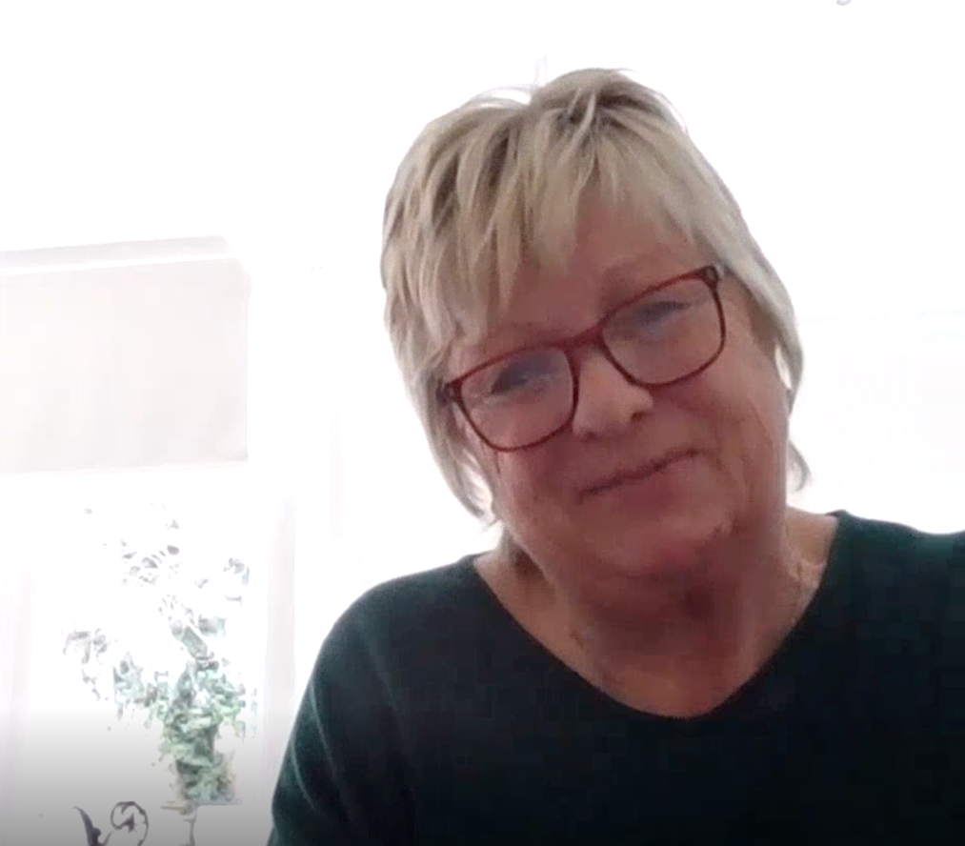
Share2Care – Carolyn’s Story
Carolyn's story of her Mum’s end of life care – click on the play link below
Notes:
Patient use case – care home –daughter tells her story about the death of her mother recently in her preferred place of death
SharePoint LHCR/ShCR Benefits - Carolyn's Story Final.mp4 - All Documents (sharepoint.com)

Slide 42
YOUR Next Steps - Menti feedback
Notes:
So what’ve you being noting in the breakout sessions is…….reflecting on Menti feedback – summary – JB/GC verbal feedback

Slide 43
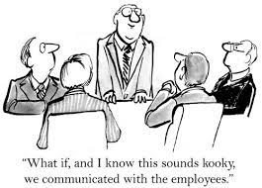
Objectives of the session – recap
To identify the best methods to overcome the challenges of benefits realisation
Priorities:
Identify benefits early – at concept stage
Engage senior staff & support your Benefits Lead
Notes:
Identify benefits early – at concept stage – if there are none/no links to objectives – why proceed to Business case or invest?
Engage senior staff so that Benefits is seen as important and stakeholders support your Benefits Leads
Communicate benefits to encourage use and increase your benefits!

Slide 44
Noted individual actions
Senior level “buy in”:
Making sure Directors in all partner organisations are engaged in the benefits.
Check it features high on my directors agenda.
Talk to exec about benefits measurement.
Execs as sponsor.
Get benefits on my programme board agenda!
To try to get greater visibility of the programme at executive level.
Engage senior management with ShCR benefits.

Slide 45
Noted individual actions
Engaging Stakeholders:
Make more awareness/staff engagement.
Ensure you take engagement from all stakeholders.
Engage directly with teams to identify a high value benefit.
Stick to identifying one high value benefit for our work and baseline that.
Make benefits of ShCR real (use cases) to change hearts and minds of users.
Focus group with frontline staff to drive usage.
Try to define some quantitative benefits of EoL information in our ShCR.
Work out how to run staff engagement workshops in our ICS.
Ensure benefits are clearly articulated and understood by stakeholders.

Slide 46
Noted individual actions
Governance/Benefits Management approach:
Look at the governance. Ensure benefits are part of the governance process!.
Keep trying to find benefits owners!!
Ensure that benefits are outlined (even if at high level) and visited regularly at every stage of a programme.
Benefits need to be readdress throughout the cycle of programmes/projects.
Portfolio management of benefits.
Align technical deliverables to benefits and their measures.
Help teams avoid creating a benefits industry. It’s not hard, just need to keep eyes on the prize.
Keep it simple but invest time and collaboration.
Concise benefits appraisal.
Ensure our benefits work is re energised and re invigorated as we move on with our programme.
I’m going to speak to our Benefits Lead and insist we carry out a review of what's been delivered and likely timeframes for anything that hasn’t.
Review/Update benefits management plan.
Review benefits approach currently employed.
Use benefits to reinforce adoption.
Engage directly with teams to identify a high value benefit.
Stick to identifying one high value benefit for our work and baseline that.
Prioritising one high value benefit.

Slide 47
Noted individual actions
Analytics:
Analyse impact of out of hours accesses and improvements to patient experience being realised.
Get creative on engaging BI.
More detailed review of usage and capture of benefits.
Define bespoke reports from auditing / reporting tool to provide evidence
Early benefits work:
Gain early outline benefits buy-in, before b/c.
Aim to implement benefits management at inception stage and continue to monitor - in short ensure all stakeholders realise the importance.
Include benefits at the conceptual stage of the project and engage with senior stakeholders.
Start think about benefits early and identify real life stories that have impact.
Business cases:
Check that the benefits highlighted in business cases are realistic and achievable.
Review all current new IT projects have good benefits mapping at business case stage.

Slide 48
Noted individual actions
Sharing knowledge and learning from each other:
Learn from other sites and go onto the NHS Future site to learn more about regional/local benefits
Collaborate and learn from other benefits captured and compare.
Learning from other organisations.
Shout about our brilliant work more.
Use comms resources from YHCR.
Collaborate with other benefits leads to highlight benefits others have achieved.
Linking in with other ShCR leads to learn and gather insights to solve programme challenges.
Publish benefits to-date.
Focus, safety in numbers and liaise with others. Learning from local
Other actions:
Speak to the centre about their vision for ShCR’s and understand how we can deliver National benefits.
I will be more tenacious!

Slide 49
Q & A
Question | Answer
Are the 12,000 projects measured all NHS projects, or a cross section of industries | Cross section, UK and international - Bent Flyvbjerg, 2017, "Introduction: The Iron Law of Megaproject Management," in Bent Flyvbjerg, ed., The Oxford Handbook of Megaproject Management (Oxford: Oxford University Press), Chapter 1, pp. 1-18; URL for print version: http://bit.ly/2bctWZt
I don't have a problem with measuring benefits for pop health projects. My problem is realising them. Clinicians are paid to work reactively. Pop health requires us to be proactive. How do we square? | That seems to be more of an ICB funding related question than a benefits question.
Shouldn’t there be clarity on organisation aspirations and benefits that for that | Yes – benefits should have a direct relationship & demonstrate achievement of organisation objectives/priorities/aims.
In addition you need to have ownership of benefits | Absolutely critical to have named benefits owners who are “invested” in embedding the change so that benefits are optimised and reported.
With national project such as ShCR’s, why do we all need to have individual benefits strategies with a huge amount of resources used? Wouldn’t it make more sense to have one from the center? | The benefits vary from one local Shared Care Record programme to another based on their local situation and legacy. For example, some areas with mature ShCRs may already have realised benefits due to previous local initiatives and investments. Problems experienced prior to implementing the ShCR could be different and the impact on these problems that the ShCR changes bring, could be different. As a result, the benefits opportunity is not evenly distributed across the country or across each benefit area. The majority of ICS had a ShCR prior to the national investment so many programmes are adding in features/user groups rather than an entirely new ShCR. To get around this we’ve provided example benefits with values and methodology in the BART and SoPB (BART has more examples). We’ve also detailed some typical benefits and how to measure them in the Benefits in common workbook.
Do you also need to identify the dis-benefits | Yes and to whom the dis-benefit applies, address wherever feasible.
How do we make large US EPR vendors more responsive? Their speed of change is akin to pre climate change glaciers | Perhaps this could be discussed at the National Programme Directors group or a sub group? We will pass this on.
Some GPs are concerned that what benefits we identify affect their bottom line as SMEs. How have delegates approached this with LMCs or PCNs? | Perhaps this could be discussed at the National Programme Directors group or a sub group? We will pass this on.
Where should benefits sit in the ICB? Is it better to sit in digital, commissioning or finance function? | Depends on your ICB and where you’ve got the best understanding of benefits and “buy in” to doing it properly across your portfolio. Whomever is likely to be most supportive and has the “clout” to make it happen.
Who leads the staff engagement workshops for benefits? Clinically led or digital? | Shared, if you’re talking to a group of clinicians. Ideally the Benefits lead plus a senior person relevant to the workshop stakeholder group so that a representative group are invited and are involved in the workshop.

Slide 50
Q & A
Question | Answer
Jae, I like your slide on keeping it simple, who did you ask at your trusts for a single benefit? | I targeted onboarding organisations, which we then prioritised to those that are most interested - the benefits leads were Operational & Programme Managers, we asked for the highest value benefit, documented as well as possible for the appropriate user group
How complete is your EPACCS dataset? i.e. how good are we at identifying people who might be at the end of their life? Once identified, how good are we at completing at electronic care plan? | Comparison against National Dataset. It’s a range, affected by population
How do you account for the fact that people's PPD may change, even in the last few hours of life? | Local query/process. Timely data entry and sharing is the key.
DNACPR forms , is there a consistency in how the documents look? Eg deciding right , RESPECT | Perhaps this could be discussed at the National Programme Directors group or a sub group? We will pass this on. https://www.england.nhs.uk/wp-content/uploads/2022/02/ambitions-for-palliative-and-end-of-life-care-2nd-edition.pdf and Publication: Decisions relating to cardiopulmonary resuscitation (3rd edition - 1st revision) | Resuscitation Council UK
When sharing DNACPRs , does all connected providers share them or is there a clinical risk noted where there are gaps in case of assumptions ? | Share2Care uses the GP record of the DNACPR status, as the final version of the truth.
Does the ambulance service base their decisions on the DNAR form being on the shared record or do they also need to see a hard copy ? | NWAS uses the ShCR, the informtion may be relayed back to them via the control centre, they do not need to see a hard copy.

Slide 51
Your Benefits Lead needs you!
Thank you for your attendance and participation​
​
Jackie Bell, jackie.bell8@nhs.net
Gareth Curt, gareth.curt@nhs.net
Jae Richardson, jae.richardson@alderhey.nhs.uk
Dr Paula Bennett, paula.bennett@nhs.net
David Grigsby, david.grigsby@graphnethealth.com
Notes:
Thank you for your time – don’t miss the Benefits session tomorrow

