Slide 1
Outcomes and actions for… Benefits – Regional and National View 20/3/23
20th – 21st March 2023, The Queens Hotel, Leeds
Workshop Leads:
Jackie Bell, Benefits & Evaluation Lead - Shared Care Records Programme, NHSE jackie.bell8@nhs.net
Gareth Curt, Benefits Analyst - Shared Care Records Programme, NHSE gareth.curt@nhs.net
Jae Richardson, Business and Benefits Analyst – Share2Care, Cheshire and Merseyside ICS jae.richardson@alderhey.nhs.uk
Dr Paula Bennett, Chief Nurse/CNIO – Health Innovation Manchester paula.bennett@nhs.net

Slide 2
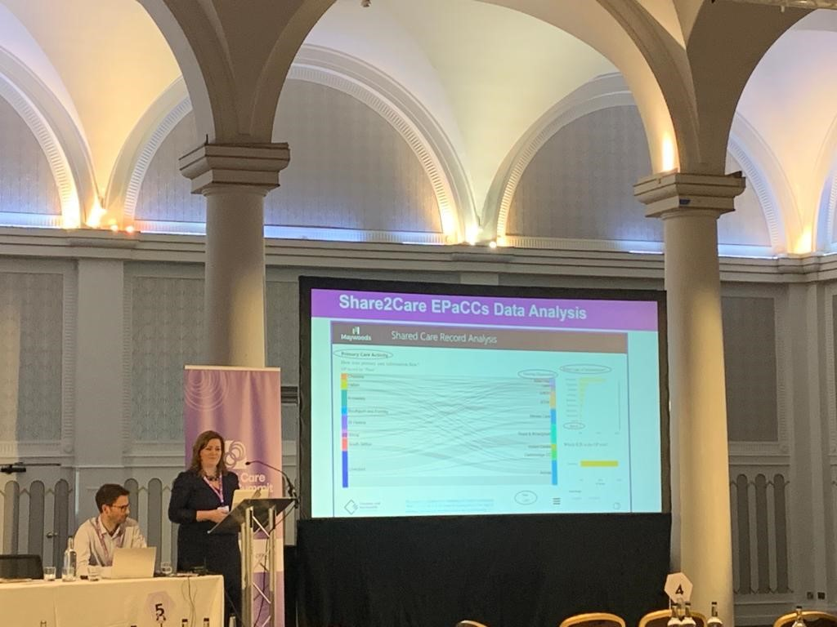
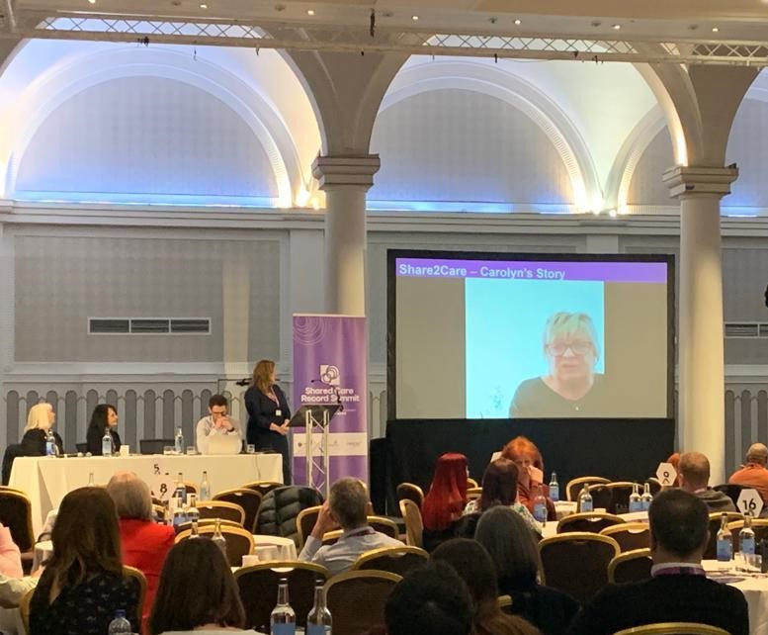
In summary:
The Benefits workshop aimed to
provide an overview of Benefits realisation management
generate actions to address two of the main challenges for ICS Benefits Leads:
Stakeholder engagement and identifying and valuing benefits after go live.
Realizing potential of an existing ShCR was discussed and mechanisms to increase utilization.
EPaCCS benefits were illustrated, and videos of user stories brought this to life.
The specific challenge that working groups discussed was
“As Digital Leaders how do we make sure that Benefits work is close to the Executives heart (high on their agenda)?”
Each delegate was also asked to log one key action that they would take back to their workplace.

Slide 3
Goals:
Please list the top 3 goals to take forward from your workshop
Engage senior staff & support your Benefits Lead
Identify benefits early, at the concept stage
Communicate benefits to encourage use of your Shared Care Record and increase your benefits

Slide 4
Detailed Outcomes & Actions
Action/Outcome | Who is involved? | Check in Date
Generate Senior level “buy in” to support Benefits leads in their engagement of stakeholders | Attendees & Benefits Leads Check for improvement with Benefits Leads at monthly networking meeting | 12/4/23
Ensure our benefits work is re energised and re invigorated as we move on with our programme | Attendees & Benefits Leads Check progress with Benefits Leads at monthly networking meeting | 12/4/23
Prioritise one high value benefit | Attendees & Benefits Leads Check progress with Benefits Leads at monthly networking meeting | 12/4/23
Include benefits at the conceptual stage of the project and engage with senior stakeholders | Attendees & Benefits Leads Check progress with Benefits Leads at monthly networking meeting | 12/4/23
Learn from other sites and go onto the NHS Future site to learn more about regional/local benefits | Attendees & Benefits Leads Check progress with Benefits Leads at monthly networking meeting & check LfL for increased use | 12/4/23

