Slide 1

Presentation title
goes here…
A presentation by Rebecca Nichells

Slide 2


Slide 3


Slide 4
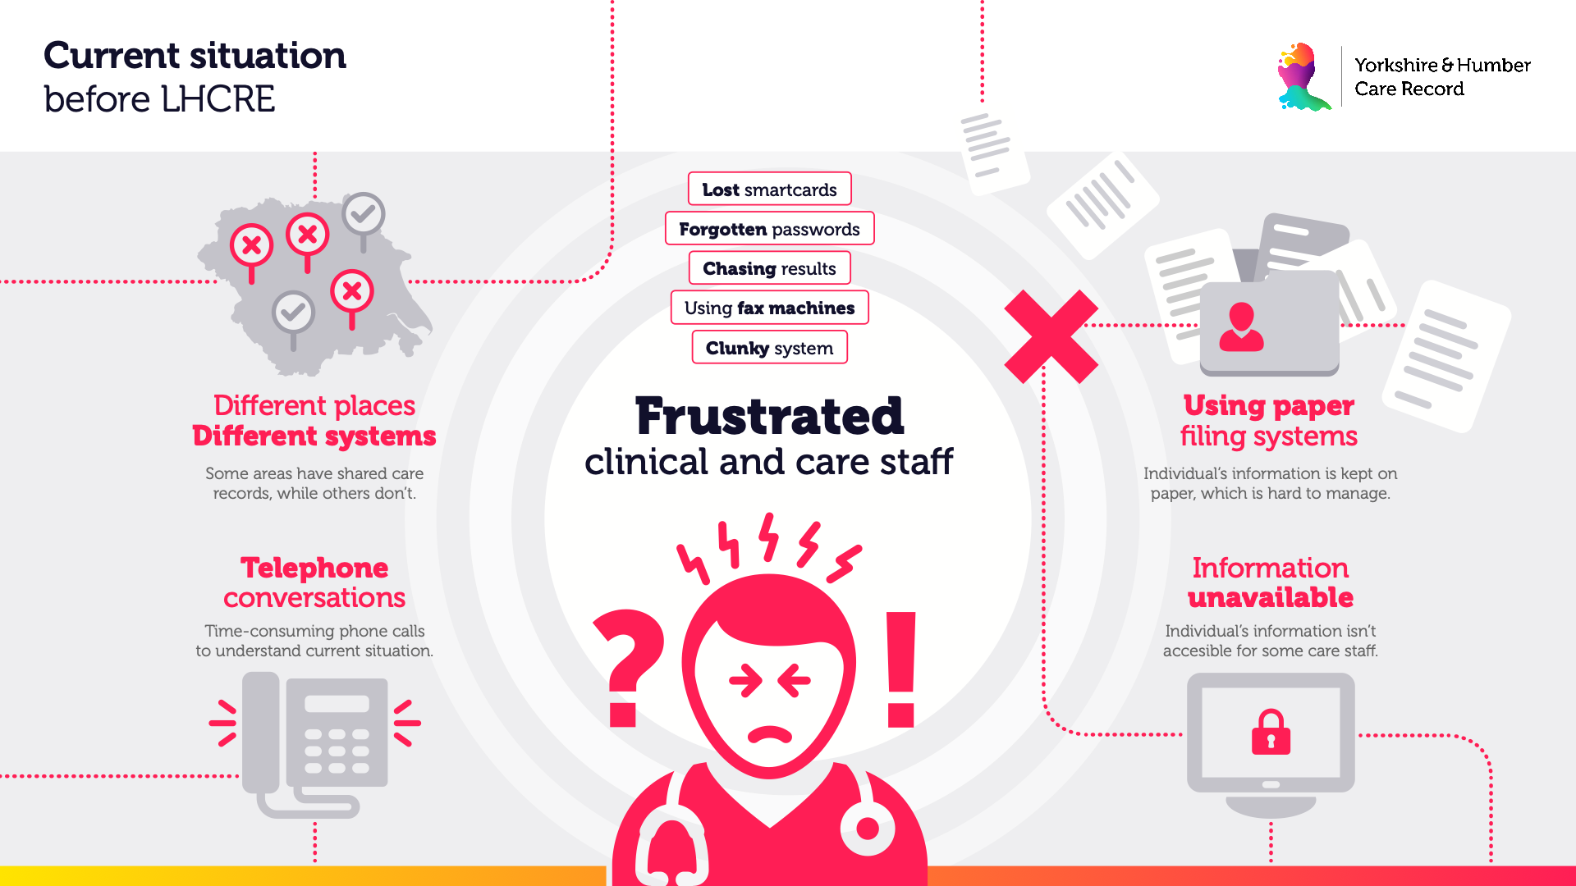
v

Slide 5
v

Slide 6
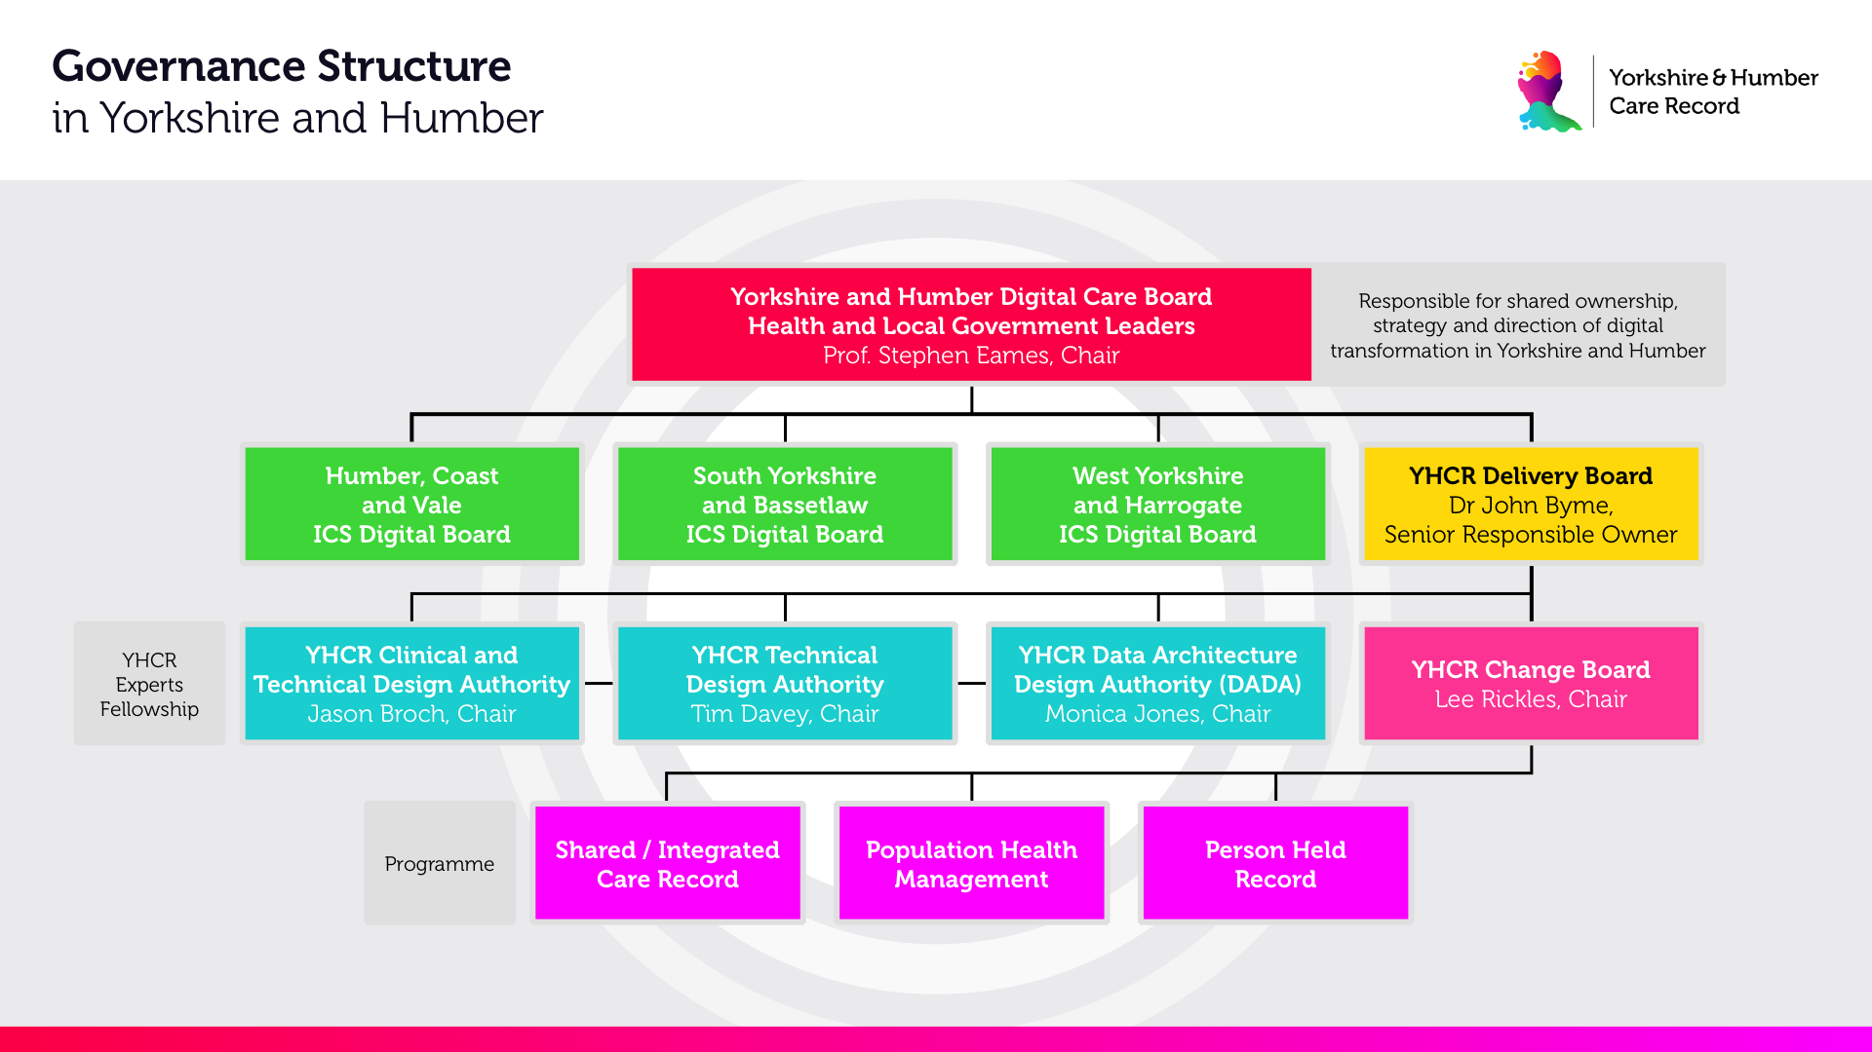

Slide 7
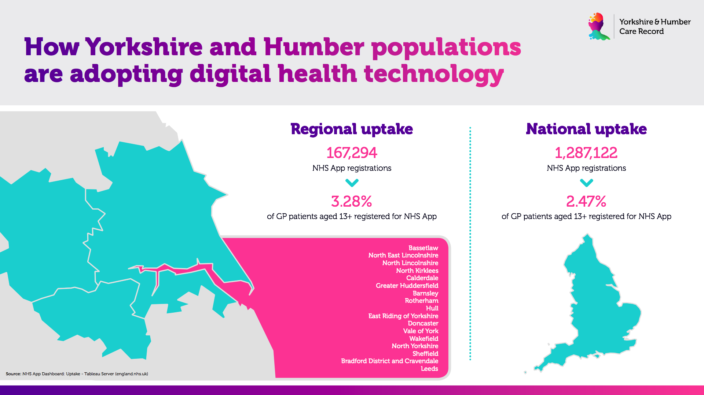

Slide 8
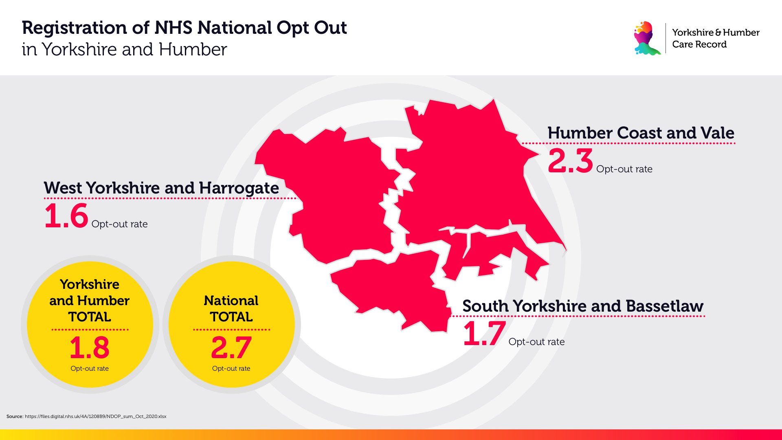

Slide 9
